Slide 1
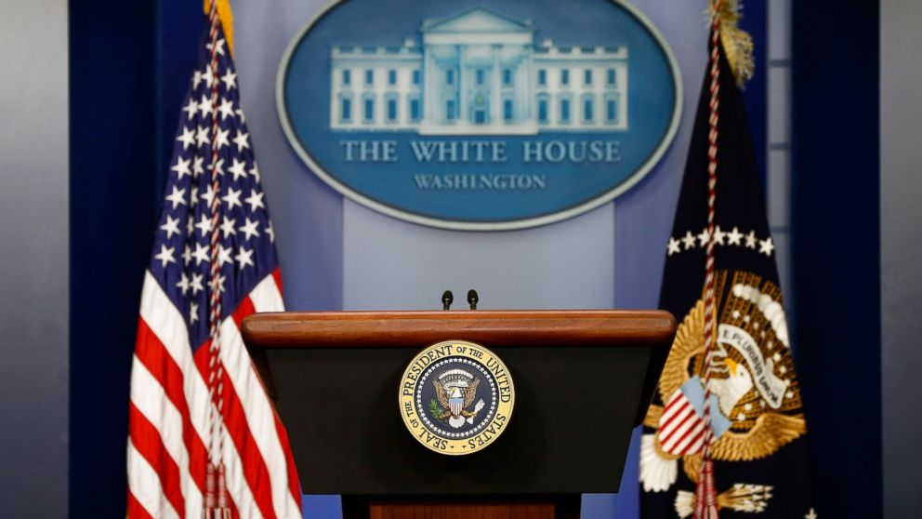
The President’s Foreign Policy
Prof. Jeff Broxmeyer
Dept. of Political Science & Public Administration
The University of Toledo

Slide 2
Reality & Myth
Presidential Role
Popular Myths
…But Many Constraints!

Slide 3
POTUS & Foreign Policy
Early Historical Precedents
Congressional Inaction
Institutional Change
Public Opinion?
Deep Partisan Divide
Consensus, Too

Slide 4
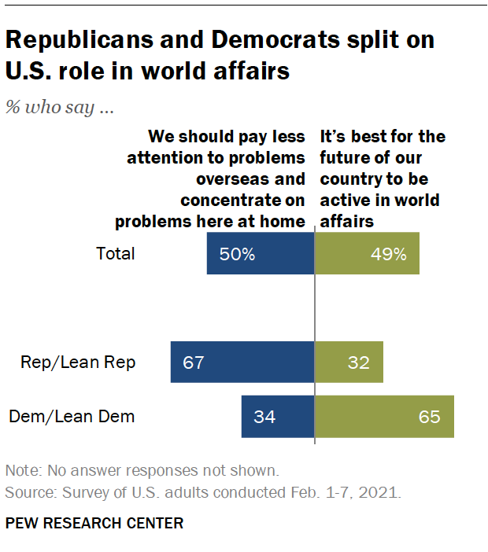

Slide 5
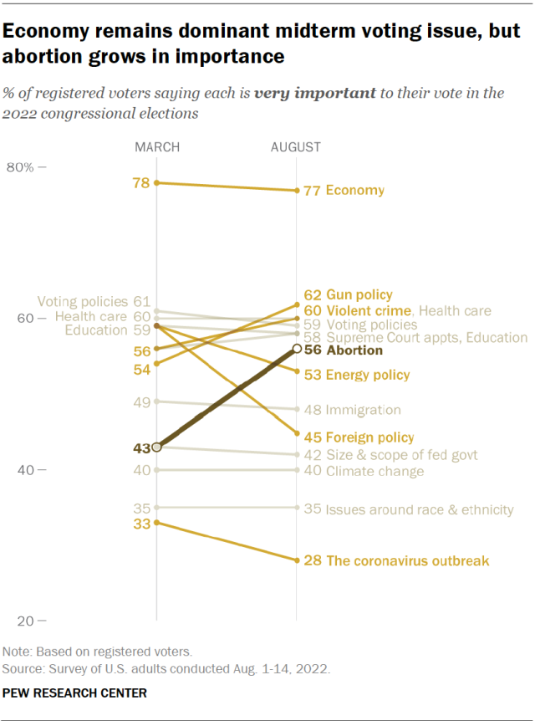
Low Public Priority (Listed 9th)
Low Salience Issue (Historically)

Slide 6
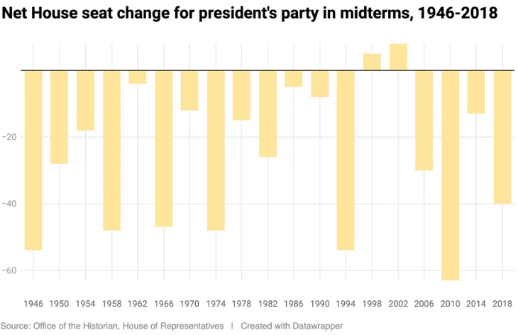

Slide 7
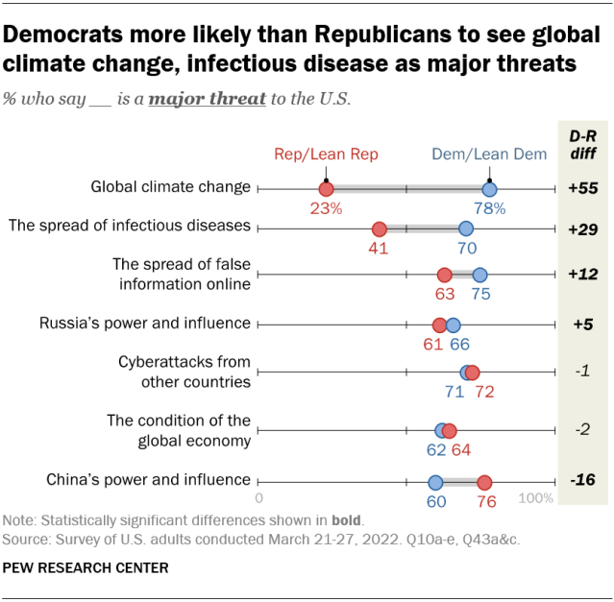

Slide 8
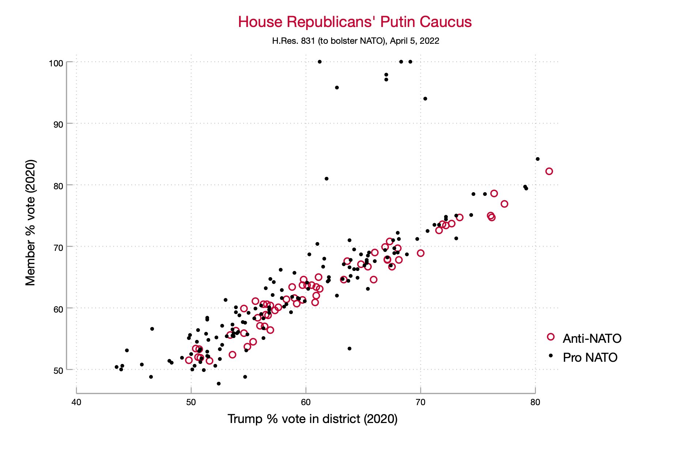
House Republicans Who Voted Against NATO Resolution
Passed 362-63
Source: Sarah Binder, George Washington University

Slide 9
Flashpoints
Afghanistan
Ukraine/Russia
China/Taiwan

Slide 10
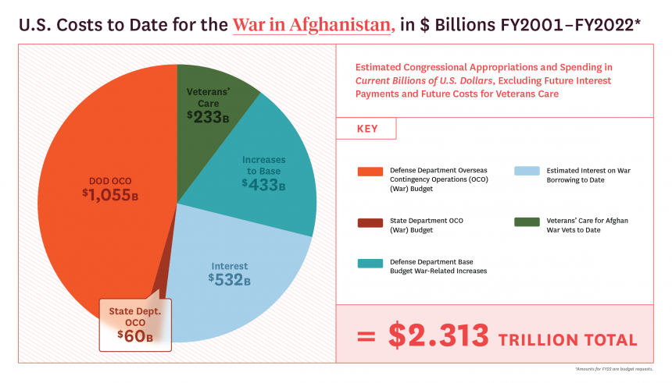
Source: Watson Institute of International and Public Affairs Brown University

Slide 11
Biden Administration
Foreign Policy Priorities
Democracy Summit
Climate Change
Onshore Strategic Domestic Manufacturing
Inflation & Supply Chain Issues

Slide 12
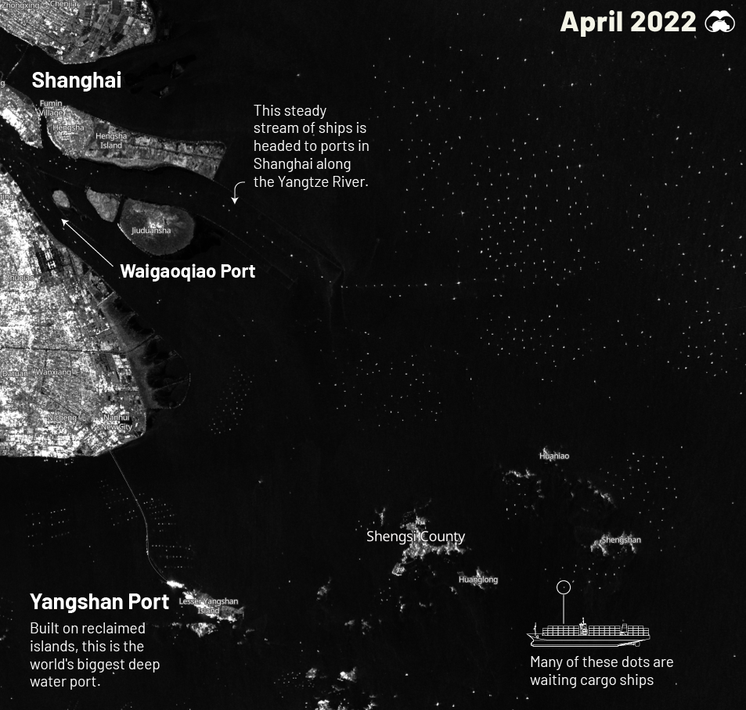
Snapshot of the Supply Chain Problem
470 Ships Waiting To Dock
Port Wait Times Increased 75% Since Lockdowns

Slide 13
Some Open Questions
What Are Major Challenges Today?
How Much Should The President Collaborate With Congress? And How Much Should The President Act Unilaterally on the World Stage?
Should or Can the U.S. Make Long-term Diplomatic Commitments Given The Current Political Divide?
Others?

