Slide 1
LinkedIn 101:
Presented by: Shelly Drouillard
Center for Experiential Learning and Career Services

Slide 2
Who Uses LinkedIn?
259M⁺
64%
professionals
64% outside the U.S.
3M⁺
150⁺
companies
industries
60K⁺
Executives from every
Fortune 500
college and university
alumni groups
company
30M⁺
students and recent grads

Slide 3
Students & recent grads = LinkedIn’s fastest-growing demographic

Slide 4
“It’s no longer enough to simply have a solid resume. Students now need a professional online presence.”
Holly Paul, Former US Recruiting Leader, PricewaterhouseCoopers

Slide 5
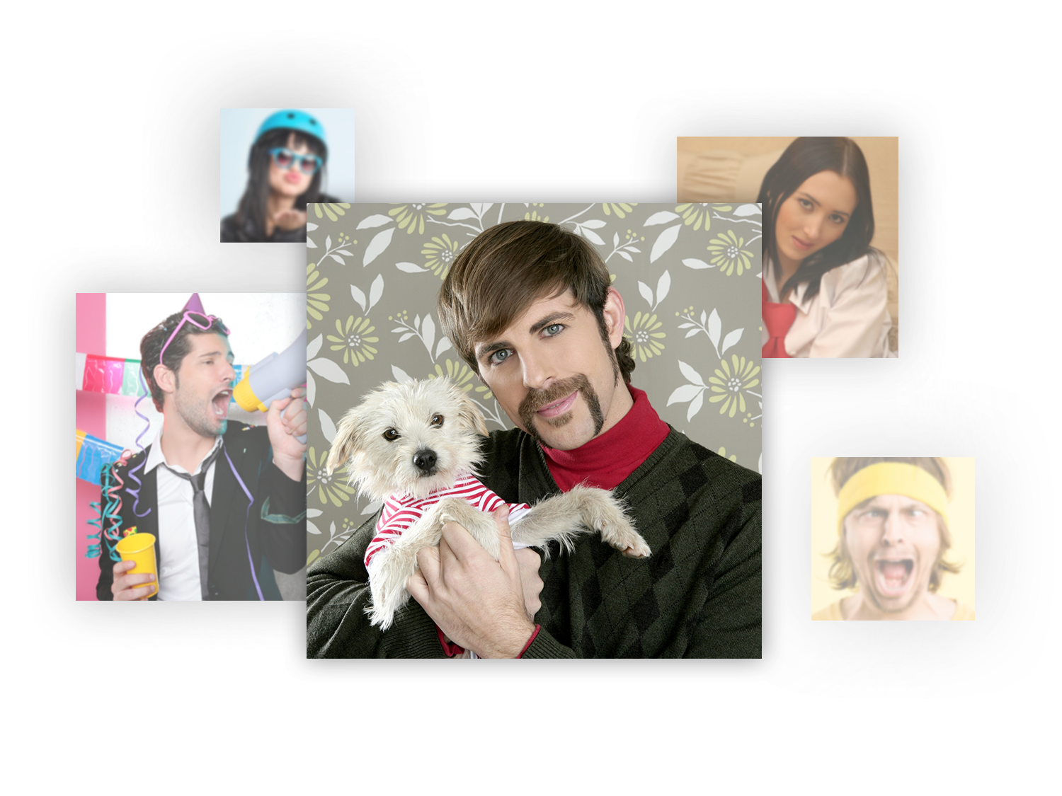
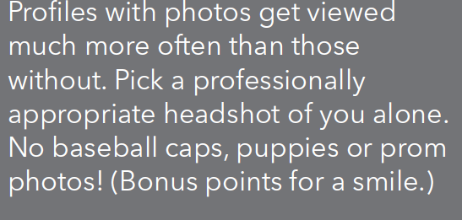
1. Build a Professional Online Presence
Facebook
LinkedIn

Slide 6
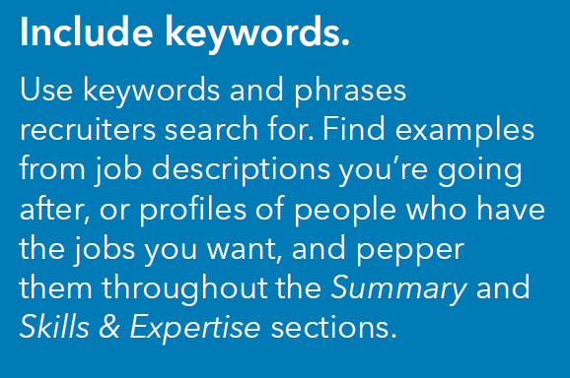
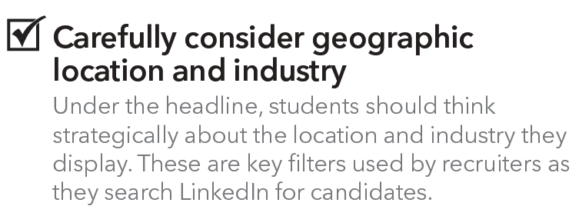
Capture Interest with Your Headline and Summary

Slide 7
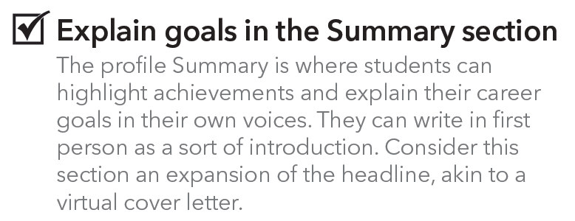
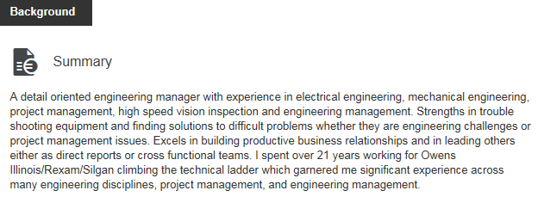
SUMMARY EXAMPLE

Slide 8
Your Turn… Summary Practice
A engineering
with experience in
Strengths in
Excels in
I spend xx months/semesters/years working for
Eager to climb the technical ladder
Ready to hit the ground running
Prepared to contribute

Slide 9
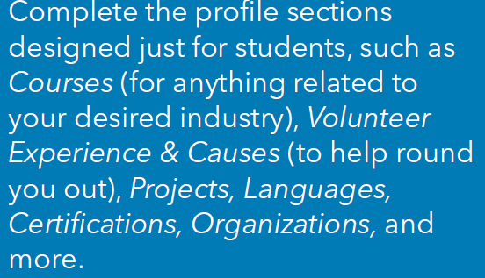
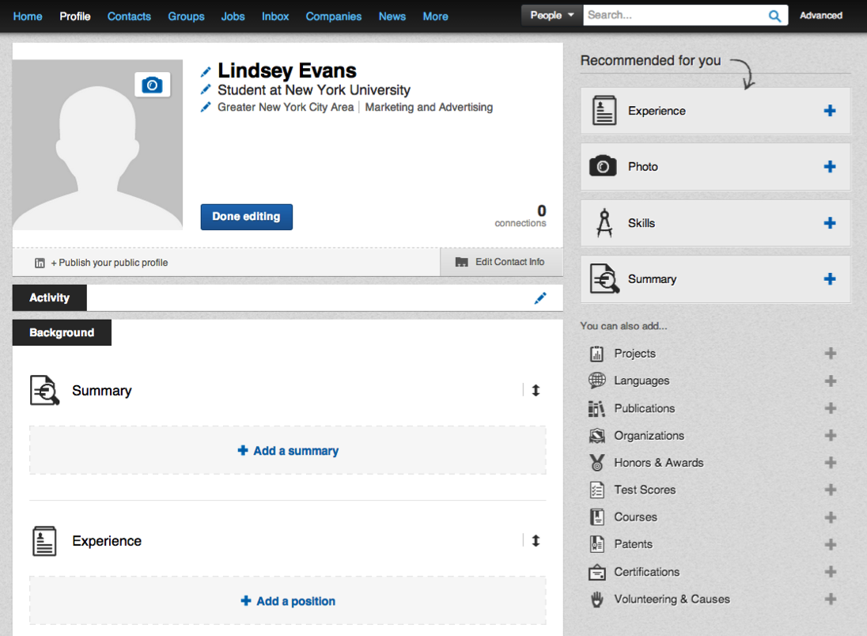
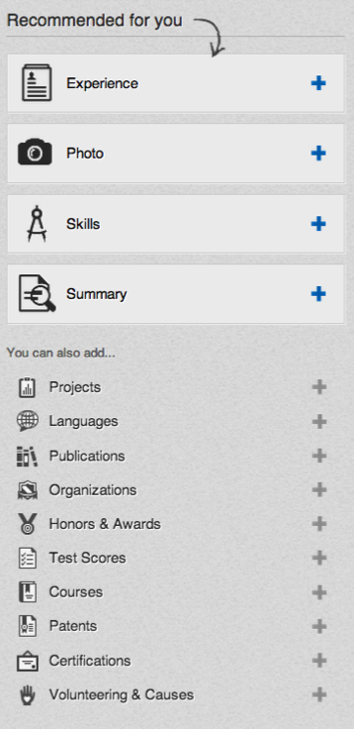
Add Sections to Enhance Student Profiles

Slide 10
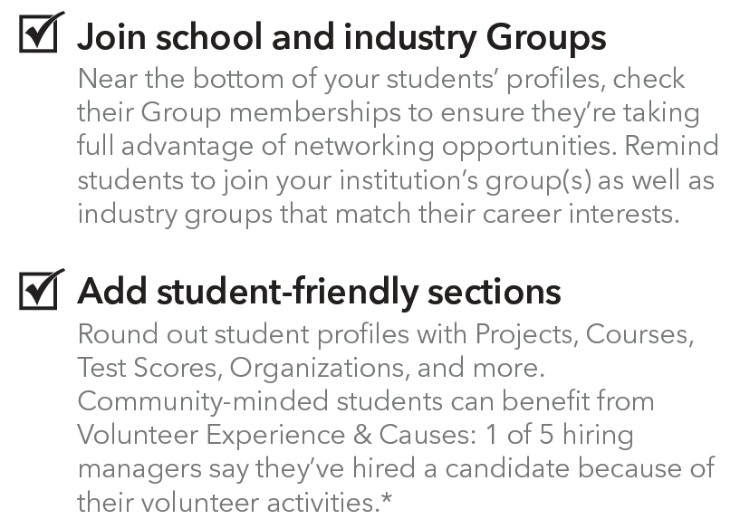
Add Sections to Enhance Student Profiles

Slide 11
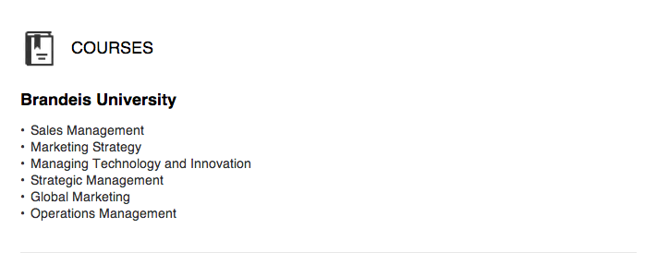
Add Sections to Enhance Student Profiles: Courses

Slide 12
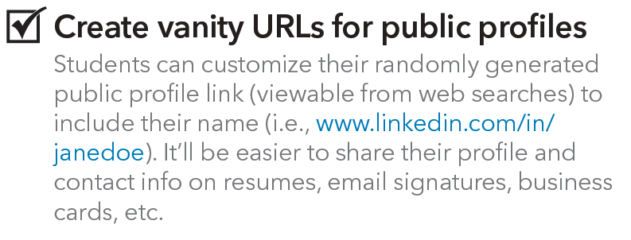
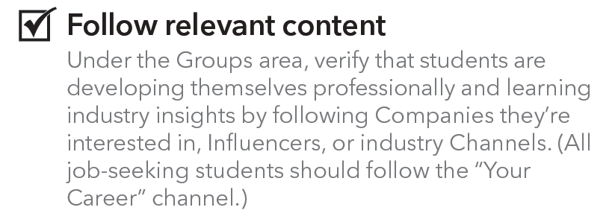
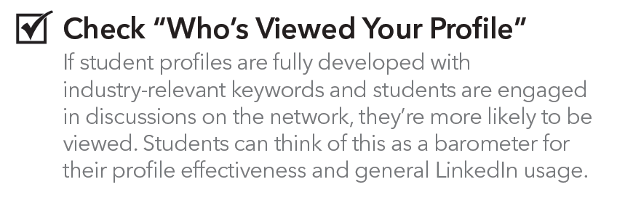
More Student Profile Tips!!!

Slide 13
2. Add connections with 'warm' contacts and alumni

Slide 14
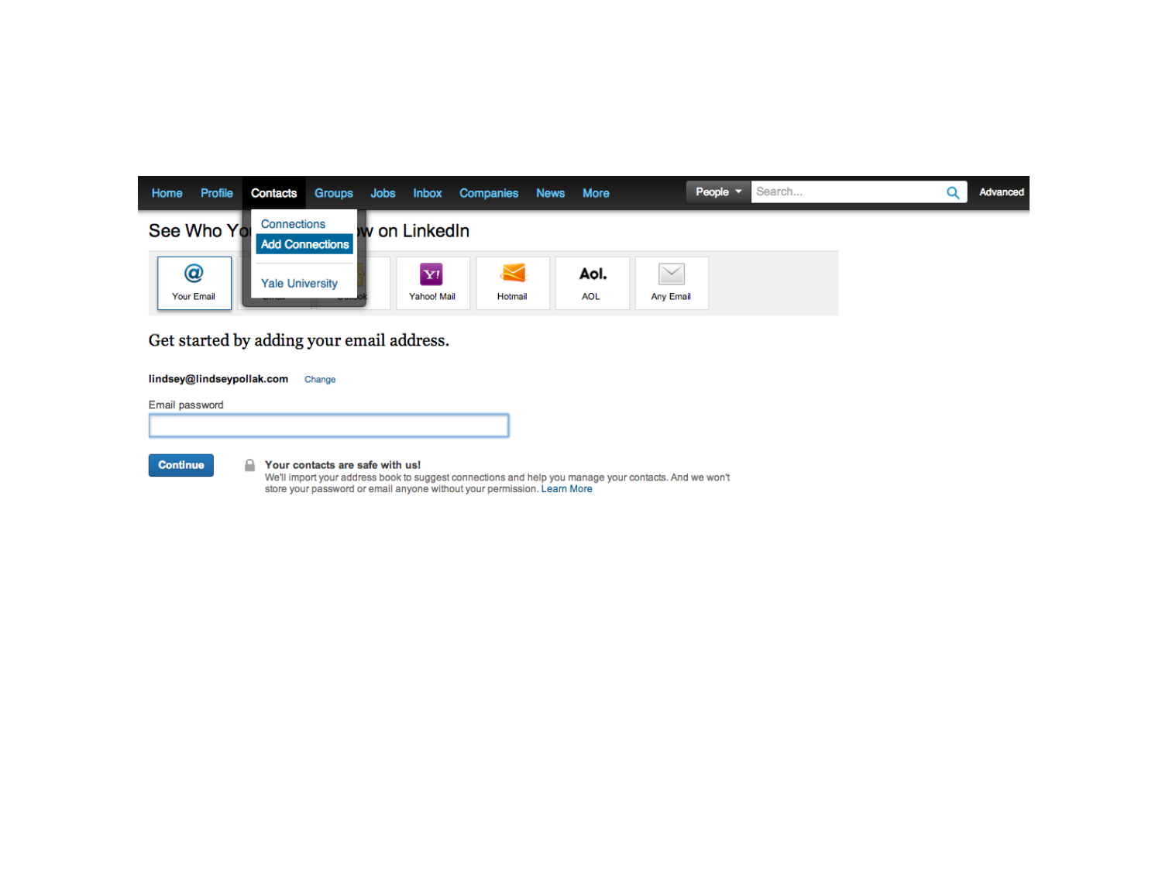
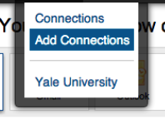
Use Address Book Uploader to Connect to People Students Already Know

Slide 15
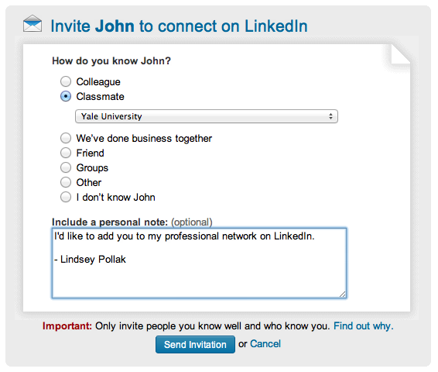
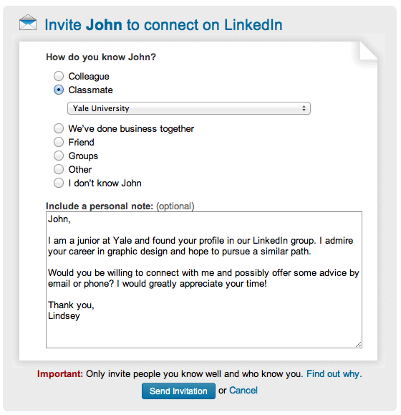
Write Personalized Connection Requests

Slide 16
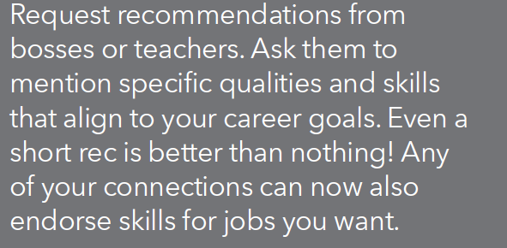
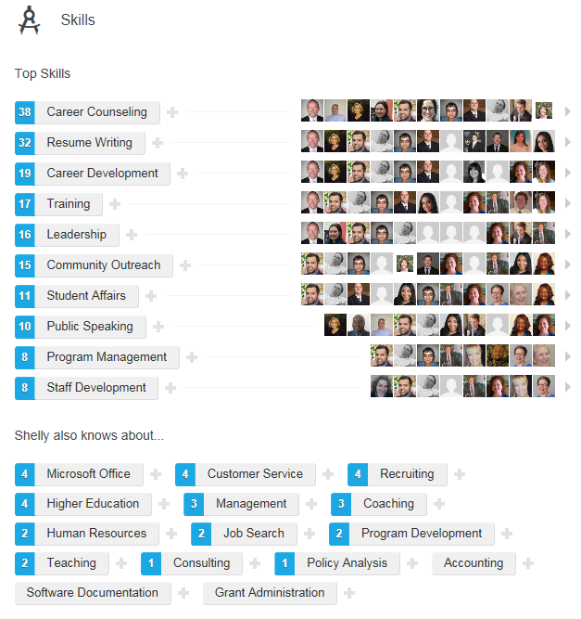
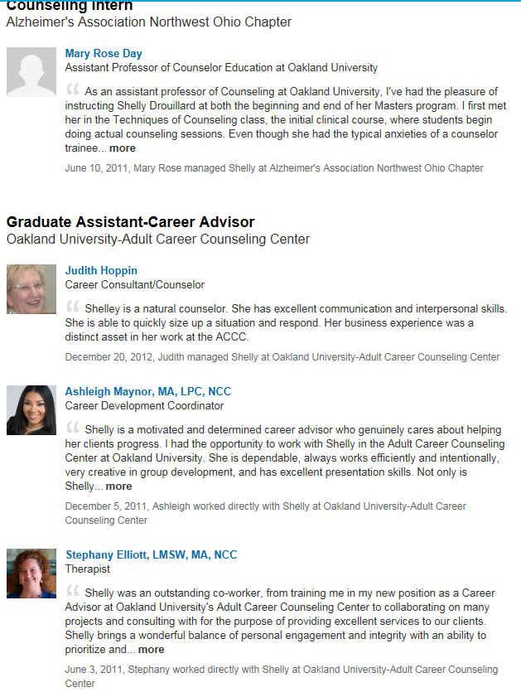
Get Recommended!!!
Recommendations from professors, advisors, internships

Slide 17
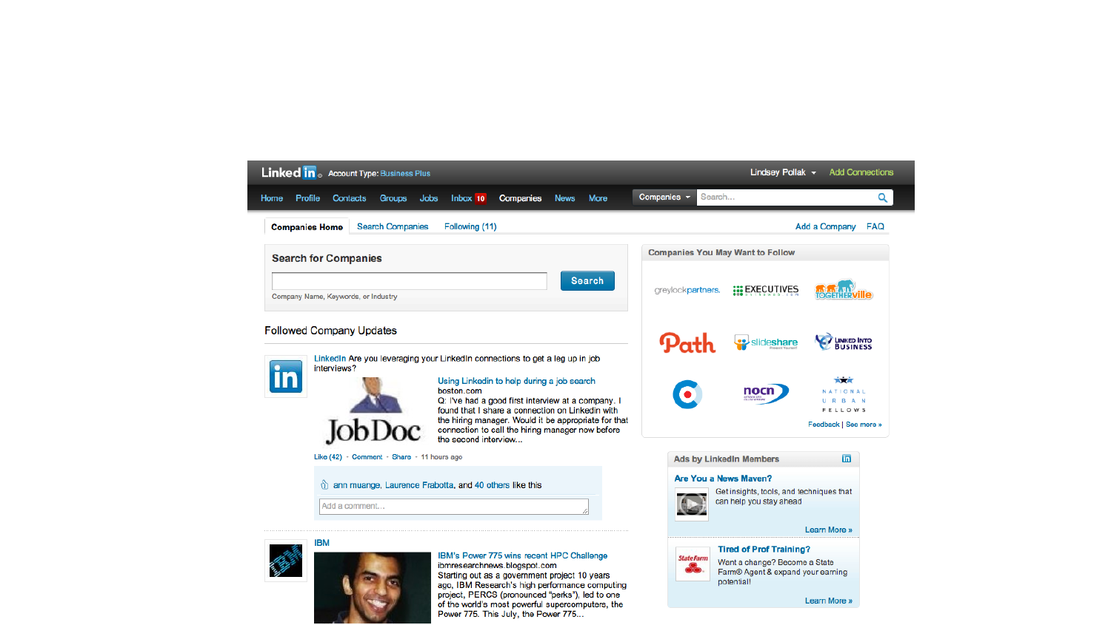
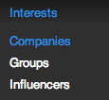
3. Research Companies & Industries

Slide 18
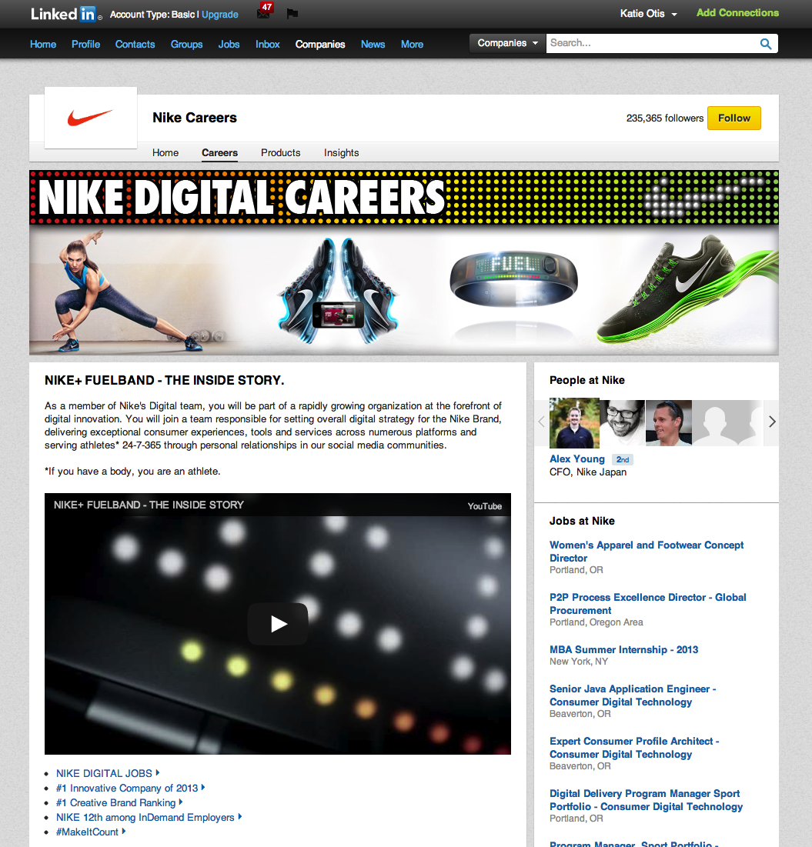
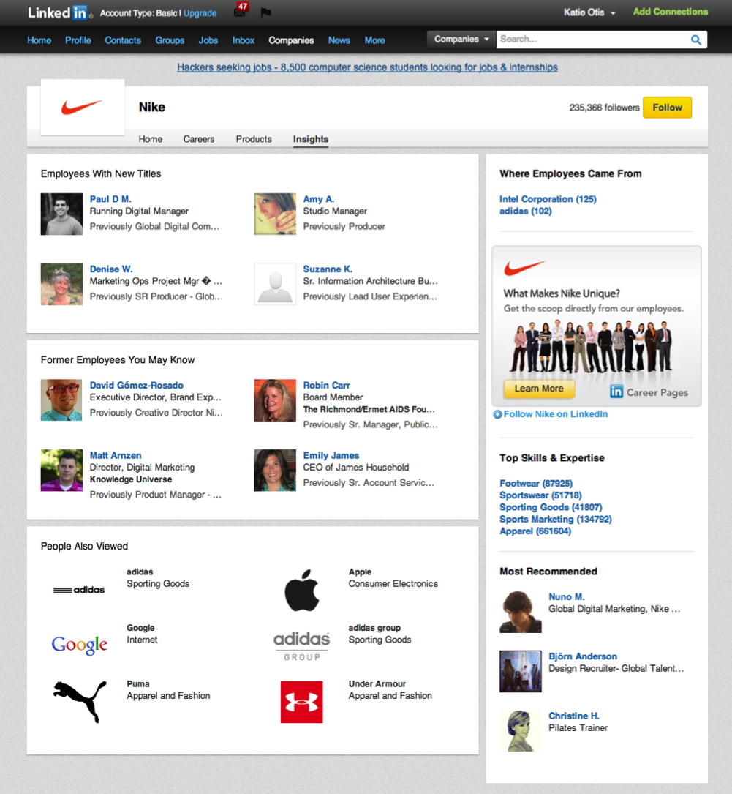

Slide 19
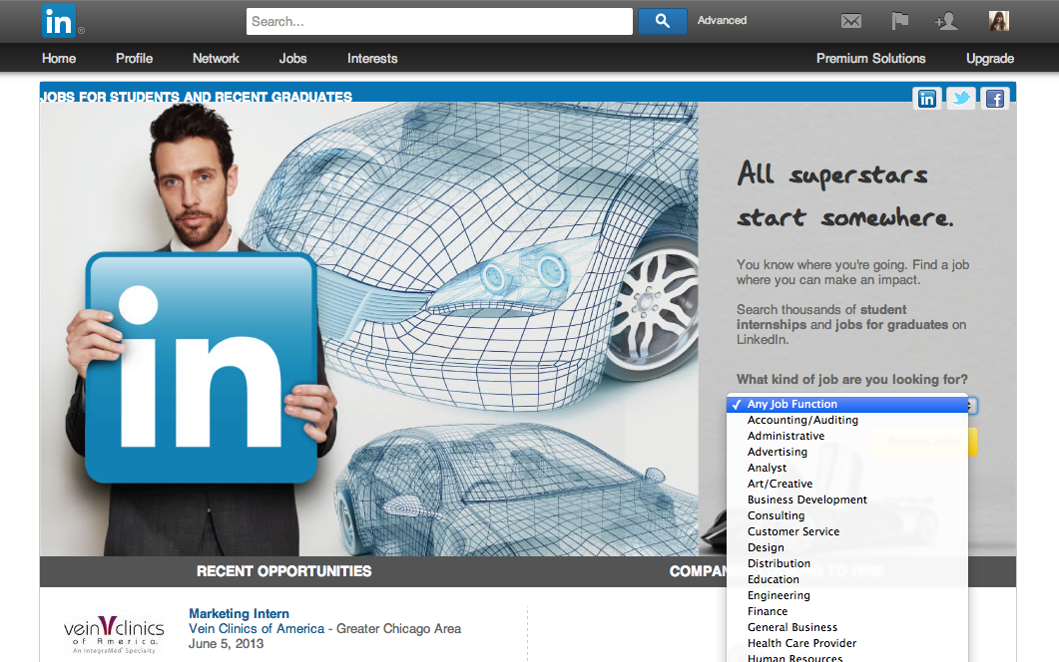
Student Jobs Portal http://linkedin.com/studentjobs
Add this link on your career center site!

Slide 20
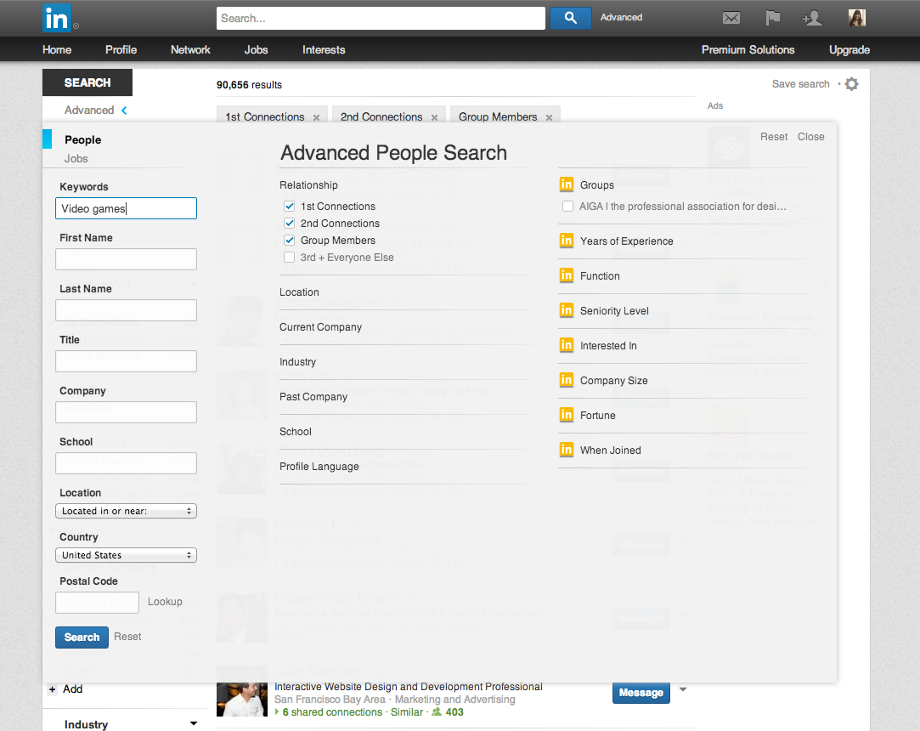
4. Explore Opportunities for Undecided Students

Slide 21
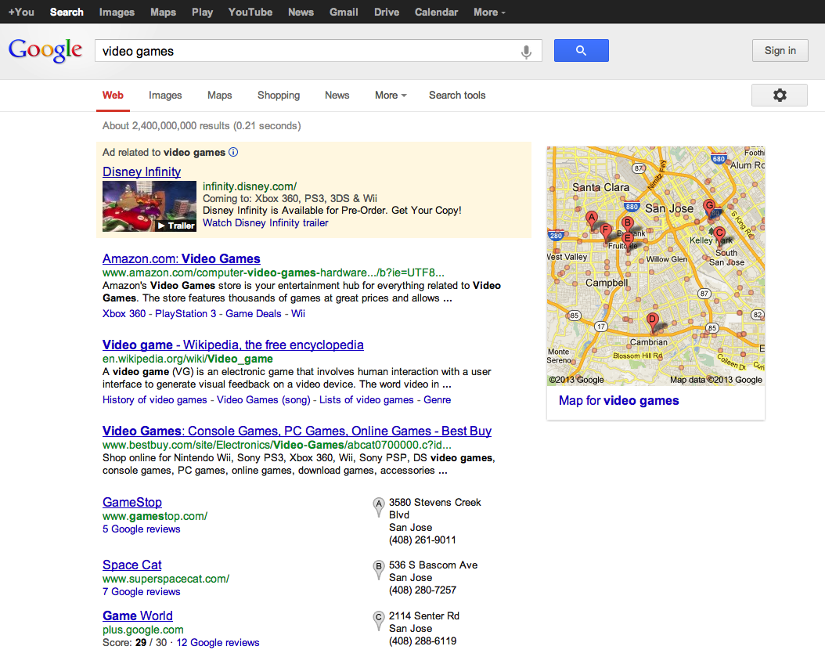

Slide 22
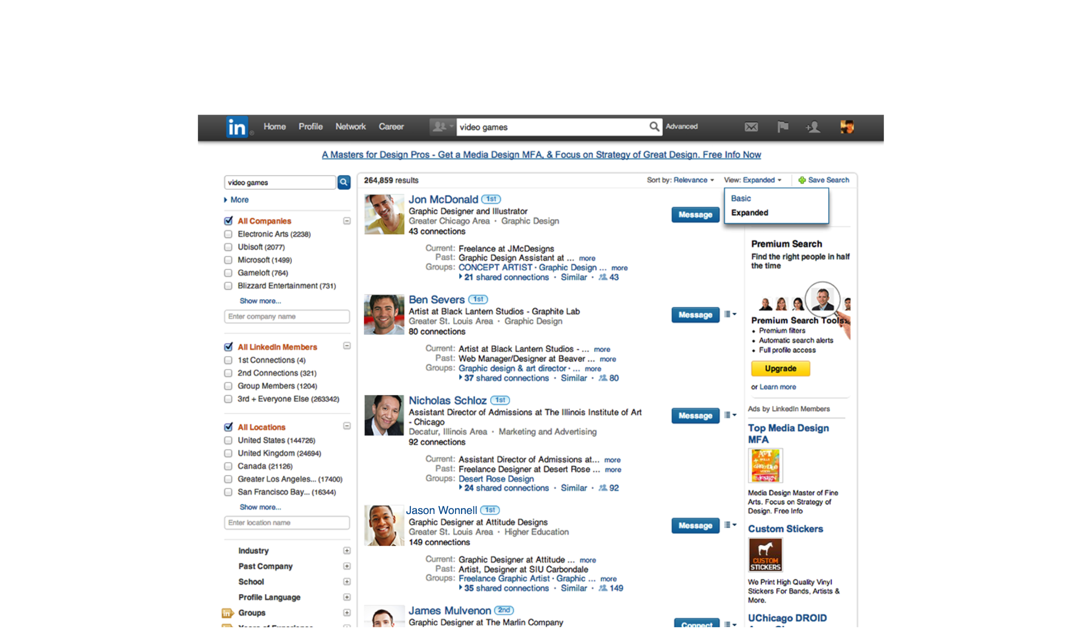
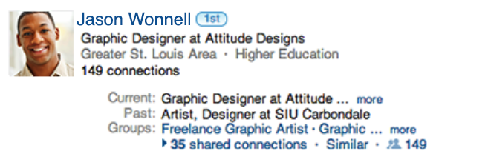

Slide 23
Use LI to Connect with Rocket Alumni!
My Network
Find Alumni

Slide 24
UT Engineering Alumni

Slide 25
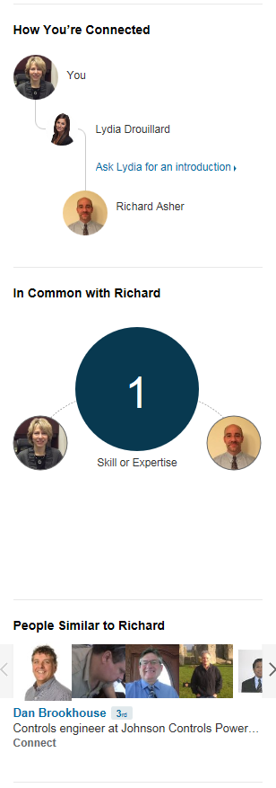
Read Up on Alum Career Path & See How Connected

Slide 26
Questions: Check out students.linkedin.com Center for Experiential Learning & Career Services SU1533 419-530-4341 celcs@utoledo.edu

