Slide 1
Professional Writing: Understanding Audience, Tone, and Structure
Presented by the UT Writing Center

Slide 2
The “Universal” Traits of Writing
All writing tasks, whether academic, professional, or personal are governed by certain shared traits
Think “SAPO”: Subject, Audience, Purpose, Outcome
Writing for the workplace, in particular, typically succeeds or fails based on the degree to which the writer has considered these traits

Slide 3
Well-Defined Subjects are “Manageable” for the Writing Task
Assess the content needs of the writing task, and then develop your subject accordingly
Be concise: ineffective professional writing can often be caused by the inclusion of subject material that is irrelevant to the core writing task

Slide 4
Know Your Audience, Know Success!
An awareness of one’s audience is perhaps the most critical trait in Professional Writing
The identity of your audience significantly influences your word choice, tone and phrasing; different audiences dictate different choices in these areas
In the age of social media and text messaging, writers (particularly recent graduates) are significantly more likely to inadvertently merge personal, informal language with professional tasks; a constant awareness of audience is the solution to this problem

Slide 5
Effective Persuasion=Audience Awareness + Relevant Evidence
Whether using appeals to logic (logos), appeals to emotion (pathos), or appeals to one’s own credibility (ethos), evidence is only effective if it fulfills the needs of the reader
Effective document design and the inclusion of engaging visual elements can also have a persuasive effect

Slide 6
Tone in Professional Communications: WHAT you say and HOW you say it MATTERS!
Consider this email message recently sent to all staff members on a large university campus:
“It is time to renew your faculty/staff parking permit. New permits are required by Nov. 1. Parking Rules and Regulations require that all vehicles driven on campus must display the current permit.”
Now, a revised version with a different tone:
“Please renew your faculty/staff parking permit by November 1.”
An enhanced version would also do the following:
Guide the recipient on how and where to renew the parking permit

Slide 7
Consider the Difference in Tone
INFORMAL TONE
PROFESSIONAL TONE
You must agree that I am qualified for the position.
You didn't read the instructions carefully, thus your system has shut down.
"I hope that you will contact me...I know that my qualifications are not very impressive, but..."
My qualifications in the areas of accounting and customer service meet your job requirements.
The system may automatically shut down if any installation errors occur.
"You can reach me at 555-2233; I look forward to hearing from you….My qualifications make me an excellent applicant for this position..."

Slide 8
Establishing Your Tone: Ask Yourself…
Why am I writing this document?
Who am I writing to and what do I want them to understand?
What kind of tone should I use? What impression do I want my reader to have upon receiving my communication?

Slide 9
Some General Guidelines Regarding Tone
Be confident
Be prepared and knowledgeable about the material you are communicating
Be courteous and sincere
Demonstrate respect, honesty, and politeness
Use appropriate emphasis
Emphasize an idea by placing it in a short sentence; ideas placed in the first paragraph and the last paragraph receive the most attention
Stress benefits for the reader
Write from the reader’s perspective; not what the reader can do for you, but what you can do for the reader
Use non-discriminatory language
Use neutral job titles (ie: chairperson instead of chairman), avoid demeaning or stereotypical terms, and do not use masculine pronouns (each student must provide his own computer)
Write at an appropriate level of difficulty
Avoid complexity your reader won’t understand; writing should be clear and simple

Slide 10
Structure of the Communication
Organization of information = Effective Argument and Persuasion
How the communication is structured directly relates to the order of importance of the presented information
The INTRODUCTION of the Communication: should answer 3 questions for your reader
What is this?
Why am I getting it?
What do you want me to do?

Slide 11
General Guidelines Regarding Structure
Communication should proceed in a logical, organized manner, moving from general to specific information
Information arranged in order of importance to your audience
Similar information is kept together
Each section is organized around only ONE main idea
Key sentences begin each paragraph

Slide 12
Document Design: Presentation MATTERS!
Document conforms to genre expectations: resume, cover letter, memo, report, etc.
Readers can easily find the information they expect to see
Key points are emphasized using boldface, underlining, or italics
The use of clear and specific headings to guide readers through the document
Improved readability by using indentation or bullets

Slide 13
Use HATS to Create Effective Documents
HATS documents are easy to access, easy to navigate, easy to remember
Headings: to promote easy navigation
Access: to promote the finding and understanding of presented information
Typography: to promote ease of reading and clear levels of information hierarchy
Space: to promote effective document design

Slide 14
The Business Letter
Includes the following parts:
Sender’s address (or on letterhead)
Date (date letter was finished, in the American Date format: February 2, 2017)
Inside address (address of recipient)
Salutation (greeting—do not use solely first names unless you know the recipient personally, and use first and last name if you are unsure of the sex of the recipient)
Body (single spaced and left justified, one blank line between each paragraph)
Closing (capitalize the first word only, and leave 4 blank lines between the closing and the signature)
Enclosures (if you have them)

Slide 15
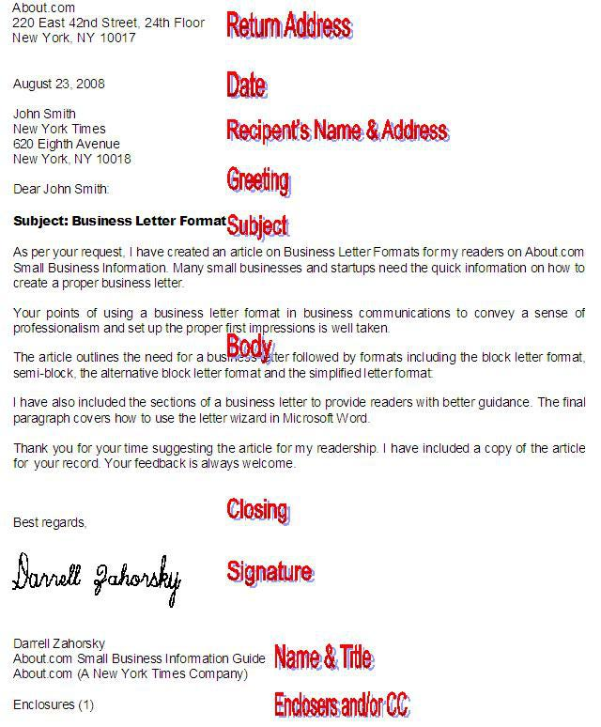

Slide 16
What’s Essential in Professional Writing
Attention to audience when composing the communication
Expressed purpose of the communication
Appropriate tone for the communication
Clear, simple language and sentences
Appropriate structure and document design
You want your reader to feel your ideas are easy to access, easy to navigate, and easy to remember*

