Slide 1
COURSE EVALUATION
Spring 2019 Pilot
August 27, 2019

Slide 2
Course Evaluation Ad-Hoc Committee
Co-Chairs: Amy Thompson and Christine Fox
Faculty Advisors on Methodology and Analysis: Svetlana Beltyukova and Christine Fox
The charge of the Course Evaluation Ad-Hoc Committee was to review best practices and procedures for assessing student perceptions of faculty teaching and make recommendations for a standardized data collection process and standardized set of common core assessment questions.

Slide 3
Survey Development Procedures
Reviewed published literature to assess best practices in course evaluation
Reviewed existing course evaluations from each of the UT colleges as well as some peer institutions
Conducted a thematic analysis to determine common constructs that reflected best teaching practices
Developed 12 core questions and 3 Open-ended questions

Slide 4
Survey Pilot Procedures
Feedback and approval was sought from the ad-hoc committee and faculty governing bodies
Individual faculty members, department chairs, and college deans were contacted to solicit volunteers for the Spring 2019 pilot
The core questions were administered to participating courses/departments/colleges electronically via Blackboard
Each participating department and college was able to include additional questions that were tailored to their own unique needs

Slide 5
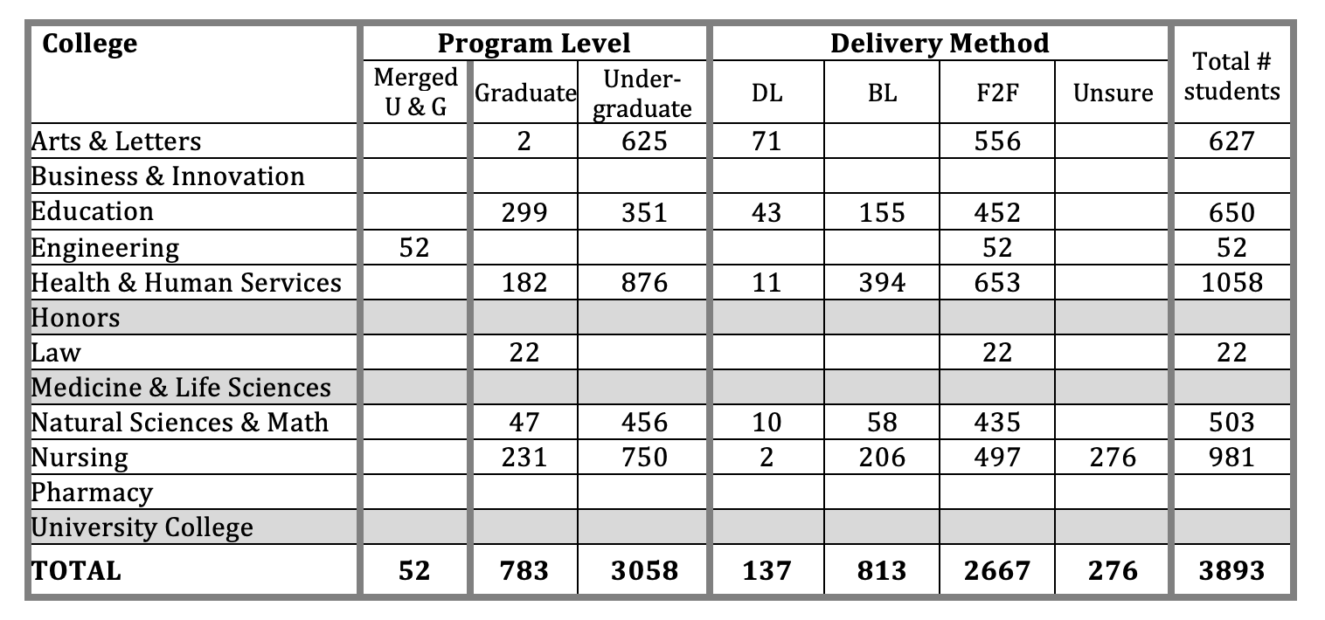
Survey Pilot RESULTS
The core questions were administered in Spring 2019 to almost 4,000 students (undergraduate and graduate) across 9 colleges

Slide 6
Psychometric Analysis
Psychometric analyses:
For the overall sample (n=3,893)
By each college
By course level (graduate & undergraduate)
By method of delivery (DL & face-to-face)
Purposes:
To determine if computing a composite course evaluation score was meaningful and justifiable
To determine if any questions needed to be analyzed and reported separately
To determine the extent to which the meaning of the composite score was stable across colleges, student levels, and methods of course delivery

Slide 7
A composite score based on 8 out of 9 questions would be meaningful and justifiable.
Question 1 (I put forth my best effort in this course) needs to be analyzed and reported separately as it does not fit both conceptually and statistically with the other questions.
The remaining 8 questions form 4 meaningful clusters/themes:
Cluster 1: Clear expectations and fair grading
Cluster 2: Climate
Cluster 3: Feedback
Cluster 4: Teaching strategies
Results of Psychometric Analysis

Slide 8
Steps in Course Evaluation Question Revisions
Think-aloud interviews with 27 graduate & undergraduate students (saturation was reached) representing the following colleges:
Arts & Letter
Education
Engineering
HHS
Natural Sciences & Math
Nursing
Medicine
Review of the think-aloud data and question revision discussion by the survey committee members

Slide 9
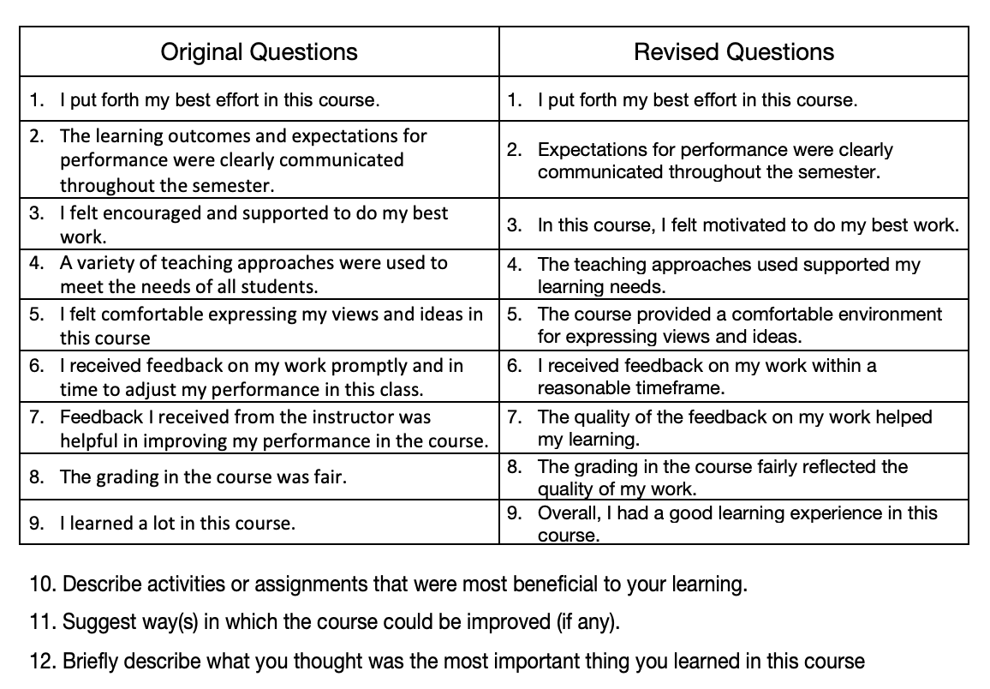
Course Evaluation Questions

Slide 10
With the original wording, students immediately thought about the syllabus and did not understand the term ‘learning outcomes.’ The intent of this question is to emphasize the importance of expectations for performance AND clear communication throughout the semester.
Original Q2: The learning outcomes and expectations for performance were clearly communicated throughout the semester.
Revised Q2: Expectations for performance were clearly communicated throughout the semester.

Slide 11
Students were interpreting “being encouraged and supported” differently. It needed to be clear that this was about the course, and motivation better captures the intent of encouragement and support because those result in motivation.
Original Q3: I felt encouraged and supported to do my best work.
Revised Q3: In this course, I felt motivated to do my best work.

Slide 12
First, the question is asking about two different things: about variety of approaches and needs of all students. Second, the students felt they could not speak for everyone’s needs. Third, the question is not about the variety of approaches but about the nature of approaches to help students be successful in the course.
Original Q4: A variety of teaching approaches were used to meet the needs of all students.
Revised Q4: The teaching approaches used supported my learning needs.

Slide 13
The question should focus on learning environment, not on feeling comfortable. Given that some students don’t feel comfortable speaking up, the original wording made it all about the student, not the course.
Original Q5: I felt comfortable expressing my views and ideas in this course.
Revised Q5: The course provided a comfortable environment for expressing views and ideas.

Slide 14
Students thought these questions were very similar as both related to adjusting performance and feedback. The suggestion was to make them shorter and focus on one component only – on feedback timeliness and quality.
Original Q6: I received feedback on my work promptly and in time to adjust my performance in this class.
Original Q7: Feedback I received from the instructor was helpful in improving my performance in the course.

Slide 15
Question revisions according to feedback…
Revised Q6: I received feedback on my work within a reasonable timeframe.
Revised Q7: The quality of the feedback on my work helped my learning.

Slide 16
Students were unclear if this question was about treating everybody the same or getting the grade they deserved or their understanding why they earned that grade. Subsequent discussion of this question with the committee made it clear that the intent of the question was about grading criteria and student understanding of the grade they earned.
Original Q8: The grading in the course was fair.
Revised Q8: The grading in the course fairly reflected the quality of my work.

Slide 17
Students felt that many required courses would “suffer” from this question as they would be required to take a course where they already know most of the material. Many also felt the question was vague and should be about engagement with the course material, relatedness of the course material, etc.
Original Q9: I learned a lot in this course.
Revised Q9: Overall, I had a good learning experience in this course.

Slide 18
Fall 2019 - ‘soft launch’ across the university using Campus Labs Software
Spring 2020 – full implementation
Department and College questions can be added
Next Steps

Slide 19
THANK YOU

