Slide 1
University of Toledo Faculty Senate
August 29, 2023
Dilip Das, Ph.D.
Vice President for DEI
Dilip.das@utoledo.edu
419-530-2260
Inclusion Statements, Student Success &
A People-Centered Culture

Slide 2
*LAND ACKNOWLEDGEMENT: "Ohio is one of those eighteen states with no reservations and no federally recognized Indians. This does not mean that there is no one Indigenous to Ohio still living in Ohio. Those Indigenous to and still in Ohio include Senecas, Wyandots, Cherokees, Lenapes, Shawnees, Miamis, Ottawas, Saponis, and Mahicans." - Retired Professor Barbara Mann, University of Toledo
*INCLUSIVE CLASSROOM STATEMENT: In this class, we will work together to develop a learning community that is inclusive and respectful. Our diversity may be reflected by differences in race, culture, age, religion, sexual orientation, gender identity/expression, socioeconomic background, and a myriad of other social identities and life experiences. We will encourage and appreciate expressions of different ideas, opinions, and beliefs so that conversations and interactions that could potentially be divisive turn, instead, into opportunities for intellectual and personal development.
I encourage you all to keep me informed on how you feel and experience on diversity, inclusion, and equity as we go through the semester. My goal is to improve our learning environment and make this class a better place for you as a learner and as a person. Your honest anonymous feedback is very important to me because I can’t improve without it.
*Still "legal"! Some faculty have asked if it's still OK to publish these statements. Yes!

Slide 3
UToledo Reimagined: 2023 – 2028 Five-Year Strategic Plan Vision & Values
Prioritize student success, health and well-being (Student Success = Goal #1 of Strategic Plan)
Create a diverse community built on foundations of respect, inclusion and belonging
Embrace a people-first culture where we are known for outstanding student experiences, alumni and donor engagement, patient satisfaction and as an employer of choice (Goal #5)
Launch graduates equipped to think critically, act ethically, collaborate and communicate effectively in diverse environments; apply their knowledge and skills to analyze and solve real-world problems
Inclusion – We foster belonging, equity and respect for all as part of our commitment to valuing diversity of people and ideas.

Slide 4
FACULTY FOCUS ON STUDENT SUCCESS (GOAL #1)
Student Success Index for UToledo Undergraduates –2021
1-Year Persistence Rates – Pell Grant Recipients: 65.9% Asian: 87.2% White: 78.7% Latino: 70.1% Black: 61.2%
6-Year Graduation Rates – Pell Grant: 43.9% Asian: 67.2% White: 62.1% Latino: 38.7% Black: 30.8%
State racial achievement gaps are strongly correlated with state racial socioeconomic disparities.
Poor-white school districts receive about $150 less per student than the national average—an injustice all to itself. Yet they are still receiving nearly $1,500 more than poor-nonwhite school districts. (https://edbuild.org/content/23-billion)

Slide 5
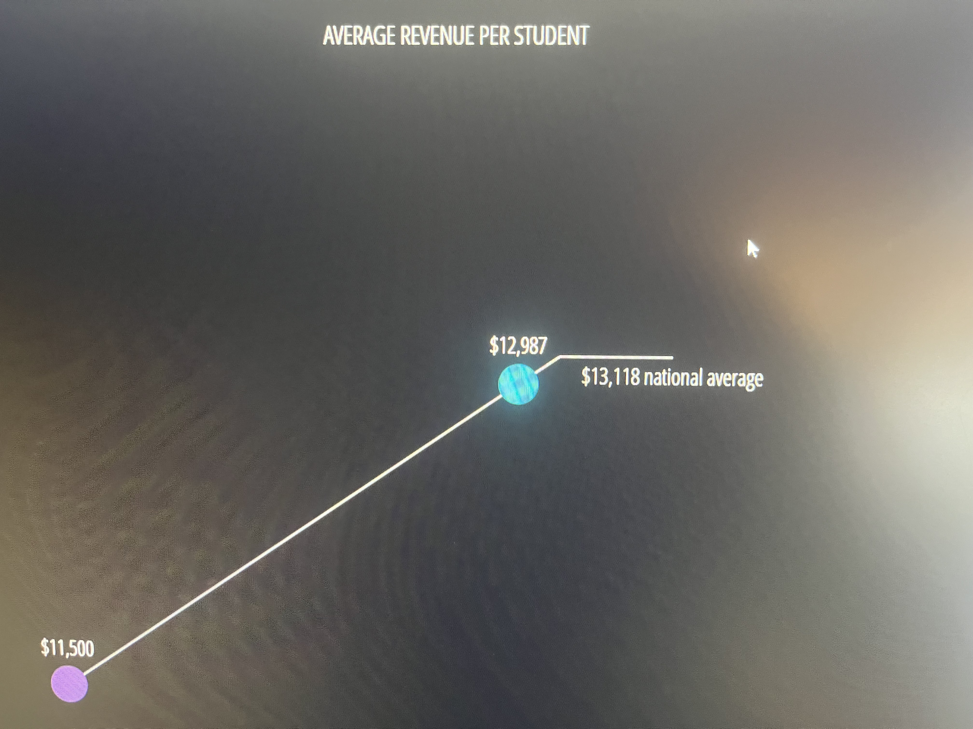
Blue = Low-Income White School Districts
Purple = Non-White School Districts
U.S. Public School Financing: https://edbuild.org/content/23-billion

Slide 6
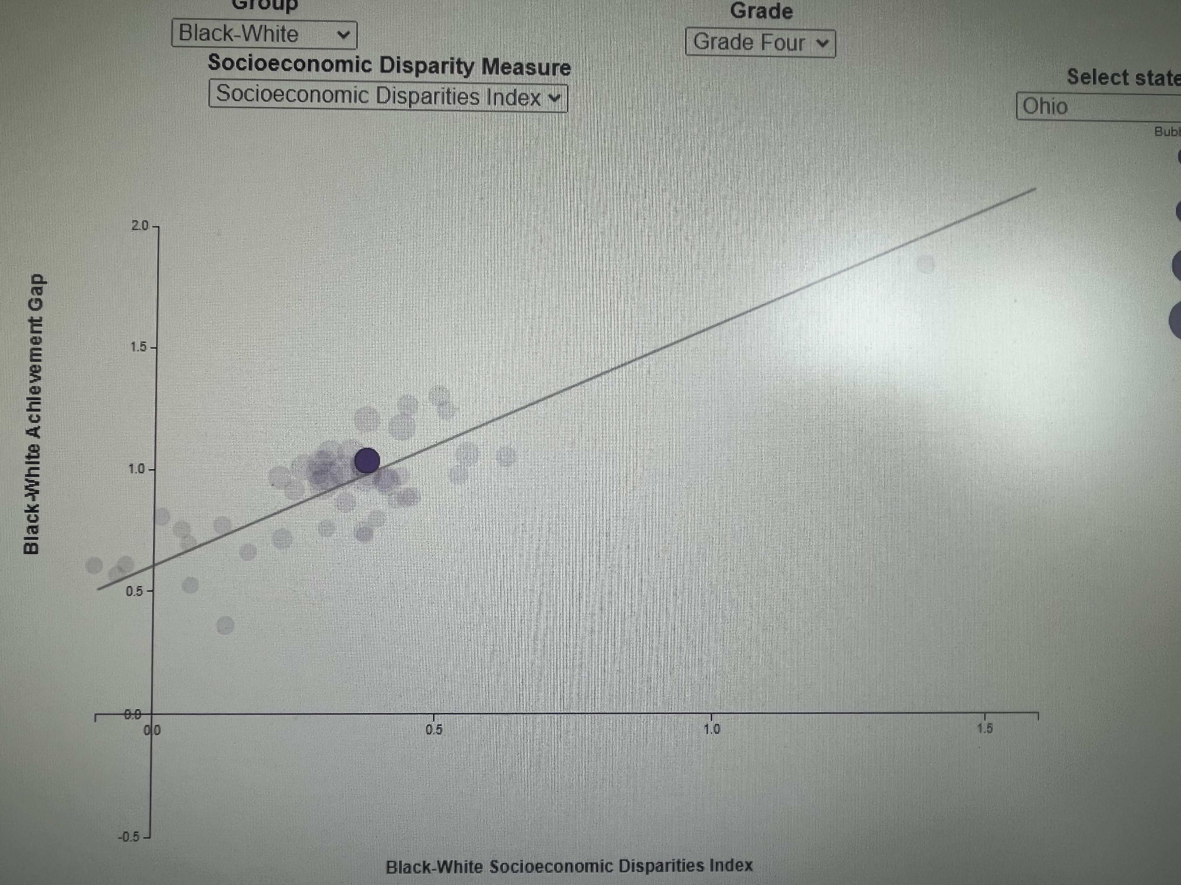
Source: Stanford Center for Education Policy Analysis

Slide 7
FACULTY FOCUS: GOAL #5
Foster a People-First Culture: Promote a Culture of Respect, Inclusion and Belonging
Campus Civility Initiative Team (CCIT): A supportive environment is vital for the success and well-being of students, faculty, and staff. By nurturing a sense of community, we aim to assist in fostering a people-centered culture for everyone to flourish. The team utilizes campus climate survey data and includes faculty and staff from Main Campus, Health Sciences Campus, Human Resources and UTMC.
CCIT is grounded in 3 Policies: Standards of Conduct. Nondiscrimination. Nonretaliation.
Goal #5 relies on reporting. Please familiarize yourself with Report A Concern on every web page.
Inclusion Officers: Each College and large unit focused on: 1) Hiring obligation Each College and Unit follows Affirmative Action Hiring Plans; 2) Goal #1 – Student Success 3) Goal #5 – Belonging

Slide 8
Health Sciences Campus: University of Toledo Medical Center, Medical, Pharmacy, Nursing Colleges
UTMC Hospital: 300,000 patients per year
New federal compliance on health equity
City of Toledo population: 266,000. White: 60% Black: 28% Latino: 9% Two or more: 6.7%
Lucas County: 426,600. White: 73.4% Black: 20.6% Latino: 8% Asian: 2% MENA: not listed
Share of Toledo population living in a neighborhood where average life expectancy is at least 10% shorter than State of Ohio: Black: 30.9% Latino: 13.3% White: 4.9% (U.S. Census Bureau, 2019).
NIH published the 2021 National Healthcare Quality and Disparities Report, which found that:
Black populations received worse care than White populations for 43% of quality measures
Hispanic populations received worse care than White populations for 36% of measures
Asian and NHPI populations received worse care than White populations for about 30% of measures
Gender-inclusive care training and delivery is a priority. Also see Inclusive Gender Practices policy

