Slide 1
ROCKET
KIDS
Join us on the Internship opportunity of a lifetime!
Let's go!

Slide 2
ABOUT
US
Rocket Kids is a newly-designed service-learning program
Partnership with U.S. Army Child and Youth Services in Europe
Our program recruits, screens, and trains interns to provide educational and recreational programming for children ages 0-5, 6-12, and Teens
Rocket Kids interns are undergraduate, graduate, and recently graduated college students
Available summer, fall, spring terms for 10 week sessions
Students receive college credit at UT for participating in the field experience and completing required coursework

Slide 3
BENEFITS FOR
STUDENTS
Build your resume
Gain experience with children and youth
Engage in a variety of cultural experiences
Housing, travel, and living stipend provided
Earn college credit/fulfill international requirement
Discover your potential and interests
Network with one of the world's largest employers
Serve the families of the U.S. Military
utoledo.edu/studentaffairs/rocketkids/

Slide 4
ABOUT
US

Slide 5
CURRENT
DESTINATIONS
Belgium
Italy
Germany
Netherlands

Slide 6
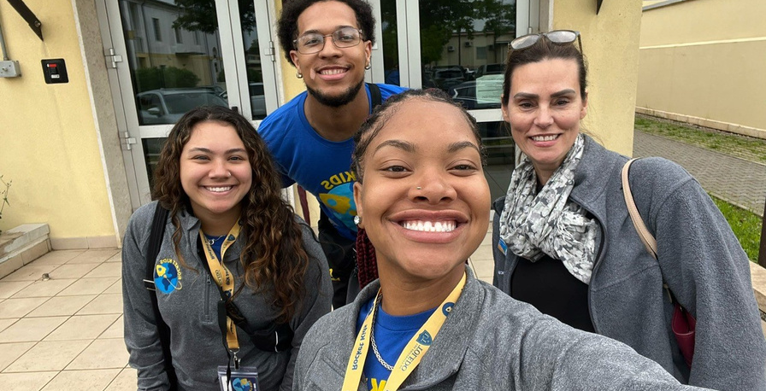
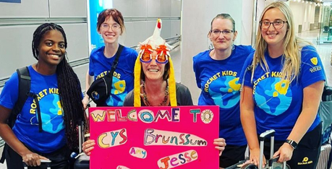
PROGRAM
COSTS
Travel
School
Misc.
$500
$500
$300
Course Tuition: $500
Background Check: $150
CISI Insurance: $160
Passport*: $190
Uniform: $200
First Aid Certification: $100

Slide 7
WHAT
WE COVER
Ticket
Work Transport
Training
Lodging
Meal stipend

Slide 8
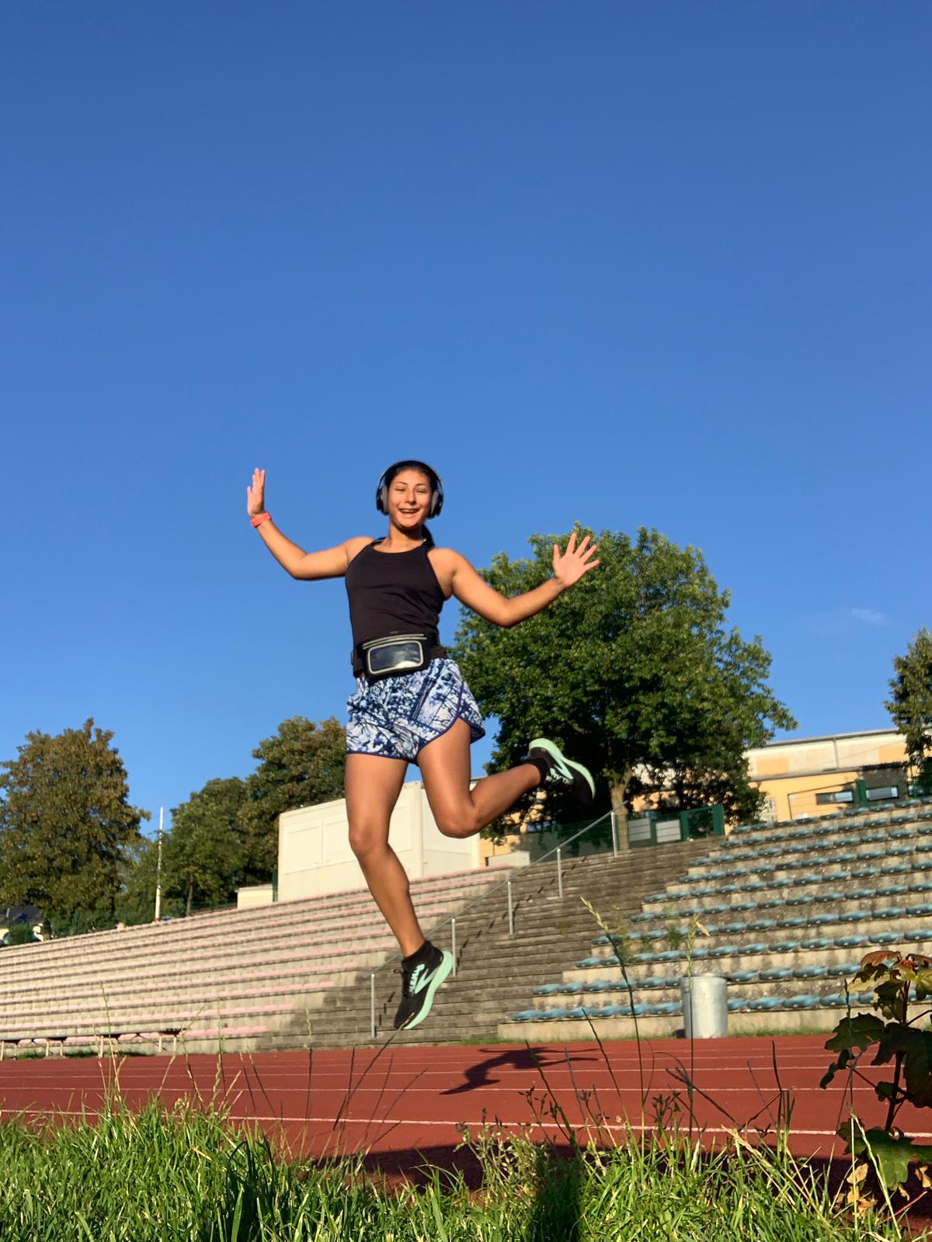
Angelina Mata-Baumholder, Germany
Living in Europe, opened my eyes to a whole new way to live life. The food has changed the way I eat now. Getting to see so many different cultures of people and learn about them has been wonderful. Also, I got to build a wonderful relationship, and going to London.
WHAT
THEY SAY
Sam Simpson- Vicenza, Italy
Going to Vicenza, Italy and working with the children, made me realize on a much deeper level my passion to work with kids. The food, culture and community were welcoming and made me feel safe. Fun fact, alfredo isn't Italian...

Slide 10
CONTACT
US
(419) 530-5277
rocketkids@utoledo.edu
2801 W. Bancroft St. Mail Stop

Slide 11
THANK
YOU
rocketkids@utoledo.edu

