Slide 1

Office of Research & Sponsored Programs
Research Ethics & Compliance
James P. Trempe, Ph.D.
Vice President for Research

Slide 2
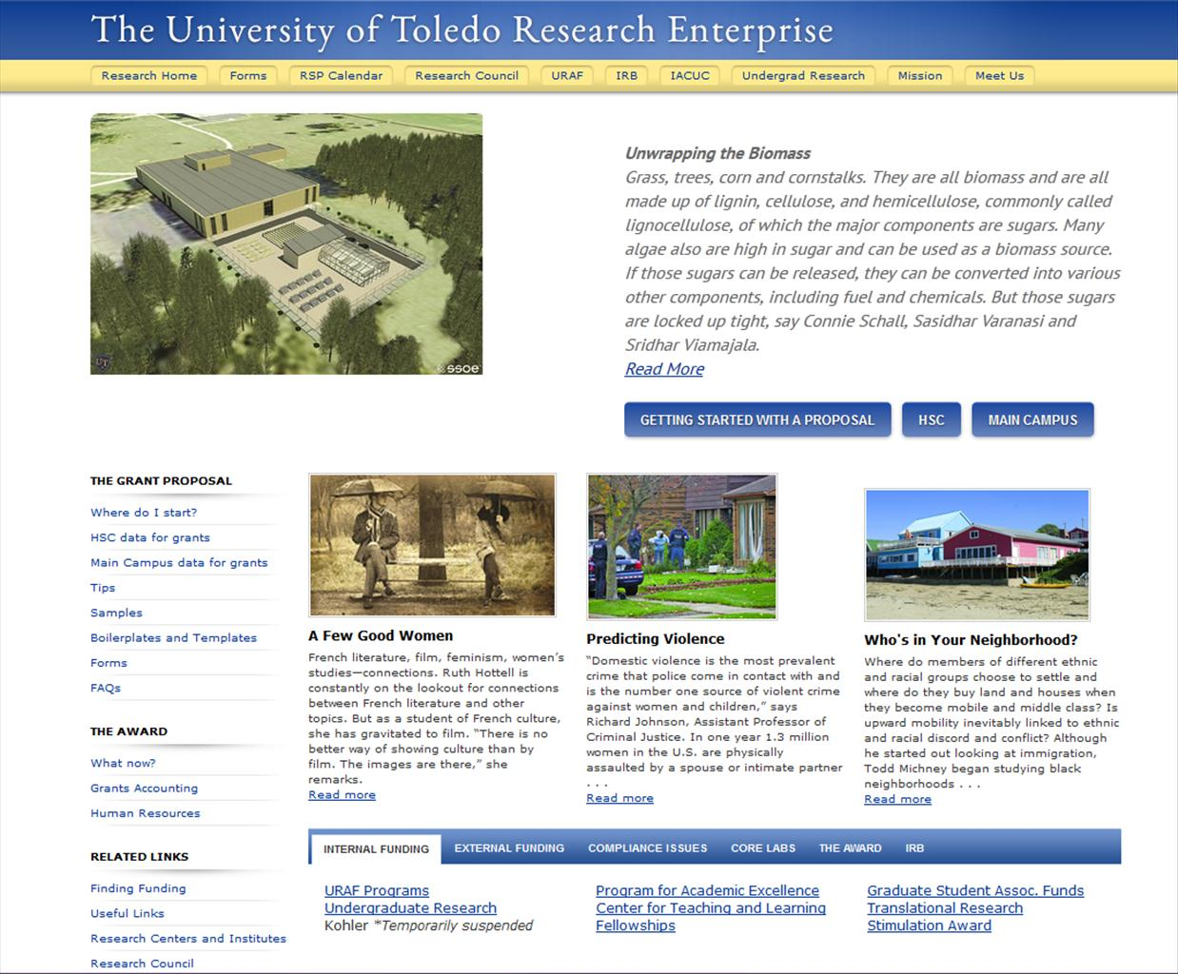
http://www.utoledo.edu/research/

Slide 3
Office of Research & Sponsored Programs
Richard Francis, Ph.D., C.R.A.
Health Science Campus
CCE 2102
Mail Stop 1020 Phone: 419.383.4252 ResearchAdmin.HSC@utoledo.edu
Brenda McKinley, C.R.A.
Main Campus UH 2300 Mail Stop 944 Phone: 419.530.2844 ResearchAdmin.MC@utoledo.edu

Slide 4
Don’t Let This Happen to You
Recent Cases
(2007) Dr. J. Reece Roth, emeritus professor of electrical
engineering at the University of Tennessee in Knoxville
recently was sentenced to four years in prison for deemed
export violations.
(2009) Dr. Ryan Wolfort, a graduate student at Louisiana State
University, was proven guilty of falsifying and fabricating data
in his doctoral dissertation and three publications. For this,
his degree was revoked and he has been banned from
receiving federal funding for two years.

Slide 5
RESEARCH ETHICS AND COMPLIANCE
Research Ethics
Data Management
Mentor/Trainee Relationships
Publication Practices
Peer Review
Collaborative Science
Research Compliance
Human Subjects
Animal Welfare
Research Misconduct
Conflict of Interest and Commitment
Environmental Safety (chemical,
radiation & biosafety)
Export Control Laws

Slide 6
RESPONSIBLE CONDUCT OF RESEARCH TRAINING
STRONGLY RECOMMENDED FOR ALL
GRADUATE STUDENTS!
New regulatory (2010) requirement for:
Faculty, post-docs and students on NIH
Training Awards (OBAS-HSC)
Post-docs and students supported by NSF
grants (CITI)
www. citiprogram.org (see Office of Research
website for more information)

Slide 7
RESEARCH ETHICS AND COMPLIANCE
Research Ethics
Data Management
Mentor/Trainee Relationships
Publication Practices
Peer Review
Collaborative Science
Research Compliance
Human Subjects
Animal Welfare
Research Misconduct
Conflict of Interest and Commitment
Environmental Safety (chemical,
radiation & biosafety)
Export Control Laws

Slide 8
HUMAN SUBJECTS RESEARCH
DEFINITION OF “HUMAN SUBJECTS”:
HUMAN SUBJECTS refers to living individuals about whom an investigator conducting research obtains:
Data through INTERVENTION or INTERACTION
with the individual, OR
IDENTIFIABLE PRIVATE INFORMATION
Research protocols must be reviewed & approved by the Institutional Review Board (IRB).
Human subjects research training at:
www.citiprogram.org

Slide 9
RESEARCH PROTOCOLS
Students MUST be Named Participants on Approved Protocols for Research Involving:
Human Subjects
Animals
Environmental Safety
Chemical, radiation & biohazards

Slide 10
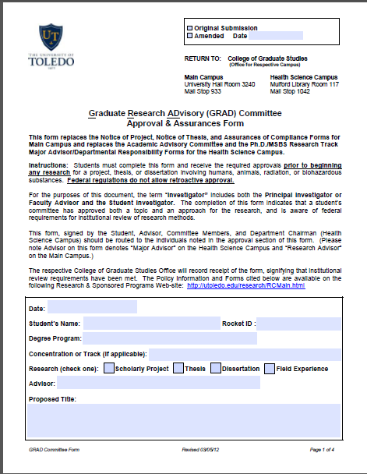
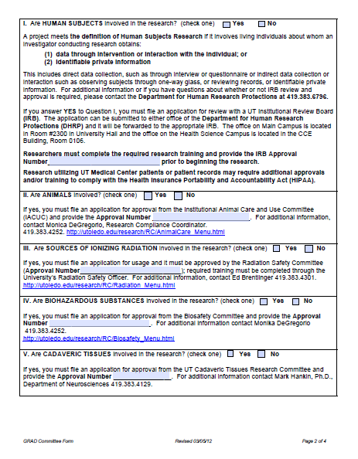
GRAD Approval & Assurance Form

Slide 11
ANIMAL SUBJECTS RESEARCH
Use of LIVE, VERTEBRATE Animals for
RESEARCH, RESEARCH TRAINING, or
BIOLOGICAL TESTING
Includes:
Lab Testing
Behavioral Testing
Field Collection
Field Observation
Protocols Reviewed & Approved by the Institutional Animal Care and Use Committee (IACUC).
Animal subjects research training at:
www.citiprogram.org

Slide 12
Financial Conflict of Interest
Any financial relationship that could potentially
compromise the impartiality of a researcher.
Formal Disclosures
Financial disclosure form needed for every grant or
protocol submission by all researchers.
http://coi.toledo.edu
Conflict of Interest Management Plans
To eliminate the conflict

Slide 13
ENVIRONMENTAL SAFETY
Chemical Safety
Toxic, Carcinogenic, Caustic or Flammable Materials
Review & Approval by Safety & Health Department
Bio-Safety
Recombinant DNA Research
Other Biohazardous Microorganisms
Review & Approval by IBC
Radiation Safety
Radioisotopes
Radiation Generating Devices
Irradiators, Electron Microscopes, Particle Accelerators
Review & Approval by Radiation Safety Committee

Slide 14
Research Protocols
Students MUST be Named Participants on Approved Protocols for Research Involving:
Human Subjects
Animals
Environmental Safety
Chemical, radiation & biohazards

Slide 15
Export Control Laws
Exports: The shipment or transfer of items,
information, or software outside the U.S. or;
the release or sharing of restricted technology
or data
Items – Tangible things, equipment or hardware
Information = “Technical Data” such as models,
formulae, engineering designs or technical assistance
such as training or instruction. “Deemed Export”
Software – Computer programs in either “Source Code”
(programming statements) or “Object Code” (machine-
readable instructions).

Slide 16
Prohibited Countries
Commerce Sanctioned Countries
Afghanistan Liberia
Armenia North Korea
Azerbaijan Syria
Belarus Tajikistan
Cuba Ukraine
Iran Vietnam
Iraq
Arms Embargoed Countries
Burma
China
Fed. Rep. of Yugoslavia
Haiti
Liberia
Somalia
Sudan
Zaire
Subject to U.S. Trade Embargoes
Burma
Cuba
Iran
Syria
North Korea
Sudan
State Sanctioned Countries
Balkans
Cote D’Ivoire
Iraq
Liberia
Libya
Palestinian Authority
Zimbabwe

Slide 17
Export Control Laws
Violations of trade sanctions and export controls can result in criminal penalties:
Heavy Institutional Fines (up to $1 M
per violation)
Individual Prison Terms (up to 20
years per violation)

Slide 18
Summary
Practice Everything You
Learned in Kindergarten
Work Hard and Do
Things Right
Be Aware of Rules and
Regulations That Effect You

Slide 19
Responsible Conduct of Research
Students MUST be Named Participants on Approved Protocols for Research Involving:
Human Subjects
Animals
Environmental Safety
Chemical, radiation & biohazards

