Slide 1
Strategic Faculty Hiring Plan FY15 and FY16
Discussion at University Council
March 21, 2014
Patricia R. Komuniecki, Ph.D.
Vice Provost for Graduate Affairs

Slide 2
Questions to Ask/Answer re Faculty Replacement
Q: Should the retiring faculty member be replaced?
A: Yes or No
If yes, then what type of faculty should be recruited as a replacement?
Tenure track? Rank?
Lecturer?
Part-time Instructor?
Graduate Assistant?
What criteria should be used to answer these questions?

Slide 3
Proposed Criteria
Program demand
Number of undergraduate majors
Graduate program? Master’s? Doctoral?
Accreditation requirements/standards
Labor market demand for graduates
Extramural research dollars
Tie to Goal 3 of Directions
Is the retiree a high contributor?
How will new position enhance excellence and distinction?

Slide 4
Proposed Criteria
Request should be consistent with the UT Directions 2011/2014 Strategic Plan
Consider potential impact on the college strategic plan
Is this an area of investment or an area of change?
Interdisciplinary work?
How will the new position work across programs of study and enhance student experience?
College/Department/Program economic bottom line
Potential increase to enrollment and growth of program
Ensure quality instruction enhanced or maintained
Positive impact on recruitment and retention

Slide 5
Other Thoughts?
Michael Crow-ASU President: Transformation at ASU was achieved by the strategic faculty hiring plan focusing on recruiting core TT faculty to contribute to the complex mission of excellence and access
Focus on the intersection of high quality, distinctiveness and economic sustainability
Focus on ‘value added’ experience

Slide 7
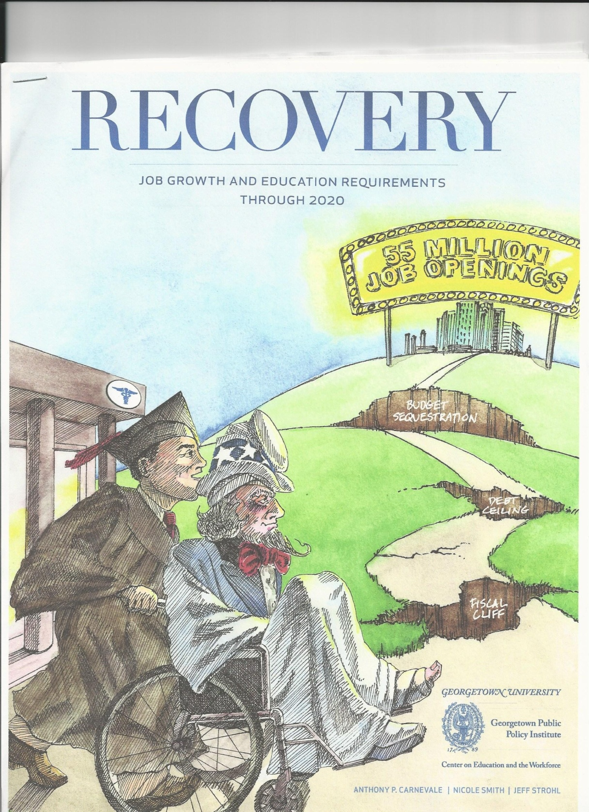
2020 Projected Workforce Needs
Georgetown University Center on Education the Workforce (July 2013) projects a
Shortage of Educated Workers by 2020
5M shortfall for 55M projected jobs
(24M new and 31M ‘baby boomer’ replacements)
By 2020, BLS estimates that the number of jobs requiring advanced degrees will increase by
2.6 million
22% increase in jobs requiring Master’s
20% increase in jobs requiring Doctorates

Slide 8
Job Opportunities-Ohio
Occupations | #Jobs 2010 | #Jobs 2020 | Growth Rate
Healthcare-Support | 181,950 | 247,600 | 36%
Healthcare-Professional/Technical | 287,500 | 340,250 | 22%
Social Sciences | 20,060 | 24,400 | 22%
STEM | 210,460 | 248,850 | 18%
Managerial/Professional | 645,100 | 755,200 | 17%
Community Service/The Arts | 209,870 | 245,060 | 17%
Food/Personal Services | 843,490 | 972,870 | 15%
Education | 289,130 | 327,360 | 13%
Sales/Office Support | 1,389,700 | 1,533,290 | 10%
Blue Collar | 1,183,770 | 1,271,890 | 7%
TOTAL | 5,252,160 | 5,967,040 | 14%
Ohio Jobs
2010-2020

