Slide 1

ETD Document Preparation and Submission Process for Main Campus
Spring 2012
http://tinyurl.com/UTETD ₁

Slide 2
Program Overview
COGS
ETDs, OhioLINK and ProQuest
Pre-Submission
Document Preparation and Format Review
OhioLINK Live Submission
ProQuest Submission
Questions

Slide 3
College of Graduate Studies
COGS – Main Campus
Graduation Requirements ₂
Deadlines ₃
ETD Submission Procedure ₄
Advisor – Department/Program
Internal deadlines
Possible additional requirements

Slide 4
What is an ETD?
Electronic Thesis and Dissertation
Technologically advanced medium
Explains student’s research or scholarship
Uploaded to an online repository

Slide 5
Benefits of ETDs
Increased Accessibility
Freely available in copyrighted form
Reduced Cost
Save on printing, binding, distribution
Inclusion of Multimedia
Images, video, audio, HTML, data files
* Uploaded as separate files
* Inclusion not covered in depth in this presentation

Slide 6
OhioLINK and ProQuest
OhioLINK ETD Center ₅
Local repository
Required: Theses AND dissertations submitted electronically
Open Access licensed online database
Linked to OhioLINK’s Worldwide ETD Index and the NDLTD – Networked Digital Library of Theses and Dissertations

Slide 7
OhioLINK and ProQuest
ProQuest/UMI ₆
Commercial repository
Required: Dissertations only submitted electronically
Sellers of electronic & physical copies of dissertations
author can receive royalties from sales
Indexed to Dissertation Abstracts (international)

Slide 8
Pre-Submission
Get Your Forms In Order
Checklist for Graduation ₂
Academic Program Forms page ₇
Plan of Study
Fill out with your program advisor
Informs COGS of your progress towards graduation
Avoid unexpected “missing requirements”

Slide 9
Document Preparation
Content and Technique
Advisor, Chair, and Committee
Writing Center ₈
Format and Proofread
Manual for the Formatting of Graduate Dissertations and Theses ₉
ETD Default Template in Word ₁
ETD APA Template in Word ₁
ETD Format Proofreading Checklist ₁₀

Slide 10
Document Preparation
Conversion
PDF Conversion Guidelines ₁₁
LibGuides #2 ₁₂
Format Review
Optional but strongly recommended
Deadline ₂ Two weeks before OhioLINK upload
Prevent Delays in Graduation

Slide 11
Format Review
Fill out and save the ETD Format Review Request ₁₃ form
Submit your thesis/dissertation and request form as PDF attachments to
etdmc@utoledo.edu

Slide 12
Format Review
College of Graduate Studies will notify you
If no changes are required
Your document will be approved for uploading
If corrections are required
You will receive list of changes that need to be made before uploading to OhioLINK

Slide 13
Submission to OhioLINK
OhioLINK notifies the Graduate College
If there are problems, COGS will contact you
Time to make corrections is very limited
Document will be available after all Graduate Students have been cleared for graduation
Typically 30 to 45 days after commencement
OhioLINK FAQs ₁₄

Slide 14
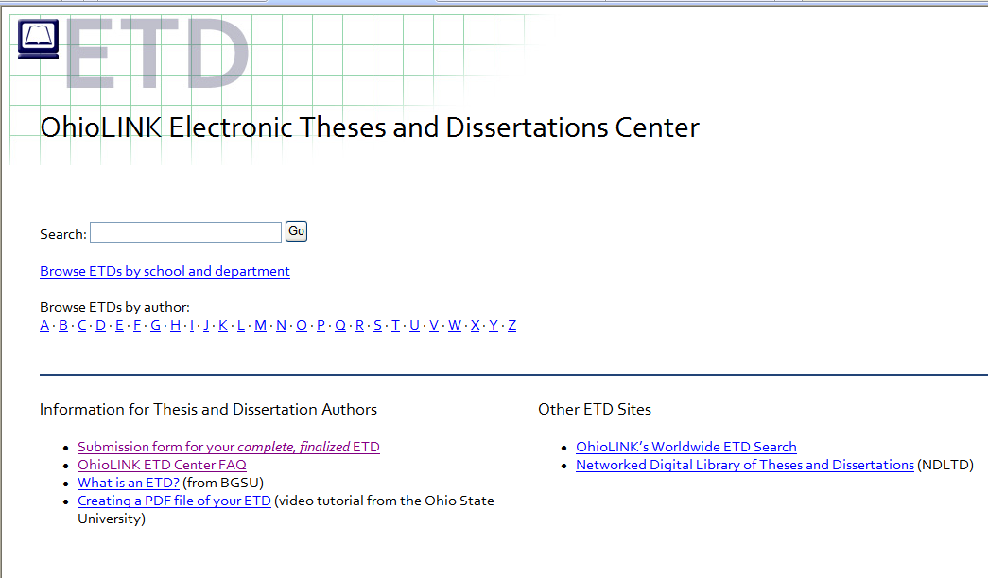
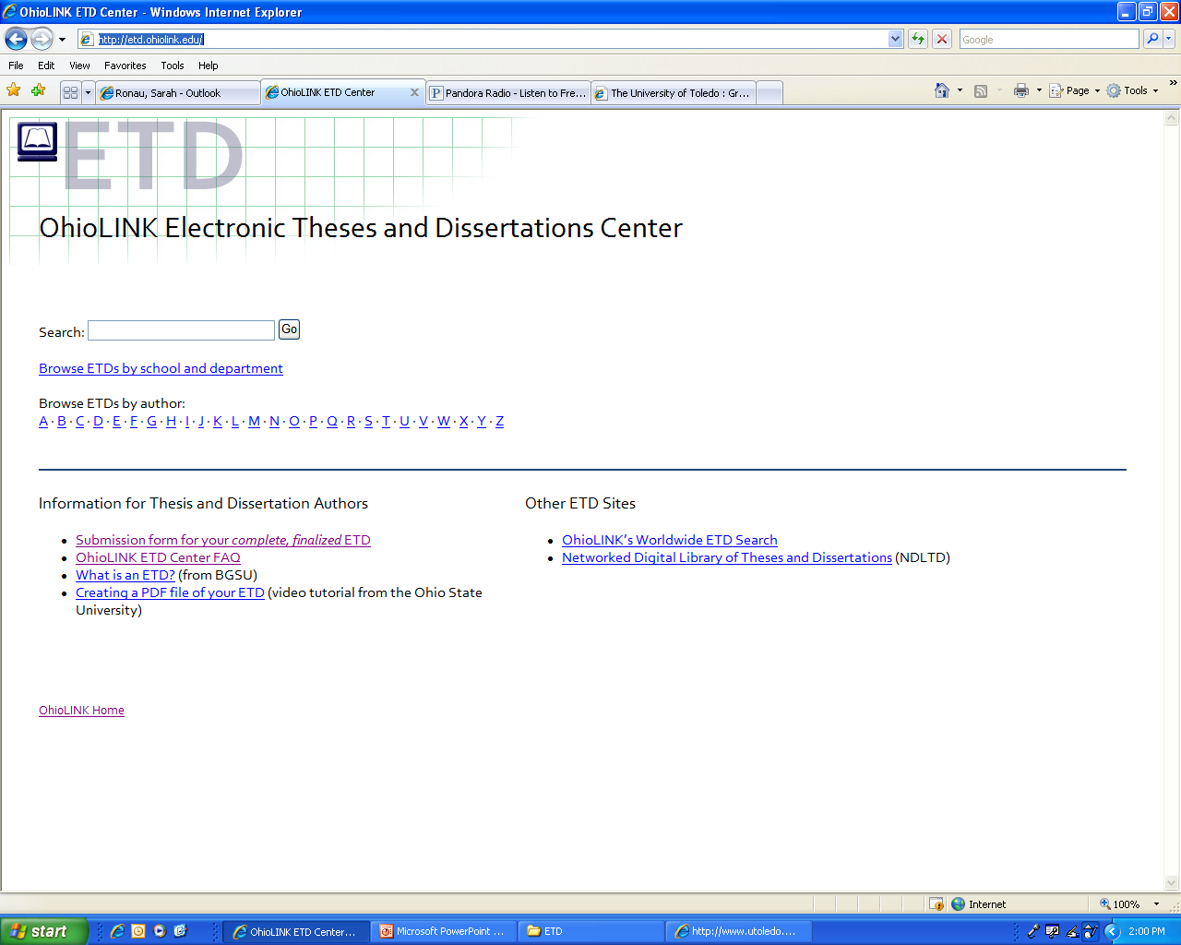
OhioLINK Submission
OhioLINK’s Home Page: http://etd.ohiolink.edu/

Slide 15
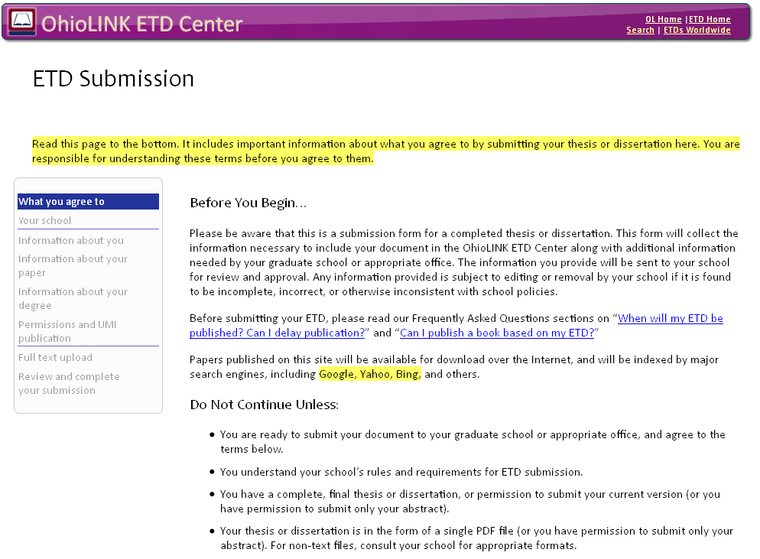
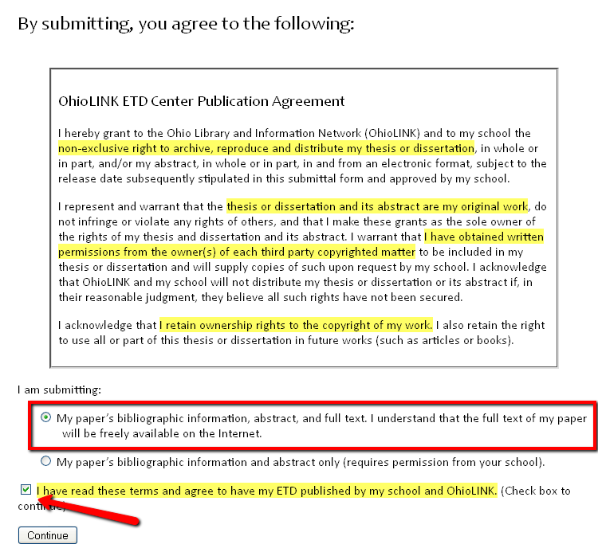
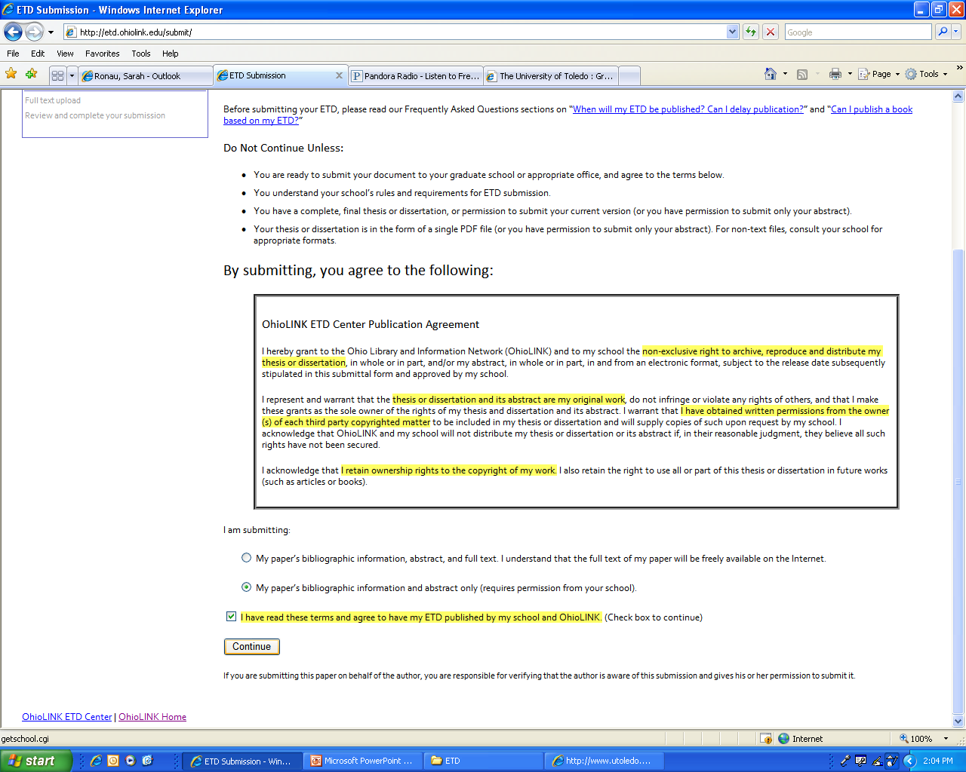
OhioLINK Submission
Scroll down to the bottom of the page and check the highlighted portion. Click ‘continue.’

Slide 16
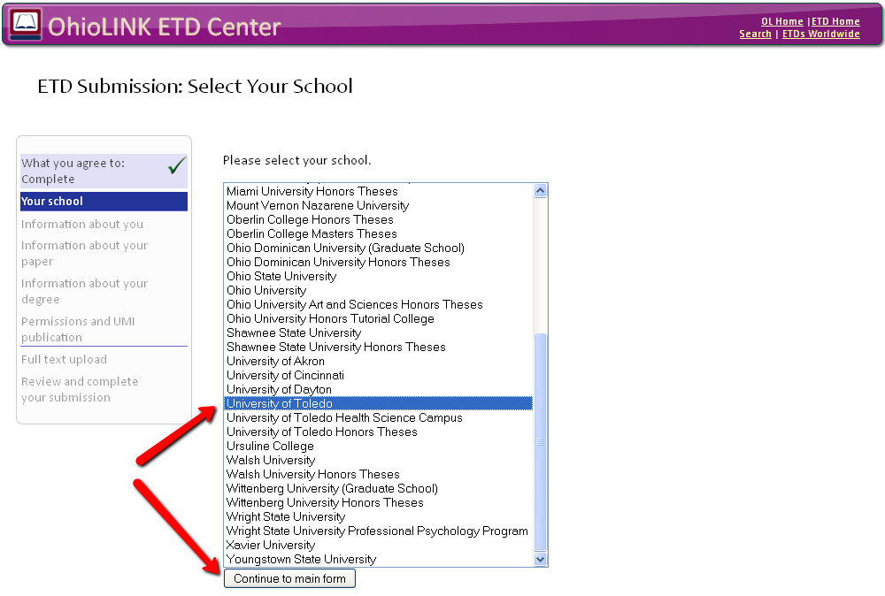
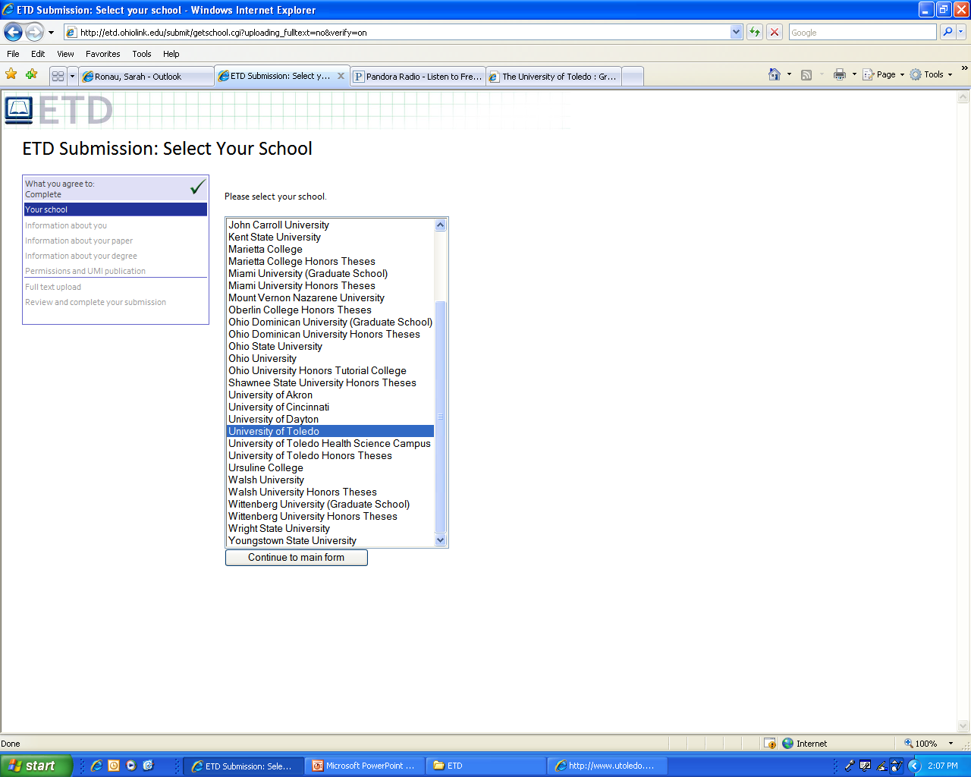
OhioLINK Submission
Select ‘University of Toledo’ and click ‘Continue to main form.’

Slide 17
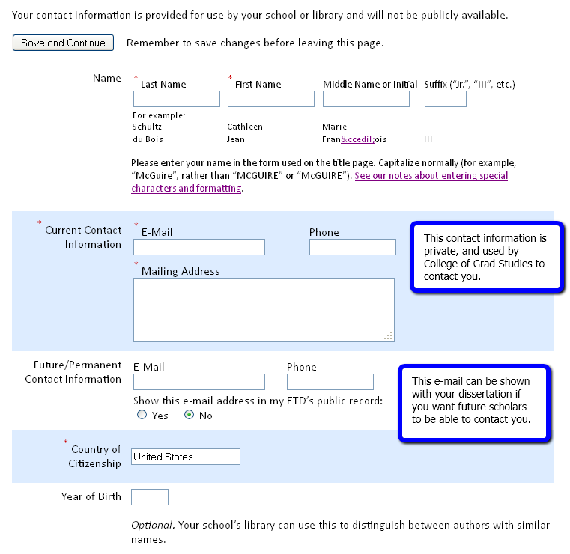
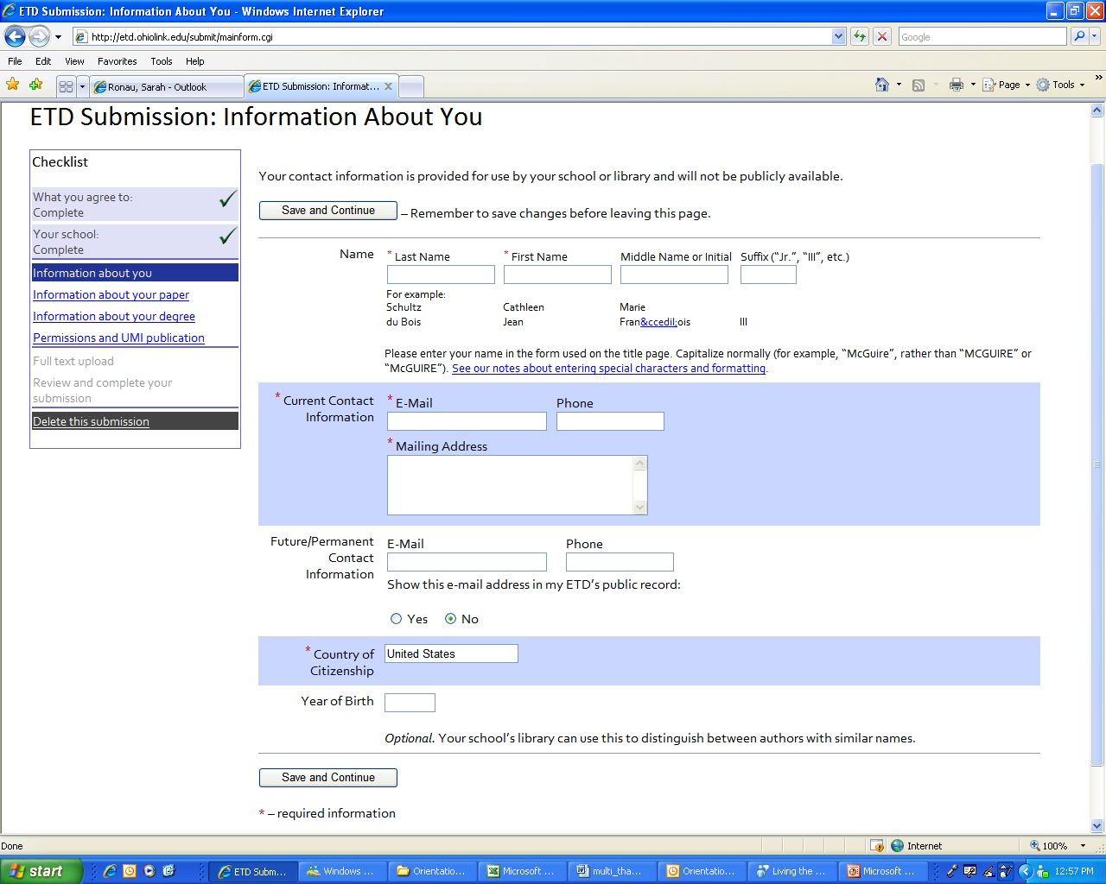
OhioLINK Submission

Slide 18
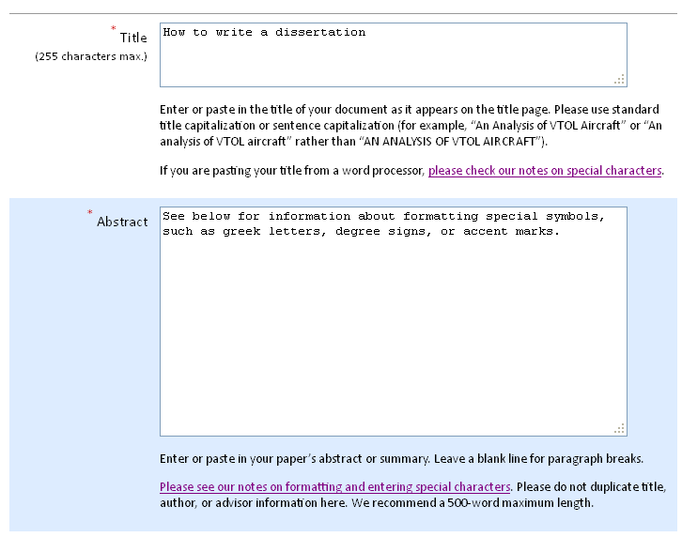
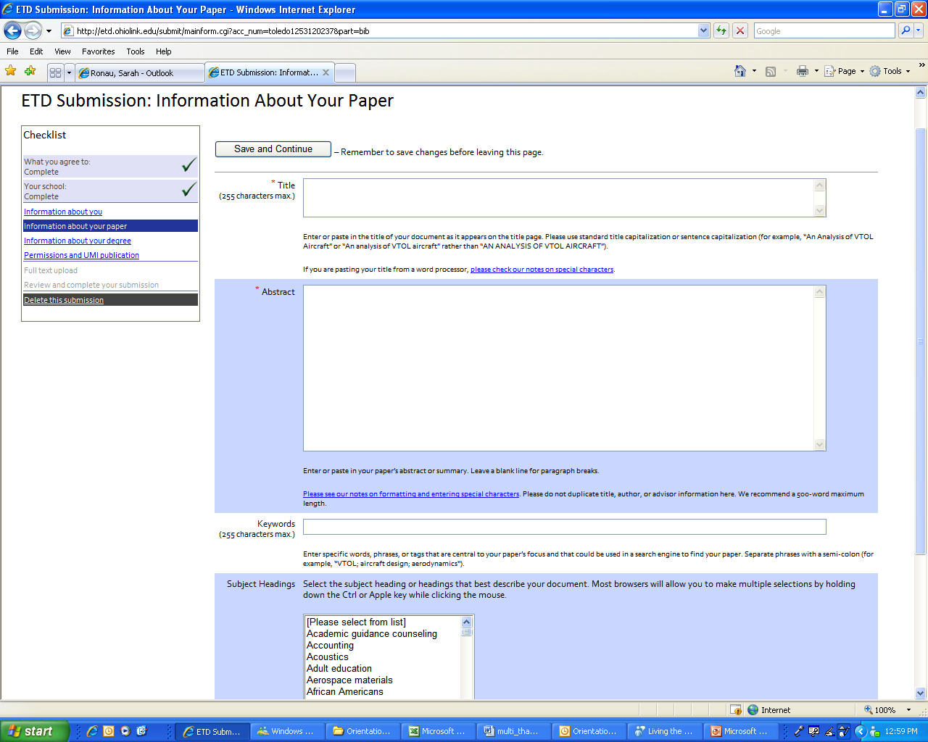
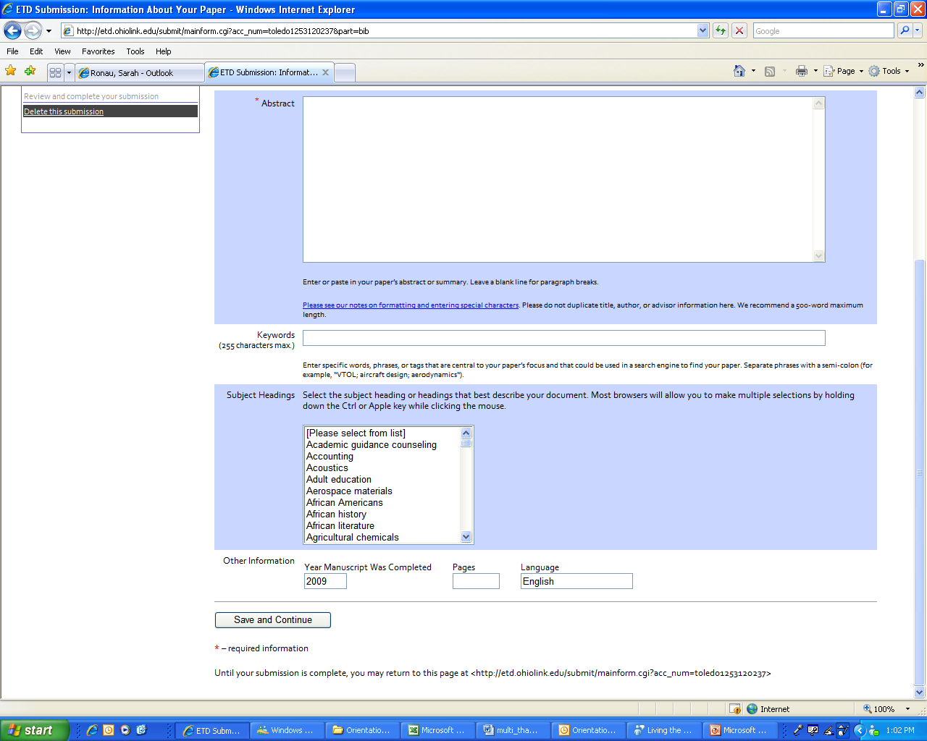
OhioLINK Submission

Slide 19
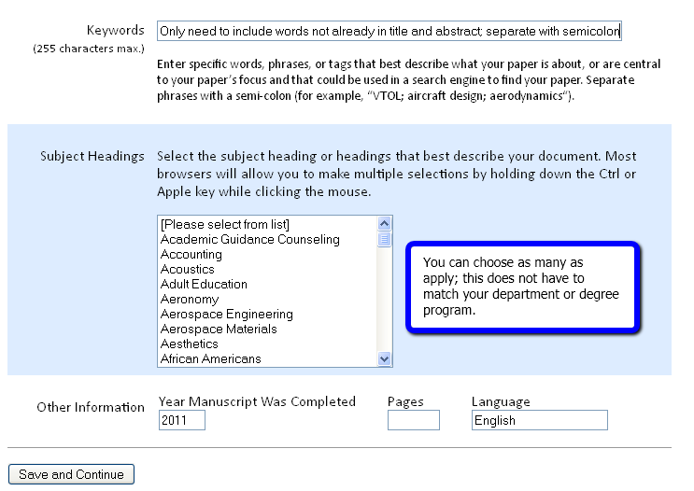
OhioLINK Submission

Slide 20
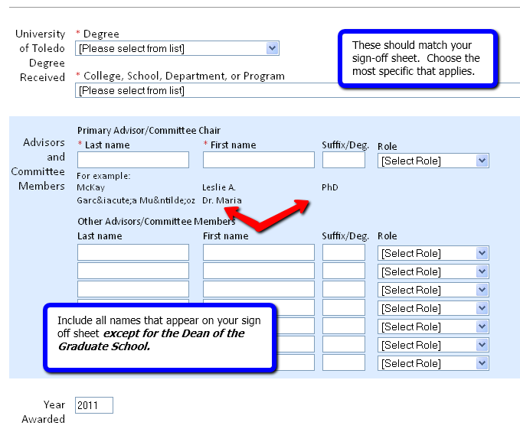
OhioLINK Submission

Slide 21
OhioLINK Submission
Permissions page:
Top part is filled out by all (Masters & Doctoral)
Creative Commons licensing
Publication delay only if you have filled out paperwork with COGS
UMI Publication
Masters should check ‘Do Not Upload’
Doctoral should choose one of the Upload options (open access & copyright registration are extra services from UMI for extra fee.)

Slide 22
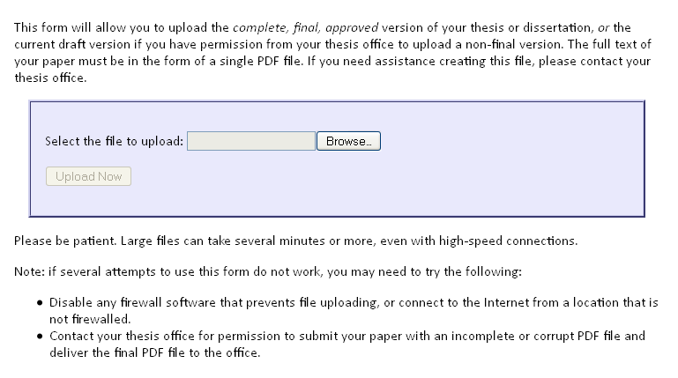
OhioLINK Submission
Upload PDF here
Verify that correct file has been uploaded
Choose ‘YES’ at the bottom of confirmation screen to complete

Slide 23
ProQuest/UMI Submission
All UT dissertations are required to be published with ProQuest/UMI
When submitting to OhioLINK, you must elect to send your dissertation to ProQuest/UMI
Must complete ProQuest/UMI publication agreement online using the
ETD Administrator tool ₁₅

Slide 24
Publishing with ProQuest/UMI
Open Access publishing
Freely available for viewing or downloading by anyone with access to the internet.
Extra fee for this option
Traditional publishing
the owner of intellectual property and author of the work contracts with the publisher to reproduce, distribute, and sell copies of the work
UMI Publishing Options Guide ₁₆

Slide 25
Copyright Issues
Copyrighting
Complex series of rules and regulations
Check with your advisor concerning copyright issues, publication delays
Resources
ProQuest/UMI Copyright Guide ₁₇
UT LibGuide/Copyright ₁₈

Slide 26
Resources
How To: Microsoft Word Tutorials (2003/2007/2010) ₁₉
Remove page numbers
Use Roman and Arabic numbering in same document
UMI Preparing Your Manuscript ₂₀

Slide 27
Links
http://www.utoledo.edu/graduate/currentstudents/academicprogramforms/theseanddissertationinfoandrscs.html
http://www.utoledo.edu/graduate/currentstudents/graduationinformatio/index.html
http://www.utoledo.edu/graduate/files/Deadline_flyer_updated_091610.pdf
http://www.utoledo.edu/graduate/currentstudents/academicprogramforms/etd_process.html
http://etd.ohiolink.edu/
http://www.proquest.com/en-US/products/dissertations/
http://www.utoledo.edu/graduate/currentstudents/academicprogramforms/index.html
http://www.utoledo.edu/centers/writingcenter/index.html
http://www.utoledo.edu/graduate/files/Formatting_Manual_12a.pdf
http://www.utoledo.edu/graduate/forms/ETDFormat.pdf
http://www.utoledo.edu/graduate/files/Converting_file_to_PDF.pdf

Slide 28
Links
http://libguides.utoledo.edu/content.php?pid=58499&sid=428705
http://www.utoledo.edu/graduate/files/ETD.pdf
http://etd.ohiolink.edu/faq.html
http://www.etdadmin.com/cgi-bin/school?siteId=284
http://www.proquest.com/assets/downloads/products/UMI_PublishingOptionsGuide.pdf
http://www.proquest.com/assets/downloads/products/UMI_CopyrightGuide.pdf
http://libguides.utoledo.edu/content.php?pid=102028&sid=767452
http://office.microsoft.com/en-us/support/training-FX101782702.aspx
http://www.proquest.com/assets/downloads/products/UMI_PreparingYourManuscriptGuide.pdf

Slide 29
Questions?
College of Graduate Studies
Teri Green etdmc@utoledo.edu
ETD Format Review, deadlines, templates
Elissa Falcone gcacademicsvcs@utoledo.edu
Graduation forms, degree audits, OhioLINK submission
University Libraries Faculty
Wade Lee Wade.Lee@utoledo.edu
OhioLINK submission, PDF conversion, multi-media upload
Lucy Duhon Lucy.Duhon@utoledo.edu
Open Access, OhioLINK submission

