Slide 1

A Program of Assessment:
Putting it all Together
(or Start with The End in Mind)
Paul A. Hemmer, MD, MPH
Professor and Vice Chair, Educational Programs
Department of Medicine
Uniformed Services University
F. Edward Hebert School of Medicine
Bethesda, MD

Slide 2
Disclaimer
The views expressed in this presentation are those of the author and do not necessarily reflect the views of the Uniformed Services University, the Department of Defense, or other federal agencies

Slide 3
Acknowledgements
Marjan Govaerts, Maastricht University, NE
Work of Joost Dijkstra, Maastricht
Faculty at USUHS

Slide 4
Overview
Definitions and Distinctions
Program of Assessment: Part 1
  Guiding principles
Conceptualizing Program of Assessment: Pt 2
  Model and Framework
  Guidelines
Small Group work and Discussion

Slide 5
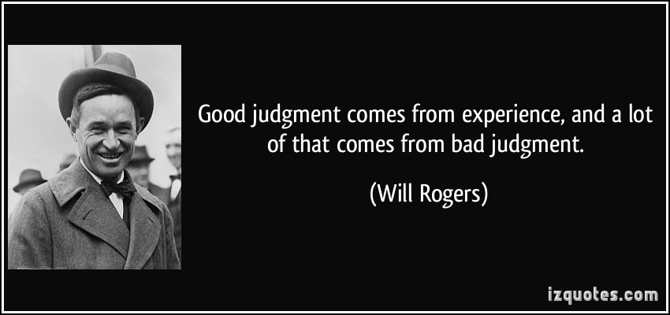
Background:
Let’s learn from each other

Slide 6
Definitions and distinctions
TERMINOLOGY

Slide 7
Program of Assessment
Cohesive whole of multiple components that gives you insight into trainee’s progress
Composed of multiple facets, actors
  Learners, teachers, context, methods, judgment and the interactions
Assessment: How depends on what, who, where, when, and why

Slide 8
To begin
Assessment
  making the observation
  “assay” (measurement)
Evaluation
  determining value
  in context of expected learner/program level
  an educational “diagnosis”
Grading/Feedback
  taking an action
  administrative/societal
  educational intervention
Observation
Reflection
Action

Slide 9
Credible Formative Evaluation:
Assessment for learning
Based on direct observations
  Questions, faculty, SPs, etc.
Accurately reflects institutional goals
Reliably occurs at key points
Generates, provides feedback
Develops a plan for improvement
Anticipates same framework as final evaluation
Think “Low Stakes”

Slide 10
Credible Summative Evaluation:
Assessment of learning
Accurately reflects institutional goals (content)
Multiple observers/observations (reliability)
Consistent across courses, sites, teachers, rotations (reliability)
Documents mastery or deficiency of core goals (predictive validity)
Think “High Stakes”

Slide 11
Reliability
Reproducibility, stability of scores/results over time/occasions
Signal to noise ratio
Often expressed on a scale of 0 to 1.0
Typically improved by increasing the number of observations
Higher stakes of the decision requires this to be robust

Slide 12
Validity
Does the assessment capture the construct it is intended to assess?
Programmatic Assessment:
  Does the program capture “competence”?
“…inferring the validity of an assessment for a certain construct is on ongoing process of building and verifying (and trying to falsify) arguments.”
Schuwirth LWT, van der Vleuten CPM. Med Educ. 2012;46:38-48.

Slide 13
Validity: Sources of Evidence
Content: do instrument items completely represent the construct?
Response process: the relationship between the intended construct and the thought processes of subjects or observers
Internal structure: acceptable reliability and factor structure
Relations to other variables: correlation with scores from another instrument assessing the same construct
Consequences: do scores really make a difference?
Cook D, Beckman T. Current Concepts in Validity and Reliability for Psychometric Instruments:
Theory and Application. AJM. 2006;119(2):166.e7-166.e16

Slide 14
Related Concepts from
Qualitative Tradition
Trustworthiness of qualitative info
  Credibility
    confidence in truth of findings
  Transferability
    findings apply in other contexts
  Dependability
    consistent and repeatable
  Confirmability
    neutrality, findings not shaped by investigator bias
Med. Educ. 2013;47:1164-74. Am J Occup Ther. 1991;45(3):214-22.

Slide 15
Authenticity of Assessment
Assessing Professional Competence: from methods to programmes.
Med Educ. 2005;39:309-317.
Descriptive Evaluation
Does
  Unannounced SPs, Chart review
  Simulations, OSCEs, mCEX
Shows How
  Simulations, Simulators, Prosthetics
Knows How
Knows
  NBME/USLME vignettes
Miller (Acad Med. 1990)
Notes:
What’s missing—Teacher’s comments.

Slide 16
Program of Assessment
Underlying Principles
Van der vleuetn CPM, et.al. A model for programmatic assessment fit for purpose.
Med Teacher. 2012;34:205-14.

Slide 17

Cees van der Vleuten
University of Maastricht

Slide 18
Program of Assessment
Should be constructed deliberately
  Developed with curriculum
  Linked to Goals/Objectives
  Combination of components
Account for elements
Central oversight (PD, CCC, Curric Cmte)
Regularly evaluated, adapted (prog evaluation)

Slide 19
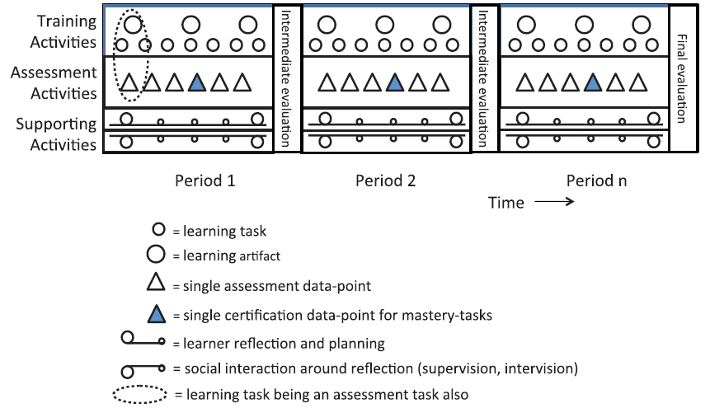
Program of Assessment Model
Medical Teacher. 2012;34:205-14
Notes:
The model is simply a schematic—the duration of the periods could be days, weeks, months, years. It could apply to a single course, clerkship, activity, residency, etc. The period could be of different lengths, contain different activities—they don’t all have to be present. It is intended to be a model, a guide, to think about and reflect on your program.
Learning task being an assessment task: In the clinical setting, this is learning to write a clinic note, progress note, or H&P. These notes are reviewed, edited, commented on each day (assessment), and some might be turned in for a more formal review according to a defined set of goals/objectives (developing clinical reasoning).

Slide 20
Principles
Any single assessment data point is flawed
Standardized assessment can have validity built-in
Validity of non-standardized assessment rests with users, less so in instruments
Know the stakes (low vs. high)
Assessment drives learning
Expert judgment imperative

Slide 21
Single Assessments
There is no magic bullet
  Every assessment has trade offs
Single assessments do not capture growth
Individual performance is highly context dependent/influenced such that multiple sampling (observations) and multiple methods over time are needed

Slide 22
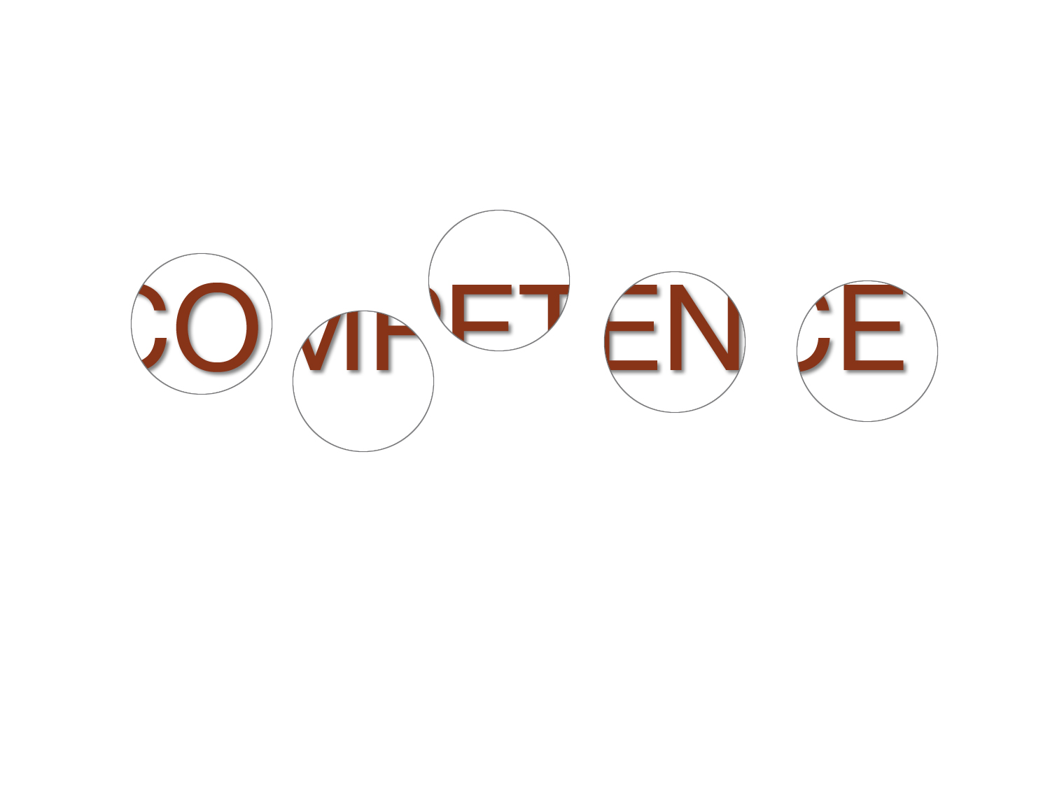
“Windows to Competence”
Caverzagie and Iobst

Slide 23

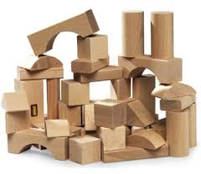
Combining Components
“…it is not only the quality of the building blocks that is relevant, but also the ways in which they are combined.”
Schuwirth LWT, van der Vleuten CPM. Med Educ. 2012;46:38-48.

Slide 24
Principles
Any single assessment data point is flawed
Standardized assessment can have validity built-in
Validity of non-standardized assessment rests with users, less so in instruments
Know the stakes (low vs. high)
Assessment drives learning
Expert judgment imperative

Slide 25
Standardized assessment:
“Build-in” validity
Careful construction of content, scoring, administration
  Item writing skills, Item analysis of exams
Training assessors, SPs possible
  Eg., train/implement use of Essential Elements of Communication instrument**
Standardized exams (e.g., NBME)
Dong T, et.al. Longitudinal Effects of Medical Students’ Communication Skills on Future Performance. Mil Med. 2015:180:24-30.

Slide 26
Principles
Any single assessment data point is flawed
Standardized assessment can have validity built-in
Validity of non-standardized assessment rests with users, less so in instruments
Know the stakes (low vs. high)
Assessment drives learning
Expert judgment imperative

Slide 27
Users and non-standard assessments
Much of real-world Workplace Assessment
It’s not the form, it’s the user
  Users need to be trained
  Users need to understand their role
  Can’t just hand them a form to complete
Without understanding their roles, assessment trivialized
  “Straight-line 5”; no comments

Slide 28
Principles
Any single assessment data point is flawed
Standardized assessment can have validity built-in
Validity of non-standardized assessment rests with users, less so in instruments
Know the stakes (low vs. high)
Assessment drives learning
Expert judgment imperative

Slide 29
Stakes
All assessments have stakes
Low Stakes
  Limited consequences for promotion, certif, etc.
  Can be a single data point
  For Learning
High Stakes
  Significant consequences
  MUST be based on multiple sources of info (including single-data points—entirety of the record)
    Exception: Mastery task (CPR)
  Entails judgment: conflict in role of teacher & judge?

Slide 30
Stakes (2)
Both low and high stakes should be present
Understanding stakes will help prioritize
  E.g., Is a low stakes, comprehensive clinical skills program worth the resources (time, expertise, etc.)?

Slide 31
Principles
Any single assessment data point is flawed
Standardized assessment can have validity built-in
Validity of non-standardized assessment rests with users, less so in instruments
Know the stakes (low vs. high)
Assessment drives learning (behavior)
Expert judgment imperative

Slide 32
It’s not what you Expect,
It’s what you Inspect
Can lead to undesirable behaviors
  Studying old exams; prep guides; sharing OSCE cases
Should generate meaningful fb to learner
  Both quantitative and qualitative (descriptive)
  Foster desirable learning activities
Low stakes should be as rich as possible
  Goal is to foster engagement/learning

Slide 33
Assessment & Learning
Testing potentiates learning
Learning more durable w/longer study time
Interleaving (integration) different types of practice problems
Spaced Education: https://qstream.com/company/brain-science/
Roher D, Pashler H. Recent research on human learning strategies challenges conventional instructional strategies. Educ Res. 2010:39(5):406-12.

Slide 34
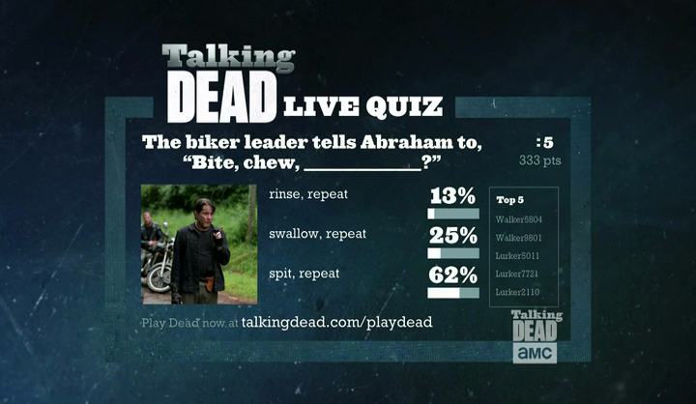
Learning through Testing
Testing enhances learning and retention
  Testing + study > study only
Testing should require recall
  Short answer > MCQ, even if final exam is MCQ
  Fill in the blank (e.g., programmed text EKGs)
  At end of a session—tell me all you remember

Slide 35
Spacing of Practice
Performance and retention is improved when instruction spaced over time vs. blocked
Increasing the study gap does not decrease final test performance.
“Right” study gap: 5-10% of test delay time
  Thus, the longer term want someone to remember, the longer should be the study gap
  Might mean revisiting something 1 year later if long retention desired

Slide 36
Interleaving
Practicing of multiple skills/activities:
  AAABBBCCC or ABCBCABCA
  Baseball—how should practice hitting 3 pitch types?
Cumulative or block testing?
  When introducing new material, how can you require practice of previous skills, knowledge?

Slide 37
Caveat:
Testing, Spacing, Interleaving
Final test/retention might be better but
  PRACTICE PERFORMANCE IS WORSE
  Return to practice will make you think you’re “failing”—you’re not.

Slide 38
Principles
Any single assessment data point is flawed
Standardized assessment can have validity built-in
Validity of non-standardized assessment rests with users, less so in instruments
Know the stakes (low vs. high)
Assessment drives learning
Expert judgment imperative

Slide 39
Expert Judgment
Interpreting assessments requires judgment
  Synthesis requires time, reflection, context
  Entirety of the record
Overcoming bias
  Random (hawks/doves): sampling strategies
  Systematic: procedural measures around decisions
Qualitative is NOT subjective
  Can be rich source to guide decisions

Slide 40
Program of Assessment Model
Medical Teacher. 2012;34:205-14
Notes:
The model is simply a schematic—the duration of the periods could be days, weeks, months, years. It could apply to a single course, clerkship, activity, residency, etc. The period could be of different lengths, contain different activities—they don’t all have to be present. It is intended to be a model, a guide, to think about and reflect on your program.

Slide 41
Program of Assessment: Challenges
Cost/resources
  Do few things well than many poorly—prioritize
  Link assessment and learning activities
  Share within/across programs (institution)
Trivialization, Reductionism
  When assessment more impt than goal
  All should know what they are doing
Legal
  What you do must fit institutional policy/procedure
Embrace complexity (and qualitative information)
  Words, descriptions, judgment matter

Slide 42
Translate Theory to Practice—Study
BMC Med Ed. 2013;13:123
Study in Netherlands
Veterinary clerkship
Program was new, designed following model
End of rotation surveys
Qualitative interviews with students, supervisors
Notes:
Background: In competency-based medical education emphasis has shifted towards outcomes, capabilities, and
learner-centeredness. Together with a focus on sustained evidence of professional competence this calls for new
methods of teaching and assessment. Recently, medical educators advocated the use of a holistic, programmatic
approach towards assessment. Besides maximum facilitation of learning it should improve the validity and reliability
of measurements and documentation of competence development. We explored how, in a competency-based
curriculum, current theories on programmatic assessment interacted with educational practice.
Methods: In a development study including evaluation, we investigated the implementation of a theory-based
programme of assessment. Between April 2011 and May 2012 quantitative evaluation data were collected and used
to guide group interviews that explored the experiences of students and clinical supervisors with the assessment
programme. We coded the transcripts and emerging topics were organised into a list of lessons learned.
Results: The programme mainly focuses on the integration of learning and assessment by motivating and
supporting students to seek and accumulate feedback. The assessment instruments were aligned to cover
predefined competencies to enable aggregation of information in a structured and meaningful way. Assessments
that were designed as formative learning experiences were increasingly perceived as summative by students. Peer
feedback was experienced as a valuable method for formative feedback. Social interaction and external guidance
seemed to be of crucial importance to scaffold self-directed learning. Aggregating data from individual assessments
into a holistic portfolio judgement required expertise and extensive training and supervision of judges.
Conclusions: A programme of assessment with low-stakes assessments providing simultaneously formative
feedback and input for summative decisions proved not easy to implement. Careful preparation and guidance of
the implementation process was crucial. Assessment for learning requires meaningful feedback with each
assessment. Special attention should be paid to the quality of feedback at individual assessment moments.
Comprehensive attention for faculty development and training for students is essential for the successful
implementation of an assessment programme.
Keywords: Programmatic assessment, Workplace learning

Slide 43
Translate Theory to Practice—Not so Easy
BMC Med Ed. 2013;13:123
Students perceived formative activities as increasingly summative
  Faculty had trouble not “judging”
  Formative becoming summative impaired Fb-seeking
Feedback from faculty not specific, focused, meaningful to drive learning
  Students need training on how to seek Fb
  Faculty need training on how to give Fb
Faculty need training on WBA
Members of CCC need training, Fb, supervision
Students wanted single coach to guide them

Slide 44
Impact of programmatic assessment on student learning.
Med. Educ. 2015;49:487-98
Preclinical curric, 50 students, Maastricht
Program of assessment
  MCQs, open ended, oral exams
  Written work, reports
  OSCEs
  Peer feedback
  Portfolio w/reflection
  Mentor

Slide 45
Programmatic assessment, student learning
How elements influenced learning depended on how learner perceived it
Formative hard to separate from summative
Pre-assessment learning effects
Assessment as learning (oral exams)
Post assessment learning (fb drove learning)
Feedback “burnout”—enough already!
Program with reflection and coaching led to positive post assessment learning
Notes:
In some regards, study confirmed things we might already know.
First, students could perceive any given component as both helping and hindering their learning. It really depended on the individual, the nature of the task, and sometimes whether different assessments were in competition (and then, which one wins might depend on the consequences, grading that is linked to it, whether a student ended up in remediation, etc.).
Students continue to see formative assessment as summative—it is still being judged by others and they see it as inevitably contributing to summative decisions. There was a formative aspect seen following assessment and in coaching with the mentor, and that the formative assessment is actually part of the feedback loop to help drive learning; the catalyst effect of assessment. Still, this study found what others have—that its really hard to separate formative from summative and is this a part of the theoretical model that doesn’t hold.
Not surprisingly, they found that pre-assessment had learning effects—students prepared and studied. Assessments themselves drove learning, such as during the oral exams when the teacher and learner engaged in a discussion to foster understanding, it was clear learning was taking place. Post assessment, the feedback helped to drive learning and was especially helpful when with a coach.
They did comment that feedback could get to be too much—that giving and receiving became so frequent that it was difficult. They also didn’t appreciate anonymous feedback in sense that they learned about things they needed to improve on or address for the first time in this form of feedback rather than in face to face, and they wanted it face to face.
Finally, the role of the coach was important.

Slide 46
Conclusions
Begin with the end in mind—even for program
Reflect on what you are doing, doing well
How can you link improving assessment with feedback and learning?
Simply adopting milestones, a framework is not enough to change behavior*
No way around it: Faculty Development
Daelmans HEM, et.al. In-training assessment: qualitative study of effects on supervision and feedback in an undergraduate clinical rotation. Med Ed. 2006;40:51-58.

Slide 48
A Program of Assessment:
Part 2
Framework and Guidelines
Paul A. Hemmer, MD, MPH
Professor and Vice Chair, Educational Programs
Department of Medicine
Uniformed Services University
F. Edward Hebert School of Medicine
Bethesda, MD

Slide 49
Developing a Program of Assessment
More than amalgamation of components
  Coherent, integrated to achieve a goal
Some program descriptions exist*
General guidance, approach lacking
Dijkstra developed framework
  Adv Health Sci Educ. 2010;15:379-93.
*Ricketts C, Bligh J. Developing a “Frequent Look and Rapid Remediation” Assessment System for a New Medical School. Acad Med. 2011;86:67-71.

Slide 50
Dijkstra J, et.al. Expert validation of fit-for-purpose guidelines for designing programmes of assessment. BMC Med Ed. 2012;12:20. http://www.biomedcentral.com/1472-6920/12/20

Slide 51
Considerations at the Start
Why are you doing what you are doing?
Understand your context
  Resources, stakeholders, expertise
Don’t make assessment an after thought
  Build it with the curriculum
  Prioritize, balance stakes with resources
Develop a plan to take a hard look

Slide 52
Guidelines (72 in all!)
BMC Med Ed. 2012;12:20. http://www.biomedcentral.com/1472-6920/12/20
General Guidelines
Decisions (and consequences) should be proportionate to the quality of the information on which they are based.
Decisions in the design process should be supported (preferably) by scientific evidence/evidence best practice.
  If evidence is unavailable to support the choices made when designing the programme of assessment, the decisions should be identified as high priority for research.
Specific expertise should be available (or sought) to perform the activities in the programme of assessment.

Slide 53
Opportunities and restrictions for the assessment programme should be identified at an early stage and taken into account in the design process.
Check design decisions against consequences for the infrastructure.
One principal purpose of the assessment programme should be formulated.
“Granting a license to commit medicine.”
Stakeholders of the assessment programme should be identified and a rationale provided for including the expertise of different stakeholders (or not) and the specific role(s) which they should fulfil.

Slide 55
Program in Action
B1 When selecting an assessment component for the programme, the extent to which it contributes to the purpose(s) of the assessment programme should be the guiding principle.
E.g., include Anatomy practical exam if it contributes to purpose(s) of assessment program.
  It’s a component of a larger program

Slide 56
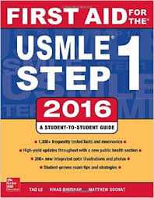
Supporting the Program
Use of NBME Customized Exams
C4: Support for constructing the assessment components requires domain expertise and assessment expertise.
  Important consideration based on available expertise @ USUHS
B6 The effect of the instruments on assessee behaviour should be taken into account.

Slide 57
Documenting the Program
Domain Mapping
  Can you link assessment to SOM goals and objectives?

Slide 58
Improving the Program
(You’re never finished)
E1 A regular and recurrent process of evaluation and improvement should be in place, closing the feedback loop.
  Plan for this from the start!

Slide 59
Justifying the Program
Effectiveness
Cost-effectiveness
  Is a component worth the investment or are there other ways to assess in light of program goals?
  Why OSCEs for each clerkship?
Acceptability

Slide 60
Handouts
Small Group Work
20 minutes to review a set of guidelines
  Can you reach consensus on what is most important?
  If important
    Are you doing it?
    Can you do it?
Report out

Slide 61
Wrap Up
A program of assessment is more than components
Know your context, resources, infrastructure
Keep the primary purpose in mind
Build in expectations for feedback

Slide 62
Thank you
Paul.hemmer@usuhs.edu

Slide 64

Beliefs about Assessment
Descriptive (words) = “Subjective”
Quantified (numerically scored) = “Objective”

Slide 65
Program Evaluation Defined
“Systematic collection and analysis of information related to the design, implementation, and outcomes of a program, for the purpose of monitoring and improving the quality and effectiveness of the program”. [ACGME]
Understanding and action
  Defining “success” and what explains it

Slide 66
“Performance” vs. “Competence”
what the learner can do under test conditions.
what the learner does do habitually under day-to-day conditions
Often used interchangeably!

Slide 67
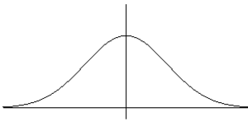
Fixed-standard vs. Normative
Normative
1.5 SD < group
mean
Fixed standard
90% = Honors
proficiency

Slide 68
Principles
Any single assessment data point is flawed
Standardized assessment can have validity built-in
Validity of non-standardized assessment rests with users, less so in instruments
Know the stakes (low vs. high)
Assessment drives learning
Expert judgment imperative

Slide 69
Measurement Tools: Criteria
Cees van der Vleuten’s utility index:
Utility = V x R x A x EI x CE
  Where:
    V = validity
    R = reliability
    A = acceptability
    E = educational impact
    C = cost effectiveness
van der Vleuten C. The assessment of professional competence: developments, research and practical implications. Adv in Health Sciences Education. 1996; 1: 41-67.

Slide 70
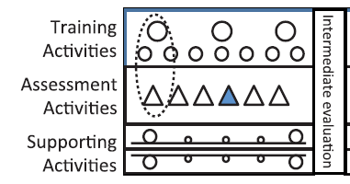
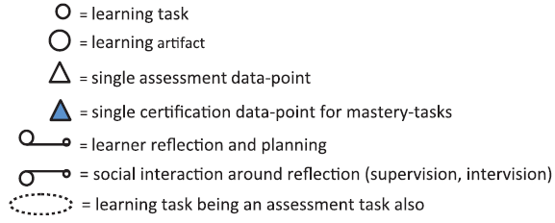
Training Activities
Learning Task
  Anything that leads to learning: lecture, sm grp, project, pt encounter
Learning Artifact
  Some thing from learning
  Product: report, lecture
  Process: logs

Slide 71
Assessment Activities
Can be any type of assessment, at any layer of Miller pyramid
Can be of activity, artifact
Arranged to support learning
Each low stakes but judgment (eval) and Fb documented
Some assessments may require mastery (dark pyr)
Grades should not be sole Fb

Slide 72
Assessment Activities (2)
“…all activities in the assessment programme conducted during a given period of the training programme should present meaningful and traceable data points of learner performance which are maximally connected to the learning programme and reinforce desirable learning behaviours.”
  Medical Teacher. 2012;34:209.

Slide 73
Supporting Activities
Learner reflection
  At least early and late
  Self-direction continuous
Social interaction
  Most SDL requires support and scaffolding: coach, mentor, peer
Documenting reflection
  Do it but don’t overdo it

Slide 74
Intermediate Evaluation
Should entail review of artifacts, assess, reflection
Should be committee (experts)
Judge against standard (milestones? Other?)
Dx, Px, Tx (incl remediation)
Tailored to individual
Intermediate stakes
Where in your program?

Slide 75
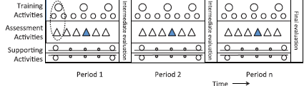
Final Evaluation
High stakes, consequences
Same committee reviews
“Entirety of the record”
Learner rights/procedures
Policy, procedures, standards, training, documentation—defined
Should withstand legal challenges

