Slide 1
Food and Disease Prevention
Presented by Nikki Laws
ndlaws@bgsu.edu

Slide 2
Objectives
Understand how to make a healthy meal complete to help fight disease.
Understand the benefits of eating a whole foods plant based diet.
Understand foods to be limited and why they are limited.
Understand the development of the 2015-2020 Dietary Guidelines for Americans in relation to healthy eating.

Slide 3
What are the components of a healthy meal?
Eating 5 or more servings of fruits and vegetables per day
Eating 3 to 5 servings of whole grains per day
Eating lean meats and plant proteins
Drinking and eating low fat dairy products
Drinking 6 to 8 glasses of water daily

Slide 4
https://www.foodnetwork.com/healthy/photos/myplate-meals

Slide 5
https://montanamovesandmeals.com/tag/myplate/

Slide 6
https://www.foodnetwork.com/recipes/food-network-kitchen/herbal-chicken-sandwiches-with-apple-avocado-smoothie-recipe-3361612

Slide 7
Tips for making meals healthy when you’re busy…
Crockpot meals
Make-ahead of time freezer meals
Sheet tray meals
Selecting simple recipes (5 ingredients or less)
Cooking in larger batches and freezing in small containers for later use
Steamable frozen vegetables for the microwave
Salad kits to save time and inspire new ideas
Tinned fruit to use for snacks or dessert
Blenders for smoothies to add in fruits and vegetables

Slide 8
What are the 2015-2020 guidelines for Americans?
Follow Healthy Eating Pattern/Portions
To maintain weight & avoid chronic diseases
Variety of nutrient dense foods from ALL food groups
Fruits, vegetables, grains, dairy, protein
Limit calories: <10% calories from added Sugars & Saturated Fats
Limit caffeine: 400 mg of caffeine (or five 8-oz cups of coffee) per day
Limit red meat: No more than 26 oz (1 ½ lbs) of red meat per week
Reduce Sodium: <2300mg/day

Slide 9
How are the guidelines developed?
There are 3 steps in this process…
Step 1: Review the Science
Step 2: Develop the dietary guidelines
Step 3: Implement dietary guidelines

Slide 10
Key Points
Make food and beverage choices that meet guidelines for food groups
Food first, supplements last
Encourage following guidelines in schools, work environments, home, etc
Encourage physical activity to promote health

Slide 11
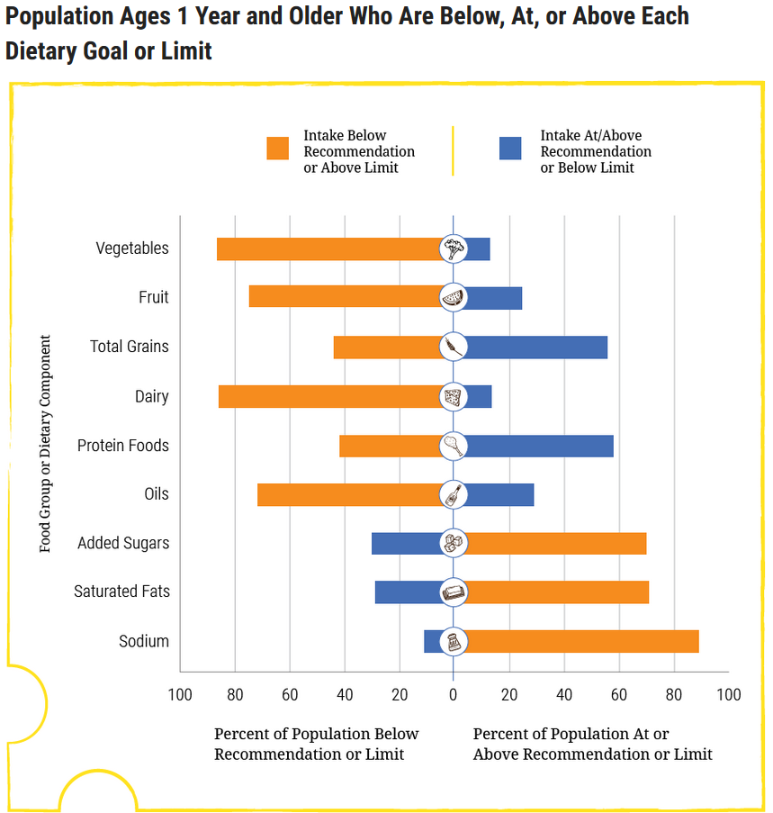
Source: health.gov

Slide 12
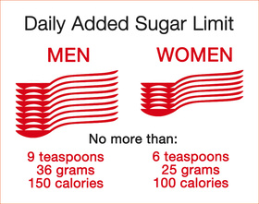
Added Sugar
< 10% of calories should come from added sugars; or limit added sugars to 6-9 tsp daily
Sources include…
Cakes
Cookies
Pies and cobblers
Dairy based desserts (like ice-cream)
Regular soda
Energy drinks
Sports drinks 4 g sugar = 1 tsp
Regular Powerade (Fruit Punch) 20 oz – 34 g sugar = 8.5 tsp

Slide 13
Unlikely Sources of Added Sugar
Pasta sauce
Salad dressings
Barbeque sauce
Ketchup
Granola
Granola and protein bars
Coffee drinks
Yogurt

Slide 14
Yoplait Yogurt | 28g / 7 tsp Chobani Yogurt | 8g / 2 tsp
1 Nutragrain Bar | 11g / 3 tsp 1 Kind Bar | 4 g / 1 tsp
Venti Starbucks Caramel Macchiato | 45 g / 10.5 tsp Cold Brew Coffee with Almond Milk | 4 g/1 tsp

Slide 15
High calorie foods
High calorie foods are often nutrient poor
Rich in fat, sugar, salt, but not in vitamins and minerals
Eating high calorie food daily may cause weight gain
Gaining weight makes become overweight or obese easier
Being overweight or obese increases the risk of developing chronic disease…
Such a Diabetes, Cancer, and Heart Disease
These diseases are all mostly preventable through lifestyle choices and diet

Slide 16
Eating out and staying healthy
Avoid These…
Buffets
Fried foods
Coffee drinks and frappe
Soda or sweet teas
Bacon
Foods high in salt
Foods labeled as ‘crispy, creamy, battered’
Large portions/Combo meals
Healthier Alternatives…
Opt for no salt, sauce, cheese, etc…
Grilled or baked sandwich or entrée
Order a salad instead of fries
Order salad dressing on the side
Reduced fat salad dressings
Choose smaller portions or split a meal
When eating out ask for a to-go container and only eat ½ the meal
Opt out of sour cream or mayonnaise

Slide 17
Diabetes
1 in 3 adults are at risk for developing Diabetes in the United States…
Risk factors for Diabetes include…
Overweight or obese weight status
BMI >25 (overweight) or BMI >30 (obese)
Physical inactivity
Insulin resistance
Genetics
Family history
Notes:
DM2 usually begins with insulin resistance, meaning that muscles, liver, and fat cells don’t use insulin well to control blood sugars. This means your body needs more insulin to get energy into the cells. The pancreas will make extra insulin to keep blood sugars normal, but after awhile will stop, and blood sugars rise. Foods that are high in carbohydrates make blood sugars high, and the pancreas work harder. This is how sugar sweetened beverages and high calorie foods can impact your likelihood of developing DM2.

Slide 18
Family History and Diabetes
Certain ethnicities are more likely to develop Diabetes (types 1 and 2) such as…
African Americans
Alaska Natives
American Indians
Asian Americans
Hispanics/Latinos
Native Hawaiians
Pacific Islanders
But family history is NOT everything; weight status, physical activity and diet are all critical in preventing diabetes.

Slide 19
Salt
How much salt is in a teaspoon?
1/4 teaspoon salt = 575 mg sodium
1/2 teaspoon salt = 1,150 mg sodium
3/4 teaspoon salt = 1,725 mg sodium
1 teaspoon salt = 2,300 mg sodium
Eat no more than 2,300mg of salt daily
500 mg per meal, 150 mg per snack
Use salt substitute, no-salt shaker recipes, no-salt herbal seasonings (like Mrs. Dash)

Slide 20
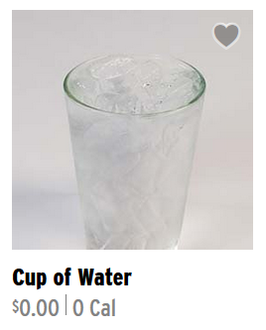
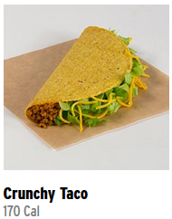
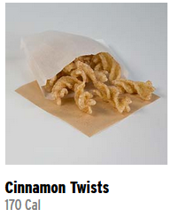
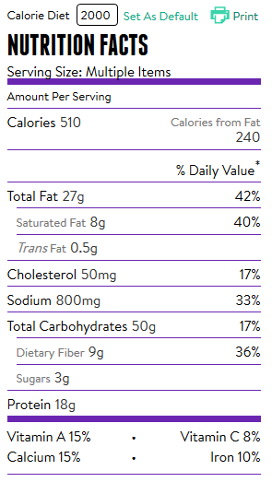
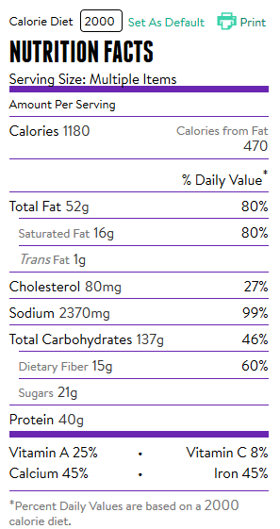
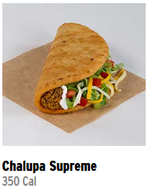
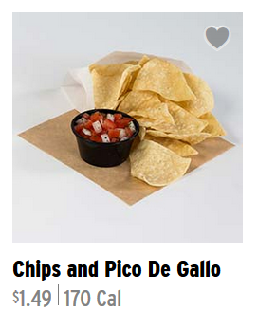

Slide 21
Fats
Shift from solid fats to oils
Should use oils rather than solid fats in food preparation where possible.
Olive or canola oil preferred in cooking and preparing foods.
Use vegetable oil in place of solid fats (butter, stick margarine, shortening, lard, coconut oil) when cooking.
Increasing the intake of foods that naturally contain oils, such as seafood and nuts, instead of meat and poultry.
Choosing other foods, such as salad dressings and spreads, made with oils instead of solid fats.

Slide 22
Why?
Oils are higher in unsaturated fats (mono and polyunsaturated)
Can contain omega-3 and 6 fatty acids
Omega 3 good for health, omega-6 not so much
Saturated and trans fats are to be avoided
Found in solid fats including coconut oil
Increase bad cholesterol
Increase risk of heart disease
Notes:
Talk about why saturated and trans fats are not desirable

Slide 23
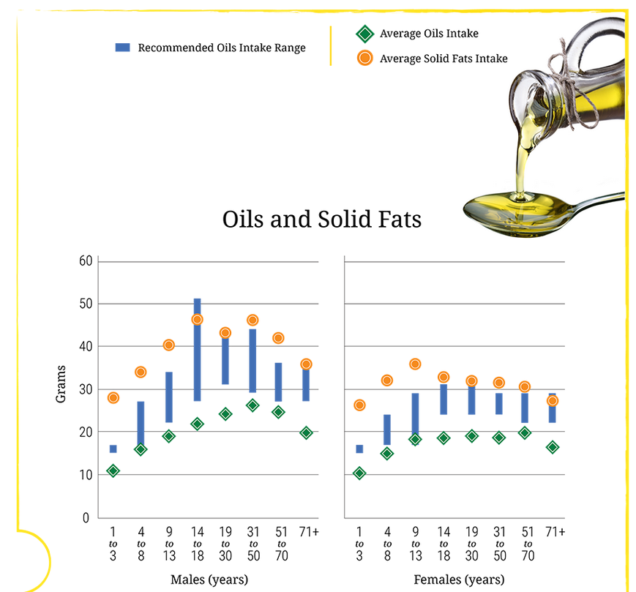
Source: health.gov

Slide 24
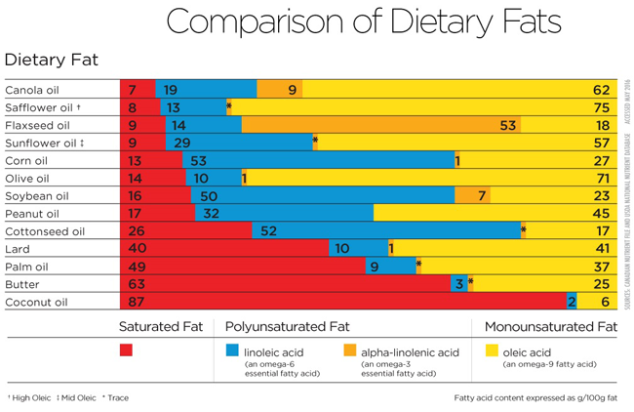

Slide 25
Heart health and fat intake
To prevent heart disease, the American Heart Association recommends...
Eating a variety of foods from ALL food groups
Fresh or frozen fruits and vegetables (without sauces or cheese)
Canned fruits and vegetables should be no-added salt or in own juices
ALL sources of fruits and vegetables will improve health and fight disease!
Eat less nutrient poor foods (e.g. Cheetos, potato chips, donuts, etc.)
Healthy cooking techniques (baked, poached, boiled)
Reducing sodium to < 2,300 mg daily
Limiting saturated and trans fats
Notes:
a variety of fruits and vegetables, whole grains, low-fat dairy products,, skinless poultry and non-fried fish, nuts and legumes, non-tropical vegetable oils

Slide 26
Physical Activity
Varies based on age…
6 to 17 years of age…
60+ minutes daily
Aerobic physical activity
3 days of muscle strengthening
Strength/resistance/endurance training
3 days of bone strengthening
Running, jumping rope, lifting weights

Slide 27
Physical Activity
Varies based on age…
18 to 64 years of age…
150 minutes (or 2hrs+30min)/week
10 minutes minimum, throughout day to equal below
20 min x7 days
30 min x5 days
2 days of muscle-strength training
Include all major muscle groups

Slide 28
Benefits of Exercise
Less likely for…
Premature (early) death;
Injuries or sudden heart attacks
Improves mental health (e.g. depression)
Diseases (heart disease, stroke, some cancers, type 2 diabetes, osteoporosis
Risk factors for disease, such as high blood pressure and high blood cholesterol
Physical fitness (e.g. aerobic capacity, muscle strength, endurance)
Functional capacity (the ability to engage in activities needed for daily living)

Slide 29
Where Americans are at currently with physical activity
Close to 80% of adults do not follow these guidelines
Most likely to exercise were between the ages of 18-24 (31%)
Followed by 65+ (16%)

Slide 30
Protein
Generally only need 0.8 to 1.0 g per kilogram of body weight.
For example… If you weighed 135 pounds you would be 61.4 kg
You would need 49 to 61 grams of protein
At most 7 (one-ounce) servings of protein.
Following MyPlate recommendations > supplements
Excessive amounts of protein can be harmful

Slide 31
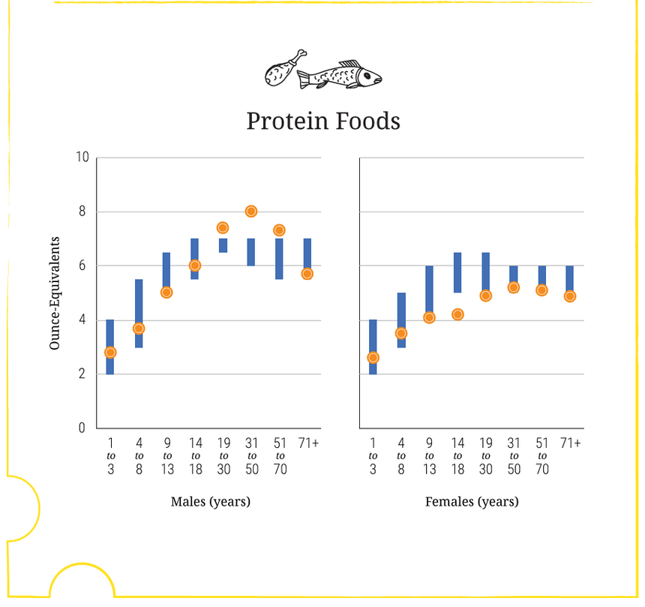
Source: health.gov

Slide 32
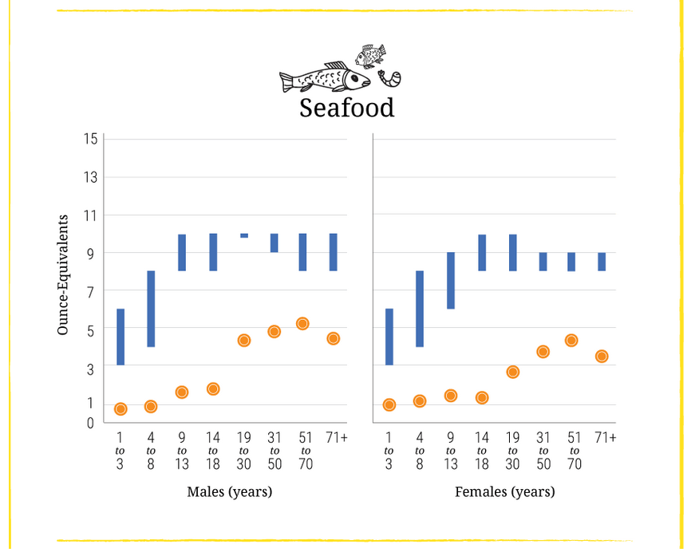
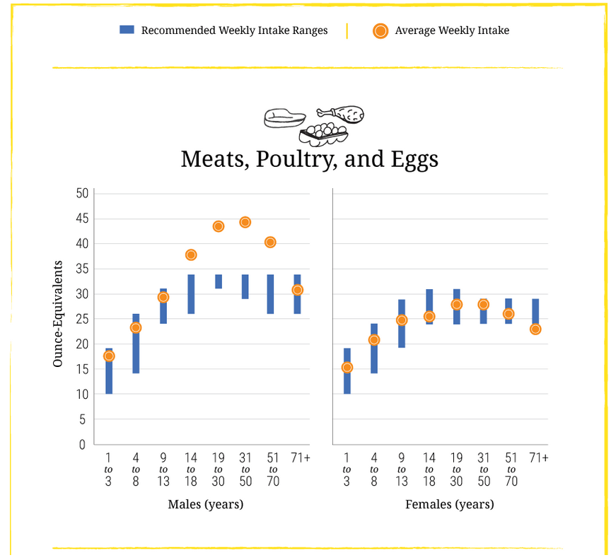
Animal Protein Sources…
Source: health.gov

Slide 33
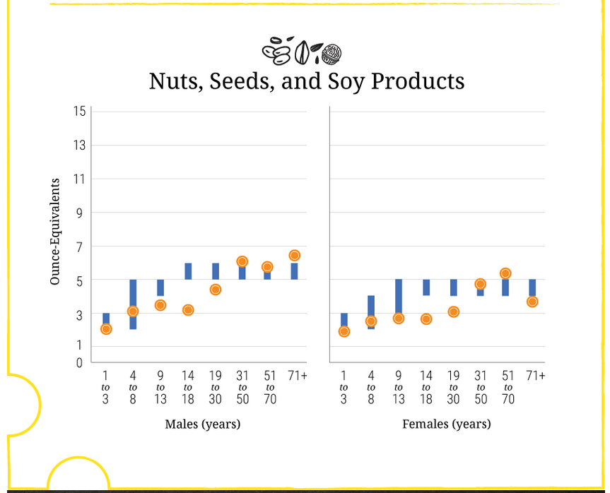
Plant Protein Sources
Source: health.gov

Slide 34
Red Meats
Limit red meat to no more than 1 pound per week
Has saturated fats that increase bad cholesterol
Instead…
Opt for lean sources of protein (e.g. turkey, chicken, fish)
Include plant based sources (beans and rice, soy)

Slide 35
Cancer
Notes:
Segue into this talking about how physical activity is critical for preventing cancer occurring and from coming back

Slide 36
Conclusion
Eating a whole foods plant based diet is key to preventing disease
Follow the 2015-2020 Dietary Guidelines for Americans
Half of your plate should be fruits and vegetables
Fresh, canned, and frozen are all good sources!
Be physically active according to guidelines
Eating a diet high in fat, salt, and sugar may lead to developing diabetes, heart disease, and cancer

Slide 37
Sources
Office of disease prevention and health promotion. The 2015-2020 Dietary Guidelines for Americans. Accessed 26 June 2018. Available from: https://health.gov/dietaryguidelines/2015/guidelines/
American Heart Association. The American Heart Association's Diet and Lifestyle Recommendations. Accessed 26 June 2018. Available from: http://www.heart.org/HEARTORG/HealthyLiving/HealthyEating/Nutrition/The-American-Heart-Associations-Diet-and-Lifestyle-Recommendations_UCM_305855_Article.jsp
Lovett, Michele. The University of Toledo Medical Center. AHA Healthy Eating. Powerpoint.
Haar, Chris Bowling Green State University. Inflammation. Powerpoint.
CBS News. CDC. CDC: 80 percent of American adults don't get recommended exercise. Accessed 26 June 2018. Available from: https://www.cbsnews.com/news/cdc-80-percent-of-american-adults-dont-get-recommended-exercise/
Office of disease prevention and health promotion. ODPHP. Chapter 2: Physical Activity Has Many Health Benefits. Accessed 26 June 2018. Available from: https://health.gov/paguidelines/guidelines/chapter2.aspx
http://www.heart.org/HEARTORG/HealthyLiving/HealthyEating/Nutrition/The-American-Heart-Associations-Diet-and-Lifestyle-Recommendations_UCM_305855_Article.jsp

