Slide 1


Professional Staff Association
Spring Semester General Meeting
Tuesday, April 19, 2011
12:00-1:30 p.m.
Main Campus
Student Union
Auditorium
Agenda
Welcome and Remarks by
Professional Staff Council Chair Joely Giammarco
and Vice Chair Deb Krohn
Year in Review
Bylaws Update
HLC Update
Professional Staff Council Committee Updates
PSA Satisfaction Survey
Q & A
Silent Auction and 50/50 Raffle
Professional Staff Association
Spring Semester General Meeting
Tuesday, April 19, 2011
12:00-1:30 p.m.
Main Campus
Student Union
Auditorium
Spring General Meeting Agenda
Welcome and Remarks by Professional Staff Council
Chair: Joely Giammarco
Professional Staff Council Committee Updates
Bylaws Update
PSA Satisfaction Survey
Q & A
Silent Auction and 50/50 Raffle
To benefit the Professional Staff
Association Scholarship Fund
Prizes include: Two pairs of UT
Football Game Suite tickets,
UT Gift Baskets and more!
Bring your Lunch and Beverage

Slide 2
Silent Auction Items
Sponsored Membership to the main campus Rec Center ($388 value)
Donated by the Rec Center
Two tickets to the President’s football suite ($200 value)
Two tickets to the Institutional Advancement football suite ($200 value)
Donated by UT’s Office of Institutional Advancement
Women’s pink polo shirt ($55 value)
Men’s gold polo shirt ($55 value)
Men’s tie ($69 value)
Women’s scarf ($50 value)
UT Swag Bag ($43 value)
Donated by UT’s External Affairs Office
UTMC Gift Basket ($50 Value)
Donated by UT Medical Center
Two Stadium Club tickets to a home football game ($48 value)
Donated by Professor Kelly Moore - College of Law
50/50 Raffle
All proceeds benefit PSA Scholarship Fund

Slide 3
PSC Year In Review

Slide 4
PSA Bylaws Update

Slide 5

PSA Bylaws Update
Article III – Section 8 - Elections
Changing language to reflect new electronic voting process
Article III – Section 9 - Responsibilities of Professional Staff Council Members
Making the attendance policy stricter
Article III – Section 10 – Past Chair Advisory Committee
Changing language as it relates to who is eligible to be on the committee
Email Voting on proposed changes will happen later this week
Notes:
8-Changing language to reflect new electronic voting process – taking ballot language out.
9-Making the attendance policy stricter – PSC members are allowed to miss only 4 meetings in a term year – if they miss more than 4 they “will” be presented to PSC for removal instead of “may” be
10-currently only chair from past 5 years can be on committee – changing language to any past chairs that are still employed at UT can be on committee

Slide 6
Higher Learning Commission Self Study
What is the UT Self Study?
Part of accreditation process
Post-merger opportunity to examine who we are, where we’re going, and what opportunities exist as a university
The HLC Study: Shaping UT’s Tomorrow
Notes:
The university is coming up for continued accreditation in February 2012. The UT Self Study is a part of the comprehensive evaluation process to determine continued accreditation status, and is also the university’s first post-merger opportunity to examine who we are, where we’re going, and what opportunities still exist.

Slide 7
What are the Criteria?
Mission and Integrity
Preparing for the Future
Student Learning and Effective Teaching
Acquisition, Discovery, and Application of Knowledge
Engagement and Service
Special Emphasis: A Newly Merged Institution Looks to its Future
The HLC Study: Shaping UT’s Tomorrow
Notes:
Within the Self Study, we must show that we meet five criteria:
Mission and Integrity: The organization operates with integrity to ensure the fulfillment of its mission through structures and processes that involve the board, administration, faculty, staff, and students.
Preparing for the Future: The organization's allocation of resources and its processes for evaluation and planning demonstrate its capacity to fulfill its mission, improve the quality of its education, and respond to future challenges and opportunities.
Student Learning and Effective Teaching: The organization provides evidence of student learning and teaching effectiveness that demonstrates it is fulfilling its educational mission.
Acquisition, Discovery, and Application of Knowledge: The organization promotes a life of learning for its faculty, administration, staff, and students by fostering and supporting inquiry, creativity, practice, and social responsibility in ways consistent with its mission.
Engagement and Service: As called for by its mission, the organization identifies its constituencies and serves them in ways both value.
Special Emphasis section on the merger between the Medical University of Ohio and the University of Toledo.

Slide 8
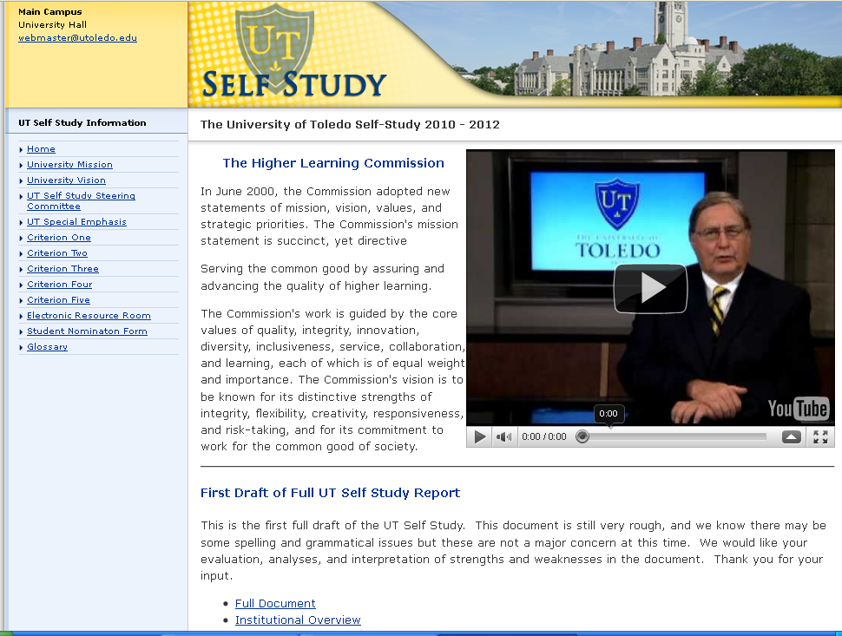
Your feedback is important!
www.utoledo.edu/accreditation
Feedback to utselfstudyfeedback@utoledo.edu
Notes:
The Self Study covers a lot of topics, and we need your help to make sure
The information already included is correct.
If there is additional information or analysis that should be included.
Is your “voice” being heard?
Please read those sections that seem most related to your area, or divide up sections among your group. Feedback can be sent via email through the end of May.
A final draft of the UT Self Study will be posted in August.

Slide 9
PSC Committee Updates

Slide 10
Professional Staff Association SATISFACTION SURVEY REVIEW
Snapshot from Fall 2010
Participation rate = 23%
Notes:
Professional Staff Council conducted a satisfaction survey of the PSA membership in October 2010. Though feeling may have shifted with current climate, we still wanted to share with you a snapshot of what
we found.

Slide 11
Question Focus Areas
Communication
PSA value to the institution
Supervisor relationships
Personal satisfaction

Slide 12
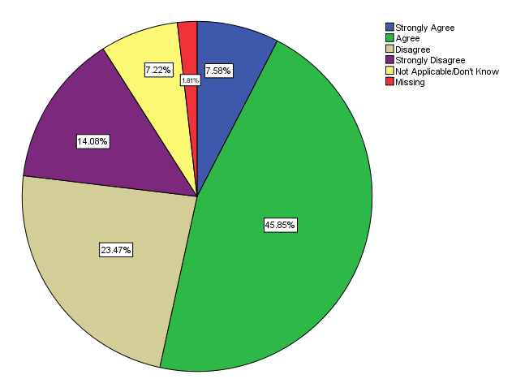
Senior leadership is providing leadership necessary for UT’s continued success
Notes:
These results seemed to be close with a little over half Agreeing to this statement

Slide 13
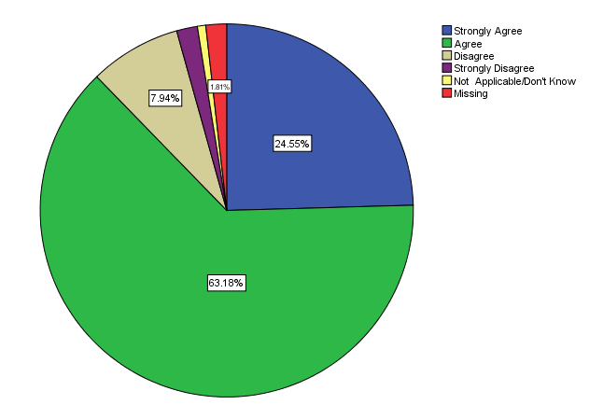
I have an understanding of the mission and values of the University
Notes:
87% said of survey responders understood the UT mission and values (strongly agree and agree combined)

Slide 14
Customer Service/Satisfaction is one of the top priorities at UT
 | Strongly Agree | Agree | Disagree | Strongly Disagree | NA/DK
Customer service/satisfaction is one of the top priorities at UT. | 17.0% | 44.6% | 25.1% | 11.8% | 1.5%
Providing good customer service is important to me. | 78.4% | 20.9% | 0.0% | 0.4% | 0.4%
I believe that customer service (good or bad) has a direct impact on UT’s enrollment, retention and ultimately bottom line. | 73.1% | 24.0% | 1.1% | 0.4% | 1.5%
Notes:
Responders note that they believe customer services is important to UT – approximately 61%
Providing good customer is important – 98% agree or strongly agree
97% believe customer service can impact the bottom line.

Slide 15
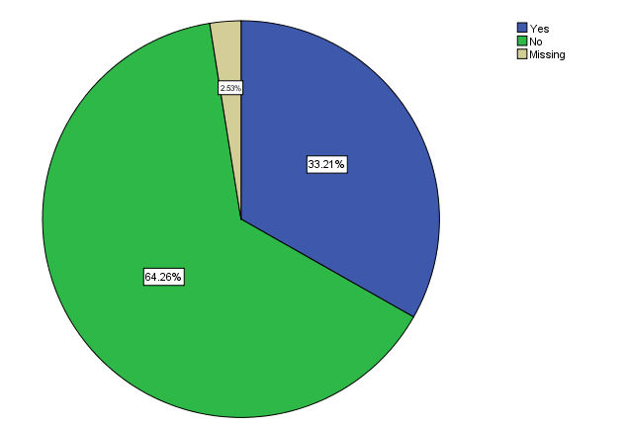
Do you feel senior leadership communicates effectively with PSA employees
Notes:
Communication seems to be a strong issue of concern among PSA members.
64% do not believe senior leadership is communicating effectively.

Slide 16
Suggestions to remove the communication gap
Senior leadership should involve the people that actually do the work with our students before making budget and policy decisions
Ask for feedback and take our opinions and concerns to heart
Hold more Open Forums specific to PSA
Acknowledge PSA in forums
Communicate Policies
Notes:
Here are some suggestions on how to improve the communication gap.
You can see more suggestions at the website we will tell you about later.
Remember that PSA will ask questions at the Town Hall meetings on your behalf if you are not comfortable.
Effectiveness of Town Halls was also split (slide not shown)

Slide 17
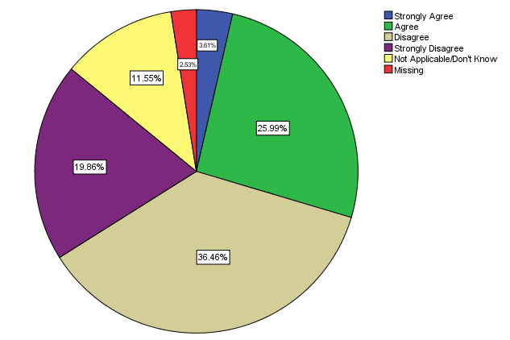
PSA employee input is taken into consideration when changes are made which affect our work life
Notes:
Results indicated that PSA voices are not being taken into consideration.
Know that a PSC representatives sits on the following committees:
Finance task force

Slide 18
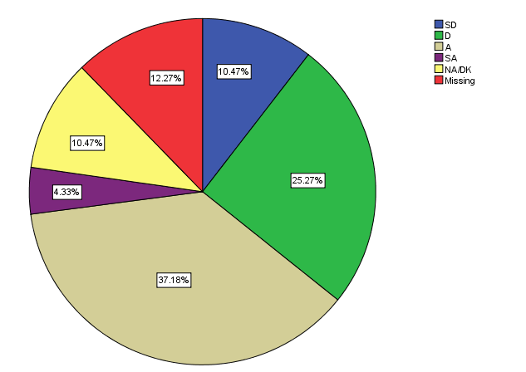
PSA employees are treated with respect at UT
Notes:
47% agreed or strongly agreed with this statement.

Slide 19
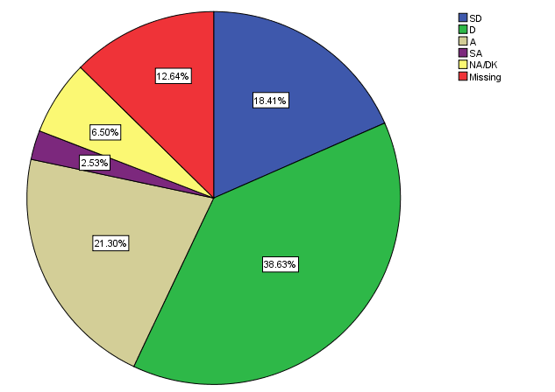
There is a high degree of trust and respect among people at UT
Notes:
67% of responders agreed or strongly agreed with this statement.

Slide 20
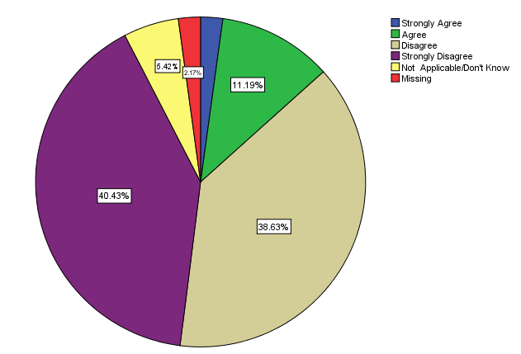
UT rewards productive, high performing PSA employees
Notes:
78% of people strongly disagreed or disagreed with this statement.
This may increase more as positions are abolished – giving people few options to move in to different positions here at UT.

Slide 21
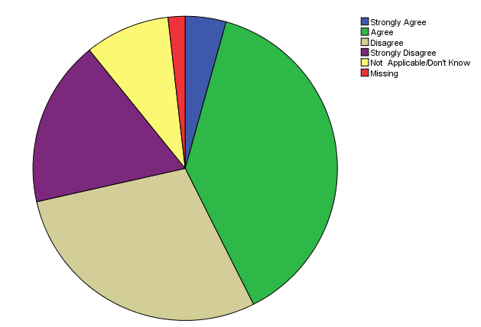
UT is interested in the health and well being of PSA employees
4.4%
9.2%
18.1%
38.7%
29.5%
Notes:
Close to 40% of responders believe UT is not interested in our health and well being.
PSC would like to see more wellness program promotion and options available to employees.

Slide 22
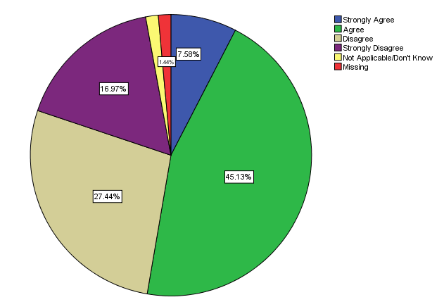
The amount of job stress I feel is reasonable
Notes:
Close to 50% of people believe the amount of stress they feel is reasonable.
This may also go up with position abolishment's.
People sited workload and short on staff at top reasons. People also noted lack of communication, poor direction from supervisor, fear of job loss and lack of respect as other contributors toward stress.

Slide 23
Supervisor Findings
 | Strongly Agree | Agree | Disagree | Strongly Disagree | NA/DK
When I take a risk in order to do my job better, I feel my supervisor will support me. | 37.6% | 40.6% | 13.3% | 4.4% | 4.1%
My supervisor is interested in learning about my ideas and suggestions. | 39.3% | 41.1% | 11.5% | 6.7% | 1.5%
Directions from my supervisor are clear and precise. | 28.0% | 39.9% | 21.6% | 7.5% | 3.0%
Notes:
The majority of responders seem to feel supported by their direct supervisor.

Slide 24
Supervisor Findings
 | Strongly Agree | Agree | Disagree | Strongly Disagree | NA/DK
I respect my supervisor’s knowledge and skills. | 43.3% | 38.5% | 10.4% | 4.8% | 3.0%
The person I report to gives me guidance in accomplishing my work. | 32.3% | 39.4% | 16.4% | 9.7% | 2.2%
When I take a risk in order to do my job better, I feel my supervisor will support me. | 37.6% | 40.6% | 13.3% | 4.4% | 4.1%
My supervisor is interested in learning about my ideas and suggestions. | 39.3% | 41.1% | 11.5% | 6.7% | 1.5%
Directions from my supervisor are clear and precise. | 28.0% | 39.9% | 21.6% | 7.5% | 3.0%

Slide 25
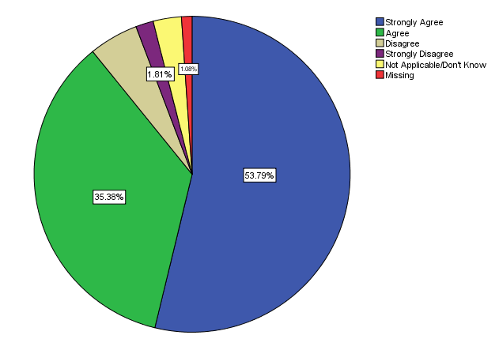
I am loyal to this University.
Notes:
89% of people agreed or strongly agreed with this statement…are loyal to UT

Slide 26
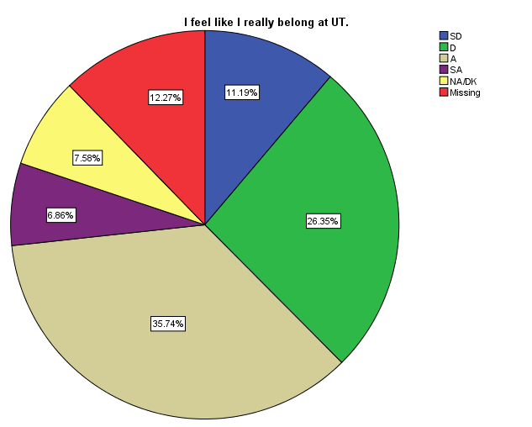
I feel like I belong at UT
Notes:
But when it comes to feeling like you belong…only 37% feel like they belong here at UT

Slide 27
What staff thinks about UT
 | Strongly Agree | Agree | Disagree | Strongly Disagree | NA/DK
Our University is respected in the community. | 13.8% | 57.8% | 14.6% | 6.7% | 7.1%
I am proud to tell people that I work for The University of Toledo. | 30.1% | 55.8% | 6.7% | 4.1% | 3.3%
Overall, I like my job, and I am satisfied with the type of work I do. | 31.0% | 55.7% | 6.3% | 3.3% | 3.7%
Notes:
Responders believe UT is respected in the community and we are proud to tell people we work for UT.
Overall, 86% of people are satisfied with the type of work they do.

Slide 28
Why people stay at UT
BENEFITS
Close to Retirement
Education Benefit for employee spouses and children
Health Care benefits
PEOPLE
Co-Workers
Students
Clients
Alum – connected to UT
Sense of helping patients
Great mentors
Supervisor is great
Talented employees
Diverse group of people to work with from all over the world
Loyalty to boss
Family atmosphere
Notes:
People stay at UT for a variety of reason, but can be broken down into categories: benefits, people

Slide 29
Why people stay at UT
WORK PLACE
University campus experience - atmosphere
The work makes a difference
Love working in health care
Love my job, enjoy what I do
Hope for advancement opportunities
Opportunity to transfer to other positions
Job matches skill set
I am appreciated
Intellectual challenge - Challenging work
Use of problem solving skills
Freedom of expression
Fulfilling work -Rewarding work
I feel like I can contribute my knowledge
Passion for education
Always learning something new
Opportunity for professional growth
Proud of the work I do
Treated with respect
Feel valuable to society
Working toward personal and professional goals –UT allows me to do so
Notes:
Workplace - like their job, contributing to society, challenging intellectual work…passion for education

Slide 30
Why people stay at UT
MISSION
Want to help the UTMC grow
Like the UT mission of making a difference in the community; UT is excellent for the community
Great place to work – love UT
Proud to be part of UT’s growth
Experience high education
Learning different aspects of university administration and the opportunity to apply it
Provided me a good education
Loyal to UT
Institution pride
Large school with small school feeling
Dr. Jacob’s mission for the changing the view of the hospital in the community
OTHER
Family Income - Pay bills
Unlikely to find same level of compensation due to age, if I left UT
Respectable job
Location - close to home
Determination to ride out the administration
Location to my family
Flexibility in hours, if needed
Can’t find a job elsewhere - Poor Toledo job market
Place bound in Toledo
Notes:
Mission: institutional pride, support the mission
Other reasons: close to family, flexibility of hours, good job

Slide 31
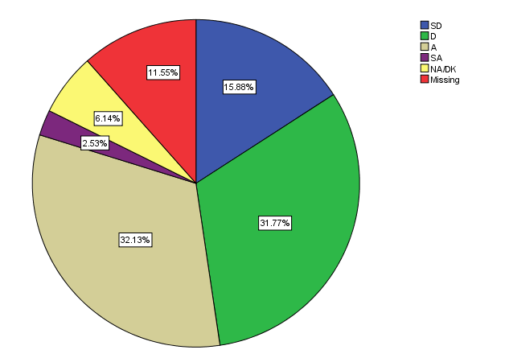
There is a spirit of cooperation and teamwork at UT
Notes:
Less than have agreed or strongly agreed with the statement of teamwork and cooperation.

Slide 32
If you could offer any suggestions on how to make this University a better place to work, what would they be?
I’m very happy to be here and feel fortunate to work for this institution. That said, I think the one thing missing is employee recognition.
Leaders: Please talk to your employees, engage them and I think you will find solutions to many of the issues that you keep trying to define and fix.
This is a university and should provide and embrace training/education necessary for job performance!
I love working for the University of Toledo and I am very proud that I am also an alumni. I would like better communication between my supervisor and our staff.
Tiered pay scale. Merit for performance. Recognition for a job well done. Appreciation!
Better integration with other departments (relationship building). The best thing I’ve done is get out and interact with other people/departments on campus.

Slide 33
Department Breakdown
Notes:
Largest participating other than “Other” were Information Technology and College of Medicine.

Slide 34
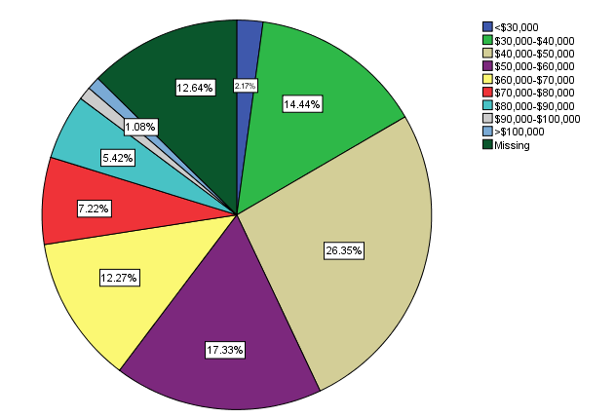
Annual Salary Breakdown
Notes:
Greatest number of responders make between $40,000 and $50,000

Slide 35
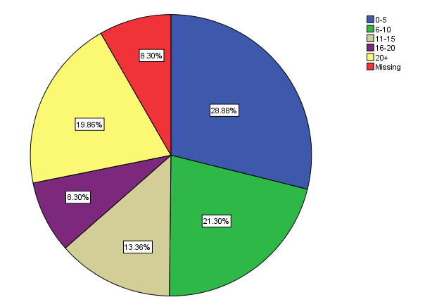
Years of Service at The University of Toledo
Notes:
Greatest number of responders have worked at UT for 5 or less years, closely behind 6-10 years

Slide 36
Satisfaction Survey Website
http://oir.utoledo.edu/Surveys/Interactive_Assessment.aspx
By division or college
By years of service
By annual salary

Slide 37
Upcoming Events
Outstanding Staff Awards –
Thursday, April 28
Scott Park Auditorium from 1:00-2:30pm
PSA Open Discussion with Dr. Jacobs
Tuesday, May 17
12:00pm in Student Union 2592
Professional Staff Council elections – May

Slide 38
Silent Auction Bidding Closing Soon!!
Sponsored Membership to the main campus Rec Center ($388 value)
Donated by the Rec Center
Two tickets to the President’s football suite ($200 value)
Two tickets to the Institutional Advancement football suite ($200 value)
Donated by UT’s Office of Institutional Advancement
Women’s pink polo shirt ($55 value)
Men’s gold polo shirt ($55 value)
Men’s tie ($69 value)
Women’s scarf ($50 value)
UT Swag Bag ($43 value)
Donated by UT’s External Affairs Office
UTMC Gift Basket ($50 Value)
Donated by UT Medical Center
Two Stadium Club tickets to a home football game ($48 value)
Donated by Professor Kelly Moore - College of Law

Slide 39
Questions?
Thank you!

