Slide 1
Changing Demographics
August 29, 2022
Toledo Public Library – Downtown Branch
M. Joel Voss, PHD
@mjoelvoss

Slide 2
Great Decisions 2022: Toledo Public Library – Downtown Branch
August 29th – Dr. Joel Voss with Changing Demographics
September 8th (Different day because of Labor Day) – Dr. Jeff Broxmeyer with The President’s Foreign Policy
September 12th – Dr. Paul Hong with Industrial Policy
September 19th – Dr. Tom Megeath with Outer Space
September 26th – Dr. Barry Jackisch and Owen Lee with Russia and the United States
October 3rd – Dr. Jetsa Caceres with Drug Policy in Latin America
October 13th (Different day because of Fall Break) – Dr. Andy Jorgensen with Climate Change

Slide 3
Overview of our talk
Clarify
Concepts
Discuss
International relations theories
Describe
Our framework
Foreign policy and economic interests
Foreign policy and security interests
Foreign policy and ‘human’ interests
Questions and answers

Slide 4
Clarifying Concepts
What are demographics?
“Demography is the statistical study of human populations. Demography examines the size, structure, and movements of populations over space and time.”
Well-known examples of demography (demographics) is the U.S. Census.
Demographics include age, gender, income, education, race, sexual orientation, race, etc.
What is international relations?
“Scientific study of the interactions between sovereign states.”
What is foreign policy?
Focus on the decision-making process of actors within the state.
U.S. foreign policy is largely found in the National Security Strategy.

Slide 6
International Relations Theories
Theory | Key Actors | Characteristics of International system | Characteristics of States | Beliefs about Change
Neorealism | States (most powerful matter) | Insecure, selfish, power seeking | Unitary actors, rational, power-seeking | Emphasis on the management and frequency of war
Liberalism | States, NGOs, IOs | Basically good, social, capable of cooperating | Anarchy abridged by interdependence among actors | Self-interest is managed by institutions which leads to cooperation and peace
Constructivism | People, elites, cultures | Key actors in the creation of meaning | An artifact that is socially constructed | Possible through socialization, diffusion of ideas, internationalization of norms
Marxism | Social classes, MNCs | States act on behalf of bourgeoisie | Hierarchal, by-product of expansion of certain economic forms | Possible through revolution
(Mingst, et al 2021)

Slide 8
1. Economic issues
Shifting populations from the global north to the global south may have a negative impact on the U.S.’s economy (and thus relative power).

Slide 14
Economic Impacts 1
Economic Growth:
Demographics suggest that labor force growth will be considerably slower than it has been in recent decades, and this will weigh on long‐​run economic growth.
Labor mobility and business dynamism, including the number of start‐​ups in key innovative sectors like high tech, have been declining for some time (CATO 2022).
In addition to affecting the economy’s trend growth rate, demographics will likely affect the composition of growth by shaping aggregate consumption, saving, and investment decisions (CATO 2022).
Population change will drive large regional shifts in economic activity: decline in the shares of global economic activity in East and Southeast Asia, Europe, and North America; and an increase in the shares of Central and South Asia and sub-Saharan Africa. Economic shifts should be greater than population shifts (Mason, et al 2022).
Changes in age structure may boost per capita economic growth in low- and lower-middle-income countries but inhibit growth in high- and upper-middle-income countries (Mason, et al 2022).
Changes in age structure may boost per capita economic growth in low- and lower-middle-income (CATO 2022).

Slide 15
Economic Impacts 2
Labor Supply:
As a result of lower population growth and labor force participation, the growth of the U.S. labor force has slowed considerably, from 2.5 percent per year, on average, in the 1970s, to around 0.5 percent per year over 2010–2016. It is expected to remain near that level over the next decade (CATO 2022).
Monetary policy:
There will be a smaller share of young borrowers able to take advantage of a decrease in interest rates but a larger share of older people who benefit from higher asset prices; similar reasoning applies for an increase in interest rates. Demographic change may mean that wealth effects become a more important channel through which monetary policy affects the economy (CATO 2022) .
Fiscal Policy:
The rising share of older people will put significant pressure on Social Security and Medicare in the United States, which are structured as pay‐​as‐​you‐​go programs, with current workers providing support for current retirees (CATO 2022).
Population aging will increase pressure for more privsate assets and/or more public debt with an uncertain impact on capital (Mason, et al 2022).

Slide 16
2. Security Interests
Changing demographics may impact the security interests of the United States by impacting the stability of foreign countries and /or the U.S.
This could lead to a decrease in relative power

Slide 25
Security Impacts
Changes in the nature of conflict:
Conflicts are likely to follow from increasing urbanization, the spread of immigrant communities, and demographic pressures on renewable resources, such as water, as well as from independent changes in military strategy and technology. Future high-intensity conflict is more likely to take place in urban areas. This presents a particular challenge to the conventional warfare capability and doctrine of U.S. ground forces (RAND 2022).
Changing sources of national power:
Demographic factors will compel both low-growth and high-growth states to develop different sources of national power (Rand 2022).
Changing sources of conflict:
Demographic factors can cause conflicts. Massive population migrations, for example, contribute to instability in both home and host countries. The home country faces the risk that those departing will use the host nation to undermine the home state, while the host nation faces challenges ranging from an overburdened infrastructure to growing ethnic imbalances (Rand 2022).

Slide 26
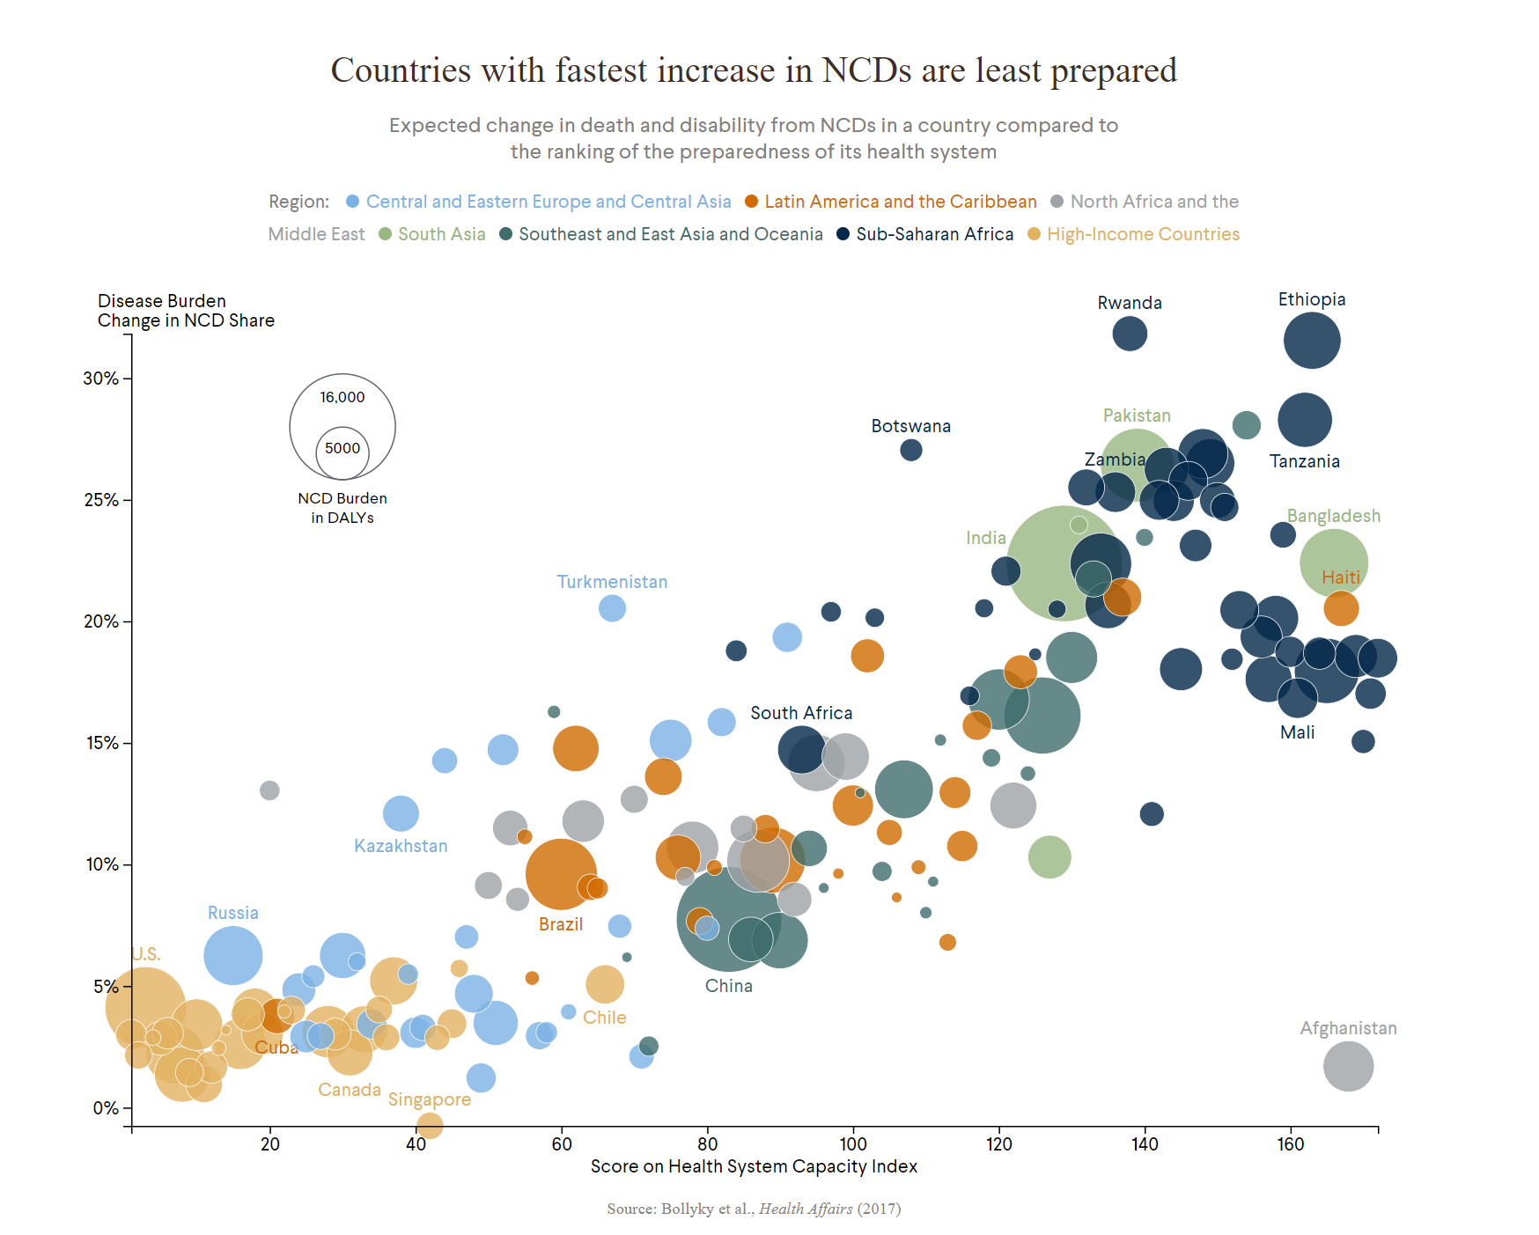
3. ‘Human’ issues
Human rights abuses
Global Health
Population mobility allows viruses to spread quickly (PRB 2022).
Population density can heighten disease transmission (PRB 2022).
Population aging may be more people at risk (PRB 2022).
Deaths and disability from non-communicable diseases are increasing in poorer nations (CFR 2022).
Climate change

Slide 27
Conclusions
1. Changing demographics will likely have a profound impact on U.S. foreign policy in the future including our economic and security concerns as well as human security concerns.
2. Administrations should do more to consider how demographics may impact our needs (excluding from NSS and other high-level documents).
3. However, other global powers are also facing very similar constraints.

Slide 28
Great Decisions 2022: Toledo Public Library – Downtown Branch
August 29th – Dr. Joel Voss with Changing Demographics
September 8th (Different day because of Labor Day) – Dr. Jeff Broxmeyer with The President’s Foreign Policy
September 12th – Dr. Paul Hong with Industrial Policy
September 19th – Dr. Tom Megeath with Outer Space
September 26th – Dr. Barry Jackisch and Owen Lee with Russia and the United States
October 3rd – Dr. Jetsa Caceres with Drug Policy in Latin America
October 13th (Different day because of Fall Break) – Dr. Andy Jorgensen with Climate Change

