Slide 1
Correcting Misperceptions
Gateway Activities in WAC classes

Slide 2
WAC approaches in Geology courses
Dealing with persistent misconceptions
A gateway question in Physical Geology
Physical Geology is a Gen Ed / Core Curriculum course
The writing prompt:
at the beginning of class, before discussing the topic
Does carbon dioxide released by human activities
affect ozone in the atmosphere?
This series was created by Dr. David Krantz, EEES, University of Toledo

Slide 3
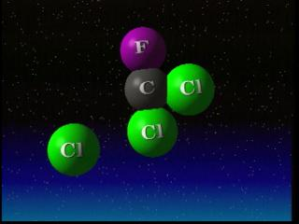
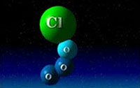
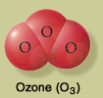
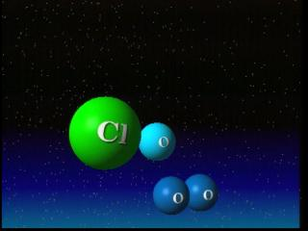
CFCs and ozone depletion
Discussion: What are CFCs?
How do CFCs degrade ozone?
CFC = chloro fluoro carbon
Discussion: What is ozone?
Why is ozone important?

Slide 4
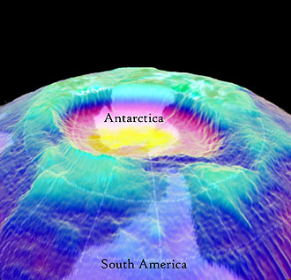
The Earth’s ozone layer
Discussion:
Global impacts
REALLY Important Point:
Ozone depletion IS NOT the same issue
as Global Climate Change

Slide 5
The Earth’s ozone layer
Discussion:
Global impacts
Another REALLY Important Point:
Carbon dioxide DOES NOT deplete ozone
** This written response reappears on the next exam **

Slide 6
Correcting Misperceptions
By asking students what they CURRENTLY think before offering instruction, you have the chance to CORRECT prior misconceptions that are going to interfere with the ability to learn new information.
In this example, if a student persists in thinking that carbon dioxide created by human activity is what is depleting the atmospheric ozone layer, they will never fully understand that there is a significant difference between the emission of chloro flouro carbons, which contribute to the depletion of the ozone layer, and carbon dioxide emissions created by human activity, which are linked to global climate change but NOT to ozone depletion.
Both ozone depletion and carbon dioxide emissions are linked to global warming, but not by the same mechanism.

