Slide 1
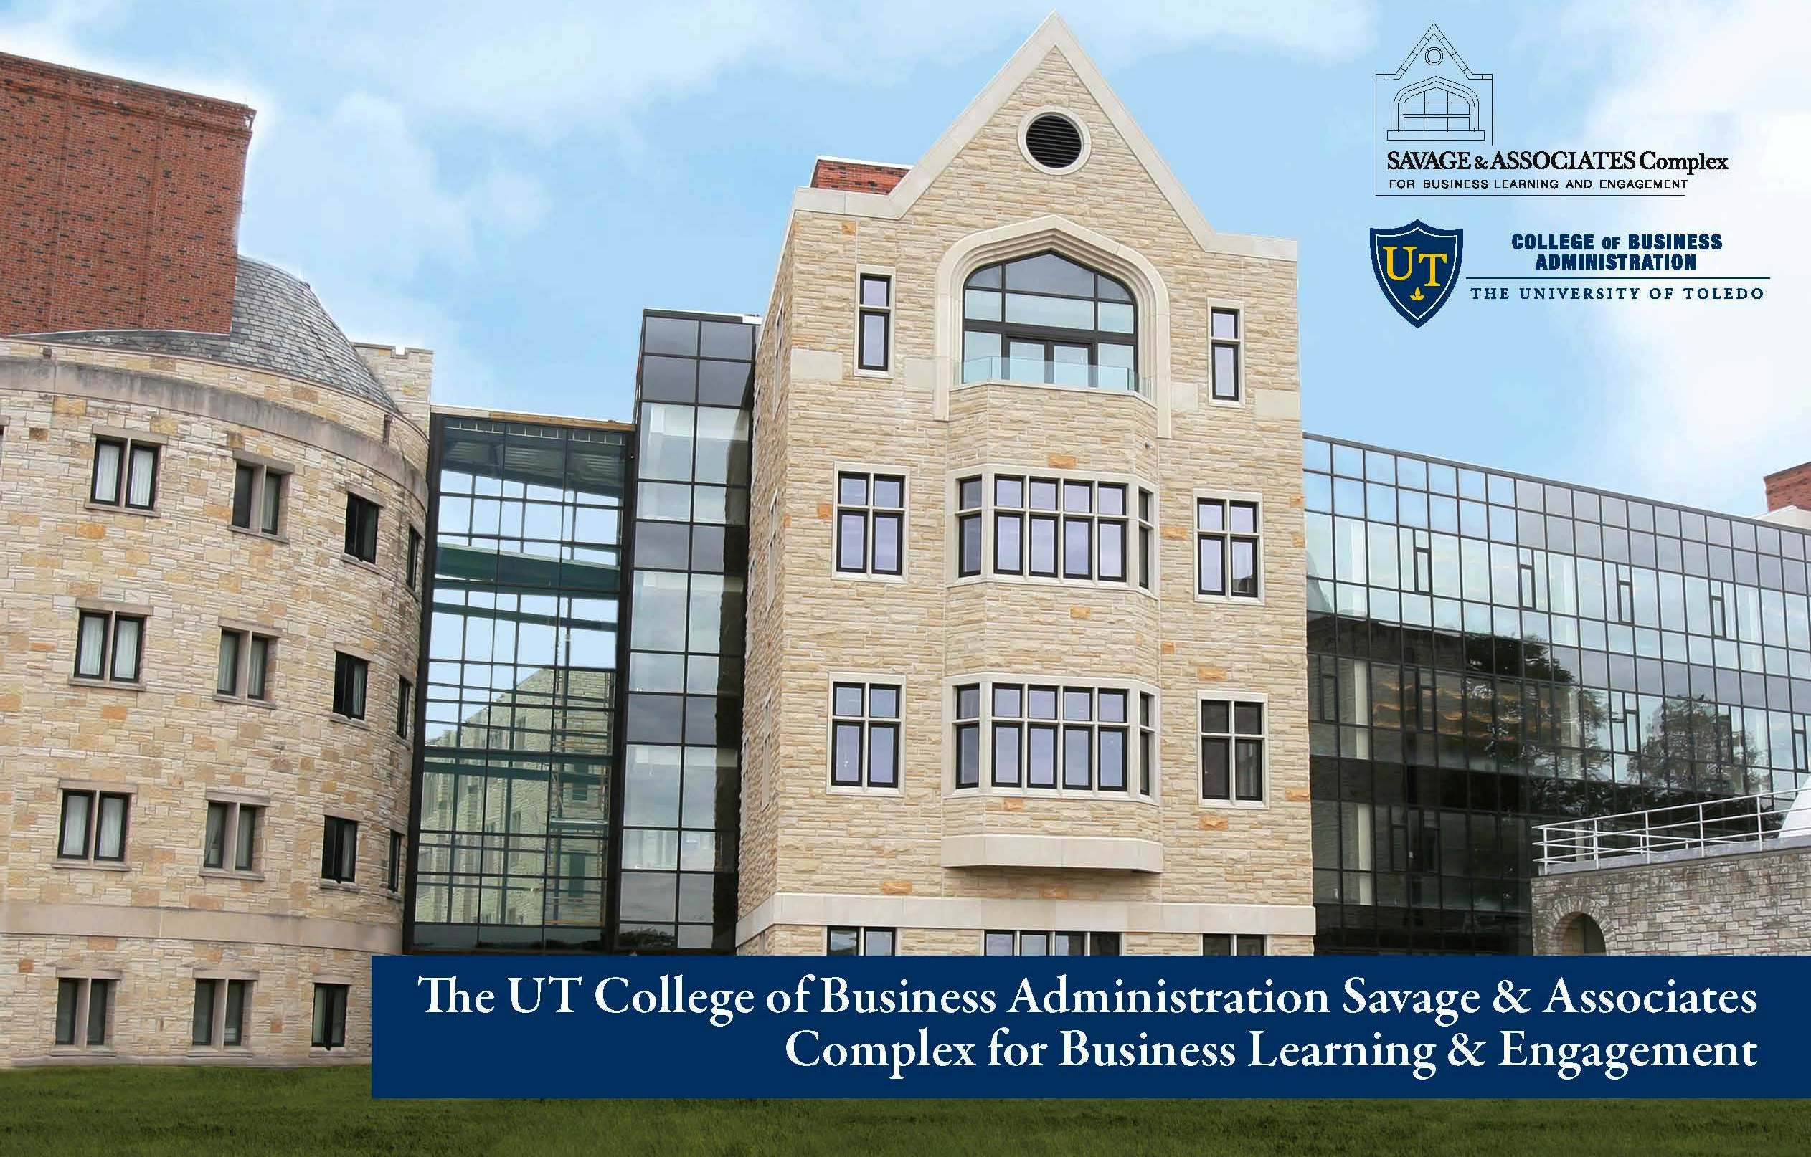
The University of Toledo Accounting Program & Careers
Why Accounting?

Slide 2
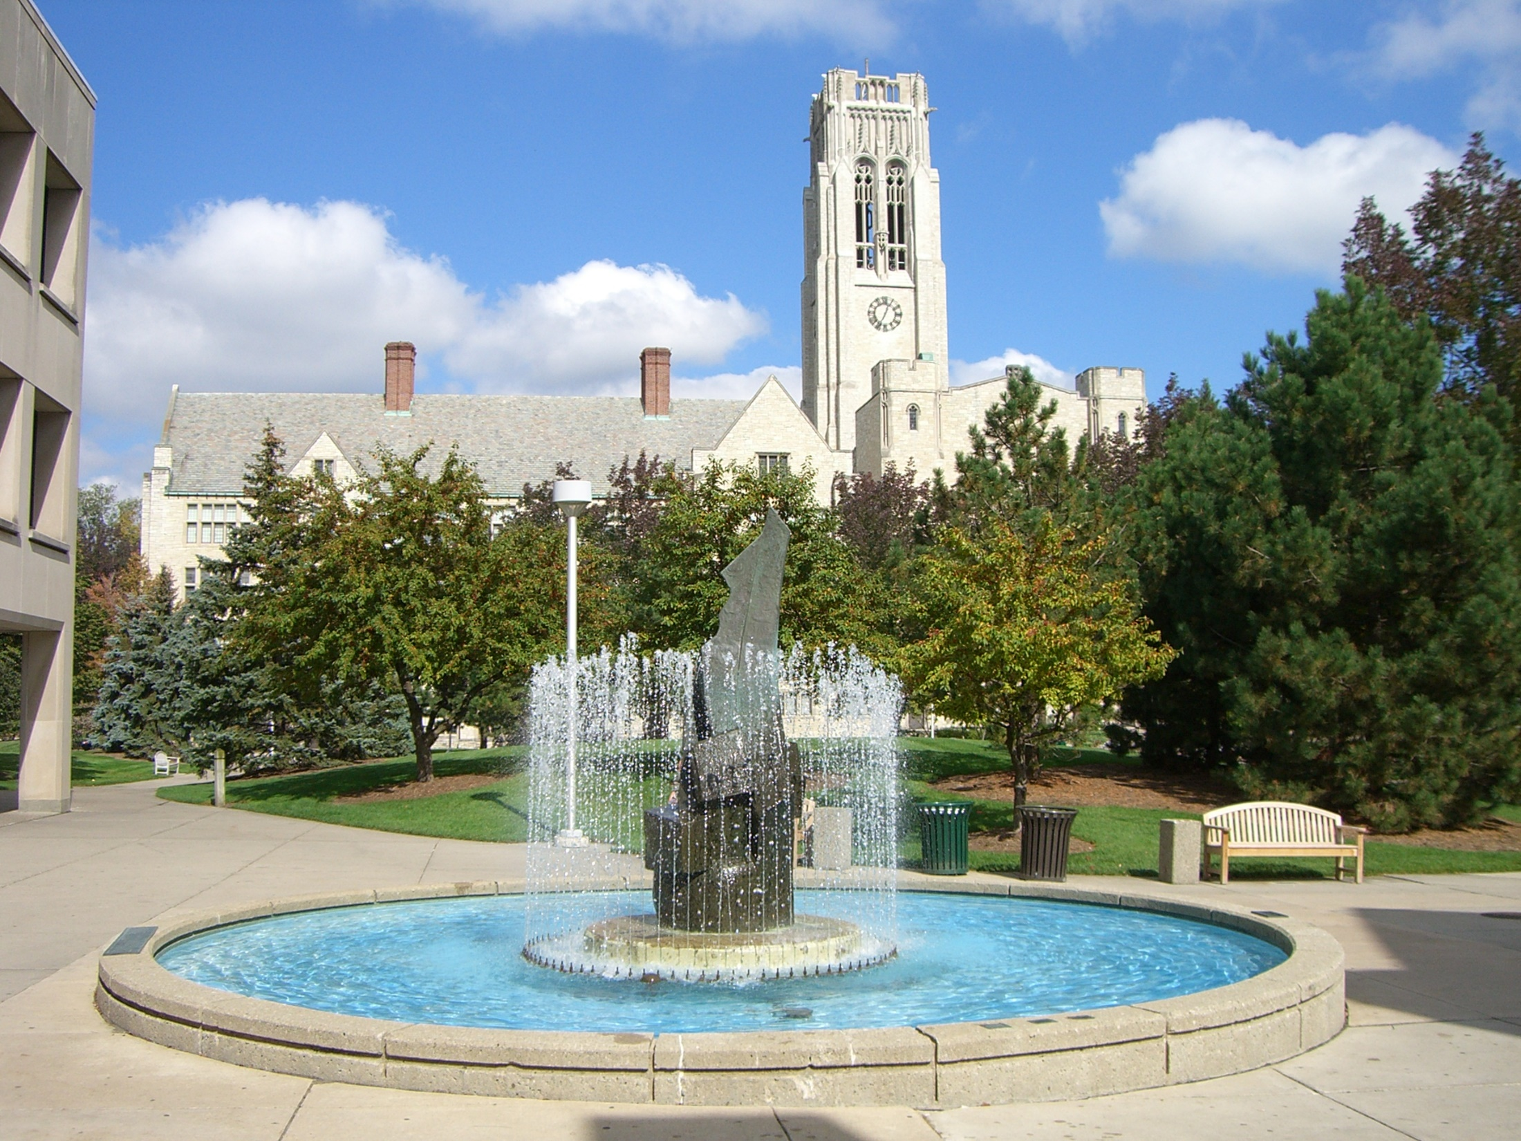
Accounting Overview
Accounting Myths
Accounting Degree Options
What is a CPA?
How do I become an accountant?
Accounting Job Prospects
Typical Accounting Salaries
Where do UT Accounting grads get jobs?

Slide 3
Myth #1: Accounting = Bookkeeping
Bookkeepers typically perform data entry tasks, but accountants take over where bookkeepers leave off
They spend most of their time in a decision-making capacity
They assist company management to understand the financial impact of business decisions
They typically have at least a four year degree and are often CPA’s

Slide 4
Myth #2:
Not true! Would you consider the following careers boring?

Slide 5
FBI Agent
Corporate Entertainment Accountant
World traveling accountant
Financial Advisor

Slide 6
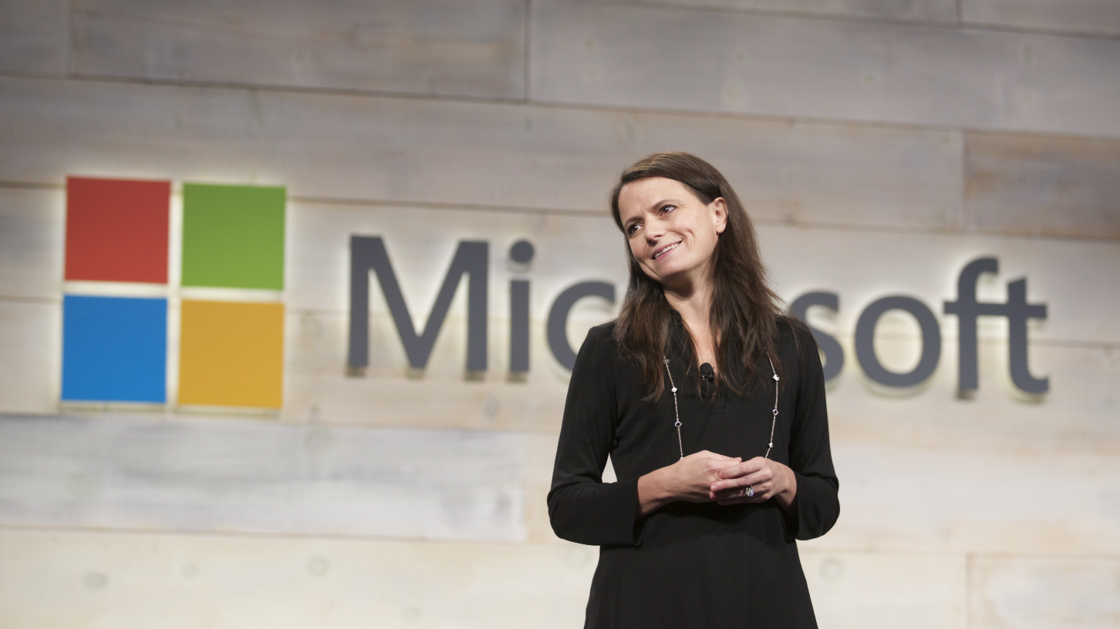
Chief Financial Officer
Plant Controller
IT Auditor

Slide 7
Accounting Degree Options
Bachelor of Business Administration (BBA) in Accounting
- 4 year degree (126 semester credit hours)
- A Minor in Accounting is also available
- 9 semester credit hour program for Business majors
Master of Science in Accountancy (MSA)
- 30 semester credit hour program
Curriculum is continuously being updated to keep up with the profession
- Accounting Advisory Board – made up of representatives from the Big 4 accounting firms, regional accounting firms, and major corporations in the region

Slide 8
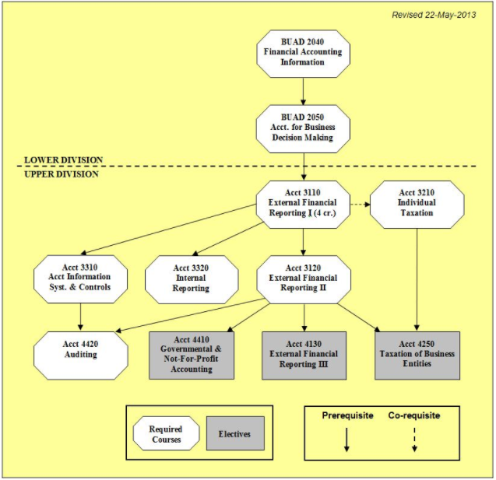
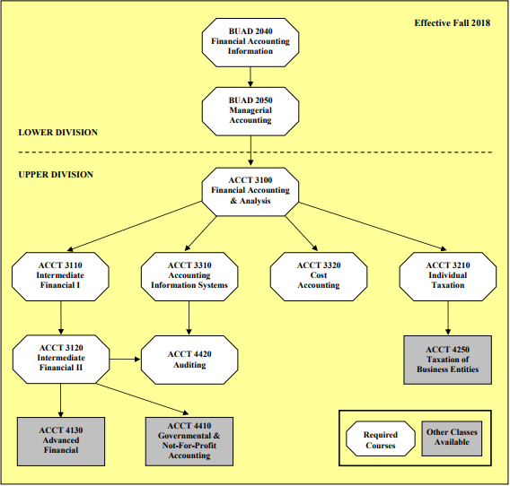
Accounting path for students under old catalog
Accounting path for students under new catalog

Slide 9
3110/3120: Intermediate Accounting I & II
4130: Advanced Accounting
3210: Individual Taxation
3310: Accounting Information Systems
3320: Internal Reporting
4250: Taxation of Business Entities
4410: Governmental & Not-for-Profit Accounting
4420: Auditing
Undergraduate Accounting Courses

Slide 10
6150: International Accounting
6190: Contemporary Accounting Problems
6210: Research in Accounting and Taxation
6310: Advanced Managerial Accounting
6430: Business Valuation and Analysis
6440: Advanced Auditing
6450: Fraud and Forensic Accounting
Graduate
Accounting Courses

Slide 11
What is a…
Education requirement: A baccalaureate degree and 150 credit hours
CPA Exam Requirement:
Apply to sit based on state requirements
Pass four exams with a 75% or higher
Exams: Auditing, Business Environment, Financial Accounting/Reporting, Regulation

Slide 12
Are there other certifications?
CMA
CIA
CGMA
CFM
CFE
CGFM
CFP
Certified Global Management
Accountant
Certified Government Financial Manager
Certified Management Accountant
Certified Internal Auditor
Certified Financial Manager
Certified Fraud Examiner
Certified Financial Planner

Slide 13
How do I become an accountant?
$
This is not an easy degree; if it was easy, everyone would do it!
You will have to work hard and a lot will be expected of you
What do you get in return if you major in accounting?
Enhanced critical thinking, problem-solving, and research skills
Thorough knowledge of correct accounting procedures
Financial expertise and experience
A job in accounting!!
Top jobs are competitive
You will need good grades, join extracurricular activities and obtain an Internship (employers prefer to hire from intern pool)

Slide 14
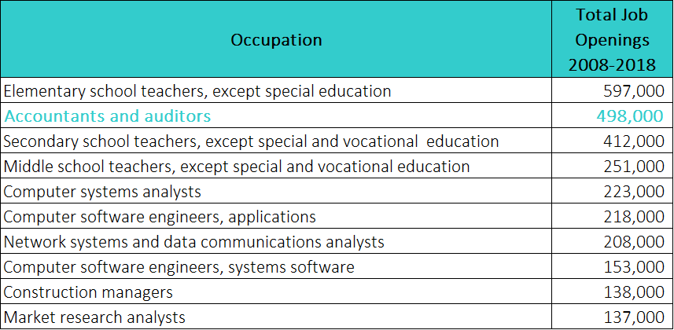
Future prospects for accounting graduates…
Source: https://bigfuture.collegeboard.org/explore-careers/careers/hottest-careers-for-college-graduates#bachelors

Slide 15
Top 10 World Employers
for New Grads
Source: http://money.cnn.com/pf/jobs/newgrads/2013/snapshots/10.html

Slide 16
What are typical accounting salaries?
available at: http://www.startheregoplaces.com/why-accounting/salary-and-demand/
Corporate Accounting and Public Accounting Firm entry-level salaries
available at: http://www.roberthalf.com/salary-guides
$35,055 - $74,250

Slide 17
Where do UT accounting graduates get jobs?
1
PricewaterhouseCoopers
11
Owens-Illinois
2
Ernst & Young
12
Dana
3
Plante Moran
13
Nestlé
4
Mosley, Pfundt & Glick, Inc.
14
HCR ManorCare
5
Gilmore Jasion Mahler
15
GE Aviation
6
CliftonLarsonAllen
16
Scotts Miracle-Gro Co.
7
Weber O'Brien Ltd
17
Solo Foods
8
William Vaughan Co.
18
The Andersons
9
James H. Miles
19
Welltower
10
Marathon Petroleum
20
Owens Corning
Based on a 2013/2014 University of Toledo accounting student survey

Slide 18
Thank you!
Do you have any questions?
Dr. Diana Franz
Department of Accounting, Chair
Diana.Franz@utoledo.edu
419-530-4264

