Slide 1
Creating knowledge, shaping people, and making connections to transform the profession of sales

Slide 2
Transforming the Profession of Sales
Creating Knowledge
Shaping People
Making Connections

Slide 3
Creating Knowledge
Motivation
Branding
International
Emotional Intelligence
Technology
Research Corner blog in Memberclicks
Impact of academic research

Slide 4
Impact of Academic Research
Elevates the profession
Sales is a profession worth researching
Identifies and guides trends in industry
Develops curricula
UToledo and beyond
Feeds textbooks

Slide 5
Research Corner
Practioner focused articles and summaries of sales research conducted by UToledo/ESSPS faculty/staff

Slide 6
Shaping People and Making Connections
Entry Sales Talent
Leadership Sales Talent

Slide 7
Entry Sales Talent
Developing potential hires
Recruiting potential hires
Developing current sales team – details forthcoming

Slide 8
Entry Sales Talent Development
Curricula Highlights (overview)
Engagement
Sales Process
Prospecting
Sales Enablement
Context (Inside)
Context (Channels)
Negotiations
Data Analytics
Emotional Intelligence
Team
Leadership
Internship
Corporate Coaching Sessions
Class Interactions
Discussion Forums
Advisory Board
Job Shadow List
Networking Night
Fete
Internal Sales Competition
Nation’s TOP + AVAILABLE sales talent

Slide 9
Sales Process – PSLS 3440
Description
Key Projects
Introduces students to the theory and practice of personal selling. Its primary focus is on the face-to-face aspects of the sales process. Its purpose is to provide a professional foundation for students interested in pursuing a career in sales.
Role Plays – Information Gathering and Proposal Presentation
Sales Call Guide
Portfolio
Proposal
Corporate Coaching Session

Slide 10
Prospecting – PSLS 3450
Description
Key Projects
Introduces students to the activities involved in supporting buyer-seller interactions and the personal selling process. Its purpose is to provide skills in areas related to prospecting, sales administration and technology, time and territory management, and managing customer follow up.
Sales Force Automation Simulation (SFA) and Customer Relationship Management (CRM) Lab
Chally Assessment
Voicemail
Virtual Role Play
Job Shadow
Social Selling
Elevator Pitch

Slide 11
Sales Enablement – PSLS 3450
Description
Key Projects
Introduces students to the activities involved in supporting buyer-seller interactions and the personal selling process. Its purpose is to provide skills in areas related to prospecting, sales administration and technology, time and territory management, and managing customer follow up.
Sales Force Automation Simulation (SFA) and Customer Relationship Management (CRM) Lab
Chally Assessment
Voicemail
Virtual Role Play
Job Shadow
Social Selling
Elevator Pitch

Slide 12
Context (Inside) – PSLS 3450
Description
Key Projects
Introduces students to the activities involved in supporting buyer-seller interactions and the personal selling process. Its purpose is to provide skills in areas related to prospecting, sales administration and technology, time and territory management, and managing customer follow up.
Sales Force Automation Simulation (SFA) and Customer Relationship Management (CRM) Lab
Chally Assessment
Voicemail
Virtual Role Play
Job Shadow
Social Selling
Elevator Pitch

Slide 13
Context (Channels) – PSLS 3080
Description
Key Projects
Looks at the purchasing function from a strategic and behavioral perspective. Today's purchasing professional must deal with complicated supply chain relationships, increased demand for supply to be "Just-In-Time," and "Total Quality," with minimal costs. This course will use role plays, simulations, exercises, and cases to investigate issues relating to negotiation, relationship management, and other strategic purchasing issues.
Role Plays – Information Gathering and Proposal Presentation
Request for Proposal (RFP)
Purchase Recommendation
Negotiation Exercise(s)

Slide 14
Negotiations – PSLS 3080
Description
Key Projects
Looks at the purchasing function from a strategic and behavioral perspective. Today's purchasing professional must deal with complicated supply chain relationships, increased demand for supply to be "Just-In-Time," and "Total Quality," with minimal costs. This course will use role plays, simulations, exercises, and cases to investigate issues relating to negotiation, relationship management, and other strategic purchasing issues.
Role Plays – Information Gathering and Proposal Presentation
Request for Proposal (RFP)
Purchase Recommendation
Negotiation Exercise(s)

Slide 15
Data Analytics – PSLS 4740
Description
Key Projects
Provides students in-depth study of advanced sales concepts including relationship management, problem solving, negotiation, and proposal writing. The course involves presentations by business people, field work, and video-taped role playing.
Emotional Intelligence Assessment
Data Analytics
Team Role Plays – information gathering and proposal presentation

Slide 16
Emotional Intelligence – PSLS 4740
Description
Key Projects
Provides students in-depth study of advanced sales concepts including relationship management, problem solving, negotiation, and proposal writing. The course involves presentations by business people, field work, and video-taped role playing.
Emotional Intelligence Assessment
Data Analytics
Team Role Plays – information gathering and proposal presentation

Slide 17
Team – PSLS 4740
Description
Key Projects
Provides students in-depth study of advanced sales concepts including relationship management, problem solving, negotiation, and proposal writing. The course involves presentations by business people, field work, and video-taped role playing.
Emotional Intelligence Assessment
Data Analytics
Team Role Plays – information gathering and proposal presentation

Slide 18
Leadership – PSLS 4710
Description
Key Projects
Focuses on the activities and problems of first line sales managers in managing the sales function in the modern business organization. The role and functions of the sales manager will be examined, including sales force size and organization, and management of the sales force. Issues related to hiring, training, supervising, compensating, and evaluating salespeople are also emphasized.
Sales Simulation Game on allocating accounts, building teams, training, motivating, and compensating
Corporate Coaching Session

Slide 19
Internship – PSLS 4940
Description
Key Projects
Practical sales experience is obtained by working in an organization
170 hours
Hands-on
Internship Report
Employer Evaluation

Slide 20
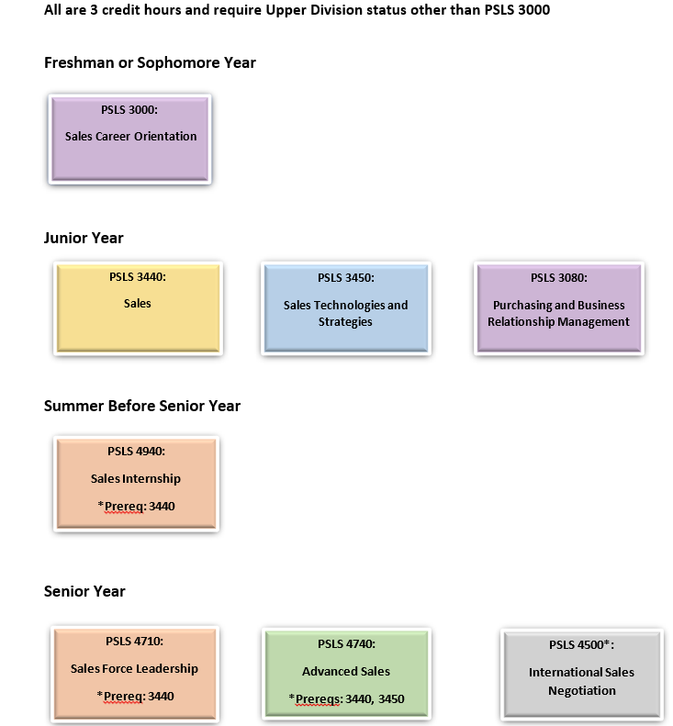
Curricula Overview
Degree Options
Learning Goals

Slide 21
Degree Options
Undergraduate
Graduate
Major
1 of 27 nationwide
Minor
Concentration
MBA Concentration (within Specialization)
UToledo ESSPS is 1 of 2 programs in the country to offer a major, minor, “other” undergraduate degree designation AND
a graduate degree designation

Slide 22
Learning Goals
Basic selling skills
Time and territory management
Advanced selling, problem solving, and planning
Salesforce leadership
Sales and purchasing strategy
Communication
Ethics
…Assurance of Learning

Slide 23
Assurance of Learning
 | LEARNING GOALS
BBA PSLS Program | 1 | 2 | 3 | 4 | 5 | 6 | 7
Assessment Methods
Description
Case Analysis |  | x | x | x | x | x | x
Writing Reports/Proposals | x | x | x | x | x | x
Decision Making projects | x | x | x | x | x | x | x
In-class experiential exercises | x | x | x | x | x | x | x
Team Work |  | x | x | x | x | x | x
Oral presentations | x | x | x | x | x | x | x
Simulations | x | x |  | x
News Analysis |  |  | x |  | x
Industry/Company/Product Analysis |  |  |  |  | x
Database (e.g., CRM) Analysis |  | x
Internet Research | x |  | x | x | x
Specialized Software |  | x | x
Guest Speakers | x | x | x | x | x | x | x
Exams/Quizzes-multiple choice |  | x |  | x
Exams/Quizzes-essay | x | x | x | x | x | x | x
Video Analysis | x |  |  | x | x | x
Field Work (interviews/data collection) | x | x | x | x |  | x

Slide 24
Corporate Coaching Sessions
30 minute, 1-1 coaching sessions each semester
Interact with sales talent that is still available for post-graduation employment
Provide relevant and valuable coaching feedback while also demonstrating a good coaching model
PSLS 3440 Sales (juniors)
PSLS 4710 Sales Force Leadership (seniors)
Diamond 4-6 students | Platinum 3-5 students | Gold 2-4 students | Recog Recruit Pending availability | A la Carte N/A

Slide 25
Class Interactions
Guaranteed invitation to speak, role play, do Q&A panel, etc in a sales class
All opportunities are schedules permitting
Put your company’s flavor on the current classroom topic
Diamond Pre-Release 2 sect/yr | Platinum 1st look 2 sect/yr | Gold 2nd look 1 sect/yr | Recog Recruit Pending availability | A la Carte N/A

Slide 26
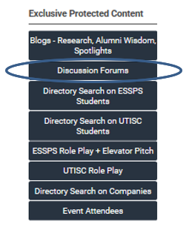
Discussion Forums
Gain insight and participate in guiding students’ professional development and skills
Diamond Yes | Platinum Yes | Gold Yes | Recog Recruit Yes | A la Carte N/A

Slide 27
Advisory Board
Meet 1-3 times a year to provide feedback and insight on alignment of ESSPS curricula, outreach, and research
Comprised of our business community partners, alumni, and students
Diamond 3 mtgs/yr | Platinum 3 mtgs/yr | Gold 3 mtgs/yr | Recog Recruit Sometimes | A la Carte N/A

Slide 28
Job Shadow List
Indicate interest in providing job shadow exposure to students
Appear in directory search performed by students
Diamond Yes | Platinum Yes | Gold Yes | Recog Recruit Yes | A la Carte N/A

Slide 29
Entry Sales Recruitment
Nation’s TOP + AVAILABLE sales talent
UToledo’s ESSPS talent
BOTH!
Preparing recruitment resources

Slide 30
Nation’s TOP + AVAILABLE Sales Talent
Student and Faculty Interaction
Pre-Screening
Student and Faculty Awareness

Slide 31
UTISC - Student and Faculty Interaction
Deep Immersion
Large Scale
Small Group
1-1
Online

Slide 32
UTISC – Deep Immersion
Role Play Scenario Based on Your Product/Service
Student Development (Skills and Insights)

Slide 33
UTISC – Large Scale Interaction
Keynote at Awards Reception
Entertainment Tickets
Award Reception Seats
Career Fair Table
Discussion Forums
Welcome Reception Seats
Faculty Reception Seats

Slide 34
UTISC – Small Group Interaction
UToledo Sales Competition Team Workshops
Student Development (Skills and Insights)

Slide 35
UTISC – 1-1 Interaction
UToledo Sales Competition Team Workshops
Coaching/Interviewing Sessions
Opportunity to Play Buyer

Slide 36
UTISC – Online Interaction
Role Play Scenario Based on Your Product/Service
Student Development (Skills and Insights)
Discussion Forum

Slide 37
UTISC - Role Play Scenario Based on Your Product/Service
Scenario Based on Your Product/Service
36 universities (and faculty), 100+ students
Sales Materials on/in UTISC Website and Showcase
Buyer in Finals
Product Yes | Rocket N/A | Glass N/A | Blue N/A | Intro N/A

Slide 38
UTISC – Keynote at Awards Reception
10 minute presentation
Inspirational, motivational
Share some corporate information
Product Yes | Rocket N/A | Glass N/A | Blue N/A | Intro N/A

Slide 39
UTISC – UToledo Sales Competition Team Workshops
1-2 workshops each semester
Train, coach, and role play
Product Yes | Rocket Yes | Glass N/A | Blue N/A | Intro N/A

Slide 40
UTISC – Student Development
Skills – Online
Selling or coaching content on UTISC website and/or UTISC Showcase
Insights – Onsite*
35 minute block to share career journeys and insights
Product Selling + Career* | Rocket Coaching (1st) + Career* | Glass Career* | Blue N/A | Intro N/A
*First 3 sponsors across those levels

Slide 41
UTISC – Entertainment Tickets
Socialize with the students and faculty
Draw, announce, and congratulate winners of the Career Fair raffle
First to know who makes it through to Semi Finals and be present to congratulate
Product 10 | Rocket 6 | Glass 4 | Blue N/A | Intro N/A

Slide 42
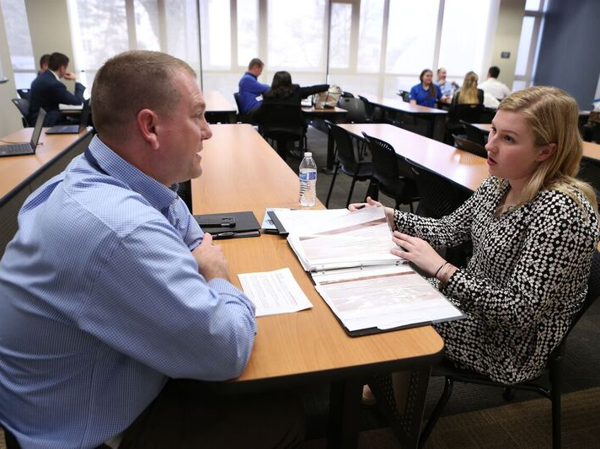
UTISC – Coaching/Interviewing Sessions
Coaching
Career
Role play prep and/or debrief
Interviewing
Internships and post graduation
1-1 session (or small group) with multiple pairings in the same room
Small groups are typically students from the same university
Competitors and Alternates and Peer Coaches (still available for post graduation hire)
All students regardless of their role and whether they advance or not in the competition
Product 3 blocks of Peer Coaches and/or Competitors | Rocket 3 blocks of Peer Coaches and/or Competitors | Glass 3 blocks of Competitors and/or Alternates | Blue Pending availability | Intro N/A

Slide 43
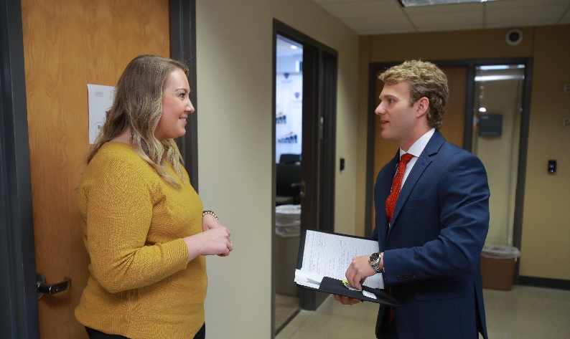
UTISC – Opportunity to Play Buyer
Buyers will interact directly with the competitors for their role play room
The buyer role and background information (story, social style, needs, objections, and acceptable closes) will be provided prior to the competition so the buyers can prepare (it is imperative that the buyer information be kept private)
Buyers will have a few minutes following each role play to talk with their student/seller in the hallway outside the role play room; precious time for feedback and networking
Both judges and buyers are expected to play their role for the duration of the round to ensure consistency and fairness
Product Yes | Rocket Yes | Glass Yes | Blue Yes | Intro N/A

Slide 44
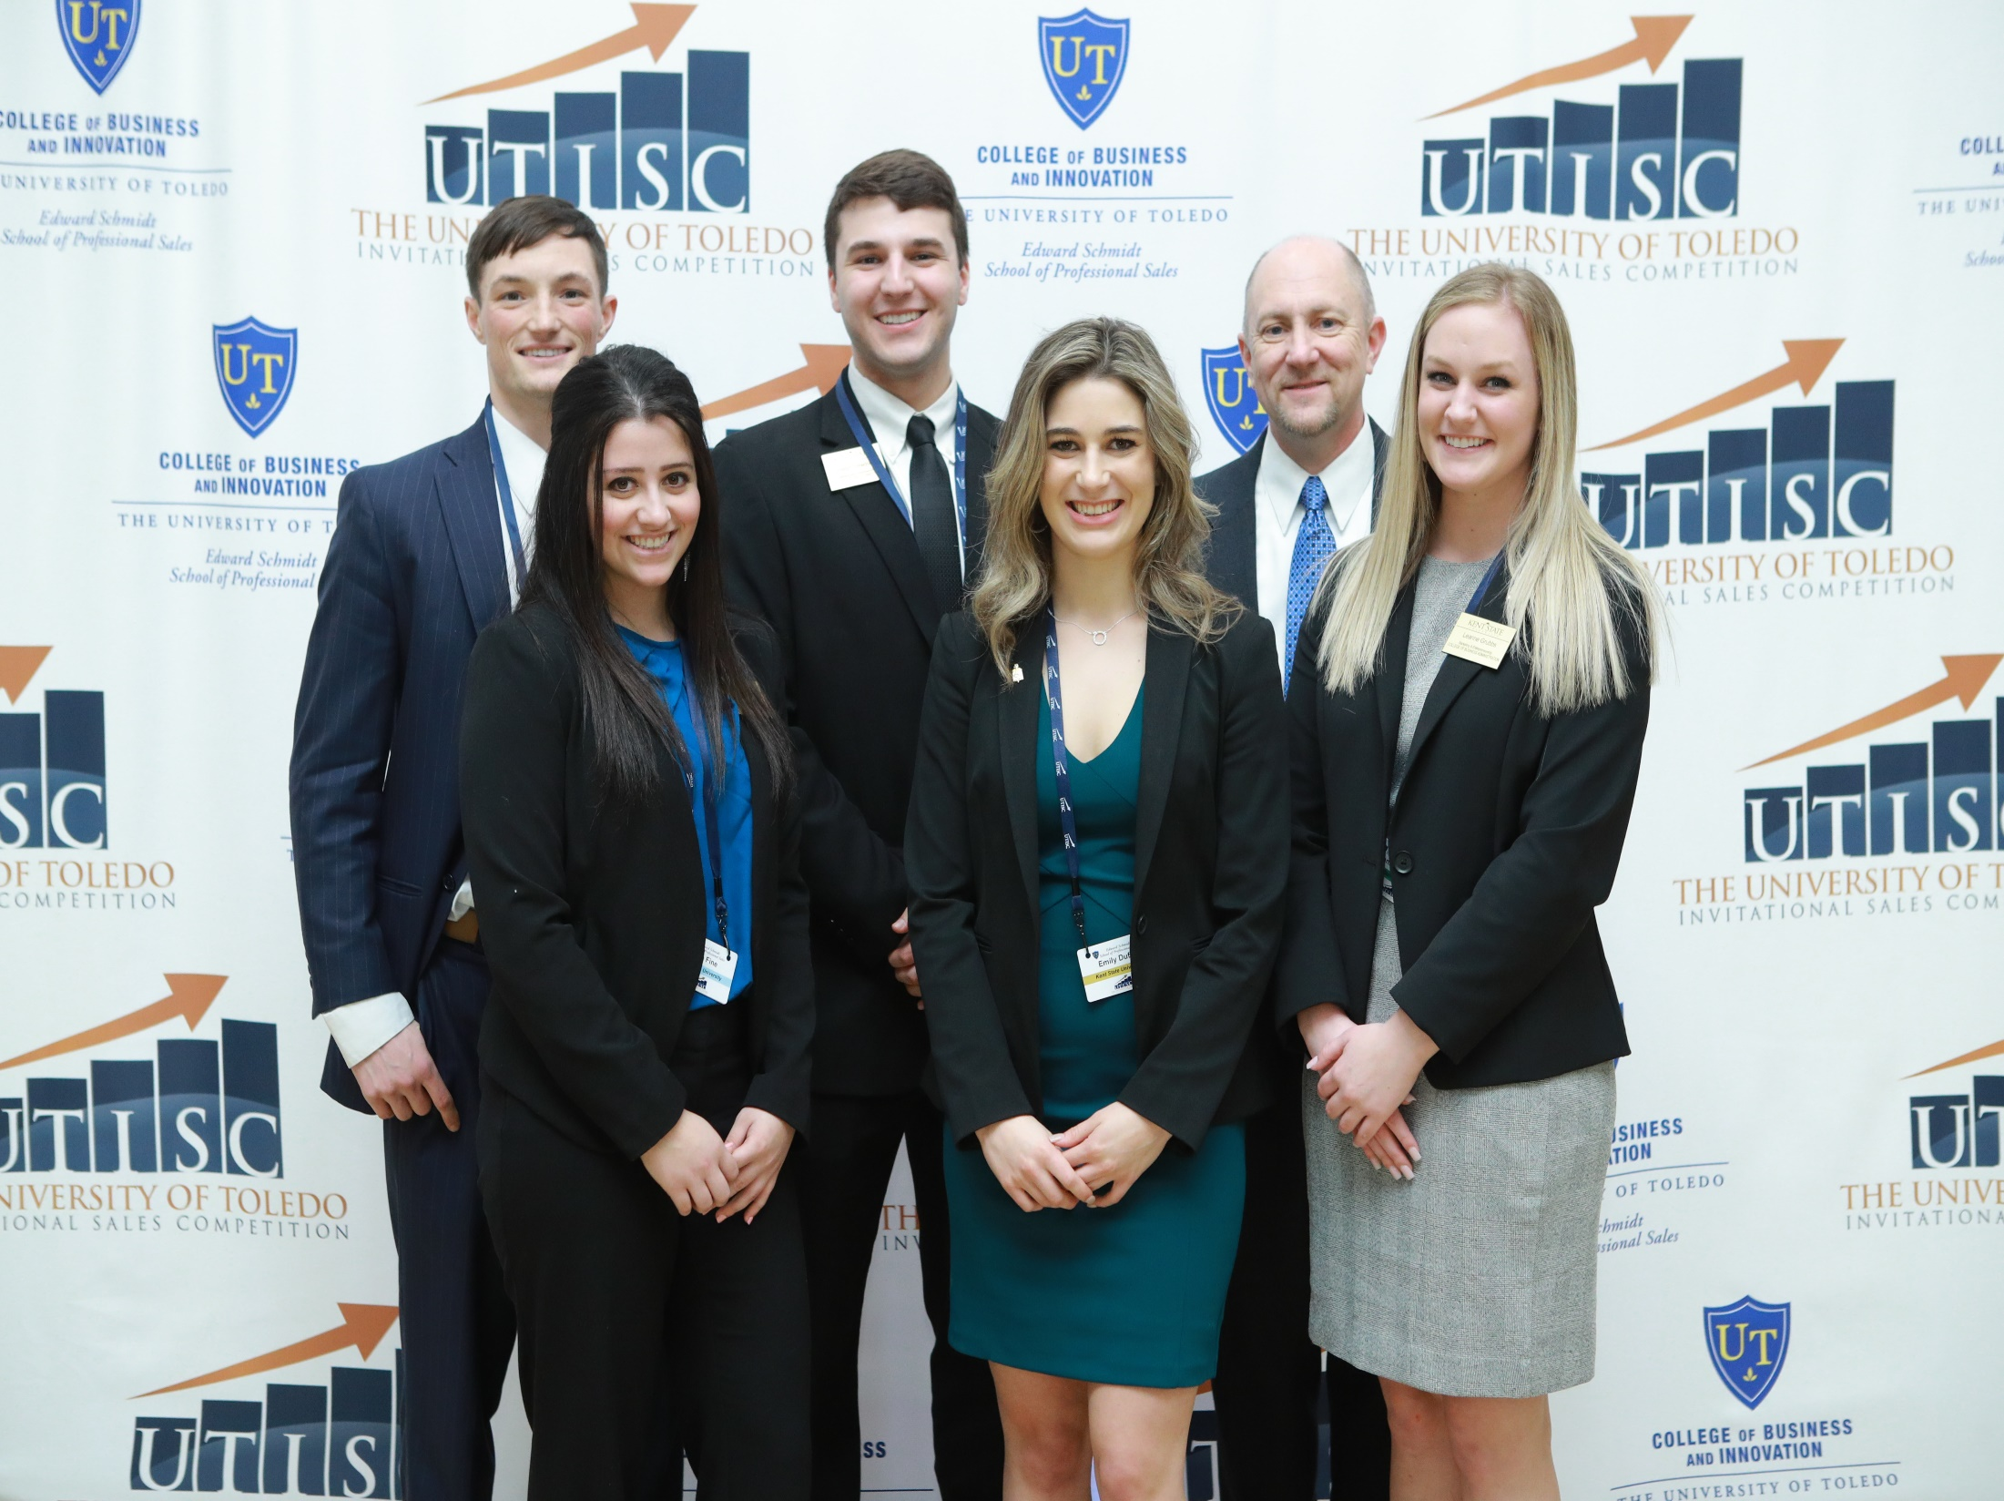
UTISC – Award Reception Seats
Luncheon at the end of the UTISC to announce placement of the Finalists, Semi-Finalists, and university teams
Product Unlimited | Rocket Unlimited | Glass 4 | Blue 2 | Intro N/A

Slide 45
UTISC – Career Fair Table
Takes place on Friday concurrent to Round 1
One skirted 6’ table and 2 chairs
Sponsors will be provided with tickets to pass out to students who actively engage them at the Career Fair. The tickets will be entered into a raffle drawing for the students to win prizes
Product Prominent | Rocket Prominent | Glass Yes | Blue Yes | Intro Yes

Slide 46
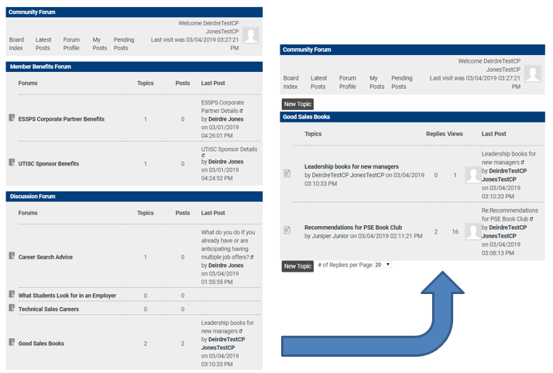
UTISC – Discussion Forums
Gain insight and participate in guiding students’ professional development and skills
Product Yes | Rocket Yes | Glass Yes | Blue Yes | Intro Yes

Slide 47
UTISC – Welcome Reception Seats
Enjoy networking and a warm meal with all of our UTISC guests to kick-off the event
Orientation sessions immediately follow the reception
Product Unlimited | Rocket Unlimited | Glass Unlimited | Blue Unlimited | Intro Unlimited

Slide 48
UTISC – Faculty Reception Seats
Faculty (university team coach) at tables to represent their university and share sales program information with interested UTISC sponsors
UTISC sponsors openly network to different university tables to learn more
Reception is held on the first day of the UTISC before the competition and career fair begin to provide dedicated interaction time for faculty and UTISC sponsors
Product Unlimited | Rocket Unlimited | Glass Unlimited | Blue Unlimited | Intro Unlimited

Slide 49
UTISC – Pre-Screening
Dedicated Interview Room
Role Play Channel, UTISC
Resumes on Competitors, Alternates, Peer Coaches, and ESSPS Workers
University Contacts Report
Observation Room Passes
Opportunity to Judge

Slide 50
UTISC – Dedicated Interview Room
Room in one of the UTISC buildings (likely Savage Business Complex)
Exclusively dedicated to applicable sponsors for the purpose of conducting interviews Ensures that the sponsor always has a private and quiet space to conduct interviews
One room per applicable sponsor
Product Yes | Rocket Yes | Glass N/A | Blue N/A | Intro N/A

Slide 51
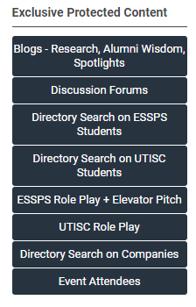
UTISC – Role Play Channel, UTISC
Online channel of all UTISC role plays for that competition sponsorship year
Access is guaranteed for at least 1 year
Product Yes | Rocket Yes | Glass Yes | Blue N/A | Intro N/A

Slide 52
UTISC – Resumes
Online, secure access to view and download resumes for competitors, alternates, peer coaches, and ESSPS workers
Access guaranteed for at least 1 year
Sent approximately 2 weeks in advance of the competition
Product Yes | Rocket Yes | Glass Yes | Blue Yes | Intro N/A

Slide 53
UTISC – University Contact Report
Names and contact information for all the attending university faculty and students
Available in the Memberclicks directory and in Dropbox approximately 2 weeks in advance of the competition
Product Yes | Rocket Yes | Glass Yes | Blue Yes | Intro N/A

Slide 54
UTISC – Observation Room Passes
Guests who are not able to commit to an entire role play round or coaching/interviewing session due to other obligations are welcome to observe for the time that they can
Product Unlimited | Rocket Unlimited | Glass 4 | Blue 2 | Intro N/A

Slide 55
UTISC – Opportunity to Judge
Provide feedback to the competitors as a judge using the UTISC evaluation sheets
Competitors will receive their evaluation sheets at the end of the competition
Both judges and buyers are expected to play their role for the duration of the round to ensure consistency and fairness
Product Yes | Rocket Yes | Glass Yes | Blue Yes | Intro Yes

Slide 56
UTISC – Student and Faculty Awareness
Logo in Social Media Photo Frame
Branding and Naming in Sales Room
Video in UTISC Showcase
Logo Visible in UTISC Showcase
Program Ad
Online Profile Visible to UTISC and ESSPS Students
Logo + Link on UTISC Website

Slide 57
UTISC – Logo in Social Media Photo Frame
Company logo incorporated into the frame/skin that is used on all the UTISC branded social media photos
Corporate logo will be added; image from earlier pilot
Product Yes | Rocket N/A | Glass N/A | Blue N/A | Intro N/A

Slide 58
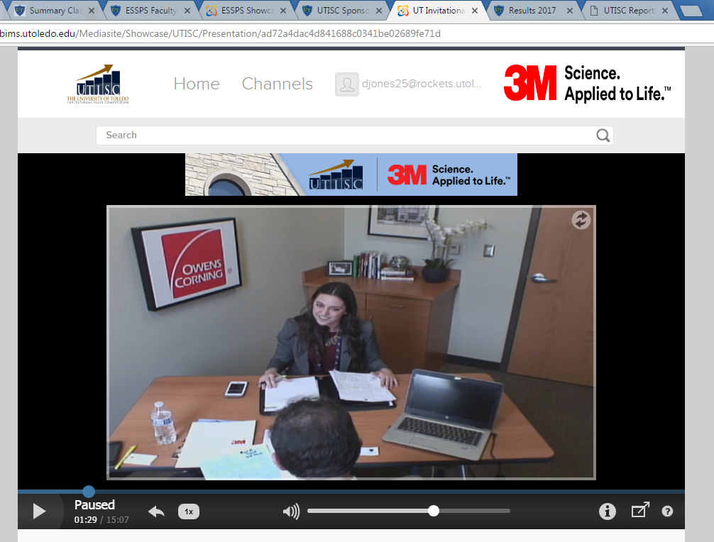
UTISC – Branding and Naming in Sales Room
Name on Door - Be seen by the UToledo sales students (approximately 200), prospective students/families, recruiters, and special guests when they are in the Huntington Sales Lab to role play, pitch, take make-up exams, tour, benchmark, etc
Interest Piece in Room - Wall decoration (approximately 3ft*3ft) that communicates the sponsor’s culture, achievements, opportunities, etc. Visible to all who enter the room and most or all who walk past in the hallway
Logo in Room - Sponsor also gets their logo on the wall (approximately 3ft*1ft) so it is visible in all role play video shots. Company logo will be seen in approximately 140 role play videos (approximately 600 views) over the course of 1 year.
Product Control Room | Rocket Role Play Room | Glass N/A | Blue N/A | Intro N/A

Slide 59
UTISC – Video in UTISC Showcase
Recruiting videos will appear in the UTISC Showcase in the Spotlight and/or Sponsor Videos Channel
Videos will be provided by the sponsors
Product Spotlight + Channel | Rocket Spotlight + Channel | Glass Channel | Blue N/A | Intro N/A

Slide 60
UTISC – Logo Visible in UTISC Showcase
Prominent placement of the sponsor’s logo in the UTISC Showcase in one or more of the following: header, player skin, role play video background, and footer
Embedded link to the sponsor’s career website is provided when linking is available
Role Play Video Background
In the case of Role Play Rooms, the company logo will be seen in approximately 140 role play videos (approximately 600 views) over the course of 1 year. Company logo will be placed on the wall in the background in as prominent a position as possible so that it is in the role play video shot (see shot adjacent). In the case of the Control Room, which is where all students check-in at, there will be a prominent sign as well.
Product Showcase header + video player | Rocket Background of all role play video shots | Glass Showcase footer | Blue N/A | Intro N/A

Slide 61
UTISC – Program Ad
Product Full page | Rocket Full page | Glass Half page | Blue N/A | Intro N/A

Slide 62
UTISC – Profiles in Memberclicks
Contact information
Job shadowing availability
Job descriptions
Career lattice
Sales development program
…and more in Memberclicks!
Product Yes | Rocket Yes | Glass Yes | Blue Yes | Intro Yes

Slide 63
UTISC – Logo + Link on UTISC Website
Product Yes | Rocket Yes | Glass Yes | Blue Yes | Intro Yes

Slide 64
Special Bundles with UTISC and ESSPS
UTISC Product includes ESSPS Platinum
UTISC Rocket includes ESSPS Platinum
UTISC Glass includes ESSPS Gold
ESSPS Diamond includes UTISC Blue
…explore national/UTISC and ESSPS talent further

Slide 65
UTISC Sponsorships
Product $35,000
Includes ESSPS Platinum
Rocket $25,000
Includes ESSPS Platinum
Glass $15,000
Includes ESSPS Gold
Blue $7,500
Introductory $4,000
First time, one time only

Slide 66
ESSPS Corporate Partnerships
Diamond $25,000/yr
Includes UTISC Blue
1-2 years with 2 year limit
Only 1-3 partners
Platinum $10,000/yr
3 year commitment
Gold $5,000/yr
3 year commitment
Recognized Recruiter $3,000/yr
1 year commitment
3 year limit

Slide 67
UToledo ESSPS Entry Sales Recruitment
Interact with Students and Faculty
Pre-Screening
Build Employer Brand Awareness
Collaboration with other UToledo groups (College of Business & Innovation, Pi Sigma Epsilon)

Slide 68
Interact with Students and Faculty
Deep Immersion
Large Scale
Small Group
1-1
Online
…check out our calendar to see important dates and to register

Slide 69
Deep Immersion
Internal Sales Competition (ISC) Product/Service Focus
Classroom Live Case

Slide 70
Large Scale Interaction
Internal Sales Competition (ISC)
Networking Night
Fete
Discussion Forums

Slide 71
Small Group Interaction
Exclusive Engagement
Lunch/Coffee NEW
Corporate Coaching Sessions
Class Speaking
Advisory Board

Slide 72
1-1 Interaction
Job Shadow List in Memberclicks
Lunch/Coffee NEW
Internal Sales Competition (ISC)

Slide 73
Online Interaction
Internal Sales Competition (ISC) Product/Service Focus
Discussion Forums

Slide 74
Internal Sales Competition (ISC) Product/Service Focus
Scenario Based on Your Product/Service
Sales Workshop
Buyer in Finals
Logo in Video Player
Logo in Social Media Photo
Diamond Yes, limit 1 | Platinum N/A | Gold N/A | Recog Recruit N/A | A la Carte N/A

Slide 75
Classroom Live Case
Project Based on Your Product/Service and Selling Environment
Coaching/Prep Workshop
Buyer for Role Plays or Judge for Presentation/Deliverable
Logo in Social Media Photo
Diamond Yes, limit 2 | Platinum N/A | Gold N/A | Recog Recruit N/A | A la Carte N/A

Slide 76
Exclusive Engagement
Breakfast, lunch, dinner, workshop, etc
Corporate Partner selects a date for a small group engagement that the ESSPS will host and organize
Special invitations will be extended to students based on interest and fit of the students and/or Corporate Partners
Diamond 2/yr | Platinum 1/yr | Gold N/A | Recog Recruit N/A | A la Carte N/A

Slide 77
Internal Sales Competition (ISC)
All day, 2 round tournament style sales competition
Top students compete or act as ambassadors to help run the event. All competitors are available for post graduation hire!
Upper Division approx 15-20
Lower Division approx 15-20
Access to resumes
Recruiters serve as judges, coaches, and buyers
Diamond 6 recruiters | Platinum 4 recruiters | Gold 2 recruiters | Recog Recruit 2 recruiters | Al Carte N/A

Slide 78
Networking Night
Business professional networking in the evening
Open networking
Table talks with conversation themes
Sit down, enjoy dinner buffet
Real career conversations with students
Diamond Table | Platinum Table | Gold Table | Recog Recruit Table | A la Carte $400

Slide 79
Fete
Business casual social interaction with students, alumni, and businesses
Live music
Dinner buffet
Diamond 6 recruiters | Platinum 4 recruiters | Gold 2 recruiters | Recog Recruit 2 recruiters | A la Carte $600

Slide 80
Pre-Screening
Internal Sales Competition (ISC)
Networking Night
Fete
Corporate Coaching Sessions
Role Play Channel

Slide 81
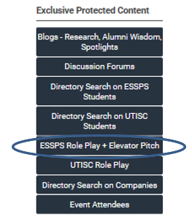
Role Play Channel
View student role plays to experience the quality, coachability, and growth
Students do 8-9 graded role plays before graduation and at least half are recorded
200 role plays each semester
Sales Competition Team (SCT) prep role plays
Diamond Yes | Platinum Yes | Gold Yes | Recog Recruit Yes | A la Carte $500

Slide 82
Build Employer Brand Awareness
Branding and Naming in Sales Room
Logo and Link on ESSPS Websites
Organization and Key Individual Profiles in the Memberclicks Directory
Recruiting Video in Spotlight, Channel, Memberclicks
Partner Feature in Memberclicks

Slide 83
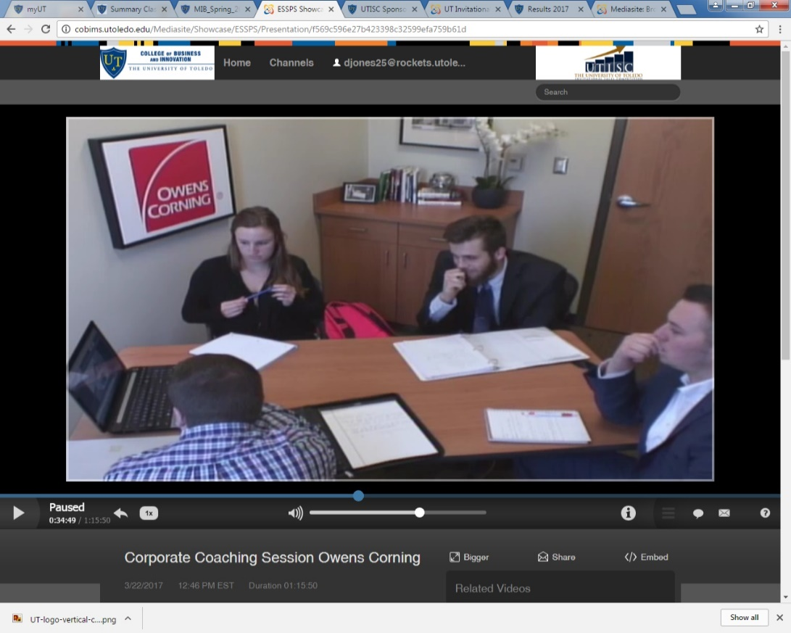
Branding and Naming in Sales Room
Name on Door - Be seen by the UToledo sales students (approximately 200), prospective students/families, recruiters, and special guests when they are in the ESSPS Suites to role play, pitch, take make-up exams, tour, benchmark, etc
Interest Piece in Room - Wall decoration (approximately 3ft*3ft) that communicates the partner’s culture, achievements, opportunities, etc. Visible to all who enter the room and most or all who walk past in the hallway
Logo in Room - Partner also gets their logo on the wall (approximately 3ft*1ft). Company logo will be seen in approximately 140 role play videos (approximately 600 views) over the course of 1 year.
Diamond Yes | Platinum N/A | Gold N/A | Recog Recruit N/A | A la Carte N/A

Slide 84
Logo and Link on ESSPS Websites
Diamond Top | Platinum High | Gold Middle | Recog Recruit Lower | A la Carte N/A

Slide 85
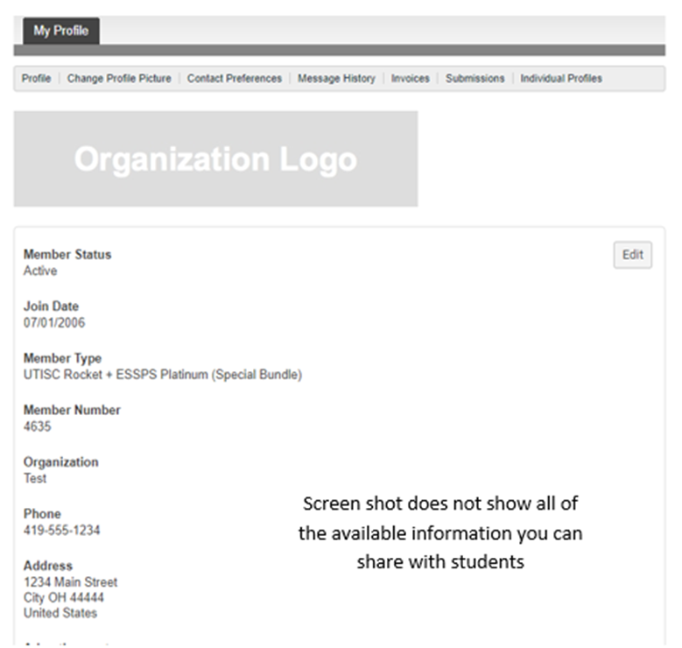
Profiles in Memberclicks
Contact information
Job shadowing availability
Job descriptions
Career lattice
Sales development program
…and more in Memberclicks!
Diamond Yes | Platinum Yes | Gold Yes | Recog Recruit Yes | A la Carte Temp, org, event only

Slide 86
Recruiting Video
Videos available 24*7*365 to promote employer brand exposure
Diamond Spotlight Fixt Channel Memberclicks | Platinum Spotlight Rota Channel Memberclicks | Gold Channel Memberclicks | Recog Recruit Channel Memberclicks | A la Carte N/A

Slide 87
Partner Feature
Picture and/or logo along with a brief interview of why the organization partners with ESSPS and what their sales career opportunities look like
Diamond # TBD | Platinum # TBD | Gold # TBD | Recog Recruit Pending availability | A la Carte N/A

Slide 88
Collaboration
COBI and Student Organization Event Notifications
COBI Job Fair
PSE Golf Outing
TOP and AVAILABLE sales talent in the nation

Slide 89
COBI and Student Organization Event Notifications
Personalized, extra follow-up for COBI and student organization recruitment events to make sure partners and sponsors are aware of relevant UToledo opportunities
Diamond Yes | Platinum Yes | Gold Yes | Recog Recruit Yes | A la Carte N/A

Slide 90
COBI Job Fair
Organized by Business Career Programs (BCP)
Fall and spring fairs
Open to all business majors
Diamond Reg Fee Incl | Platinum Via BCP, $200 | Gold Via BCP, $200 | Recog Recruit Via BCP, $200 | A la Carte Via BCP, $200

Slide 91
PSE Golf Outing
Organized by Pi Sigma Epsilon (PSE)
Typically held in the fall
Diamond 3 People Incl | Platinum Via PSE, $120/person | Gold Via PSE, $120/person | Recog Recruit Via PSE, $120/person | A la Carte Via PSE, $120/person

Slide 92
Preparing Recruitment Resources
Bring top people and recent graduates
People and cultural fit are #1 factor (Harvard Business Review)
Align recruitment approach with sales approach (collaborative, relationship)
Invest
Time
Talent
Treasure

Slide 93
Invest Time
Engage students via ESSPS, COBI, and student organizations
Deliver consistent presence each semester and year
Recognize freshmen, sophomores, and juniors
Offer an internship

Slide 94
Invest Talent
Coordinate with sales and HR
Involve frontline and leadership level team members
Bring alumni
Offer an internship

Slide 95
Invest Treasure
Participate a la carte or as a partner/sponsor
Offer an internship

Slide 96
Leadership Sales Talent
Development
Recruitment

Slide 97
Leadership Talent Development
General – concentration on sales leadership

Slide 98
General MBA
Marketing specialization with a concentration in sales leadership
Core MBA classes (24 hrs) – finance, marketing, management, supply chain, information technology, etc
Concentration (9 hrs)
MKTG 6240 Sales Force Leadership and Strategy
MKTG 6250 Global Sales and Strategic Customer Management
Elective options: MKTG 6980 Special Topics Sales for Social Impact or International Sales Negotiations, MKTG 6140 Customer Relationship Marketing, MKTG 6220 Integrated Marketing Communications

Slide 99
Leadership Sales Recruitment
Graduate students are included in all recruitment events/interactions
Graduate student attendance varies greatly due to many graduate students already having jobs

