Slide 1
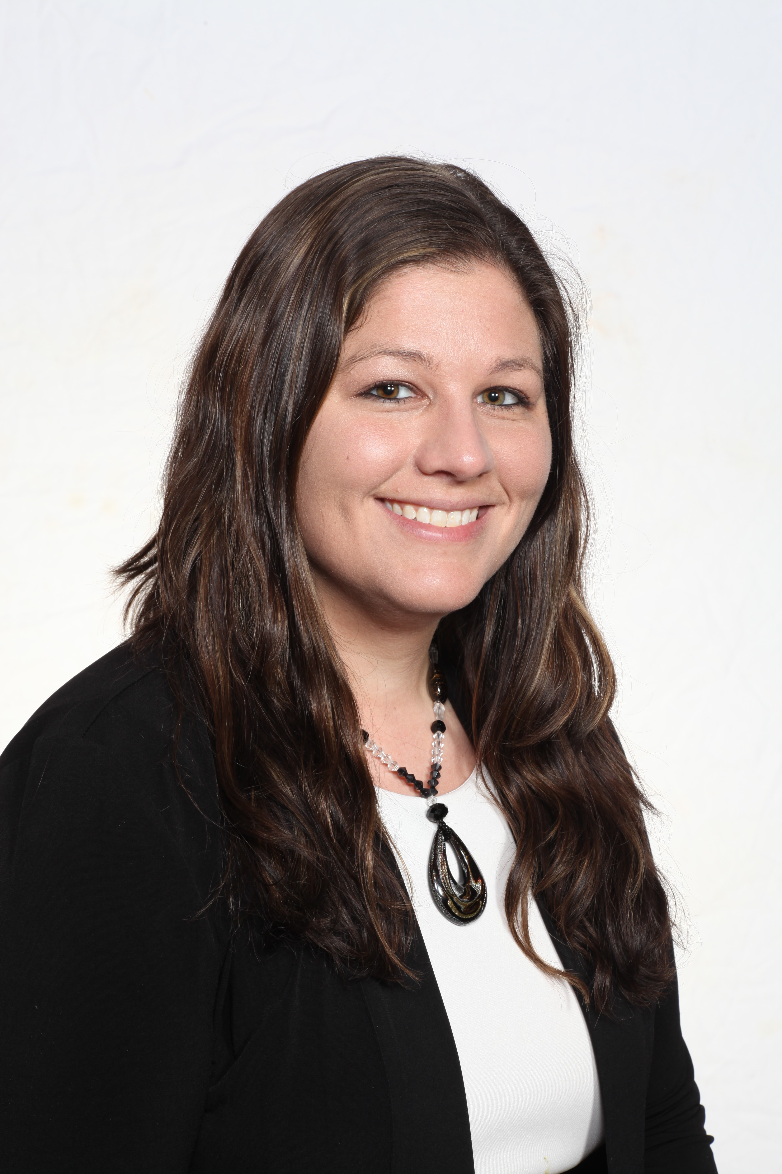
THE UNIVERSITY OF TOLEDO COLLEGE OF BUSINESS AND INNOVATION (COBI)
Graduate Programs
COMMENTARY BY:
Kelly Barger
Graduate Enrollment and Brand Manager
College of Business and Innovation

Slide 2
Why UToledo Graduate Programs?
Flexible, student-centered
Hands-on assistance with career placement (90%+ placement rate in their given field after graduation)
Extremely affordable and competitive tuition
One of only 5% of universities worldwide to earn the prestigious AACSB Accreditation

Slide 3
COBI Offers the Following Master’s Degree Options:
Master of Business Administration (MBA)
Master of Science Accountancy (MSA)
Master of Applied Business Analytics (MABA)
Master of Science in Business Analytics (MS)
Executive Master of Business Administration (EMBA)
Executive Master of Sales Leadership (EMSL)

Slide 4
Master of Business Administration (MBA)
Available in nine concentrations:
Program Details
Administration
Finance
Healthcare Systems Management: Public Health
Human Resource Management
Information Systems
International Business
Leadership
Marketing: Marketing Management or Professional Sales
Operations and Supply Chain Management
Flexible; classes available seated, online or in mixed format
Full-time and part-time options available
Can be completed in as few as 11 classes
In-state tuition is currently $562.21 per credit hour
FUELING TOMORROWS

Slide 5
Master of Business Administration (MBA)
Admissions Process
An undergraduate GPA of 2.7 or higher is preferred along with a 450 or higher GMAT score
Online application for graduate admission includes:
Non-Refundable Application fee ($45 Domestic; $75 International)
Typed Statement of Purpose
Official transcript from each collegiate institution attended other than The University of Toledo
Graduate Management Admission Test (GMAT) results GRE scores may be substituted. Test results must be from within the last 5 years. Official scores must be sent directly from the Educational Testing Service to the College of Graduate Studies.
GMAT waivers are available for those who qualify. Please contact Kelly Barger at Kelly.barger@utoledo.edu for more information.
A minimum of one letter of recommendation
In addition International Students will need to submit:
In the case of students whose native language is not English, a score of at least 550 (paper based), 213 (computer based), or 80 (internet based) on the Test of English as a Foreign Language (TOEFL) or a 6.5 on The International English Language Testing System (IELTS)
FUELING TOMORROWS

Slide 6
Master of Science Accountancy (MSA)
Available in the following concentrations:
Program Details
General
Auditing & IT
Financial Reporting and Finance
Strategic Managerial Accounting and Strategic Operations Management
The MSA Program is 30 credit hours and is available primarily seated with a few online course options
Students that do not have undergraduate coursework in accounting will be required to take several course in addition to the 30 credit hour program
Students may attend at the full-time or part-time pace
In-state tuition is $585.28 per credit hour
Placement rate after graduation is currently 100%
Program is designed specifically around Ohio CPA licensure requirements
FUELING TOMORROWS

Slide 7
Master of Science Accountancy (MSA)
Applicants are considered for admission on the following criteria
A 3.0 undergraduate GPA on a 4.0 scale, and if accounting major, student must have 3.0 GPA in major
A minimum score of 500 on the Graduate Management Admissions Test (GMAT) with a minimum score of 20 in both the verbal and quantitative sections
Passed the CPA/CMA exam within the last five years, or active CPA/CMA*
*Passing the CPA/ CMA is not an admissions requirement but it would be considered during the admissions process if an applicant had already passed either exam.
FUELING TOMORROWS

Slide 8
Master of Science Accountancy (MSA)
Application Process
Online application for graduate admission includes:
Non-Refundable Application fee ($45 Domestic; $75 International)
Official transcript from each collegiate institution attended other than The University of Toledo.
Graduate Management Admission Test (GMAT) results GRE scores may be substituted. Test results must be from within the last 5 years. Official scores must be sent directly from the Educational Testing Service to the College of Graduate Studies. GMAT waivers are available for those who qualify. Please contact Kelly Barger at Kelly.barger@utoledo.edu for more information
Most recent resume or curriculum vitae including contact information for two references (name, title, place of employment, phone number and e-mail address)
In addition International Students will need to submit:
In the case of students whose native language is not English, a score of at least 550 (paper based), 213 (computer based), or 80 (internet based) on the Test of English as a Foreign Language (TOEFL) or a 6.5 on The International English Language Testing System (IELTS)
FUELING TOMORROWS

Slide 9
Master of Applied Business Analytics (MABA) Master of Science in Business Analytics (MS)
Applied Business Analytics is available in both thesis (MS, Business Analytics) and non-thesis (MABA) options.
Both 30 credit hour programs. They can be completed in one year of full-time study or two years of part-time study
In-state tuition is $585.28 per credit hour
Assistance with career placement is available to current students and alumni
Emphasizes marrying one applied business discipline with business analytics
For non-business undergraduates, up to four business pre-requisites may be needed

Slide 10
Master of Applied Business Analytics (MABA) Master of Science in Business Analytics (MS)
For admission to the MS/MABA in Applied Business Analytics Program, you must possess:
A minimum of 2.8 undergraduate GPA on a 4.0 scale
A score of 480 on the Graduate Management Admissions Test (GMAT) with a minimum score of 25 in verbal and 28 in quantitative sections

Slide 11
Master of Applied Business Analytics (MABA) Master of Science in Business Analytics (MS)
Application Process
Online application for graduate admission includes:
Non-refundable application fee ($45 domestic; $75 International)
Typed Statement of Purpose
Official transcript from each collegiate institution attended other than The University of Toledo
Graduate Management Admission Test (GMAT) results or GRE test results. Test results must be from within the last 5 years. Official scores must be sent directly from the Educational Testing Service to the College of Graduate Studies
Exceptionally qualified applicants are those who meet at least one of the following criteria:
Very high Undergraduate GPA
Recent graduates (3 years or less) with high GPA
Possess significant, relevant work experience (deemed acceptable by the Program Chair)

Slide 12
APPLICATION DEADLINES
DOMESTIC STUDENTS
Fall Semester: August 1
Spring Semester: November 15
Summer Semester: April 15
INTERNATIONAL STUDENTS
Fall Semester: May 1
Spring Semester: October 1
*Summer start is not currently recommended for international students outside of the U.S. because of travel restrictions due to COVID-19

Slide 13
Executive Master of Sales Leadership (EMSL)
Program Details
100% online
No GMAT or GRE required
Fast track development for your emerging and current sales leaders
Strategic refinement of your senior sales professionals
Bottom-line results with improved sales team performance and retention
Special attention and consulting from academic experts on the project your organization chooses for the independent study

Slide 14
Executive Master of Sales Leadership (EMSL)
Program Details
Complete and submit the Executive Programs Application and attach/upload the following documents:
Professional Resume
Statement of Purpose (explain why you wish to enroll in this program)
3 Letters of recommendation from individuals familiar with your professional experience
Official transcripts from all institutions attended (UToledo transcripts do not need to be requested)
Admissions interview; can be completed on the phone, virtually or in person.

Slide 15
Executive Master of Business Administration (EMBA)
Program Details
Requires 3-5 years of managerial/ supervisory work experience
Undergraduate degrees of all areas welcome
38 credit hour intensive one year program
Cohort based with heavy group work; meets on campus one Friday and Saturday a month from 8:00am - 5:00 pm
Includes International study trip
Tuition includes books, fees, food when on campus and many fees associated with the international trip
Starts once a year in October with orientation in September
No standardized testing required
Includes Executive Coaching; current students and alumni receive assistance with career placement

Slide 16
Executive Master of Business Administration (EMBA)
Admissions Process
Submit Executive Programs Application Online
Submit detailed resume
Two letters of recommendation and Employer nomination form OR submit three letters of recommendation
Official transcripts from all institutions attended (UToledo transcripts do not need to be requested).
Statement of Purpose that discusses what you hope to gain from the program as well as what others in the class will learn from you
Admissions interview; can be completed over the phone, virtually or in person
Admissions is determined primarily by work experience and the admissions interview.
All applications should be submitted by July 1st to provide students with time to complete EMBA 5500. Students may begin working on this class as soon as they are admitted and their seat deposit is paid

Slide 17
Master of Business Administration (MBA) Master of Science Accountancy (MSA) Master of Applied Business Analytics (MABA) Master of Science in Business Analytics (MS) Executive Master of Business Administration (EMBA) Executive Master of Sales Leadership (EMSL)
Graduate Programs Available:

Slide 18
THANK YOU
If you have questions regarding any of our College of Business and Innovation graduate programs or wish to set up an appointment, please contact: Kelly Barger at Kelly.barger@utoledo.edu

