Slide 1
UT Task Force Health Science Team
Akira Takashima, M.D., Ph.D.
The University of Toledo College of Medicine
Specific Health Concerns
Microcystin Toxicity
Microbiological Solutions

Slide 2
Expertise & Team Members
Clinical Medicine
Chris Cooper, M.D. (Dean, College of Medicine)
Thomas Sodeman, M.D. (Department of Medicine)
Bob Mrak, M.D. (Department of Pathology)
Ken Hensley, Ph.D. (Department of Pathology)
Public Health & Biosafety
Sheryl Milz, Ph.D. (Department of Public Health)
Mike Valigosky, Ph.D. (Department of Public Health)
April Ames, Ph.D. (Department of Public Health)
Microbiology & Molecular Biology
Isabel Novella, Ph.D. (Department of Micro & Immunol)
Jason Huntley, Ph.D. (Department of Micro & Immunol)
George Bullerjahn, Ph.D. (BGSU)
Mike McKay, Ph.D. (BGSU)

Slide 3
Specific Resources
Clinical Samples & Information
blood, urine, biopsy & autopsy samples, clinical tests & information
Analytical Chemistry
UT-Shimadzu Mass Spec Center
Assay Development
intravital imaging, flow cytometry, mAb/aptamer production, HTP tests
Infrastructures for Translational Research
Jacobson Center for Clinical & Translational Research (JCCTR)
Center for Biomarker Research & Individualized Medicine (BRIM Center)
Department of Laboratory Animal Resources (DLAR)
Interprofessional Immersive Simulation Center (IISC)

Slide 4
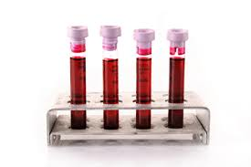
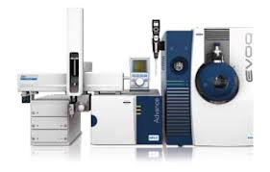
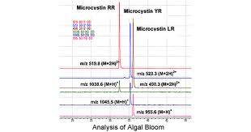
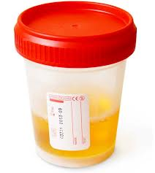
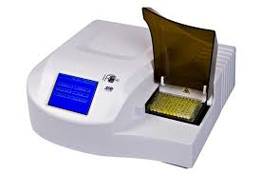
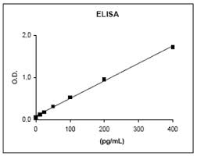
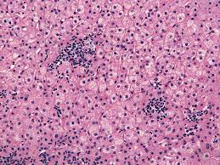
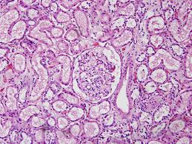
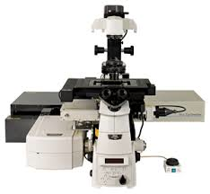
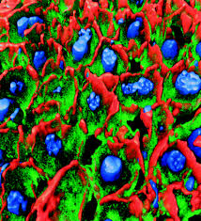
Measurement of Microcystins in Biological Samples
>50 variants
Mass Spec
ELISA
Imaging

Slide 5
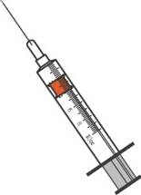
Toxicity in Individuals with Preexisting Liver Disease
Healthy mice
Mice with fatty liver
IP injection of microcystin
(large dose)
Microcystin in drinking water
(small dose)
12-72 hours
3-12 months
Lethality
Acute toxicity
Chronic toxicity
Comprehensive pathology
Pharmacokinetics
Motile and cognitive performance

Slide 6
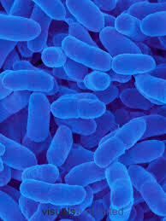
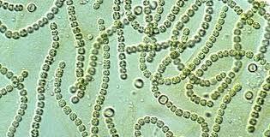
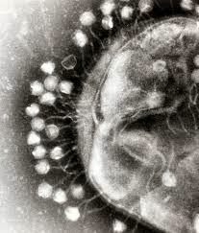
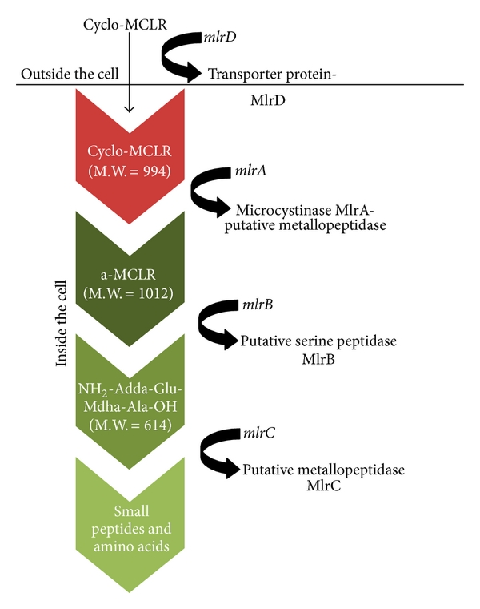
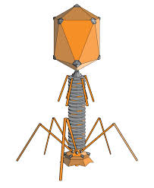
Microbiological Solutions: Use of Natural Enemies
Cyanobacteria
Sphingomonas
Microcystin
Degradation
Bacteriophage
Selective killing

Slide 7
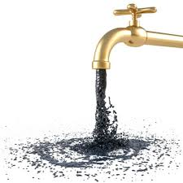
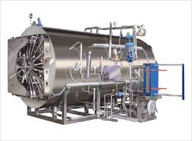
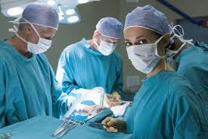
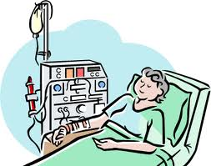
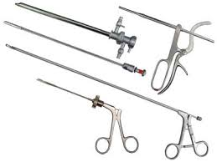
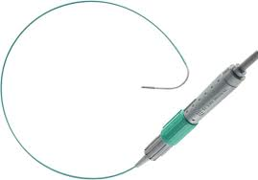
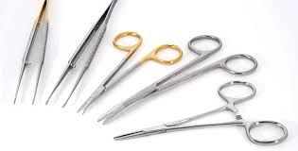
Laboratory Size Treatment of Hospital Water
Activated charcoal filter
Nanofiltration systems
Synthetic filter with Sphingomonas biofilm
Recombinant enzymes to degrade microcystin
Enzyme pills
Microcystin
Degradation
Operation
Dialysis
Sterilization

