Slide 1



Land Use & Water Quality Committee
UT: Ricky Becker, Tom Bridgeman, Kevin Czajkowski, Daryl Dwyer, Kevin Egan, Hans Gottgens,
Patrick Lawrence, Carol Stepien (chair), Von Sigler
ARS: Charles Krause
BGSU: Anita Simic

Slide 2
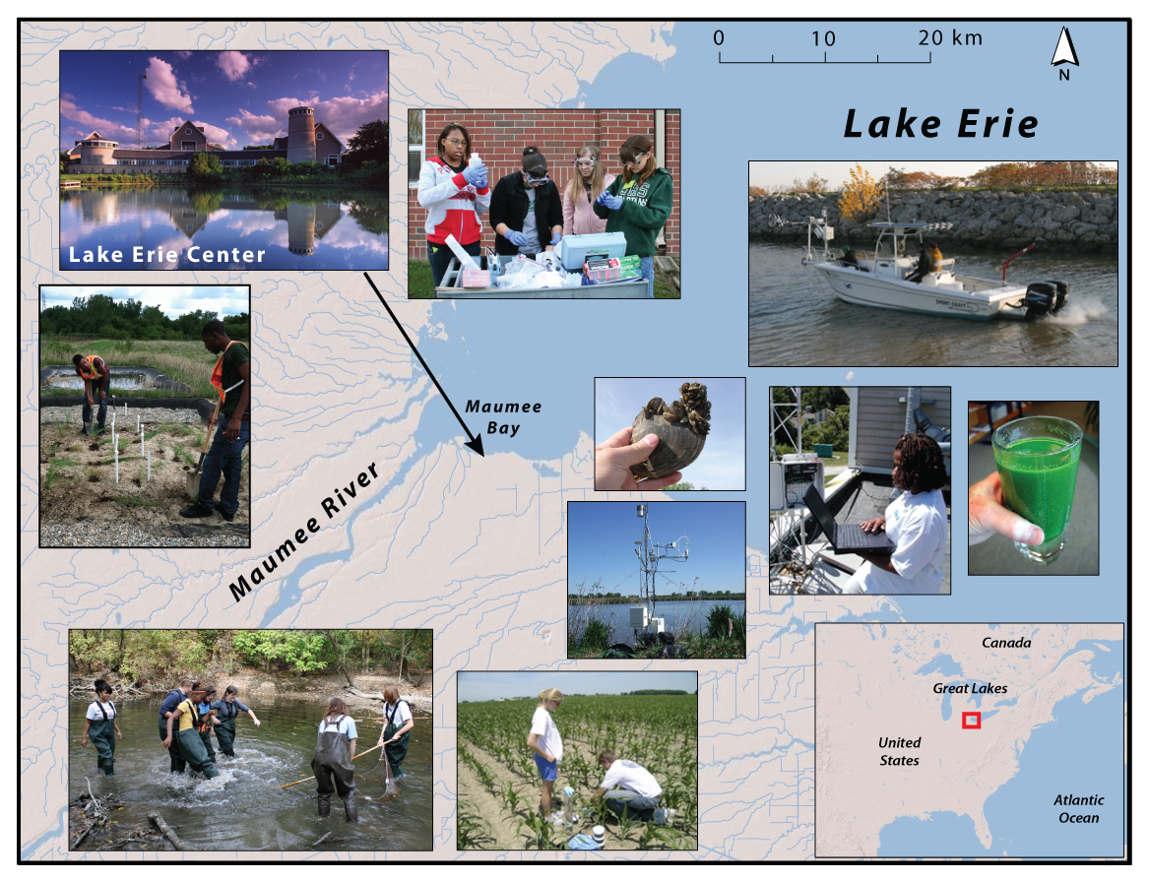
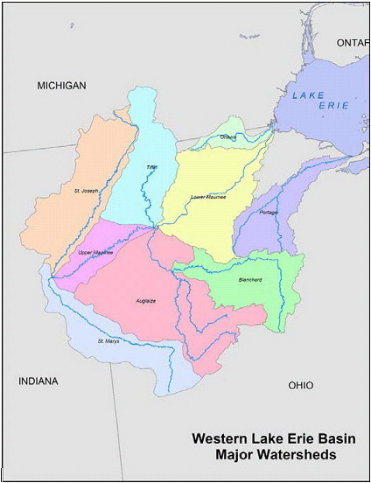
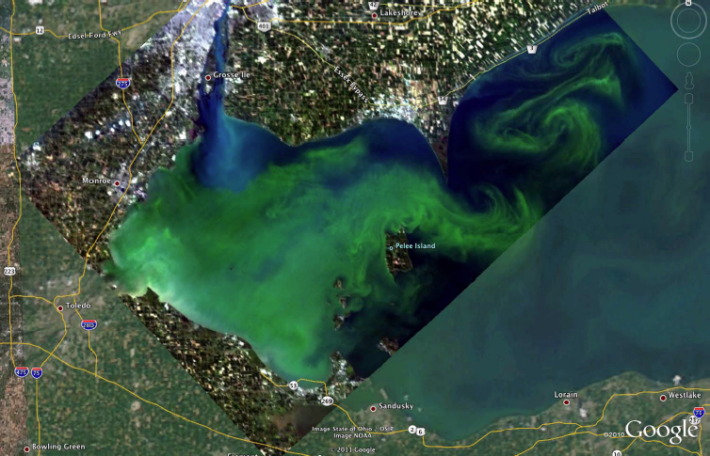
Challenge: Linkage of Land Use, Water Quality & Ecosystem Services

Slide 3
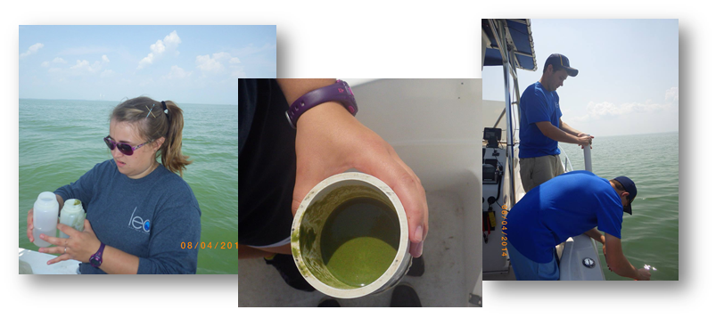
Project 1:
Establishment of NEW Water Quality, Nutrient & HAB Testing Lab at the Lake Erie Center
Water quality, nutrients, HABS & toxins
Process research project samples & Toledo & Oregon water treatment plants
  Improve methodology, standardization, fast diagnosis & response
  Rapidly assess samples- farm edges, tile systems, ditches, creeks, streams, shorelines
Citizen Science water testing program
Schoolyard stream testing program
On-line public-access website wi/ GIS data mapping & synchronization

Slide 4
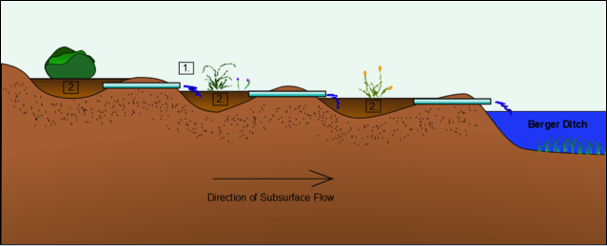
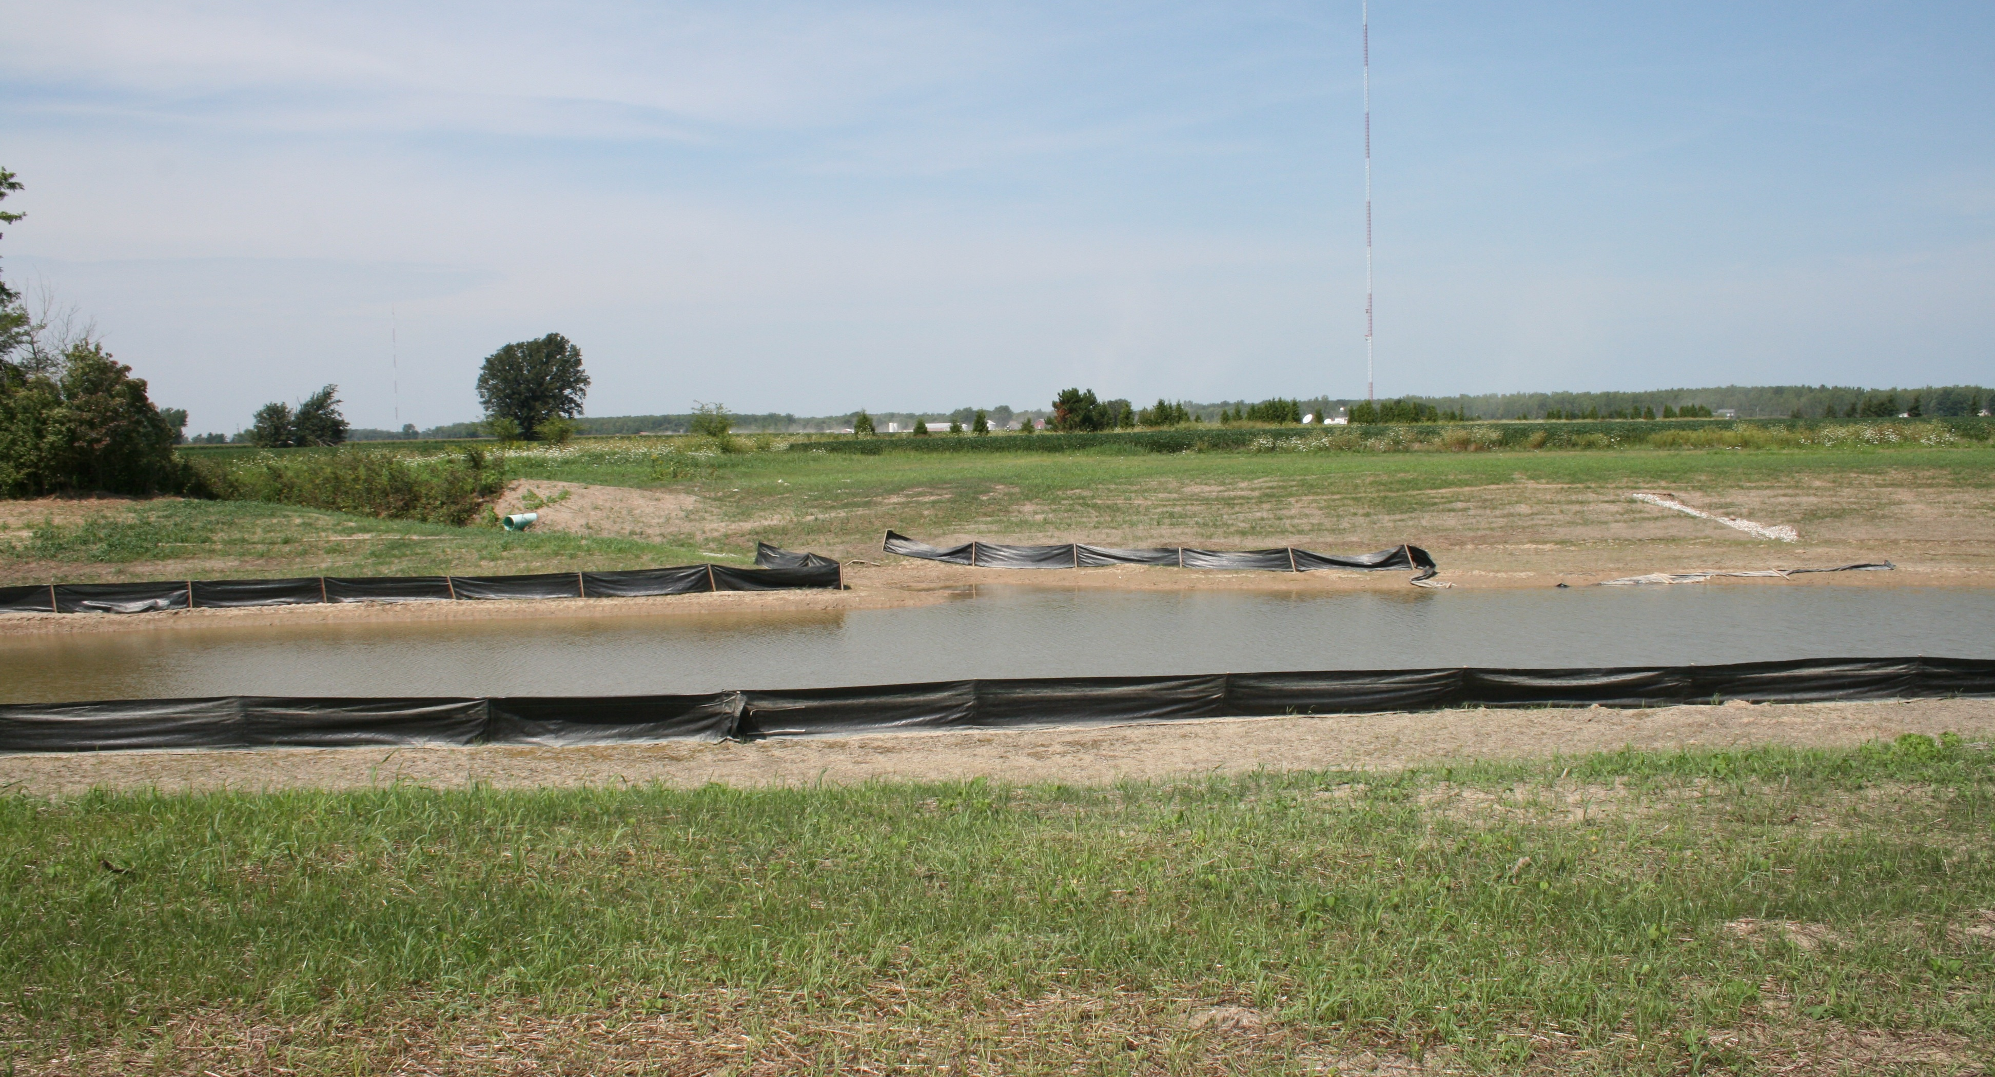
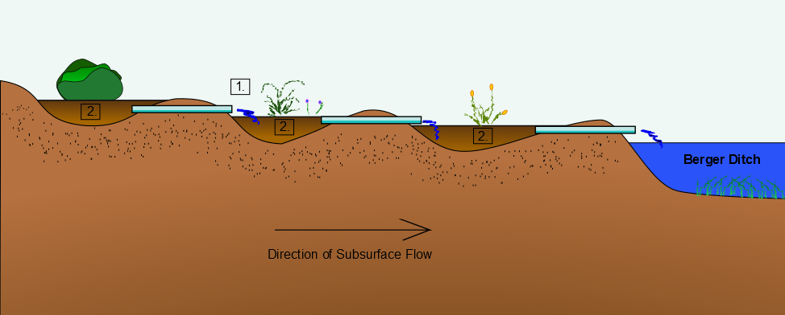
Project 2:
Implement innovative wetland designs to improve water quality
Restore ecosystem services via natural wetland processes
Pinpoint key locations to alleviate phosphorous, bacteria, sedimentation
(1) Sediment Collector, (2) Wetland System & (3) Nutrient Interceptor
Current Wolf Creek Results (Dwyer USEPA GLRI project
  50% reduction in suspended sediment
  75% reduction in dissolved phosphorous
Test samples in new LEC lab
On-line public-access website w/ GIS data mapping & synchronization

Slide 5

Integration & Output Plans
Today: Student research posters at LAMP conference MBSP
Sigma Xi Scientific Society Science Café: A Science take on the Toledo Water Crisis- Tues. Oct. 28 5 pm
HABs and the 2014 Toledo Drinking Water Crisis Session at IAGLR (International Association for Great Lakes Research) 2015 Conference May 2015
US EPA Great Lakes Program Office 2015 Great Lakes Area of Concern Conference March 10-11 at UT
13th annual Great Lakes Water Conference on Friday, Nov. 7 at the University of Toledo College of Law.

Slide 6





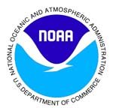







Established Network of Community Partners & Agency Collaborators
American Rivers
Toledo-Lucas County Rain Garden Initiative
Western Lake Erie Waterkeepers
Partners for Clean Streams
Maumee Area of Concern TMACOG Environmental Council
Stormwater Coalition
Western Lake Erie Partnership
Sierra Club
Maumee River Basin Partnership of Local Governments (MRBPLG)
Toledo MetroParks
Black Swamp Conservancy
Ottawa National Wildlife Refuge
Ducks Unlimited
The Nature Conservancy
Duck and Otter Creek Partnership
Maumee Scenic River
Great Lakes Fishery Commission
Great Lakes Commission
USDA ARS
USGS
USFWS
USEPA
NOAA GLERL
NOAA Sea Grant
Ohio DNR
Ohio EPA
Ohio Sea Grant
Ohio Lake Erie Commisssion
Michigan DNR

