Slide 1
Water Treatment, Water Infrastructure, Water Testing, Detection and Monitoring
Isabel C. Escobar, Chemical & Environmental Engineering
April Ames, Public Health & Prevent Medicine
Defne Apul, Civil Engineering
Thomas Bridgeman, Environmental Sciences
Daryl Dwyer, Environmental Sciences
Cyndee Gruden, Civil Engineering
Charles Lehnert, Corporate Relations
Michael Valigosky, Public Health & Prevent Medicine

Slide 2
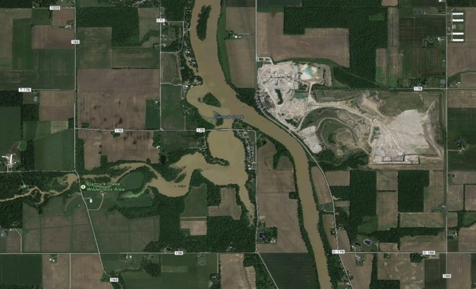
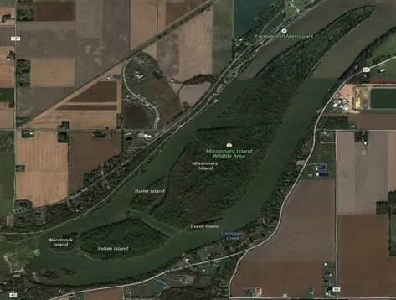
Sedimentation ponds to improve water quality:
Daryl Dwyer
Sedimentation Pond – For preliminary results after 2 months, estimations of the overall improvements in water quality on an annual basis = 10 tons (50 %) of phosphorus prevented from entering Lake Erie and 75 % of E. coli in Wolfe Creek prevented from entering beach waters
If scaled to Maumee River watershed this could prevent 1,000 tons (~50 % reduction) of phosphorus from entering Lake Erie which exceeds the target value of 37 % (Phosphorus Task Force II – Final Report)
For this to be effective in the Maumee River watershed we must implement sedimentation ponds in a variety of locations throughout the watershed
Possible Locations for Future Implementation
Flatrock Creek, Auglaize, OH
Missionary Island, Waterville, OH
**Chokepoints

Slide 3
Current Water Treatment Techniques
Must use several methods in conjunction to eliminate both cells and toxins
    Coagulation/flocculation/sedimentation are not enough
    Activated carbon
    Final treatment with chlorination
Pretreatment with an oxidant will kill the algae and release T&O compounds
    The algae and T&O compounds can increase DBP production

Slide 4
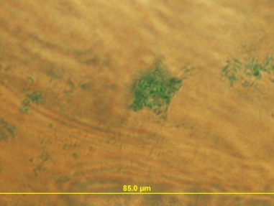
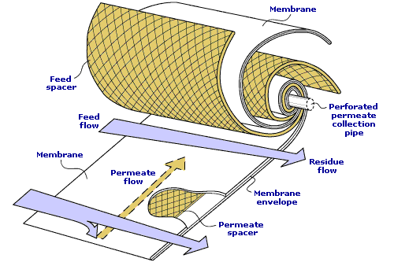
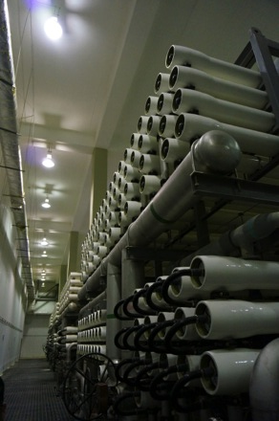
Polishing Water Treatment:
Isabel Escobar
The application of activated carbon is one of the most efficient measure for dissolved toxin removal
Oxidation & disinfection:
  Assessment of the influence of water quality parameters (DOC, alkalinity, pH, temperature, ammonia) on toxin oxidation
  Need biofiltration to follow
Membrane filtration efficiency (ultrafiltration, nanofiltration, reversed osmosis):
  Limited information available
Algal exopolymer particles (TEP) on a membrane surface

Slide 5
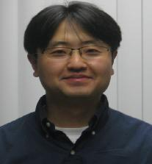
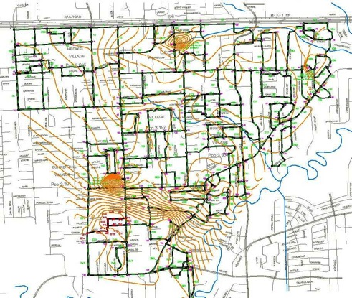
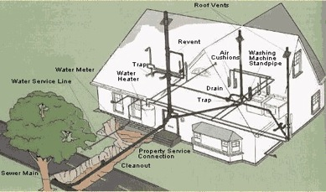
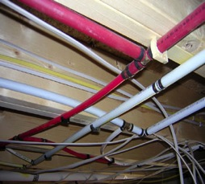
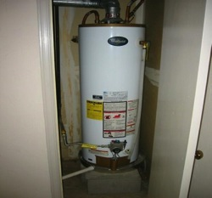
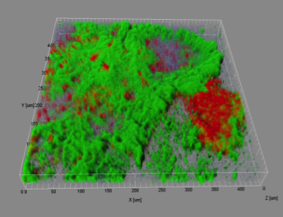
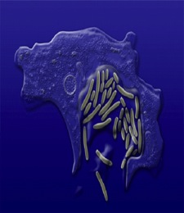
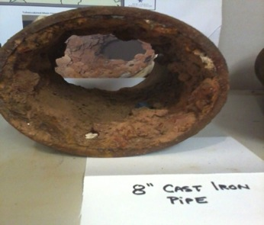
Transport and Fate of Cyanotoxins in Aged Drinking Water Distribution Systems and Building Water Systems
Youngwoo Seo
Scopes
Understand interaction (accumulation and degradation) of cyanotoxins with pipe surface
Develop removal methods at the treatment plant or at local water distribution points
Develop decontamination protocols with hydraulic and water quality modeling
Scaling and bacterial biofilm formation on a corroded pipe
Accumulation and potential degradation of cyanotoxinx

Slide 6
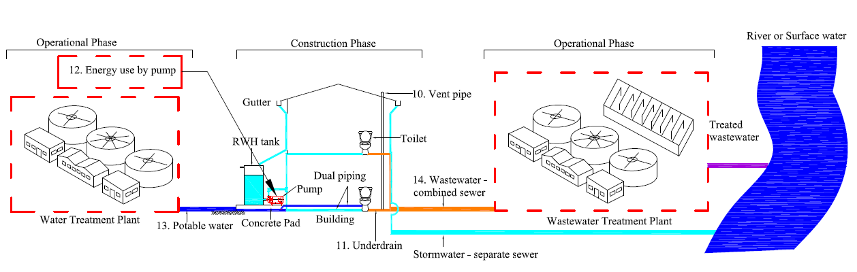
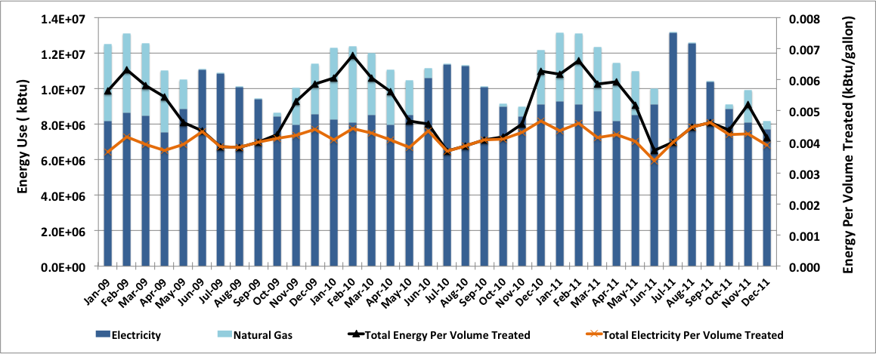
Rain Harvesting Systems:
Defne Apul
Notes:
Dr Apul is interested in rainwater harvesting systems(rwhs). Rwhs provide an alternative water source to municipally supplied water. RWHS can also reduce the stormwater runoff and help our wastewater and stormwater infrastructure. The figure shows how RWHS is connected to both wtp and wwtp when rainwater is used in toilet flushing.
Dr. Apul is also interested in analyzing energy, greenhouse gas and other environmental impacts (e.g. eutrophication) of wtp and wwtps. Below figure is an example data for our local water treatment plant that shows how much energy is being used at the plant.

Slide 7
Detection in Water Samples:
Joseph Lawrence, Isabel Escobar
ELISA (Enzyme-Linked ImmunoSorbent Assay) specific immunological assay based on the reaction of all microcystins with antibodies.
  Interferences, such as calcium
HPLC (High Performance Liquid Chromatography) separates individual microcystin variables by their absorption spectrogram in a photodiode array detector.
  Interferences, such as humics in surface water

