Slide 1
Promotion & Tenure Workshop
Wafaa Hanna, M.B.A., Director
Office of Faculty Affairs and Development
Dinkar Kaw, M.D., Chair of the COMLS APT Committee
Stanislaw Stepkowski, Ph.D., Vice Chair
March 2025

Slide 2
Appointment, Promotion, & Tenure Process Overview
All recommendations for promotion to/appointment at the rank of Associate Professor or Professor are reviewed by the COMLS APT Committee and require approval by the Dean and the Provost. This applies to UToledo COMLS Salaried Faculty, ProMedica Practitioners, and Community-Based Practitioners
Rules for faculty appointment and promotion are determined by the College of Medicine & Life Sciences Bylaws (Faculty Rules and Regulations) document:
https://www.utoledo.edu/depts/facaffairs/medicine/pdf/Final.FacultyRulesandRegs12.14.20.pdf
Only one cycle for promotion and tenure dossier review, as outlined in the UToledo Academic Personnel Calendar, but ongoing/revolving reviews for new hires
Applications of active UToledo COMLS salaried faculty are submitted through “Faculty 180” (myUT)
ProMedica- and Community-based faculty do not use Faculty 180 – hard copies of dossier required

Slide 3
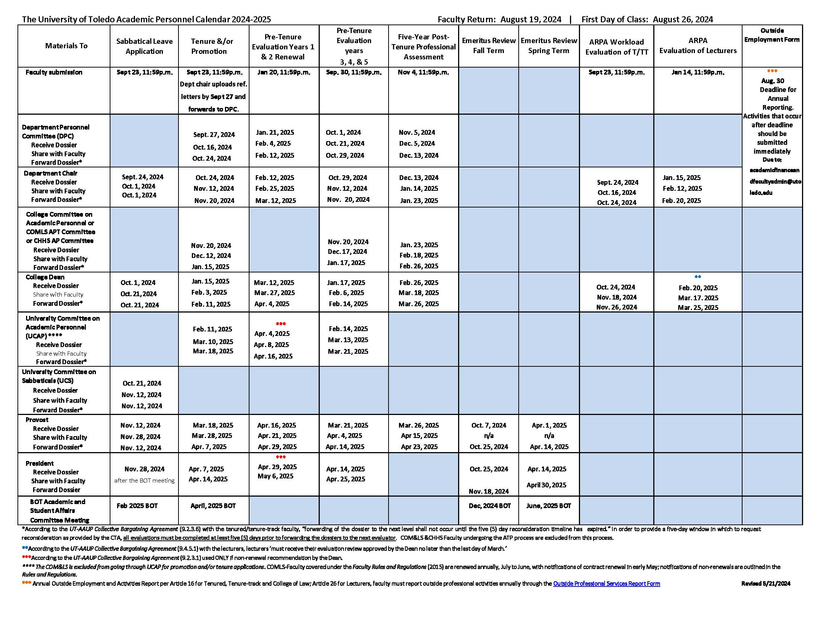

Slide 4
Completed applications are reviewed in the following order:
Departmental APT Committee (dAPT)
Department Chair
College APT Committee
College Dean
Provost
President and BOT

Slide 5
Departmental APT (dAPT) Review
(before review starts, Chair solicits recommendation letters and uploads them to Faculty180, checks letters and dossier for completeness)
dAPT is the start of the review process each fall
The completed dossier (in Faculty 180 for the UToledo Salaried Faculty; in paper format for PPG and Community-Based/Volunteer Faculty) is reviewed by the dAPT committee
dAPT recommendation, with detailed summary letter, is made to the Chair (uploaded into Faculty180)

Slide 6
Chair’s Review
Second step in the review process
Chair assesses the dossier and considers the dAPT recommendation
Chair writes a ‘Chair’s letter’ which makes a recommendation to the COMLS APT Committee and Dean (uploaded into Faculty 180)

Slide 7
COMLS APT Committee Review
Members are faculty representing basic science and clinical departments (most departments are represented)
Members must be full Professors with tenure
No Department Chairs can be members
Members are recused from discussion, nor can they vote for applicants in their home departments/divisions or if there is a conflict of interest
Members sign a COI and confidentiality attestation at each meeting
Three independent reviewers evaluate each dossier with written evaluations
Votes are by secret ballot after committee discussion
Promotion is voted on first, then tenure is separately discussed and voted on (if applicable)
Incomplete applications will be returned to the department and the APT process ends for the cycle as they cannot be forwarded on

Slide 8
After the COMLS APT review……
After the APT committee vote, the vote tally and recommendation letter is forwarded by the APT chair to the Dean
The COMLS Dean then reviews the dossier, summary letters (dAPT, Chair, APT) and makes a recommendation to the Provost
The Provost makes the final, official recommendation to the President, who then forwards it to the Board of Trustees (BOT)

Slide 9
APT Committee Members
Dinkar Kaw, M.D. (Chair) Medicine Associate Dean for Faculty Affairs &
Joan Duggan, M.D. Medicine Development
Hossein Elgafy, M.D. Orthopedic Surgery Wafaa Hanna, M.B.A. (Ex-officio)
Ehab Eltahawy, M.D. Medicine
Rujun Gong, Ph.D. Medicine
Champa Jayasuriya, Ph.D. Orthopedic Surgery
Mouhammad Jumaa, M.D. Neurology
Sadik Khuder, Ph.D. Medicine
Beata Lecka-Czernik, Ph.D. Orthopedic Surgery
Deepak Malhotra, M.D., Ph.D. Medicine
Munier Nazzal, M.D. Surgery
Shoba Ratnam, M.D., Ph.D. Medicine
Paul Schaefer, M.D., Ph.D. Family Medicine
Stanislaw Stepkowski, Ph.D. (Co-Chair) Medical Microbiology & Immunology
Matam Vijay-Kumar, Ph.D. Physiology/Pharmacology
Xin Wang, Ph.D. Psychiatry
Youngsook Yoon, M.D. Medicine
Yue Zou, Ph.D. Cell & Cancer Biology

Slide 10
COMLS Faculty Tracks
Track is assigned at time of hire and is indicated in the offer letter
Faculty can change tracks only once during employment with UToledo
UT Salaried Faculty Tenure-Eligible Faculty Tracks
1. Academic Basic Scientist Track
2. Basic Science Educator Track
3. Clinical Scholar Track
4. Clinical Educator Track
UT Salaried Faculty Non-Tenure Eligible Tracks
5. UToledo Practitioner Track
6. Research Track
----------------------------------------------------
7. ProMedica Practitioners (also Practitioner Track)
8. Community-Based/Volunteer Track

Slide 11
COMLS Faculty Timeline
Annual Reviews and Third Year Pre-Promotion Review to assess progress
Promotion from Assistant to Associate professor in the 4 tenure-eligible tracks must occur within 7 years of hire
Faculty can work with Chairs/Dean to request an extension (up to a maximum of three years)
There is no requirement for promotion from Associate Professor to full Professor, but it is strongly encouraged
There is no requirement for tenure, but it is encouraged
The 7-year “up or out” rule does not apply for non-tenure eligible tracks
Faculty can request a change to a different track (either to a tenure track or to a non-tenure track) depending on their activities. However, only 1 track change is allowed and this must be approved by the Chair and the Dean
Faculty changing into a tenured track have 7 years from that change date for promotion

Slide 12
COMLS Faculty Timeline
From the “Faculty Tracks for Academic Rank and Criteria for Promotion” document, each track notes:
“A candidate may be considered for promotion in this track during the sixth (6th) year after attaining a university appointment at the current rank (i.e., dossier is reviewed by the COMLS APT committee during the 6th year of appointment).”
AND
“In rare circumstances, an earlier promotion may be considered for those truly exceptional candidates who have significantly exceeded all criteria set forth in this criteria document for their track and proposed rank.”

Slide 13
APT Information for a Successful Application
Please see the COMLS Faculty Affairs and Development website:
http://www.utoledo.edu/depts/facaffairs/
Faculty Tracks & Criteria for Promotion
APT Checklist
Tenure Questionnaire & Criteria for Tenure
Standard CV template
APT Procedures
UToledo Academic Personnel Calendar (deadlines and approval process)
Link to Faculty 180
Track Change Procedure

Slide 14
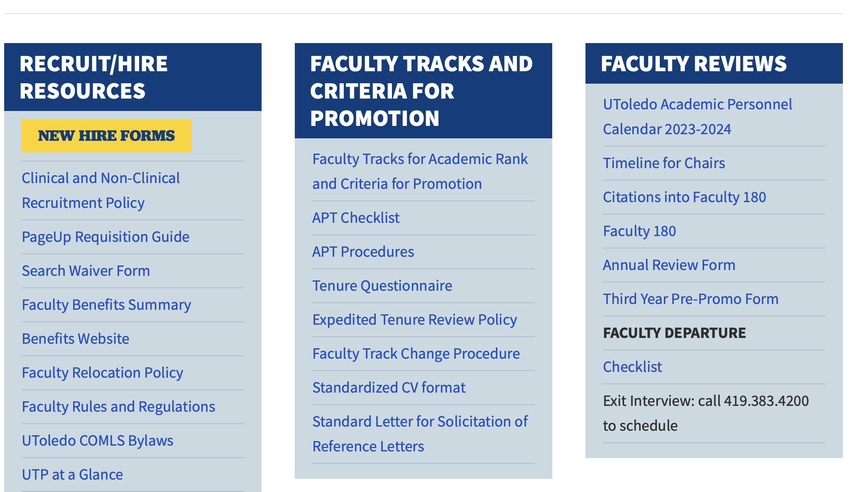

Slide 15
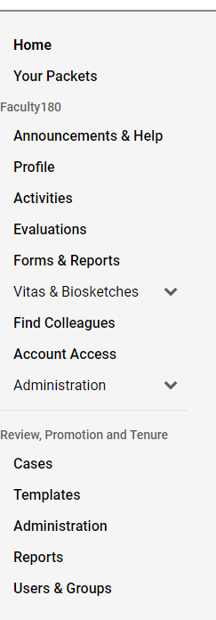
Faculty 180

Slide 17
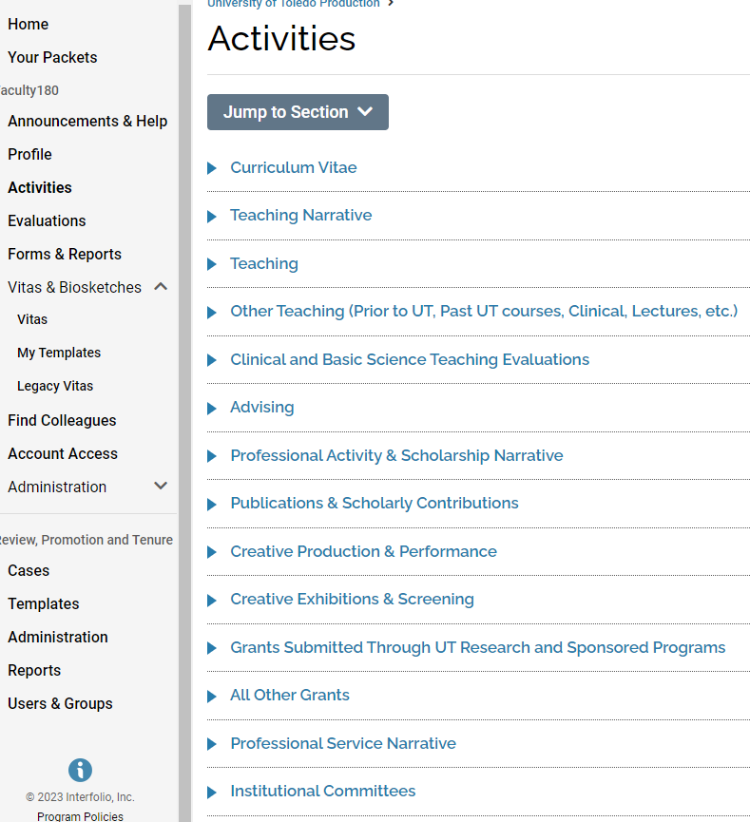

Slide 18
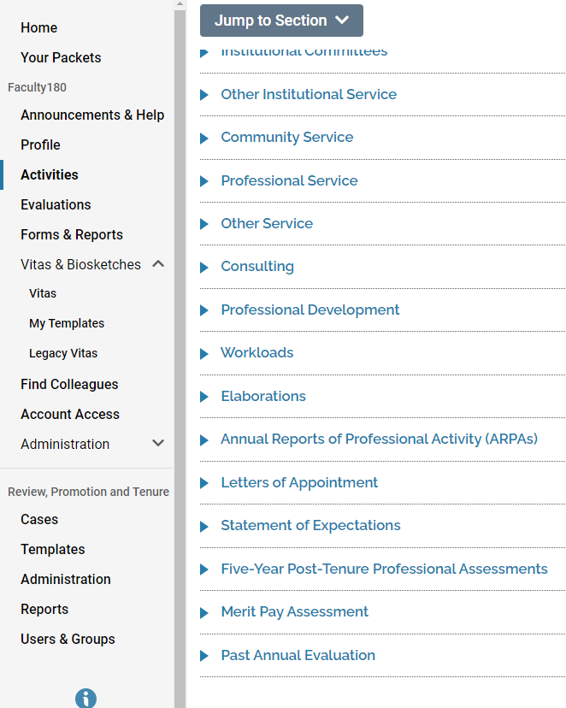

Slide 19
Promotion & Tenure
The promotion process is the evaluation of your academic career
Your career is summarized and presented for review in your CV (and Faculty180) and all attached materials
Promotion is earned
Promotion is based on: 1. Education; 2. Scholarship; 3. Service (including clinical, institutional, national, international); 4. Professionalism
Annual evaluations are an excellent opportunity to discuss promotion
A dAPT review of the dossier at the end of the third year in a tenure eligible track (third year review) is required for faculty at the rank of Assistant Professor

Slide 20
Advocate for Yourself
Updated CV using standardized format

Slide 21
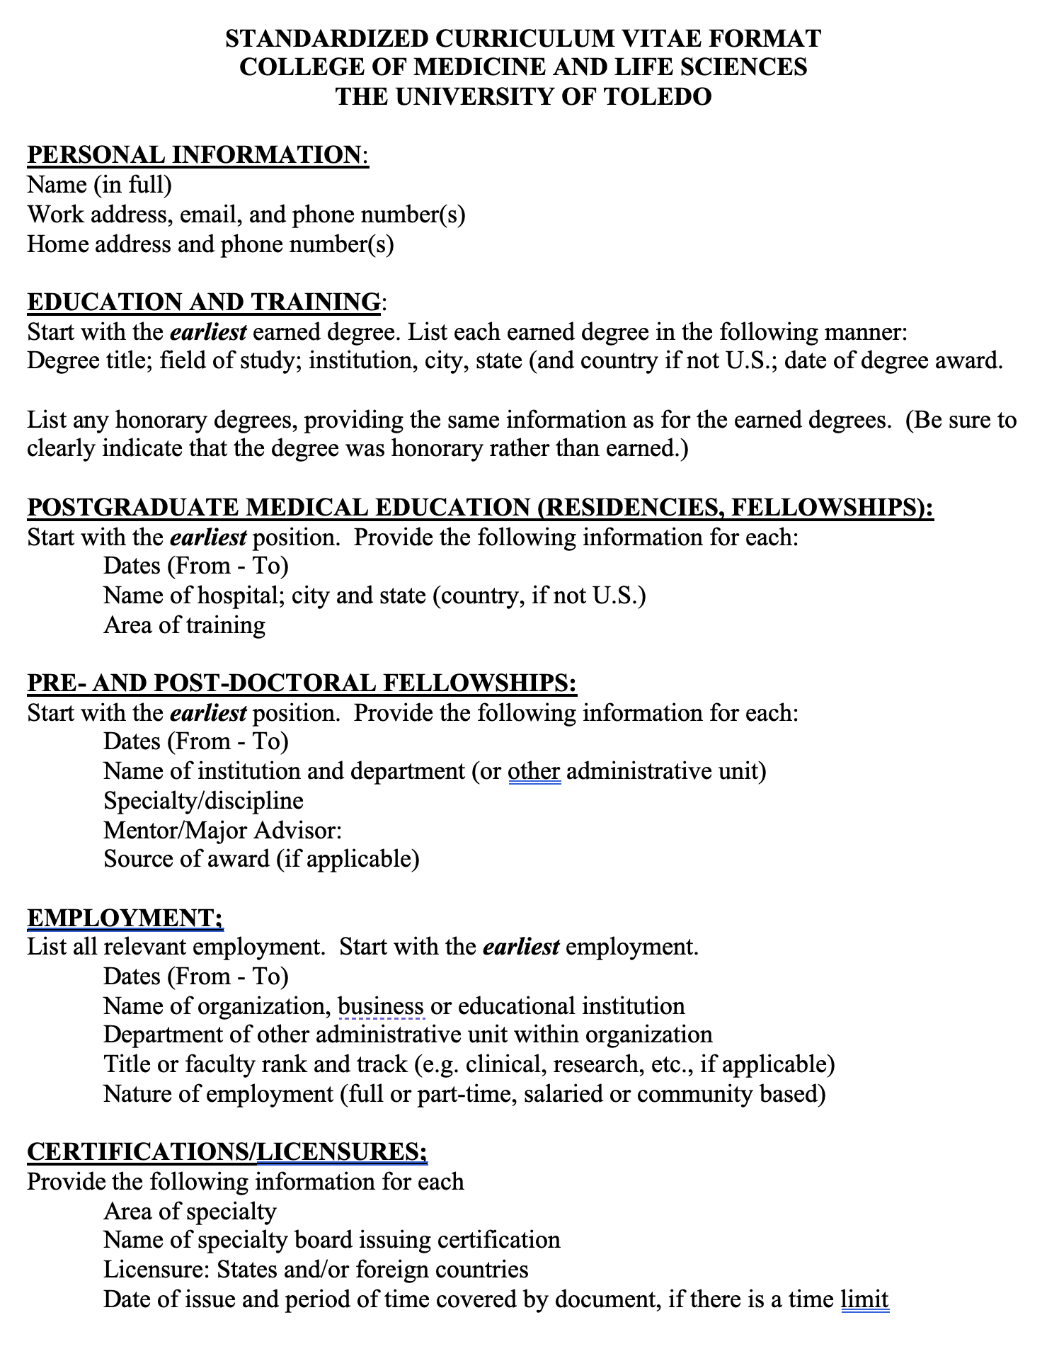

Slide 22
Advocate for Yourself
Updated CV using standardized format
Review and update all Faculty180 information
Know the promotion and/or tenure criteria for your track:
1. Scholarship
2. Education
3. Service
4. Professionalism
Potential reference writers (internal, external, number) – start May/June
Learner evaluations for the last 3 years, for all courses/activities
Self-assessment (separate section for each of the above areas)
Tenure questionnaire (if applicable)
Threshold vs. Excellence

Slide 23
Tenure
Merit as an Academician
External grant funding: Explain how your previous and current external funding supporting your scholarly activity significantly exceed the threshold criteria in your track. Explain your role on the projects and your future plans to sustain your scholarly work.
Publications, presentations, national reputation: Explain how you have demonstrated the prominence of your academic reputation at the national/international levels and have significantly exceeded the threshold criteria in your track (e.g., h-index; impact factor of journals where your research has been published; presentations at national/international meetings; unique area of expertise; honors and awards; invited reviews and editorial activities; service for professional societies, etc.).
Education: Explain your stellar record of commitment to educating COMLS learners, development of either creative and innovative educational material, or new knowledge, or unique areas of expertise (as applicable to your current track) that have significantly exceeded the threshold criteria in your track.
Service: Explain how your service to UToledo, COMLS, and your Department has significantly exceeded the threshold criteria in your track.
Future goals: Give an assessment and description of your plans for continued career development.
Value to UToledo and COMLS
Describe your long-term commitment to UToledo and COMLS in terms of your previous and planned academic accomplishments (e.g., education, scholarship, service, clinical service, administration, etc.).
Explain innovative contributions to the development of programs at UToledo and COMLS in areas of teaching, scholarship, and service, at the clinical, research, national, professional, community and/or administrative levels (as applicable).

Slide 24
Your Dossier
Follow the Checklist for your faculty track!
Checklist outlines the minimum attachments/information that need to be included

Slide 25
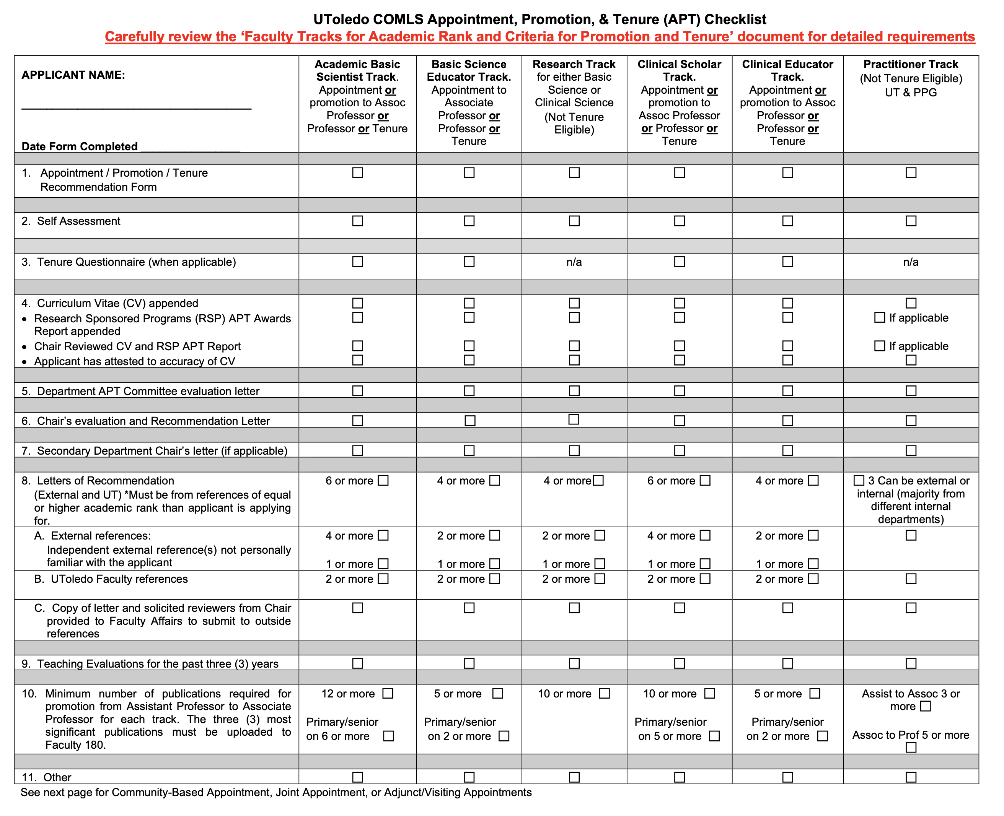

Slide 26
Your Dossier
Follow the Checklist for your faculty track!
Checklist outlines the minimum attachments/information that need to be included
All dossiers require the following (minimum):
CV (in the standard format and each page must be signed/dated)
Self-assessment (1. Scholarship, 2. Education, 3. Service)
Recommendation letters
Educational activities (teaching, mentoring)
Student/resident evaluations from the last three years
Copies of the 3 most significant publications
Grants (if applicable; check Faculty180 information for accuracy)
Tenure questionnaire (if applicable)
All dossiers need to be completed by mid-September
- Faculty need to start gathering components in the spring (now)

Slide 27
Recommendation Letters
VERY IMPORTANT, so plan ahead!!!
The chair solicits, receives, and uploads all recommendation letters
Recommendation letters are confidential (not shared with you) and the letter of request from the chair’s office is required in the dossier, in addition to all returned letters
Number/type of recommendation letter needed depends on the track
Must be from a faculty member at equal or higher rank than the rank the applicant is applying for
(external) Must indicate if applicant would receive promotion and/or tenure at their institution
Academic Basic Scientist/Clinical Scholar tracks: 6 letters
4 external letters (of which 1 must be “arms length” or not personally known)
2 internal (UToledo) letters
Basic Science Educator/Clinical Educator/Research: 4 letters
2 external letters (of which 1 must be “arms length” or not personally known)
2 internal (UToledo) letters
Practitioner/Community-based tracks: 3 letters
- Can be internal or external

Slide 28
Professionalism: A criterion for all tracks/ranks
Faculty Professionalism: COMLS expects all faculty to understand and comply with the AAMC guiding principles for promoting a positive learning environment and the COMLS Policy 3364-081-004-018-00, “The Learning Environment and Faculty Professionalism”
Standards of professional behavior in educational settings:
Creating a positive atmosphere conducive to learning and supporting the ethical principles of medicine including honesty and confidentiality
Maintaining appropriate boundaries, trust, humanism, respect for diversity and appropriate forms of communication with students, faculty, staff, patients and others and using a dignified approach to conflict resolution
Maintaining ethical standards
Excellence in professionalism is required in all tracks and ranks.

Slide 29
Track-Specific Criteria (see ‘Faculty Tracks for Academic Rank and Criteria for Promotion and Tenure’ document)

Slide 30
Practitioner Track (non-tenure eligible)
Faculty who “are involved in teaching and clinical practice.”
For promotion from Assistant to Associate Professor (UToledo, PPG):
1. Service: Board certified; excellence in providing clinical services to patients
2. Education: Effective supervision of medical learners
All evaluations from learners must be submitted from the last three years prior to applying for promotion. Must include no less than 12 evaluations – student evaluations are important!
3. Scholarship:
3 publications in professional journals (may include case reports) with majority (2) published after appointment to Assistant Professor (no requirement for primary/senior author)
Other positive factors include being co-investigator or PI on educational, research or clinical trials or multicenter trials and Oral or poster presentations at regional and national meetings.

Slide 31
Practitioner Track (non-tenure eligible)
For Promotion from Associate to full Professor
Same 1. Service and 2. Education requirements as Associate Professor
3. Scholarship
- Five (5) publications in professional journals (may include case reports) published after appointment to associate professor
- Do not need to be first or senior author on any of the publications

Slide 32
Research Track (non-tenure eligible)
For faculty immersed in research
Scholarship is the primary criterion for promotion
No requirement for extramural grants as PI
Publication of a minimum of ten (10) peer-reviewed articles in high-quality national or international journals as well as review articles, chapters and books.
No requirement to be first/senior author
Education - Recognition as an effective educator in the classroom or research laboratory.

Slide 33
Academic Basic Scientist Track (tenure-eligible)
For promotion from Assistant to Associate Professor
1. Scholarship: Excellence in scholarly activity – recognition for original, independent and significant contributions to a chosen field of endeavor.
• Sustained and ongoing…peer-reviewed extramural research support as PI
• Publication of at least 12 articles in peer-reviewed journals, and review articles in journals, chapters in books. The candidate must be the primary contributor or senior author on at least six (6) of these.
• Invited presentations at regional, national or international meetings.
Education: Recognition as an effective teacher in the classroom and the laboratory. Recognition of mentoring skills and contribution to the design, organization, presentation, and/or evaluation of educational programs.
3. Service: Based on participation on institutional committees, professional societies, editorial review and scientific advisory boards.

Slide 34
Clinical Scholar Track
For promotion to Associate Professor: Individual will have attained independence, leadership, and creativity as a clinical scholar, with achievements in education and service.
1. Scholarship: excellence criteria include
Success in obtaining extramural support for research
Publication of a minimum of ten (10) peer-reviewed articles in high-quality national or international journals as well as review articles, chapters and books is a threshold criterion.
2. Education: Recognition as an effective teacher; participation in continuing education programs
3. Service: Participation on institutional committees, professional scientific societies

Slide 35
Educator Tracks-Basic science or Clinical
Promotion to Associate Professor is based on achievements in education, scholarship, and service, with excellence in education and one other category.
Education: Excellence requires significant accomplishment in teaching and curriculum plus 1 of the other 3 categories at least (AAMC categories) .
a. Teaching – required category
b. Curriculum – required category
c . Learner Assessment
d. Advising/Mentoring
e. Educational leadership/Administration
2. Scholarship: Publication of a minimum of 5 manuscripts, program descriptions or evaluations, book chapters, monographs, or other innovative educationally-relevant materials. Must be primary (or senior-basic science track) author on at least two (2) publications. PI on educational, research or other trials or on extramural educational or research grants.
3. Service: Leadership in defining and disseminating superior quality care. Established local or regional reputation for expertise in a field or evidenced by productivity and clinical competence.

Slide 36
QUESTIONS???

