Slide 1
“The whole of science is nothing more than a refinement of everyday thinking”
Albert Einstein

Slide 2
Learning Objectives
To review the basic structure of a research publication
To learn from an expert on tips to publish in high impact journals
To understand an Editor’s perspective
How to Title a piece of research work!
Disclaimer: Experience is the best teacher!

Slide 3
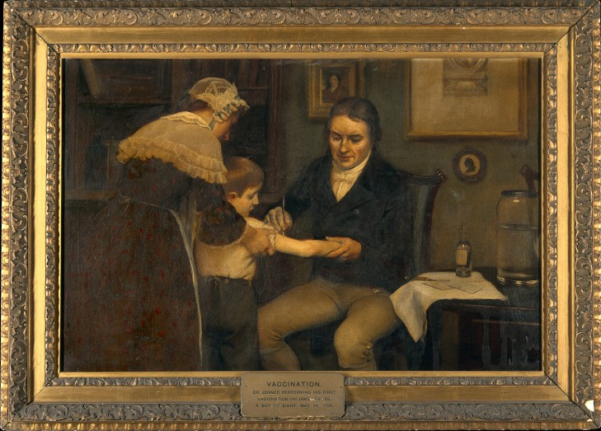
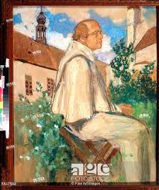
Clinician Scientist
Basic Scientist
Gregor Mendel, Father of Genetics, with his pea plants
in St.Thomas Abbey, Austria
Mendel, Gregor Johann. “Versuche über Pflanzen-Hybriden” [Experiments Concerning Plant Hybrids]” [1866]. In Verhandlungen des naturforschenden Vereines in Brünn [Proceedings of the Natural History Society of Brünn]
Dr. Jenner (Father of Immunology) performing his first vaccination. 14 May 1796.
Royal Society publication
Royal Society

Slide 4
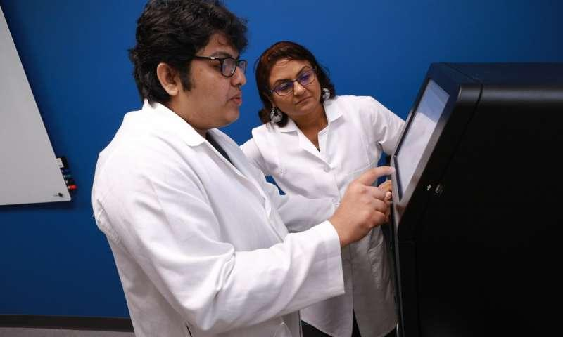
Basic Scientists: Then and Now (You!)
Gregor Mendel, Father of Genetics, with his pea plants
in St.Thomas Abbey, Austria
Saroj Chakraborty, a fourth-year Ph.D. student at the University of Toledo, left, and Dr. Bina Joe, Distinguished University Professor and chair of UT's Department of Physiology and Pharmacology. Oct 17,2018
Mendel, Gregor Johann. “Versuche über Pflanzen-Hybriden” [Experiments Concerning Plant Hybrids]” [1866]. In Verhandlungen des naturforschenden Vereines in Brünn [Proceedings of the Natural History Society of Brünn]
Cell Reports

Slide 5
THE MOTIVATION TO DO RESEARCH HAS CHANGED WHEREBY THE WAYS TO PUBLISH HAVE ALSO CHANGED

Slide 6
Impactful research publication = Large team science?
COLLABORATIONS!

Slide 7
NO MATTER THE SIZE OF THE RESEARCH GROUPS, THE STRUCTURE OF A RESEARCH PAPER REMAINS THE SAME

Slide 8
Bad data cannot be written well,
good data can be written poorly
THE LARGEST FACTOR DIFFERENTIATING
A GOOD PAPER FROM A BAD ONE IS:
DATA
THE SECOND LARGEST FACTOR DIFFERENTIATING
A GOOD PAPER FROM A BAD ONE IS:
WRITING

Slide 9
Learning Objectives
To review the basic structure of a research publication
To learn from an expert on tips to publish in high impact journals
To understand an Editor’s perspective
How to Title a piece of research work!

Slide 10
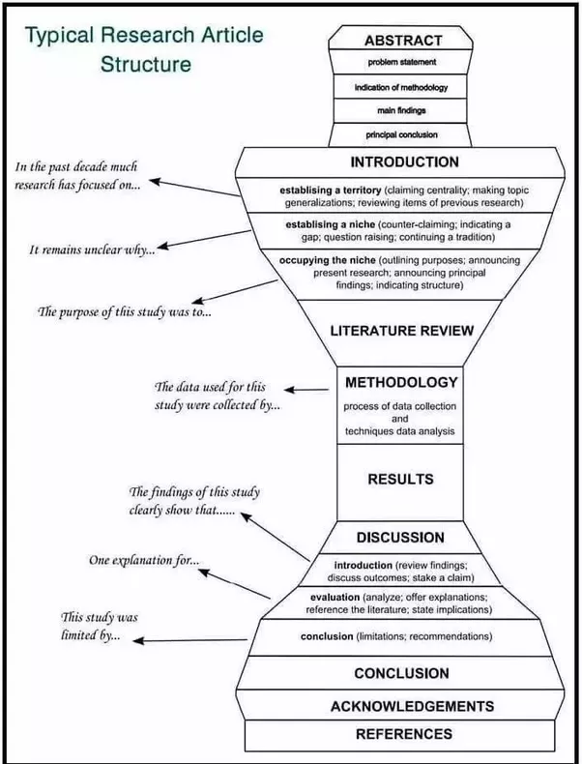

Slide 11
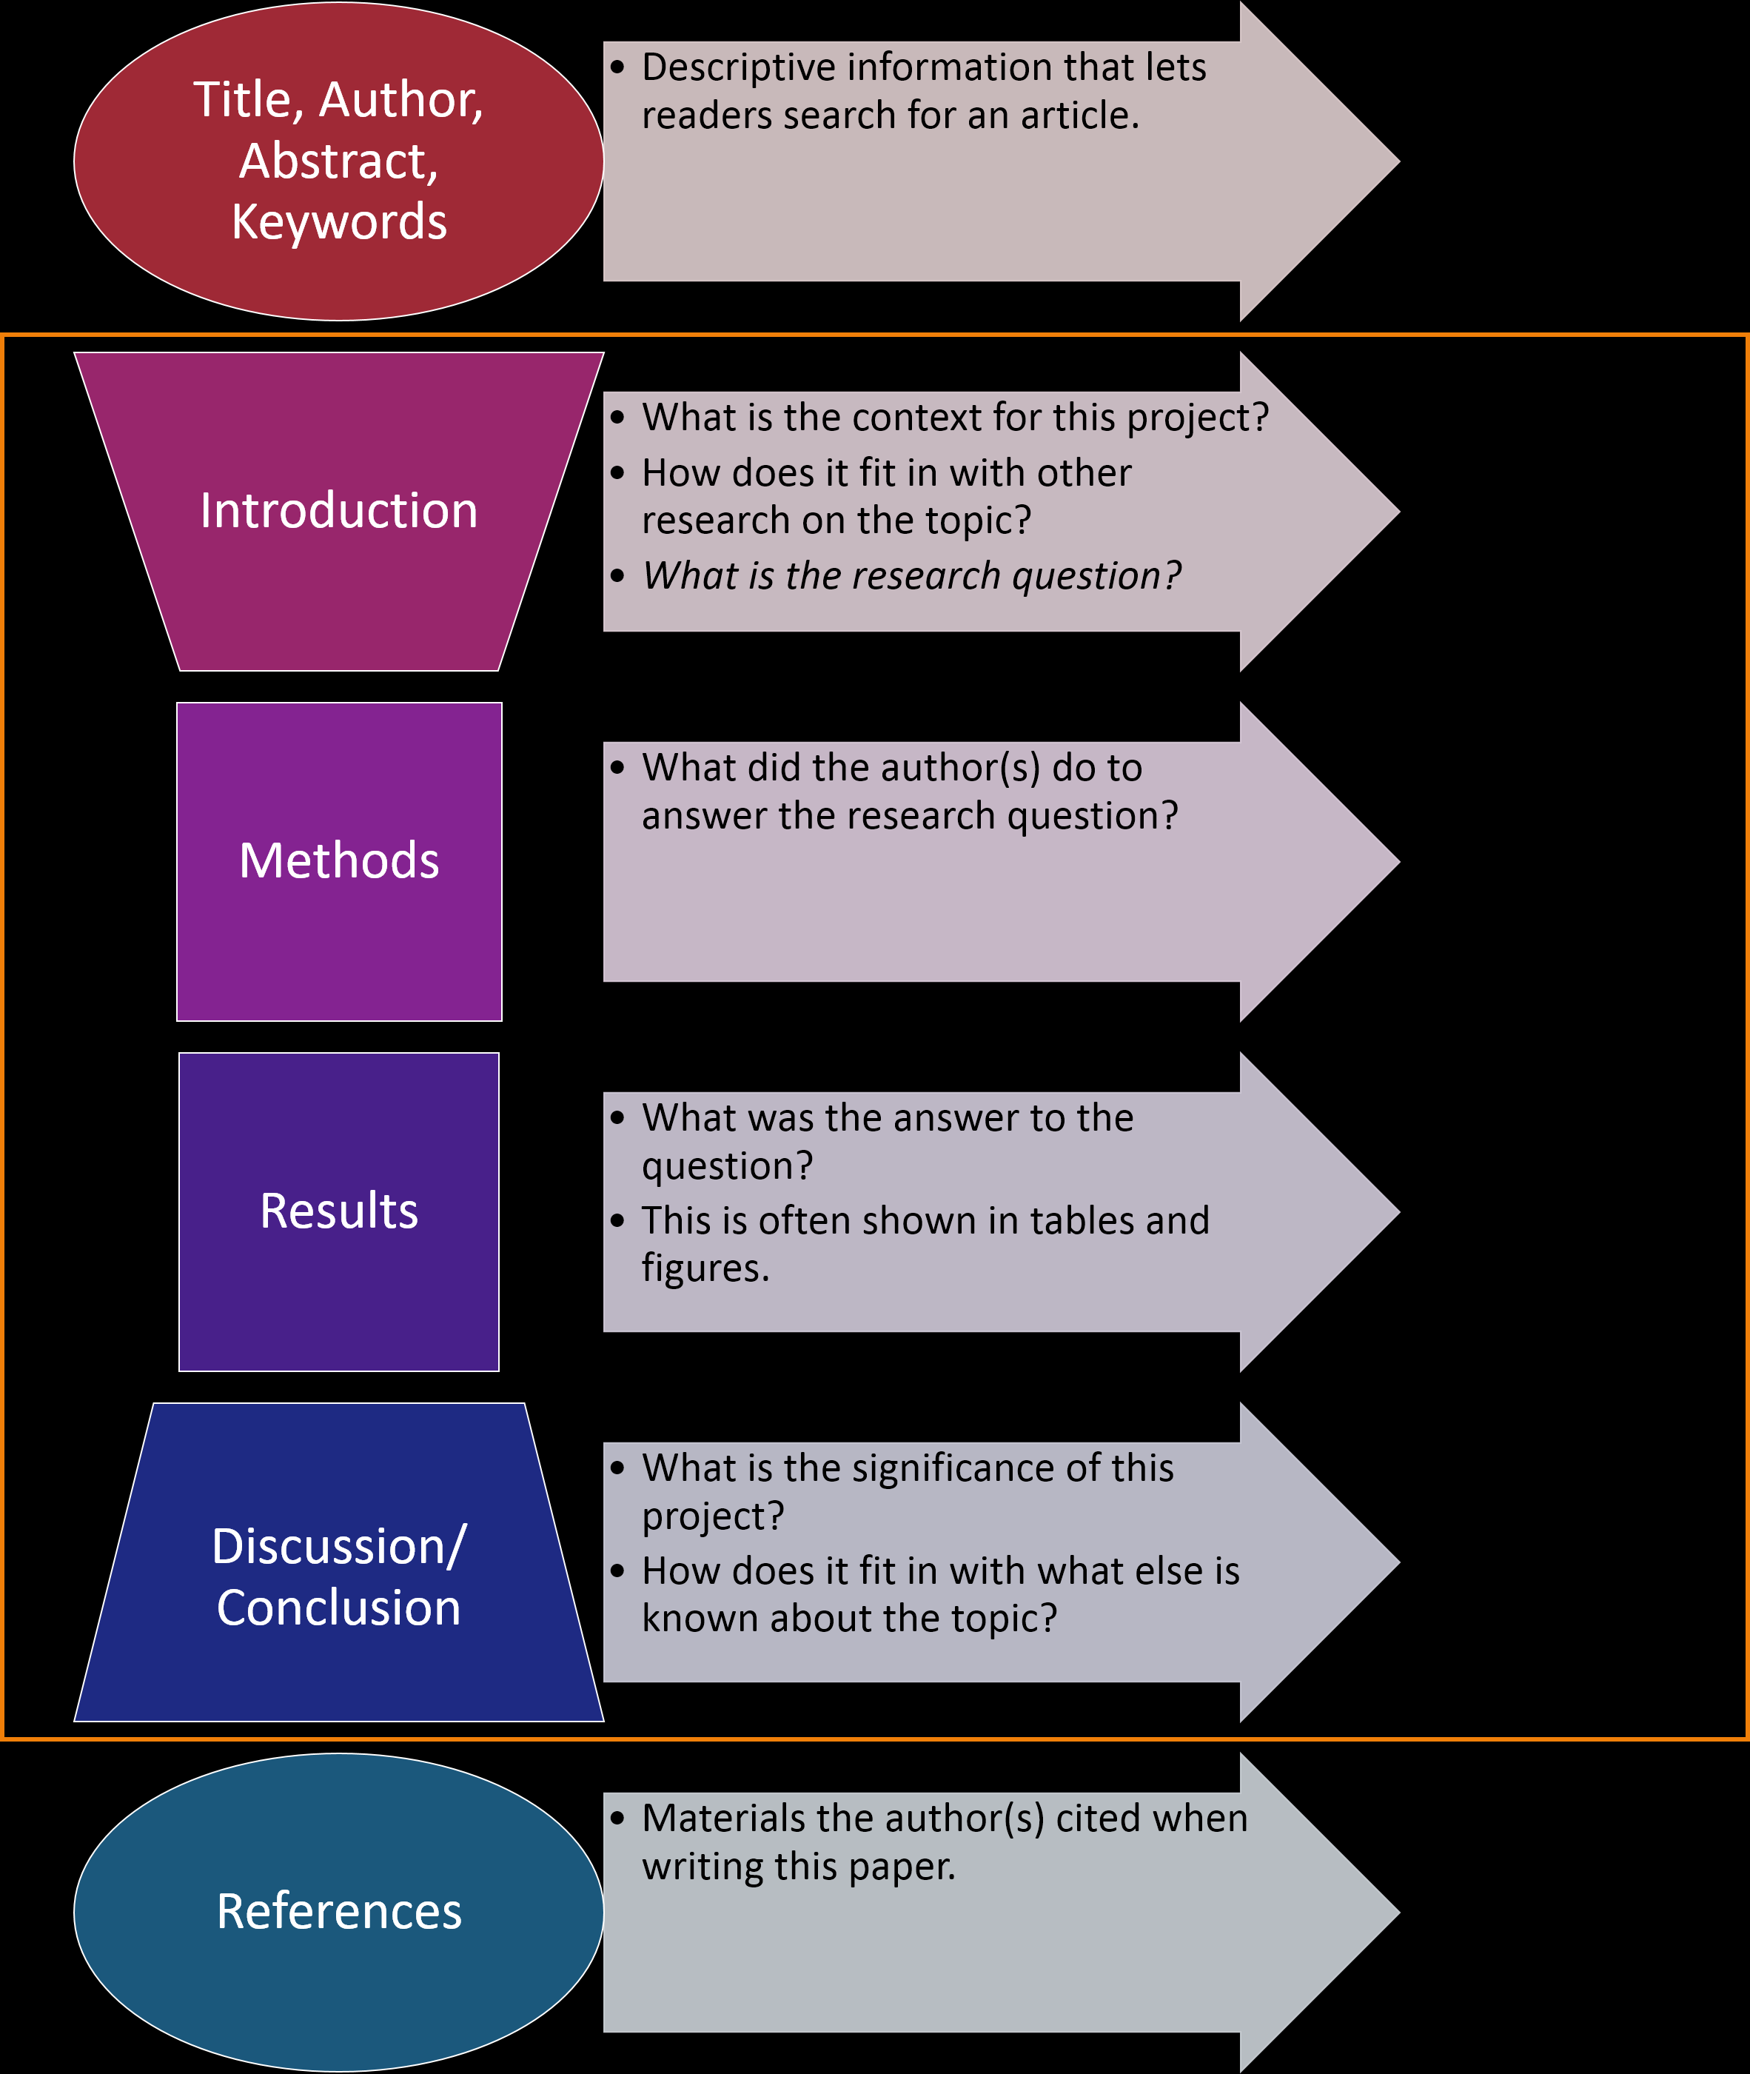
WHY?
HOW?
WHAT?
SO
WHAT?

Slide 12
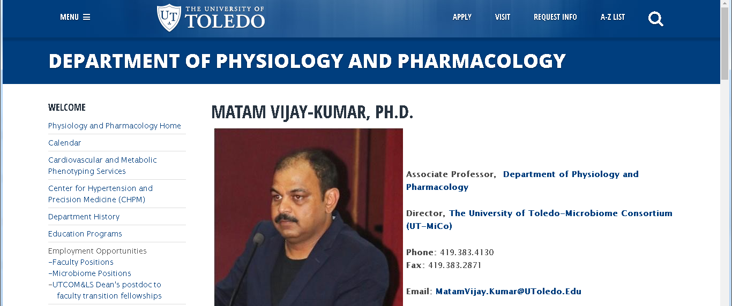
Learning Objectives
To review the basic structure of a research publication
To learn from an expert on tips to publish in high impact journals
To understand an Editor’s perspective
How to Title a piece of research work!

Slide 15
Learning Objectives
To review the basic structure of a research publication
To learn from an expert on tips to publish in high impact journals
To understand an Editor’s perspective
How to Title a piece of research work!

Slide 16
An Editor’s REAL job description
Raise the IMPACT FACTOR of the journal
Build a team of Ambassadors (Associate Editors, Board members)
Attract papers with high citation value
-Popular content, guideline papers
Promote by writing editorials, news and views
Promote via Social Media

Slide 17
AN EDITORS DAILY PRAYER
GOD, PLEASE DO NOT MOTIVATE AUTHORS TO FABRICATE THEIR DATA IN MY JOURNAL
GOD, PLEASE DESTROY ALL PREDATORY COMPETITIVE JOURNALS!

Slide 18
HOW TO USE THIS KNOWLEDGE TO YOUR ADVANTAGE?

Slide 19
WARNING:
FABRICATING DATA IS
DELETERIOUS TO
YOU!!

Slide 20
“Begin with the end in mind”
End Goal: To publish in a Journal with high impact for readership
Manuscript
MARKETING TO THE EDITOR
Cover letter
Editor-in-Chief
Associate Editor
NEGOTIATION
Reviewers
Editor-in-Chief
Appeal
Reject
Decision
Accept
Market

Slide 21
Tools for Marketing
Work with the Editor: News and Views/Editorial
Cover Art
Institutional media support
Promote on Social Media
Submit work at prestigious meetings

Slide 22
Learning Objectives
To review the basic structure of a research publication
To learn from an expert on tips to publish in high impact journals
To understand an Editor’s perspective
How to Title a piece of research work!

Slide 23
TITLE
MARKETING TO THE EDITOR
Cover letter

Slide 24
LAB MEETING: PLEASE LISTEN TO THE NEXT FEW SLIDES CAREFULLY

Slide 25
BACKGROUND

Slide 26
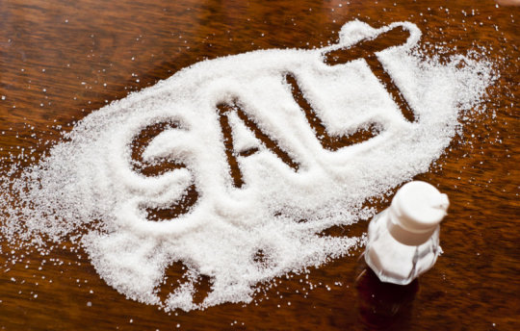
HIGH SALT DIET INCREASES
BLOOD PRESSURE

Slide 27
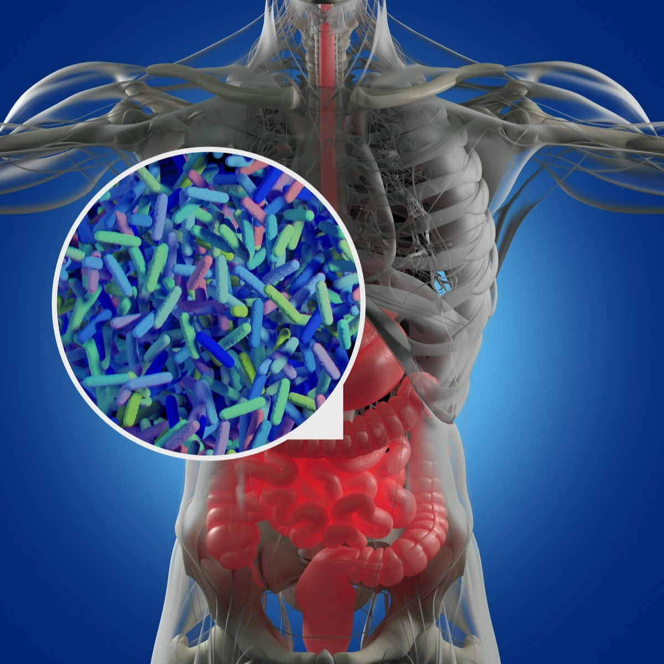
Bacteria in your gut control regulate your blood pressure

Slide 28
Purpose of the study: To determine if salt increases BP via altering any circulating metabolites (either from bacteria or from the host)

Slide 29
NEW DATA (RESULT 1)
HIGH SALT DIET LOWERS LEVELS OF A key metabolite: KETONE BODY

Slide 30
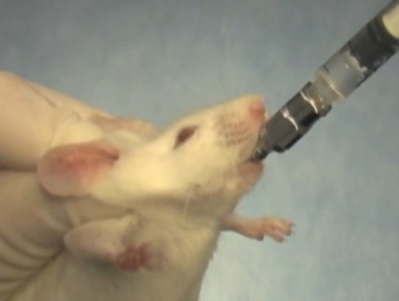
NEW DATA (RESULT-2)
FEEDING RATS WITH THE KETONE BODY LOWERS THEIR BLOOD PRESSURE
KETONE BODY
HYPERTENSIVE RAT
ON A HIGH SALT DIET

Slide 31
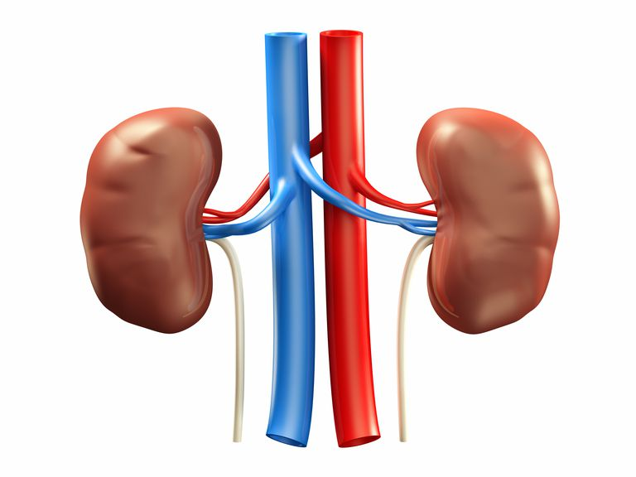
MECHANISM: RENAL INFLAMMATION IS LOWERED BY THE KETONE BODY BY A KEY PATHWAY OF LOWERING ACTIVATION OF A KEY COMPONENT OF INFLAMMATION : The Nlrp3 inflammasome
NEW DATA (RESULT-3)

Slide 32
DISCUSSION POINTS TO NOTE FROM THE LITERATURE

Slide 33
EXERCISE INCREASES KETONE BODY PRODUCTION

Slide 34
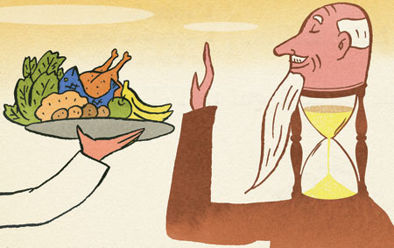
CALORIE RESTRICTION INCREASES KETONE BODY PRODUCTION

Slide 35
HOW TO “BEGIN WITH THE END IN MIND”?
CHOICE OF JOURNAL

Slide 36
Which speciality
journal
To target?
KETONE
BODY
HYPERTENSION
SALT
Metabolism?
Cardiovascular?
INFLAMMATION
Immunology?

Slide 37
BREAKOUT SESSION: 30 MINUTES
Background:
A high salt diet increases blood pressure (hypertension)
Purpose:
To study whether salt alters any circulating metabolites
Data:
Result 1: Metabolomics study
A high salt diet lowers the level of a key metabolite: a ketone body
Result 2: Intervention study
Feeding the ketone body to high salt fed animals lowers their blood pressure
Result 3: Mechanistic study
Ketone body improves BP by lowering activation of Nlrp3 inflammasome
In the kidneys.
Discussion point: Exercise and calorie restriction increase this ketone body
TASKS:
DECIDE ON A JOURNAL
COME UP WITH A TITLE
WHAT WOULD YOU EMPHASIZE IN THE COVER LETTER?
WRITE A FEW SENTENCES

Slide 39
COVER LETTER

Slide 41
MEDIA

Slide 42
Learning Objectives
To review the basic structure of a research publication
To learn from an expert on tips to publish in high impact journals
To understand an Editor’s perspective
How to Title a piece of research work!
Disclaimer: Experience is the best teacher!

Slide 45
Reviewers consider the following five criteria to be the most important in decisions about whether to accept manuscripts for publication:
the importance, timeliness, relevance, and prevalence of the problem addressed;
the quality of the writing style (i.e., that it is well‐written, clear, straightforward, easy to follow, and logical);
the study design applied (i.e., that the design was appropriate, rigorous, and comprehensive);
the degree to which the literature review was thoughtful, focused, and up‐to‐date;
the use of a sufficiently large sample.
Reasons that reviewers reject manuscripts.
inappropriate, incomplete, or insufficiently described statistics;
over‐interpretation of results;
use of inappropriate, suboptimal, or insufficiently described populations or instruments;
small or biased samples;
text that is poorly written or difficult to follow

