Slide 1
How to write a book, and yes, you can do it!
Phillip T. Robinson, DVM
[ if I can do it anyone can ]

Slide 2
Introductory Comments

Slide 3
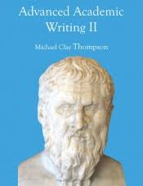
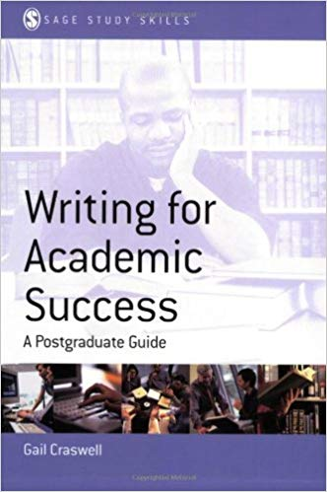
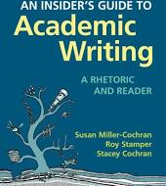
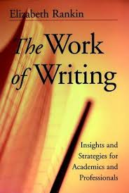
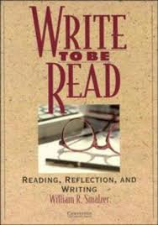
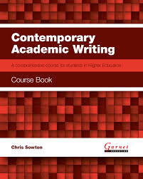
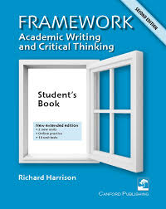
Today’s topics
A. General comments about writing
B. My bio-sketch as it explains motives for my 3 books
C. Some questions for the audience
D. A summary of my 3 book projects
E. Describe my book logistics with Oxford Univ. Press
F. Reasons you should consider writing a book.

Slide 5
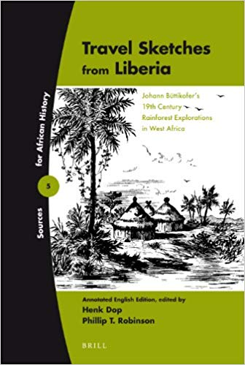
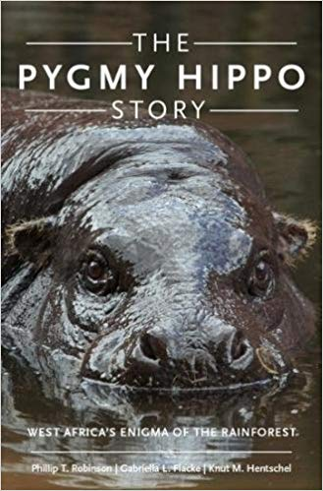
3 Books
2004 Columbia
University Press
30 year project
2012 Brill Academic
Press
15 year project
2017 Oxford Univ.
Press
50 year project

Slide 6
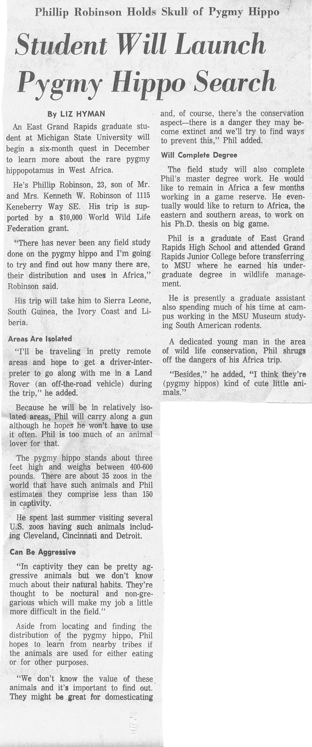
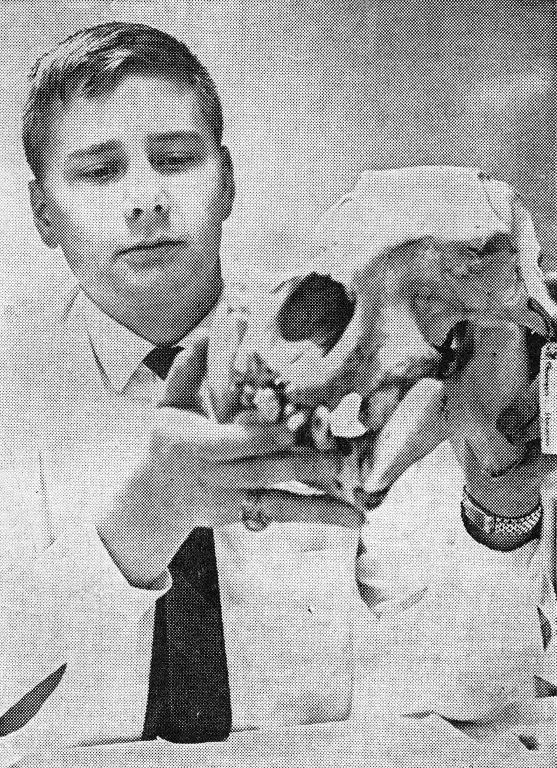

Slide 7
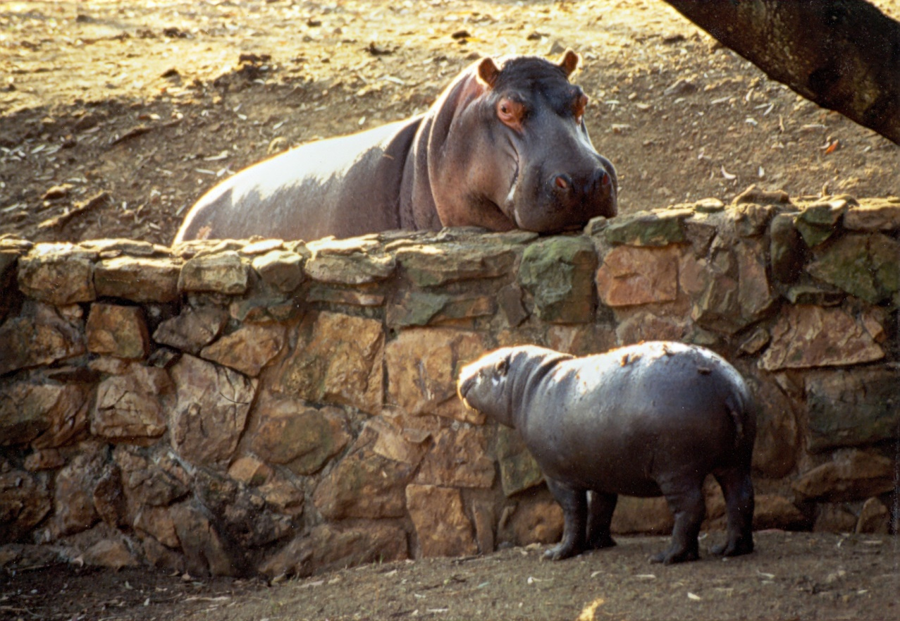

Slide 9
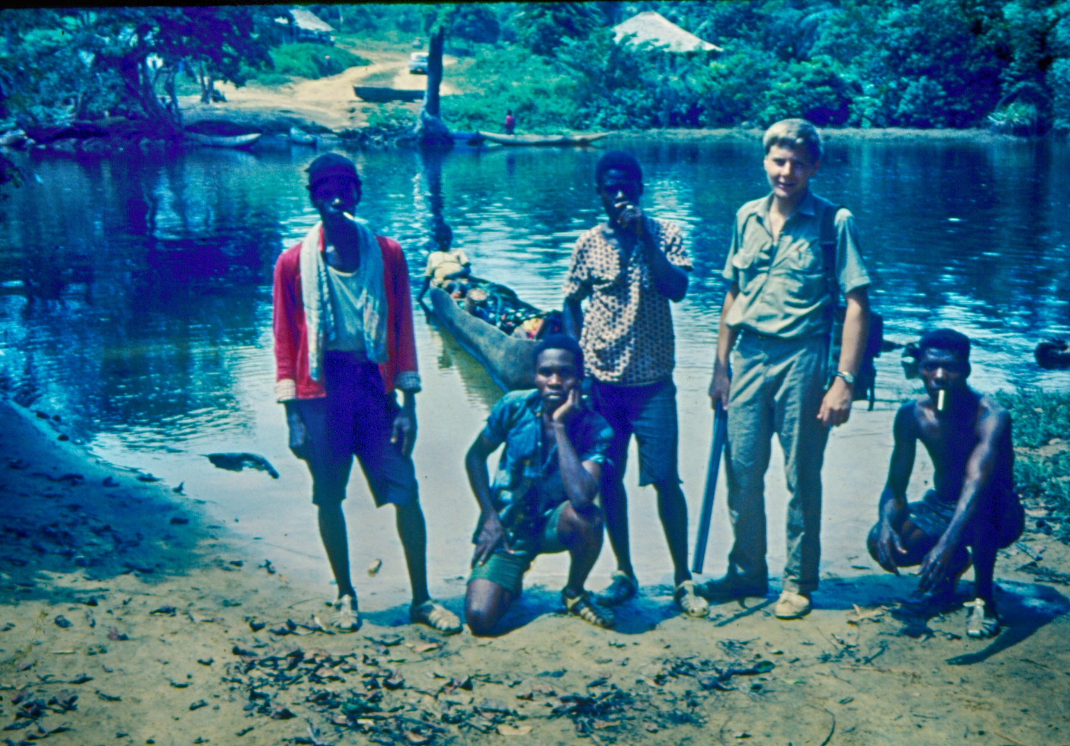
St. John’s River, Liberia, 1968

Slide 10
Isle Royale NP, 1967

Slide 11
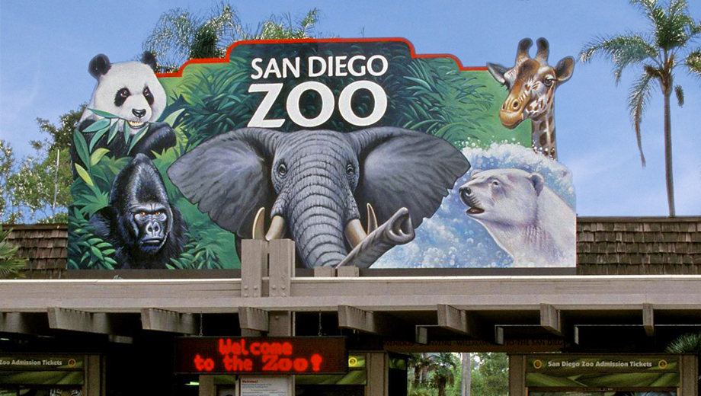
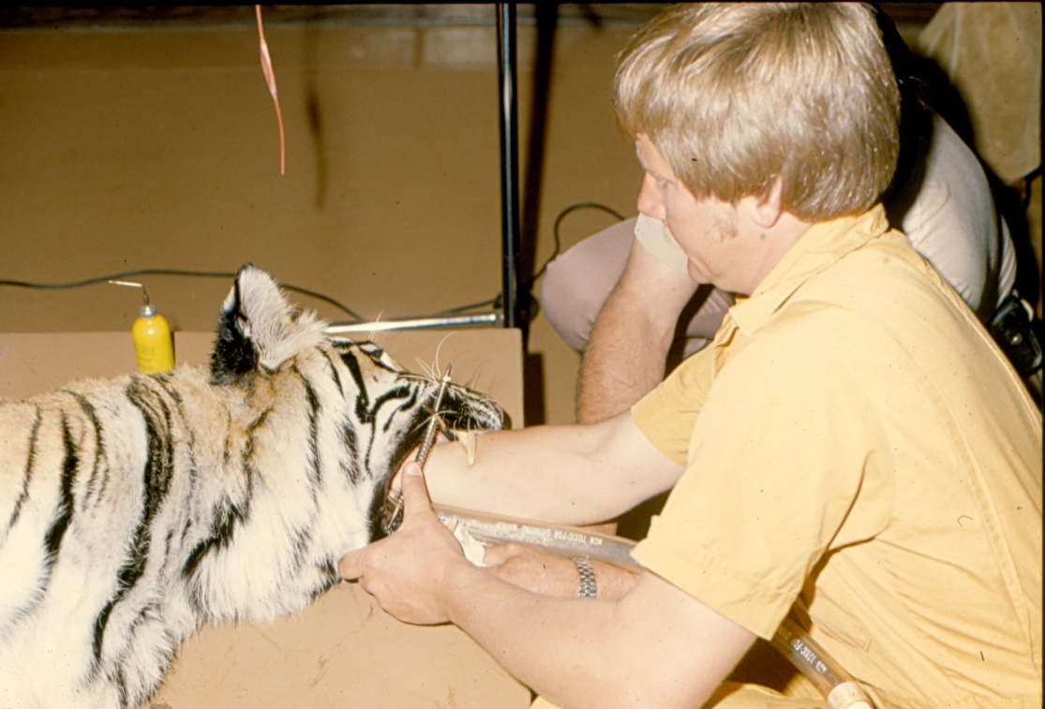

Slide 12
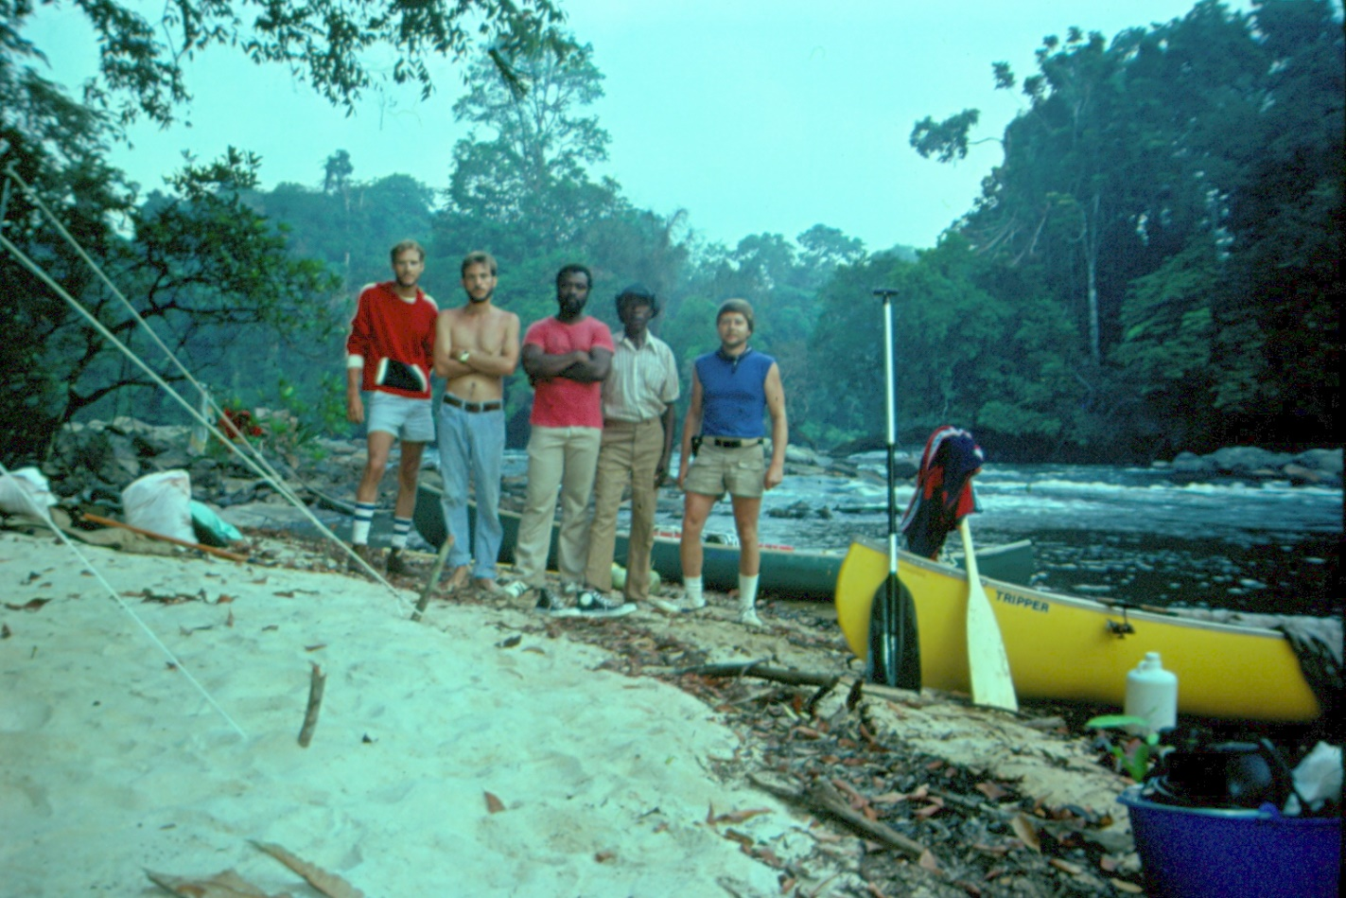
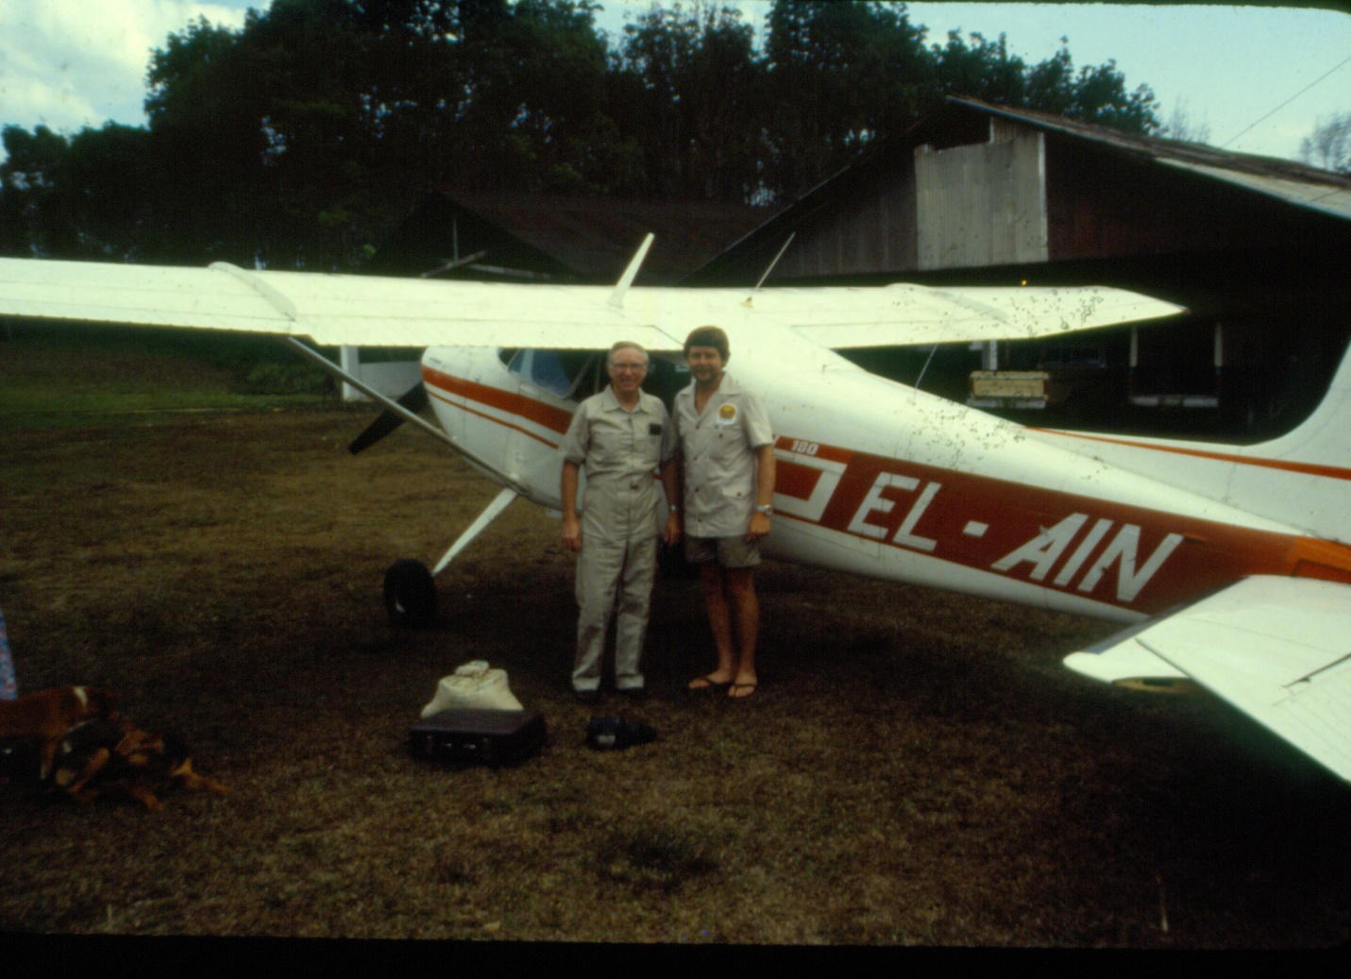

Slide 13
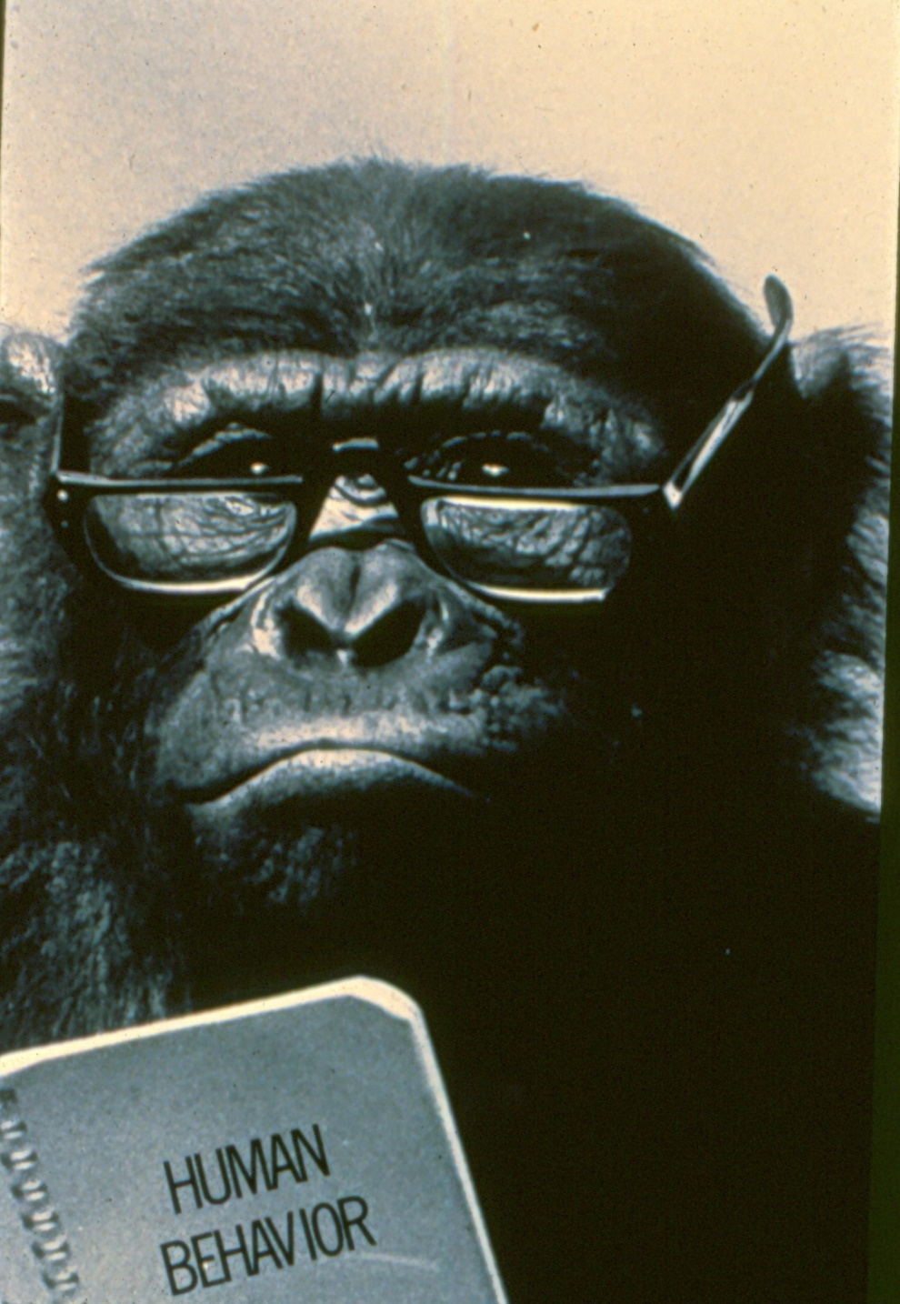

Slide 14
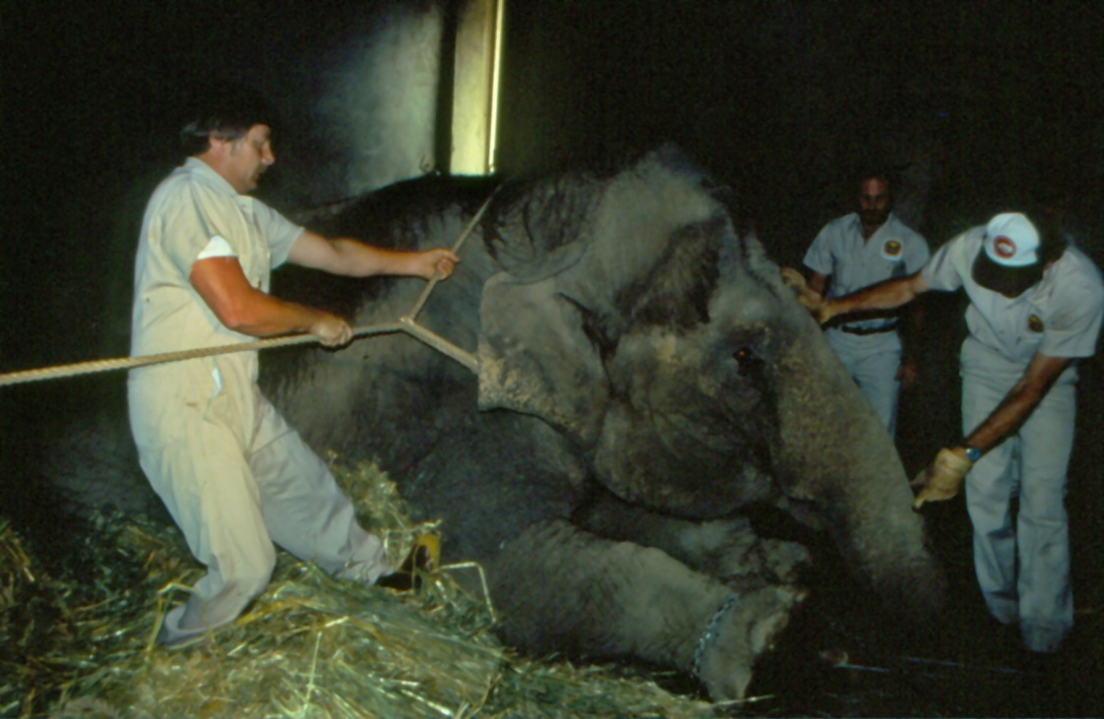
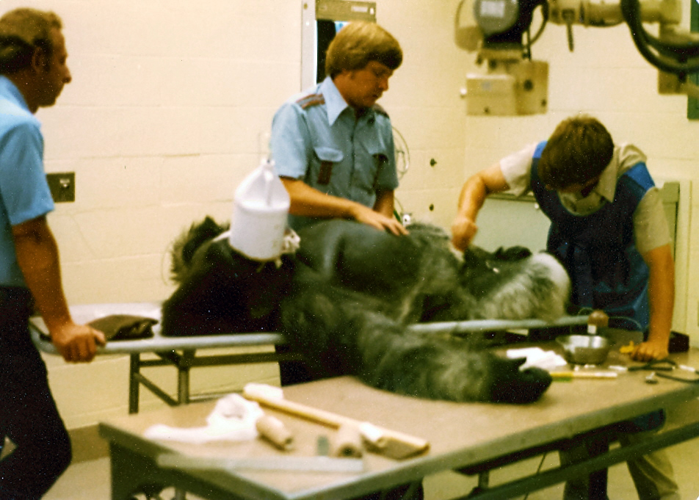
Life at the Zoo
Columbia University Press, 2004

Slide 15
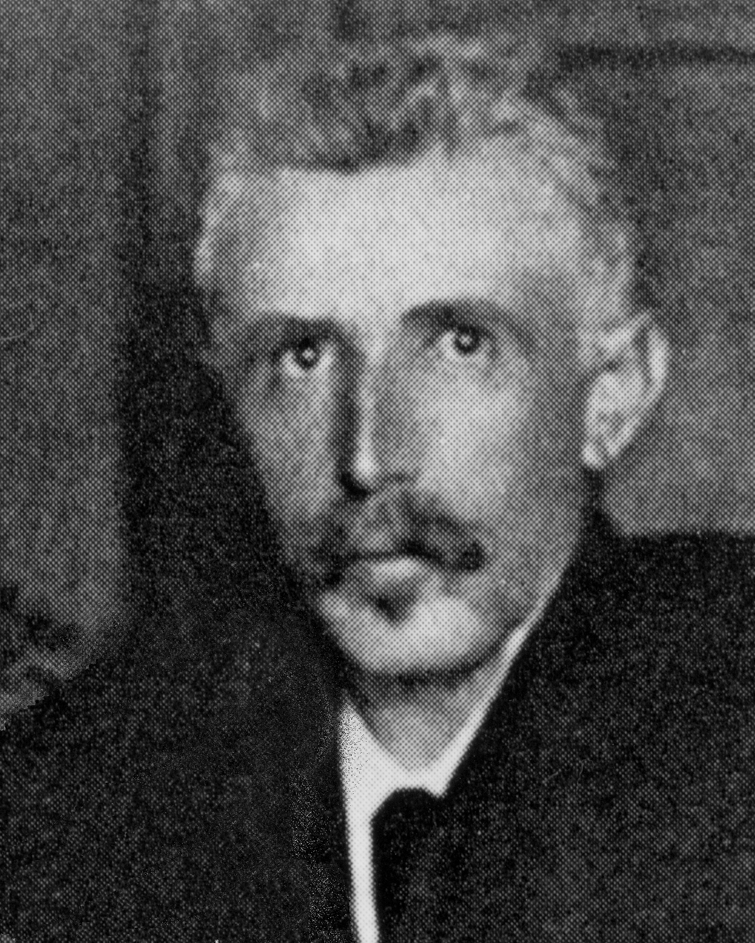
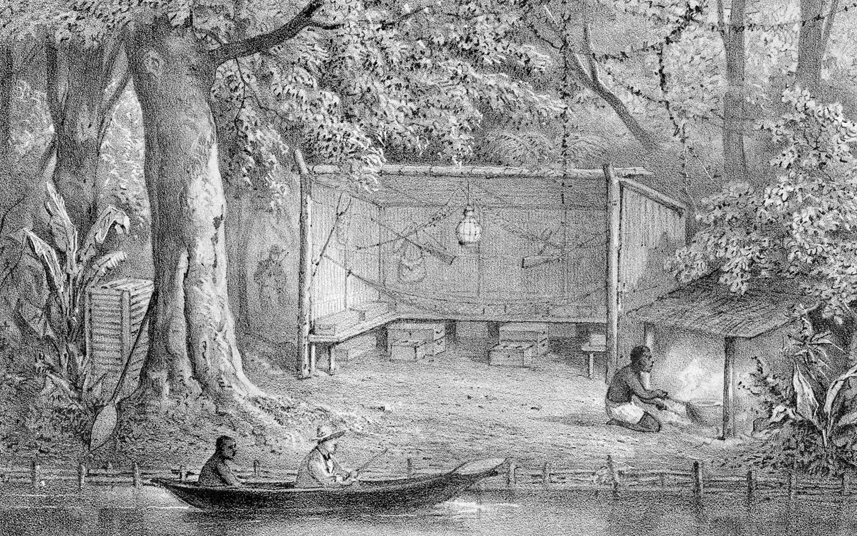
Travel Sketches from Liberia Johann Buttikofer’s Rainforest Explorations in West Africa

Slide 16
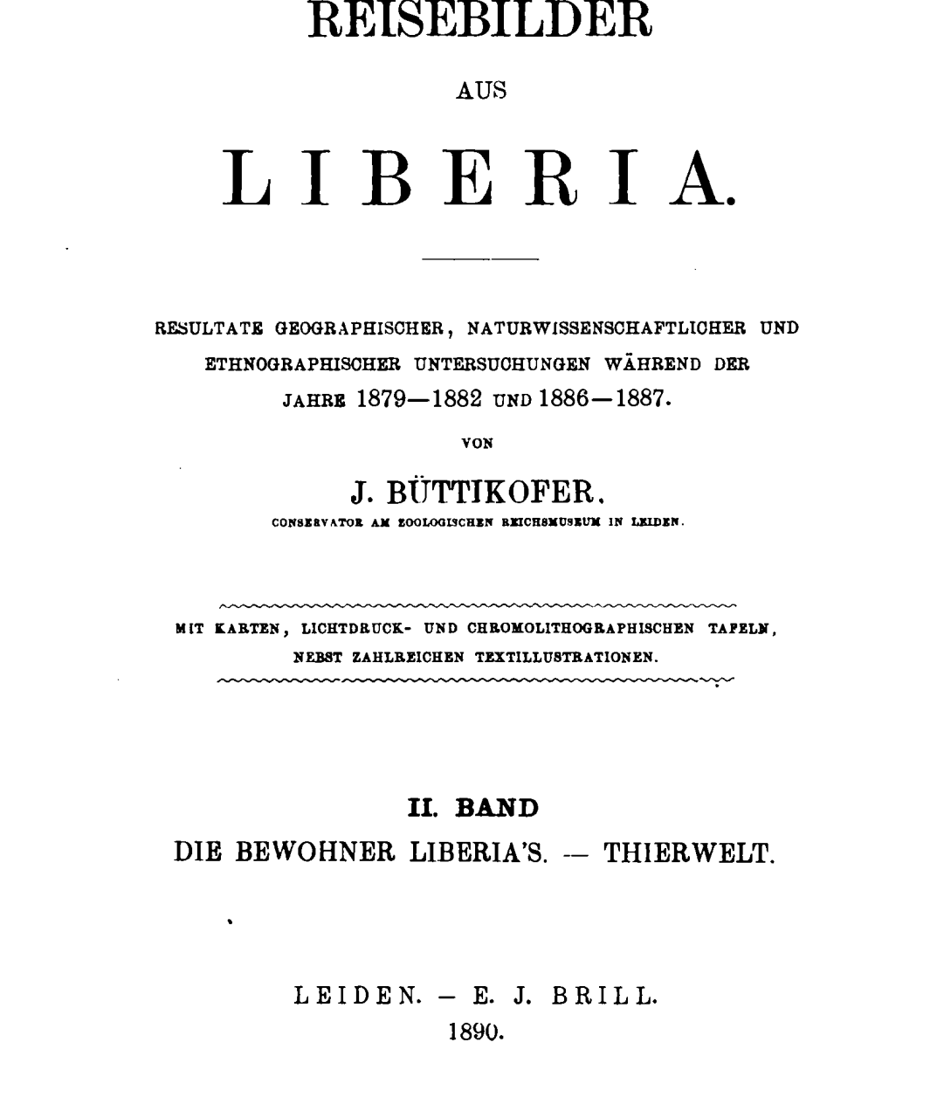

Slide 17
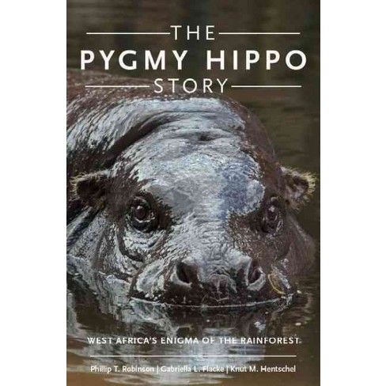
The Pygmy Hippo Story West Africa’s Enigma of the Rainforest
2017

Slide 19
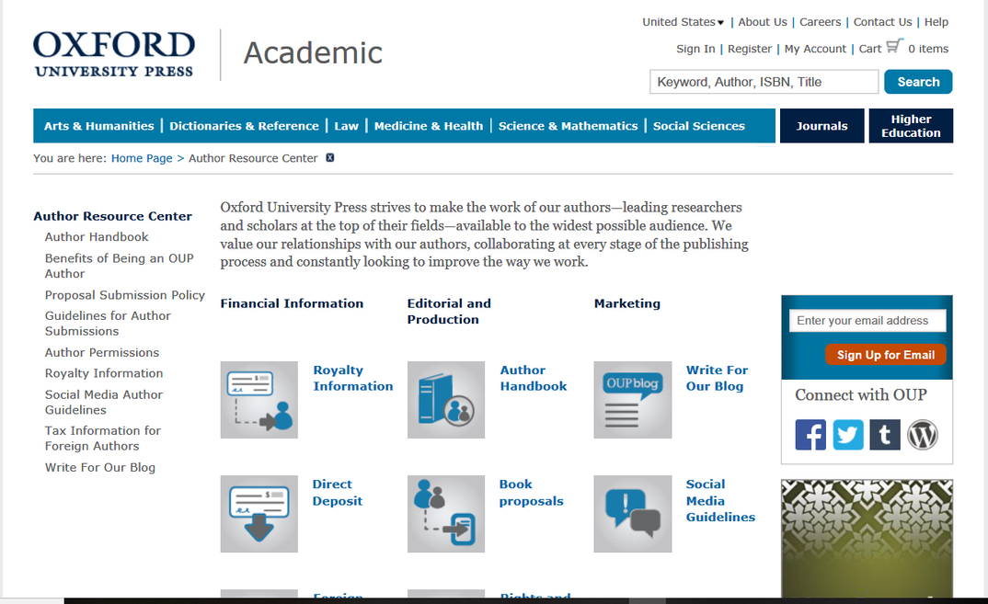

Slide 20
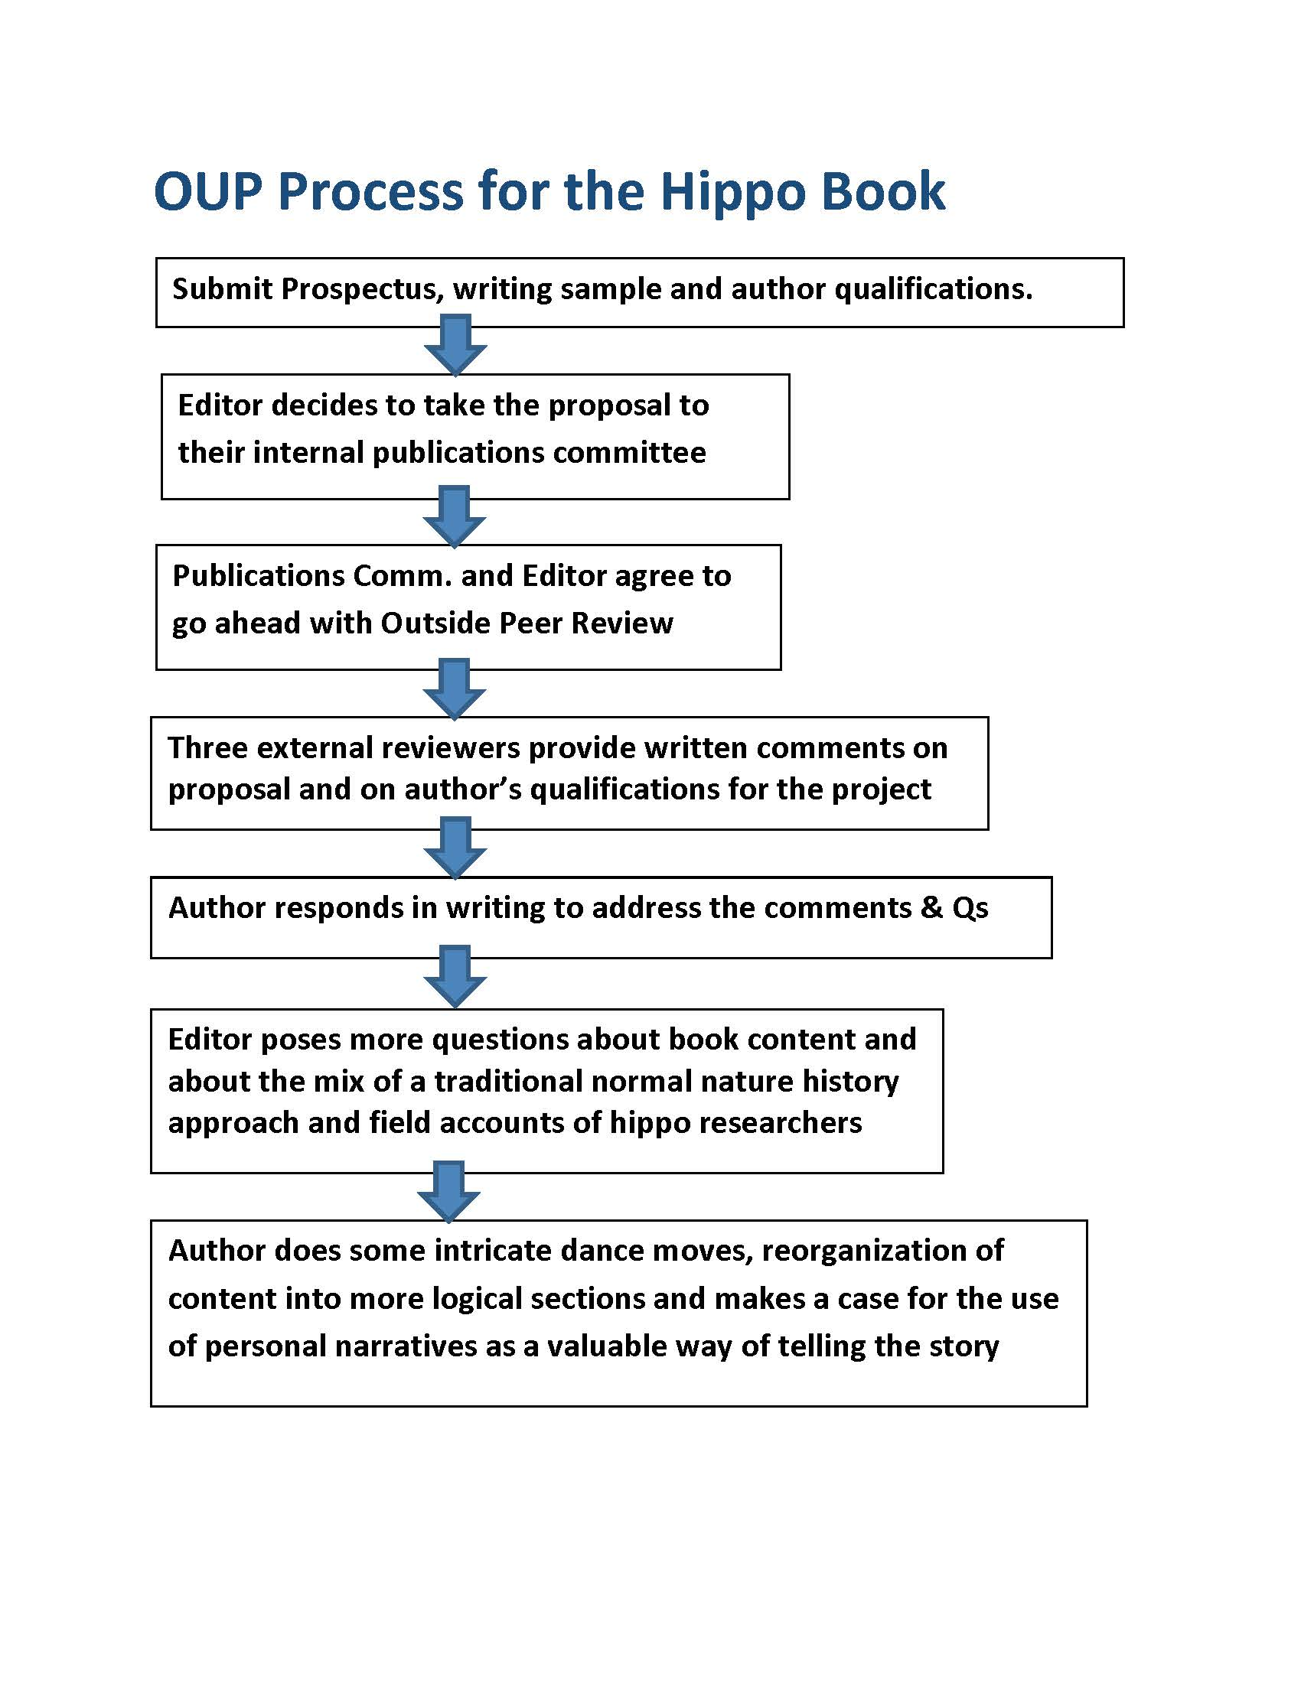
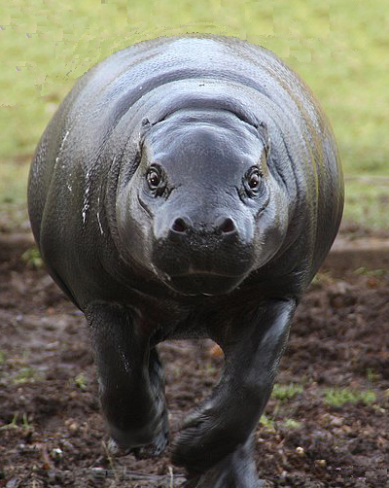

Slide 24
A few things I learned worth repeating
1. Start writing. Start writing--an essay, a chapter, a few pages.- you don’t need to have a detailed outline to test the water.
2. An idea may need to marinate a little before you begin to organize your thoughts.
3. Start making a list of books in your subject area that seem to be the most important.
4. Begin researching other relevant books and publications early in the process.
5. Write a few paragraphs about how your proposed book would add to the knowledge on the subject and complement other works.
6. When you proceed toward a publisher, ask yourself if your sanity and your project would benefit from having a co-author.
7. Become familiar with what presses are looking for in your topic area and look at lists of upcoming publications, when available.
8. Don’t quit your day job. Politics and fiction books have more economic potential . Frans Kafka, the short story writer, was an insurance underwriter by day and did not achieve fame until after his death.

Slide 25
In Summary

