Slide 1
Ask the Librarian! How to Utilize Library Resources for Research and Training
Margaret Hoogland, MLS, AHIP
margaret.hoogland@utoledo.edu
15 August 2019

Slide 2
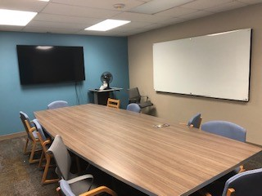
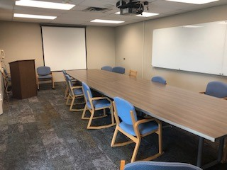
NEW MEETING OR STUDY ROOMS
MLB 517
MLB 520
Schedule by emailing margaret.hoogland@utoledo.edu or calling 419.383.4214

Slide 3
STANDING/KNEELING DESKS

Slide 4
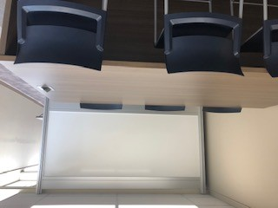
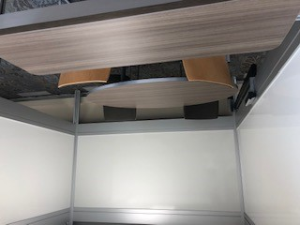
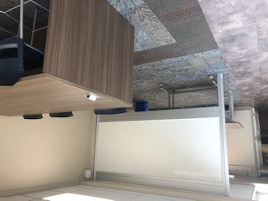
NEW COLLABORATIVE STUDY SPACES
6th Floor - Use Non-AEC Elevators to access.

Slide 5
Self-Directed Mindfulness Space
Beginning: 26 August 2019
Location: MLB 517
Times: 7:30 am to 1 pm
Contact person: lance.talmage@utoledo.edu

Slide 6
UT APPs
VisualDx
UpToDate
DynaMed
ClinicalKey
Access Medicine

Slide 7
DynaMed
Drug Information
Location of Citation Information
Content Updates
Peer Reviewed Publishing Opportunity

Slide 8
EMBASE
1) Drug Development Database
2) European Perspective
3) Oncology, Infectious Diseases, etc.

Slide 9
Staying Current
MDPhD
Custom searches
Table of Contents
Tell Margaret!
Read by QxMD

Slide 10
Customized Websites
Find an e-book, print book, or app for your specialty.
Go to your professional association website.
Investigate the journal requirements for submitting a poster or paper abstract.

Slide 11
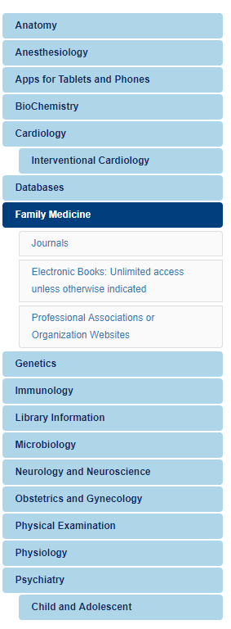
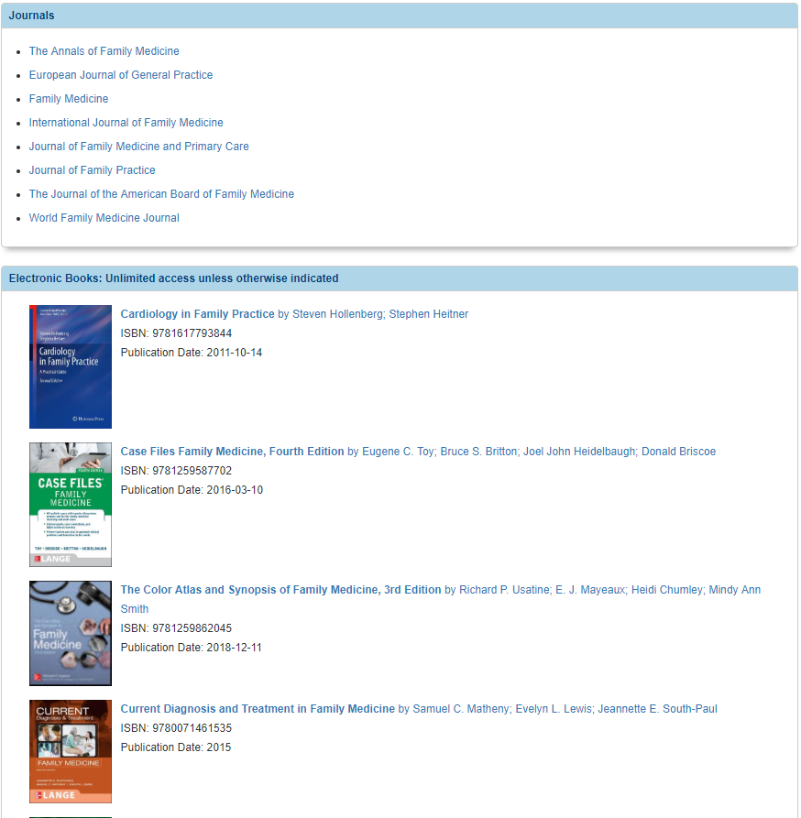
libguides.utoledo.edu/md/familymedicine

Slide 12
LIBRARY SERVICES
Literature Searches
Citation Management
Writing Assistance

Slide 13
Search Strategy – Example 1
("Hallucinations"[Mesh] OR pseudo hallucinations[tiab] OR non-psychotic hallucinations[tiab] OR non psychotic hallucinations[tiab]) AND pediatrics

Slide 14
Search Strategy – Example 2
(immune related adverse events[tiab] OR irAE's[tiab] OR thyroiditis[tiab] OR endocrinopathies[tiab] OR rash[tiab] OR colitis[tiab] OR pneumonitis[tiab] OR hypophysitis[tiab] OR nephritis[tiab] OR hepatitis[tiab]) AND (checkpoint inhibitors[tiab] OR nivolumab[tiab] OR pembrolizumab[tiab] OR ipilimumab[tiab] OR durvalumab[tiab] OR atezolizumab[tiab] OR avelumab[tiab]) AND (response rates[tiab] OR clinical efficacy[tiab] OR patient outcomes[tiab])

Slide 15
Tips for Searching
Keep like (similar) terms together
Use parentheses and connectors to organize your terms
Practice, Practice, Practice!

Slide 16
Shortcuts | What does it do? | Typical Impact on Results | What do librarians call it?
[tiab] | This searches the databases for terms in the title/abstract of articles. | Reduces | Title/Abstract Limiter
[mesh] | It indicates a MESH term in PubMed and it is placed immediately after the term. | Reduces | MESH (Medical Subject Headings)
AND | It restricts the database to locating terms in the articles before and after this connector. | Reduces | Boolean Operator Connector
OR (i.e. Either/Or) | Articles with terms on either side of the connector will be retrieved. | Increases | Boolean Operator Connector
NOT | Articles with terms following this connector are excluded. | Drastically Reduces | Boolean Operator Connector
Adj (Adjacent) | This indicates term(s) must be adjacent to another terms within an article to be retrieved. | Drastically reduces | N/A
w/3 (Within 3) | This indicates the two terms must be within 3 words of each other. | Usually reduces | N/A
*, # | These are used to indicate variations of a term. | Usually increases | Truncation Symbols
Exp (Explode) | This is used to include similar terms to the one a searcher selects | Usually increases | N/A

Slide 17
Web of Science
1) Locate the Impact Factor of Journals
2) Determine your H-Index
3) Compare/Contrast Scholarly Activity

Slide 18
Reproducibility
Quantity
Quality

Slide 19
Discoverability
Quality Journals
Ex 1. Academic Medicine
Ex 2. New England Journal of Medicine
Researcher ID, ORCID
Indexing (e.g. Is it in PubMed?)

Slide 20
Other Discoverability Factors
Impact Factor
Altmetric
Social Media (e.g. Twitter, Blogs, etc)
Digital Object Identifier (DOI)

Slide 21
Print Decision Making Process
2 Hour Reserve
$1500 Budget
Request
3 Day Reserve

Slide 22
Electronic Decision Making Process
Cancel
Committee Meets
Renew
Request
Acquire

Slide 23
FACULTY 180
Required System
Tenure & Promotion
Annual Reports of Professional Activities

Slide 24
Faculty 180: Faculty Responsibilities
1) Profile Tab
2) Activities Tab
Curriculum Vitae
Presentation, Poster, Conference Documentation
3) Be consistent

Slide 25
FACULTY 180: Citation Options
PubMed/Medline citations
Google Scholar Profile
EndNote
ORCID

Slide 26
Debunking Myths
A journal’s impact factor determines where I should submit my article.
Everything in PubMed is peer reviewed.
X journal only publishes good research.
OhioLINK has everything, Mulford has nothing.

Slide 27
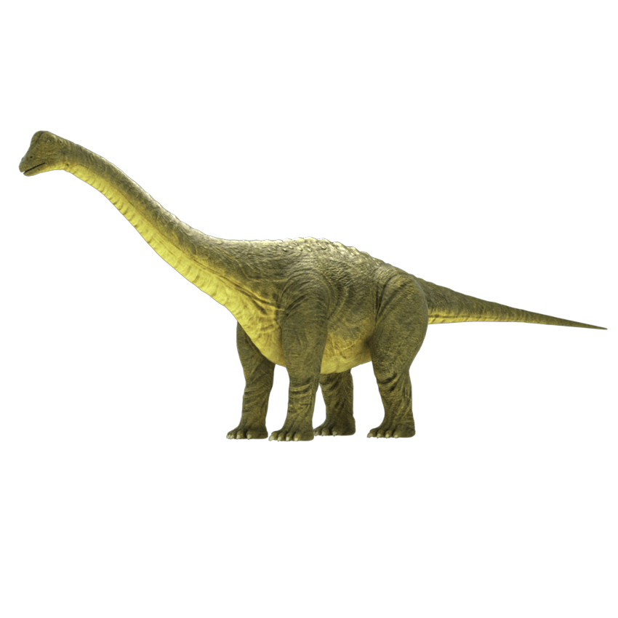

Slide 28
MY BACKGROUND
2006-Present
National Library of Medicine
Association of American Medical Colleges
Welch Medical Library – Johns Hopkins University
5 States (DC area, MO, VA, OH, MI)
6 Positions

Slide 29
CONTACT INFORMATION
Office: Mulford Library Building, 4th Floor
Phone: 419.383.4214
Direct Email: margaret.hoogland@utoledo.edu
General Library Email: mulfordreference@utoledo.edu

