Slide 1
Research and Writing for the Medical Literature
Intro & Library Updates
Tenure & Promotion
Grants
Scholarly Actiivites
Searching
Conclusion
Margaret Hoogland, MLS, AHIP
19 November 2020

Slide 2
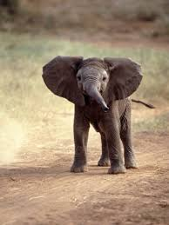
Intro & Library Updates
Tenure & Promotion
Grants
Scholarly Actiivites
Searching
Conclusion
Acknowledgement
Of
Elephants

Slide 3
Positive Pandemic Changes
Intro & Library Updates
Tenure & Promotion
Grants
Scholarly Actiivites
Searching
Conclusion
University Libraries
Using evidence based (aka data-driven) decisions for renewing and acquiring books, databases, and journals.
Function and support faculty, staff, and students effectively both remotely and in-person.
Liaisons can now purchase electronic books!

Slide 4
Current Electronic Book Purchase Requests
Intro & Library Updates
Tenure & Promotion
Grants
Scholarly Actiivites
Searching
Conclusion
AMA Manual of Style – 2020 (11th edition)
Fatal Invention: How Science Politics, and Big Business Re-Create Race in the 21st Century
General Pediatrics: Board Review 2020
DSM V – 2013 (5th Edition)

Slide 5
Faculty 180
Intro & Library Updates
Tenure & Promotion
Grants
Scholarly Actiivites
Searching
Conclusion
Curriculum Vitae
Update after a presentation, publication, etc.
Activities > Scholarly Contributions
Add your invitation or confirmation email (deadline dependent)
Add slides, awards, etc. after conference or presentation
Publications
Include Impact Factor (if available)
Indicate role for contributors

Slide 6
Web of Science
Intro & Library Updates
Tenure & Promotion
Grants
Scholarly Actiivites
Searching
Conclusion
H-Index
This varies by source.
Ex. Web of Science says mine is 1 and Google Scholar says 2.
Impact Factor
List by article publication year – do not use information from InCites.

Slide 7
Intro & Library Updates
Tenure & Promotion
Grants
Scholarly Actiivites
Searching
Conclusion
Funding &
Grant Information

Slide 8
Intro & Library Updates
Tenure & Promotion
Grants
Scholarly Actiivites
Searching
Conclusion
Internal Grant Information
URFO Small Awards Programs: Apply Anytime!
https://www.utoledo.edu/research/rsp/urfo/SmallAward.html
Dearce-Koch Memorial Endwoment Fund: Due 20 January 2021
https://www.utoledo.edu/research/rsp/urfo/dearce.html
Research Awards and Fellowship Program: Due 20 January 2021
https://www.utoledo.edu/research/rsp/urfo/rafp.html
Interdisciplinary Research Initiation Award Program
Letter of Intent Due 02 November; Full Proposal, Due 20 January 2021, by Invitation Only
https://www.utoledo.edu/research/rsp/urfo/iria.html
Research Innovation Program
Letter of Intent Due 02 November; Full Proposal, Due 20 January 2021, by Invitation Only
https://www.utoledo.edu/research/rsp/urfo/ResearchInnovationProgram.html

Slide 9
Intro & Library Updates
Tenure & Promotion
Grants
Scholarly Actiivites
Searching
Conclusion
External Grant Information
Office of Research and Sponsored Programs
https://www.utoledo.edu/research/rsp/
External Grants
https://www.utoledo.edu/research/rsp/GettingStarted.html
Complete New Proposal Intake
Work with Grants Coordinator

Slide 10
Scholarly Activities
Intro & Library Updates
Tenure & Promotion
Grants
Scholarly Actiivites
Searching
Conclusion

Slide 11
Intro & Library Updates
Tenure & Promotion
Grants
Scholarly Actiivites
Searching
Conclusion
Staying Current
Journal Table of Contents
Saved Searches – PubMed, Embase, etc.
Google Scholar Alerts
Twitter (weird but true!)

Slide 12
Intro & Library Updates
Tenure & Promotion
Grants
Scholarly Actiivites
Searching
Conclusion
Systematic Reviews
3 Different Databases
Adjust search to be repeatable but specific to each database
Register Protocol in Prospero – Complete PRISMA
Depending on the type of review, allocate a minimum of 3-6 months from project start-to-finish.
More information: libguides.utoledo.edu/sysrev

Slide 13
Translations Journal
Intro & Library Updates
Tenure & Promotion
Grants
Scholarly Actiivites
Searching
Conclusion
Open Access – No Publication Charge
~8 weeks from submission to acceptance
Accepted Submission Types
Original Basic or Clinical Research Articles
Case Reports
Accepts Reviews on All Aspects of Medical Sciences

Slide 14
Intro & Library Updates
Tenure & Promotion
Grants
Scholarly Actiivites
Searching
Conclusion
Author Dashboard

Slide 15
Intro & Library Updates
Tenure & Promotion
Grants
Scholarly Actiivites
Searching
Conclusion
Features | EndNote | Mendeley | Zotero | SciWheel
Deduplication | Best – multiple options and a tutorial are available to facilitate this! | Ok | Ok | Not great
Operating System & Storage options | Apple, PC Does not work with Chromebook or Surface! | Web based, Desktop App Additional Storage can be purchased. | Web based, Desktop App Open Source | Web based, Desktop App Limits shareable folders Suggest Tagging projects
Ideal for ____ type of projects. | Systematic Reviews, Meta Analysis, Projects requiring sophisticated deduplication | Systematic Reviews, Meta Analysis, Articles, Reviews, etc. | Best for non-Systematic Review and Meta Analyses projects | Best for non-Systematic Review and Meta Analyses projects
Learning Curve | Steep | Middle of the Road | Fairly simply | Easy
Collaborative Projects | Not good – shared folders with each person maintaining an individual EndNote files (libraries) works best. | Varies (browser, wifi strength). Use the desktop browser and then share folders/files. | Free file sharing Share individual folders. | Google Plug-in Upload Document in shared account Connect to shared account from Word

Slide 16
General Database Tips
Intro & Library Updates
Tenure & Promotion
Grants
Scholarly Actiivites
Searching
Conclusion
Left Side
Middle or Right Side
Publication Year
Study Type
Geography (some databases)
FindIt@UT (within records)
Save or print listed records
Search History: Save, Email or Print
Export to Citation Manager(s)
Email or save full-text articles

Slide 17
Searching Web of Science
Intro & Library Updates
Tenure & Promotion
Grants
Scholarly Actiivites
Searching
Conclusion
General Tricks
Free text searching (keywords, etc)
Limit to topic (broadest), Title (slightly narrower), Abstract/Subject –most narrow)
Author Search
For some names (e.g. Hoogland), simple search works.
Compare/contrast with your Google Scholar and PubMed Records

Slide 18
PubMed Specific Tips
Intro & Library Updates
Tenure & Promotion
Grants
Scholarly Actiivites
Searching
Conclusion
1) Always Use the Advanced Search Screen
2) Add Fields (Used in 98% of my searches!)
All fields [all fields]
Mesh [mesh]
Text word [tw]
3) Add to history
4) Is PubMed a good interpreter? Scrutinize the Search Details

Slide 19
Intro & Library Updates
Tenure & Promotion
Grants
Scholarly Actiivites
Searching
Conclusion
Getting to PubMed
Portal
myut.utoledo.edu >Login to My UT>Libraries>Mulford
Mulford website
www.utoledo.edu/library/mulford > More Databases > PubMed@UT
Customized website
Libguides.utoledo.edu/md/databases > PubMed > PubMed@UT

Slide 20
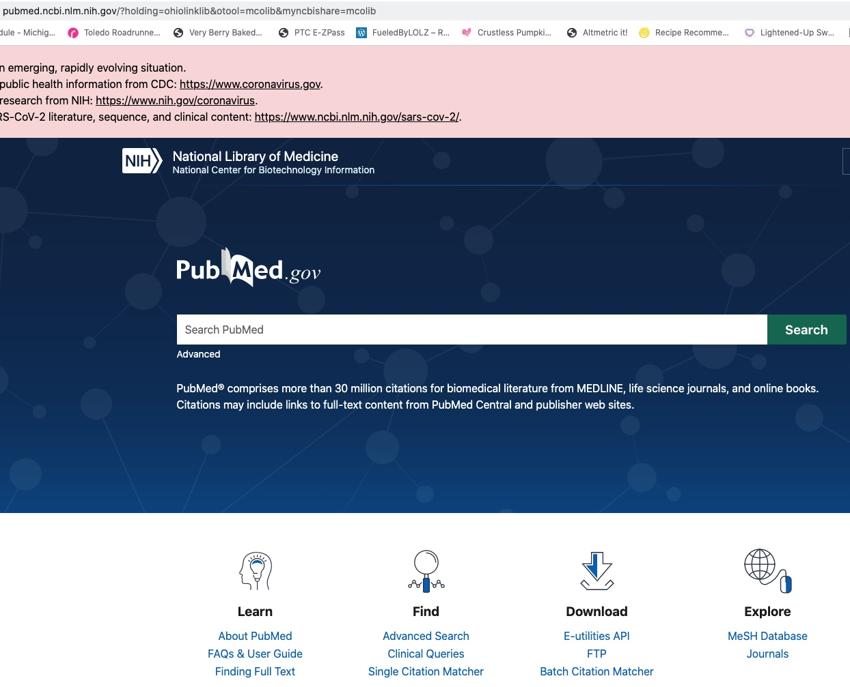

Slide 21
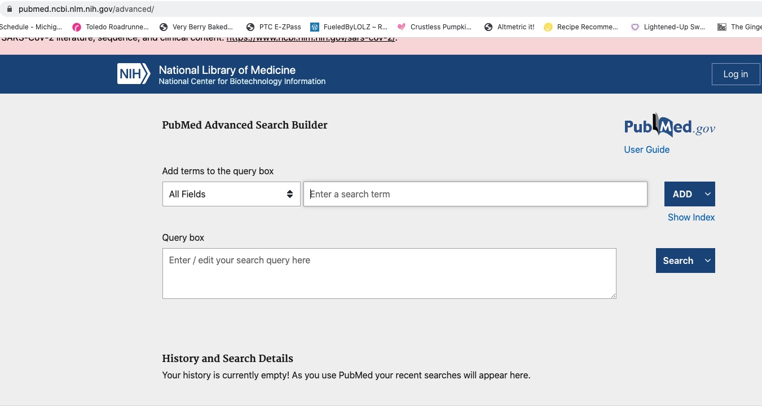

Slide 23
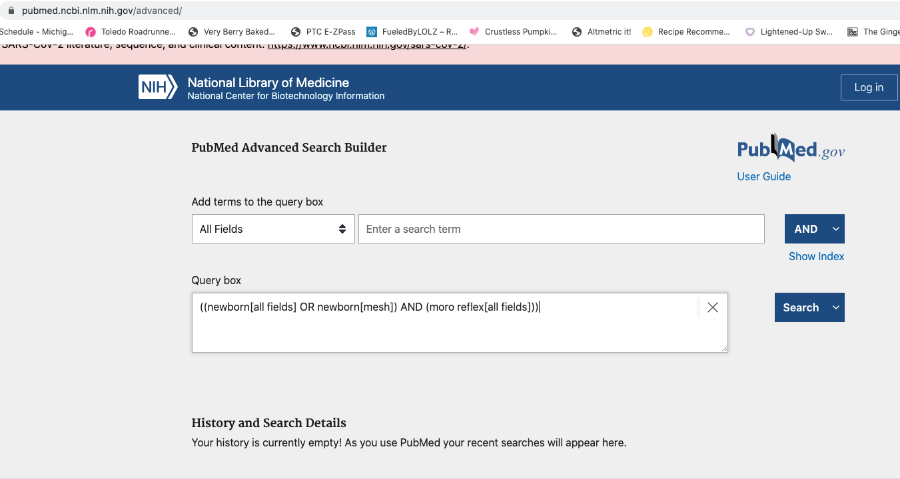

Slide 24
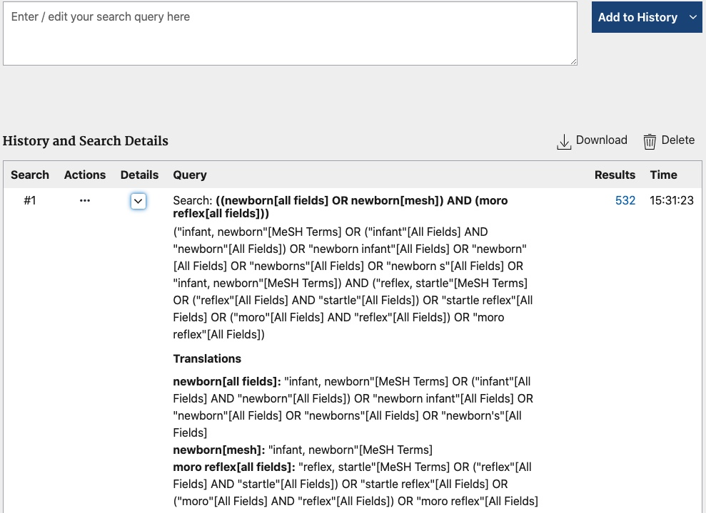

Slide 25
Intro & Library Updates
Tenure & Promotion
Grants
Scholarly Actiivites
Searching
Conclusion
Alternatives to PubMed
OVID Medline
Embase
New and emerging drugs, alternatives for medication resistant situations, oncology
CINAHL and Cochrane
ERIC
SportDiscus

Slide 26
Locating Margaret Tips
Intro & Library Updates
Tenure & Promotion
Grants
Scholarly Actiivites
Searching
Conclusion
Real Time – No Delay – Instant Message Chat Hours
Mondays and Wednesdays from 11 to 1:30 pm
Fridays from 1:30-4 pm
Email
Use High Importance and/or Specific Subject Lines
Expect results in 48 business hours (usually it is sub 24 hours!)
Nudge me after 48 business hours – it keeps me on track.
Office Phone (419-383-4214)
Expect a response within 30-60 minutes.
Consults & Searching Sessions
Offering only remote sessions at this time.

Slide 27
Intro & Library Updates
Tenure & Promotion
Grants
Scholarly Actiivites
Searching
Conclusion
Thank you
&
Happy Thanksgiving

