Slide 1
How to write Clinical Publications: Case Reports, Case Series and Original Articles
April 19, 2018

Slide 2
What is a Case Report, Case Series, Analytical Study?
John Nemunaitis, M.D.

Slide 3
Case Report
Detailed report of the symptoms, signs, diagnosis, treatment and follow up of an individual patient
Used to describe a novel/suggestive occurrence or to imply an input → output relationship so as to…
Provide a basis for further/expanded evaluation.

Slide 4
Case Series (Clinical Series)
Descriptive report on patients who received similar treatment
Can be prospective or retrospective
Can be consecutive or non consecutive
Non quantitative/not conclusive
Does not involve hypothesis testing but…
Can be used to generate an hypothesis

Slide 5
Clinical Study Design
Applies to trials and experiments involving human beings
Goals can include safety, feasibility, mechanism of action, identification of a sensitive patient subset, and efficacy of a new drug or device
Can be descriptive (case series) or analytical
Ultimately, the focus of a summary of trial results involving case reports, case series is to lead to an analytical design* that is utilized for product justification (and FDA registration) through a New Drug Application (NDA) process
* Typically analytical design captures top journal publications

Slide 6
Analytical Study
A non-comparative (phase I, II) or comparative (phase II/III) study designed to (one or more of the below):
Delineate parameters of study agent/device
Assess predictability of proposed biomarker
Test validity of hypothesized relationships between risk factors and outcome
Quantify associations and determine whether association exists between variables

Slide 7
Analytical Trial Design
Randomized controlled trial
Blinded
Non blinded
Statistical justification of population size per cohort
Crossover (i.e. PFS endpoint) vs. non crossover (i.e. OS endpoint)

Slide 8
How to Start Writing a Paper
Matthew Metzinger

Slide 9
My research background…
Basic science research at the University of Notre Dame
Involvement in authoring three research articles
How I sought out this research opportunity…
Interest in Internal Medicine and Hematology/Oncology
UT News article about the Cancer Program in Sept. 2017
Meeting with Dr. Brunicardi who connected me with Dr. Nemunaitis in Dec. 2017
Emailing Dr. Nemunaitis and meeting in January 2018

Slide 10
My concerns with pursuing a research project…
Time commitment and deadlines
Not knowing much about conducting a literature review
Benefits from our collaboration thus far…
Foundations of a review article about an exciting new cancer treatment
Background for a lecture on Lymphoma for our PA Program
Mentoring and career advice as I begin applying to residency programs

Slide 11
What I’ve found especially beneficial…
Focus on an up-and-coming topic that undoubtedly will benefit me as a future clinician
Ease of communication and arranging meetings with Dr. Nemunaitis
Understanding of my time constraints with clinical rotations
Willingness to include me in presentations and research meetings
Environment conducive to asking questions and seeking guidance

Slide 12
Case Report
John Nemunaitis, M.D.

Slide 13
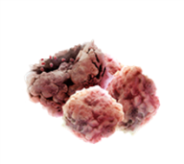
Case Report: Element 1 – Novel Science Vigil is a Plasmid Transfected Autologous Tumor Immunotherapy Targeting Knockdown of Furin and Expression of GMCSF at the Site of Vaccination
“Local” Administration
CMV Promoter
Kan resistance
GM-CSF
huGM-CSF2
2A
poly A
Vigil
5140 bp
“Systemic” Effect
sh-Fur
Ori
Vigil
Tumor cell
Ag
Tumor
IFNγ
TGFβ_{1,2}
Y
Y
CTL
“Systemic” Effect
Y
Y
ELISPOT+ effector cell
Y
Y
Y
Antibody
Ag
Y
Y
Y
CTL
Vigil Induced Humoral and (Serology) Cellular Mechanistic (ELISPOT) Verified
Y
Ag
Ag
CTLr
B Cell
CD4 Cell
MHC II
MHC I
Y
Y
Ag
CD4 Cell
Y
Ag
CTLr
B Cell
CD4 Cell
Ag
CD4 Cell
CTLr
Cancer Testis Ag
Cancer Neoantigen

Slide 14
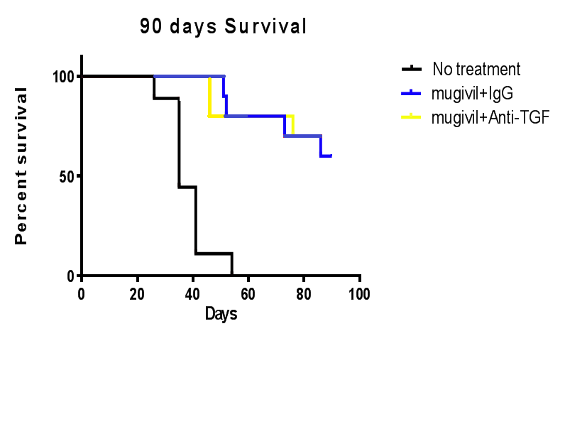
Element 2 – Animal Support Murine Vigil Immune Model Development Lei Zheng, Johns Hopkins University/Transgene
1. Ongoing Study to Determine PD-L1/TIL Expression of Vigil Combination Activity (GVAX +/- aTGFβ ab, Vigil +/- aTGF β ab +/- PD-1/PD-L1 Inhibitor)
Overall Survival
*GVAX, GVAX/TGFβ Trap positive control
Soares et al Oncotarget 2015, 6(40): 43005-15

Slide 15
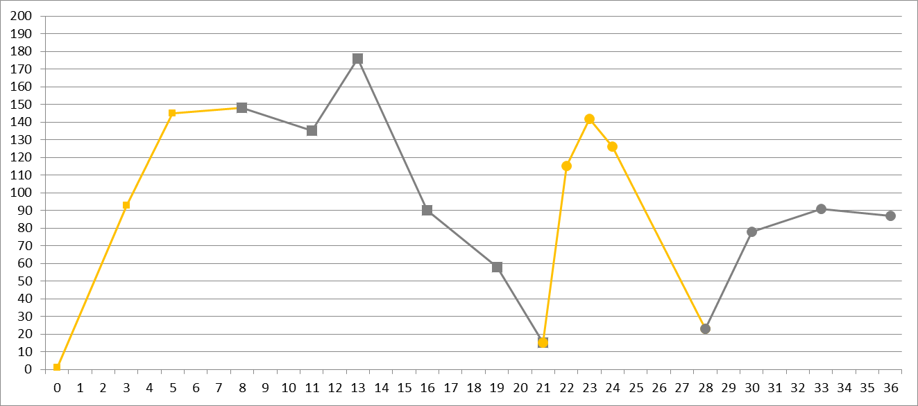
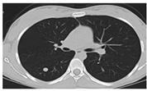
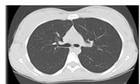
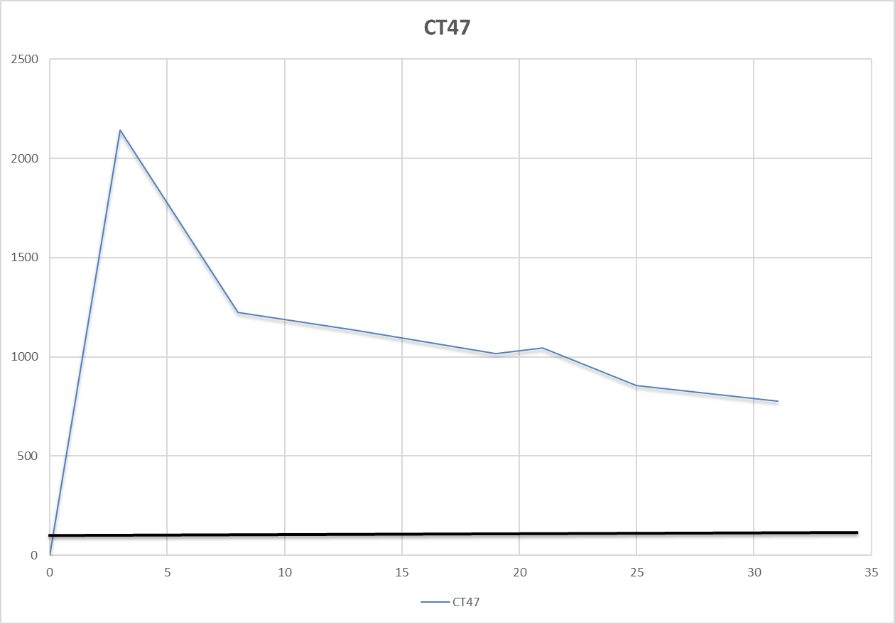
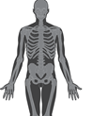
Element 3 – Unique Clinical Response “Related to Science” Ewing’s Sarcoma Case Report 1 (#-062) Clinical and ELISPOT Response in Relapsed Patient
CD8 Cellular Response
Recurrence
1st Vigil
2012
NED
No treatment
2016
Months since Treatment Start
.
CD4 Humoral Response
(CT47 ag*)
176
Month 13
.
.
.
.
93
Month 3
.
0
Baseline
Chemo/radiation
1st Vigil
2nd Vigil
*NYESO1 humoral response also observed
No additional treatment
2010
2012
2014
2016
2017
Metastatic EWS
Recurrence
SD ≥ 18 mo
PD
NED ≥ 10 mo
NED CR by PET ≥ 9 mo
Ghisoli et al Journal of Pediatric Hematology/Oncology 2017

Slide 16
QUESTIONS?

Slide 17
Case Series
John Nemunaitis, M.D.

Slide 18
Based on this case report with Ewing’s Sarcoma, extension of the Phase I database lead to a case series involving third-line Ewing’s Sarcoma patients

Slide 19
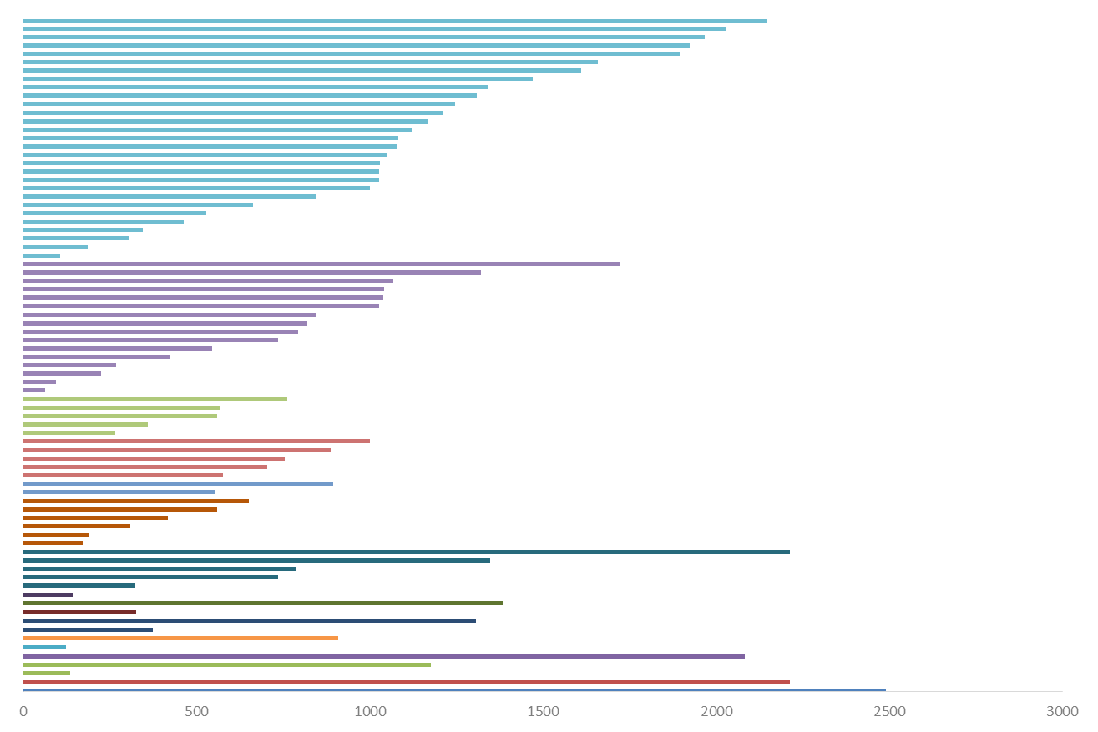
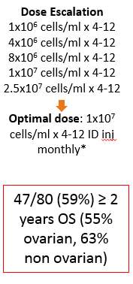
Vigil Phase 1
Days since procurement (n=80)
Predicted survival range
Alive
Data as of 03-23-17

Slide 20
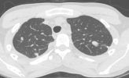
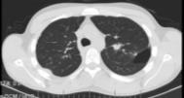
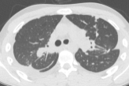
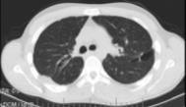
Ewing’s Sarcoma Case Report 2 (#-089) Clinical and ELISPOT Response in Relapsed Patient
Treatment History
Intensive chemotherapy from Oct 2008 – May 2009
Intermittent radiation and experimental agents in 2010, 2011, and 2013
Vigil Ph1: Surgical resection of lung lesion (11/2013)
8 doses of Vigil administered Feb-Sept 2014
Patient had radiographically confirmed partial response
Radiology Results
Tumor Measurements
ELISPOT Conversion
Date | Result
4/08/14 | 25%↓ target lesions
5/19/14 | 38%↓ target lesions
7/10/14* | 35%↓ target lesions
1/09/2015 | Disease Progression
ELISPOT | Positive Spots
Baseline (2/26/2014) | 0
Month 2 (3/24/2014) | 174
Month 3 (4/21/2014) | 155
02/19/14
05/19/14
*All non targeted lesions ↓ or completely gone

Slide 21
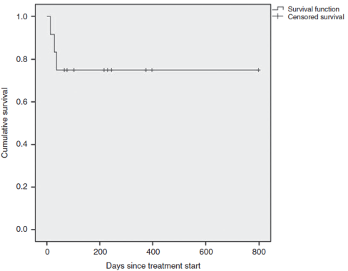
Response of Vigil Treated Ewing’s Sarcoma (EWS) Patients → Case Series Report*
ID | ELISPOT Result Pre/Post | Days Since Procurement | Vaccines Received | Optimal Treatment Status | Survival Status
058 | NE | 417 | 1 | PD | Dead
062 098 | -/+ | 825ª N/A | 8 | CR | Alive
063 | NE | 219 | 1 | PD | Dead
081 | -/+ | 439 | 3 | SD | Alive
083 | -/+ | 425 | 4 | SD | Alive
089 | -/+ | 334 | 8 | PR | Alive
090 | -/+ | 307 | 9 | SD | Alive
092 | -/+ | 271 | 4 | SD | Alive
095 | -/+ | 236 | 3 | SD | Alive
101 | -/+ | 146 | 4 | SD | Alive
104 | -/+ | 104 | 4 | SD | Alive
107 | NE | 58 | 1 | PD | Dead
N/A, not applicable. ªSince first procurement, treatment.
* Ghisoli et al Molecular Therapy 2015
KM Survival for Case Series > 75%
Standard chemotherapy for third-line EWS results in < 25% 1 year survival

Slide 22
What do Non Physician Care Takers get from a Case Report, Case Series
Michael Vasko, PA

Slide 23
Case Reports and the Non-physician Provider:
What do case reports mean to us?
From a PA-C, or “mid-level” provider’s, perspective it depends on what hat is being worn.
Clinician
Educator
Student
Researcher

Slide 24
Case Reports and the Non-physician Provider:
Non-physician provider:
Often utilize case reports as CME, but also as a way to expand our knowledge of pathologies we may see in clinical practice
Educator:
Provides scenarios which can be employed to develop skills relevant to clinical practice, and reinforce traditional lecture based material
Student:
Case-based learning allows for enhancement of core curriculum, and application of knowledge obtained
Researcher:
Traditionally, mid-level providers are not viewed as “research-intensive” but many are primary/co-authors, or aspire to be involved in this field
Notes:
Non-physician provider: PA, NP, RN
- CME usage, clinical practice (particularly in sub-specialties as more mid-level providers are sub-specializing).
Educator: program faculty, preceptors
- Provide complicated/challenging material for students, foster the development of analytical skills, develop diagnostic skills, and application of knowledge that has been learned.
- PA program and NP program will be piloting an inter-professional program this summer for case-based learning, and application of case reports are the main focus of this program.
Student:
- Application of knowledge learned, integration of all aspects of clinical practice (medical history, physical exam, clinical medicin, pathophysiology, pharmacology, and research.
Researcher:
- While not generally regarded as a “research-intensive” role, mid-level providers are often co-authors on many publications, as well as primary authors of original research.
- Mid-level providers are often employed through research studies to assist in developing, running, and writing for publication, and case reports can be beneficial in developing the skills to accomplish these tasks.

Slide 25
Overview of Services and Resources
by
Margaret A. Hoogland, MLS, AHIP
Jodi Jameson, MLIS, AHIP
Gerald (Jerry) Natal, MLIS, AHIP
19 April 2018

Slide 26
Carlson Library – Main Campus
419.530.2324
Mulford Library – HS Campus
419.383.4225
mulfordreference@utoledo.edu
All Subject Matter experts are listed here:
libguides.utoledo.edu/subjectliaisons

Slide 27
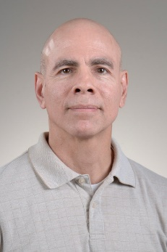
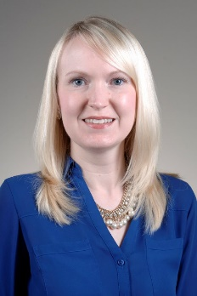
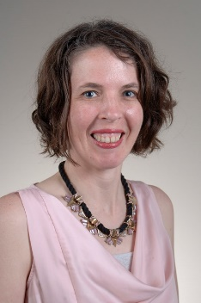
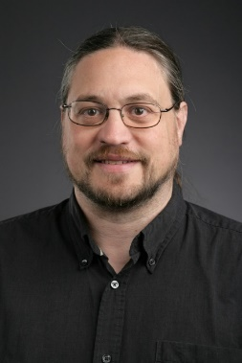
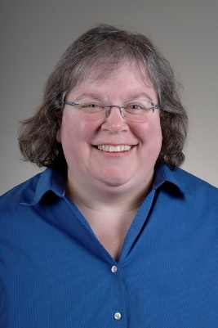
University Libraries College Liaisons
Gerald Natal, MLIS
Health Sciences Librarian
Dept. of Physical Therapy
419.383.4227
gerald.natal@utoledo.edu
Wade Lee, MLS
Science Reference Librarian
College of Pharmacy
419.383.5329/419.530.4490
wade.lee@utoledo.edu
Jolene Miller, MLS, AHIP
Mulford Library Director Physician Assistant Studies
419.383.4959
jolene.miller@utoledo.edu
John Napp, MLS
Engineering Librarian
Carlson Library
419.530.3948
john.napp@utoledo.edu

Slide 28
How can we help with your research?
EndNote Training/Proper Citation Formatting
Typically lasts for 30-60 minutes.
Makes citations for Posters, Presentations, and Articles easy…almost fun!
Literature Reviews
48 hour or 2 Business Days turnaround time
Please provide a brief description (1-2 sentences) and keywords!

Slide 29
What else can we do for you?
Interlibrary Loan
Accessible here: http://libguides.utoledo.edu/ill
Articles will be emailed to you within 24-48 hours.
ILLIAD (system) passwords do not change with your UTAD passwords
Email mulfordreference@utoledo.edu or your college liaison with questions.

Slide 30
What else can we do for you?
Systematic Review Service
What is a Systematic Review?
Read about it here: http://libguides.utoledo.edu/sysrev
What is involved?
Plan for 6 months minimum from start to finish
Develop a protocol and locate articles
Schedule a meeting with the Systematic Review Team to get an overview of the process

Slide 31
What else can we do for you?
Journal Selection for Manuscript Submission
Instructions to Authors: http://mulford.utoledo.edu/instr
Elsevier® Journal Finder: https://journalfinder.elsevier.com/
Springer: https://journalsuggester.springer.com/
Journal Citation Reports: https://0-jcr.incites.thomsonreuters.com.carlson.utoledo.edu/
Ulrich's Web: https://ulrichsweb.serialssolutions.com/
Journal Author Name Estimator: http://jane.biosemantics.org/

Slide 32
Statistical Support
Tian Chen, Ph.D.

Slide 33
Statistical Analysis
Two components:
Analysis Plan: sample size justification and methods description
Results: Descriptive
Descriptive statistics
Analytical results

Slide 34
Analysis Plan: Sample Size
Power analysis and sample size calculation
ES is the magnitude of the difference one wants to detect
It is the difference regarded as scientifically meaningful and important.
The larger ES, the smaller sample size is required.
Sample Size
Power, 0.8
Effect Size (ES)
SD of outcome
Significance level, 0.05

Slide 35
Analysis Plan: Sample Size
Power analysis and sample size calculation
Sample Size
Power, 0.8
Effect Size (ES)
SD of outcome
Significance level, 0.05
The selection of ES:
Scientific knowledge of the investigator
From prior studies to make an informed guess.
Choose the smallest effect size in one’s opinion that would be scientifically meaningful

Slide 36
Analysis Plan: Sample Size
The greater the variability of the outcome variable, the larger the sample size required to attain a given power at the chosen level of significance.
SD is not exactly known:
Look into literature
Pilot study
Don’t confuse SD with SE: SE involves sample size n
Power analysis and sample size calculation
Sample Size
Power, 0.8
Effect Size (ES)
SD of outcome
Significance level, 0.05

Slide 37
Analysis Plan: Method description
What methods have been used:
Simple comparison: 2-sample t, ANOVA (Any post-hoc intervals? If yes, then what type?)
Advanced modeling: Linear regression, logistic regression, Cox proportional hazard model etc.
What predictors are included in the model and how they are selected (if necessary)
What software is used to perform the analysis and what the level of significance is.

Slide 38
Results
Descriptive statistics for baseline characteristics:
Continuous: mean ± sd or median ± IQR if skewed dist or having outliers.
Categorical: frequency with percent.
Analytic results:
Interpretation of the model coefficient.
Always add 95% CI.

Slide 39
What method to use?
Question/Data | Methods | Conditions | Alternative
Compare two independent sample mean | 2-sample t-test | Normality | Wilcoxon-rank sum test, no assumption needed but less power.
Compare two paired sample means | Paired t-test | Normality | Wilcoxon signed rank test
Compare means among several groups | ANOVA | Normality Equal variance | Kruskal-Wallis test
Time to event data | Kaplan-Meier log rank test | None | None
 | Cox model | Proportional hazard | Consider a more complicated model (might need a quadratic term etc) Stratification on categorical predictor (no coef for that variable).
Repeated measurements over time | Random effects model or GEE | Random effects assume normality while GEE does not.

Slide 40
How to Request?
Calls for assistances are directed to Dr. Don White
Office number: 419-530-4502
Email: Donald.White@UToledo.Edu

Slide 41
10 Minute Break

Slide 42
Scientific Correlation Opportunity in Case Report/Case Series
Jim Willey, M.D.

Slide 43
Definition of Scientific method
A method of research in which a problem is identified, relevant data are gathered, a hypothesis is formulated from these data, and the hypothesis is empirically tested.
Example; Practice of Medicine
Patient evaluation
Problem identified
Patient complaint
Relevant data are gathered
History, physical, tests
A hypothesis is formulated from these data
Working diagnosis
Hypothesis is empirically tested
How well does patient’s course and additional evidence correspond to that for the working diagnosis
Remember the story of Barry Marshall and Robin Warren:
Won 2005 Nobel prize for discovering role of h pylori in gastric and duodenal ulcers.

Slide 44
Scientific Correlation Opportunity in Case Report/Case Series
Example: Development of a lung cancer risk test (LCRT) biomarker
Phase 1: Discovery: —Preclinical Exploratory Studies
(e.g., Crawford et al, Cancer Research, 2001).
Case/control study; Analysis of regulation of over 200 protective antioxidant, DNA repair, cell cycle control genes in normal airway epithelial cells of individuals with or without lung cancer: what is different in subjects with cancer?
Primary Aims
To identify and prioritize leads for potentially useful biomarkers.
Primary Outcome Measure
Over or under expression of genes in normal airway epithelial cells
Evaluation of Study Results
For each gene measured, how well did it distinguish between case and control subjects.
Calculate the true-positive rate (TPR), i.e., the proportion of case subjects who are biomarker positive, and the false-positive rate (FPR), i.e., the proportion of control subjects who are biomarker positive.
Assemble multi-analyte biomarker from best performing individual gene expression
Summarize ability to discriminate between disease and non-disease: Receiver operator characteristic (ROC).

Slide 45
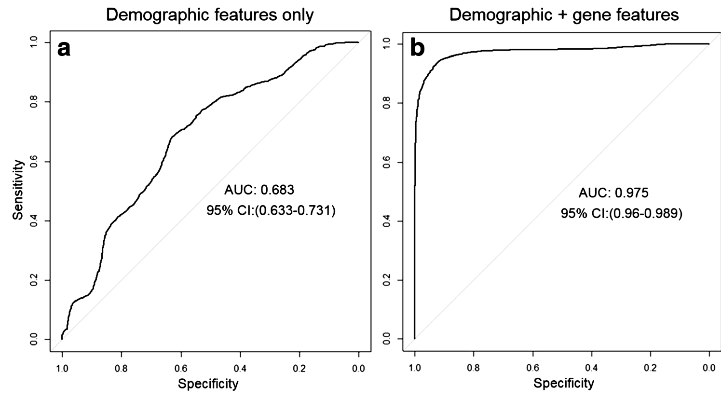
Scientific Correlation Opportunity in Case Report/Case Series
Example: Development of a lung cancer risk test (LCRT) biomarker
Phase 2: Modeling in Clinical Development
Case/control studies (Normal bronchial epithelial cells collected from >600 subjects)
First case/control study (Mullins et al, 2005).
Second case/control study (Blomquist et al, 2009).
Further optimize model (analytes and interactions in model).
Test optimized model in third case/control study (Yeo et al, 2017)
Evaluation of Study Results
Estimates of the TPR and FPR or ROC curve were calculated.
Primary Aims
To identify and prioritize leads for potentially useful biomarkers.
Evaluation of Study Results
Summarize ability to discriminate between cancer and non-cancer: Receiver operator characteristic (ROC).
Primary Outcome Measure
Result of the clinical biomarker assay

Slide 46
Scientific Correlation Opportunity in Case Report/Case Series
Example: Development of a lung cancer risk test (LCRT) biomarker
Phase 4: Prospective Cohort Study: (Crawford et al, 2017); normal bronchial epithelial cells collected from 384 subjects at 12 clinical sites.
Clinical specimens collected from high risk subjects without lung cancer and followed to identify prospective cancer patients, then determine whether a positive test correlates with risk for developing lung cancer
This study is ongoing, expect to be completed in one year.

Slide 47
Second Case Series: What to Do?
John Nemunaitis, M.D.

Slide 48
→ Analytical Study (but not) CL-PTL-121 Randomized Trial of Vigil vs. Gemcitabine/Docetaxel in Third-line Recurrent Metastatic Ewing’s Sarcoma
Metastatic Ewing’s sarcoma in
≥2nd Relapse
Surgical Candidate
with
Non-osseous Tumor
Vigil
1.0 x 10⁷ cells/ml ID q 28d
Randomization 1:1
N = 62
HR = 0.383; p = 0.05
Power 90%
Primary Endpoint:
Overall Survival
R
Gemcitabine: 675 mg/m²
Day 1 & 8
Docetaxel: 75 mg/m² Day 8
Insufficient Accrual
13 patients over 1 year
Once randomized to standard treatment patients withdrew…Even FDA…I’ll explain!

Slide 49
Further “Case Series” Long Term Follow up of 2 EWS Analysis Vigil in Ewing’s Sarcoma (Phase 1 and 2b): All Vigil Consented Patient Demographics
High Risk Second Line / Third Line Ewing’s Sarcoma Patients
 | Vigil | Control
Number of Patients | 21 | 22
Sex (M/F) | 14/7 | 9/13
Age Median | 19 | 16.5
Age Range | (12-59) | (7-30)
ECOG (0 or 1) | 21 | 22
Ethnicity
Caucasian | 16 | 18
Asian | 1 | 1
Hispanic/Latino | 4 | 1
Other | 0 | 2
Prior Systemic Treatment (frontline / 2nd line / 3rd line) | 1/5/15 | 3/4/15
Metastatic Disease | 21 | 22
Dose Level
2.5 x 10e7 | 3 | 4
1.0 x 10e7 | 13 | 14
8.3 x 10e6 | 1 | 0
4.0 x 10e6 | 4 | 2
Insufficient | 0 | 2
Randomized/Phase I Study | 5/16 | 8/14
Male sex & Age >15 years higher EWS risk for death

Slide 50
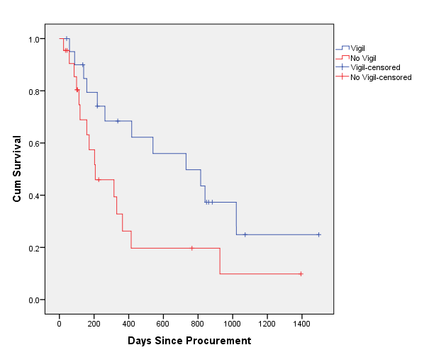
Vigil in Ewing’s Sarcoma (Phase 1 and 2b): All Vigil Consented Patient: OS
Median PFS is 6 mo
Expected median PFS 1.5-2mo*
* Yoon et al 2014; Tap et al 2012; Choy et al 2014; Juergens et al 2011
Assessed prior to 02/16/2017 Peter Bross, MD discussion
Group | N | Median Survival (mo) | P- value (Log Rank)
MC/RC* | 22 | 6.8 | .041
Vigil | 21 | 24.0
*MC/RC = Matched Control (n=14) /Randomized Control (n=8)
Limited validity to “mix” 2 trial populations BUT successful in FDA move forward

Slide 51
So What Do We Do With This

Slide 52
Story End of Second Series
John Nemunaitis, M.D.

Slide 53
What is our Ultimate Focus?

Slide 54
Clinical Study Intent
Ultimately, the focus of a summary of trial results involving case reports, case series is to lead to an analytical design* that is utilized for product justification (and FDA registration) through a New Drug Application (NDA) process
* Typically analytical design captures top journal publications

Slide 55
FDA Process: From Concept to Clinical Use
Idea
Mechanism Discovery
In Vitro Proof of Principle
In Vivo Demonstration of Activity/ Mechanism
In Vivo Justification of Dose
Investigational New Drug Application (IND)
Phase I Trial
Phase II Trial
Phase III Trial
New Drug Application (NDA)
Phase IV Studies for Expanded Use
Product, Marketing, Use

Slide 56
Vigil in Ewing’s Sarcoma (Phase 1 and 2b): All Vigil Consented Patient: OS
Median PFS is 6 mo
Expected median PFS 1.5-2mo*
* Yoon et al 2014; Tap et al 2012; Choy et al 2014; Juergens et al 2011
Assessed prior to 02/16/2017 Peter Bross, MD discussion
Group | N | Median Survival (mo) | P- value (Log Rank)
MC/RC* | 22 | 6.8 | .041
Vigil | 21 | 24.0
*MC/RC = Matched Control (n=14) /Randomized Control (n=8)
Limited validity to “mix” 2 trial populations BUT successful in FDA move forward

Slide 57
Key Vigil Background Justification/Development Peer Review Manuscripts
Reference
Topic
Key Message
Senzer N et al Molecular Therapy 2012
Phase I in ST
Safety & Dose Escalation
Senzer N et al Journal of Vaccines &
LT-FU Phase I in ST
OS Efficacy Correlation to ELISPOT
Vaccination 2013
Nemunaitis J et al Oncology 2014
Phase I in Hepatocellular
OS Efficacy Support in HCC
Cancer
Ghisoli M et al Molecular Therapy 2015
Phase I in Ewing's Sarcoma
OS Survival Advantage in EWS
Ghisoli M et alMol Ther. 2016
LT-FU Phase I in Ewing's
OS Efficacy Correlation to ELISPOT
Sarcoma
Nemunaitis J et al Faculty of 1000, 2016
Phase I Cancer Vaccine in
Differentiation to Cancer
ST
Peptide/Antigen Vaccines
Ghisoli M et al Pediatric Cancers-Clinics in
Exploratory Approaches in
Exhausted Treatment Options for
Oncology 2016
EWS
EWS
Oh J et al Gynecologic Oncology 2016
Phase II in Ovarian Cancer
RFS Efficacy and Correlation to
ELISPOT in Ovarian Cancer
Nemunaitis J et al Annals of Translational
Tumor Vaccines and Cellular
Role of Vigil in current
Medicine 2016
Immunotherapies
Immunooncology
Barve M et al Biomedical Genetics and
Phase I and II in Melanoma
OS Efficacy in Melanoma
Genomics 2016
Ghisoli M et al Journal of Pediatric
Case Report: Phase I in
NED in Ewing's Sarcoma Patient
Hematology/Oncology 2017
Ewing's Sarcoma
Manning L, Nemunaitis J F1000 2017
Clinical Targets of Immune
Limits of antigen-targeted
Response
Immunotherapies
Manning L Journal of Gynecology and
Future Directions in Ovarian
Progress and Limits of
Women’s Health 2017
Cancer
Immunotherapy in Ovarian Cancer
Manning L et al Clinics in Oncology 2017
Phase I in ST, Low Dose
Low Dose Vigil Activation of
ELISPOT "+" T Cells

Slide 58
Based on Clinical Data Registration Acceptable Randomized Design Was Accepted in EWS
Metastatic Ewing’s Sarcoma,
1st Relapse
Surgical Candidate,
Non-osseous Tumor
Temozolomide/Irinotecan Vigil 1 x 10⁷ cells/ml, Day 15
Metastatic Ewing’s Sarcoma
Crossover Design
PFS Endpoint
N=104
HR 0.45, p=0.05
Power 90%
R
Fast Track Registration
Temozolomide 100mg/m2/day, Days 1 - 5 (PO)
Irinotecan 50mg/m2/day (PO) Days 1 - 5
1 Cycle = 21 days

Slide 59
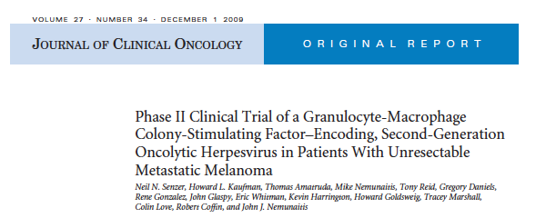
Clinical Analytical Paper – TVEC
Neil Senzer, M.D.

Slide 60
Leveraging clinical data analytics for the value-based care transition
Many types of clinical analytics varying by:
The data involved
The users of the information
The clinical decisions that the data supports
Clinical decision support (CDS) systems are prospective and/or normative (performance measures/guidelines)
Prospective CDS tools can be:
Algorithm-based, encoding biomolecular, pre-clinical and clinical knowledge (designed by research+clinical team)
Based on mathematical models that create benefit-risk score using statistical correlations or machine learning technologies (evolving)
Performance measures categorized on whether they analyze an input to the care process or an output of the care process and can include:
Resource allocation measures
Process measures-ability to comply/adhere to study outcome proposed guidelines
Outcome measures- impact on healthcare quality, cost-effectiveness, and patient satisfaction (=value-based care)

Slide 61
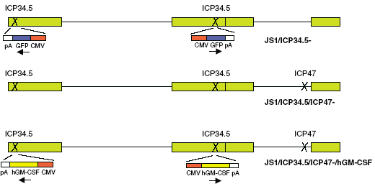
Vector/Effector: T-VEC (talimogene laherparepvec)
HSV-1 strain JS1
ICP34.5 and ICP47 deletion
GM-CSF insertion
Modes of Action
Oncolytic (tumor specific)
-ICP34.5 (decreased normal tissue virulence)
US11 (enhanced oncolytic cytotoxicity)
Immunogenic
-ICP47 (enhanced antigen presentation)
+hGM-CSF (induction, differentiation & proliferation of DC precursors)
Safety and efficacy
Thymidine kinase gene intact (acyclovir/gancyclovir sensitive)
*Lack of effect of pre-existing anti-HSV immunity

Slide 62
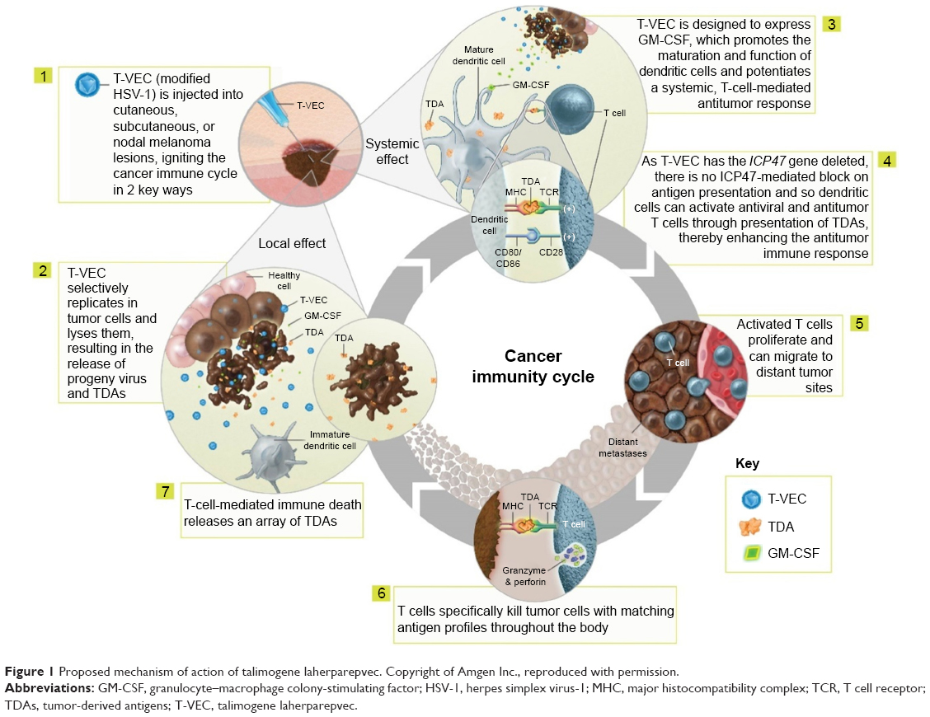
Rationale: Local Systemic mechanism of action T-VEC

Slide 63
Phase II primary objective: To assess clinical efficacy via response rates at both injected/uninjected sites
Open-label evaluation of OncoVEX^{GM-CSF} alone in up to 50 evaluable patients with unresectable stage IIIc or stage IV melanoma
Initial intralesional injection of 10⁶ pfu/mL (up to 4 mL*) into 1-10 tumors followed by 3-week interval, then
Continued two-weekly injections of 10⁸ pfu/ml (up to 4 mL*) to a total of 24 injections
Melanoma Stages IIIc/IV
OncoVEX^{GM-CSF}
10⁶ → 10⁸ pfu/ml
0 3 5 7
Week
Up to maximum 24 injections
*volume dependent on tumor size

Slide 64
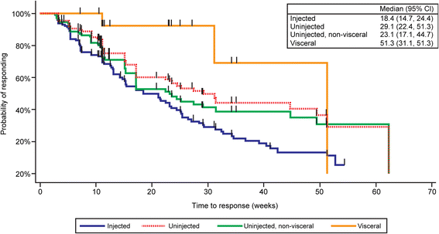
T-VEC phase II systemic vs. local responses

Slide 65
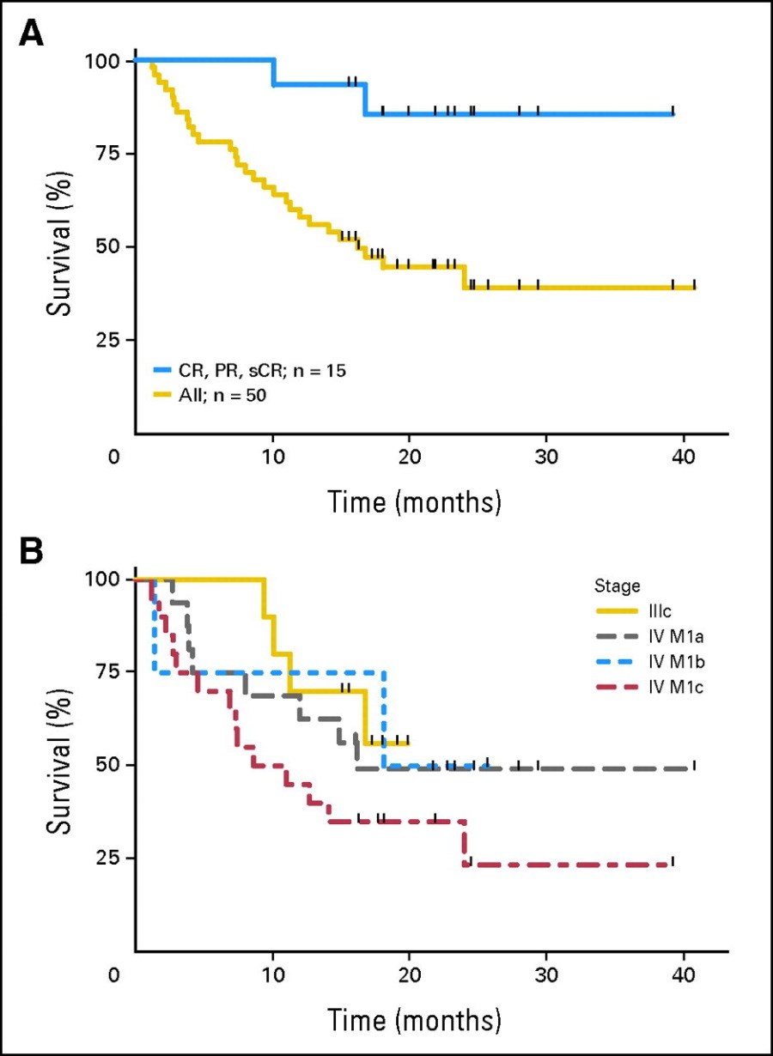
Clinical analytic paper: an integral component of a CDS system that segues into value-based care transition
T-VEC 1-yr OS
All patients (n=50): 52%
CR, PR, sCR (n=15): 87%
T-VEC 1-yr OS
Stage IIIc (n=10): 60%
All stage IV (n=40): 58%
IV M1a (n=16): 75%
IV M1b (n-4): 75%
IV M1c (n=20): 40%
FDA Approves IMLYGIC™ (Talimogene Laherparepvec) As First Oncolytic Viral Therapy In The US (Oct. 27, 2015)
Phase III

Slide 66
Choosing the Right Journal
Bill Maltese, Ph.D.

Slide 67
How Do You Select a Journal for Your Article?
Go with what you know – “same old, same old”
Always had luck in the past, so why change?
Go for the big splash – “high profile, high impact factor”
It will look great on my CV when I come up for promotion/tenure!
Go for the quick/easy acceptance – “we’ll take anything journal”
Need to get some papers published quickly for my grant application or promotion!
Avoid journals where “big name” experts in the field sit on the editorial board
They might steal my ideas or be too picky about the results!

Slide 68
Read carefully the scope of the journal: What are they looking for?
Comparison of two AACR journals
“Cancer Research seeks manuscripts that offer pathobiological and translational impact to inform the personal, clinical, and societal problems posed by cancer.”
An incisive rationale that could interest a broad audience.
Manuscripts containing in vivo data. Although in vivo data is not required, studies containing such data are preferred.
A potentially generalizable, broad impact conclusion.
“Molecular Cancer Research publishes articles describing novel basic cancer research discoveries of broad interest to the field. The journal prioritizes analyses performed at the molecular and cellular level that reveal novel mechanistic insight into pathways and processes linked to cancer risk, development, and/or progression.”
Picking the wrong journal wastes time!
Example:
Active Ras Triggers Death in Glioblastoma Cells through Hyperstimulation of Macropinocytosis
Cancer Research: Reject Molecular Cancer Research: Accept

Slide 69
Know the Odds:
Some publishers provide data on typical review times and acceptance rates for their journals.
Example: From Springer Journal Finder
Search title: “Small molecule treatment of glioblastoma”
Impact Factor First decision (average) Acceptance Rate
Cellular and Molecular Neurobiology 2.39 26 days 30%
Neurochemical Research 2.58 21 days 44%
NeuroMolecular Medicine 3.29 40 days 63%
Cancer Cell International 2.74 30 days 41%
J. Molecular Neuroscience 2.23 22 days 38%
Cancer Communications 4.11 19 days 17%
BMC Cancer 3.29 65 days 44%
Cellular Oncology 3.79 25 days 32%
J. Translational Medicine 3.79 36 days 40%
J. Molecular Medicine 4.69 13 days 25%

Slide 70
Conclusion
John Nemunaitis, M.D.

Slide 71
Our ultimate focus is to utilize our individual skills and the skills of our team at University of Toledo College of Medicine and Life Sciences for the betterment of patient care
One paper can have impact to millions around the world
The better the paper…The greater the impact!

Slide 72
The Commitment to Excellence Continues!
How to Write a Textbook
Francis Charles Brunicardi, M.D.
May 17, 2018
8am – 10am
HEB 105

