Slide 1
THE UNIVERSITY OF TOLEDO Faculty development series “How to write/edit a textbook” Lloyd A. Jacobs, MD August 16, 2018
Notes:
NOTE:
To change the image on this slide, select the picture and delete it. Then click the Pictures icon in the placeholder to insert your own image.

Slide 2
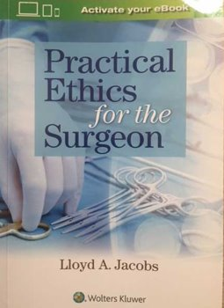
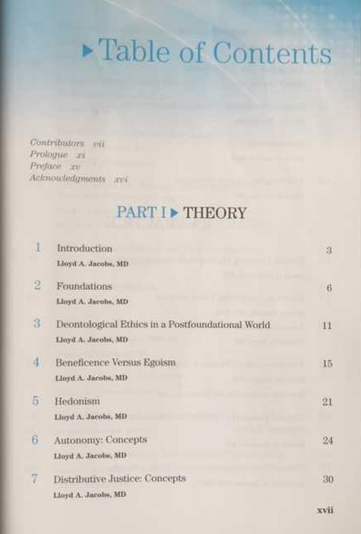

Slide 3
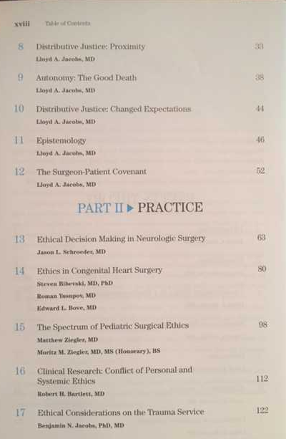
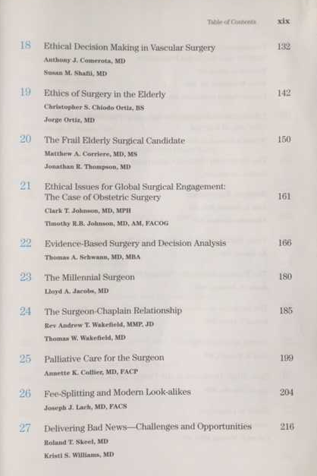

Slide 4
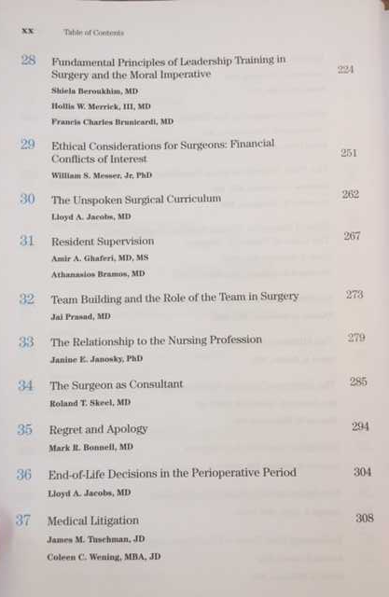
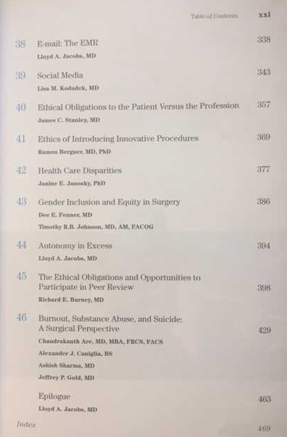

Slide 5
conception
Something you care about
Something you know about
There exists a demonstrable need
Beyond information

Slide 6
gestation
Single author—multiple author
Publishers often prefer single author
Begin gaining commitments EARLY
YOU must set up Table of Contents and assignments
Draw boundaries (preferably written) around body of knowledge to be communicated
Think about subliminal message.

Slide 7
PARTURITION -- 1
Begin publisher search early
Be persistent – expect rejections!
Use your connections!
Send stuff that is finished and perfect

Slide 8
PARTURITION -- 2
Do not send in many tranches
Do not allow authors excessive changes
Get permission upfront when possible
Set deadlines
Be psychologically prepared to walk away from any author

Slide 9
PARTURITION -- 3
Turn proofs and galleys around promptly
Be flexible with persons at publishing house
Balance interests of authors and publisher
Observe deadlines

Slide 10
Subliminal Messaging -- Example
The Surgical Method
You are an interchangeable widget
Your love of place is irrelevant
Your family ties are superseded
Never mind your kids are in school
Never mind your spouse teaches Sabbath school

Slide 11
SUBLIMINAL MESSAGES in “Practical Ethics for the Surgeon”
You are a human with faibles
Ethics are easy until applied
The discipline of surgery includes a spiritual connection
Burnout is ubiquitous: depression, suicide, substance, errors
It is your ethical duty to stay healthy: body and spirit

