Slide 1
How to Write a Chapter
Stephen Markowiak M.D., F. Charles Brunicardi M.D.
University of Toledo, Dept. of Surgery
College of Medicine and Life Sciences

Slide 2
My experience…

Slide 3
My “hands-on” experience…
Schwartz “Leadership in Surgery” and “Ambulatory Surgery” with Drs. Brunicardi, Merrick, Nazzal
Cameron’s “Management of Duodenal Ulcers” with Dr. Brunicardi
Lawrence Principles of General Surgery “Surgical Bleeding” with Dr. Merrick

Slide 4
Dreyfus Model of Skill Acquisition

Slide 5
Dreyfus Model of Skill Acquisition

Slide 6
Objectives
Share my experience with writing textbook chapters
What do experts have to say?
Pathway to success

Slide 7
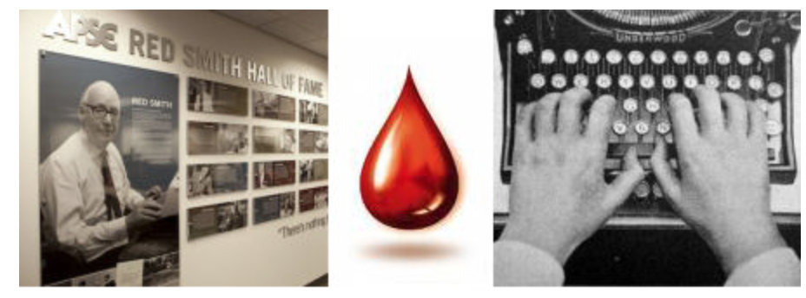
“Writing is Easy. I just sit at my typewriter until beads of blood form on my forehead.”
Notes:
https://idiomation.wordpress.com/2014/03/14/measure-twice-cut-once/https://en.wikipedia.org/wiki/Benvenuto_Cellini#/media/File:Benvenuto_cellini,_papa_clemente_VII,_1534.JPG
https://en.wikipedia.org/wiki/Benvenuto_Cellini#/media/File:Persee-florence.jpg

Slide 8
“Writing is Easy. I just sit at my typewriter until beads of blood form on my forehead.”
Variously attributed to Tom Wolfe, Ernest Hemmingway, Red Smith, etc…
Notes:
https://quoteinvestigator.com/2011/09/14/writing-bleed/

Slide 9
Lesson #1 – Writing is NOT easy
Proper writing requires time, dedication, passion, and methodology
Notes:
https://quoteinvestigator.com/2011/09/14/writing-bleed/

Slide 10
Time to write…
Schwartz Leadership Chapter
20h per week x 15 weeks -> 300 hours
Reviewed > 300 articles
Doubled chapter length with focus on new content, modern concepts, comprehensiveness
References list from 45 -> 165
One of the single things I am most proud of

Slide 11
Proficiency with practice

Slide 12
“Mark seven times, cut once.”
Notes:
https://idiomation.wordpress.com/2014/03/14/measure-twice-cut-once/https://en.wikipedia.org/wiki/Benvenuto_Cellini#/media/File:Benvenuto_cellini,_papa_clemente_VII,_1534.JPG
https://en.wikipedia.org/wiki/Benvenuto_Cellini#/media/File:Persee-florence.jpg

Slide 13
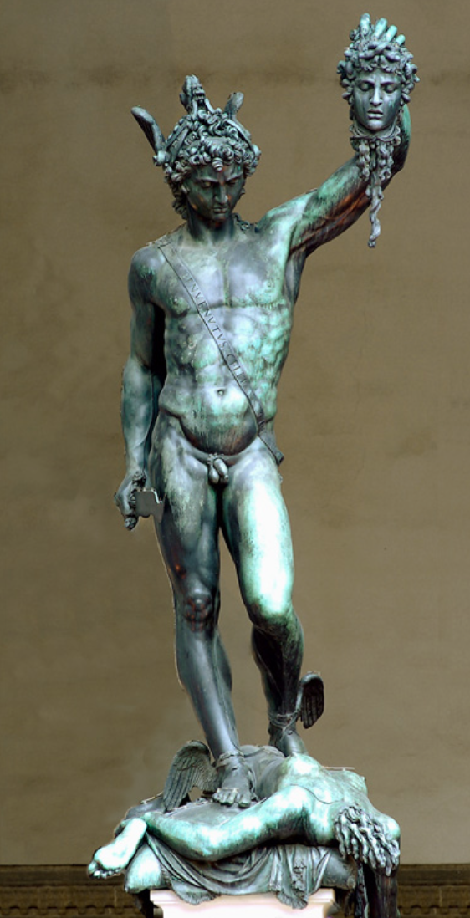
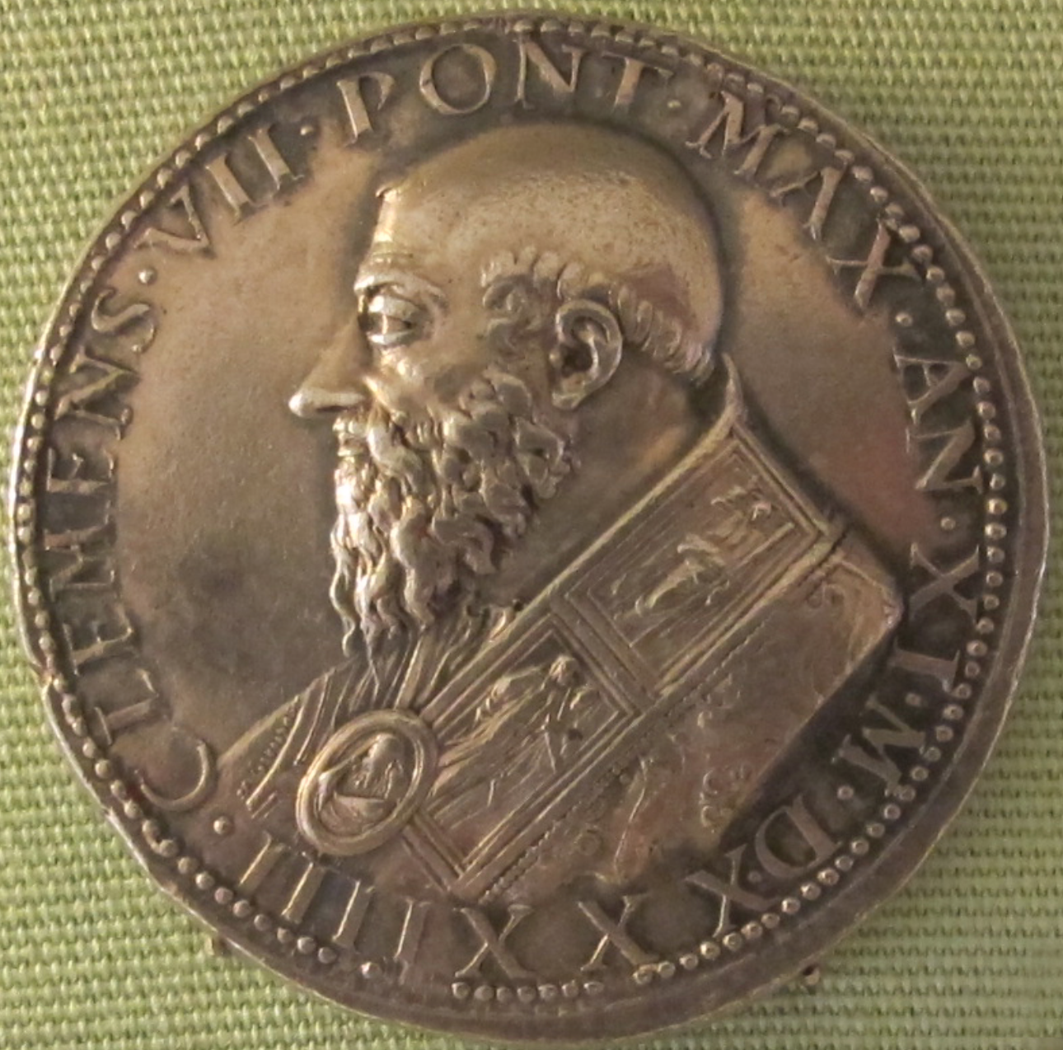
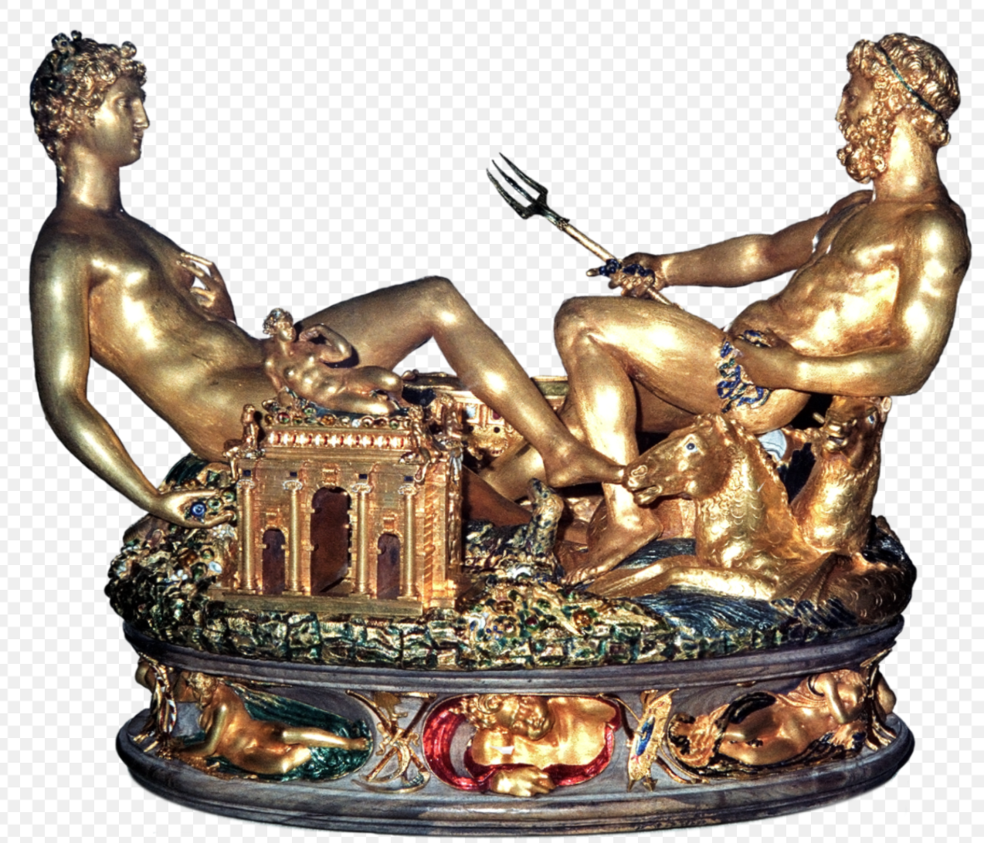
“Mark seven times, cut once.”
Benvenuto Cellini, 1558. Italian master goldsmith, sculptor, draftsman, soldier, musician
Notes:
https://idiomation.wordpress.com/2014/03/14/measure-twice-cut-once/https://en.wikipedia.org/wiki/Benvenuto_Cellini#/media/File:Benvenuto_cellini,_papa_clemente_VII,_1534.JPG
https://en.wikipedia.org/wiki/Benvenuto_Cellini#/media/File:Persee-florence.jpg

Slide 14
“Mark seven times, cut once.”
Lesson #2
Outline, outline, outline
Proper outline solves many problems related to technical writing
Notes:
https://idiomation.wordpress.com/2014/03/14/measure-twice-cut-once/https://en.wikipedia.org/wiki/Benvenuto_Cellini#/media/File:Benvenuto_cellini,_papa_clemente_VII,_1534.JPG
https://en.wikipedia.org/wiki/Benvenuto_Cellini#/media/File:Persee-florence.jpg

Slide 15
“Chief Complaint”
HPI
PMH, PSH, FH
Vitals
Physical Exam
Labs
Imaging
Assessment
Plan
“Leadership”
Definition
History and Examples
Principals of Leadership
Why We Lead
Leadership Styles
Measuring Leadership
Legacy Building
Conclusion

Slide 16
“An ounce of prevention is worth a pound of cure.”
Benjamin Franklin, speaking on fire safety
Notes:
https://www.ag.ndsu.edu/news/columns/beeftalk/beeftalk-an-ounce-of-prevention-is-worth-a-pound-of-cure/

Slide 17
“An ounce of prevention is worth a pound of cure.”
Lesson #3: Know your formatting and publishing requirements and write to them, rather than writing and reformatting
**Hint** - I’ve done it both ways, and it is objectively faster to do it right the first time
Lesson #4: Choose writing partners carefully, and agree on who will contribute and how beforehand. This helps ensure professionalism and collegiality
Notes:
"One day I will find the right words, and they will be simple." --Jack Kerouac

Slide 18
"One day I will find the right words, and they will be simple." -Jack Kerouac
“Employ a simple and straightforward style.”
Mark Twain
“The adverb is not your friend.”
Stephen King
Notes:
https://www.ag.ndsu.edu/news/columns/beeftalk/beeftalk-an-ounce-of-prevention-is-worth-a-pound-of-cure/

Slide 19
Lesson #5: “Flowery” writing and editorializing has little place in textbook writing
Adverbs – words that modify verbs or adjectives. These are particularly bad
Often end in “-ly”
Notes:
https://www.ag.ndsu.edu/news/columns/beeftalk/beeftalk-an-ounce-of-prevention-is-worth-a-pound-of-cure/

Slide 20
“A stitch in time, saves nine.”
French sailor’s proverb on how to properly bury a fellow at sea, 1700’s
Notes:
https://www.quora.com/What-is-the-origin-and-meaning-of-the-saying-“a-stitch-in-time-saves-nine-”
http://www.piratesurgeon.com/pages/surgeon_pages/deceased3.html

Slide 21
“A stitch in time, saves nine.”
Lesson #6: There is a right way to do something.
…Use that way
Notes:
https://www.quora.com/What-is-the-origin-and-meaning-of-the-saying-“a-stitch-in-time-saves-nine-”
http://www.piratesurgeon.com/pages/surgeon_pages/deceased3.html

Slide 22
Writing a textbook chapter is a technical process
Idea and Acceptance
AKA, should I agree to do this?
Outline, Outline, Outline
Review the Literature. Become the Expert
Write. Get writers block. Write through the pain!
Look at final draft with a microscope. Dedicate time for this.
Be a critical editor. Accept feedback.

Slide 23
Writing a textbook chapter is a technical process
Idea and Acceptance
AKA, should I agree to do this?
Outline, Outline, Outline
Review the Literature. Become the Expert
Write. Get writers block. Write through the pain!
Look at final draft with a microscope. Dedicate time for this.
Be a critical editor. Accept feedback.

Slide 24
Writing a textbook chapter is a technical process
Idea and Acceptance
AKA, should I agree to do this?
Outline, Outline, Outline
Review the Literature. Become the Expert
Write. Get writers block. Write through the pain!
Look at final draft with a microscope. Dedicate time for this.
Be a critical editor. Accept feedback.
FINAL STEP: BASK IN YOUR SHARED SUCCESS!

Slide 25
Thank you!
Dr. F. Charles Brunicardi
Dr. Hollis Merrick
Dr. Munier Nazzal

