Slide 1
University IP & Tech Transfer
Anatomy of an Invention Disclosure Form
Katherine Pollard
Sr. Licensing Associate, Technology Transfer
Associate Director of Venture Development, Business Incubator
Rev. 03/23

Slide 2
What are Technology Transfer Offices (TTOs)?

Slide 3







Introduction to Technology Transfer Offices
      Research performed at universities is funded, in part, by government agencies
      Sometimes the research results in a discovery that has commercial potential
      Researchers are required to disclose the invention to the funding agency
Prior to 1980, funding agencies would take title to the inventions created with their grants. It had been documented that nearly 30,000 technologies were sitting on government shelves with no plan for development

Slide 4




Introduction to TTOs
Taxpayers want a return on their investment in research
In 1980, the Bayh Dole Act was passed, which allowed universities and small companies to own inventions derived from federal funding
Technology Transfer Offices were formed to assist in the process of transferring discoveries and innovations to the commercial sector
  Technology Transfer Offices (TTO) report inventions

Slide 5
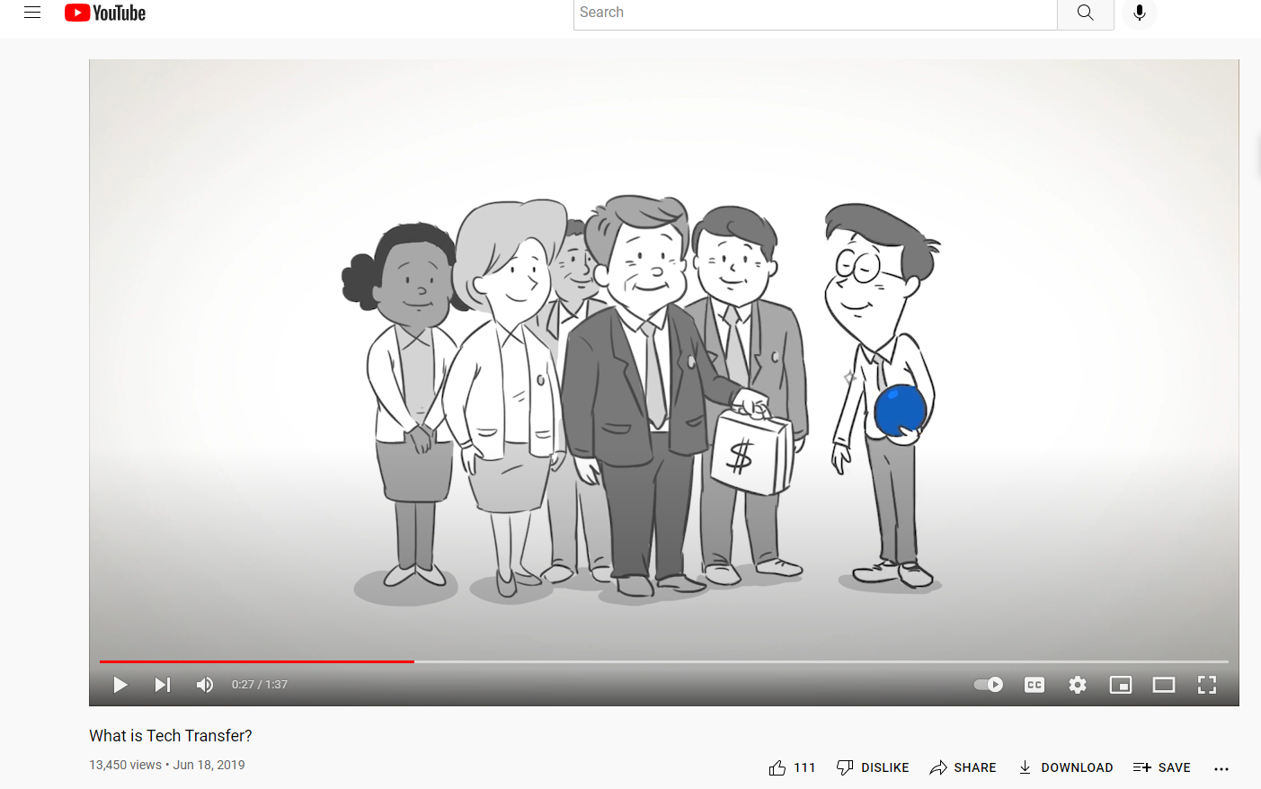
Video
https://www.youtube.com/watch?v=TRY_p-59_bY

Slide 6
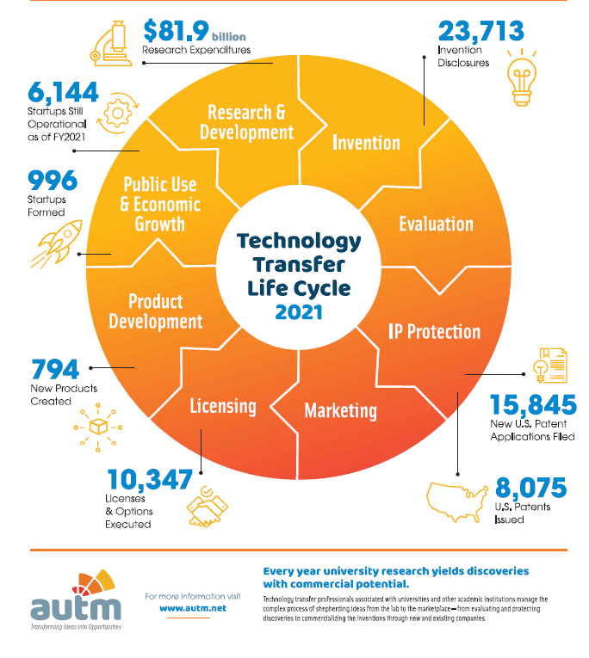
Benefiting Society and the Economy
Academic Technology
Transfer for 2021
Notes:
Notice the decreasing numbers between research expenditures to IDFs, and from IDFs to patents filed, patents filed to patent issued, and so on. Innovation is exciting and impactful, but inherently risky. The Tech Transfer Office aims to get a return on the investment and must routinely review the portfolio to make room for new technologies.

Slide 7





UToledo Technology Transfer Office
Works with faculty, staff, and students to:
  Identify & report novel technologies
  Assist with Material Transfer,
  Non-Disclosure, Interinstitutional & Sponsored Research Agreements
  Protect IP through patents
  Market Technology & identify potential commercial partners
  License the technology to a commercial partner
The ultimate goal is to transfer the technology to a company that will put in further investments needed to commercialize the invention.

Slide 8
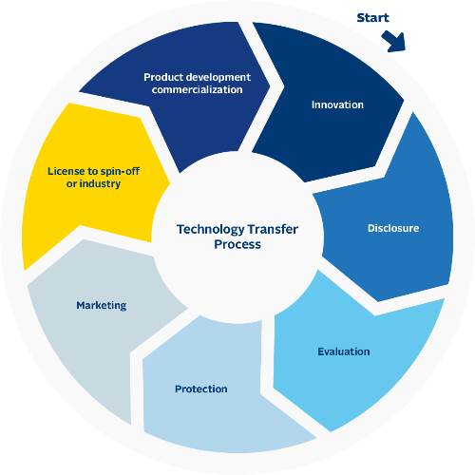
Tech Transfer Process

Slide 9




Why Disclose to TTO?
Employees of University of Toledo are required as a condition of employment or matriculation to disclose their inventions or discoveries.
Starts the process of protecting and commercializing the innovation which provides the greatest opportunity for the innovation to be used in practice for the public good.
The same process provides the greatest opportunities for the innovation to generate revenue to be shared among the innovator(s) as well as the University.
Reporting requirements from funders.
Ex. Federal agencies such as NSF; Foundations such as AHA

Slide 10

Why are patents valuable?

Slide 11

Overview of Patents
Investment in technology needs to be protected from copycats.
Patents excludes others from making the same.
Incentive for R&D and innovation.
Patent systems:
  Offer the possibility of reward for inventor and investor.
  Stimulate more investments to further develop the invention.
  Encourage early public disclosure, thus reducing duplicate efforts.
  Promote exchange of information between nations.
Notes:
https://pubmed.ncbi.nlm.nih.gov/32125404/
The mean cost of developing a new drug has been the subject of debate, with recent estimates ranging from $314 million to $2.8 billion.

Slide 12
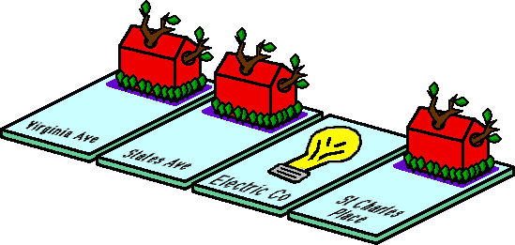
Why do governments grant patents?
A quid pro quo:
Disclosure of the invention to the government in exchange for exclusive rights to a time limited monopoly
A patent is the mechanism by which the federal government grants rights to exclude others from practicing (making, using, offering for sale, selling, or importing) an invention for a term of 20 years from the date of filing.
Most countries have patent systems. You only get the rights in the countries where you have a granted patent.
After 20 years, the patent falls into the public domain for all to use.
Notes:
Quid pro quo – this for that

Slide 13

Journey of a patent
International Phase
National Phase
PCT Patent
Filed with the USPTO; Holding place
US Patent
Filed with the PTOs of choice; Wait
Provisional Patent filed with the USPTO; Holding place
18 months
12 months
Estimated 22 months
3.5 years
Only time new data can be added
Prosecution begins (estimate)
Issued patent
Fees due to remain active:
3.5 years after grant,
7.5 years after grant, &
11.5 years after grant
12 months
Enforceable rights
12 months
Better understanding of IP strength
National Phase
US Patent
Filed with the USPTO; Wait
Notes:
“Holding place” provides an applicant a priority date.
No patent rights until it issues, but you can license a pending patent.
PCT= Patent cooperative treaty.
Prosecution is the back and forth between the examiner and the applicant until the patent issues (hopefully).

Slide 14




Patent requirements
  Fully Disclosed
  Non-Obvious
  (to one skilled in the art)
  Useful
  Novel
Conception:
Formation in the mind of a definite and permanent idea of the complete and operative invention, as it is to be applied in practice
Reduction to Practice:
The embodiment of the concept of the invention
Actually making the invention
Filing of an application

Slide 15
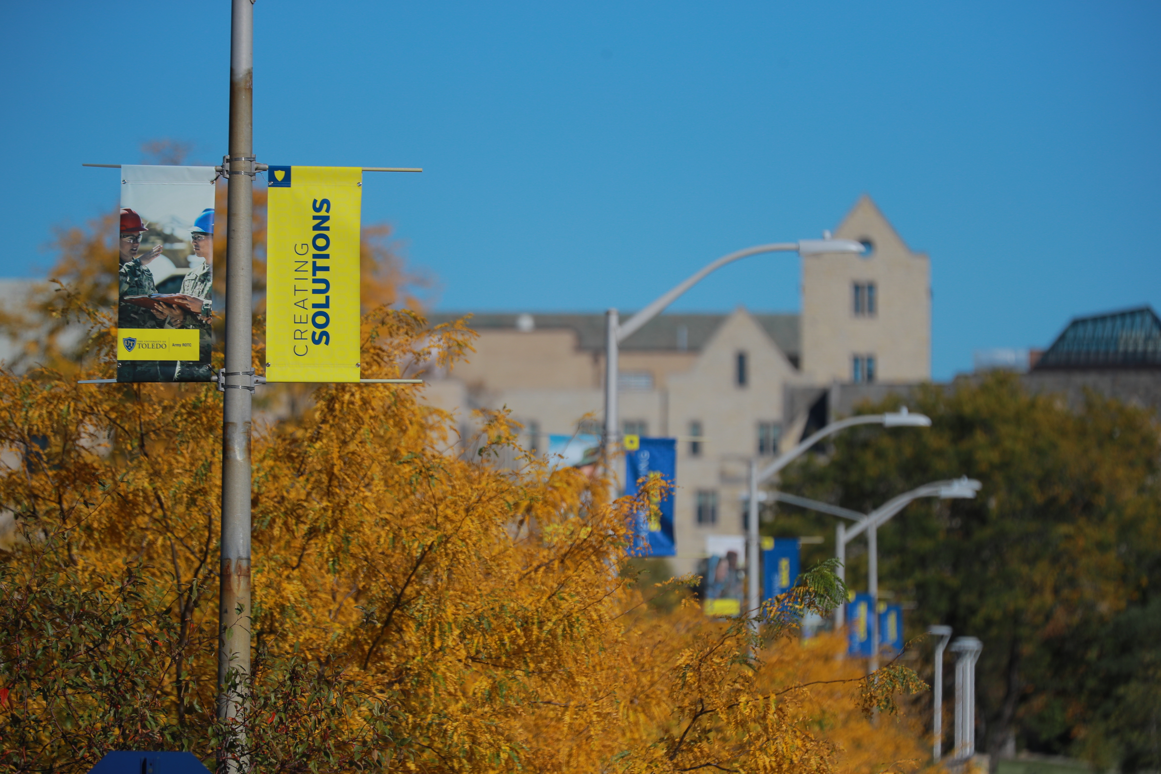
What if someone at UT develops something novel with commercial potential?

Slide 16
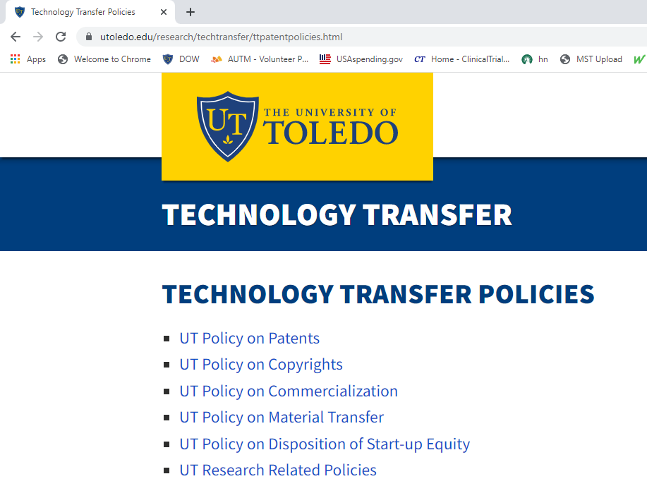
University Policy
Recognizing that time is of the essence in the protection of the legal interests of both the University and its employees in their inventions, it shall be the duty of each employee to:
  Report in writing to the Universities all patentable inventions resulting from research or investigations via a standard Invention Disclosure Form (IDF)
  Cooperate with agents to enable the evaluation and disposition of the submitted invention.
  Cooperate with agents to secure all legal protection for such inventions, including preparation and signing of all papers attendant thereto
  Assist with marketing and transfer efforts
Notes:
University must recover its costs before this distribution
40% inventors
40% university
10% Inventor’s research account
5% Inventor’s department
5% Inventor’s college

Slide 17
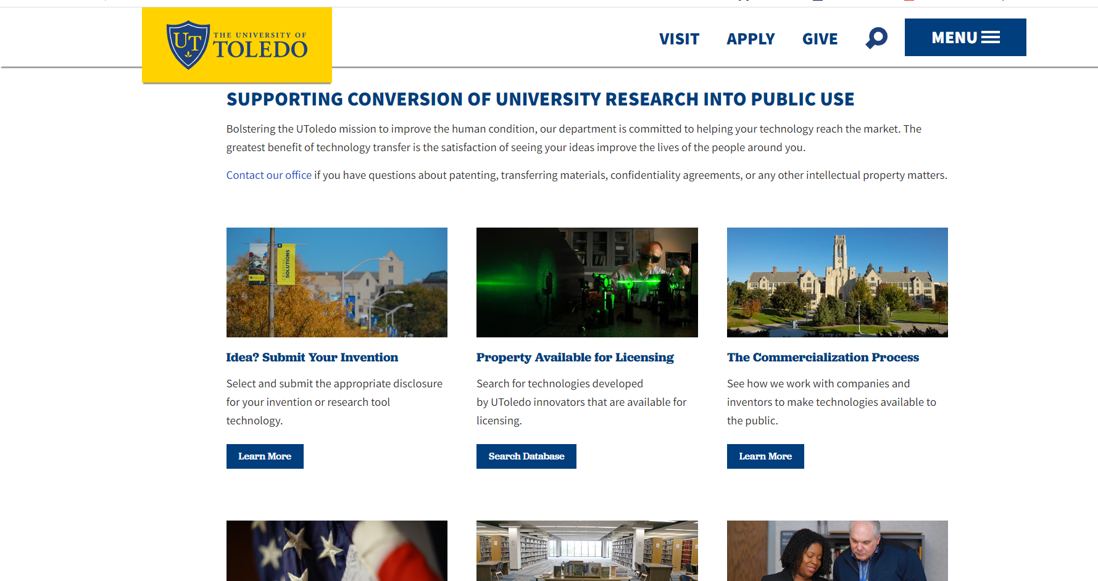
Invention Disclosure Form (IDF)

Slide 18
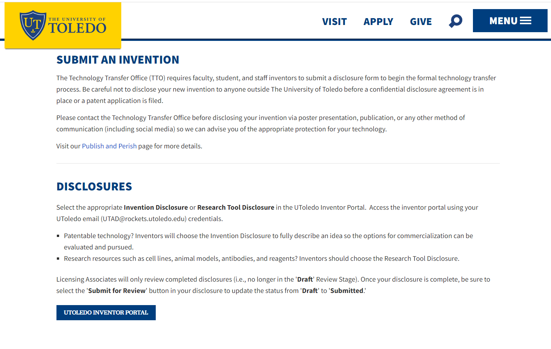
Inventor Portal
Log in with UTAD

Slide 19
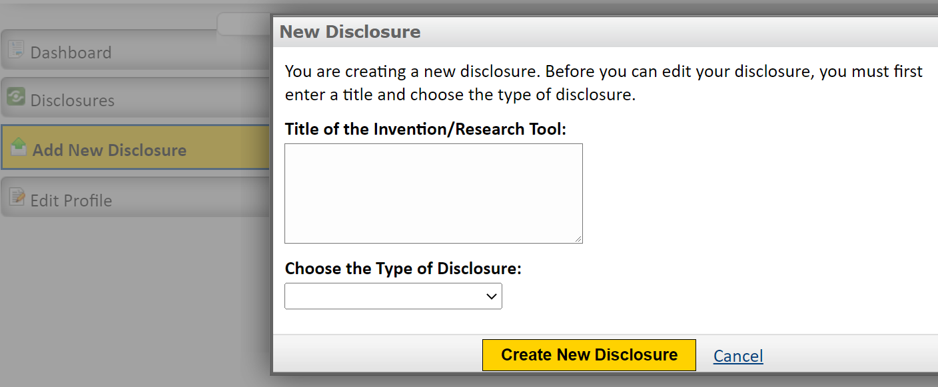
IDF: Title of the Invention

Slide 20
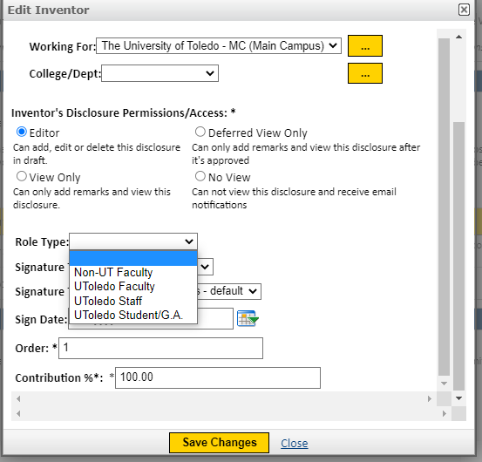
IDF: Inventors
Name
UToledo information
  Email contact
  Department
  Title
  Personal contact information
Level of contribution
Notes:
Tenure of most students and faculty is less than 20 years (the life of a patent).

Slide 21
Inventorship
Co-Inventors do not need to physically work together
Contributions need not be equal
Co-Author ≠ Co-Inventor
Not subjective, inventorship is a legal determination
Each must materially contribute to at least one claim

Slide 22
You are not an inventor if you:
Generally suggest how to realize the invention
Follow instructions of another to reduce it to practice
Are merely knowledgeable about the problem
Notes:
Red flags: if there are a large number of inventors or just the faculty member on a PhD student’s primary independent-thinking research project.

Slide 23
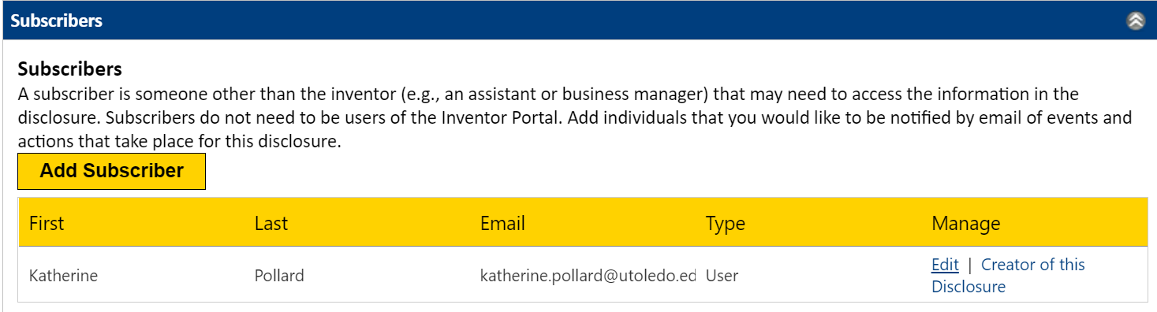
IDF: Subscribers

Slide 24
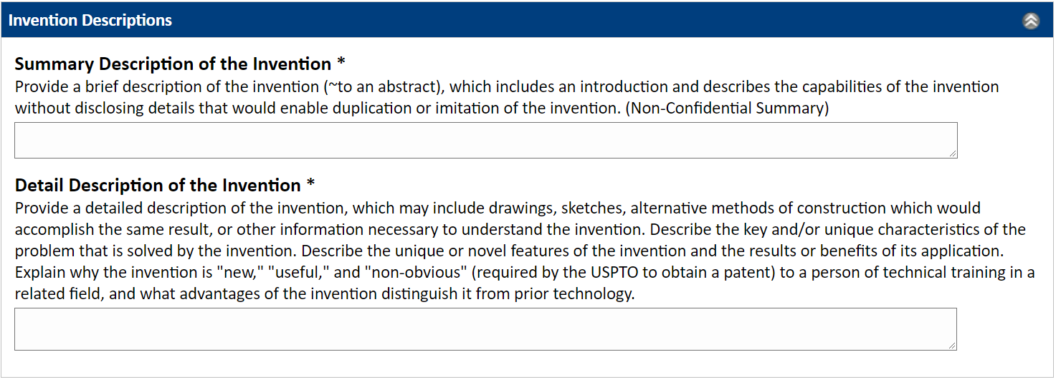
IDF Descriptions of the invention

Slide 25
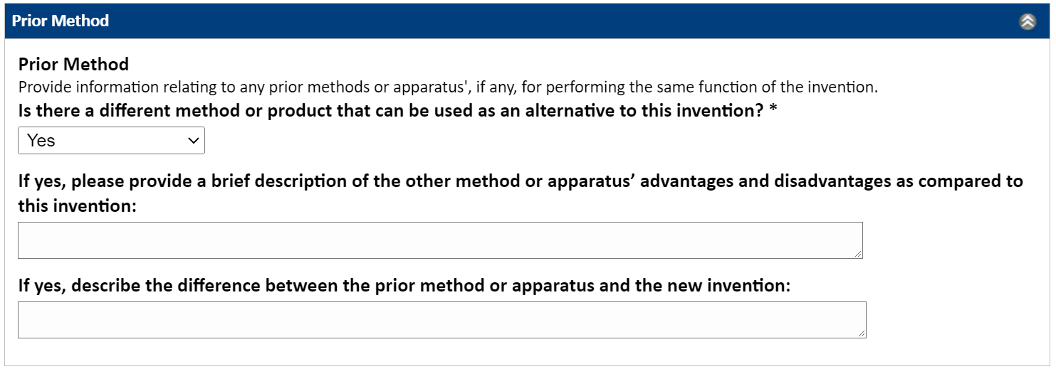


IDF Prior Method
Technology: Drug to cure diabetes
Prior method: Insulin Injections
Notes:
Substitute products – ones that are the same or similar functionality as your product
Conducting a search for prior art using google patents: https://www.youtube.com/watch?v=lJoqSlonZjM Fun case study: Beerbrella

Slide 26
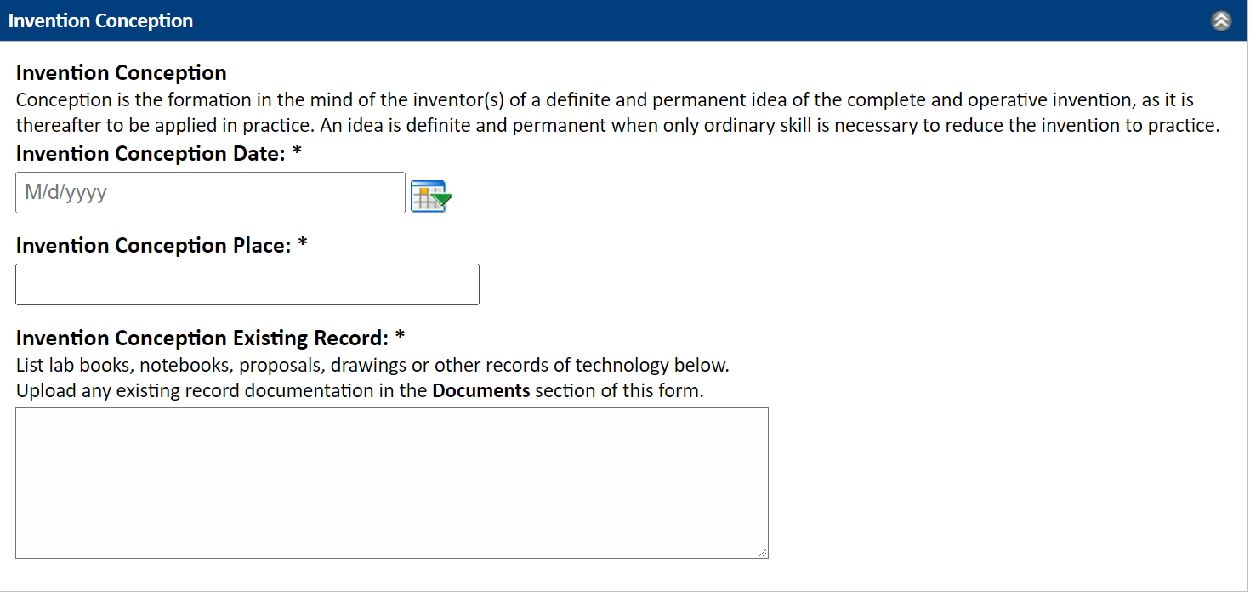
IDF: Conception

Slide 27
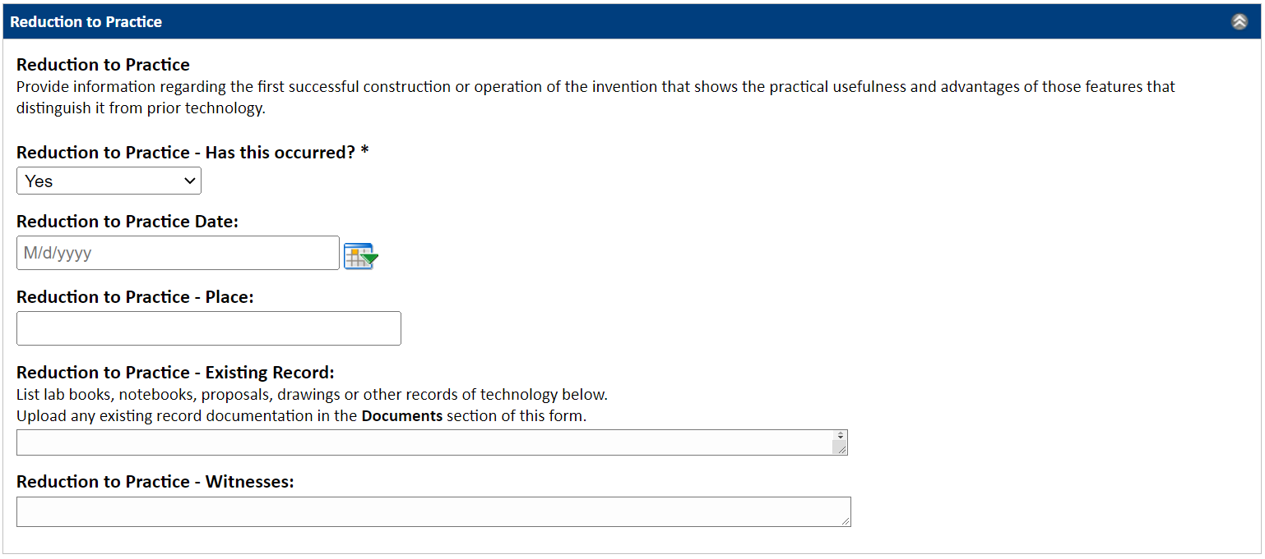
IDF: Reduction to Practice

Slide 28





America Invents Act
Contains provision that transitioned the U.S. to a first-to-file system
Previously was a first-to-invent
Submitting an IDF does not mean the invention is filed
Must be filed with the U.S. Patent and Trademark Office to hold a priority date (patent pending)
Once issued, the patent will provide 20 years of protection from the priority date

Slide 29
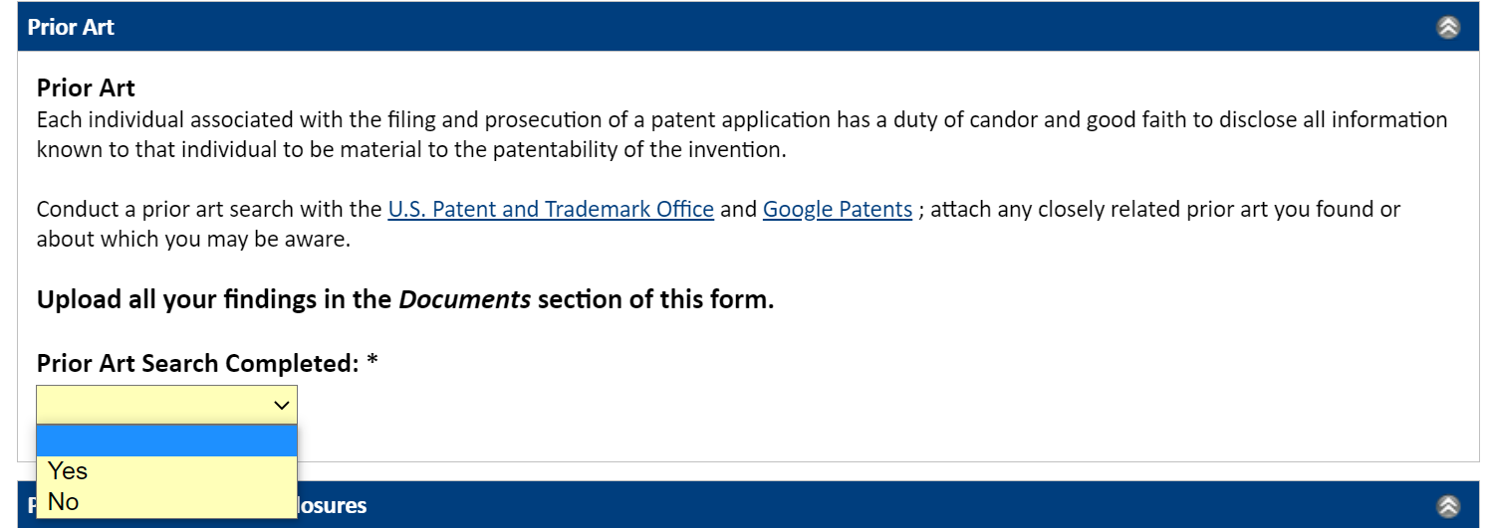
IDF: Prior Art
Even your own work can be prior art held against you.

Slide 30
Can you think of some examples of prior art?

Slide 31
Prior Art examples
Issued or pending patents
Manuscripts
Abstracts
Posters
Public Presentations
Job Interviews
Posting on informal internet webpages
Youtube videos
Disclosing outside of the inventor’s institution

Slide 32
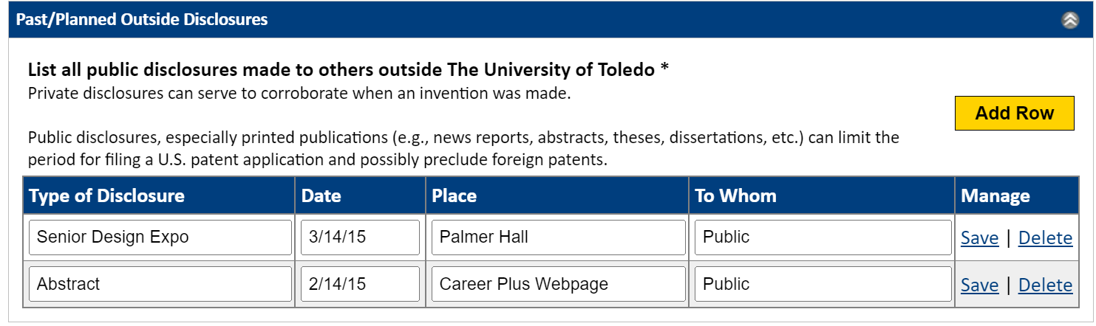
IDF: Past and planned disclosures

Slide 33
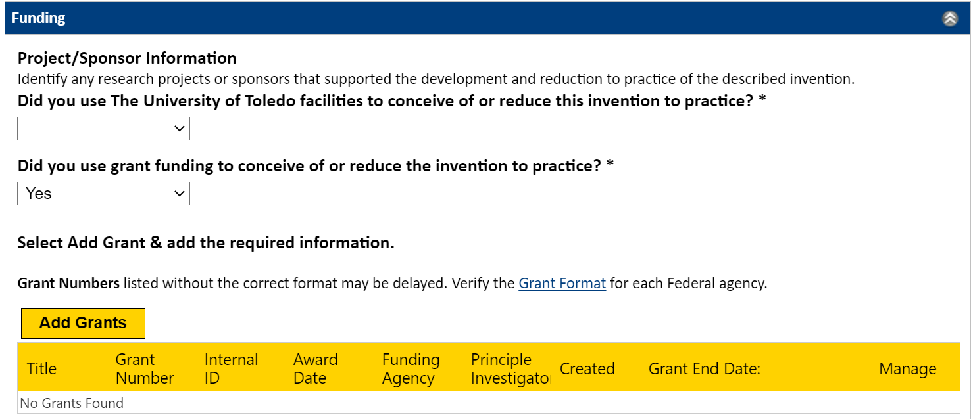
IDF: Project Sponsor

Slide 34
Project Sponsor
Ownership:
If University would have right to IP, it will continue its assessment
Reporting:
Inventions must be reported by the TTO to the funding agency through Interagency Edison
Reporting to your program officer is not sufficient

Slide 35
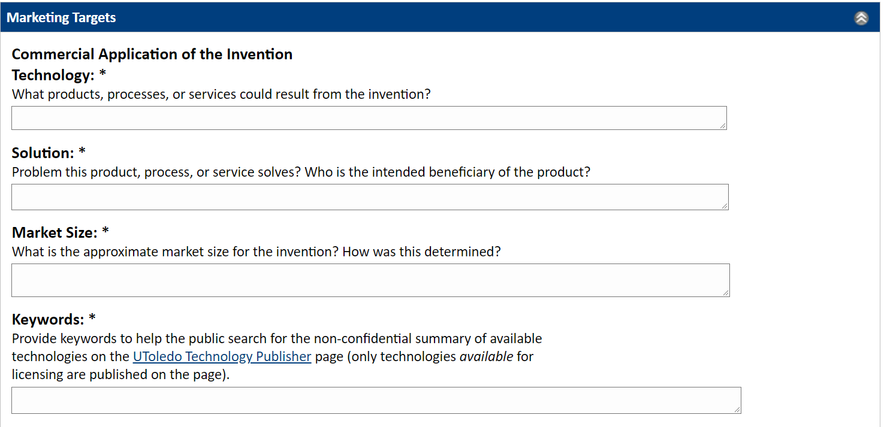
IDF: Marketing Targets

Slide 36
IDF: Commercial Application
Business Tool
License patent rights to a company
Exclusive licensees are the only ones allowed to practice the invention
Prevents competitors from making, etc. the same
Why are patents valuable?

Slide 37
Commercial Application
#1 Start-up failure reason: no market need
Dollar size of market
Compound annual growth rate (CAGR)
Level of consolidation of market players
Why are patents valuable?

Slide 38
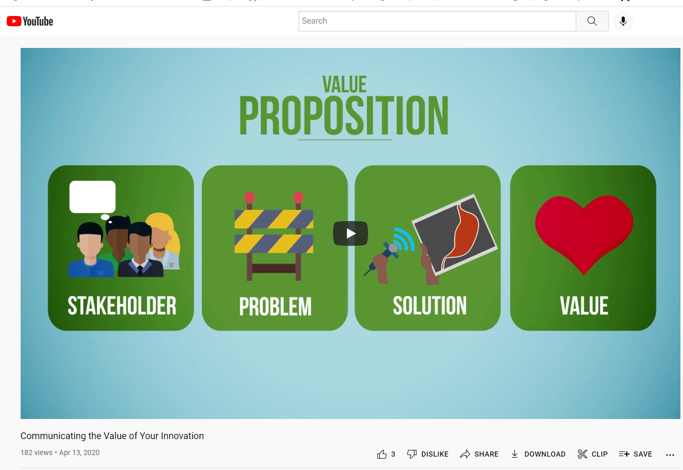
Video
https://www.youtube.com/watch?v=QombVXfnb8c
Notes:
https://www.youtube.com/watch?v=QombVXfnb8c

Slide 39

How do we get meetings with industry?
  TTO active marketing
  TTO passive marketing
    Technology Publisher Webpage
  Inventor contacts
    Publications
    Conferences/posters
    Other media
    Periodically these efforts are summarized in a marketing report

Slide 40

Tto active marketing
Qualifying companies
  Who could be a partner?
  Could this overlap with company goals/capabilities?
Prospecting new leads at qualified companies
  Which individual evaluates new technologies?
  Which individual will see the value?
  Find their contact information
Following up with leads
  Responsive or not
  Track relationships over long periods of time

Slide 41
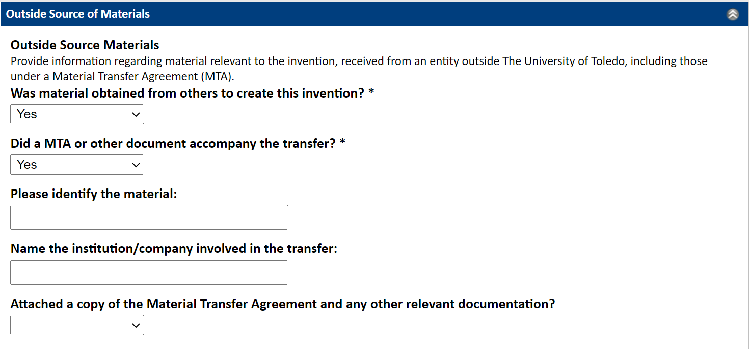
IDF: Outside source of materials
A Material Transfer Agreement could impact commercial potential

Slide 42
Material Transfer Agreements

Slide 43
What are Material Transfer Agreements (MTAs)?
Contracts defining respective rights and obligations of the Provider and Recipient of materials used in research
  Ex : Research use only, no further transfers allowed, time limited
Allocates the rights that result from their use
Can be either incoming or outgoing
Promotes collaboration between academic institutions and between industry and the University

Slide 44
What are Material Transfer Agreements (MTAs)?
Typically not patented
Cannot be commercially purchased (otherwise go to Purchasing)
Can include biological materials such as:
  Antibodies
  Cell lines
  Genetic constructs
  Plasmids
  DNA
  Proteins
  Reagents
  Animal models/organisms (mice, rats, etc.)
  Seed lines
  Plant germplasm
  Chemical compounds or polymers

Slide 45
Research Tool Disclosure Form
Notes:
If it was disclosed in a report to the program officer and if it described as new in a publication, it should be also be disclosed to our office.

Slide 46

Why do we need MTAs?
Promote university collaborations & expand scientific discovery
Avoid disputes regarding material use
Protect publication rights
Avoid limiting future research
Gain access to industry technology to advance research
Promote university-industry collaborations that could lead to sponsored research
Notes:
Establishes chain of custody

Slide 47

MTA Goal:
A Balancing Act
Help investigators acquire or send materials to advance research
Protect investigator’s freedom to pursue future, related research problems
Allow timely publication
Respect other party’s commercial interests
Assure that institution can meet its contractual obligations
Facilitate public stewardship of invention for public benefit--Bayh-Dole provisions

Slide 48

Process for obtaining a fully - executed MTA
Checklist
MTA Admin
2. MTA Admin
3. Draft / Review / Revise
1. Checklist
Draft/Review/Revise
Reviewed for compliance
5. Fully executed Agreement [Authorized signatory]
6. Transfer of materials
4. Negotiate
the Terms of
Agreement
Notes:
Check with different offices to ensure appropriate protocols: IRB, IUCAC, or IBC. Export control.

Slide 49
IDF: Outside source of materials
If third party material is included in the invention, commercial use may be restricted, or the third party may have rights.

Slide 50


Incorporating outside materials/inventions
Invention:
CAR-T cell technology

Slide 51
Incorporating outside materials/inventions
Received from academic collaborator:
Antibody

Slide 52
Incorporating outside materials/inventions
Patented by company:
Transmembrane domain, hinge, and activating domains

Slide 53
Incorporating outside materials/inventions
Commercial application may be limited
Check terms of Material Transfer Agreement with academic provider for the antibody
Freedom to operate
    You must use the company’s patent in order to practice the invention
    If the patent is still active, ask company for a license

Slide 54
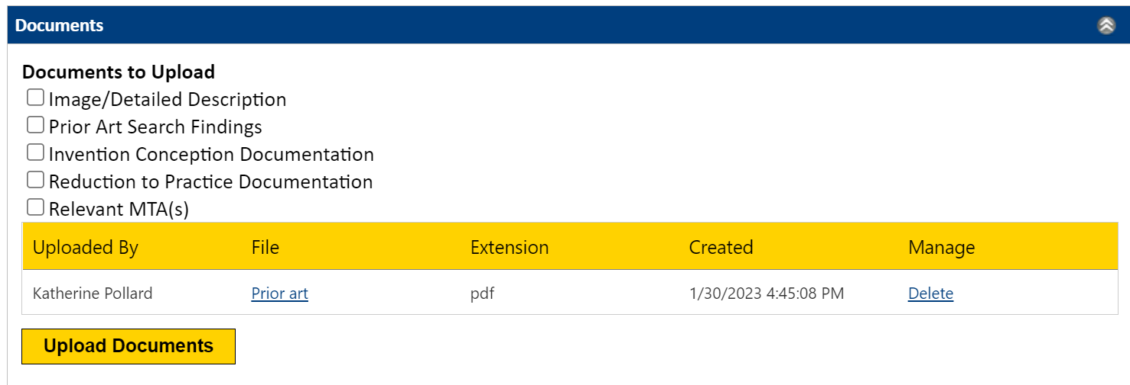
IDF: Document Upload
Notes:
Max file size 10MB

Slide 55
IDF: Signatures

Slide 56

Tech Transfer Process
Invention Disclosure Form

Slide 57
After IDF Submission
Evaluated by Technology Transfer Staff
  Reporting requirements
  IP ownership
  Prior art
  Commercial potential
Patent Committee Meeting
  Inventor(s) present technology
  Committee decides next steps
  Next steps are often filing a provisional application or doing a prior art search

Slide 58
Marketing
Cold Call
Meeting
Partnership
Average response rate for cold calling is ~30-40%
  Of those, conversion rate to a meeting is about 50%
~15-20%
Industry meeting request
  Provides an opportunity to get a partner on board
  Can provide new perspective – good or bad news
  Can add credibility to our commercialization forecast
  Can improve chances of the patent moving to the next stage

Slide 59
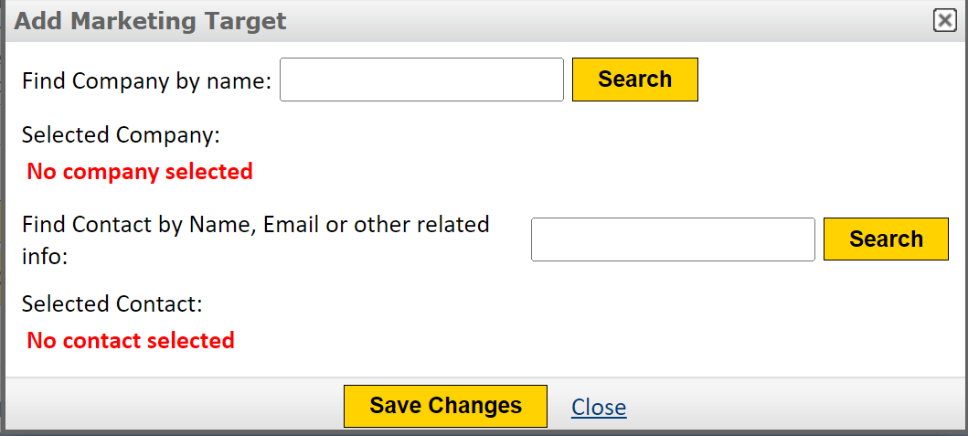
IDF: Marketing Targets

Slide 60



General format of meetings with industry
Introductions
Inventor presentation of technology
Questions and answers
Next Steps
  The company needs to review further with colleagues
  Information from one or both sides to be exchanged
    Non-disclosure agreement
  Immediate feedback
    Too early, out of scope, bad timing
    Provide budget, agreement terms

Slide 61

Licensing
TTO negotiates and puts in place the license agreement
  Options
  Commercial licenses
The patent rights are licensed (not sold)
  Issued or pending patents
  Materials (no patent rights required)
Most often, the license generates revenue through royalties on the licensed product/service
Revenue sharing occurs as stated in the patent policy

Slide 62

UToledo Tech Transfer Statistics
Fiscal Years 2017-2021
253 Invention Disclosures
102 Issued Patents
90 New Applications Filed
53 New licenses and/or option agreements
7 start-up companies formed
$10.6M in licensing revenue
  ~$6M paid to the inventors, colleges, departments and research accounts
Third Party Reviews
Ranked 68th best university for technology transfer and commercialization in 2017 - Miliken Institute
  Measures public & private research universities’ 4 year averages of research expenditures, patents, licenses executed, licensing income and startup companies
Ranked among the top 100 universities in the world for patents issued in 2017 - National Academy of Inventors
Ranked 79 out of 166 in 2022 – Heartland Forward
  Think and do tank spearheaded by the Walton family

Slide 63
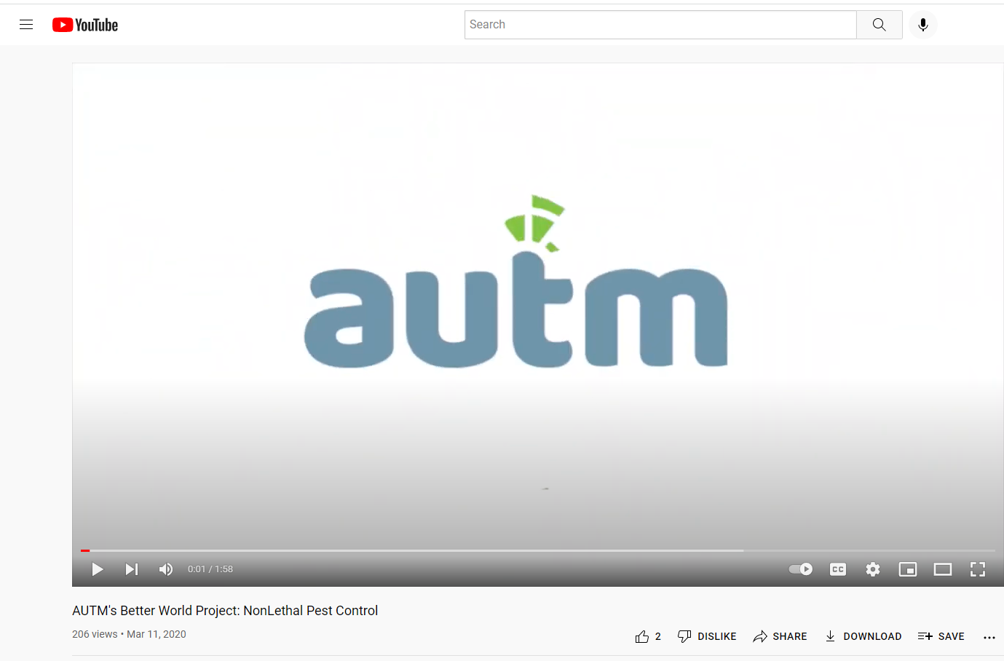
Improve the Human Condition
Better World Project
https://www.youtube.com/watch?v=2CXONd4RikE
Notes:
Better world project videos
https://www.youtube.com/watch?v=2CXONd4RikE (beads)
https://www.youtube.com/watch?v=0EmOW8_rok4 (Faculty founder)
https://autm.net/about-tech-transfer/better-world-project/bwp-stories/robotic-exoskeleton

Slide 64
Questions?
www.techtransfer.utoledo.edu
Visit us online!

