Slide 1
Tips to Prepare an IRB Protocol for a Timely Approval
Susan L. Pocotte, Ph.D.
Professor, CON
Chair, Biomedical Institutional Review Board

Slide 2
Tip 1: Keep the primary concern in your mind at all times.
It does not minimize the work, but it motivates us to put our best effort forward from the beginning and work together for the best interests of human subjects in research.

Slide 3
The protection of Human subjects, their biospecimens and their private data is the primary concern.
All other concerns are secondary.

Slide 4
Federal Regulations
Based on the three Belmont principles
Respect for Persons- Individual allowed to choose participation.
Beneficence- Max. benefits and minimum risk; “do no harm”
Justice- No group should bear the risks when the benefits apply broadly.
Two parallel sets of regulations were written and enacted in 1981.
Department of Health and Human Services (DHHS)
Food and Drug Administration (FDA) – regulated drug, devices
Common rule/Final rule

Slide 5
The Common Rule
A general set of regulatory provisions governing human subjects protections.
Important aspects of the Common Rule:
Requirements for compliance by research institutions.
Requirements for IRB memberships, responsibilities, functions, review of research, and record-keeping.
Requirements for obtaining and documenting informed consent.
Recognizes there are additional requirements for the protection of vulnerable subjects –vulnerable to coercion or undue influence, such as children, prisoners, individuals with impaired decision-making capacity, or economically or educationally disadvantaged persons.

Slide 6
Why an IRB?
Federal law and regulations require such review.
Research ethics require independent review.
Past abuses demonstrate that researchers cannot determine benefits/risks.

Slide 7
TIP 2: Understand the UToledo processes for IRB approval of Human Subject Research.
HRPP staff will keep up to date with the Federal Regulations and incorporate them into our policies and procedures.
We are here to help- not hinder.

Slide 8
Two primary groups work with the IRB Applications via a 2 Step Process
1. Human Research Protections Program (HRPP)
2. Institutional Review Board (IRB)
Additionally, many Human Subject Clinical Research Protocols require input from other stakeholders at UTMC, UToledo Compliance, or UToledo Research Sponsored Programs.

Slide 9
UToledo Policy: 3364-70-05 Protection of human subjects in research
Human Research Protection Program (HRPP)
Provides support to UToledo IRBs.
Provides educational activities.
Serves as a resource for faculty, staff and student researchers.
Recommends and implements policies and regulations for the protection of human subjects in research.
Ensures compliance with relevant laws, regulations, and ethical standards while addressing the needs and concerns of investigators who conduct research with human subjects.

Slide 10
HRPP Processes IRB Applications before IRBs Review/Approve
Initial point of contact for researcher’s questions.
Receive submission and conduct pre-review.
Check training completion.
Check for electronic signatures.
Check application is complete and documents consistent.
Determine level of review. IRB can change level.
Determine that a certain application is not human subject research.
Communicate with researcher regarding needed corrections.
Assign for IRB review.

Slide 11
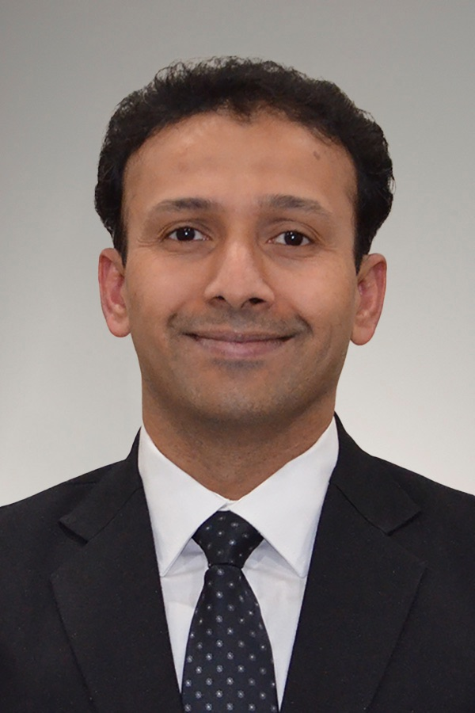
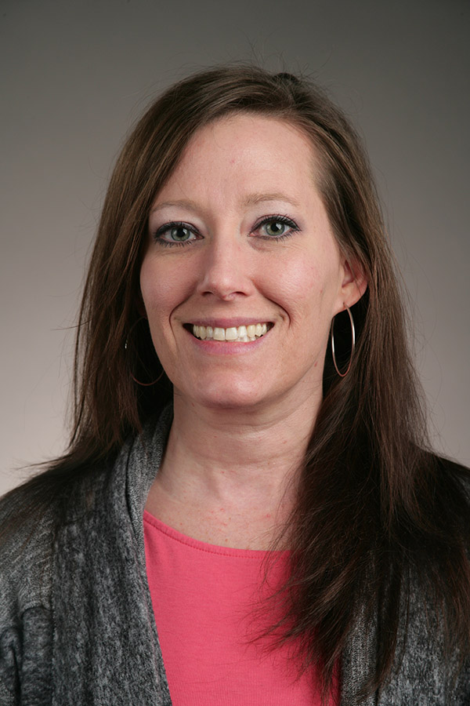
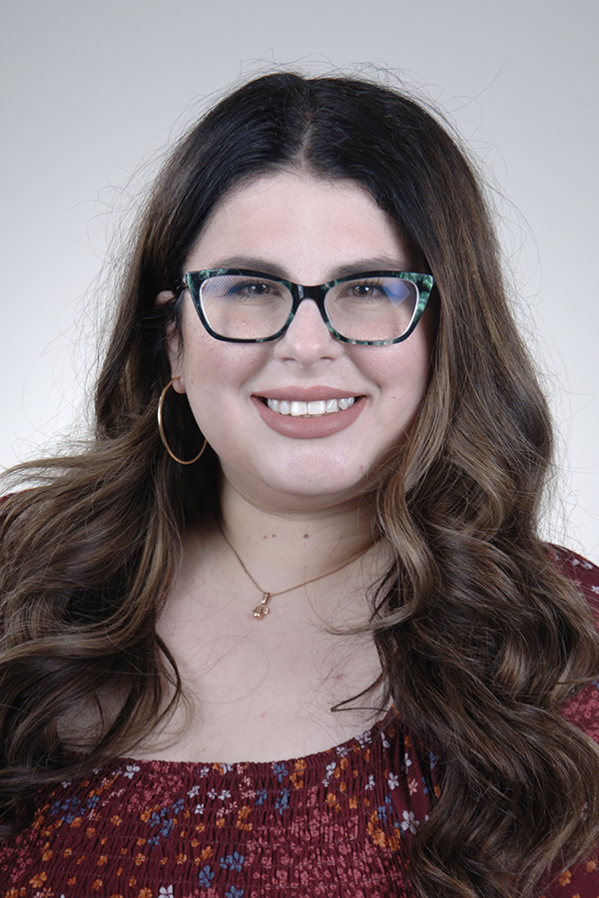
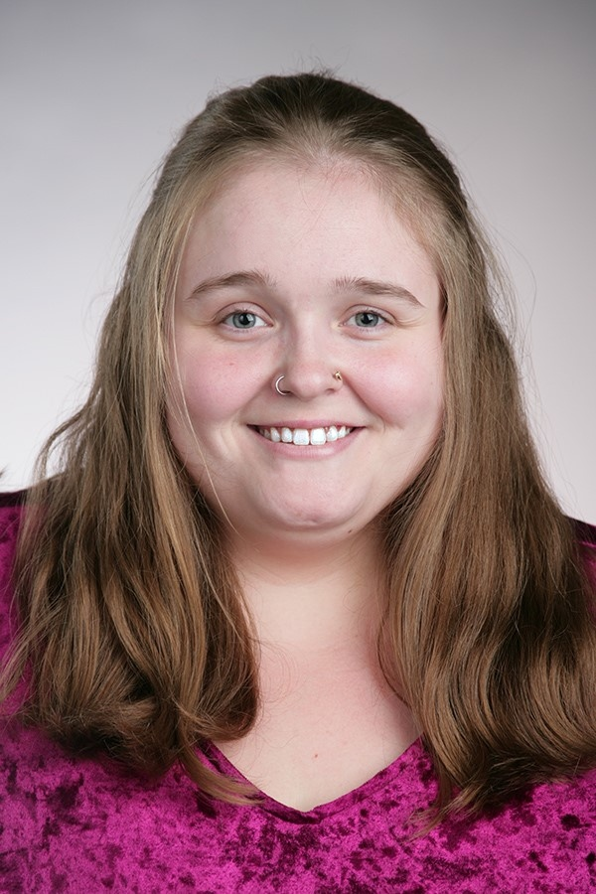
Human Research Protection Program (HRPP)
Mahesh Pillai, MD, PhD
Manager
Research Compliance
R1 1020A
419-383-4251
Nicole Lederer, MEd
Analyst
SBE IRB
R1 1020D-1
419-530-6167
Marina Muchnik, BS
Associate Analyst
Biomedical IRB
R1 1020E
419-383-6903
Madison Rowe, BSE
Associate Analyst
IRB
R1 1020D-3
419-383-6904
Gabrielle McMunn, MS
Associate Analyst
IRB
R1 1020D-4
419- 383-6902
http://www.utoledo.edu/research/rsp/irb

Slide 12
HRPP Staff
2 are certified IRB Professional (CIP) through PRIM&R, others in training
Report to Assoc Vice President for Research, Dr. Schall
Public Responsibility in Medicine and Research (PRIM&R) is a 501(c)(3) nonprofit, that works to ensure the highest ethical standards in research by providing education, membership, and other professional resources to the research and research oversight community, including those who work with human subjects protections programs (HRPPs), institutional review boards (IRBs), animal care and use programs, and institutional animal care and use committees (IACUCs).

Slide 13
UToledo Policy: 3364-70-05 Protection of human subjects in research
All UToledo-related research involving human subjects must be reviewed and approved by the appropriate UToledo IRB or a UToledo-authorized external IRB prior to beginning the research, and at intervals specified by the reviewing IRB.
UToledo Biomedical IRB may approve clinical research performed at UToledo-affiliated practice sites or sites where the university is formally authorized to review research.
The UToledo IRBs have the authority to determine the appropriate course of action with respect to study deviations and adverse events depending on the degree of risk to subjects or affected individuals and previous deviations by the investigator.

Slide 14
UToledo Policy: 3364-70-05 Protection of human subjects in research
Research covered by this policy that has been approved by an IRB may be subject to further appropriate review and approval or disapproval by officials of the institution. However, those officials may not approve the research if it has not been approved by an IRB.

Slide 15
What does the IRB do with Applications?
Conducts initial reviews and continuing reviews of research involving human subjects.
Conducts reviews of proposed changes to approved research involving human subjects.
Follows up on issues related to research involving human subjects such as:
Subject complaints or concerns
Suspected violations of federal or state regulations
Suspected violations of UT policies
Only the IRB can approve the modification or waiver of informed consent.
Final determination level, and risk.
Final approval and signatory for Human Subject research.

Slide 16
Who is the IRB?
A group of individuals charged with protecting the rights and welfare of human research subjects.
faculty and staff appointed by the Institutional Official (IO)
community members and nonscientists appointed by the (IO)
Responsibilities of the Board given directly by the federal government.
IRB is separate from UToledo administration and shared governance.
The Board does NOT make regulations.
Volunteer

Slide 17
Institutional Review Boards
Biomedical IRB
Social, Behavioral & Educational (SBE) IRB
Interventions including therapies (e.g., drugs, diet, exercise, surgical interventions, or medical devices), diagnostic procedures (e.g., CAT scans), preventive measures, and review of medical records.
Questionnaires, observations, studies of existing data (no PHI), and non-biomedical interventions.
Submit to the most appropriate IRB, regardless of which campus you are on.
Only faculty and staff can serve as PI. This does include residents and community based clinical or research faculty.

Slide 18
BIOMEDICAL IRB
Member | Scientific | Affiliated UToledo | Role and Specialization
Batts, Gary | No | No | Community Member
Baum, Caitlin Emily Ph.D. | Yes | Yes | Member (Pathology)
Federman, Douglas M.D. | Yes | Yes | Vice Chair (Internal Medicine)
Honisko, Marcia E. Pharm.D. | Yes | No | Member (Promedica clinical oncology Pharmacy)
Hoyt, Alastair M.D. | Yes | Yes | Member (Neurosurgery)
Hunter, Kimberly E. Ph.D. | Yes | Yes | Member (Psychiatry)
Khuder, Sadik Ph.D. | Yes | Yes | Member (Biostatistics)
Koffman, Boyd M.D., Ph.D. | Yes | Yes | Member (Neurology)
Linker, David | No | No | Community Member
McLuckie, Rachel Elizabeth PharmD | Yes | Yes | Chair Designee (Investigational Drug and Patient Safety)
Miller, Jolene MLS, BS, AHIP | No | Yes | Member (Mulford Library)
Palmer, Anthony C. M.D. | Yes | No | Member (Pediatric Oncology)
Peseckis, Steven M. Ph.D. | Yes | Yes | Vice Chair (Medicinal Chemistry)
Pillai, Mahesh R M.D., Ph.D. | Yes | Yes | Member (Biological Sciences, IRB Admin)
Pocotte, Susan Ph.D. | Yes | Yes | Chair (Pharmacology, Pathophysiology)
Stein, Dagmar T. M.D., Ph.D. | Yes | No | Member (Pediatric Oncology)
Taylor, Colleen Y. PhD, RN, FNP-BC CRG | Yes | Yes | Member (Nursing Practice)

Slide 19
Social, Behavioral & Educational IRB Members
Member (voting) | Specialization
Patricia Case, PhD (Chair) | Sociology and Anthropology
Sarah Alberts, MSW | Community Member
Wesley Bullock, PhD | Psychology
Shelley Cavalieri, JD (Vice Chair) | Law
Nicole Lederer, MEd, CIP | Mental Health, IRB Admin
Alexia Metz, PhD | Occupational Therapy
Mahesh Pillai, MD, PhD, CIP | Biological Sciences, IRB Admin
Jason Rose, PhD | Psychology
Nilgun Sezginis, PhD, RHIA, CCS (Chair Designee) | Health Information Administration

Slide 20
TIP 3: Know the location of the policies, procedures, IRB application documents.
Essential to due process:
●HRPP Written Procedures
●Policy 3364-70-05: Protection of human subjects in research

Slide 21
Where can you get information?
Web site - http://www.utoledo.edu/research/rsp/irb/ , under “Research”
Policies and procedures, Regulations
Guidance documents, consent form templates, answers to FAQs
IRB Manager - https://utoledo.my.irbmanager.com/
xForms
Study documents
Mahesh Pillai, M.D., Ph.D. – Manager, Research Compliance
Human Research Protection Program (R1 Building)
Telephone – 419-383-6796
E-mail – irb.biomed@utoledo.edu

Slide 22
Geez- Can’t we speed up the Approval Process?

Slide 23
HRPP and IRBs are committed to: 1. improving our processes; and 2. reducing the time between submission and approval.

Slide 24
HRPP and the IRBs are committed to:
Advocating on behalf of the researchers to other groups for improved processes.
2. Helping the researchers learn and more efficiently navigate what can appear to be a mysterious system of procedures.

Slide 25
TIP 4: Initial preparation steps for Researcher(s) to speed up the Pre-Review.
Make your “to do” list before submission of your IRB application.

Slide 26
Step A. Does my project need IRB Review?
Not sure?
Contact HRPP.

Slide 27
IRB Jurisdiction
Human Subject:
Living individuals, about whom an investigator (whether professional or student) conducting research:
(i) Obtains information or biospecimens through intervention or interaction with the individual, and uses, studies, or analyzes the information or biospecimens; or
(ii) Obtains, uses, studies, analyzes, or generates identifiable private information or identifiable biospecimens.
Recording heart beat, blood draw, survey, interview
Secondary data with identifying information attached

Slide 28
IRB Jurisdiction
Systematic investigation - well-defined question(s) and organized data collection
Research development, testing and evaluation - “Pilot" activities are considered to be research and require IRB review
Generalizable knowledge - Add to the overall body of knowledge. Typically, by publication or presentation.
Retrospective Chart Review
Central IRB applications
Humanitarian Use Devices (HUD)

Slide 29
Not Usually IRB Jurisdiction
The IRB has always said that case reports – up to 3 cases – did not meet the regulatory requirements for IRB review, because the reports are not generalizable. Federal Regulations define research as “a systematic investigation, including development, testing, and. evaluation, designed to develop or contribute to generalizable knowledge1 ” (45CFR46.102(d)).
Many internal quality improvement projects are not subject to IRB review. However, please check with HRPP especially if it is part of Student Scholarly Work that is intended for publication, not part of the student’s employee responsibilities, and/or includes interventions that are not standard of care.
If you need verification, HRPP can provide a Not Human Subjects Research application.

Slide 30
Levels of Review
Not Human Subjects Research
Exempt, Expedited, Full Board
Exempt - least invasive and of minimal risk to subjects. UT policy requires that the HRPP makes the exempt determination
Expedited - Involves minimal risk, but potentially some
Full Board - Greater than minimal risk
* minimal risk means that the probability and magnitude of harm or discomfort anticipated in the research are not greater in and of themselves than those ordinarily encountered in daily life or during the performance of routine physical or psychological examinations or tests. (45 CFR 46.102(i))

Slide 31
Exempt Projects
The use of educational tests, survey procedures, interview procedures or observation of public behavior
Participation is anonymous, or
Disclosure of responses outside the research would not place the subjects at risk
The collection or study of existing data
If data are publically available, or
If the information is recorded by the investigator in such a way that subjects cannot be identified

Slide 32
Expedited Projects
Prospective collection of biological specimens for research purposes by noninvasive means. For example: deciduous/permanent teeth at the time of indicated extraction.
Collection of data through noninvasive procedures routinely employed in clinical practice
Research involving materials that were collected for non research purposes
Retrospective Chart Reviews
Surveys (not eligible for exempt)
New/modified Intervention

Slide 33
Full Board Projects
Some types of research automatically require full Board review:
Research with prisoners
Certain types of research with children (such as when a waiver of parental consent is requested by the researcher)
More than minimal risk to participants
Research involving new drugs
Research involving new devices

Slide 34
Step B. Study Personnel Obtain and Maintain Appropriate Training

Slide 35
Training for Human Subjects Research
CITI (Collaborative Institutional Training Initiative) training website at https://www.citiprogram.org.
This training must be completed before an individual can be approved as a member of the research team.
The appropriate Curriculum are: Biomedical Researchers & Students OR Social & Behavioral- Educations Researchers & Students. The Social & Behavioral- Educational Researcher IRB accepts Biomedical Researchers & Students CITI training.
There are two training courses:
BASIC Basic training must be completed before completing refresher courses. Comparable basic training form other institutions may be considered by contacting the HRPP Office. BASIC training will expire three years
REFRESHER- complete every three years in the rotating cycle that your training expires. The system will direct you as to when another Basic course is due in your rotation cycle. Basic training is due once every 9 to 12 years (see below).
If you have a lapse in CITI training, you may be informed you are due for BASIC training when the rotation cycle would indicate Refresher training.
BIOMEDICAL IRB study= BASIC → REFRESHER → REFRESHER → REFRESHER → BASIC
SBE IRB study = BASIC → REFRESHER → REFRESHER → BASIC
IRB HIPAA Training Requirements
All researchers that will access/view/analyze PHI on an IRB approved projects must complete UToledo’s HIPAA compliance training. This training is completed annually.
For additional information regarding HIPAA, please visit the Internal Audit and Compliance Office website (https://www. utoledo.edu/offices/compliance/traiing.html).

Slide 36
utoledo.my.irbmanager.com
IRB Manager is the product used for the entire lifecycle of human subjects research, from the development and submission of protocol applications by researchers to the review of the applications by the Institutional Review Board through approval, amendment, renewal, and eventual closure.
IRB Manager, despite its name, allows for the full suite of compliance processes to be handled in one system, and is the system used for IACUC and IBC protocol submission and review.
Most people are able to navigate the application quite easily, but help with navigating the system overall will be provided by Human Research Protection staff, and through the short online videos linked above.

Slide 37
Optional HRPP Programing
The HRPP is offering IRB trainings to support student, staff and faculty researchers who conduct research with human subjects. It is not mandatory but is encouraged if you are not familiar with the IRB process, federal regulations, UToledo policy, HRPP procedures, or best practices.
The primary audience for the application training is those who have a clear research plan and need some guidance ensuring their procedures are in compliance with IRB approval procedure, providing the information in each application question that is needed for the IRB to make a determination, and general IRB Manager navigation. Please feel free to come with specific questions as this training is meant to not only provide a baseline understanding but to also help you in completing your application. This training is NOT to learn the IRB Manager system. Additionally, this is NOT the required human subjects training through CITI that all researchers who conduct research which human subjects must take. You may attend this training multiple times but class sizes are limited to ensure that we can give individualized attention where needed.
The primary audience for the Q&A sessions are all faculty, staff, and student researchers that have general questions about IRB processes, human subject research regulations, and UT policies and procedures associated with conducting research with human subjects. These sessions are for both Biomedical and Social, Behavioral, and Educational research. The format for these sessions is unstructured.
To Schedule: Contact Mahesh Pillai, M.D., Ph.D. – Manager, Research Compliance E-mail – irb.biomed@utoledo.edu

Slide 38
Step C. Principal Investigators- Please Train and Monitor your Study Personnel.
Please help your study coordinator or graduate student prepare the IRB application and documents.

Slide 39
Principal Investigator Assurance Statement
• By electronically signing this submission with my UTAD and password, I certify that I am the person listed as PI of this study. Note that UT policy 3364-54-01, “Responsible technology use policy”, states that accounts and passwords may not be shared with or used by other persons. Violations will be handled though university disciplinary procedures applicable to the relevant user. • I certify that the information provided in this application is complete and accurate. • I understand that as Principal Investigator, I have the ultimate responsibility for the protection of the rights and welfare of human subjects, and the strict adherence to any study-specific requirements imposed by the IRB. • I agree to comply with all IRB and Institutional policies and procedures, as well as with all applicable Federal, State, and local laws and regulations regarding the protection of human subjects in research and the conduct of clinical research. • I also agree to the following:
1. to accept responsibility for the scientific and ethical conduct of this research study, 2. to obtain prior approval from the Institutional Review Board before amending or altering the research protocol or implementing changes in the approved consent form, study sites or study personnel, recruitment procedures, 3. to immediately report to the IRB any serious adverse reactions and/or unanticipated effects on subjects which may occur as a result of this study, 4. to train study personnel in the proper conduct of human subjects research, 5. to assure that the personnel approved to explain and obtain consent have read the protocol, understand the study, and are fully knowledgeable of ALL details of the protocol and are able to answer ALL questions from research subjects such as risks and alternative treatments and therapies. 6. to complete the Continuing Review and Final Report Forms required by the UT IRB, 7. to adhere to the standards of Good Clinical Practice (GCP)*, developed by the International Conference on Harmonization (ICH).

Slide 40
PI Responsibilities and Compliance Requirements
Primary responsibility for the ethical conduct, which includes:
Training and supervising research assistants,
Ensuring the integrity and safeguarding of all data,
Following consent process,
Adhering to the research protocol,
Complying with the continuing review requirements,
Responding to HRPP requests for information,
Reporting all serious and unexpected adverse events as they occur,
Assuring compliance with all IRB and related UT policies,
Maintaining signed consent documents and related records for at least 5 years (6 years for studies with PHI) following the completion of the project. FDA regulated studies may have requirement for longer retention of records.

Slide 41
Step D. Use the correct document templates for the IRB application.
First decide if you are using Biomedical or SBE IRB.
The templates are on the WebSite https://www.utoledo.edu/research/rsp/irb/

Slide 42
Consent Overview It is a process, not just a document.
Are all the elements of informed consent included?
Information - Is sufficient information given for potential subjects to make an informed decision about participation?
Comprehension - Is the information given in a way that potential subjects are likely to understand it?
Voluntariness - Do consent procedures ensure that potential subjects understand that they may choose whether to participate, free of coercion and undue influence?
Is the consent procedure respectful and sensitive to subjects’ vulnerabilities?
How will subjects’ agreement be documented?

Slide 43
Consent Templates
Follow the directions on the templates.
Biomed or SBE
PHI or non PHI
Language in 8th grade level
Assent and parental consent documents if needed.
Sample page next slide.

Slide 44
Consent: Key Information

Slide 45
Step E. Provide sufficient details on xForm and all documents.
Do not be worried that we will say no to your research. We will delay and ask for clarifications.
It is Federal regulation that we are clear on the risk/benefit. Underrepresenting risk is a violation.

Slide 46
Risks and Benefits (Beneficence)
Have both risks and anticipated benefits been clearly explained to the IRB?
Have both risks and anticipated benefits been clearly explained to potential participants?
Have all types of potential risks - physical, legal, financial, social, emotional - been considered?
Have any risks to subjects been minimized (confidentiality)?
Do the anticipated benefits of conducting the project outweigh the risks to subjects? X

Slide 47
When data are primary source of risk
What can you do to minimize the risk?
Collect data anonymously
Remove identifying information as soon as possible
Use codes for identifiers and keep the code list in a separate secure location.
Report data in aggregate or use pseudonyms
Store consent documents and data in a secure location
Limit who has access to data
X

Slide 48
TIP 5. Lessons learned from common errors and required modifications.

Slide 49
Investigator Initiated and Sponsored Research
Investigator Initiated
Provide sufficient information.
Use the Template “elements of a research protocol” for the attached document.
Provide track changes and clean documents for modifications.
Sponsored research
For amendments: Please include a summary statement what has changed at the beginning of the textbox of xForm.
Use ICF UToledo Templates
The literature review of IB and research protocol can be used in place of preparing your own.

Slide 50
Adverse Events
Did the event involve risks to subjects or others?
• Includes adverse events, protocol deviations, other problems or events
• May involve physical, psychological, social, legal or economic harms
IF yes:
Do not delay in reporting!
Use the form please.
IF no: then report at continuing review.
This is part of human protections.

Slide 51
Deviations and Violations
Flow chart on web site for guideline to report.
Do not delay in reporting!
to the IRB within 10 working days after the deviation
Single Subject Exception Request form can be submitted in advance of planned deviation.
If Sponsor or FDA study, then it might require IO reporting.
Device studies: deviations must be reported within 5 days
This is part of human protections.

Slide 52
UToledo Policy: 3364-70-05 Protection of human subjects in research
Submit final reports within thirty days following the expiration date of UToledo IRB approval or completion of data collection, analysis and cessationof all study activity (whichever comes first).
If no expiration date is indicated, submit final reports within thirty days following the completion of data collection, analysis and cessation of all study activity.
The UToledo IRB may withhold approval of subsequent research applications from an investigator who has not submitted a final report from previous research.

Slide 53
Common Issues that Delay Review/Approval because xForm returned to researcher.
Typos, grammar, incomplete sentences on xForm
Clarification on methods
Incomplete or missing data collection tools
More information about data security measures
Provide all recruiting materials
Clarification in consent document/provide required information- Consent is a process- not just a document.
Consent language too complicated for the human subject.
Old versions of required forms- ICF, assents

Slide 54
Common Issues that Delay Review/Approval because xForm returned to researcher.
Documents don’t correspond/discrepancies
Need to document approval from facility/school/organization
Signed and updated CV for PI
Lack of PI oversight, training, or editing of applications submitted by students. PI is responsible for mentoring.

Slide 55
Common Issues that Delay Review/Approval
For unsponsored research: Digitally signed COI for all personnel
Expired HIPAA
Expired CITI
Missed deadlines for convened meetings
Missed deadlines for continuing review
Continuing review applications with subject number discrepancies
Delayed response to HRPP inquiries via the IRB manager or HRPP email system

Slide 56
Issues requiring other approval groups
Funding contract reconciliation/approval on sponsored research.
Revisions of ICFs on sponsored research.
Missing Institutional Biosafety Committee (IBC) approval if applicable.
Potential COI that requires review by COI committee.
Privacy Officer approval for PHI access on patient charts.
IT approval for other data retrieval needs.
UTMC Clinical research resource utilization for all IN-PATIENT clinical trials.

Slide 57
Where can I get additional information?
Web site - http://www.utoledo.edu/research/rsp/irb/ , under “Research”
Policies and procedures, Regulations
Guidance documents, consent form templates, answers to FAQs
IRB Manager - https://utoledo.my.irbmanager.com/
xForms
Study documents
Mahesh Pillai, M.D., Ph.D. – Manager, Research Compliance
Human Research Protection Program (R1 Building)
Telephone – 419-383-6796
E-mail – irb.biomed@utoledo.edu

Slide 58
This Photo by Unknown Author is licensed under CC BY-NC-ND

Slide 59
QUESTIONS?

