Slide 1
Main Campus Business manager’s step by step of the position workflow
HRIS
2024

Slide 2
Workflow introduction
Workflow Purpose
Microsoft Form Review
PowerBI Data Retrieval
Email Correspondences Review
List Review
Final Email

Slide 3
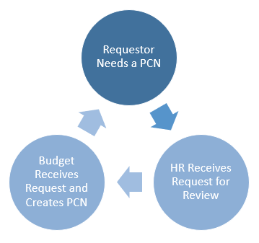
Workflow Purpose
The goal for a business manager/requestor in this process is to ensure to get an accurate Position Control Number (PCN) from budget. To make this process work it is essential that all data entered in the form is accurate as possible.
https://www.utoledo.edu/depts/hr/hris/positioncreation.html

Slide 4
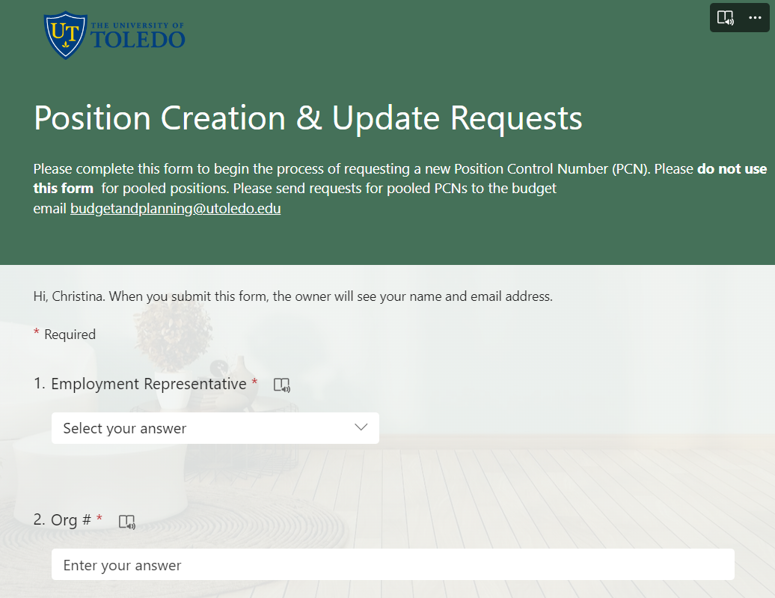
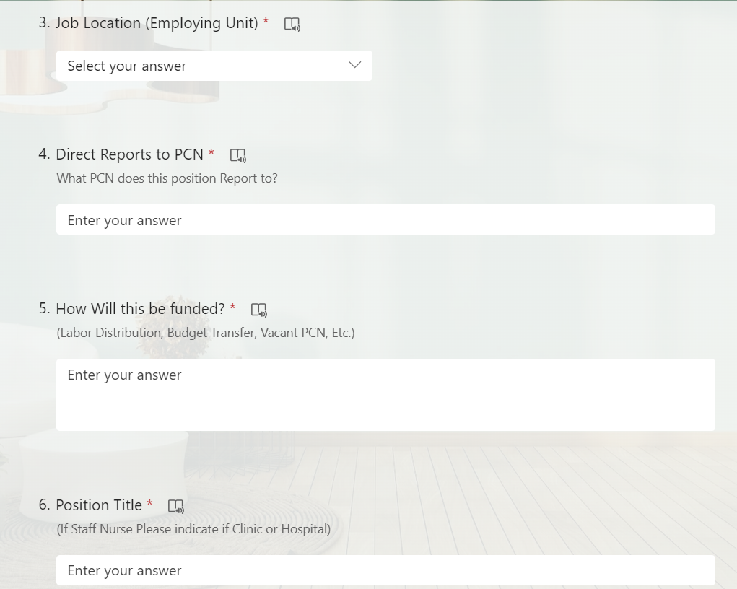
Form review
FORM REVIEW
Employment Representative: This is the Human Resources Employment Representative that will be assisting you with the Job posting later down the line.
2 & 3. Org # and Job Location/Employing Unit: This is your organization number and Job Location number that can be located on the PowerBI report
4. Direct Reports to PCN: This is the PCN Number that the new position will be reporting to
How this will be funded: Your notes on how the new position will be funded
Position Title: The Exact Title (specific towards contracts) this position will have

Slide 5
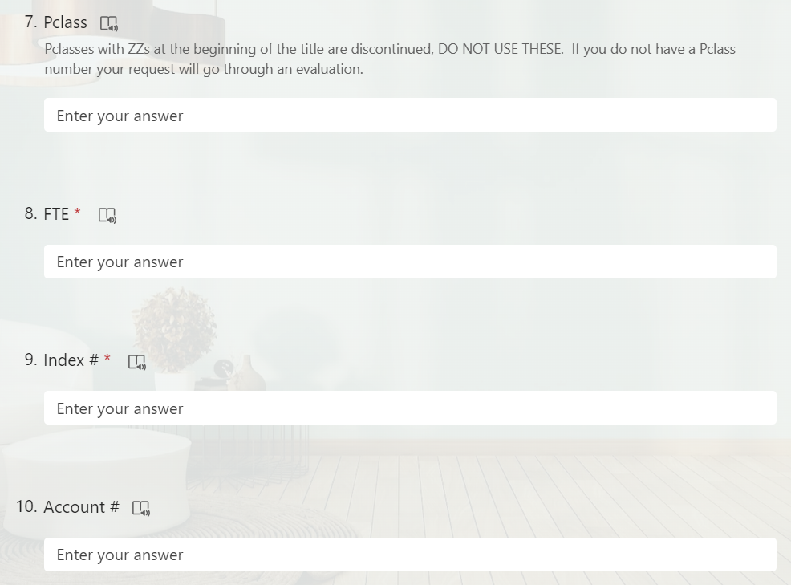
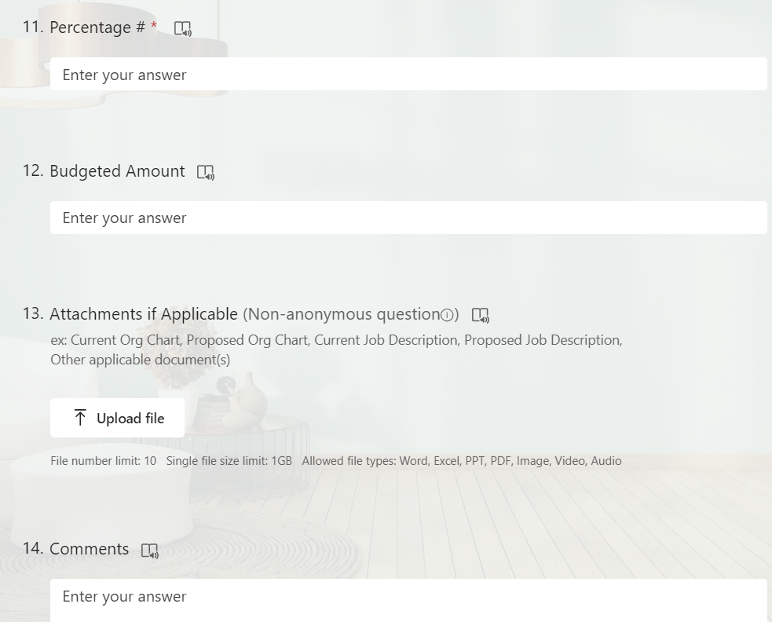
FORM REVIEW
7. Pclass: This is an HR used number that you may not have but is useful if you do
FTE: The FTE being assigned to this position
Index #: The Index/s # this position is being assigned to (can be found on PowerBI Report)
Account #: The account # this position is being assigned to (can be found on PowerBI report)
Percentage #: The % going into the specific index/s above
Budgeted Amount: The Amount Budgeted for this Position
Attachments: You must attach all emails related with required approvals
Comments: Anything you want to relay to budget

Slide 6
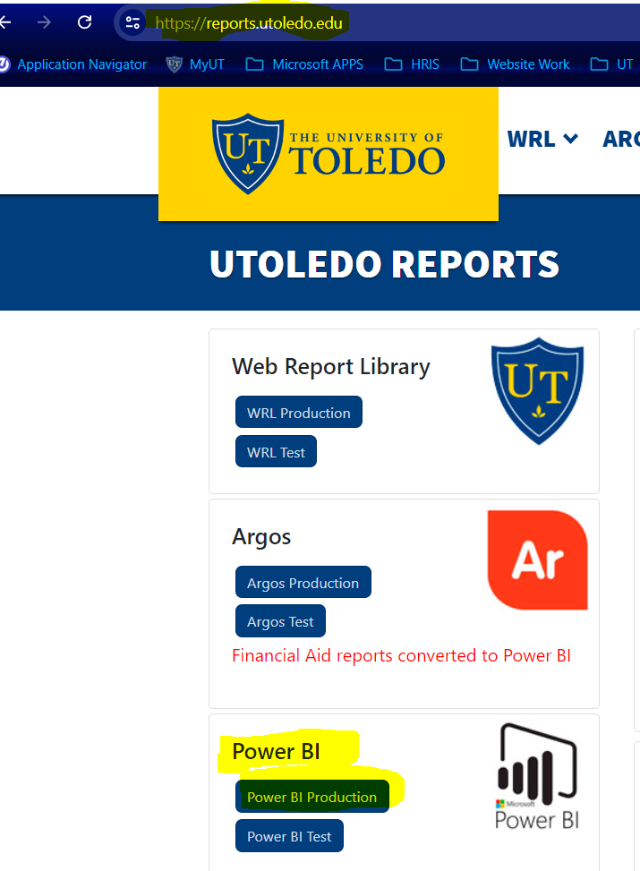
Power BI Report
The PowerBI Report you will want to utilize for this is located in one of two places. If you have access to either one of these, you can get the information you need.

Slide 7
PowerBI report-2 locations
Home > Human Resources >Business Partners > Employee Position Info by Dept Name or ID v2
Or
Home > Human Resources > General Inquiry> Employee Position Info by Dept Name or ID
You can find on these reports (relevant to the form request):
Position Numbers, Position Titles, Account Codes, Index Numbers, Labor Distribution %s, FTE and Job Locations
If you do not have access to ONE of these reports please contact us at hrsupport@utoledo.edu.

Slide 8
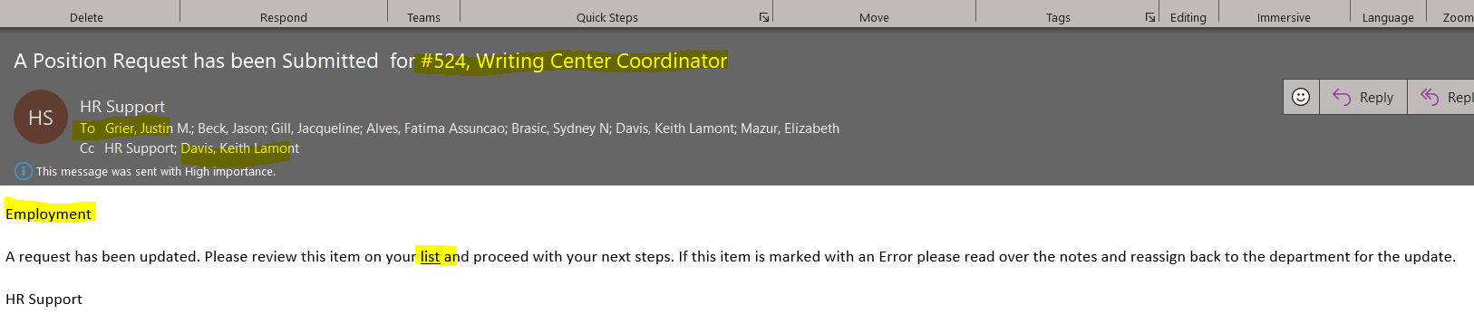
Email Correspondence-Main Campus
First Email
1
2
3
4
5
# on the list and Title of Position
Whom the email was sent to (all of hr employment)
CC of receivers (You the business manager/requestor (new), your selected hr employment representative on the form <hrsupport has been removed>)
Whom the email is attention to, and whom is to take action
A link to the position list

Slide 9
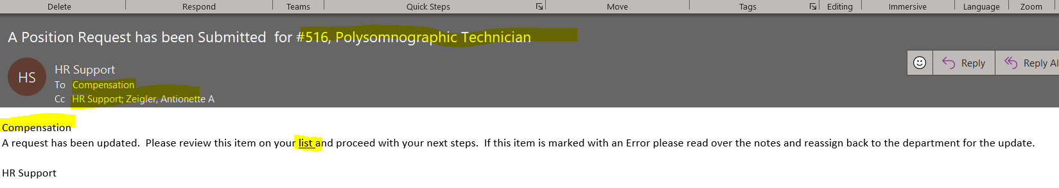
Email Correspondence-Main Campus
Possible Follow Up Email-Compensation
1
2
3
4
5
# on the list and Title of Position
Whom the email was sent to (Compensation)
CC of receivers (You the business manager/requestor (new), your selected hr employment representative on the form <hr support has been removed>)
Whom the email is attention to, and whom is to take action
A link to the position list

Slide 10
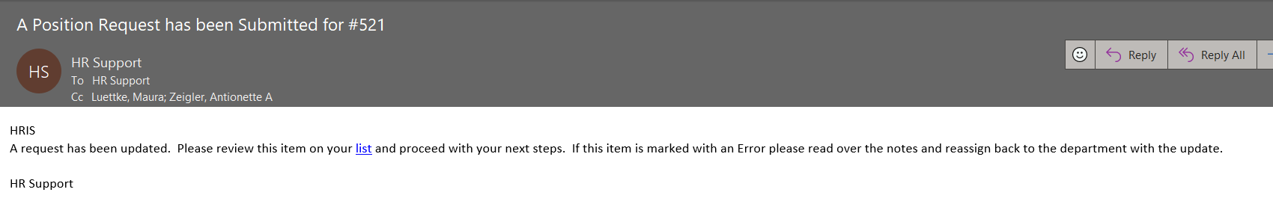
Email Correspondence-Main Campus
Possible Follow Up Email-HRIS
1
2
3
HR Support
xxxx
4
5
# on the list
Whom the email was sent to (HR Support <updated name>)
CC of receivers (You the business manager/requestor and your selected hr employment representative on the form)
Whom the email is attention to, and whom is to take action
A link to the position list

Slide 11
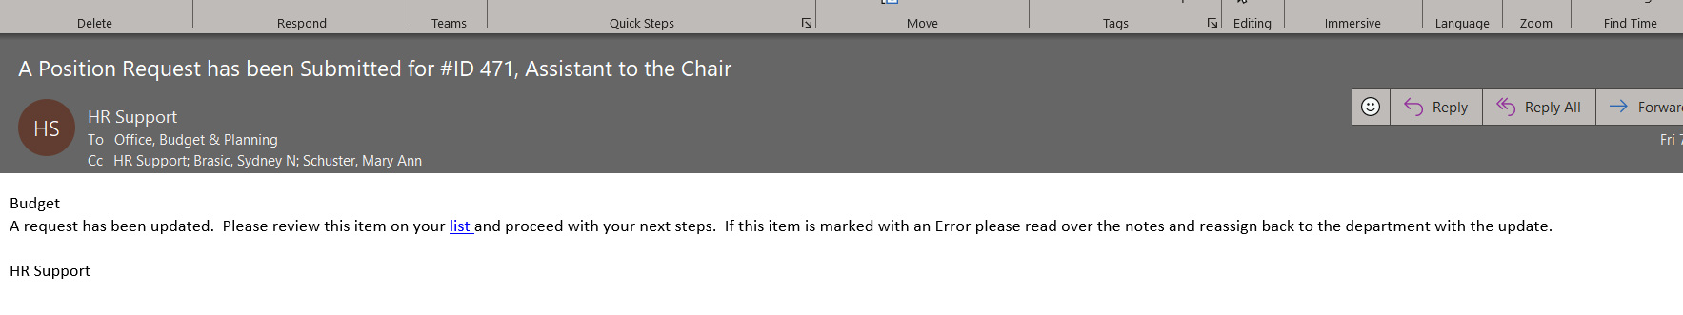
Email Correspondence-Main Campus
Follow Up Email-Budget
1
2
3
4
5
# on the list & Title
Whom the email was sent to (Budget)
CC of receivers (You the business manager/requestor and your selected hr employment representative on the form, <hrsupport has been removed>)
Whom the email is attention to, and whom is to take action
A link to the position list

Slide 12
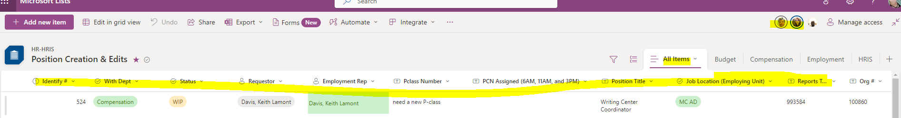
LIST REVIEW
**NOTES**
You Will Not Have Editing Rights this is just to View the Progress of your Request
13
12
1
2
3
4
5
6
7
8
9
10
11
Scrolls Right
At any time during the workflow, if you click on an email that has the words List highlighted it will take you to the list view (see above slides)
Identify #- is the #s associated with all emails
With Department-Department the request is with
Status-Status the Request is in
Requestor-The person that filled out the form
Employment Rep-The Employment rep filled out on the form
Pclass-The Pclass filled out on the form OR the Pclass HRIS has assigned to the request
PCN-The PCN assigned to the request via budget (do NOT use this until Completed email is sent)
Position Title-The Position Title filled out on the form OR the updated title to match contract/request
Job Location-The Job Location filled out on the form
Reports t…- The reports to PCN # filled out on the form
Org #: The Organization # filled out on the form
All Items Tab: this is the tab you want to be on to see everything
Images: If you scroll over you can see whom is in this list viewing it at the time
Scrolls Right

Slide 13
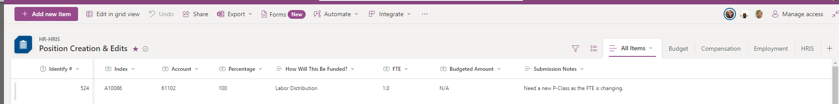
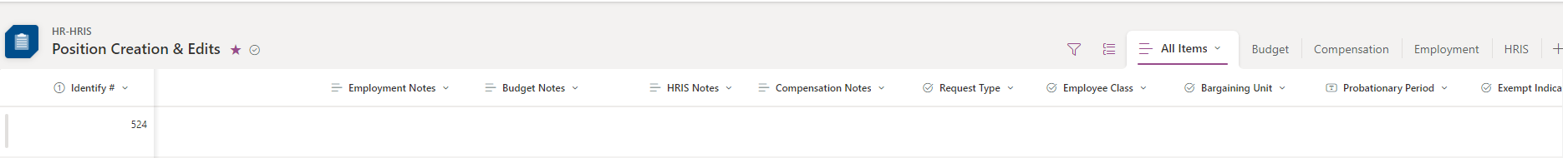
LIST REVIEW cont
**NOTES**
You Will Not Have Editing Rights this is just to View the Progress of your Request
14
15
16
17
18
19
20
21
Scrolls Left & Right
14. Identify # (it scrolls with)
Index #-The Index # filled out on the form
Account-The Account # filled out on the form or updated via Budget
Percentage-The % filled out on the form
How will this be Funded-The Info filled on the form
FTE-FTE filled out on the form
Budgeted Amount-The Budgeted amount filled out on the form
Submission notes-the notes you filled out on the form
Scrolls Left & Right
Stop Here
22
23
24
25
26
Data Not Needed For BMs
Scrolls Left & Right
Identify # (it scrolls with)
Employment Notes-Notes that the Employment Representative had regarding the request
Budget Notes-Notes that Budget had regarding the request
HRIS Notes-Notes that HRIS had regarding the request
Compensation notes-Notes that Compensation had regarding the request
Scrolls Left & Right

Slide 14
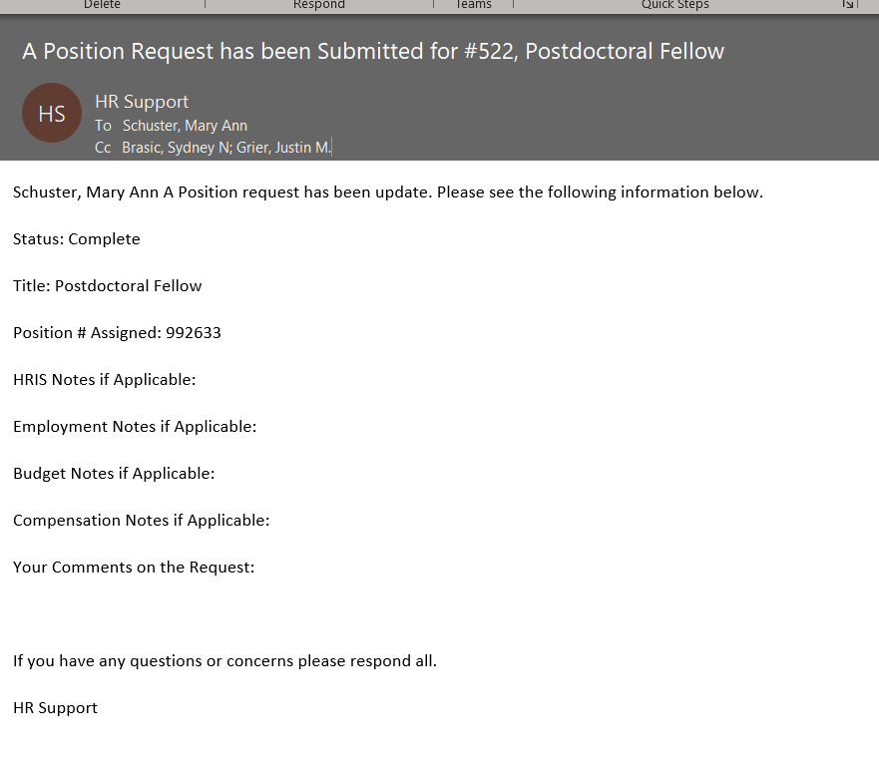
Email Correspondence-Main Campus
# on the list & Title
Whom the email was sent to (You the Business Manager/Requestor)
CC of receivers (your selected hr employment representative on the form, the last person to update the request)
Whom the email is attention to, and whom is to take action (You)
Status: The status of the request. If this says anything but Complete, There are important next steps for you to respond to this email on. Please ensure you respond All.
The Title the Position was assigned and will come up on Pageup
The Position number
8, 9, 10, 11. Notes from corresponding departments. This will be very important if the status is not complete
12. Any original comments you had
Final Email
1
2
3
4
5
6
7
8
9
10
11
12
** NOTES**
IF the status is Complete you should have everything you need to post this position to Pageup

Slide 15
Any Questions?
Please contact hrsupport@utoledo.edu
HRIS
2024

