Slide 1
2024-25 UToledo Student Health Insurance Plans
Tia Wright
Student Health Insurance Specialist
419.530.4747 option 1
Tia.Wright@UToledo.edu
StudentHealthInsurance@UToledo.edu

Slide 2
Empowering students to make healthier decisions now and create healthier habits for life
Welcome to an engaging, integrated health care experience tailor-made for student life. One backed by 75 years of experience and two decades in the student health marketplace, with over 175,000 students served across the country.

Slide 3
Commonly Used Insurance Terms
Health Insurance shouldn’t be complicated. Here are some health insurance terms that you should be aware of. If you have any questions, please contact us.
Premium: The cost you pay for the insurance.
Deductible: The amount you must pay before the insurance company will start paying. There is no “deductible” for care obtained by a University of Toledo (UT) facility of provider.
Out of Pocket Maximum (OOPM): The maximum amount you are responsible for. Once you meet your OOPM the insurance will pay at 100%*. The individual OOPM is $5,000.
Co-payment/Coinsurance: Copayment is a dollar amount and Coinsurance in a percentage you will be responsible to pay. The Emergency Room Copay is $250. Coinsurance is between 20%-40% depending on provider status.
Provider Network (Anthem Blue Cross Blue Shield): The Provider Network is doctors and/or facilities that are contracted with Anthem and offer care at lower out of pocket cost.
Learn More about health care in the United States at https://student.anthem.com/student/healthcare-101/
* Exclusions may apply.

Slide 4
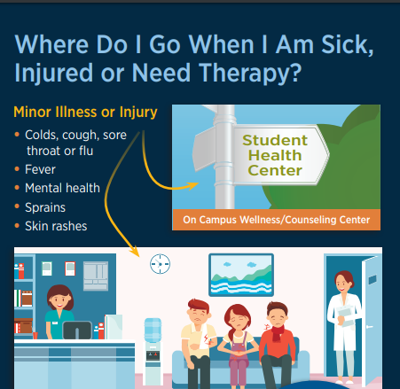
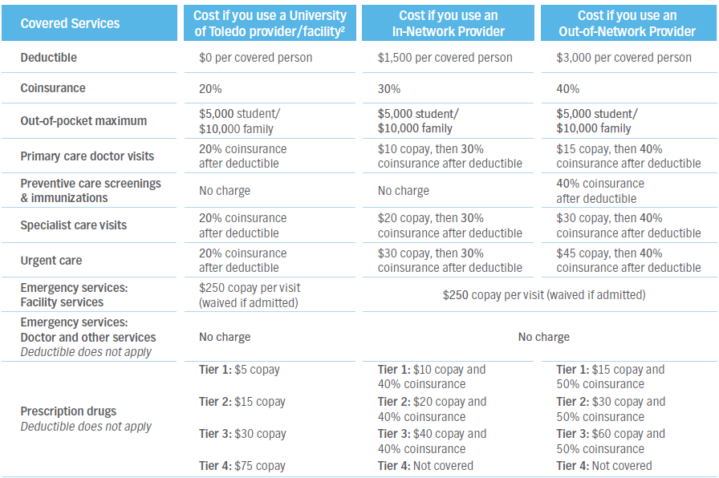
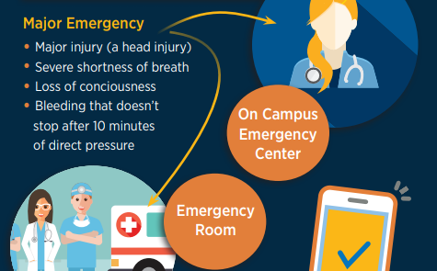
Your Benefits at a Glance
For the lowest out-of-pocket cost please visit The University Health Center on Main Campus or The University of Toledo Health Science Campus Student Health and Wellness Center
For life-threatening or emergency situation, call 911
* Exclusions may apply.

Slide 6
Health Care Overview
Healthcare providers are not paid by the government. They are private businesses that bill for the services they perform.
In general, you can expect to see approximate charges of:
Office visit: $100–$350
Emergency room visit: $2,000-$2,500
Hospital stay: $3,000-$5,000 per night
These costs do not include labs, x-rays, or other tests, which are extra.
Prescription medications on average cost 2.5+ time more in the U.S. than for the same drug in other countries.
Total approximate cost for typical services (including doctors, facility, prescriptions and ancillary services):
Childbirth: ~$13,000
Diabetes management: ~5,750
Simple fracture: $2,750

Slide 7
Health Insurance Overview
To cover the cost of these services, most people in the U.S. purchase health insurance.
Health Insurance companies in the U.S. are highly regulated, both in terms of required benefits and patient protections. Policies are “filed” each year with regulatory agencies to ensure compliance with Federal and State Laws.
Plans are that filed and approved in the U.S. generally will cover “essential health benefits” such as inpatient, outpatient, mental health, maternity, and prescriptions. In addition, there are rules that must be followed that protect the consumer.
Health insurance policies do not cover all services. Health insurance companies use various tools to control cost, including:
Cost sharing: Deductible, coinsurance and copays are paid by the patient when accessing care.
Network management: Some plans require you to see certain providers or follow certain rules when accessing care.
Policy exclusions: It is common to exclude care that is not medically necessary, experimental, or not at the right “sight of service.

Slide 8
Market Overview
Student Health Insurance plans are required to follow these regulations.
Compared to other forms of health insurance, Student Plans
Have low deductibles
Utilize broad national networks that do not require “referrals”.
Have access to on campus student clinics
Include Medical Evacuation, repatriation, and other student friendly services.
Are generally lower premium than comparable plans.
Insurance Plans that are marketed specifically for international students are NOT regulated in the same way as Student Insurance Plans are.
As a result, most schools require students to have a plan that is “filed and approved” in the U.S. in order to waive the student health insurance to ensure student are adequately insured.
Insurance Pro Tip: Do not make decisions on health insurance based solely on cost. Look at benefit levels,
networks, and exclusions.

Slide 9
2024-25 Toledo Student Health Insurance Plans
Presentation Topics:
Eligibility
Automatically Enrolled vs. Voluntary Enrollment
Waiving Coverage (Automatically Enrolled Students)
Enrollment (Voluntary Students)
Student Medical and Prescription Drug Plan Coverage & Premiums
Student Dental Plan Coverage & Premiums
Student Vision Plan Coverage & Premiums
Vendor and UToledo Staff Contacts

Slide 10
Eligibility

Slide 11
2024-25 UToledo Student Health Insurance Plans
Who is Eligible for the Student Health Insurance Plans?
All degree-seeking students enrolled in at least 1 credit hour.
Who is Automatically Enrolled in Medical/Prescription Drug Plan?
All domestic undergraduate students registered six (6) or more credit hours
All domestic graduate students registered six (6) or more credit hours
All international students registered one (1) or more credit hour
All students who participate in patient care and/or are required by their program to have health insurance
How are Premiums Paid?
Automatically enrolled students – through their student account
Voluntarily enrolled students – directly to the vendor(s)

Slide 12
Automatically Enrolled Students vs.
Voluntarily Enrolled Students

Slide 13
2024-25 UToledo Student Health Insurance Plans
What does it mean to be automatically enrolled?
The medical/prescription drug insurance premium is assessed to your student account.
Automatically enrolled students may choose to remain on the plan or may submit a waiver to have the premium removed from their student account by providing documentation of coverage under another plan by the published deadline.
Fall 2024 deadline is Sept 9th
Spring 2025 deadline is Feb 1^{tst}
Summer 2025 deadline is July 1st (newly enrolled students only)
What does it meant to be voluntarily enrolled?
Degree-seeking domestic students enrolled in 1-5 credit hours can voluntarily enroll in the student medical/prescription drug insurance plan.
Voluntarily enrolled students pay their medical/prescription drug premiums directly to Anthem Student Advantage.
All eligible students wanting dental and/or vision insurance coverage will need to voluntarily enroll and pay their premiums directly to UHP (University Health Plans).

Slide 14
Waiving the UToledo Student
Medical and Prescription Drug Insurance Plan (Automatically Enrolled Students)

Slide 15
2024-25 UToledo Student Health Insurance Plans
How to Waive Student Medical and Prescription Drug Coverage (Automatically Enrolled Students)
Log in to the myUT Portal using your utad and password
Select “Health Insurance – Enroll or Waive” located in “My Toolkit”
Select term (Fall 2024, Spring 2025 or Summer 2025)
Select “Request Waiver”

Slide 16
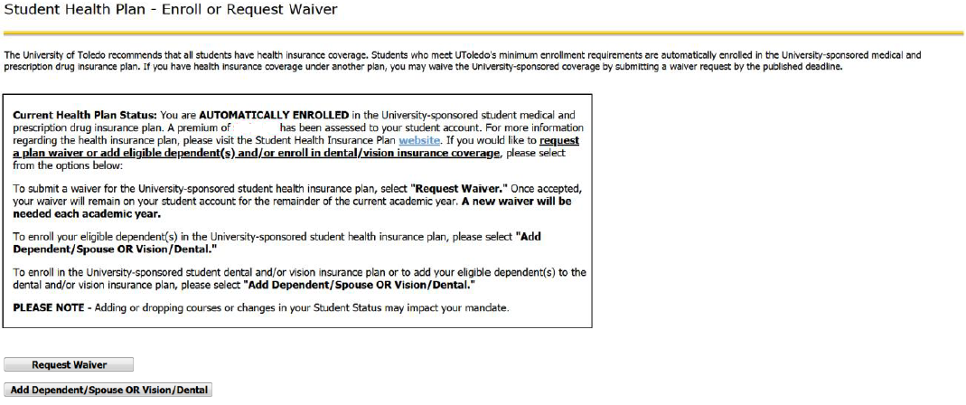
2024-25 UToledo Student Health Insurance Plans
https://myut.utoledo.edu/portal/

Slide 17
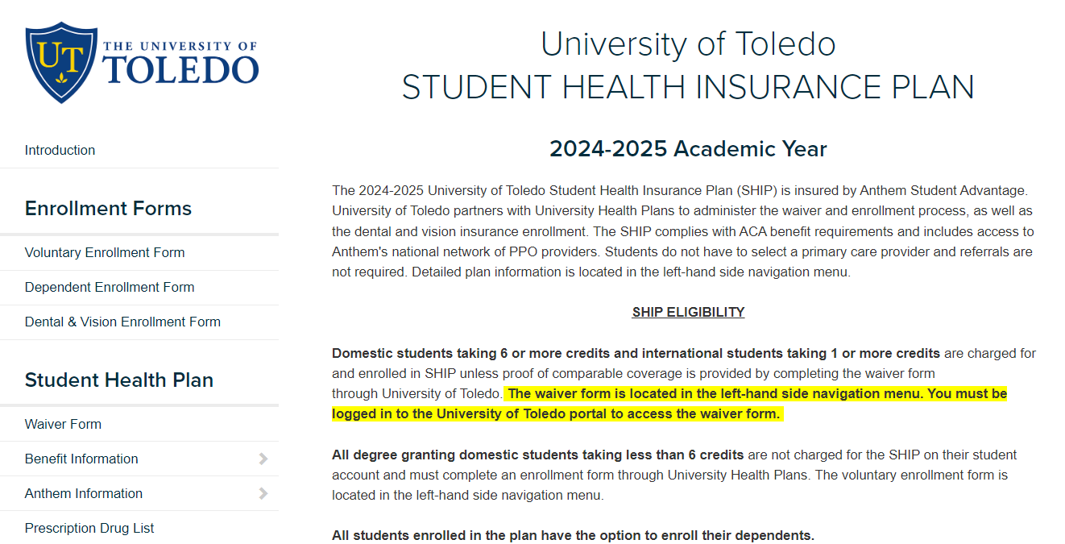

Slide 18
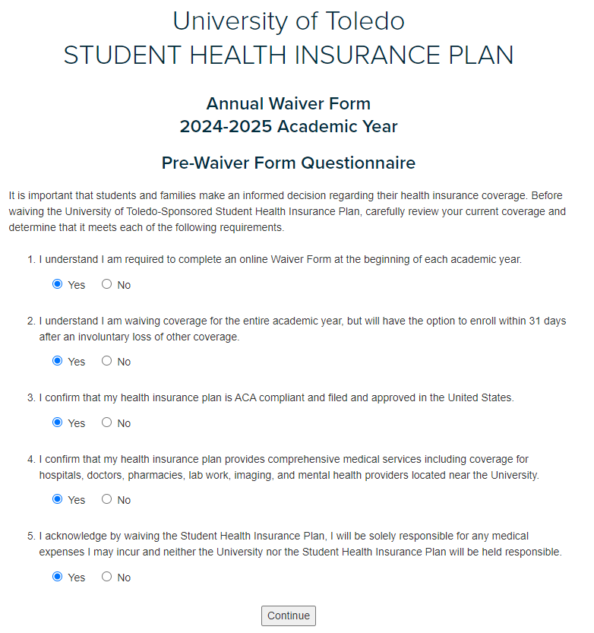

Slide 19
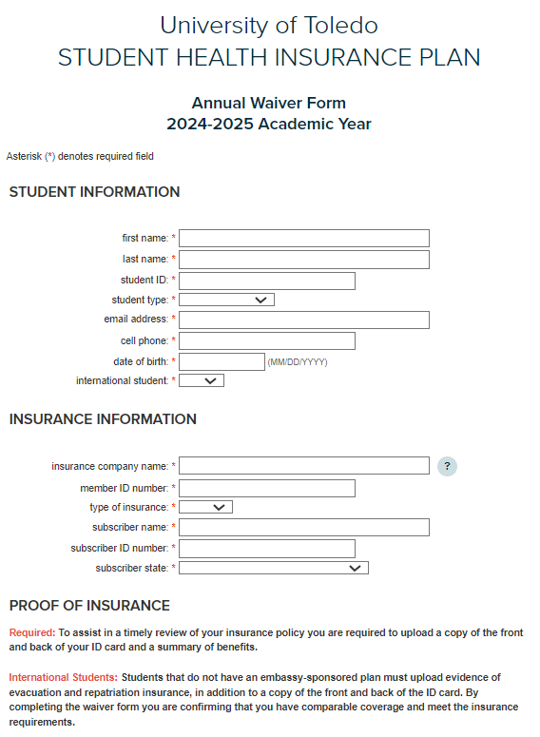
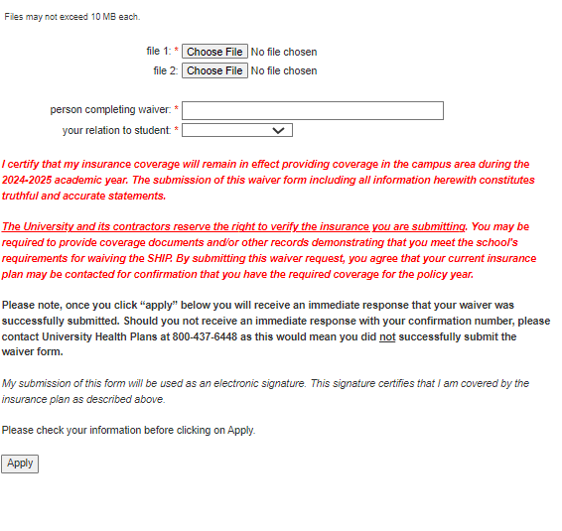
Once accepted, the waiver will remain on the student’s account for the remainder of the academic year.
A new waiver is needed each academic year.
Fall waiver would carry over to Spring and Summer
Spring waiver would carry over to Summer, but a new waiver would be needed for Fall
Summer waiver (new students only) would not carry over, new waiver needed for Fall

Slide 20
Enroll in the UToledo
Student Health Insurance Plan
(Medical/Rx Voluntary Dependent(s) & Dental/Vision Enrollment)

Slide 21
2024-25 UToledo Student Health Insurance Plans
How to Enroll in the Student Medical and Prescription Drug Coverage (Voluntary Students)
Log in to the myUT Portal using your utad and password
Select “Health Insurance – Enroll or Waive” located in “My Toolkit”
Select term (Fall 2024, Spring 2025 or Summer 2025)
Select “Enroll”
Premium is paid directly to University Health Plans (UHP)

Slide 22
2024-25 UToledo Student Health Insurance Plans
How to Add Dependents and/or Enroll in Dental and/or Vision
Log in to the myUT Portal using your utad and password
Select “Health Insurance – Enroll or Waive” located in “My Toolkit”
Select term (Fall 2024, Spring 2025 or Summer 2025)
Select “Add Dependent/Spouse or Vision/Dental”
Premium is paid directly to University Health Plans (UHP)

Slide 23
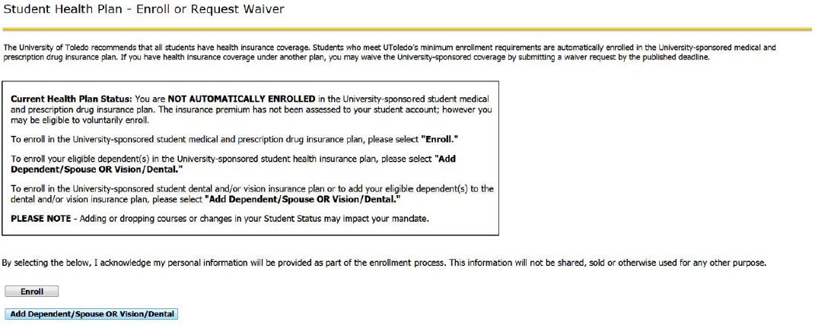
2024-25 UToledo Student Health Insurance Plans
https://myut.utoledo.edu/portal/

Slide 24
Medical and Prescription Drug Insurance Plan
Premiums and Coverage Details

Slide 25
2024-25UToledo Student Health Insurance Plans
Medical and Prescription Drug Insurance Plan Premiums
Semester: | Fall | Spring/Summer | Summer Only* | Full Year**
Coverage Begins: | Aug. 11, 2024 | Jan. 1, 2025 | May 12, 2025 | Aug. 11, 2024
Coverage Ends: | Dec. 31, 2024 | Aug. 10, 2025 | Aug. 10, 2025 | Aug. 10, 2025
Student | $898 | $1,394 | $546 | $2,292
Student & 1 Dependent | $1,796 | $2,788 | $1,093 | $4,584
Student & 2+ Dependents | $2,694 | $4,182 | $1,639 | $6,876
*Summer only premium is available only for UToledo students newly enrolled for summer 2025.
**Students must enroll in both fall 2024 and spring/summer 2025 semesters to have coverage for the full year.

Slide 26
Dental Insurance Plan
Premiums and Coverage Details

Slide 27
2024-25 UToledo Student Health Insurance Plans
Dental Insurance Plan Premiums
Coverage Period | Aug. 11, 2024 – Aug. 10, 2025
Student | $252
Student & 1 Dependent | $508
Student & 2+ Dependents | $1131
Students may enroll in the dental plan for Fall and Spring only. The annual premium will remain the same no matter when you begin coverage.
The annual premium is not subject to a pro-rated premium for coverage beginning in Spring/Summer semester.

Slide 28
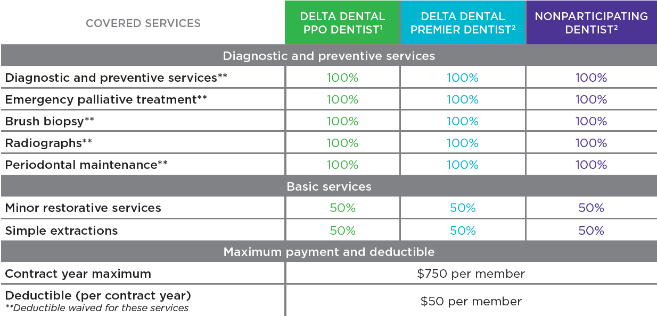
2024-25 UToledo Student Health Insurance Plans
Dental Insurance Plan Coverage Details

Slide 29
Vision Insurance Plan
Premiums and Plan Details

Slide 30
2024-25 UToledo Student Health Insurance Plans
Vision Insurance Plan Premiums
Coverage Period | Aug. 11, 2024 – Aug. 10, 2025
Student | $17
Student & Spouse | $56
Student & Child(ren) | $38
Student & Family | $83
Students may enroll in the vision plan for Fall and Spring only. The annual premium will remain the same no matter when you begin coverage.
The annual premium is not subject to a pro-rated premium for coverage beginning in Spring/Summer semester.

Slide 31
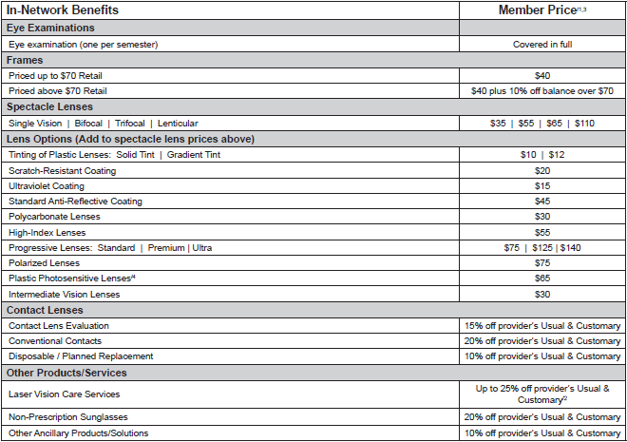
2024-25 UToledo Student Health Insurance Plans
Vision Insurance Plan Coverage Details

Slide 32
Vendor and Program Contacts

Slide 33
2024-25 UToledo Student Health Insurance Plans
Vendor Contact Information
Anthem Student Advantage Medical and Prescription Drug Insurance Plan Anthem BCBS (studentsatanthem.com) Phone: 844.412.0752
Delta Dental Dental Insurance Plan
https://deltadentaloh.com Phone: 800.524.0149
Davis Vision Vision Insurance Plan
https://davisvision.com Phone: 888.825.8390
University Health Plans (UHP)
https//www.universityhealthplans.com
Enrollment and Premium Payment
800.437.6448

Slide 34
2024-25 UToledo Student Health Insurance Plans
UToledo Student Health Insurance Contacts
Website:
https://utoledo.edu/depts/hr/benefits/student/
E-Mail:
StudentHealthInsurance@UToledo.edu
Phone:
419.530.4747 option 1

Slide 35
Questions

