Slide 1
PageUp Annual Performance Review
2026

Slide 2

PageUp Management website

Slide 3
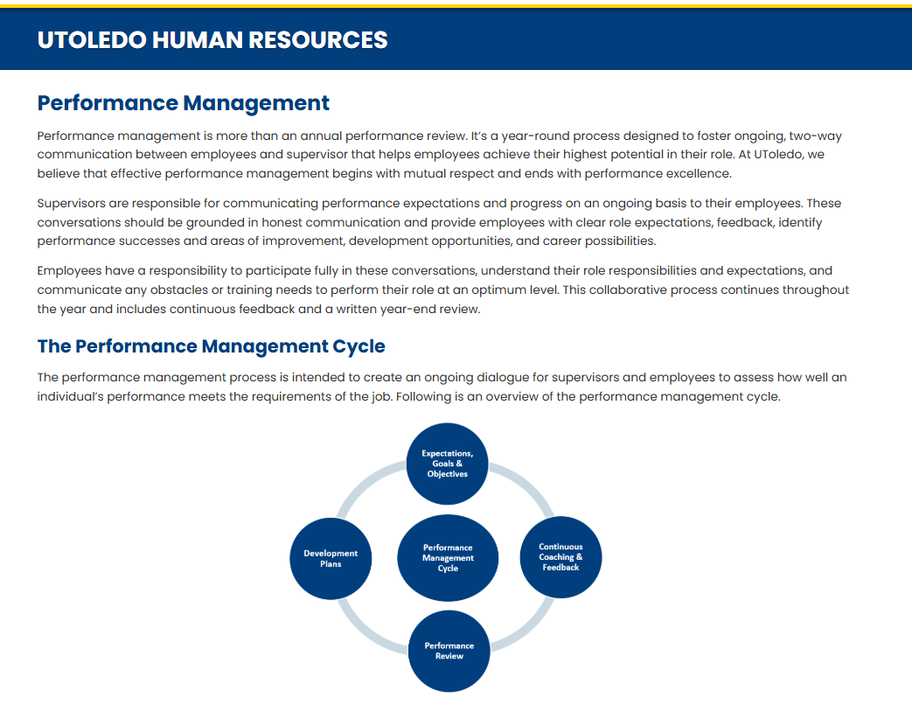

Slide 4
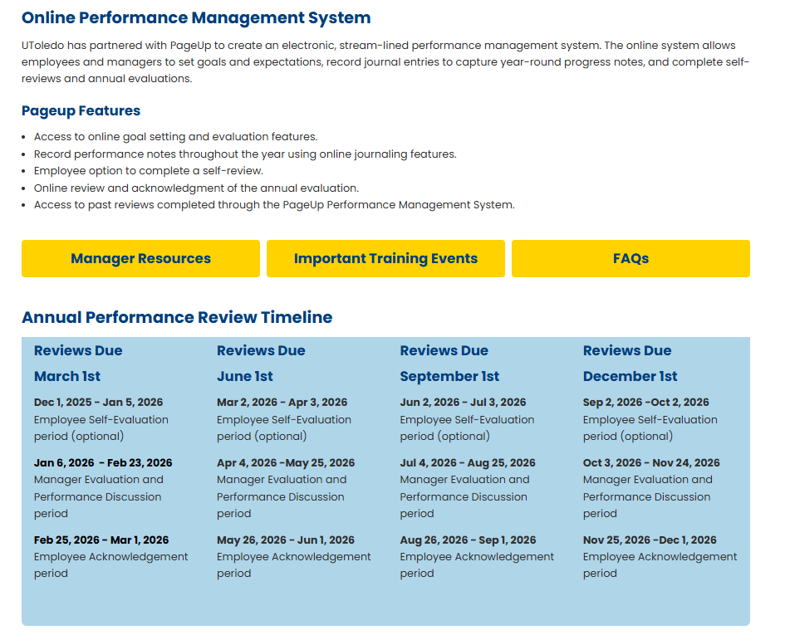

Slide 5
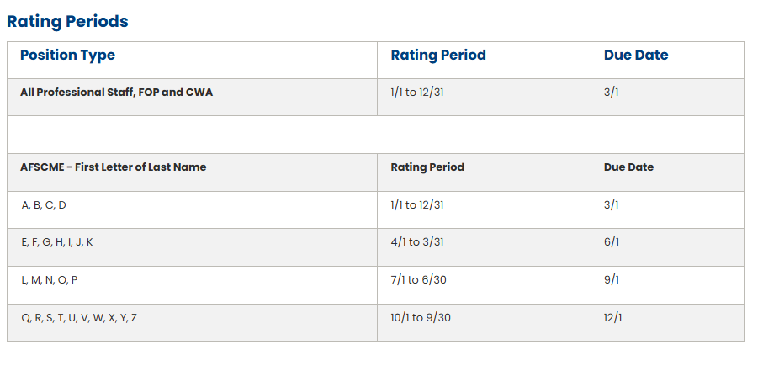

Slide 6

Access the PageUp Annual Performance Review from your MyUT portal.

Slide 7
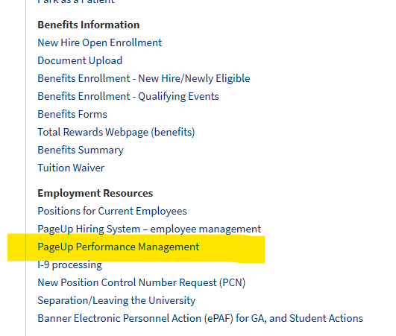
Click on PageUp Performance Management to open the home page.

Slide 8
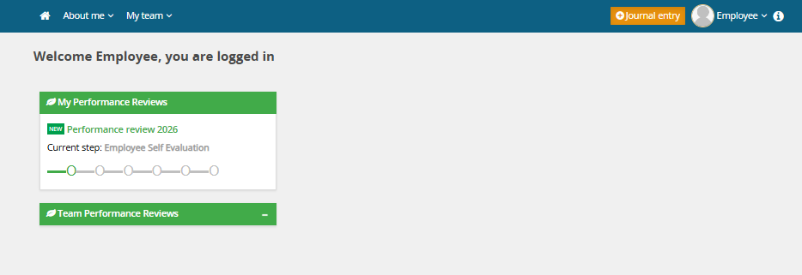
Step 1: Employee Self Evaluation
The employee has the option of completing,
Step 1: Employee Self Evaluation within the first month the review was initiated.
Click the green title of the review that corresponds to the current review that the manager needs to complete.

Slide 9
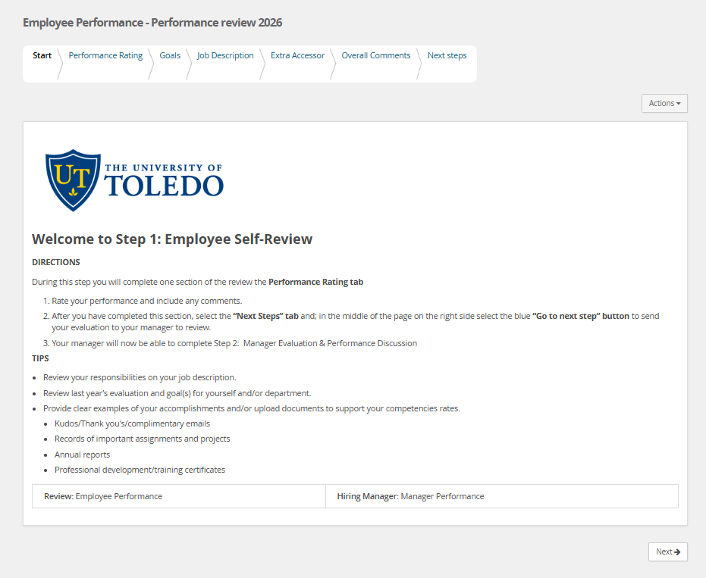
The Start Tab provides step-by-step instructions for the Employee to complete during Step 1: Employee Self Review.

Slide 10
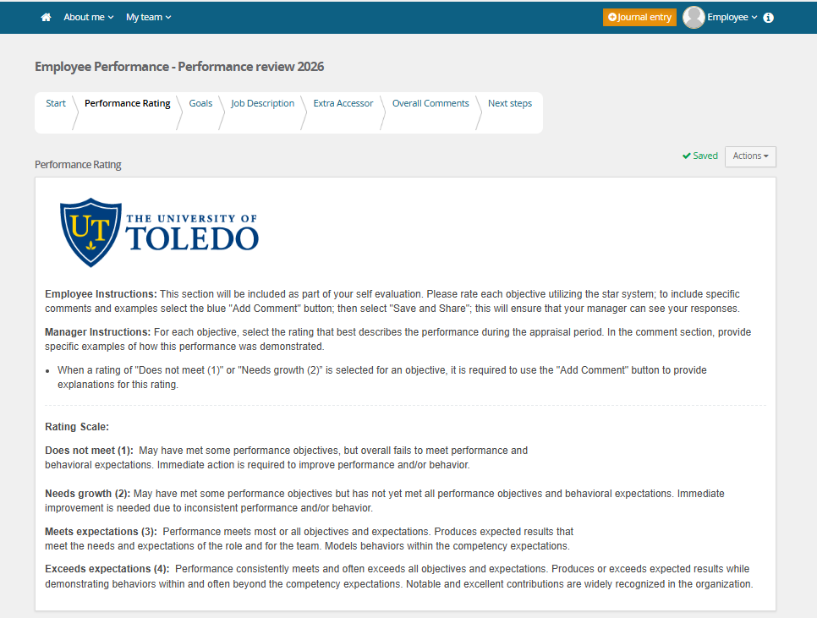
The Performance Rating tab provides employees with an overview of the four-point star rating scale, along with definitions for each level. Employees are given the opportunity to assess nine performance objectives. Each objective includes a summary for review prior to selecting a rating, as well as an 'Add Comment' option to provide specific examples of how they demonstrated that particular performance.

Slide 11
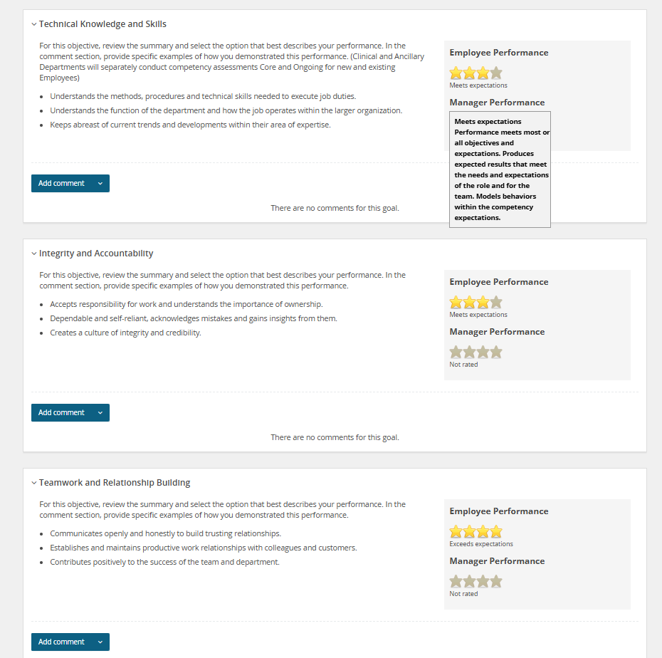
When you hover over a rating star, a tooltip appears displaying the definition for that specific rating level.

Slide 12
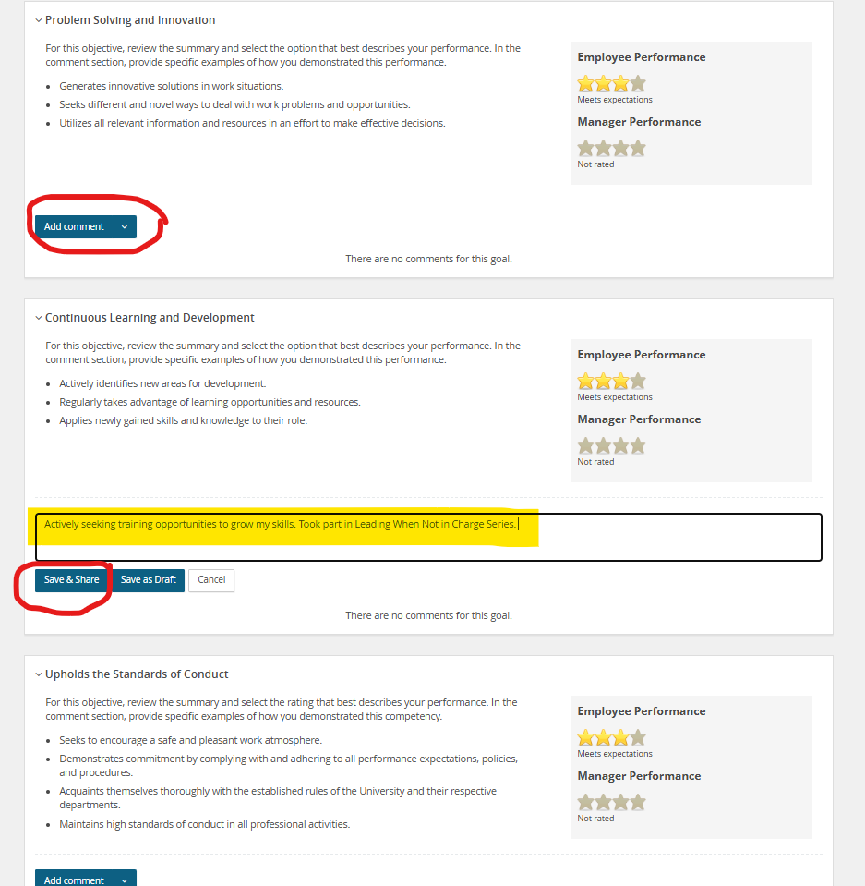
To add a comment to the performance objective, click “Add Comment” to open the text box.
Enter your comment, then select the “Save & Share” button to submit it.

Slide 13
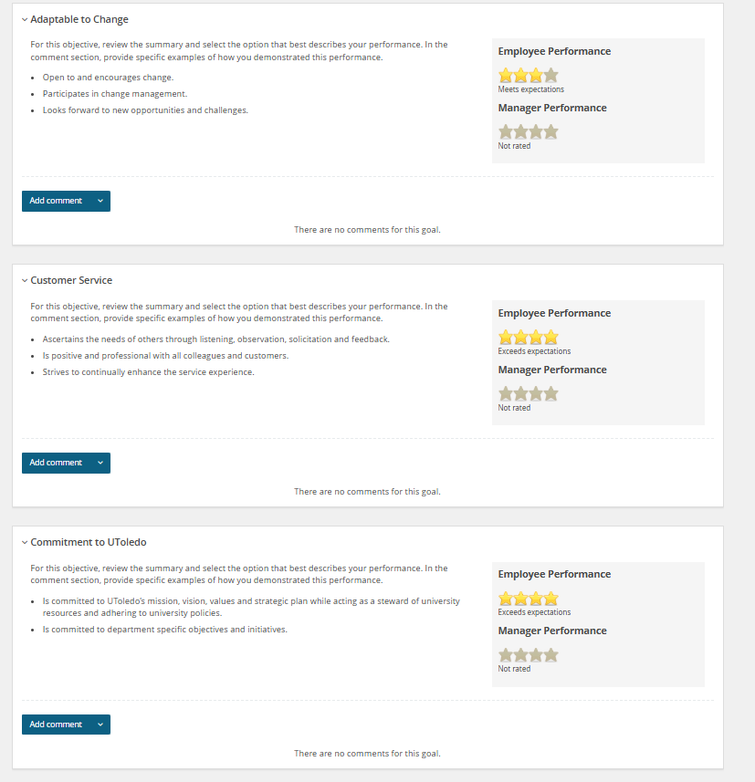

Slide 14

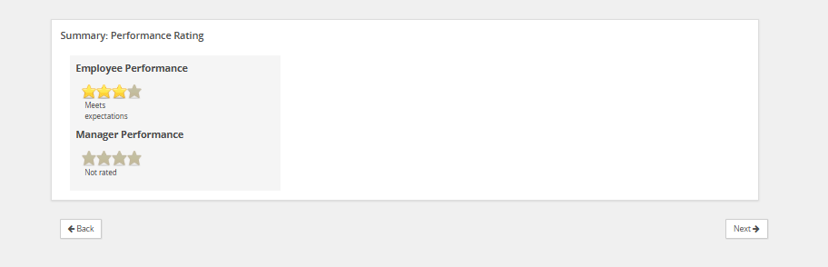
Overall employee performance rating average is shown after all nine performance objectives are rated.
Hit the “Next” button to move through the review until you get to the “Next Step” tab or hit the “Next Steps” tab at top of page to access.

Slide 15
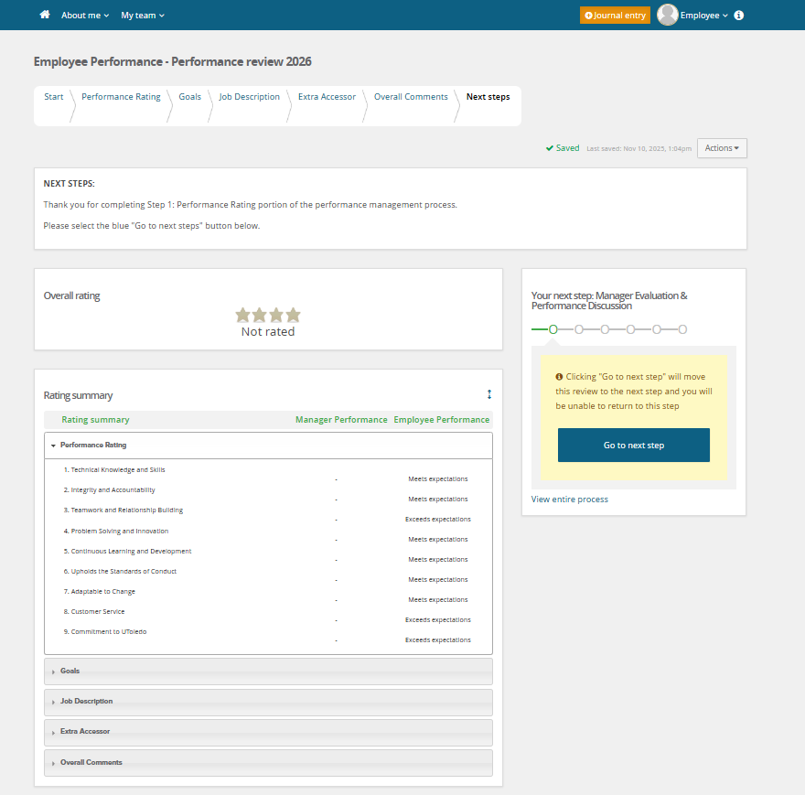
After the employee has finished filling out the “Performance Rating” tab.
Click the “Go to next step” button to move review to Step 2: Manager Evaluation & Performance Discussion.

Slide 16
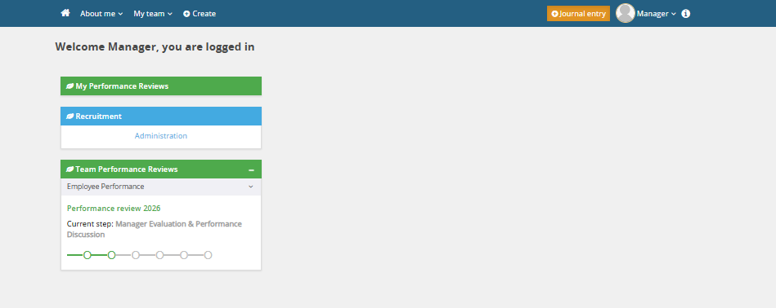
Step 2: Manager Evaluation & Performance Discussion
The manager is responsible for completing the employee’s Annual Performance Review.
Click the green title of the review that corresponds to the current review that the manager needs to complete.

Slide 17
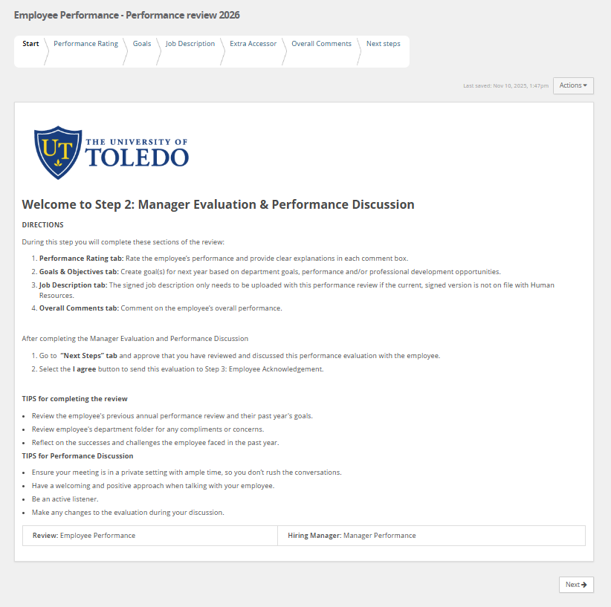
The Start Tab provides step-by-step instructions for the Supervisor to complete step 2 of the performance review process.

Slide 18
The Performance Rating tab provides managers with an overview of the four-point star rating scale, along with definitions for each level. Managers are required to assess nine performance objectives. Each objective includes a summary for review prior to selecting a rating, as well as an 'Add Comment' option to provide specific examples of how the employee demonstrated that particular performance.

Slide 19
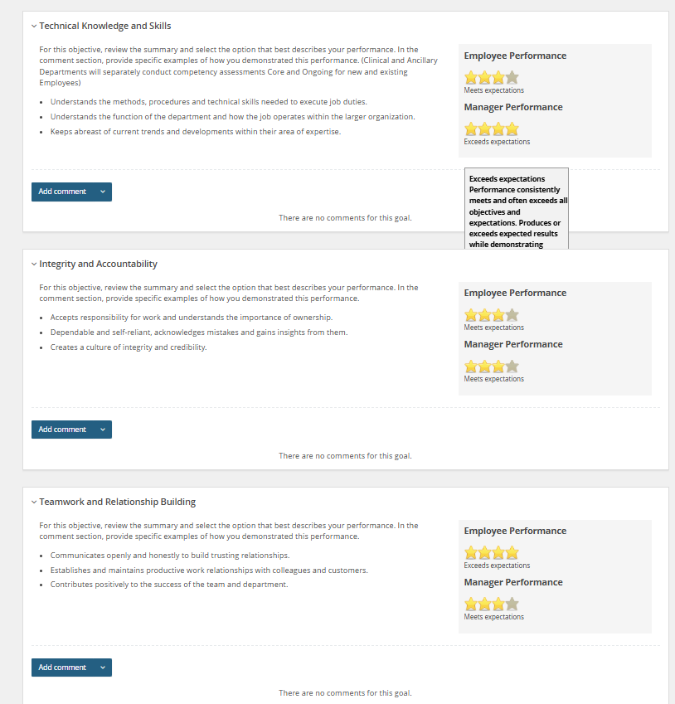
When you hover over a rating star, a tooltip appears displaying the definition for that specific rating level.

Slide 20
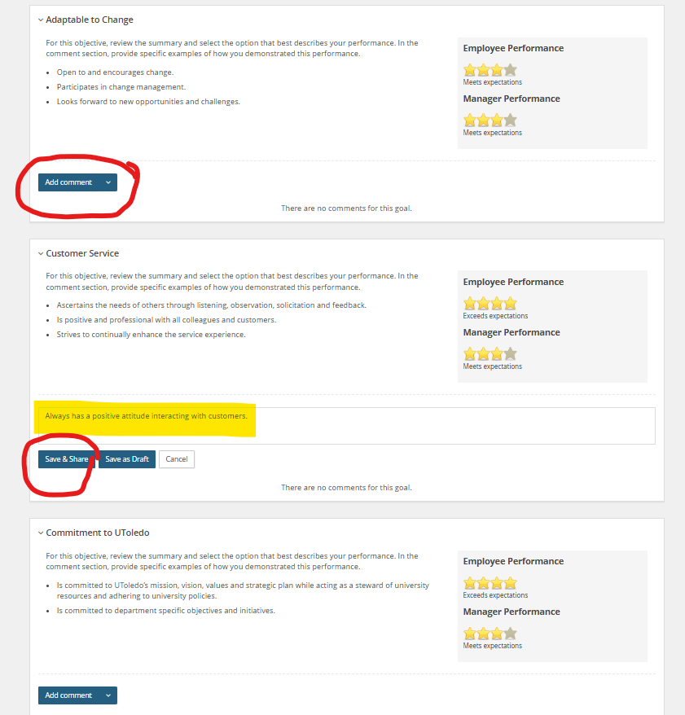
To add a comment to the performance objective, click “Add Comment” to open the text box.
Enter your comment, then select the “Save & Share” button to submit it.

Slide 21
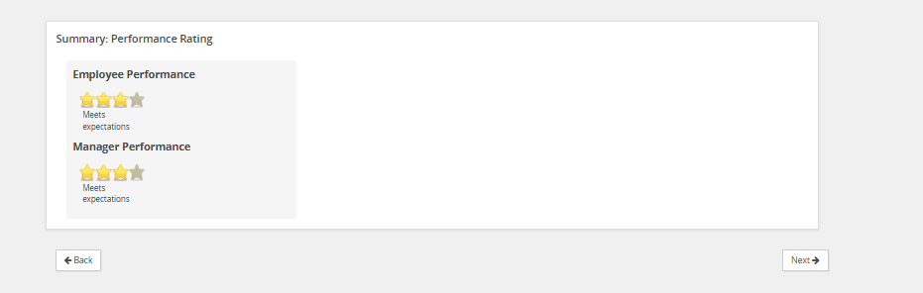
Overall employee performance rating average is shown after all nine performance objectives are rated by the manager.
Hit the “Next” button to move onto the “Goals” tab.

Slide 22
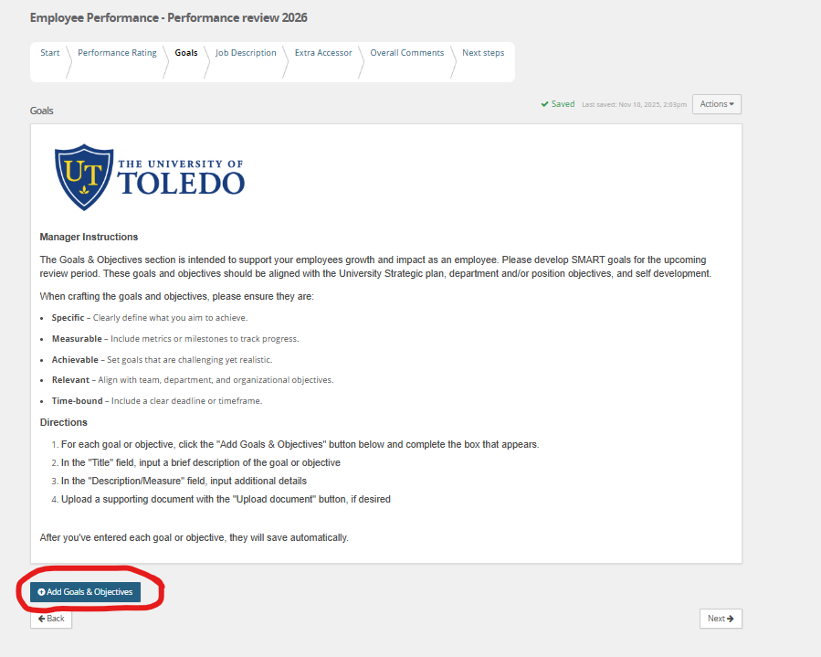
Click add “Add Goals & Objective” button to create a fillable box.

Slide 23
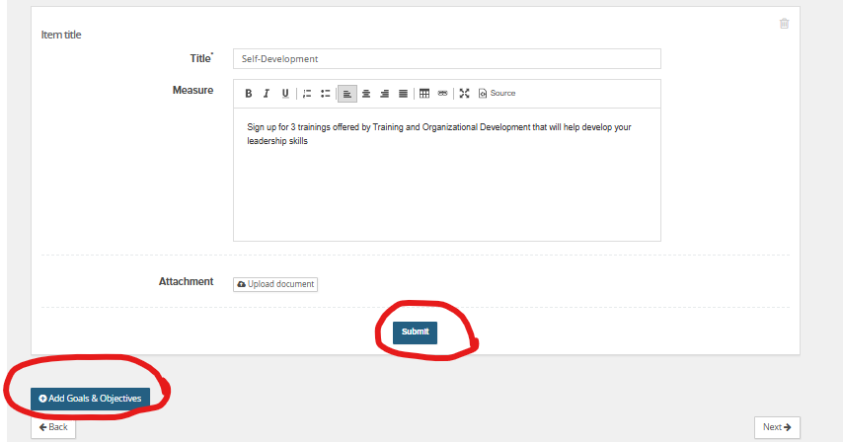
In the "Title" field, input a brief description of the goal or objective.
In the "Description/Measure" field, input additional details
Upload a supporting document with the "Upload document" button, if desired
For each goal or objective, click the "Add Goals & Objectives" button and complete the box that appears.
After you've entered each goal or objective, hit the “Submit” button or click on the “Next” button and they will save automatically save.

Slide 24
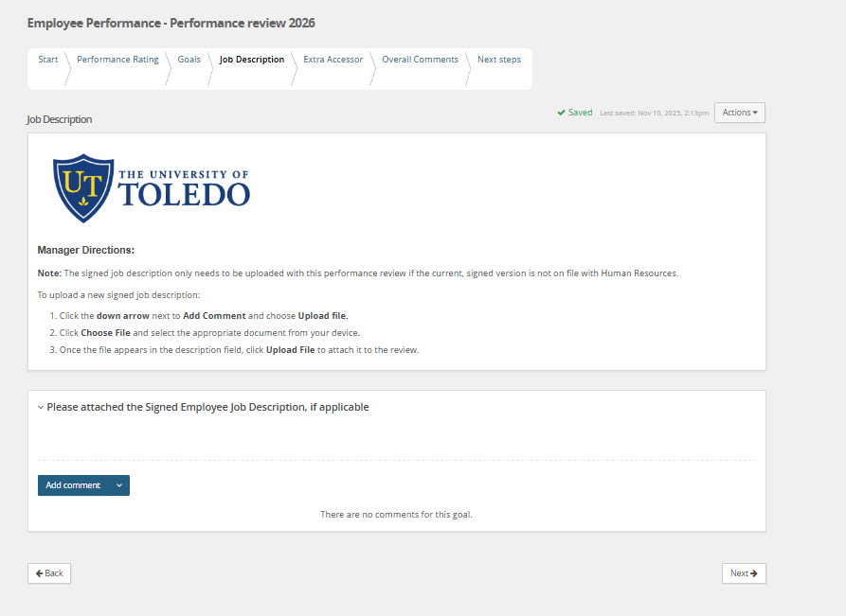
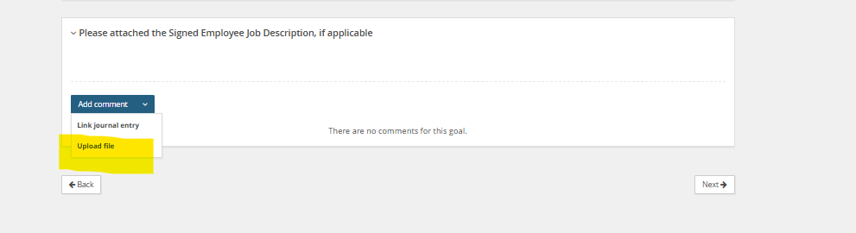
If signed JD needs attached.

Slide 25
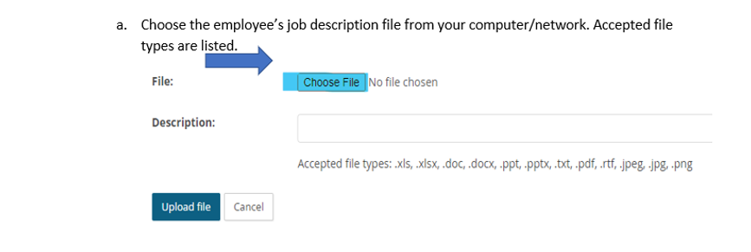
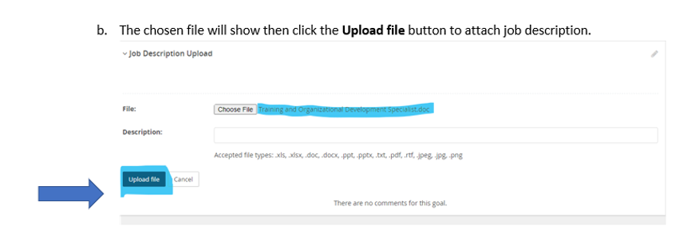
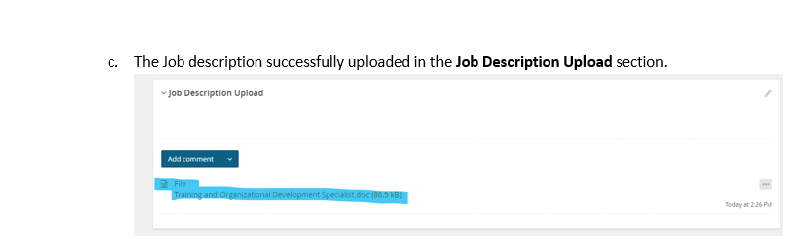
Follow these directions on how to attach JD if applicable.

Slide 26
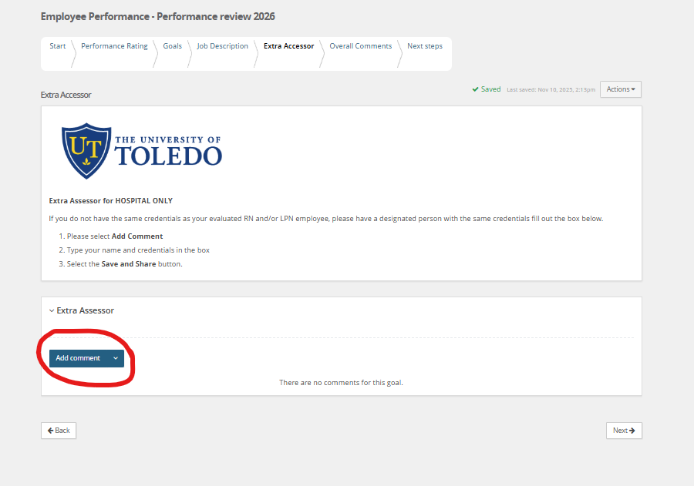

Slide 27
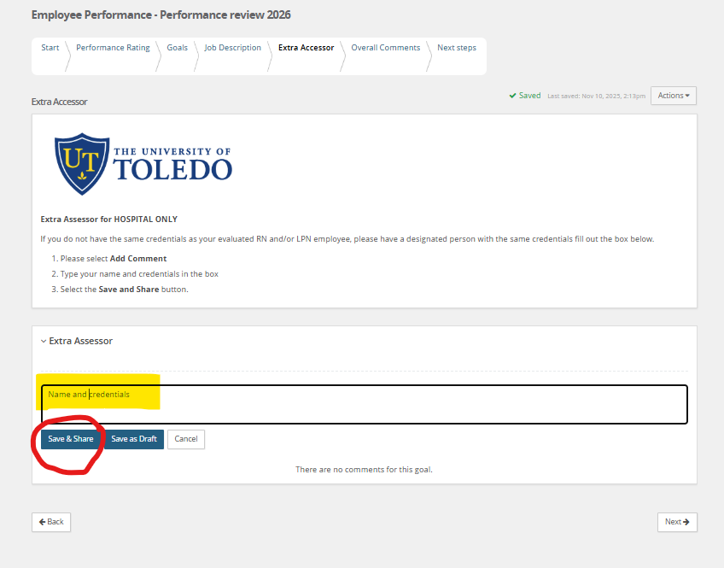

Slide 28
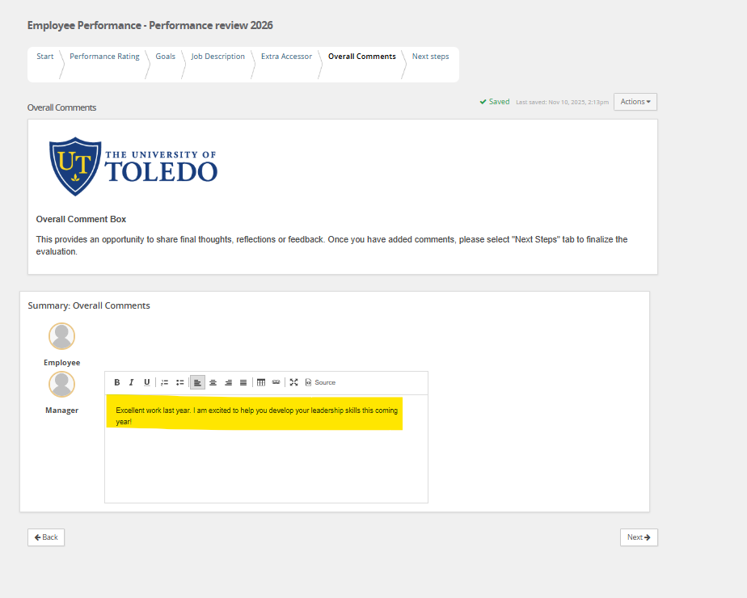
In the “Overall Comments” Tab, the manager has an opportunity to share final thoughts, reflections or feedback.
Once you have added comments, please select "Next Steps" tab to finalize the manager’s evaluation.

Slide 29
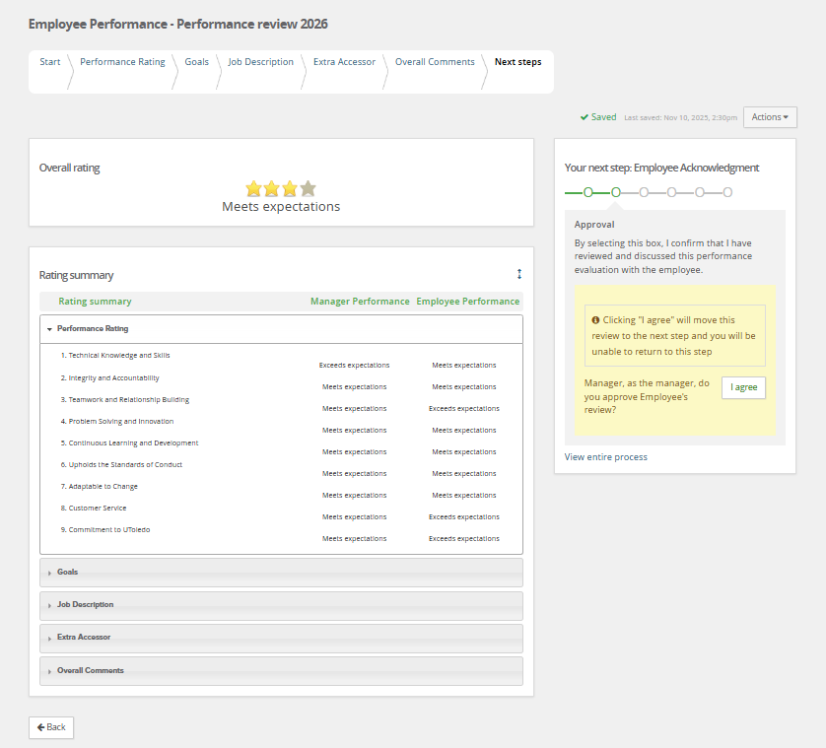
Hit the “I agree” button to complete this step of the review. The review will move to Step 3: Employee Acknowledgement.
**If not ready to move forward for employee to acknowledge then hit the “Home” icon to close review.**

Slide 30
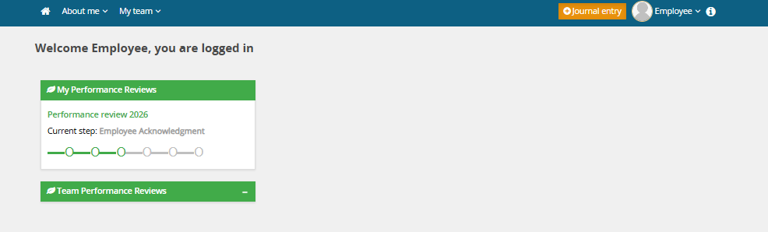
Step 3: Employee Acknowledges Review
It is now time for the employee's responsibility to complete the Annual Performance Review by formally acknowledging their section of the evaluation.
Click the green title of the review that corresponds to the current step in the Employee Evaluation process.

Slide 31
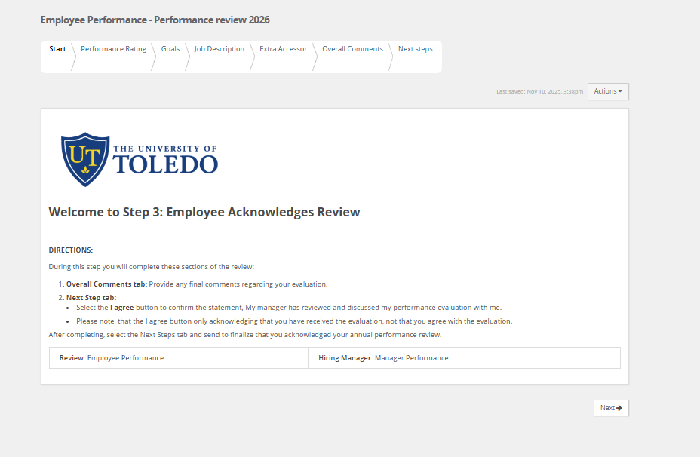
The Start Tab provides step-by-step instructions for the employee to complete the performance review process.

Slide 32
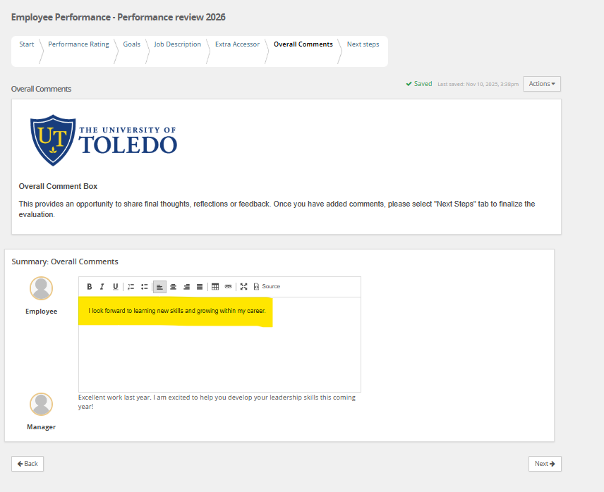
In the “Overall Comments” Tab, the employee has an opportunity to share final thoughts, reflections or feedback.
Once you have added comments, please select "Next Steps" tab to finalize the evaluation.

Slide 33
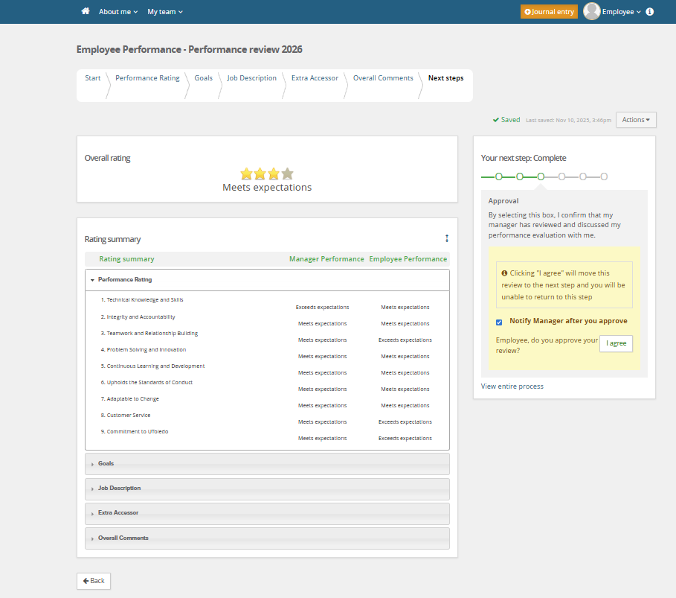
Hit the “I agree” button to complete this step of the review. It is now complete and will notify HR.

Slide 34
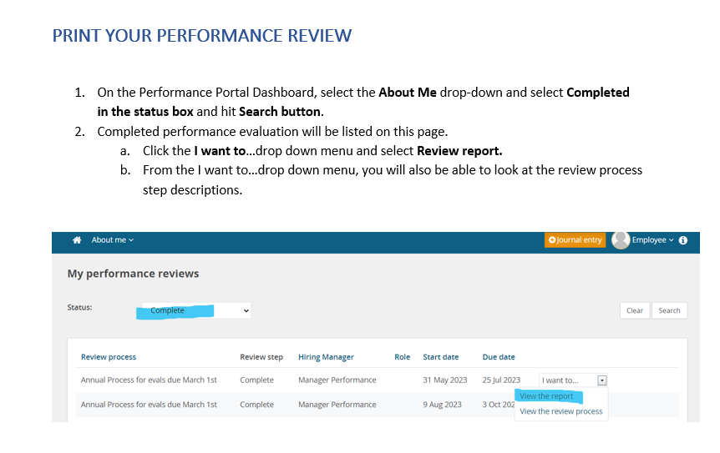
Review is now complete

Slide 35
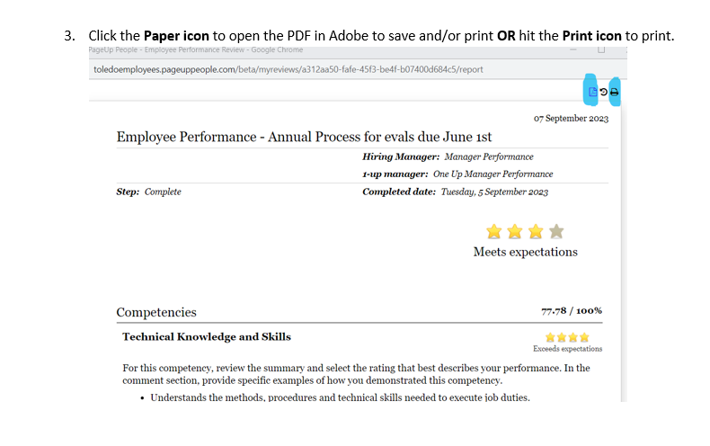

Slide 36
Thank you!

