Slide 1
PageUp Demonstration for Probationary Reviews (Mid/End) and Student Reviews
2026

Slide 2

PageUp Management website

Slide 3
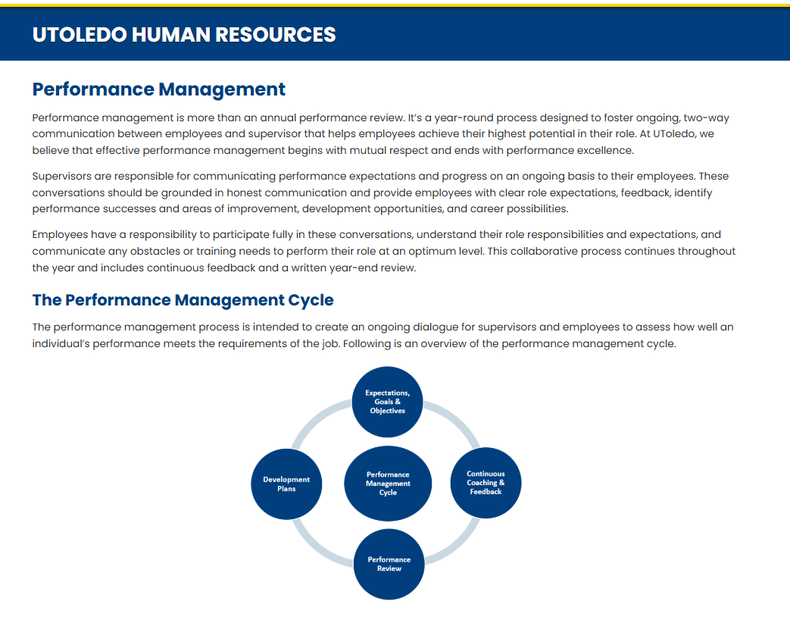

Slide 4
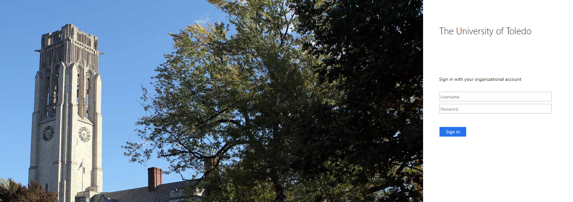
Access the PageUp Mid and End Performance Review from your MyUT portal.

Slide 5
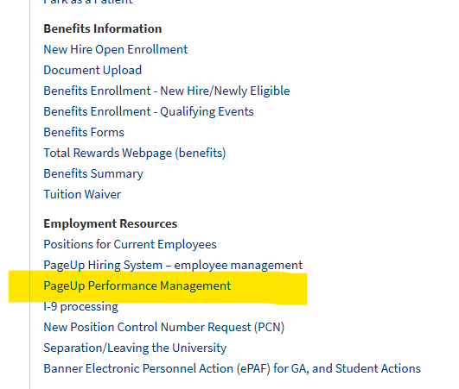
Click on PageUp Performance Management to open the home page.

Slide 6
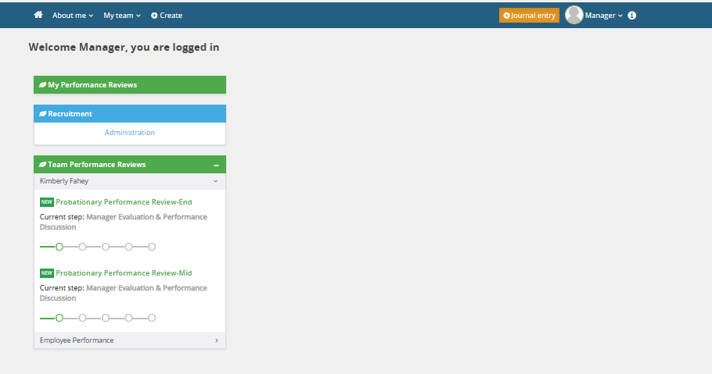
Step 1: Manager Evaluation & Performance Discussion
The manager is responsible for completing the employee’s Mid-Probationary Performance Review within the first 90 days of employment.
The End-Probationary Performance Review should be finalized near the conclusion of the employee’s 180-day probationary period.
The Student (S8) Performance Review should be completed by September 1st
Click the green title of the review that corresponds to the current review that the manager needs to complete.

Slide 7
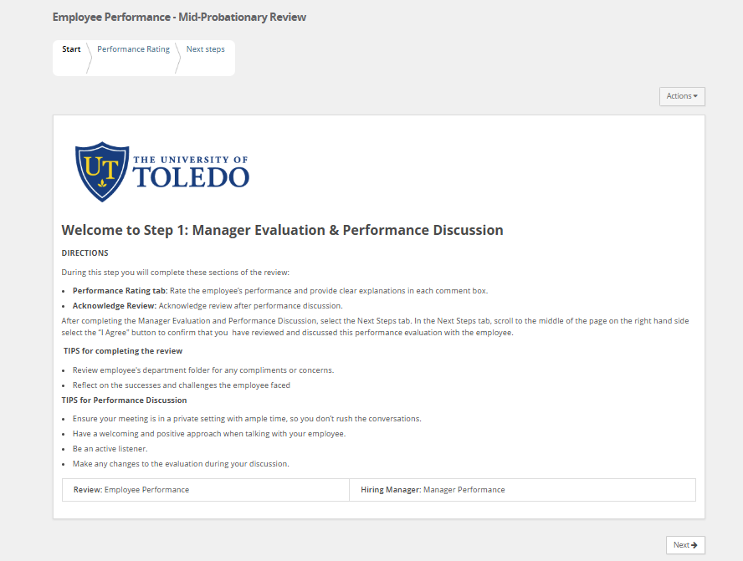
The Start Tab provides step-by-step instructions for the Supervisor to complete the performance review process.

Slide 8
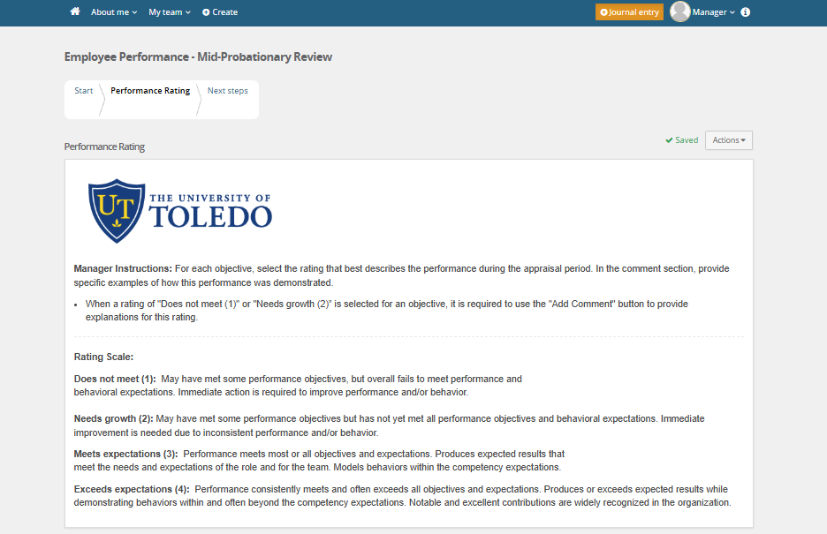
The Performance Rating tab provides managers with an overview of the four-point star rating scale, along with definitions for each level. Managers are required to assess nine performance objectives. Each objective includes a summary for review prior to selecting a rating, as well as an 'Add Comment' option to provide specific examples of how the employee demonstrated that particular performance.

Slide 9
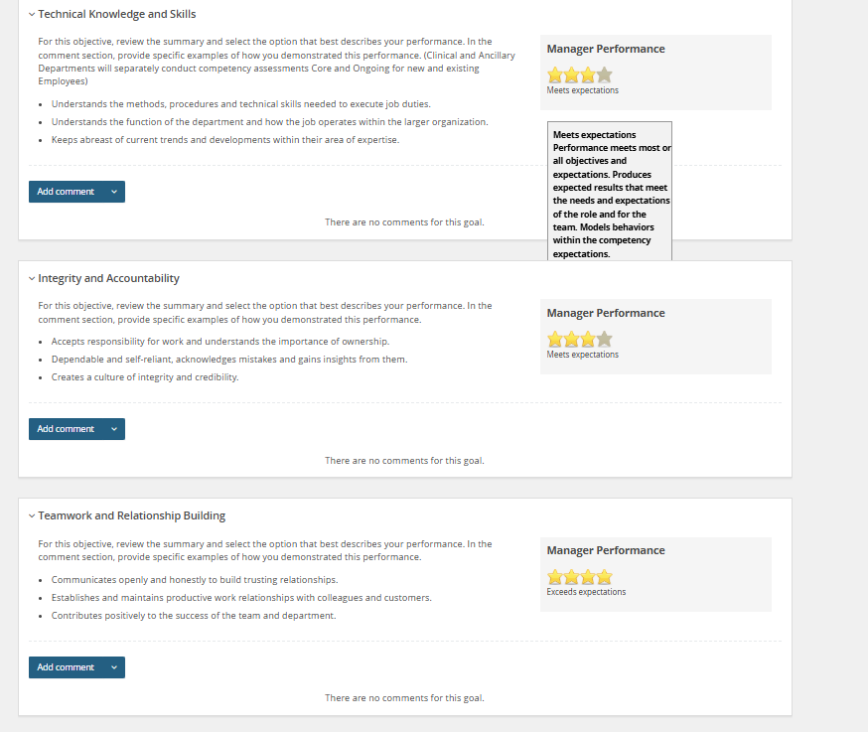
When you hover over a rating star, a tooltip appears displaying the definition for that specific rating level.

Slide 10
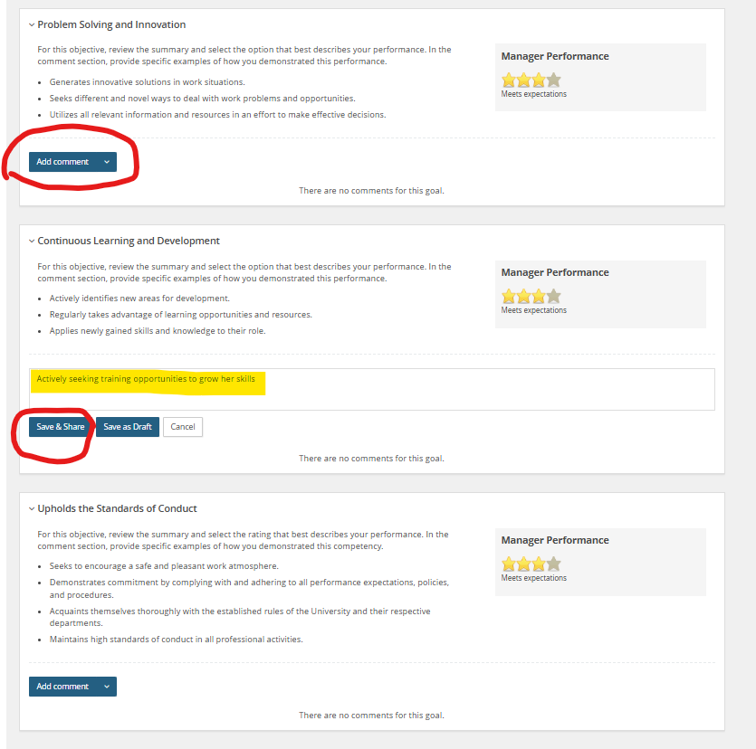
To add a comment to the performance objective, click “Add Comment” to open the text box.
Enter your comment, then select the “Save & Share” button to submit it.

Slide 11
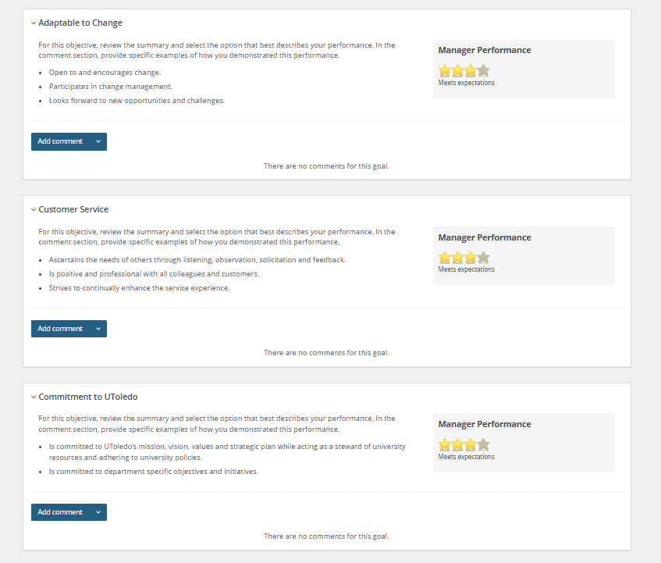

Slide 12
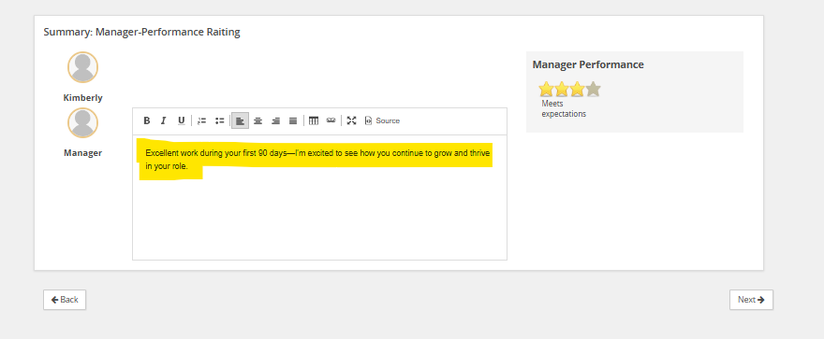
Type your overall comment for the probationary review into the text box, then click the 'Next' button to continue.

Slide 13
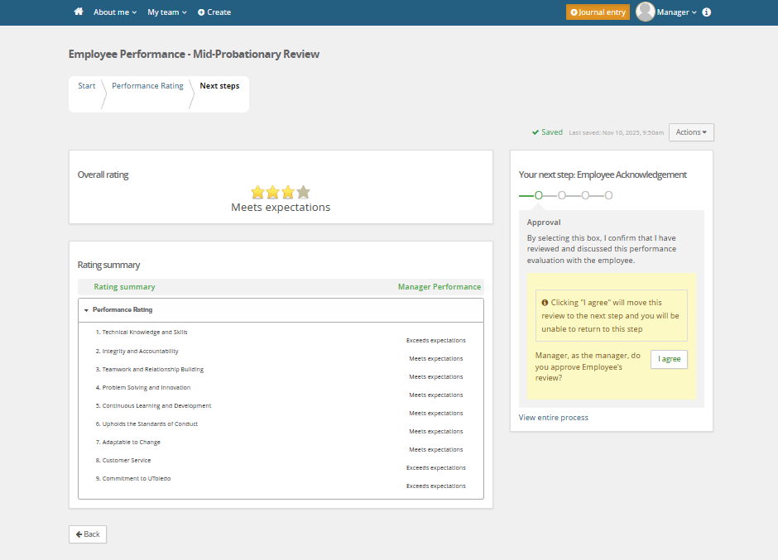
Hit the “I agree” button to complete this step of the review. The review will move to Step 2: Employee Acknowledgement.
**If not ready to move forward for employee to acknowledge then hit the “Home” icon to close review.**

Slide 14
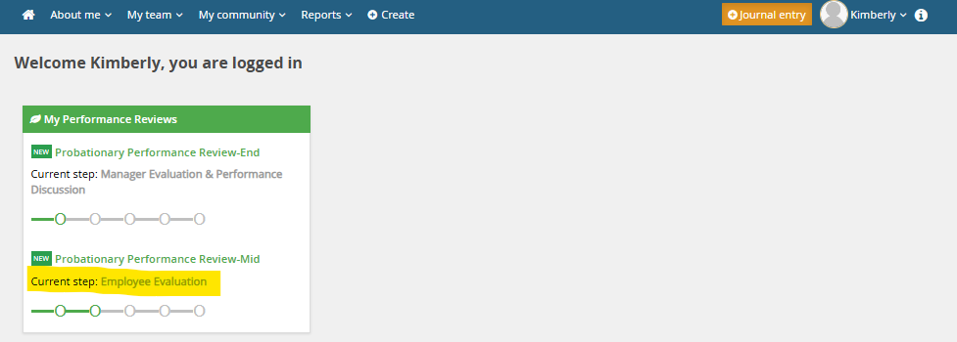
Step 2: Employee Acknowledges Review
It is now time for the employee's responsibility to complete the Probationary Performance Review and/or Student Review by formally acknowledging their section of the evaluation.
Click the green title of the review that corresponds to the current step in the Employee Evaluation process.

Slide 15
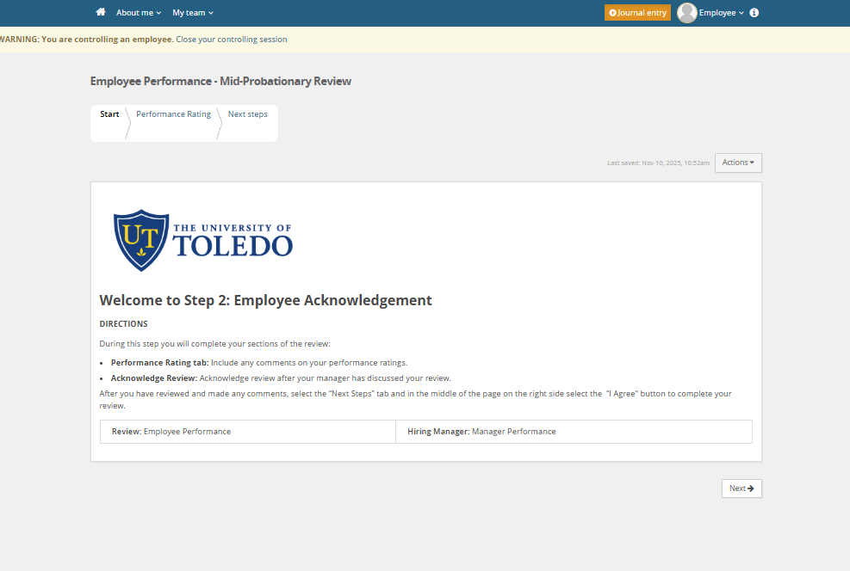
The Start Tab provides step-by-step instructions for the employee to complete the performance review process.

Slide 16
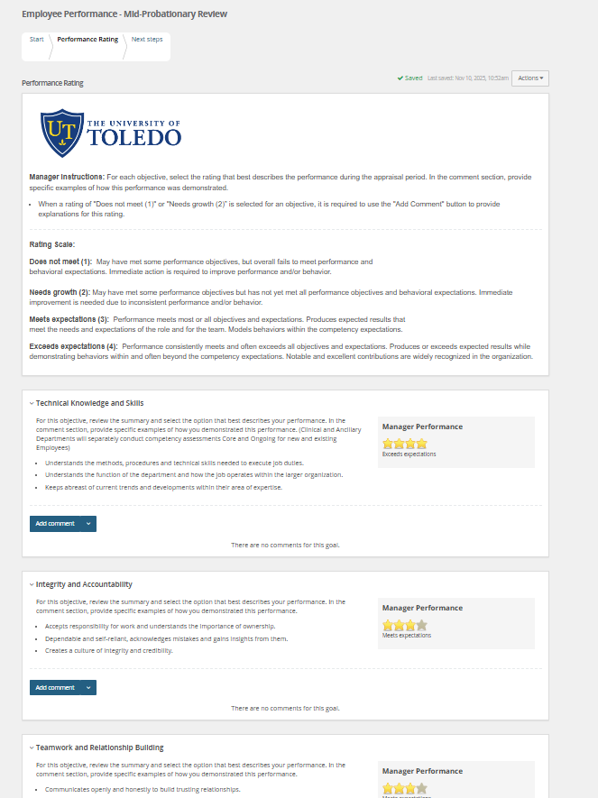
In the Performance Rating Tab, the employee can review the performance rating scores discussed with their manager during the performance review meeting.
They also have the opportunity to provide comments for each performance objective, as well as an overall comment.

Slide 17
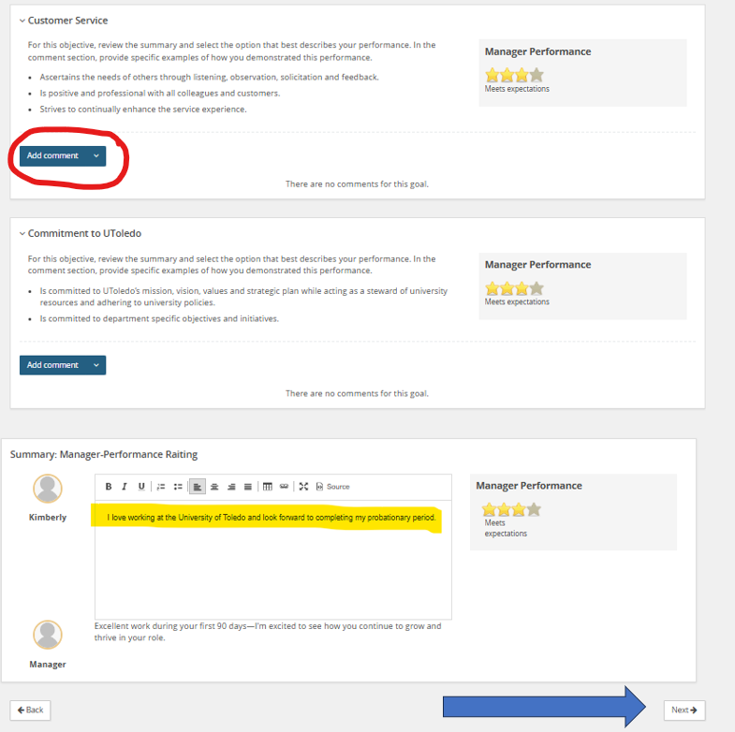
To add a comment to the performance objective, click “Add Comment” to open the text box.
Enter your comment, then select the “Save & Share” button to submit it.
Enter your overall comment on the probationary review in the text box then click the “Next” button.

Slide 18
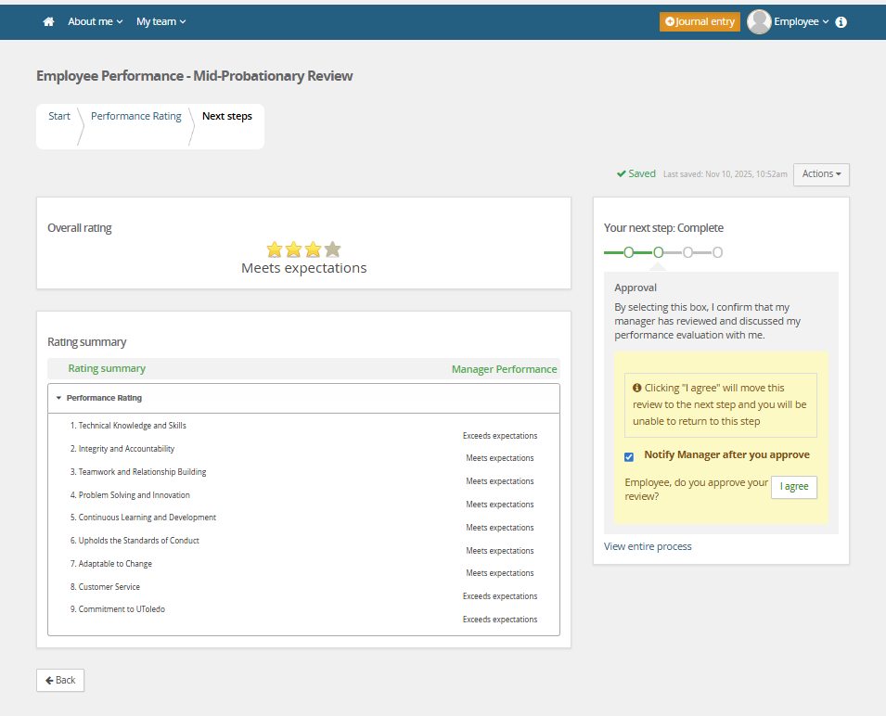
Hit the “I agree” button to complete this step of the review. It is now complete and will notify HR.

Slide 19
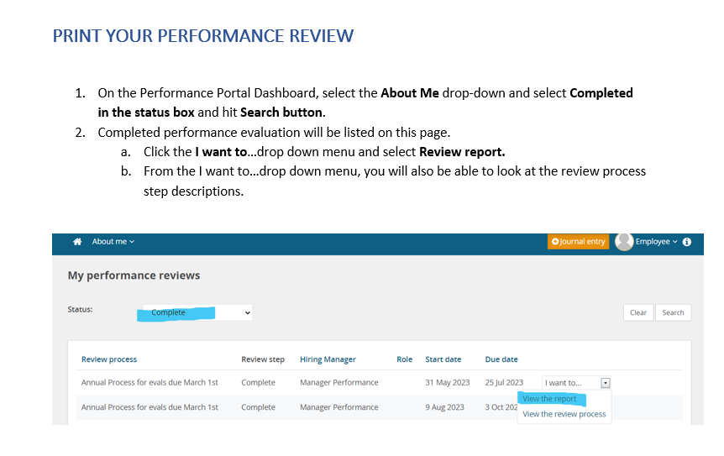
Review is now complete

Slide 20
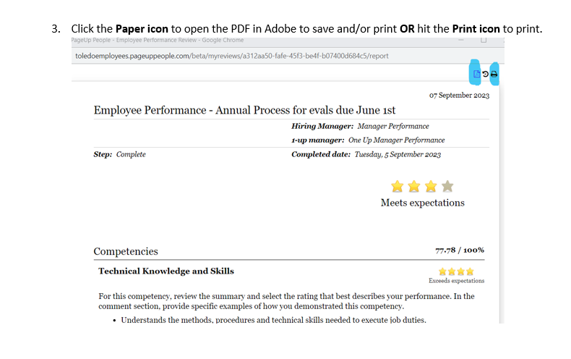

Slide 21
Thank you!

