Slide 1

Commit Taskforce august 2025 meeting

Slide 2

July Agenda recap
DISP. STETHOSCOPES
TOURNIQUETS
HOT AND COLD PACK

Slide 3
Agenda
EVAC CONTAINERS (1)
MEDICAL SKIN PREP PADS (1)
PATIENT CLEANSING (1)
HOT AND COLD PACK (2)
PATIENT PLASTICS (11)

Slide 4
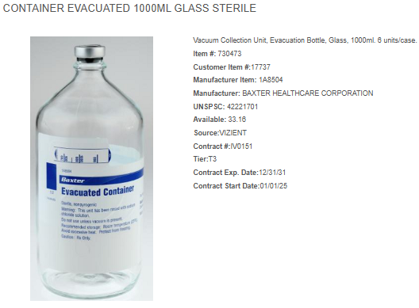
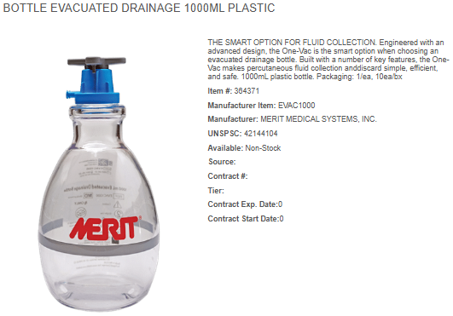
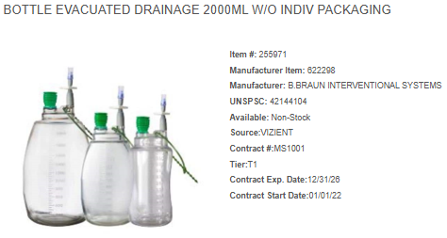

Slide 5
Current Annual Usage:
Lum: 58 EA
Inventory: 158 EA
Total: 216 EA
Current Product:
Manufacturer: Baxter
Pricing: $20.05/EA
Current Annual Spend: $4,330.80
New Product:
Manufacturer: B Braun
Pricing: $17.33/EA
New Annual Spend: $3,743.28
New Product:
Manufacturer: Merit
Pricing: $15.00/EA
New Annual Spend: $3,240.00

Slide 6



Slide 7
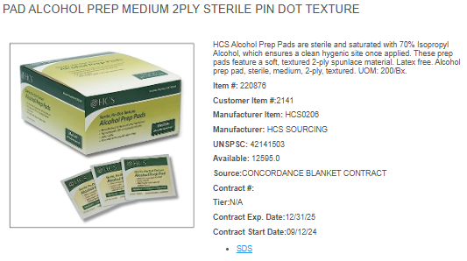
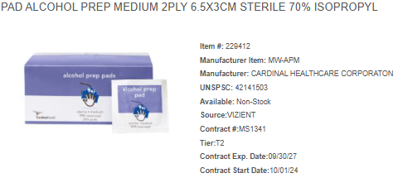

Slide 8
Current Annual Usage:
Lum: 1881 BX
Inventory: 1748 BX
Total: 3,629 BX
Current Product:
Manufacturer: HCS
Pricing: $1.45/BX
Current Annual Spend: $5,262.05
New Product:
Manufacturer: Cardinal
Pricing: $1.16/BX
New Annual Spend: $4,209.64

Slide 10
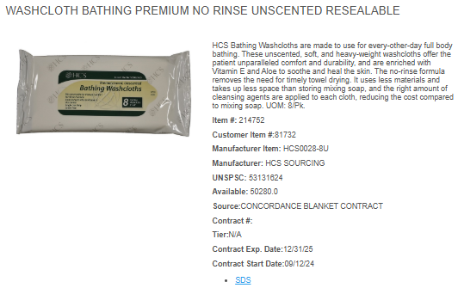
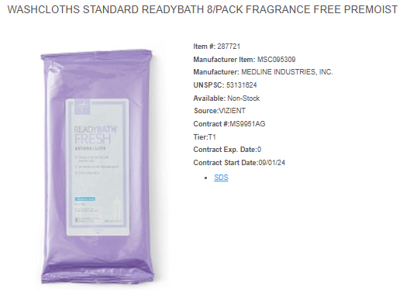
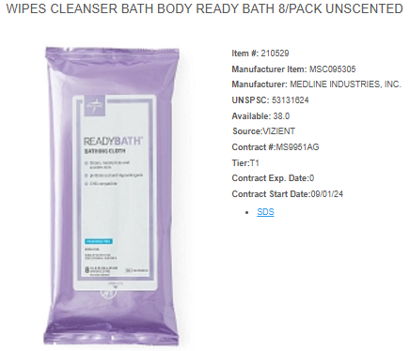
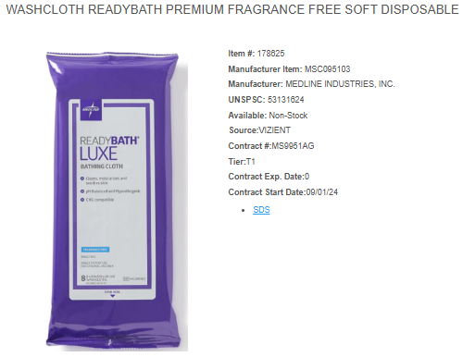

Slide 11
Current Annual Usage:
LUM: 42,403 PK
Inventory: 4,733 PK
Total: 47,136 PK
Current Product:
Manufacturer: HCS
Pricing: $.88/PK
Current Annual Spend: $41,479.68
New Product:
Manufacturer: Medline
MSC095309
Pricing: $0.61/PK
New Annual Spend: $28,752.96
New Product:
Manufacturer: Medline
MSC095305
Pricing: $0.762/PK
New Annual Spend: $35,917.63
New Product:
Manufacturer: Medline
MSC095103
Pricing: $1.09/PK
New Annual Spend: $51,378.24

Slide 12



Slide 13
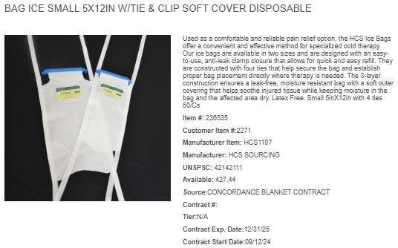
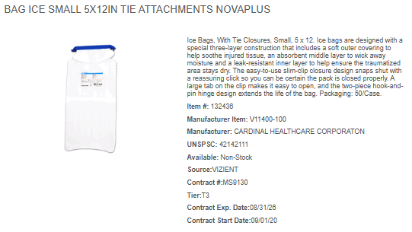

Slide 14
Current Annual Usage:
LUM: 5424 EA
Inventory: 700 EA
Total: 6,124 EA
Current Product:
Manufacturer: HCS
Pricing: $0.78/EA
Current Annual Spend: $4,776.72
New Product:
Manufacturer: Cardinal
Pricing: $0.66/EA
New Annual Spend: $4,041.84

Slide 15
LUM
Inventory

Slide 16
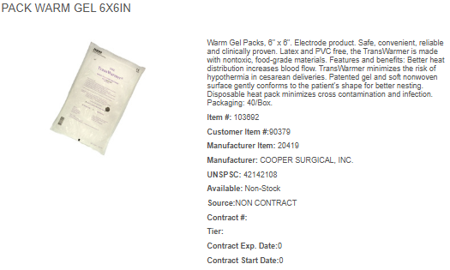
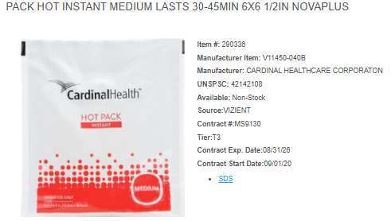

Slide 17
Current Annual Usage:
Inventory: 760 EA
Total: 760 EA
Current Product:
Manufacturer: Cooper Surgical Pricing: $4.32/EA
Current Annual Spend: $3,279.59
New Product:
Manufacturer: Cardinal
Pricing: $0.39/EA
New Annual Spend: $296.40

Slide 18

No Lum for this item

Slide 19
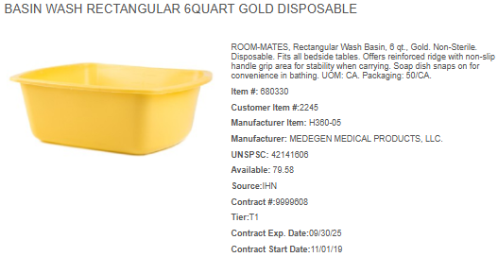
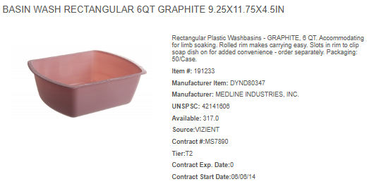

Slide 20
Current Annual Usage:
Lum: 17,187 EA
Inventory: 3,820 EA
Total: 21,007 EA
Current Product:
Manufacturer: Medegen Pricing: $0.51/EA
Current Annual Spend: $10,713.57
New Product:
Manufacturer: Medline
Pricing: $0.42/EA
New Annual Spend: $8,822.94

Slide 21
LUM
Inventory

Slide 22
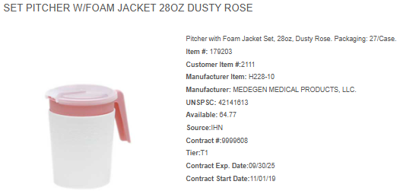
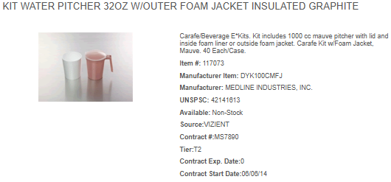

Slide 23
Current Annual Usage:
Lum: 4,837 EA
Inventory:1,975 EA
Total: 6,812 EA
Current Product:
Manufacturer: Medegen
Pricing: $0.74/EA
Current Annual Spend: $5,040.88
New Product:
Manufacturer: Medline
Pricing: $0.82/EA
New Annual Spend: $5,585.84

Slide 24
LUM
Inventory

Slide 25
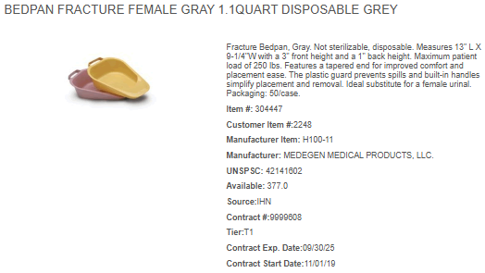
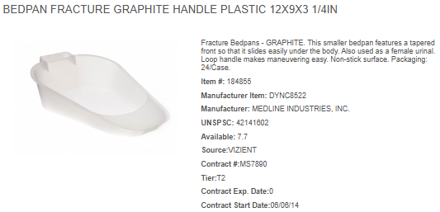

Slide 26
Current Annual Usage:
Lum: 1,724 EA
Inventory: 172 EA
Total: 1,896 EA
Current Product:
Manufacturer: Medegen
Pricing: $0.66/EA
Current Annual Spend: $1,251.36
New Product:
Manufacturer: Medline
Pricing: $0.73/EA
New Annual Spend: $1,384.08

Slide 27
LUM
Inventory

Slide 28
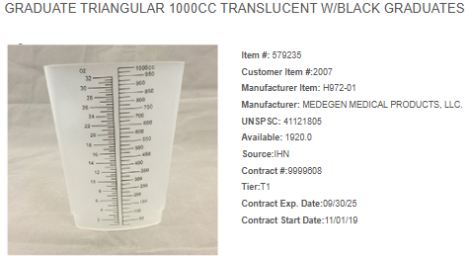
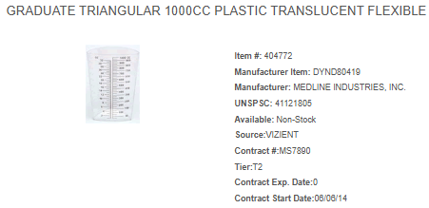

Slide 29
Current Annual Usage:
Lum: 5,689 EA
Inventory: 2,574 EA
Total: 8,263 EA
Current Product:
Manufacturer: Medegen
Pricing: $0.22/EA
Current Annual Spend: $1,817.86
New Product:
Manufacturer: Medline
Pricing: $0.25/EA
New Annual Spend: $2,065.75

Slide 30
LUM
Inventory

Slide 31
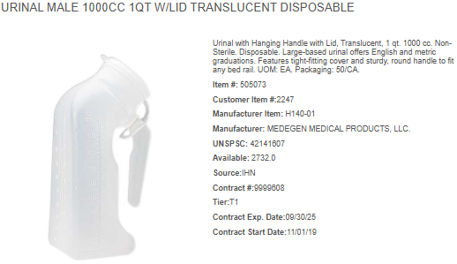
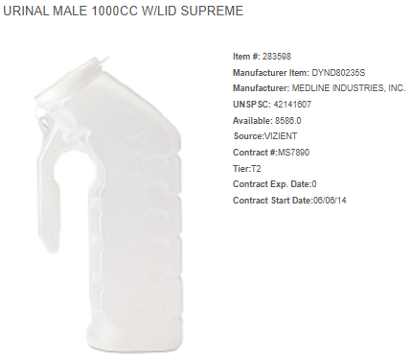

Slide 32
Current Annual Usage:
Lum: 10,002 EA
Inventory: 2,583 EA
Total: 12,585 EA
Current Product:
Manufacturer: Medegen
Pricing: $0.35/EA
Current Annual Spend: $4,404.75
New Product:
Manufacturer: Medline
Pricing: $0.37/EA
New Annual Spend: $4,656.45

Slide 33
LUM
Inventory

Slide 34
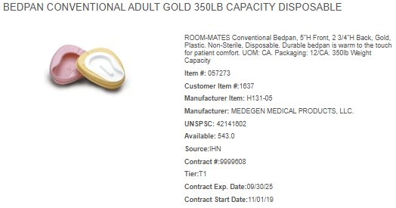
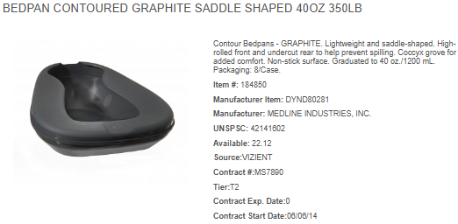

Slide 35
Current Annual Usage:
Lum: 2767 EA
Inventory: 763 EA
Total: 3,530 EA
Current Product:
Manufacturer: Medegen
Pricing: $1.32/EA
Current Annual Spend: $4,659.60
New Product:
Manufacturer: Medline
Pricing: $2.71/EA
New Annual Spend: $9,566.30

Slide 36
LUM
Inventory

Slide 37
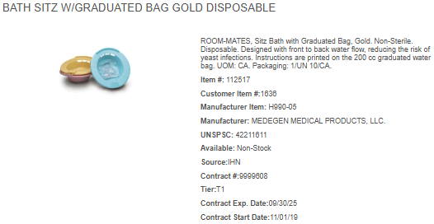
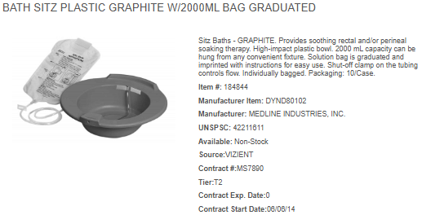

Slide 38
Current Annual Usage:
Lum: 0 EA
Inventory: 41 EA
Total: 41 EA
Current Product:
Manufacturer: Medegen
Pricing: $2.12/EA
Current Annual Spend: $86.92
New Product:
Manufacturer: Medline
Pricing: $2.35/EA
New Annual Spend: $96.35

Slide 39

LUM
Inventory

Slide 40
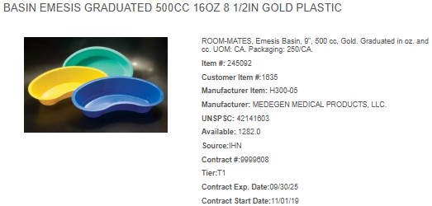
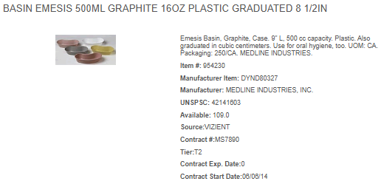

Slide 41
Current Annual Usage:
Lum: 5138 EA
Inventory: 660 EA
Total: 5798 EA
Current Product:
Manufacturer: Medegen
Pricing: $0.07/EA
Current Annual Spend: $405.86
New Product:
Manufacturer: Medline
Pricing: $0.07/EA
New Annual Spend: $405.86

Slide 42
LUM
Inventory

Slide 43
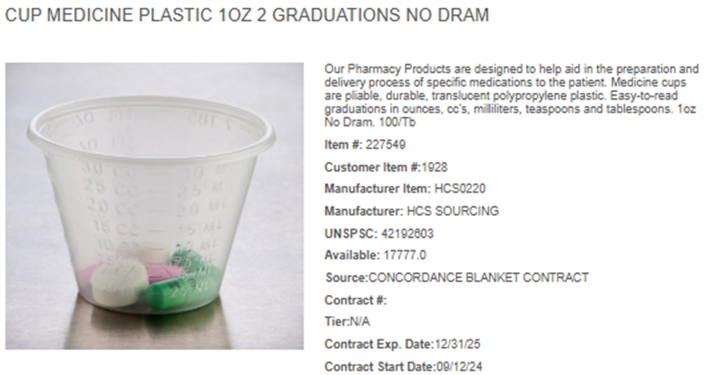
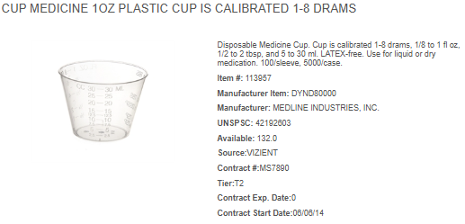

Slide 44
Current Annual Usage:
Lum: 743 TB
Inventory: 187 TB
Total: 930 EA
Current Product:
Manufacturer: Medegen
Pricing: $0.72/TB
Current Annual Spend: $669.60
New Product:
Manufacturer: Medline
Pricing: $0.78/TB
New Annual Spend: $725.4

Slide 45
LUM
Inventory

Slide 46
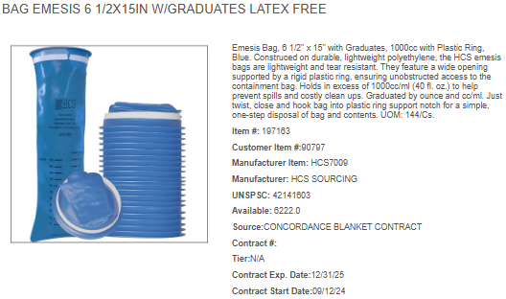
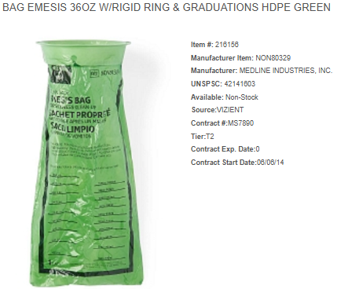

Slide 47
Current Annual Usage:
Lum: 222 EA
Inventory: 0 EA
Total: 222 EA
Current Product:
Manufacturer: HCS
Pricing: $0.34/EA
Current Annual Spend: $75.48
New Product:
Manufacturer: Medline
Pricing: $0.34/EA
New Annual Spend: $75.48

Slide 48
LUM
Inventory
No Inventory for this item

Slide 49
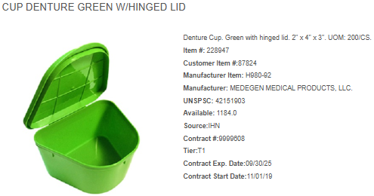
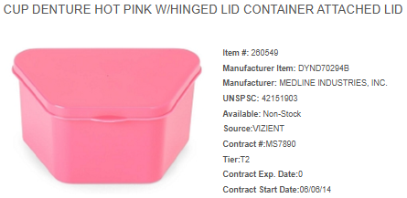

Slide 50
Current Annual Usage:
Lum: 1,062 EA
Inventory: 1,095 EA
Total: 2,157 EA
Current Product:
Manufacturer: HCS
Pricing: $0.09/EA
Current Annual Spend: $194.13
New Product:
Manufacturer: Medline
Pricing: $0.29/EA
New Annual Spend: $625.53

Slide 51
LUM
Inventory

