Slide 1

Nursing and patient care cva DECEMBER 2025 meeting

Slide 2

NOVEMBER recap
3M CHG DRESSING (APPROVED)
SPECIALTY BAGS (APPROVED)
IV CATHETERS (SUBCOMMITTEE REQ)

Slide 3
DECEMBER AGENDA
SACRUM DRESSING (Trial Request)
FACIAL PROTECTION (Category Review)
OXIVIR TRIAL (Trial Update)Q
MEDLINE CHG WIPES (Committee Notice)

Slide 4
Urine output system – trial request

Slide 5
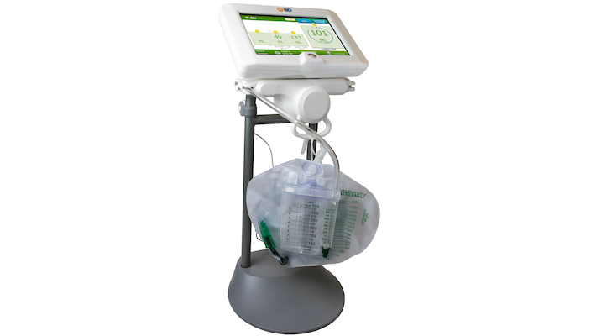
Sensica Urine Output system
Overview
The Sensica™ Urine Output System is an automated system for continuous monitoring of urine output (UO) and core bladder temperature when connected to a temperature-sensing Foley catheter.
The Sensica™ Urine Output System is intended for bedside monitoring of urine output for any patient with an indwelling, urological catheter, drainage tubing and collection bag.

Slide 6
TRIAL LOCATIONS
2ND FLOOR ICU
4TH FLOOR

Slide 7
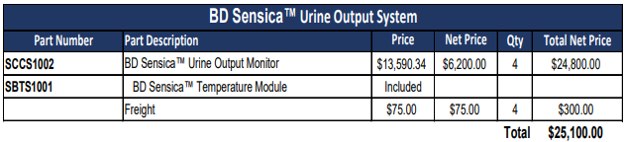
Capital pricing
CONSUMABLE pricing
Disposable Rings: $25/single patient use for 29 days

Slide 8
RESPIRATORY DISPOSABLES (ROUTINE) – COMMITTEE NOTICE

Slide 9
RESPIRATORY DISPOSABLES (ROUTINE) conversion Savings
Conversion Items:
Est. Annual Savings
Peak Flow Meter Asthmamd
Inhalation Solution, Sterile Saline
Oxygen Nasal Cannula, Standard
Oxygen Connectors, Disposable
$1
$193
$162
$681
Est. Conversion Savings: $1037
Additional Commit Savings: $720.18
Total Est. Savings: $1,757.18

Slide 10
FACIAL PROTECTION COMMITTEE REVIEW

Slide 11
Facial protection Conversion (x2 Items)
Current Prod |  | New Prod |  | Savings
Face Mask, Tissue, Yellow (HCS) |  | Face Mask, Tissue, Yellow (O&M) |  | $(238.14)
Shield, Face, Three Qtr Length |  | Shield, Face, Three Qtr Length |  | $2,209.48
 |  |  | Total Est. Savings: | $1,971.34

Slide 12
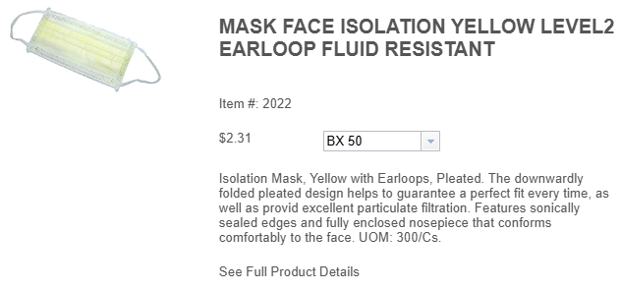
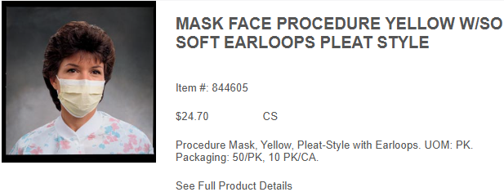

Slide 13
Current Annual Usage:
Lum: 58,100 EA
Inventory: 140,350 EA
Total: 198450 EA
Current Product:
Manufacturer: Concordance
Pricing: $.0458/EA
Current Annual Spend: $9,089.01
New Product:
Manufacturer: O&M
Pricing: $.047/EA
New Annual Spend: $9,327.15

Slide 14


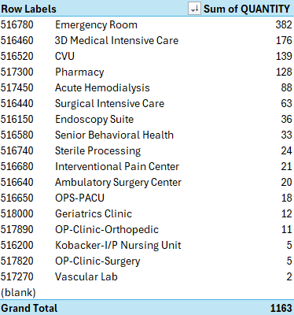

Slide 15
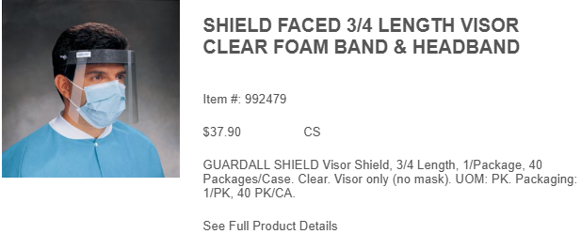
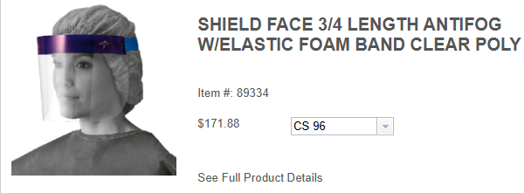

Slide 16
Current Annual Usage:
Lum: 2784 EA
Inventory: 15 EA
Total: 2799 EA
Current Product:
Manufacturer: Medline
Pricing: $1.73688/EA
Current Annual Spend: $4,861.53
New Product:
Manufacturer: O&M
Pricing: $0.94750/EA
New Annual Spend: $2,652.05

Slide 17



Slide 18
Personal protection equipment COMMITTEE REVIEW

Slide 19
Personal protection equip. Conversion (x10 Items)
Current |  | New |  | Savings
Cap, Surgeon (Medline) |  | Cap, Surgeon (O&M) |  | $784
Cover, Shoe, Flu. Bar (S&M) |  | Cover, Shoe, Flu. Bar. (O&M)
Cover, Shoe, One-Size (HCS) |  | Cover, Shoe, One-Size (O&M) |  | $1276.2
Cover, Shoe, XL (HCS) |  | Cover, Shoe, XL (O&M) |  | $3,204
Coverall, 2XL, White (HCS) |  | Coverall, 2XL, White (O&M) |  | $5,520
Cap, Bouffant, Blue (HCS) |  | Cap, Bouffant, Blue (O&M) |  | $4,790
Jacket, Lab, Disp, L (Valuemax) |  | Jacket, Lab, Disp, L (O&M) |  | $399.30
Jacket, Lab, Disp, M (Valuemax) |  | Jacket, Lab, Disp, M (O&M) |  | $471.90
Jacket, Lab, Disp, S (Valuemax) |  | Jacket, Lab, Disp, S (O&M) |  | $242
Jacket, Lab, Disp, XL (Valuemax) |  | Jacket, Lab, Disp, XL (O&M) |  | $350.90
 |  | Total Est. Savings: |  | $17,038.30

Slide 20
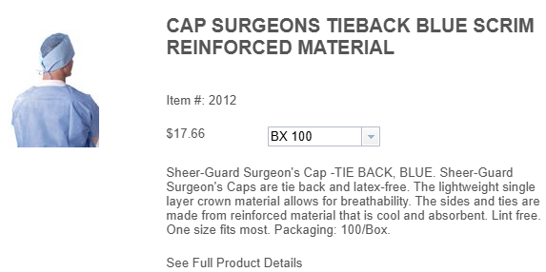
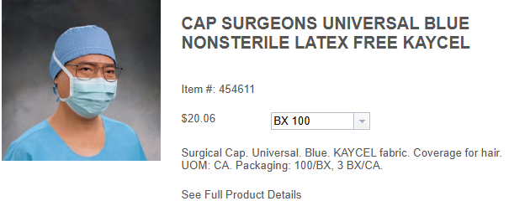

Slide 21
Current Annual Usage:
Lum: 19,100 EA
Inventory: 500 EA
Total: 19,600 EA
Current Product:
Manufacturer: Medline
Pricing: $0.17/EA
Current Annual Spend: $3,332
New Product:
Manufacturer: O&M
Pricing: $0.13/EA
New Annual Spend: $2,548

Slide 22
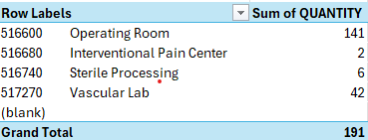
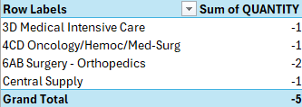

Slide 23
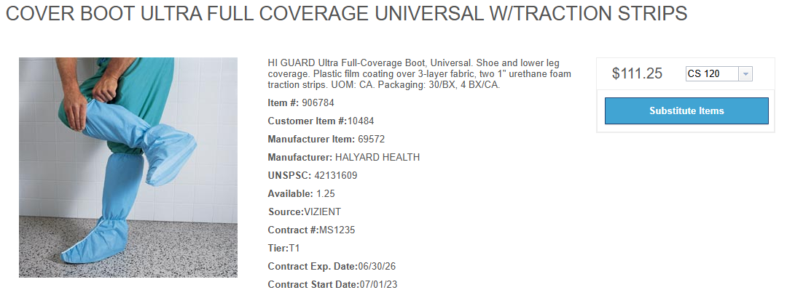
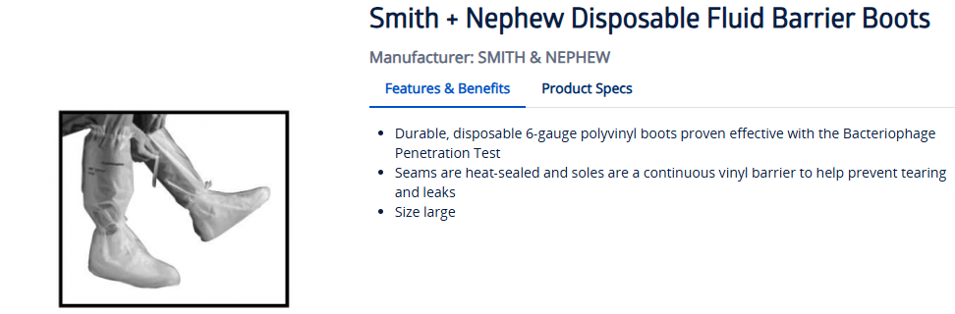

Slide 24
Current Annual Usage:
Lum: 0 EA
Inventory: 300 EA
Total: 300 EA
Current Product:
Manufacturer: Concordance
Pricing: $4.20/EA
Current Annual Spend: $1,260
New Product:
Manufacturer: O&M
Pricing: $0.60/EA
New Annual Spend: $

Slide 25



Slide 26
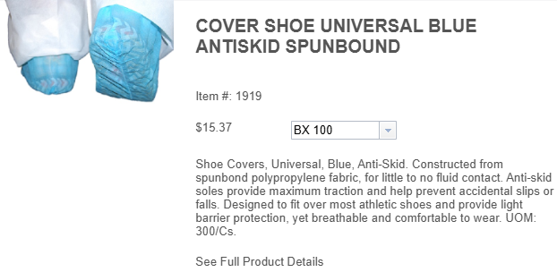
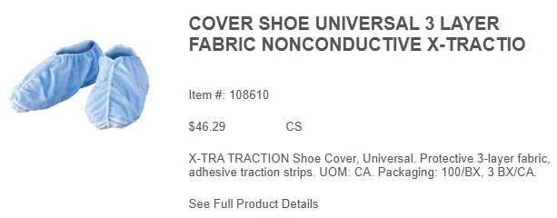

Slide 27
Current Annual Usage:
Lum: 13,000 EA
Inventory: 8,300 EA
Total: 21,300 EA
Current Product:
Manufacturer: HCS
Pricing: $0.15/EA
Current Annual Spend: $3,195
New Product:
Manufacturer: O&M
Pricing: $.09/EA
New Annual Spend: $1,918.8

Slide 28
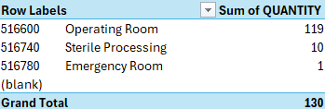
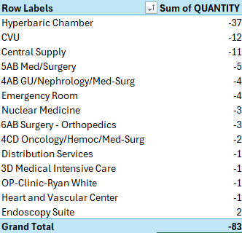

Slide 29
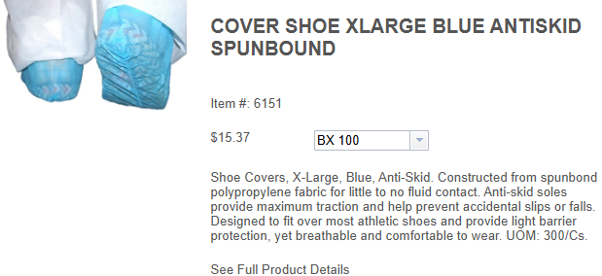
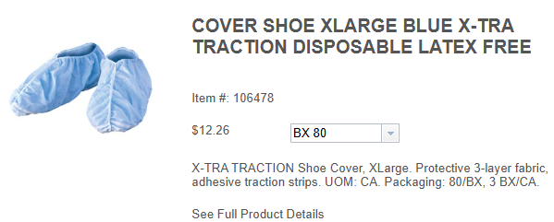

Slide 30
Current Annual Usage:
Lum: 47,600 EA
Inventory: 5,800 EA
Total: 53,400 EA
Current Product:
Manufacturer: HCS
Pricing: $0.15/EA
Current Annual Spend: $8,010
New Product:
Manufacturer: O&M
Pricing: $0.09/EA
New Annual Spend: $4,806

Slide 31
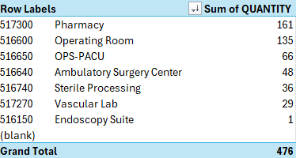
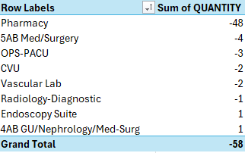

Slide 32
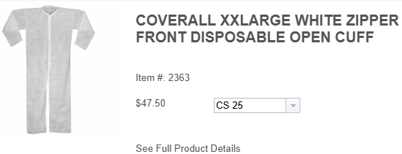
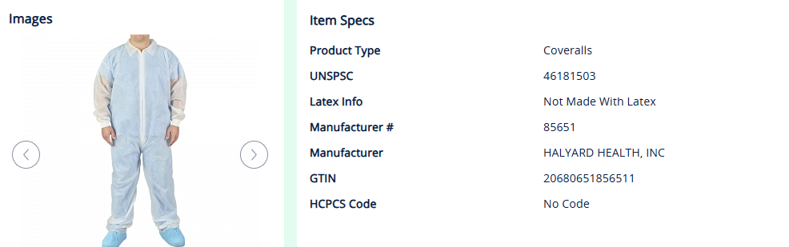

Slide 33
Current Annual Usage:
Lum: 5,175 EA
Inventory: 1,725 EA
Total: 6,900 EA
Current Product:
Manufacturer: HCS
Pricing: $2.03/EA
Current Annual Spend: $14,007
New Product:
Manufacturer: O&M
Pricing: $1.23/EA
New Annual Spend: $8,487

Slide 34
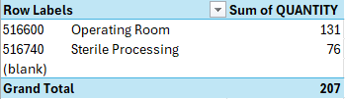
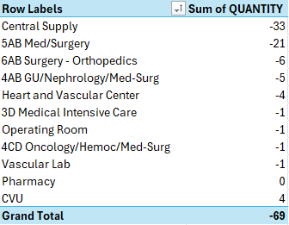

Slide 35
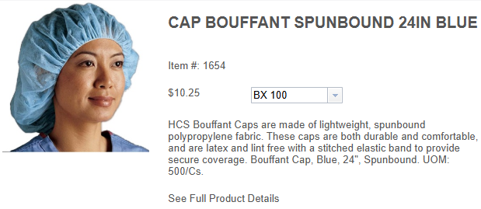
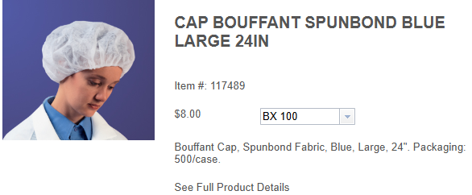

Slide 36
Current Annual Usage:
Lum: 73,400
Inventory: 22,400
Total: 95,800
Current Product:
Manufacturer: HCS
Pricing: $0.10
Current Annual Spend: $9,580
New Product:
Manufacturer: O&M
Pricing: $0.05
New Annual Spend: $4,790

Slide 37
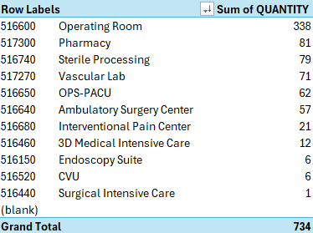
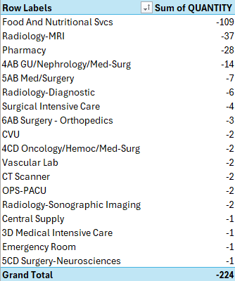

Slide 38
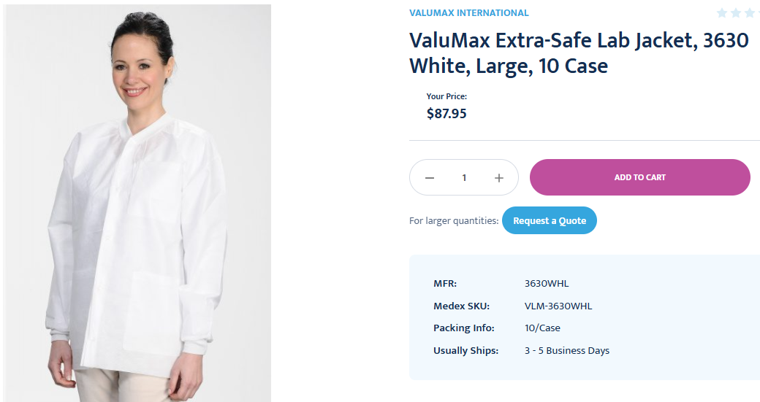
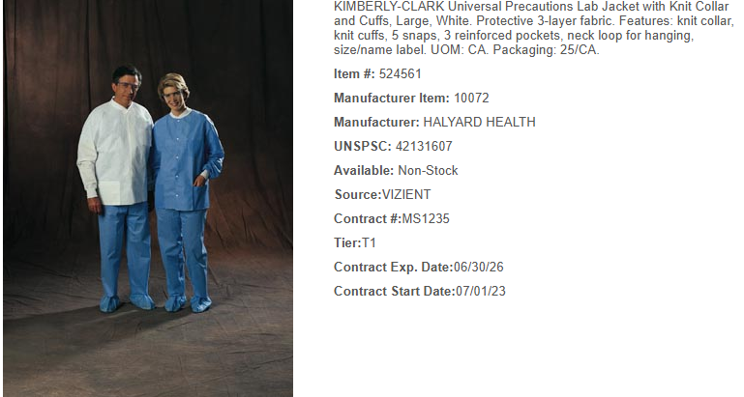

Slide 39
Current Annual Usage:
Lum: 0
Inventory: 330 EA
Total: 330 EA
Current Product:
Manufacturer: Valuemax
Pricing: $3.62/EA
Current Annual Spend: $1,194.6
New Product:
Manufacturer:
Pricing: $2.41
New Annual Spend: $795.3

Slide 40


Slide 41
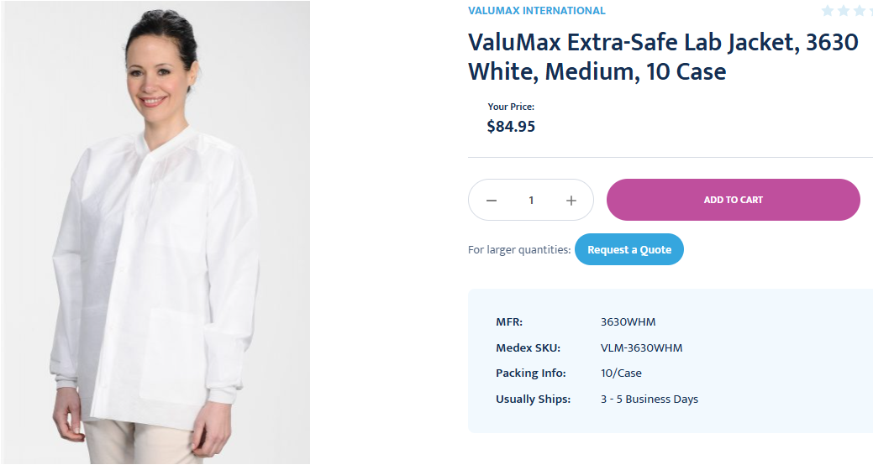
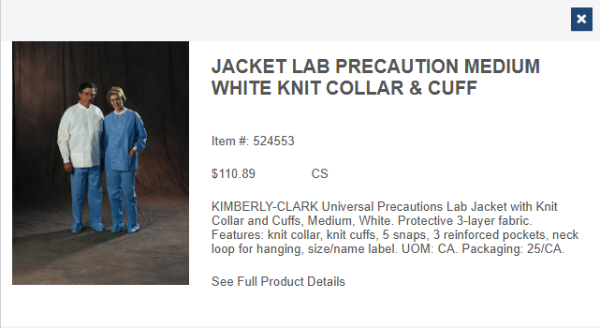

Slide 42
Current Annual Usage:
Lum: 0
Inventory: 390 EA
Total: 390 EA
Current Product:
Manufacturer: Valuemax
Pricing: $3.62/EA
Current Annual Spend: $1,411.80
New Product:
Manufacturer:
Pricing: $2.41
New Annual Spend: $939.90

Slide 43


Slide 44
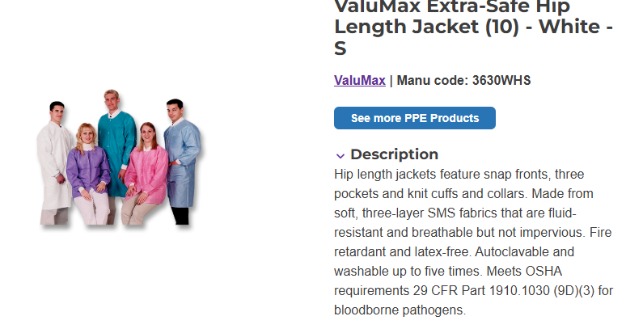
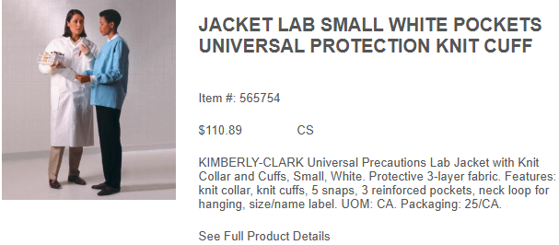

Slide 45
Current Annual Usage:
Lum: 0
Inventory: 200 EA
Total: 200 EA
Current Product:
Manufacturer: Valuemax
Pricing: $3.62/EA
Current Annual Spend: $724
New Product:
Manufacturer:
Pricing: $2.41/EA
New Annual Spend: $482

Slide 46


Slide 47
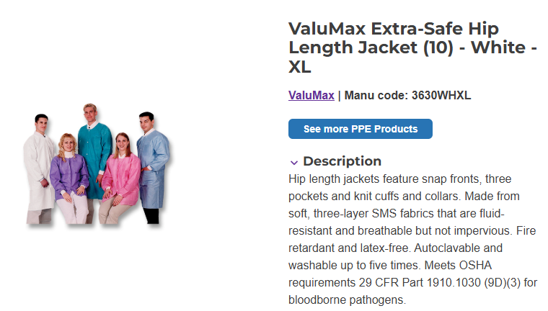
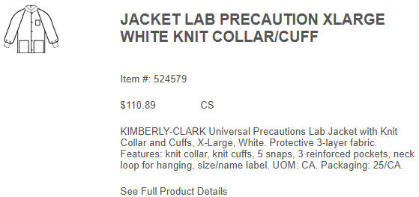

Slide 48
Current Annual Usage:
Lum: 0
Inventory: 290 EA
Total: 290 EA
Current Product:
Manufacturer: Valuemax
Pricing: $3.62/EA
Current Annual Spend: $1,049.80
New Product:
Manufacturer:
Pricing: $2.41/EA
New Annual Spend: $698.90

Slide 49
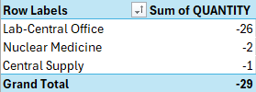

Slide 50
OXIVIR – TRIAL UPDATE
TRIAL LOCATIONS:
SICU
MICU
Senior Behavioral Health
TRIAL DURACTION:
One Month; Estimated Start: Early-Mid January
MONTHLY USAGE:
SICU: 11 TB
MICU: 25 TB
Senior Behavioral Health: 16 TB
DIVERSEY SUPPORT:
72 free canisters
In Person Trial Support

