Slide 1

Nursing and patient care cva FEBRUARY 2026 meeting

Slide 2

JANUARY recap
CUSHIONS & OVERLAYS (Review by Wound Care)
PERSONAL PROT. EQUIP (Partial Approval)

Slide 3
FEBRUARY AGENDA
ADV. WOUND CARE - (Update)
OXIVIR TRIAL - (Update)
PNEUMATIC COMPRESSION DEVICE - (COMMITTEE REVIEW)
DIAGNOSTIC PROCEDURE TRAYS - (COMMITTEE REVIEW)

Slide 4
OXIVIR TRIAL – COMMITTEE UPDATE
Diversey is completing compatibility Assessment
Reviewing 125 Assets compiled by Infection Prevention
Assessment has target completion end of February

Slide 5
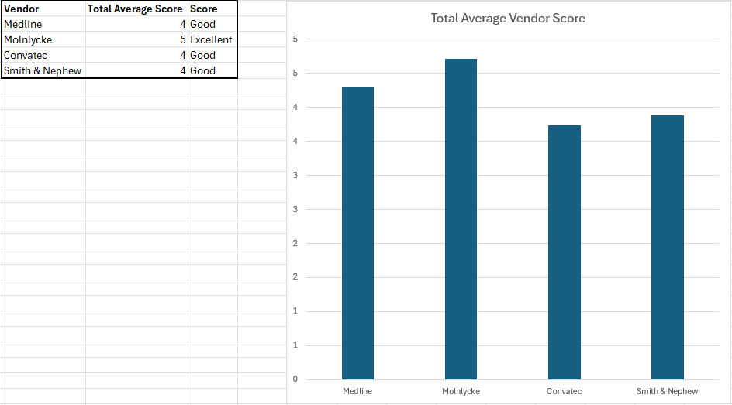
ADVANCED WOUND CARE – COMMITTEE UPDATE

Slide 6
PNEUMATIC COMPRESSION DEVICE - COMMITTEE REVIEW

Slide 7
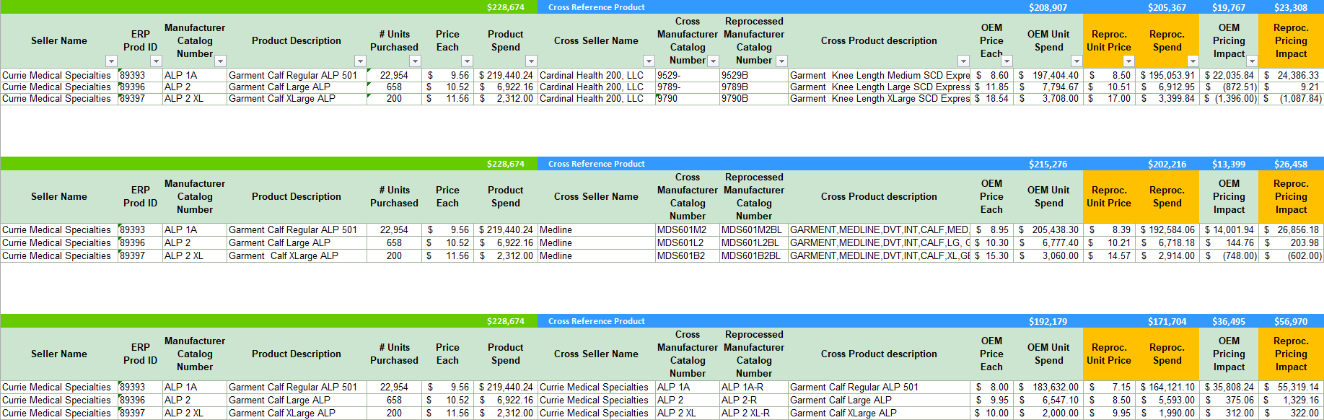
PNEUMATIC COMPRESSION DEVICE (x3 sku)

Slide 8
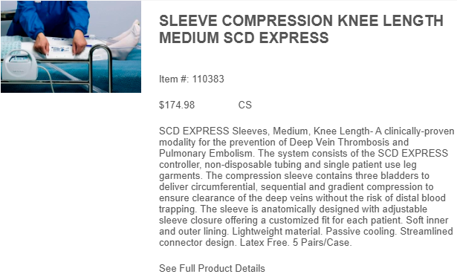
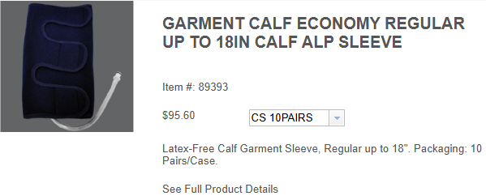
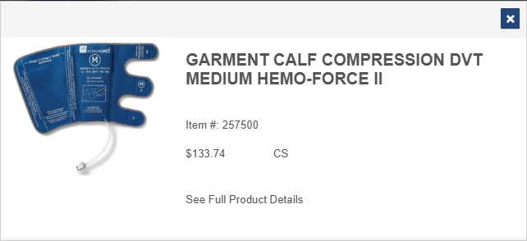

Slide 9


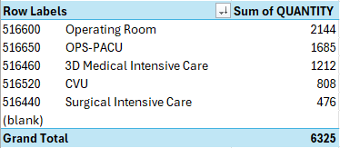
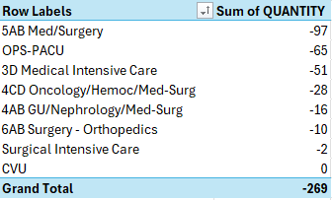

Slide 10
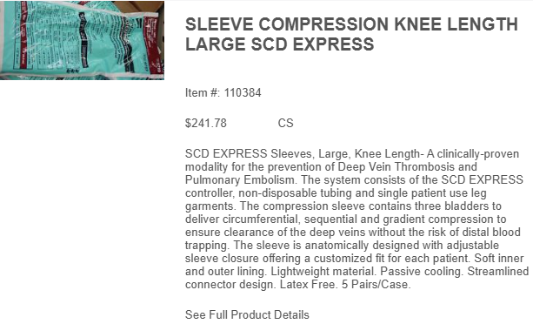
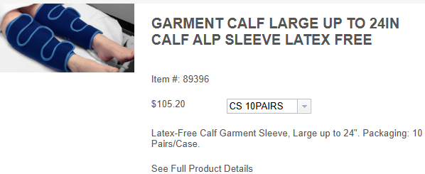
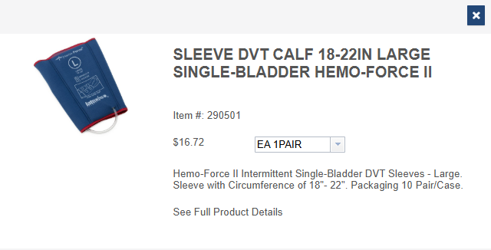

Slide 11
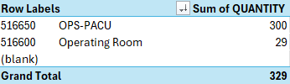
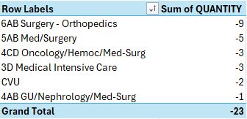

Slide 12
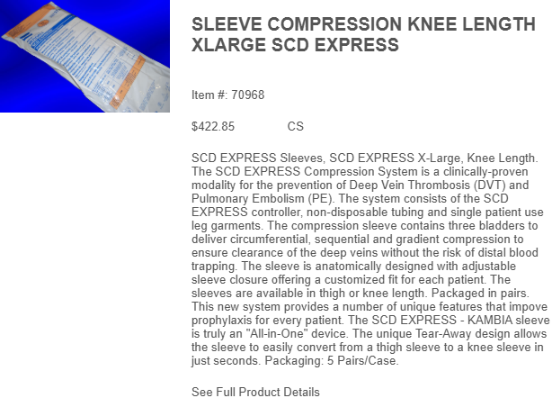
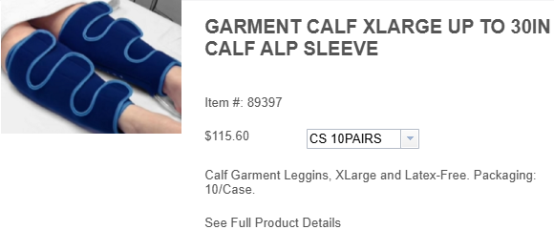
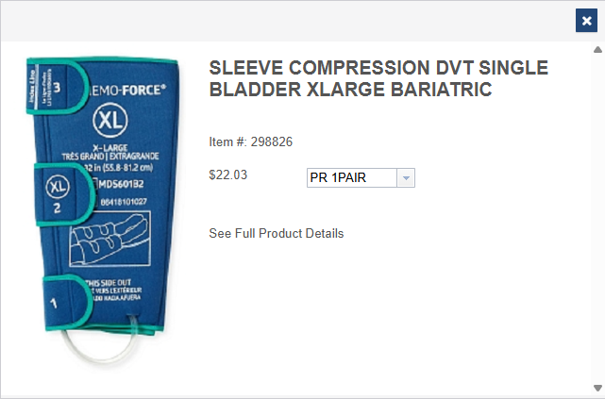

Slide 13

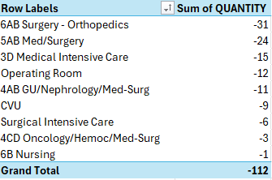

Slide 14
DIAGNOSTIC PROCEDURE TRAYS – NON-THORACIC COMMITTEE REVIEW

Slide 15
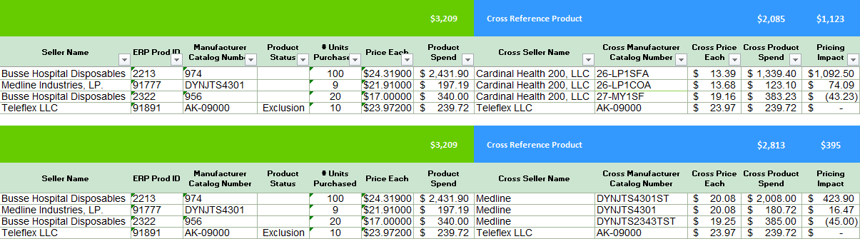
DIAGNOSTIC PROCEDURE TRAYS NON-THORACIC (X3 SKU)

Slide 16
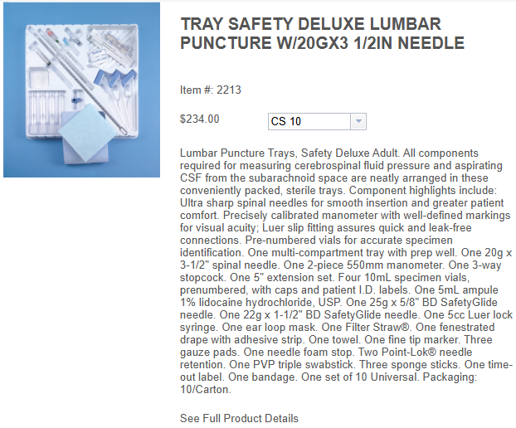
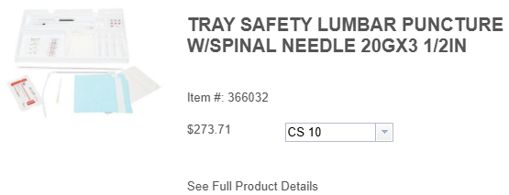
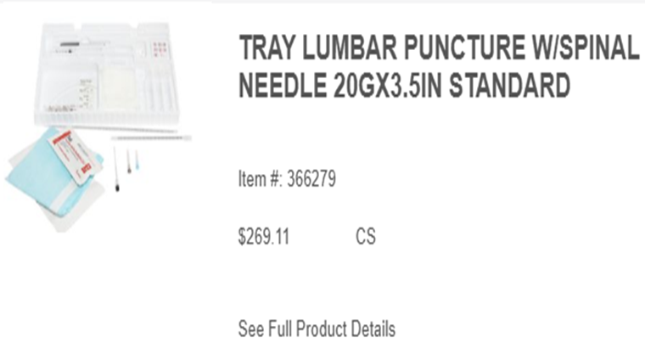

Slide 17

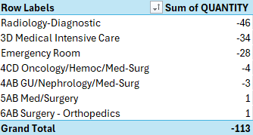

Slide 18

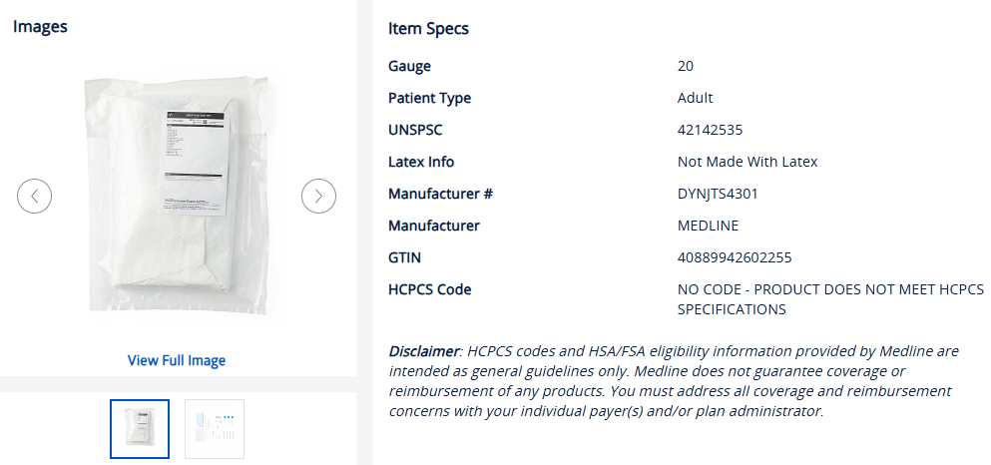

Slide 19
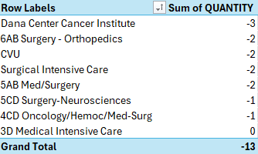

Slide 20
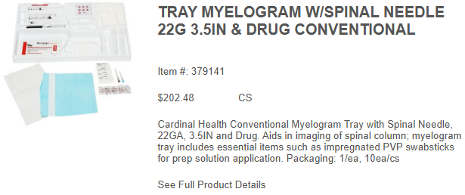
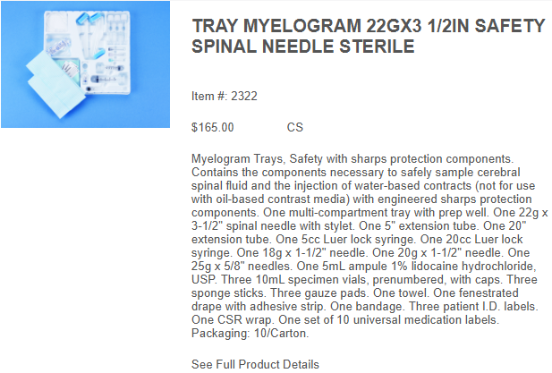
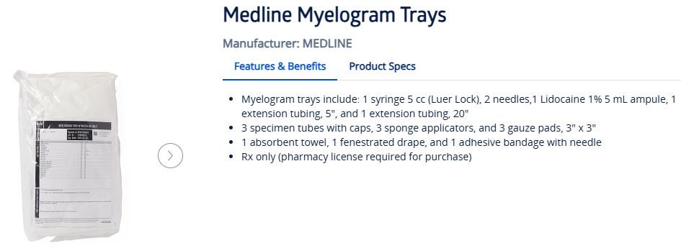

Slide 21


Slide 22
WOUND DRAINAGE - COMMITTEE REVIEW

Slide 23
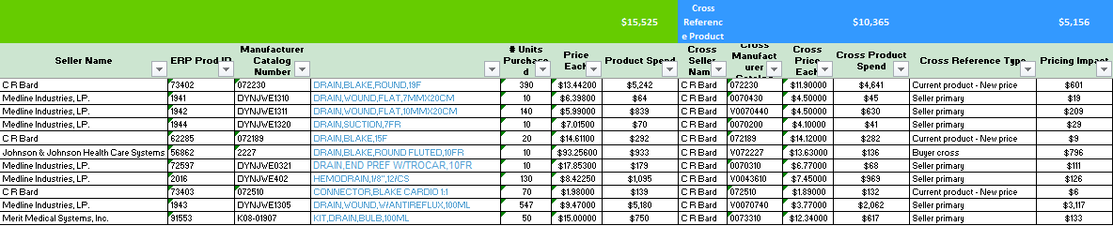
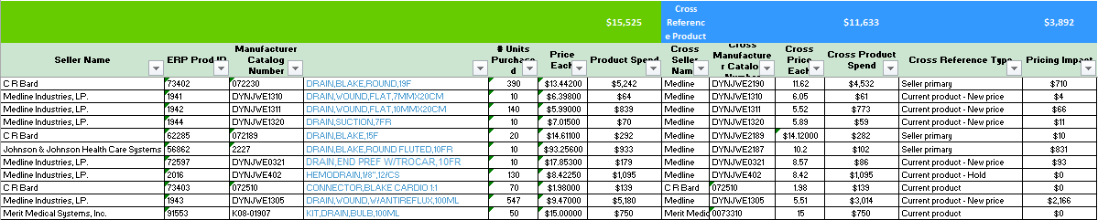
WOUND DRAINAGE (x11 sku)

Slide 24
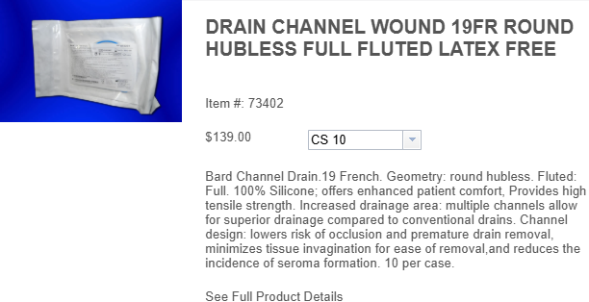
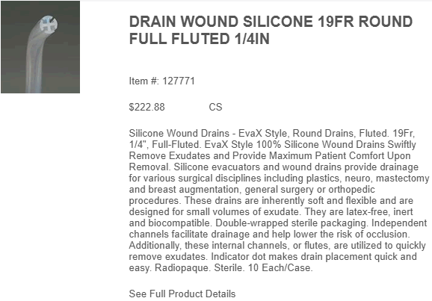

Slide 26
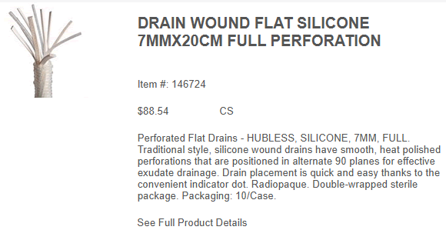
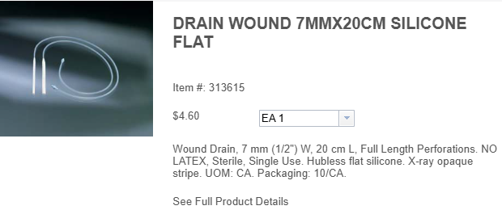

Slide 28
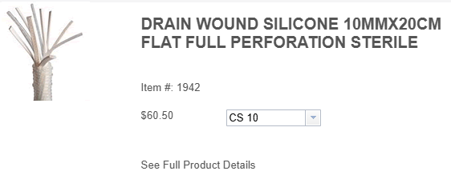
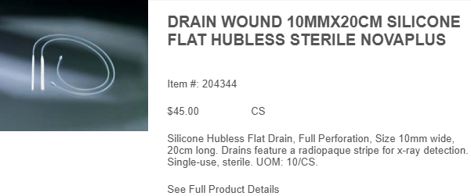

Slide 30
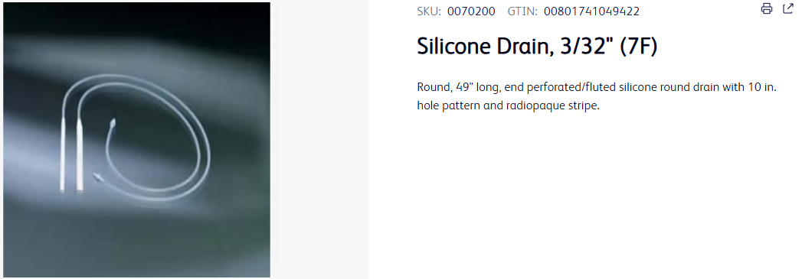


Slide 32
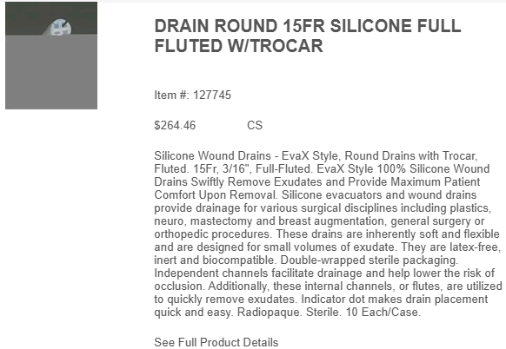
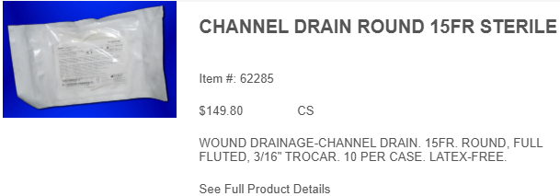

Slide 40
OXIVIR – TRIAL UPDATE
TRIAL LOCATIONS:
SICU
MICU
Senior Behavioral Health
TRIAL DURACTION:
One Month; Estimated Start: Early-Mid January
MONTHLY USAGE:
SICU: 11 TB
MICU: 25 TB
Senior Behavioral Health: 16 TB
DIVERSEY SUPPORT:
72 free canisters
In Person Trial Support

