Slide 1

Nursing and patient care cva JANUARY 2026 meeting

Slide 2

DECEMBER recap
3M CHG DRESSING (APPROVED)
SPECIALTY BAGS (APPROVED)
FACIAL PROTECTION (NOT APPROVED)
ADV. WOUND CARE (APPROVAL OF SUB-COMM.)

Slide 3
JANUARY AGENDA
QTR REVIEW TO DATE (October-December)
ADV. WOUND CARE (Update)
OXIVIR TRIAL (Update)
CUSHIONS AND OVERLAYSQ
PERSONAL PROTECTION EQUIPMENT

Slide 4
QTR REVIEW TO DATE (OCT 2025 - DEC 2025)

Slide 5
Review Date | Item | Est. Savings (Annually)
October | Sage Heel Protector | $467.67
October | Medline Bath wipe | $4,448.13
November | Biopatch to CHG Dressing | $(9,643.50)
November | Specialty Bags | $943.69
December | None | N/A
Total QTR Savings Total YTD Savings |  | $(3,784.01) $12,211.85

Slide 6
ADVANCED WOUND CARE – COMMITTEE UPDATE

Slide 7
OXIVIR TRIAL – COMMITTEE UPDATE

Slide 8
CUSHIONS AND OVERLAYS - COMMITTEE REVIEW

Slide 9
CUSHIONS AND OVERLAYS Conversion (x1 Item)
Current |  | New |  | Savings
Overlay Mattress (Stryker) |  | Overlay Mattress (EHOB) |  | $12,364
Current Product Add. Savings |  |  |  | $3,087
 |  | Total Est. Savings: |  | $15,451

Slide 10
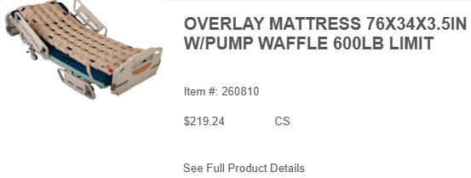
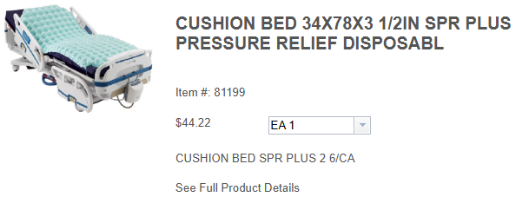

Slide 11
Current Annual Usage:
Lum: 0
Inventory: 1142 EA
Total: 1142 EA
Current Product:
Manufacturer: Stryker
Pricing: $43.803
Current Annual Spend: $50,023.026
New Product:
Manufacturer: EHOB
Pricing: $33.50
New Annual Spend: $38,257

Slide 12



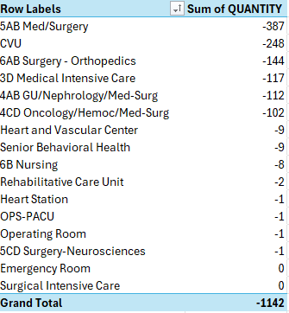

Slide 13
Personal protection equipment - COMMITTEE REVIEW

Slide 14
Personal protection equip. Conversion (X11 Items)
Current |  | New |  | Savings
Cap, Surgeon (Medline) |  | Cap, Surgeon (O&M) |  | $784
Cover, Shoe, Flu. Bar (S&M) |  | Cover, Shoe, Flu. Bar. (O&M)
Cover, Shoe, One-Size (HCS) |  | Cover, Shoe, One-Size (O&M) |  | $1,917
Cover, Shoe, XL (HCS) |  | Cover, Shoe, XL (O&M) |  | $4,272
Coverall, 2XL, White (HCS) |  | Coverall, 2XL, White (O&M) |  | $5,520
Cap, Bouffant, Blue (HCS) |  | Cap, Bouffant, Blue (O&M) |  | $4,790
Jacket, Lab, Disp, L (Valuemax) |  | Jacket, Lab, Disp, L (O&M) |  | $399.30
Jacket, Lab, Disp, M (Valuemax) |  | Jacket, Lab, Disp, M (O&M) |  | $471.90
Jacket, Lab, Disp, S (Valuemax) |  | Jacket, Lab, Disp, S (O&M) |  | $242
Jacket, Lab, Disp, XL (Valuemax) |  | Jacket, Lab, Disp, XL (O&M) |  | $350.90
Gown, Protection, XL (HCS) |  | Gown, Protection, XL (O&M) |  | $2,517
Gown, Protection, Iso, XL (HCS) |  | Gown, Protection, Iso, XL (O&M) |  | $235
 |  | Total Est. Savings: |  | $21,499

Slide 15
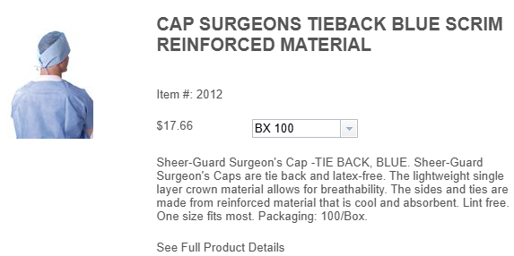
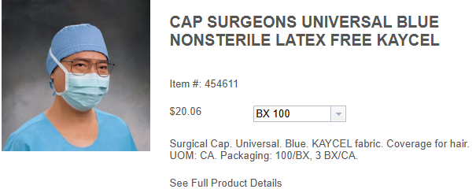

Slide 16
Current Annual Usage:
Lum: 19,100 EA
Inventory: 500 EA
Total: 19,600 EA
Current Product:
Manufacturer: Medline
Pricing: $0.17/EA
Current Annual Spend: $3,332
New Product:
Manufacturer: O&M
Pricing: $0.13/EA
New Annual Spend: $2,548

Slide 17
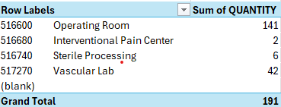
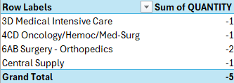

Slide 18
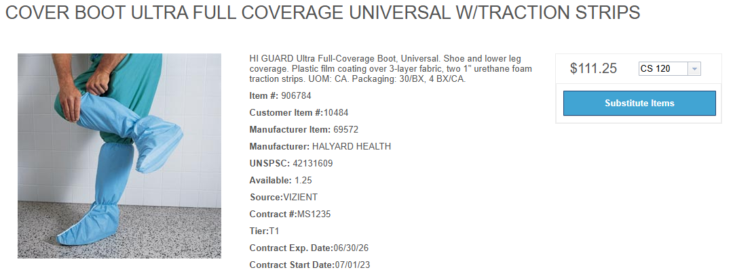
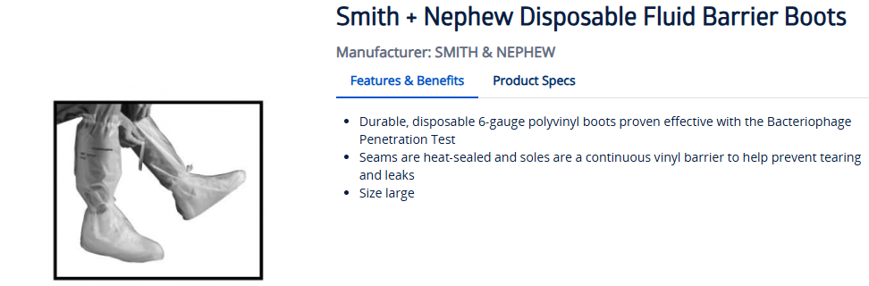

Slide 19
Current Annual Usage:
Lum: 0 EA
Inventory: 300 EA
Total: 300 EA
Current Product:
Manufacturer: Concordance
Pricing: $4.20/EA
Current Annual Spend: $1,260
New Product:
Manufacturer: O&M
Pricing: $0.60/EA
New Annual Spend: $

Slide 20


Slide 21
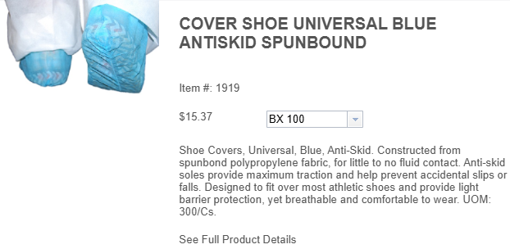
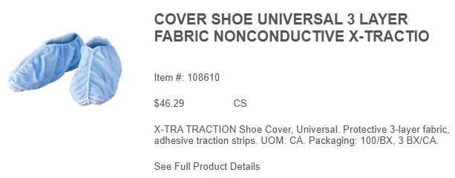

Slide 22
Current Annual Usage:
Lum: 13,000 EA
Inventory: 8,300 EA
Total: 21,300 EA
Current Product:
Manufacturer: HCS
Pricing: $0.15/EA
Current Annual Spend: $3,195
New Product:
Manufacturer: O&M
Pricing: $.06/EA
New Annual Spend: $1,278

Slide 23
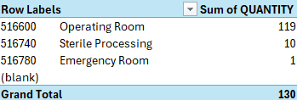
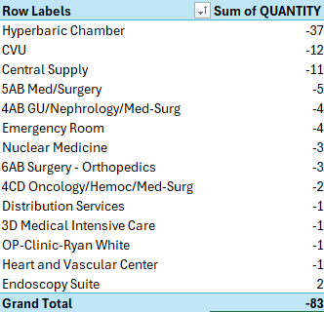

Slide 24
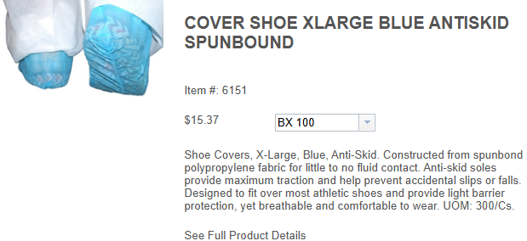
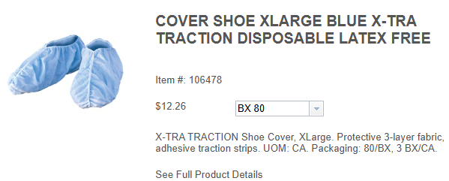

Slide 25
Current Annual Usage:
Lum: 47,600 EA
Inventory: 5,800 EA
Total: 53,400 EA
Current Product:
Manufacturer: HCS
Pricing: $0.15/EA
Current Annual Spend: $8,010
New Product:
Manufacturer: O&M
Pricing: $0.07/EA
New Annual Spend: $3,738

Slide 26
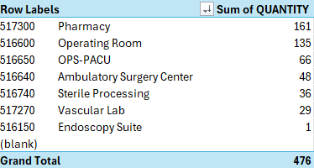
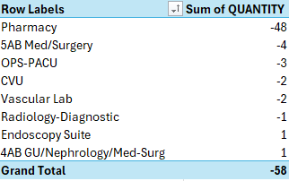

Slide 27
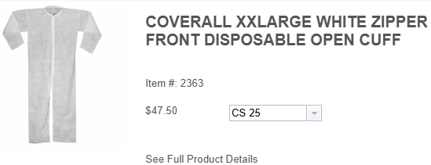
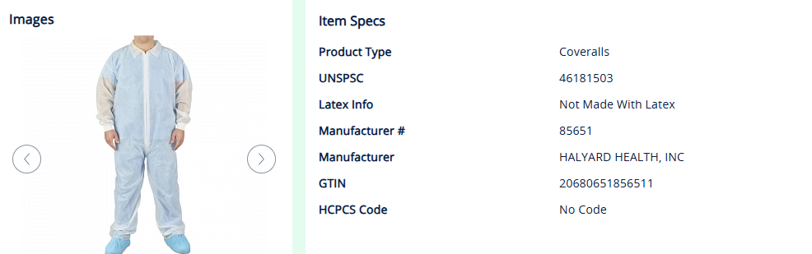

Slide 28
Current Annual Usage:
Lum: 5,175 EA
Inventory: 1,725 EA
Total: 6,900 EA
Current Product:
Manufacturer: HCS
Pricing: $2.03/EA
Current Annual Spend: $14,007
New Product:
Manufacturer: O&M
Pricing: $1.23/EA
New Annual Spend: $8,487

Slide 29
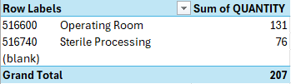
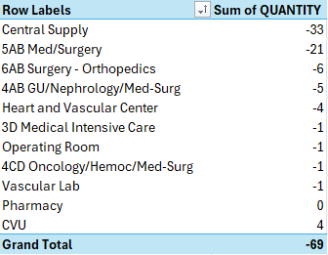

Slide 30
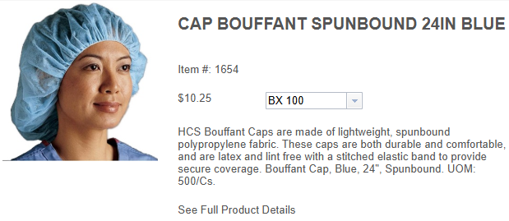
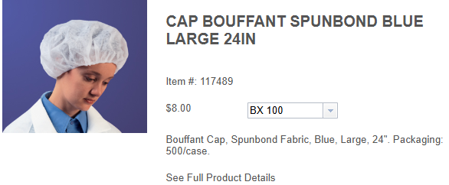

Slide 31
Current Annual Usage:
Lum: 73,400
Inventory: 22,400
Total: 95,800
Current Product:
Manufacturer: HCS
Pricing: $0.10
Current Annual Spend: $9,580
New Product:
Manufacturer: O&M
Pricing: $0.05
New Annual Spend: $4,790

Slide 32
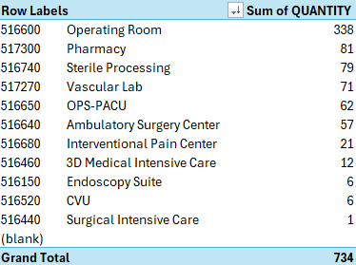
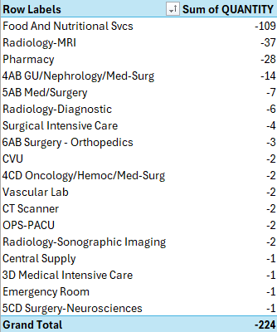

Slide 33
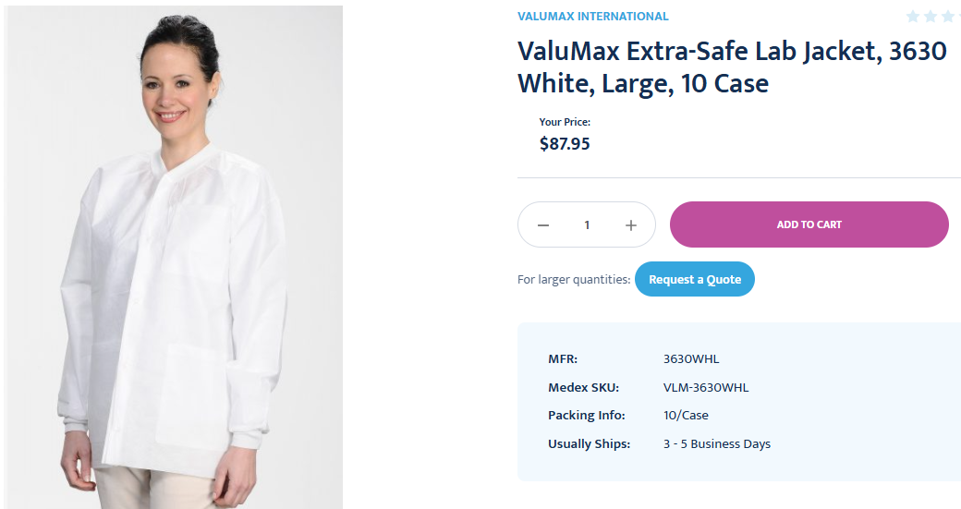
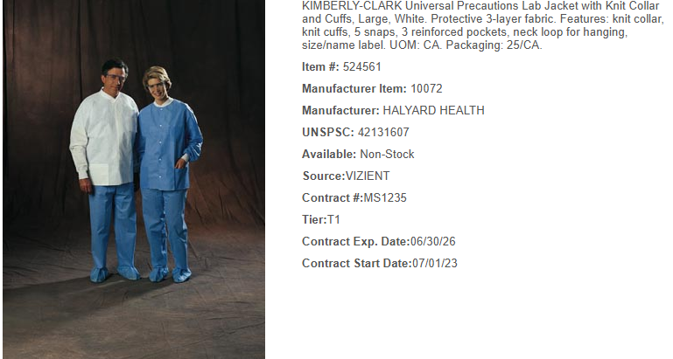

Slide 34
Current Annual Usage:
Lum: 0
Inventory: 330 EA
Total: 330 EA
Current Product:
Manufacturer: Valuemax
Pricing: $3.62/EA
Current Annual Spend: $1,194.6
New Product:
Manufacturer:
Pricing: $2.41
New Annual Spend: $795.3

Slide 35


Slide 36
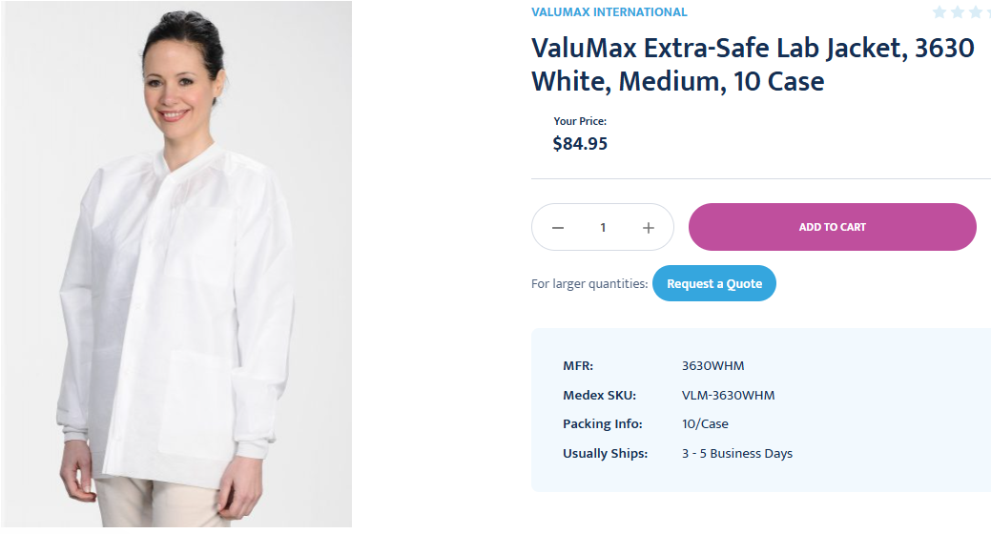
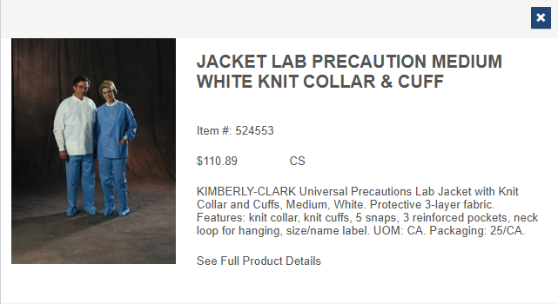

Slide 37
Current Annual Usage:
Lum: 0
Inventory: 390 EA
Total: 390 EA
Current Product:
Manufacturer: Valuemax
Pricing: $3.62/EA
Current Annual Spend: $1,411.80
New Product:
Manufacturer:
Pricing: $2.41
New Annual Spend: $939.90

Slide 38


Slide 39
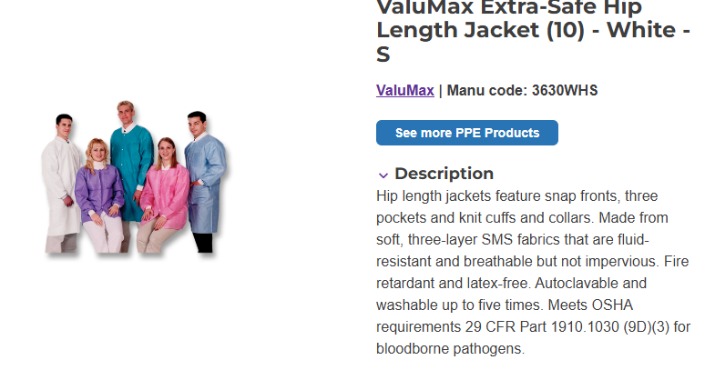
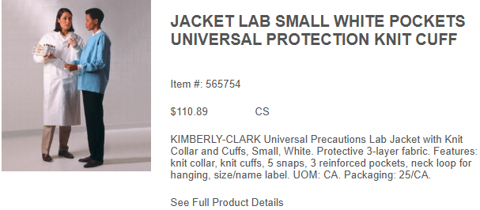

Slide 40
Current Annual Usage:
Lum: 0
Inventory: 200 EA
Total: 200 EA
Current Product:
Manufacturer: Valuemax
Pricing: $3.62/EA
Current Annual Spend: $724
New Product:
Manufacturer:
Pricing: $2.41/EA
New Annual Spend: $482

Slide 41


Slide 42
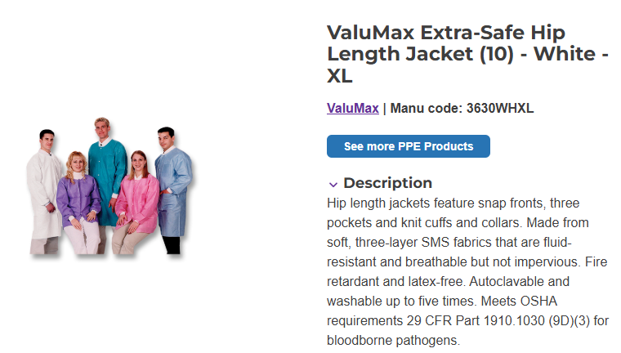
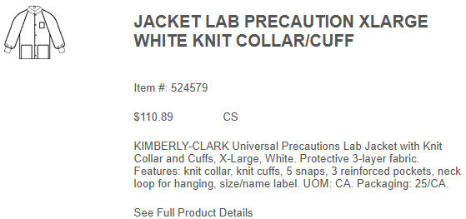

Slide 43
Current Annual Usage:
Lum: 0
Inventory: 290 EA
Total: 290 EA
Current Product:
Manufacturer: Valuemax
Pricing: $3.62/EA
Current Annual Spend: $1,049.80
New Product:
Manufacturer:
Pricing: $2.41/EA
New Annual Spend: $698.90

Slide 44
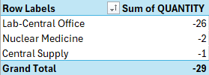

Slide 45
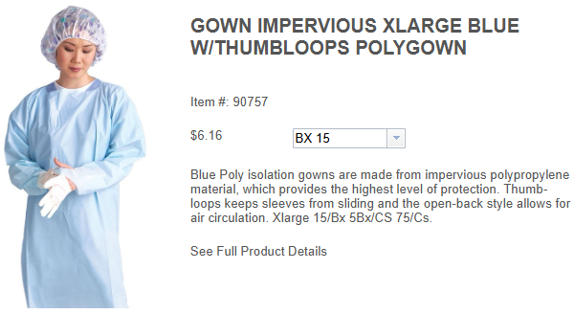
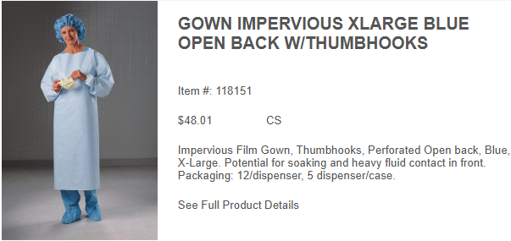

Slide 46
Current Annual Usage:
Lum: 1,830 EA
Inventory: 133,905 EA
Total: 135,735 EA
Current Product:
Manufacturer: HCS
Pricing: $0.40667/EA
Current Annual Spend: $55,199.35
New Product:
Manufacturer: O&M
Pricing: $0.38817/EA
New Annual Spend: $52,688.25

Slide 47

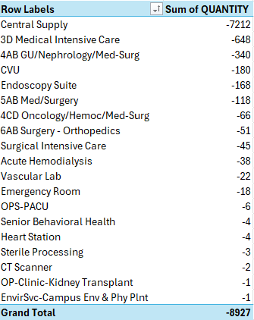

Slide 48
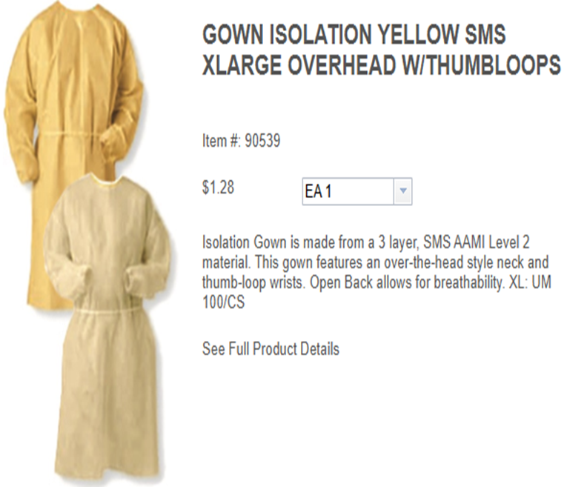
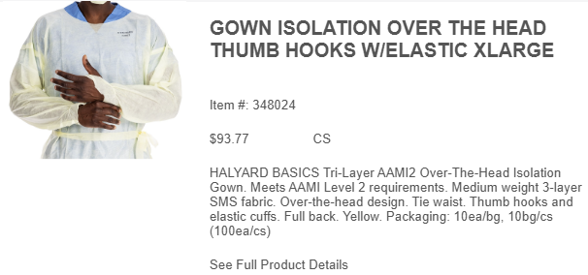

Slide 49
Current Annual Usage:
Lum: 0
Inventory: 206 EA
Total: 206 EA
Current Product:
Manufacturer: HCS
Pricing: $1.26850/EA
Current Annual Spend: $261.311
New Product:
Manufacturer: O&M
Pricing: $0.67970/EA
New Annual Spend: $140.0182

Slide 50

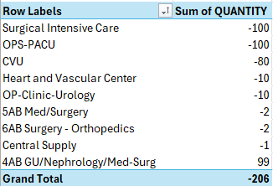

Slide 51
OXIVIR – TRIAL UPDATE
TRIAL LOCATIONS:
SICU
MICU
Senior Behavioral Health
TRIAL DURACTION:
One Month; Estimated Start: Early-Mid January
MONTHLY USAGE:
SICU: 11 TB
MICU: 25 TB
Senior Behavioral Health: 16 TB
DIVERSEY SUPPORT:
72 free canisters
In Person Trial Support

Slide 52
DISINFECTING CAPS COMMITTEE REVIEW

Slide 53
DISINFECTING CAPS Conversion (1 Item)
Current |  | New |  | Savings
Cap Connector (ICU Medical) |  | Cap Connector (3M) |  | $(1,079.92)
 |  | Total Est. Savings: |  | $(1,079.92)

Slide 54
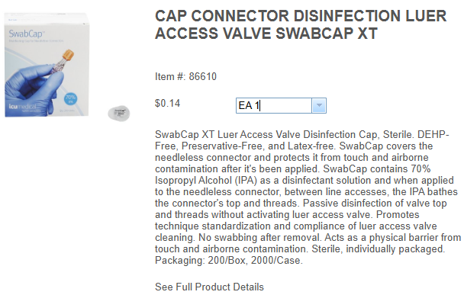
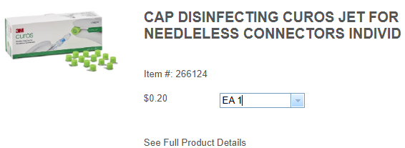

Slide 55
Current Annual Usage:
Lum: 103,532 EA
Inventory: 50,740 EA
Total: 154,272 EA
Current Product:
Manufacturer: ICU Medical
Pricing: $0.14/EA
Current Annual Spend: $21,598.08
New Product:
Manufacturer: O&M
Pricing: $0.147/EA
New Annual Spend: $22,678

Slide 56
