Slide 1

Nursing and patient care cva November 2025 meeting

Slide 2

OCTOBER recap
SAGE HEEL PROT. BOOTS (APPROVED)
MEDLINE BATHWIPE (APPROVED)
OXIVIR WIPE (TRIAL APPROVED)

Slide 3
Agenda
CHG DRESSINGS
SPECIALTY BAGS
IV CATHETERS
TRIAL PROCEDURE DISCUSSION

Slide 4
RESPIRATORY DISPOSABLES (ROUTINE) – COMMITTEE NOTICE

Slide 5
RESPIRATORY DISPOSABLES (ROUTINE) conversion Savings
Conversion Items:
Est. Annual Savings
Peak Flow Meter Asthmamd
Inhalation Solution, Sterile Saline
Oxygen Nasal Cannula, Standard
Oxygen Connectors, Disposable
$1
$193
$162
$681
Est. Conversion Savings: $1037
Additional Commit Savings: $720.18
Total Est. Savings: $1,757.18

Slide 6
Chg dressing Post trial COMMITTEE REVIEW

Slide 7
3m Tegaderm dressing eval summary
Performance | Much Worse | Worse | Same As | Superior | Far Superior | N/A or Not Observed
Ease of applying dressing over I.V. site |  |  | 2 | 8 | 11
Time required to apply dressing |  |  | 3 | 9 | 9
Ability to visualize the I.V. site |  |  |  | 6 | 15
Ability to absorb fluid |  |  | 1 | 9 | 9 | 2
Catheter Securement |  |  | 8 | 6 | 7
Dressing adherence |  |  | 3 | 6 | 12
Dressing wear time |  |  | 4 | 5 | 9 | 3
Ease of dressing removal |  | 1 | 2 | 6 | 10 | 2
Overall performance |  |  | 2 | 8 | 11

Slide 8
3m Tegaderm i.v. port dressing eval summary
Performance | Much Worse | Worse | Same As | Superior | Far Superior | N/A or Not Observed
Ease of Application |  | 2 | 1 | 1 | 4
Ability to visualize insert site |  |  | 2 | 1 | 5
Ability absorb fluid |  |  |  | 1 | 4 | 3
Overall securement |  |  |  | 4 | 4
Ease of removal |  | 1 | 1 | 2 | 3 | 1
Gentle to skin |  |  | 2 | 2 | 4
Dressing wear time |  |  | 2 | 2 | 4
Patient Comfort |  |  | 2 | 1 | 4 | 1
Overall Performance |  |  | 1 | 2 | 4 | 1

Slide 9
Chg dressing swap opportunity
Current Items:
Recommended New Items:
Kit, Introducer, Percutaneous, 9F
Kit, Cath, 7FR-Lumen
Kit, Cath, 7FR 20cm
Kit, Dressing, BioPatch
Kit, Dressing, Change, Chloraprep
Dressing, Antimicrobial, 4mm, BioPatch
Same kit w/BioPatch switched out for 3M CHG Dressing
Kit, CVC, PI, 3 Lumen 7 FR
Kit, PI CVC 3 Liter 7FRx16cm
Same kit w/BioPatch and Sorbaview Dressing swapped out for 3M CHG Dressing
Same kit w/BioPatch and Transparent Film Dressing swapped out for 3M CHG Dressing
3M CHG IV Securement Dressing

Slide 10
Chg dressing Conversion Savings
Alternative Items:
Est. Annual Savings
Kit, Introducer, Percutaneous, 9F
Kit, Cath, 7FR-Lumen
Kit, Cath, 7FR 20cm
Kit, Dressing
Kit, Dressing, Change, Chloraprep
3M CHG IV Securement Dressing
$68.40
$(781.20)
$(1,119.30)
$4,406.40
$0.00
$742.98
Total Est. Annual Savings: $(3,317.28)

Slide 11
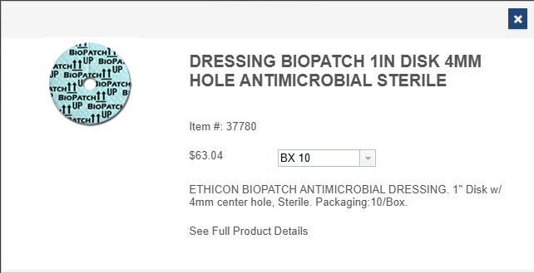
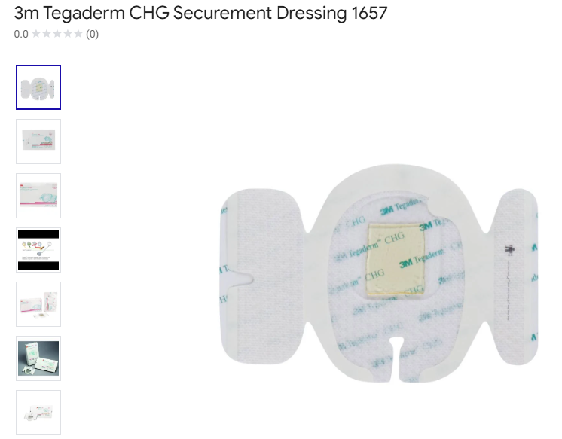

Slide 12
Current Annual Usage:
Lum: 715
Inventory: 152
Total: 867
Current Product:
Manufacturer: Ethicon
Pricing: $6.30/EA
Current Annual Spend: $5,462.10
New Product:
Manufacturer: 3M
Pricing: $5.43/EA
New Annual Spend: $4,707.81

Slide 13


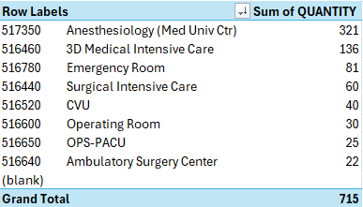
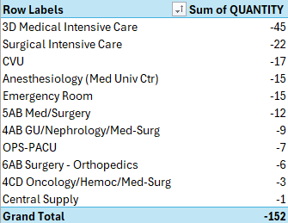

Slide 14
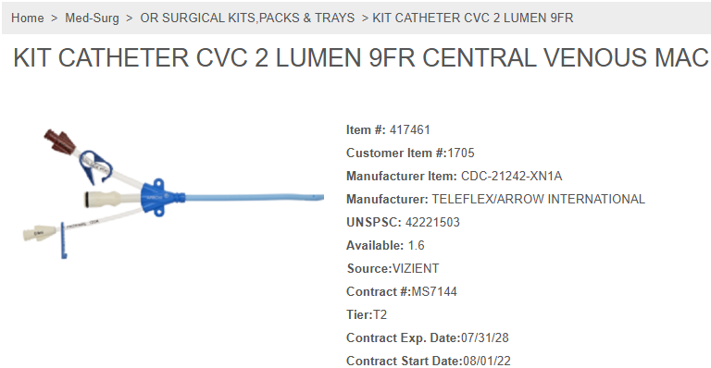
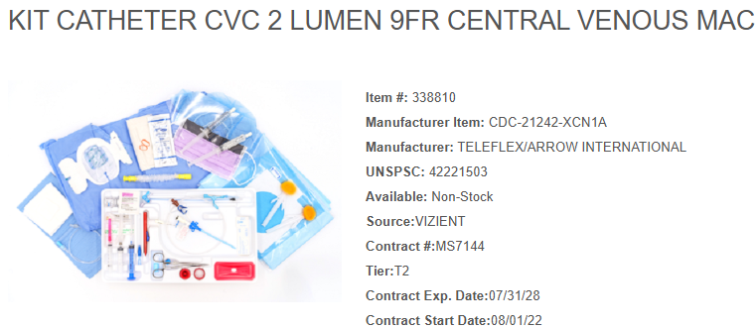

Slide 15
Current Annual Usage:
Lum: 95 EA
Inventory: 18 EA
Total: 113 EA
Current Product:
Manufacturer: Teleflex/Arrow
Pricing: $198.80/EA
Current Annual Spend: $22,464.40
New Product:
Manufacturer: Teleflex/Arrow
Pricing: $198.20/EA
New Annual Spend: $22,396.60

Slide 16
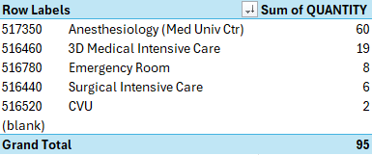
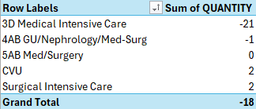

Slide 17
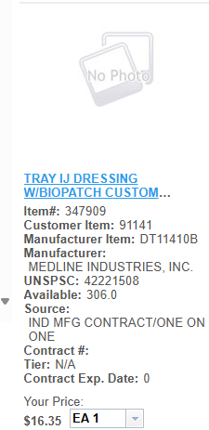

Slide 18
Current Annual Usage:
Lum: 3701 EA
Inventory: 0
Total: 3701 EA
Current Product:
Manufacturer: Medline
Pricing: $16.35 EA
Current Annual Spend: $60,511.35
New Product:
Manufacturer: Medline
Pricing: $
New Annual Spend: $

Slide 19
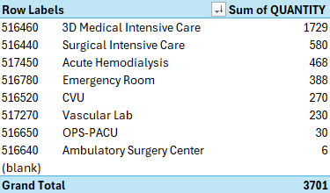


Slide 20
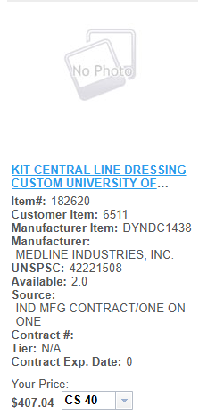

Slide 21
Current Annual Usage:
Lum: 0
Inventory: 3337
Total: 3337
Current Product:
Manufacturer:
Pricing: $10.18/EA
Current Annual Spend: $33,970.66
New Product:
Manufacturer: Medline
Pricing: $
New Annual Spend: $

Slide 22

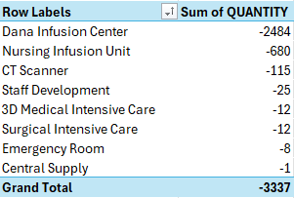

Slide 23
Specialty Bags COMMITTEE REVIEW

Slide 24
Specialty bag Conversion opportunity
Current Items:
Recommended Alternative Items:
Bag Ziplock 12in 15in 4mil Clear Multiuse
Bag Plastic Ziplock Reclosable w/ White Block Clear 2mil Thick 5in x 8in
Bag Body Without Handles Transport 48in x 90in Adult Curved Zipper
Bag Patient Belonging 20x20in 1.5ml Clear w/Drawstring HCS700215
Bag Biohazard 3 Wall Reclosable Pouch Flap w/Orange Black Symbol
Bag Plastic Ziplock 12in x 15in 4mil
Bag Plastic Ziplock White Block Reclosable Poly Latex Free
Bag Body without Handles Transport 36in x 90in Adult Curved Zipper
Bag Patient Belonging Drawstring Clear Printed 20in x 20in
Bag Specimen Transport 3 Wall Flap Reclosable

Slide 25
Specialty bag Conversion Savings
Alternative Items:
Est. Annual Savings
Bag Plastic Ziplock 12in x 15in 4mil
Bag Plastic Ziplock White Block Reclosable Poly Latex Free
Bag Body without Handles Transport 36in x 90in Adult Curved Zipper
Bag Patient Belonging Drawstring Clear Printed 20in x 20in
Bag Specimen Transport 3 Wall Flap Reclosable
$1,111.36
$(56.37)
$1,085.78
$1,145.67
$5
Total Est. Annual Savings: $3,291.44

Slide 26
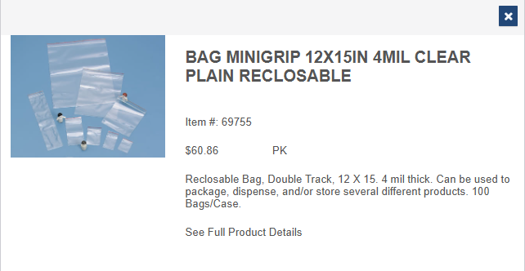
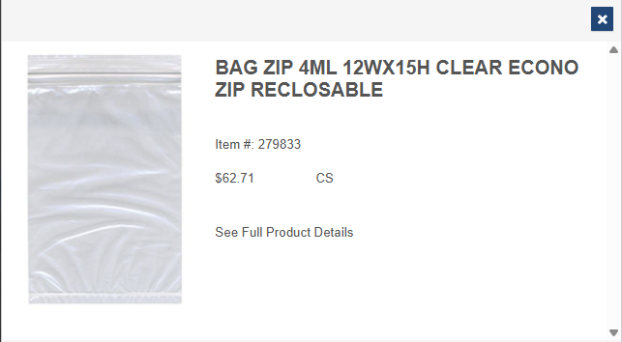

Slide 27
Current Annual Usage:
Lum: 0
Inventory: 23 PK/100
Total: 23
Current Product:
Manufacturer: Healthcare Logistics
Pricing: $60.86 PK/100
Current Annual Spend: $1,399.78
New Product:
Manufacturer: Action Bag Company
Pricing: $12.54 PK/100
New Annual Spend: $288.42

Slide 28

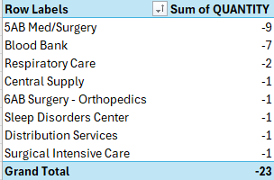

Slide 29
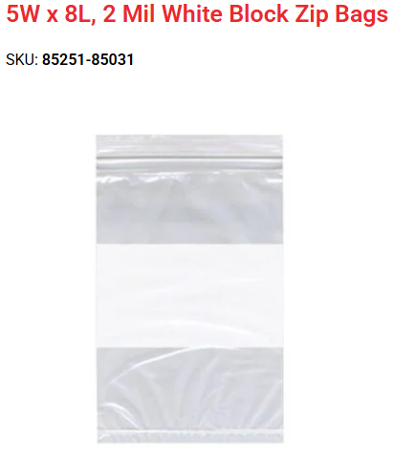
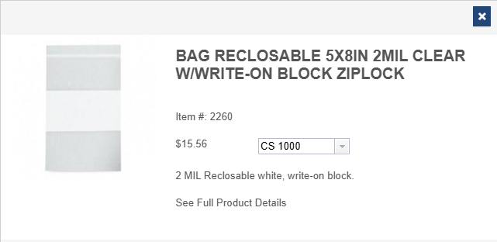

Slide 30
Current Annual Usage:
Lum: 98 PK
Inventory: 101 PK
Total: 199 PK
Current Product:
Manufacturer: RD Plastics Co.
Pricing: $1.56
Current Annual Spend: $310.44
New Product:
Manufacturer: Action Bag Company
Pricing: $1.843
New Annual Spend: $366.757

Slide 31
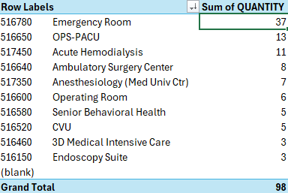
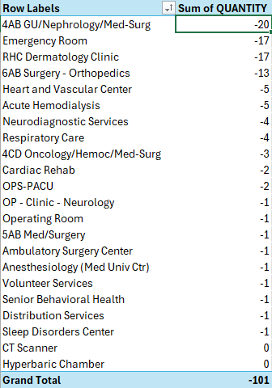

Slide 32
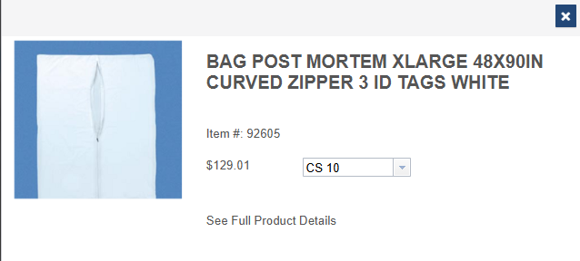
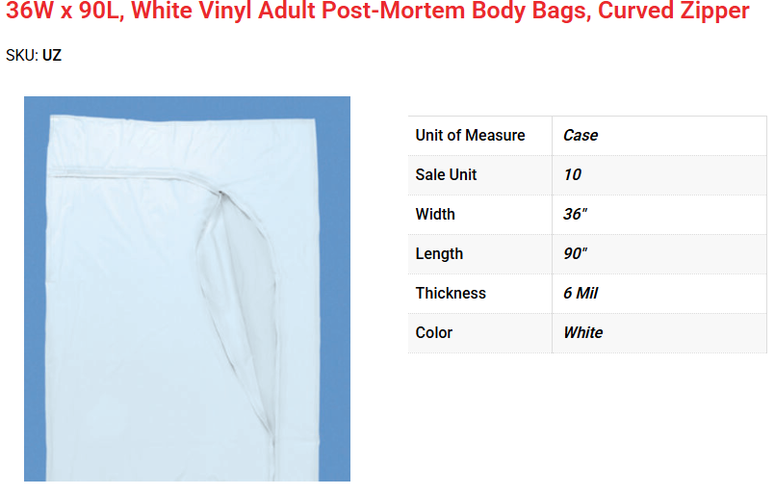

Slide 33
Current Annual Usage:
Lum: 184/EA
Inventory: 49/EA
Total: 233/EA
Current Product:
Manufacturer:
Pricing: $12.90/EA
Current Annual Spend: $3,005.70
New Product:
Manufacturer:
Pricing: $8.24
New Annual Spend: $1,919.92

Slide 34
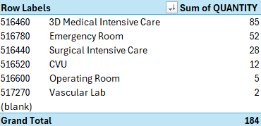
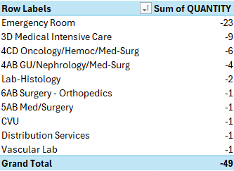

Slide 35
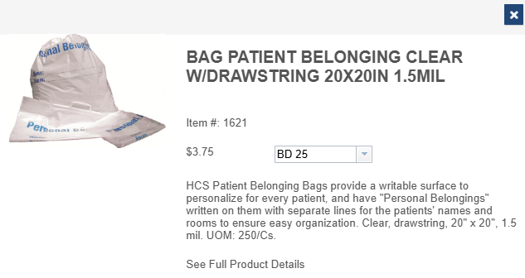
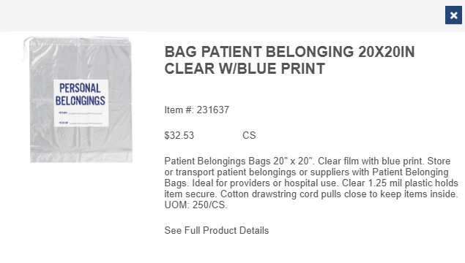

Slide 36
Current Annual Usage:
Lum: 35000
Inventory: 3189
Total: 38189
Current Product:
Manufacturer: HCS Sourcing
Pricing: $.15/EA
Current Annual Spend: $5,728.35
New Product:
Manufacturer: Action Health Co.
Pricing: $.12
New Annual Spend: $4,582.68

Slide 37
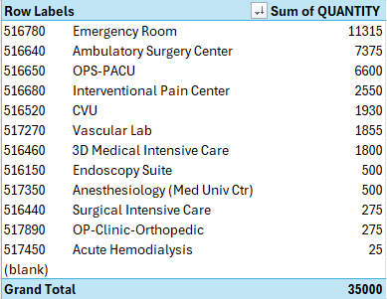
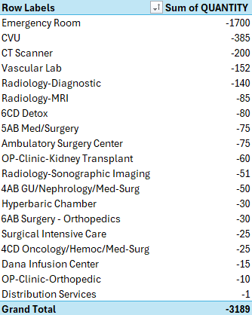

Slide 38
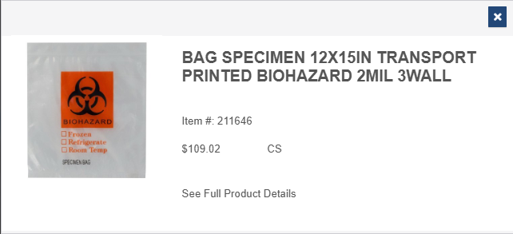
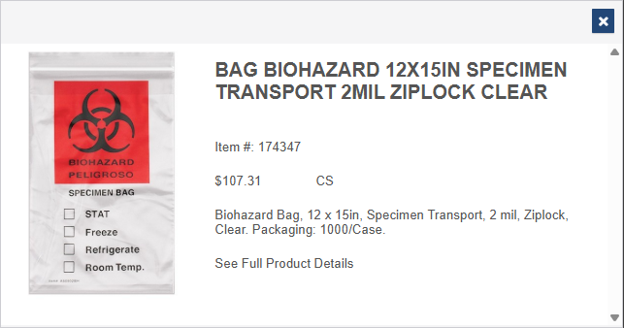

Slide 39
Current Annual Usage:
Lum: 0
Inventory: 12PK
Total: 12
Current Product:
Manufacturer:
Pricing: $10.90
Current Annual Spend: $130.80
New Product:
Manufacturer:
Pricing: $10.50
New Annual Spend: $126

Slide 40

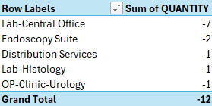

Slide 41
IV Catheter COMMITTEE REVIEW

Slide 42
IV Catheter Conversion opportunity
Current B Braun Items:
Recommended BD Alternative Items:
Catheter IV Safety 14ga x 1-1/4in Straight PUR Introcan Safety
Catheter IV Safety 24ga x 3/4in Straight Thin Wall FEP Introcan Safety
Catheter IV Safety 22ga x 1in Straight FEP Introcan Safety
Catheter IV Safety 20ga x 1-1/4in Straight FEP Introcan Safety
Catheter IV Safety 18ga x 1-1/4in Straight FEP Introcan Safety
Catheter IV Safety 16ga x 1-1/4in Straight FEP Introcan Safety
Catheter IV Safety Extended 18ga x 1-3/4in Straight PUR Introcan Safety
Catheter IV Safety Extended 14ga x 1.77in Straight Vialon Gray Insyte Autoguard
Catheter IV Safety 24ga x 0.75in Staight Vialon Yellow Insyte Autoguard
Catheter IV Safety 22ga x 1in Straight Vialon Blue Insyte Autoguard
Catheter IV Safety 20ga x 1.16in Straight Vialon Pink Insyte Autoguard
Catheter IV Safety 18ga x 1.16in Straight Vialon Green Insyte Autoguard
Catheter IV Safety 16ga x 1.16in Straight Vialon Gray Insyte Autoguard
Catheter IV Safety Extended 18ga x 1.88in Straight Vialon Green Insyte Autoguard

Slide 43
IV Catheter Conversion Savings
BD Alternative Items:
Est. Annual Savings
Catheter IV Safety Extended 14ga x 1.77in Straight Vialon Gray Insyte Autoguard
Catheter IV Safety 24ga x 0.75in Staight Vialon Yellow Insyte Autoguard
Catheter IV Safety 22ga x 1in Straight Vialon Blue Insyte Autoguard
Catheter IV Safety 20ga x 1.16in Straight Vialon Pink Insyte Autoguard
Catheter IV Safety 18ga x 1.16in Straight Vialon Green Insyte Autoguard
Catheter IV Safety 16ga x 1.16in Straight Vialon Gray Insyte Autoguard
Catheter IV Safety Extended 18ga x 1.88in Straight Vialon Green Insyte Autoguard
$35
$230
$1173
$2923
$768
$52
$48
Total Est. Annual Savings: $5,229

Slide 44
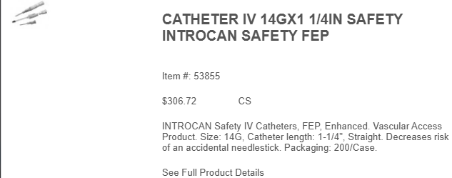
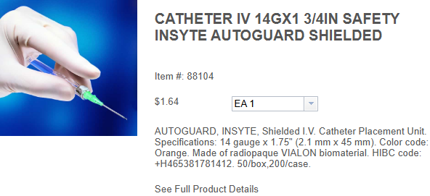

Slide 45
Current Annual Usage:
Lum: 0 EA
Inventory: 485 EA
Total: 485
Current Product:
Manufacturer: B Braun
Pricing: $1.52/EA
Current Annual Spend: $737.2
New Product:
Manufacturer: BD
Pricing: $1.45/EA
New Annual Spend: $703.25

Slide 46
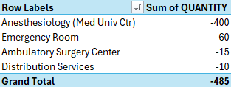

Slide 47
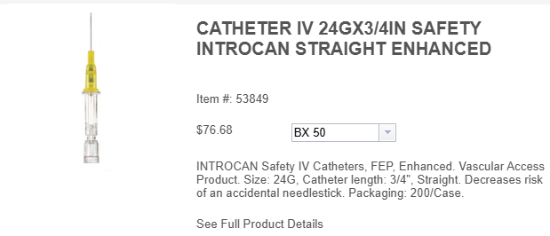
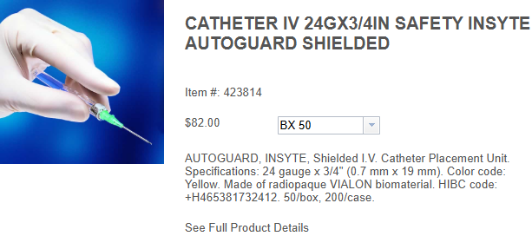

Slide 48
Current Annual Usage:
Lum: 649 EA
Inventory: 693 EA
Total: 1342
Current Product:
Manufacturer: B Braun
Pricing: $1.52/EA
Current Annual Spend: $2,039.84
New Product:
Manufacturer: BD
Pricing: $1.45/EA
New Annual Spend: $1,945.9

Slide 49
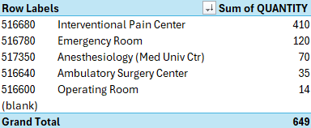
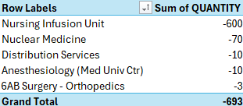

Slide 50
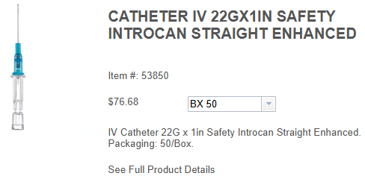
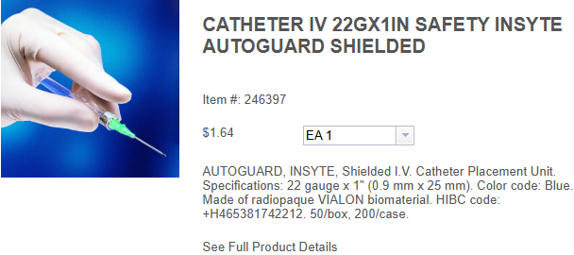
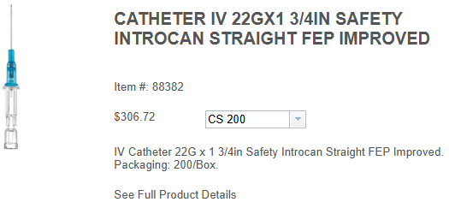

Slide 51
Current Annual Usage (53850):
Lum: 6788
Inventory: 2943
Total: 9731
Current Annual Usage(88382):
Lum: 10
Inventory: 1006
Total: 1016
Current Product:
Manufacturer: B Braun
Pricing: $1.52/EA
Current Annual Spend: $14,791.12
Current Product:
Manufacturer: B Braun
Pricing: $1.52/EA
Current Annual Spend: $1,544.32
New Product:
Manufacturer: BD
Pricing: $1.45/EA
New Annual Spend: $15,583.15

Slide 52
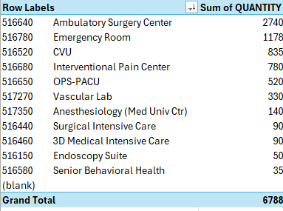
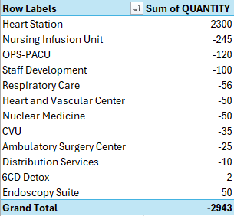

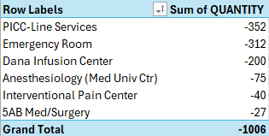

Slide 53
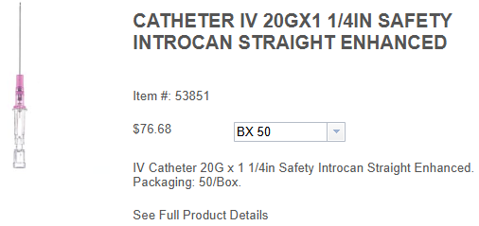


Slide 54
Current Annual Usage:
Lum: 34827
Inventory: 1165
Total: 35992
Current Product:
Manufacturer: B Braun
Pricing: $1.52/EA
Current Annual Spend: $54,707.84
New Product:
Manufacturer: BD
Pricing: $1.45/EA
New Annual Spend: $52,188.4

Slide 55
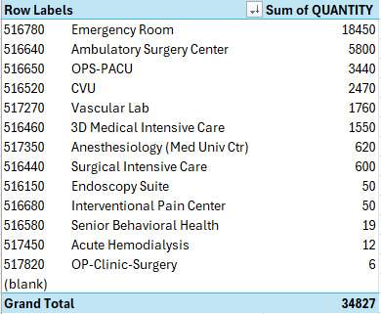
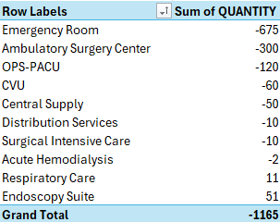

Slide 56
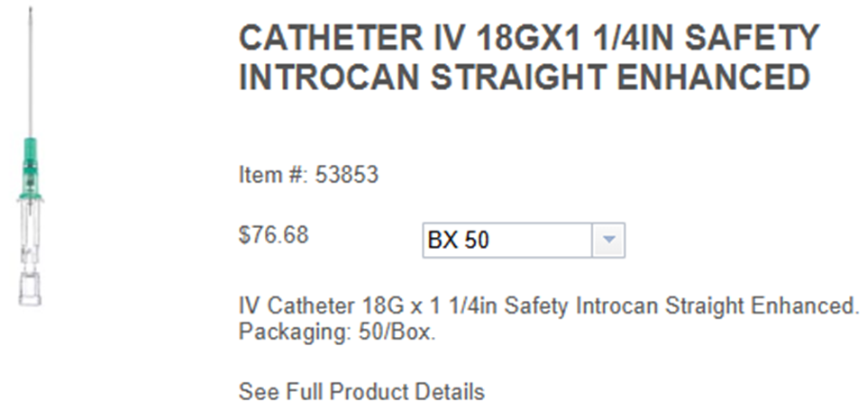
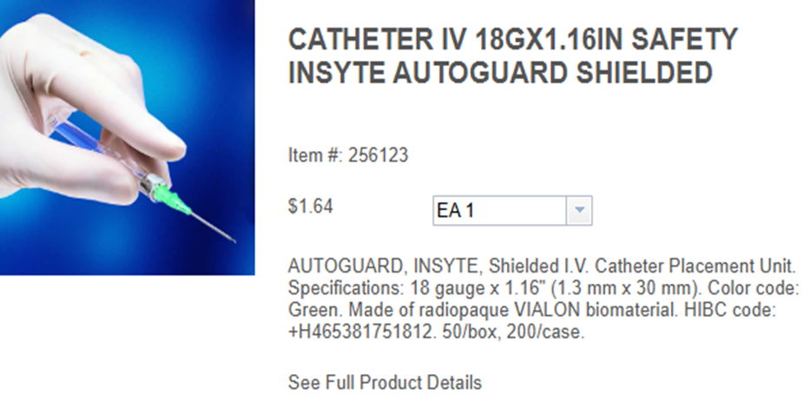

Slide 57
Current Annual Usage:
Lum: 10016 EA
Inventory: 252 EA
Total: 10,268 EA
Current Product:
Manufacturer: B Braun
Pricing: $1.52/EA
Current Annual Spend: $15,607.36
New Product:
Manufacturer: BD
Pricing: $1.45/EA
New Annual Spend: $14,888.6

Slide 58
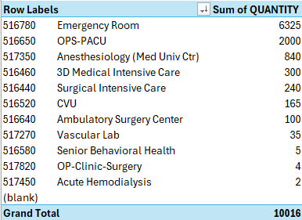
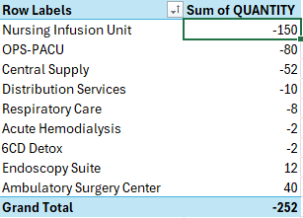

Slide 59



Slide 60
Current Annual Usage:
Lum: 712 EA
Inventory: 43 EA
Total: 755 EA
Current Product:
Manufacturer:
Pricing: $1.52/EA
Current Annual Spend: $1,147.6
New Product:
Manufacturer:
Pricing: $1.45/EA
New Annual Spend: $1,094.75

Slide 61



Slide 62



Slide 63
Current Annual Usage:
Lum: 660 EA
Inventory: 0 EA
Total: 660 EA
Current Product:
Manufacturer: B Braun
Pricing: $1.52/EA
Current Annual Spend: $1003.2
New Product:
Manufacturer: BD
Pricing: $1.45/EA
New Annual Spend: $957

Slide 64



