Slide 1

Nursing and patient care cva April - 2026 meeting

Slide 2

MARCH recap
QUICKTRACH - APPROVED
PRESSURE INFUSION BAGS - APPROVED
DIAG. PROC TRAYS NON-THOR - APPROVED

Slide 3
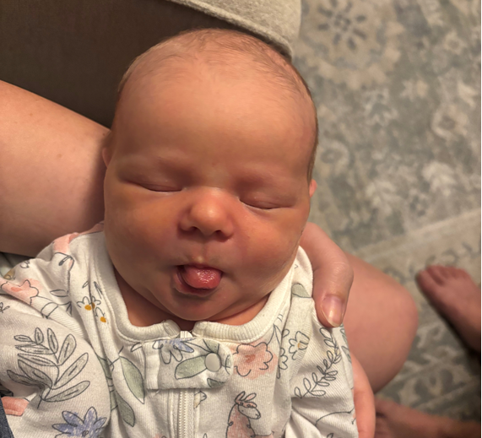
Harper lynn Spotts
8 lbs 1OZ

Slide 4
APRIL AGENDA
BABY SPOTTS
QTR REVIEW TO DATE
CVA ITEM REQUEST PORTAL
ADV. WOUND CARE - (Update)
OXIVIR TRIAL - (Update)
WOUND CARE – (COMMITTEE REVIEW)
WOUND DRAINAGE – (COMMITTEE REVIEW)
OSTOMY PRODUCTS - (COMMITTEE REVIEW)

Slide 5
QTR REVIEW TO DATE (JAN 2026 - MAR 2026)

Slide 6
Review Date | Item | Est. Savings (Annually)
January | PERSONAL PROT. EQUIP. | $14,474.00
February | PNEUMATIC COMP. DEV. | $36,495.00
March | PRESSURE INF. BAGS | $9,324.00
March | DIAG. PROC. TRAYS (NON –THORACIC) | $1,123.00
TOTAL QTR | SAVINGS | $61,416.00
Total Y-T-D Savings |  | $73,627.85

Slide 7
new item request submission portal
Supply Chain Management

Slide 8
WOUND CARE - COMMITTEE REVIEW

Slide 9
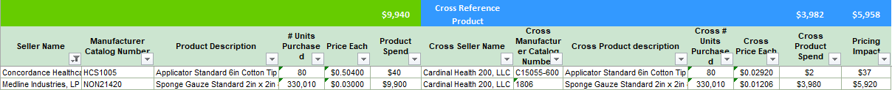
WOUND CARE (X2 SKU)

Slide 10
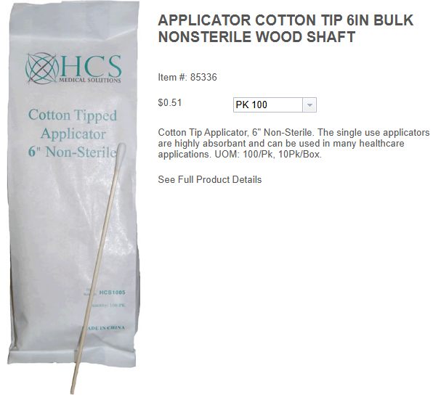
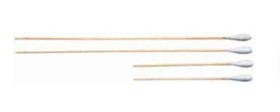

Slide 11


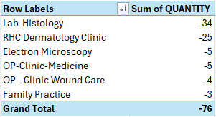
NONE

Slide 12
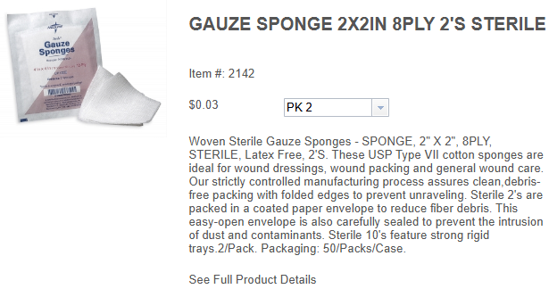
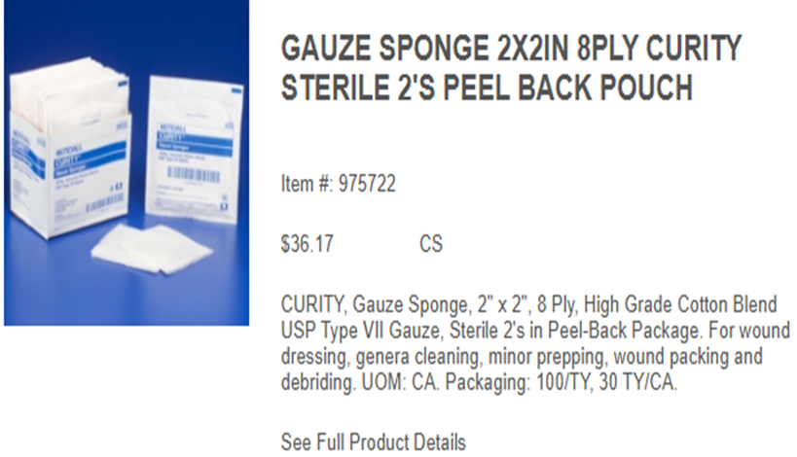

Slide 13
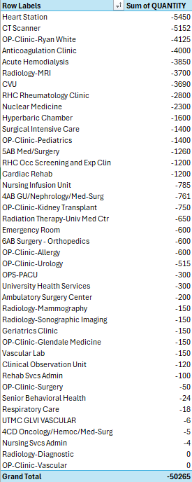
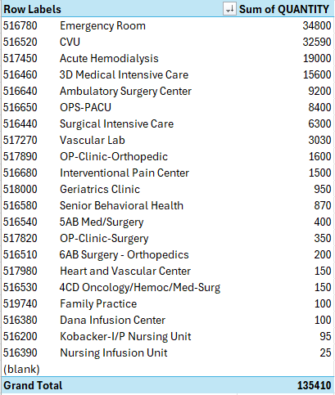

Slide 14
BOWEL MANAGEMENT SYSTEMS - COMMITTEE REVIEW

Slide 15
BOWEL MANAGEMENT SYSTEMS (X2 SKU)

Slide 16
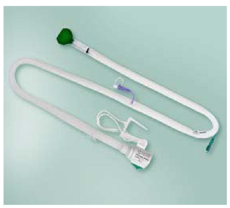
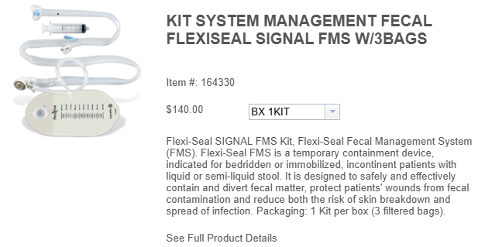

Slide 17
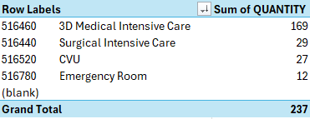
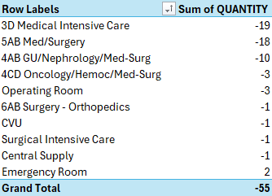

Slide 18
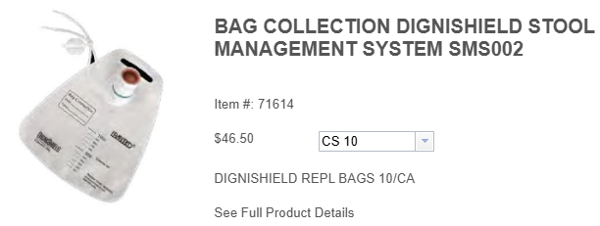
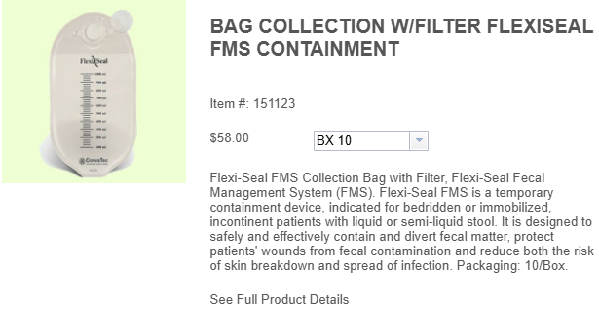

Slide 19
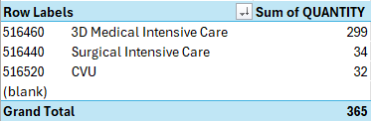
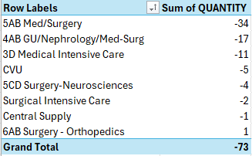

Slide 20
WOUND DRAINAGE - COMMITTEE REVIEW

Slide 21
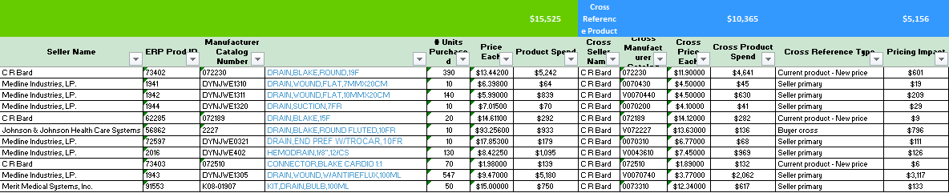
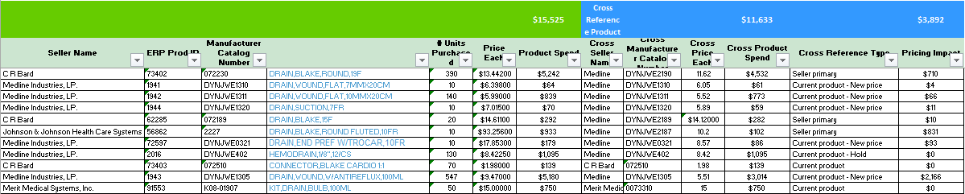
WOUND DRAINAGE (x11 sku)

Slide 22
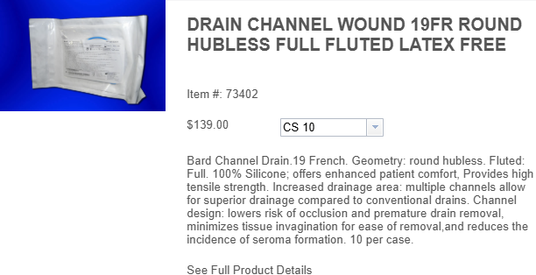
No Picture

Slide 23



Slide 24
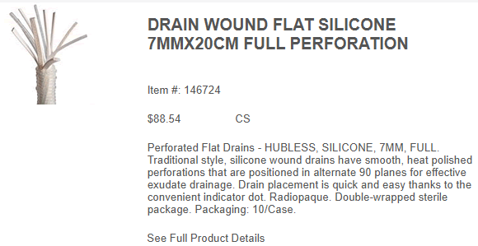
No Picture

Slide 25



Slide 26
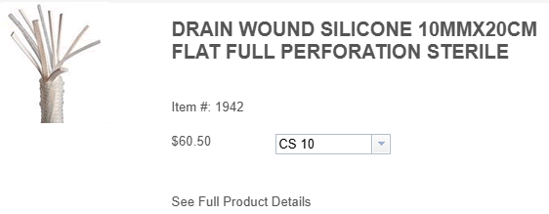
No Picture

Slide 27

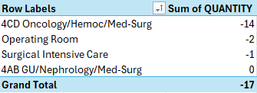

Slide 28
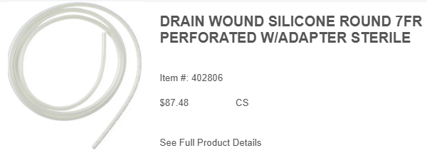
No Picture

Slide 29



Slide 30
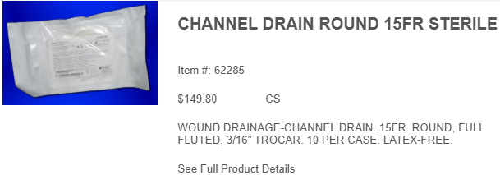
No Picture

Slide 31


Slide 32
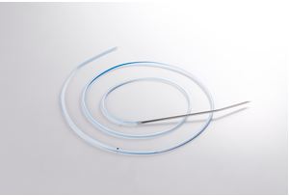
No Picture

Slide 33



Slide 34

No Picture

Slide 35



Slide 36
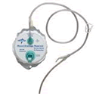
No Picture

Slide 37

No Inventory for
this Item

Slide 38
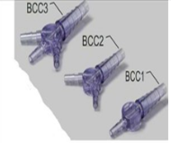
No Picture

Slide 39



Slide 40
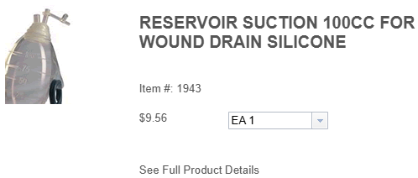
No Picture

Slide 41

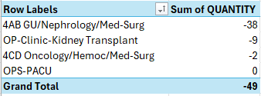

Slide 42
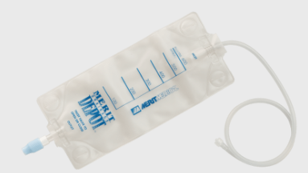
No Picture

Slide 43



