Slide 1

Procedural & Surgical cva august 2026 meeting

Slide 2

AUGUST AGENDA
Galaxy Robot – Dr. Turner
Illuminoss – Dr. Sanford
Paradise Renal Denervation System – Dr. Cooper
Symvess Recap Discussion

Slide 3
GALAXY bronchoscopy system clinical champion(s):
- dr. TURNER vendor: Noah medical
FDA Approval: 12-19-17
The Request: approval for trial

Slide 4
ANY CONFLICTS OF INTEREST?

Slide 5
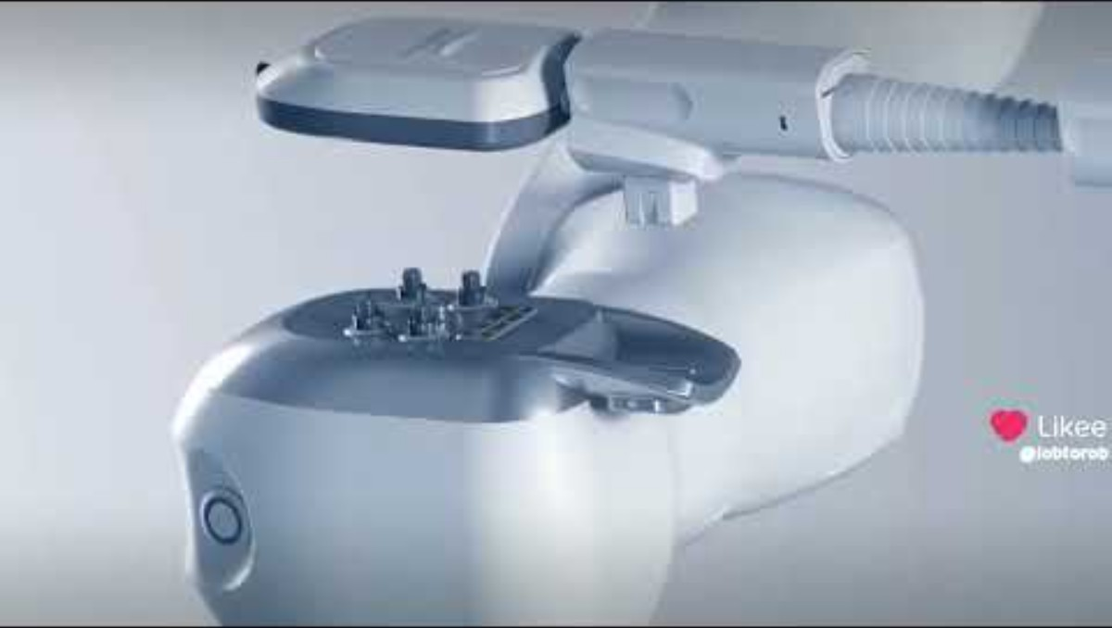
Product overview

Slide 6
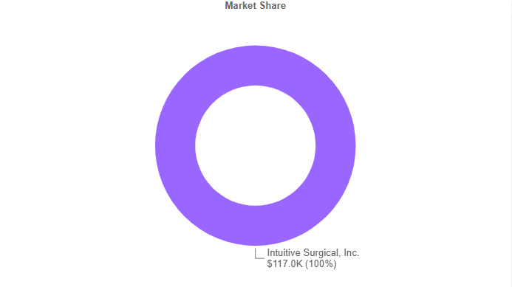
Supply Chain Information
Product Segment: image-guided navigation bronchoscopy
Dual 80/20 vendor Space (Stryker/J&J)
$1.9 million Spend (Annual)
No contract breach risks

Slide 7
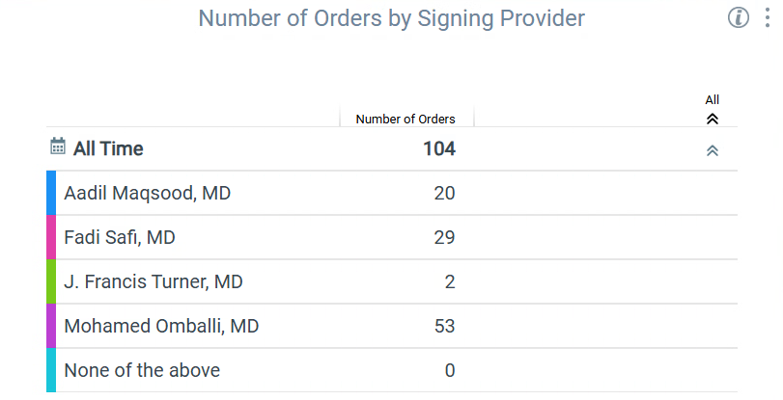
Physician utilization mix – Robotic bronchoscopy
Data Pull (AUGUST/2025 – JULY/2026)

Slide 8
Ion vs Galaxy Cost Comparison
ION (INTUITIVE)
GALAXY (NOAH MEDICAL)
Endoluminal Enhanced Vision Probe: $900.00/case
Annual Service Fee: $60,000.00
UTMC Owned System
GAP PROGRAM:
$2,000/case
No additional fees (1st year)
12 months
110 target case volume (no true up)
$69,500 annual fee after 1st year
PURCHSE:
GALAXY SYSTEM: $625,000.00
DISPOSABLES: $2,200/KIT
RENTAL:
$10,000/MONTH
DISPOSABLES: $2,000/KIT

Slide 9
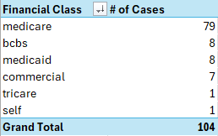
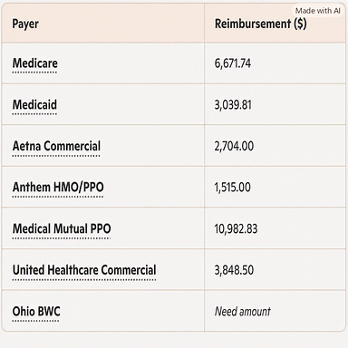
Reimbursement (OUTPATIENT)
Bronchoscopy Cases w/ION

Slide 10
IlluminOss clinical champion(s):
- dr. Sanford vendor: illuminoss medical
FDA Approval: 12-19-17
The Request: approval for trial

Slide 11
ANY CONFLICTS OF INTEREST?

Slide 12
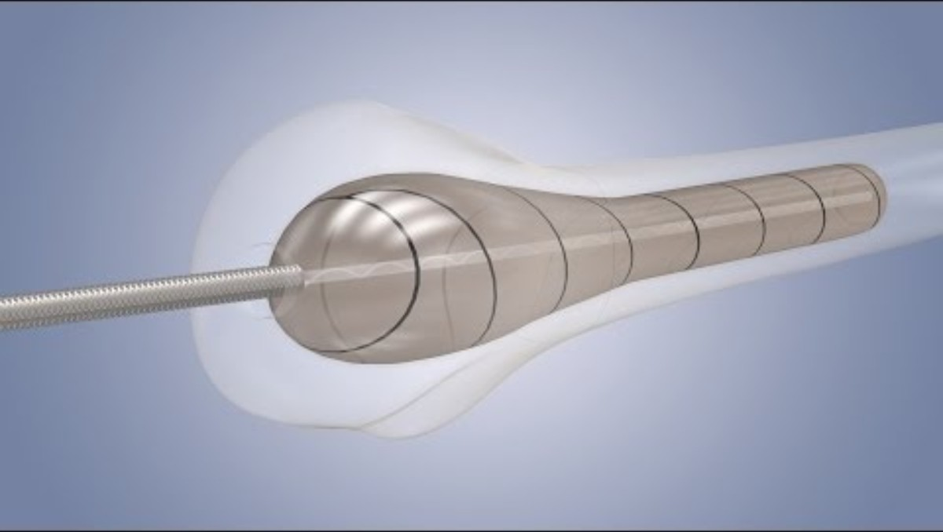
Product overview

Slide 13
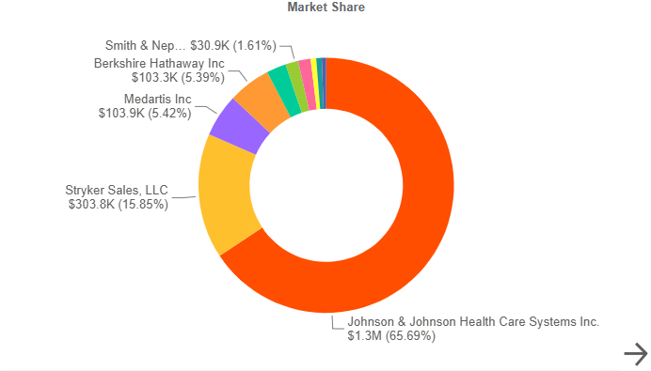
Supply Chain Information
Product Segment: trauma
Dual 80/20 vendor Space (Stryker/J&J)
$1.9 million Spend (Annual)
No contract breach risks

Slide 14
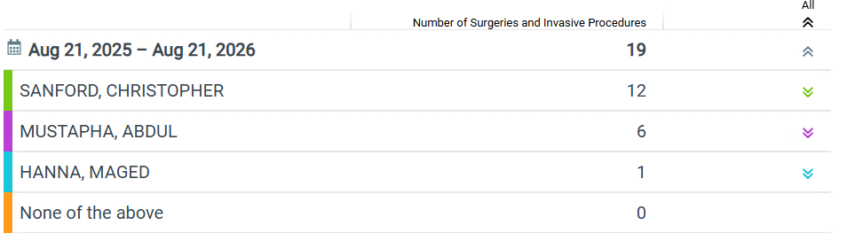
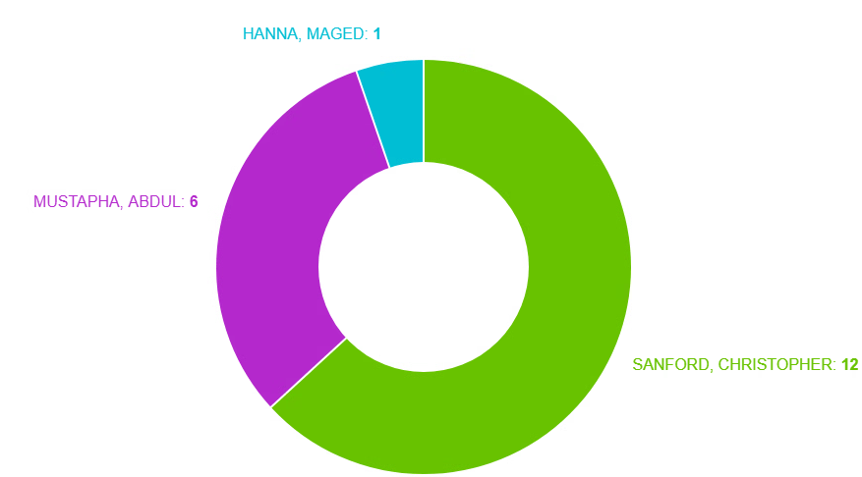
Physician utilization mix – ORIF, fracture, humerus, proximal
Data Pull (August/2025 – August/2026)

Slide 15
Illuminoss Cost vs current practice
Current Practice Pricing:
Illuminoss Component Pricing:
(multiple sizes) Bone Screws: Pricing varies
(x1) Bone Plate: $2,040.00 - $2,625.00
(multiple sizes) Drill Bit: Pricing Varies
(Certain Cases) Guidewire: $105.00
Median Trauma Item Total: $5,064.00
(x1) Illuminoss Kit: $5,300.00 - $6,000.00 (Size Dependent)
(x1) Scoring Tool: $139.00
(x1) Guidewire: $148.00
Illuminoss Total: $5,587 - $6,287
Est. $523 - $1,223 increase per procedure

Slide 16
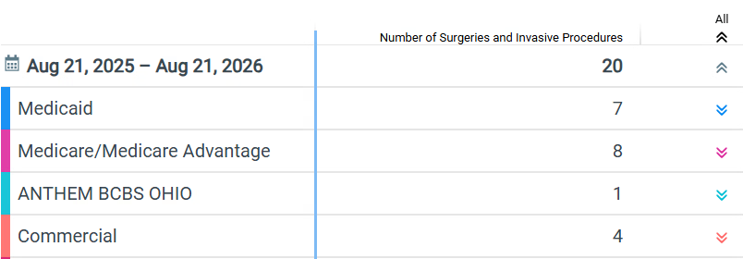
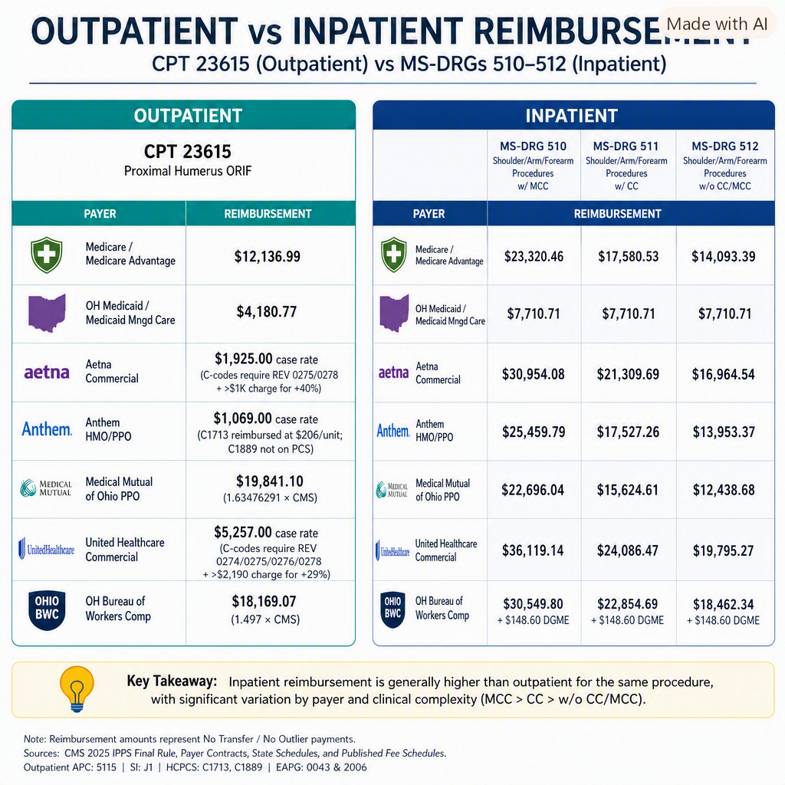
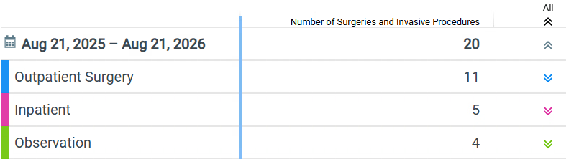
Reimbursement

Slide 17
Paradise renal denervation system clinical champion(s):
- dr. Cooper vendor: recor medical
FDA Approval: 11-7-23
The Request: approval for trial

Slide 18
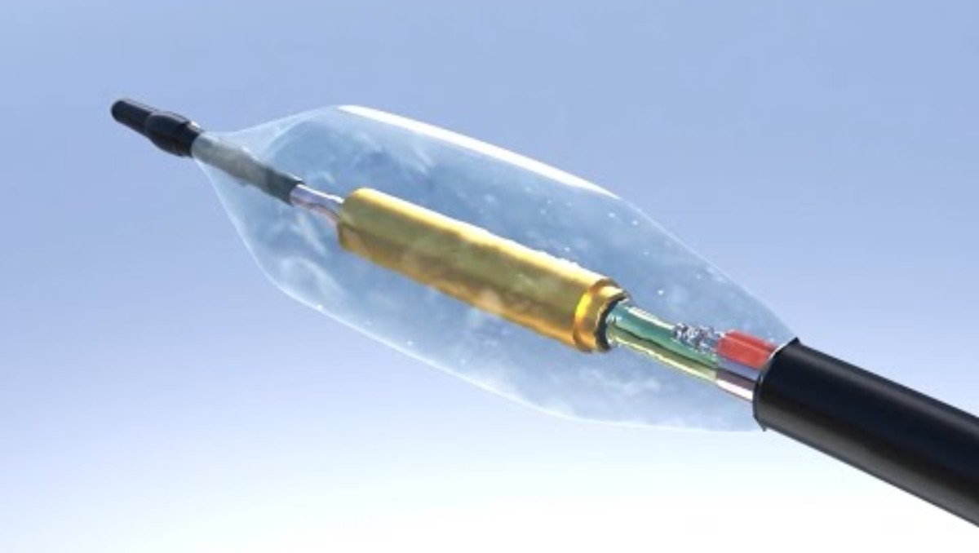
Product overview

Slide 19
ANY CONFLICTS OF INTEREST?

Slide 20
Supply Chain Information
Vizient contract category: renal denervation
No Vcc for renal denervation
Vizient spend category: coronary vascular products and accessories
No contract breach risks
NONE

Slide 21
Physician utilization mix – renal denervation
Data Pull (May/2025 – April/2026)
NEW PROCEDURE

Slide 22
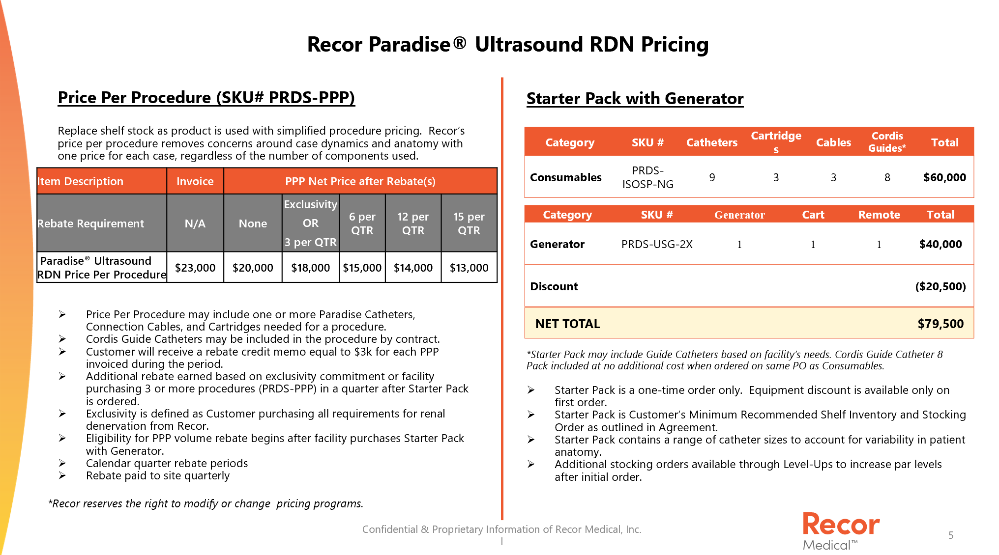
Recor paradise Cost
Trial Pricing:
Long-Term Pricing:
Per Procedure Purchase: $18,000.00
All equipment is brought in on a per case basis including generator.

Slide 23
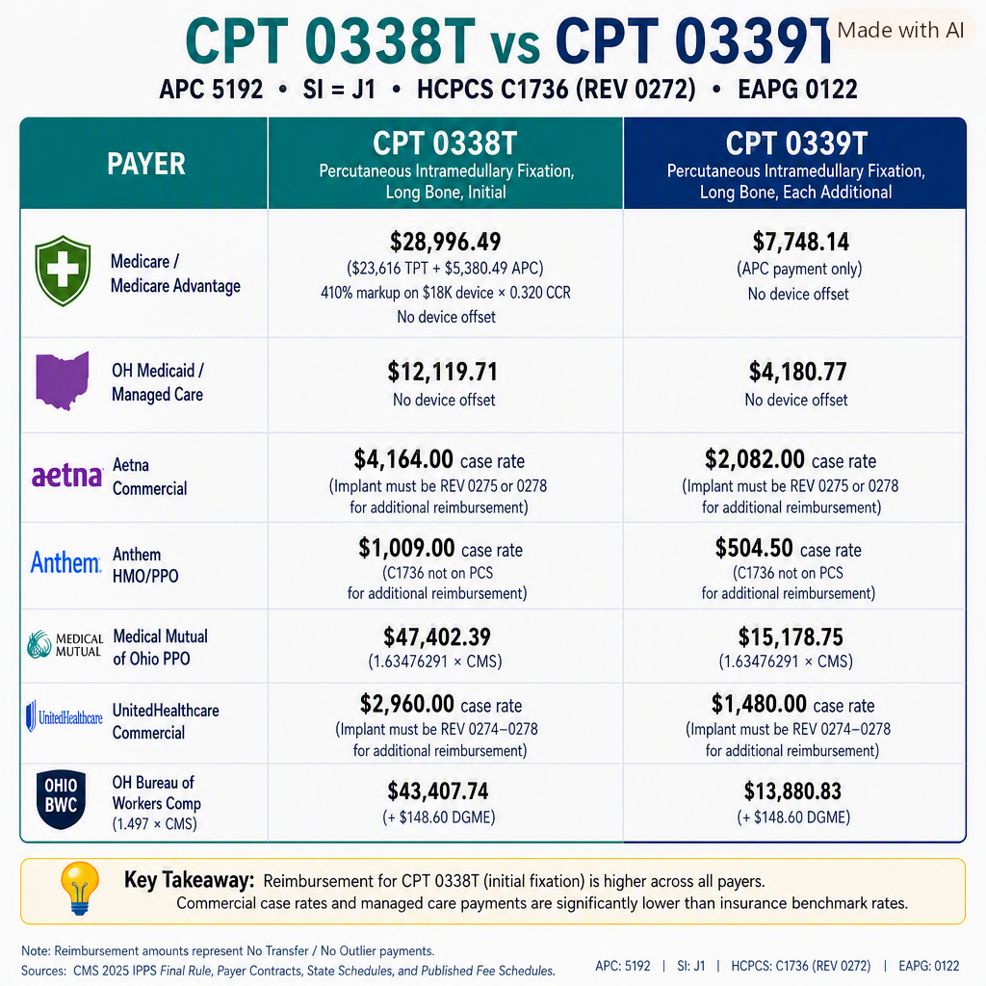
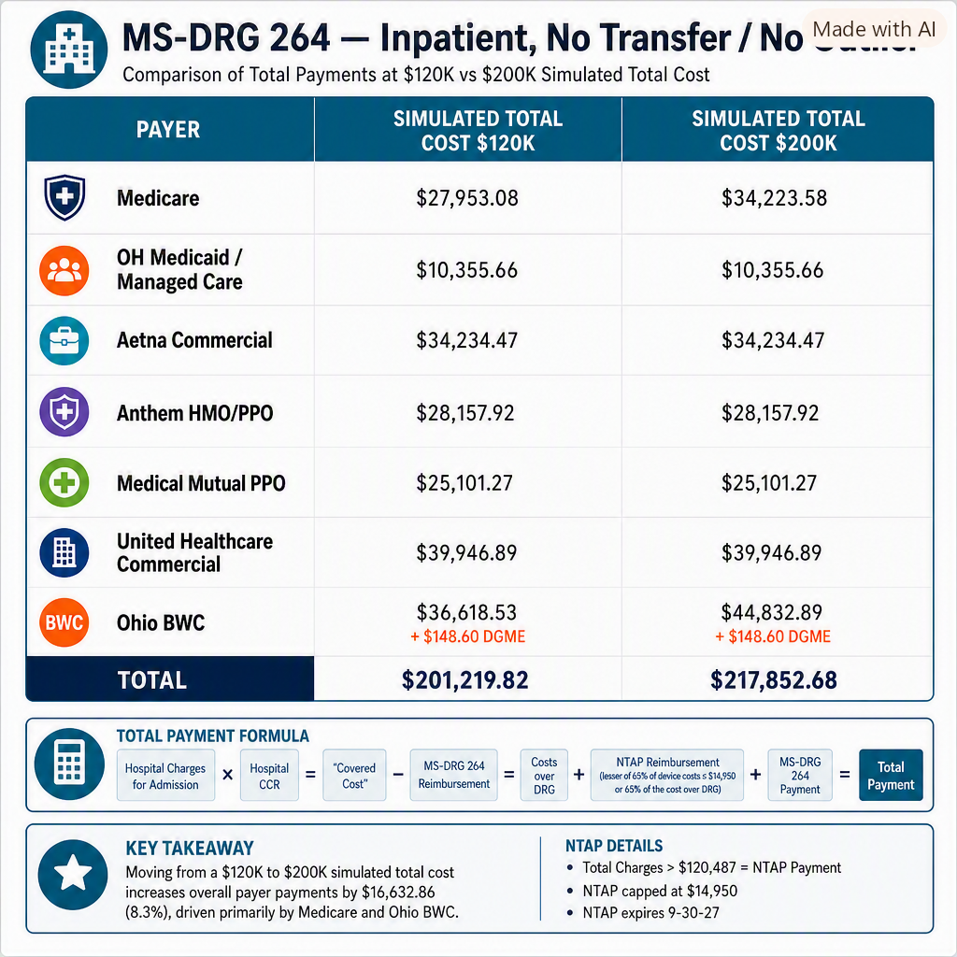
Reimbursement (outpatient)
Reimbursement
Reimbursement (INPATIENT)

Slide 24
Symvess pricing discussion clinical champion(s):
- dr. Cuddy vendor: humacyte
The Request: permanent placement

Slide 25
Symvess Pricing programs
Bulk Purchase Discount
Buy 2 at normal price, 3rd is discounted 50% = $42,500 which equals $14,167 per unit
Documentation
Eric will send quote with Full Shipper Discount Topic
Process
Processed per normal shipping and invoicing with discounts included
Price at initial purchase savings, not a credit
Price Capitated Program
If the repair calls for a composite and/or two vessels are needed
Two vessels: cap at $27.5K
$6500 credit toward future spend applied to account
Reduced Length, Reduced Price
If less than 20cm is used, cost is $10K
Documentation
Patient card must be completed in full and sent to customercare@humacyte.com
Subject- Reduced Length (Account Name)
Process
Card sent to Customer Care
$7000 credit toward future spend applied to account
Invoice sent per normal contracted terms
Patient card needs to be filled out in its entirety
This program will be sunset as soon as we have shorter sizes commercially available.

Slide 26
Symvess Partnership Pricing
Re: Symvess (acellular tissue engineered vessel) — Discounted Pricing Offer, Calendar Year 2026
Under this offer, Symvess will be made available at a discounted price of $10,000 per unit, a reduction of $7,000 from the standard price of $17,000 per unit. The discount applies to all units ordered during the offer term:
This pricing is extended in consideration of the following commitments:
Par Level of 3. UTMC will maintain a par level of three units.
Sustained utilization. A replenishment cadence averaging approximately one (1) unit per week reviewed on a quarterly basis
Term. Effective till December 31, 2026
Following the 2026 term Humacyte will conduct a business review and if the utilization levels have been met Humacyte may extend this pricing. This offer is contingent upon the order commitments described above and is otherwise subject to Humacyte’s standard terms and conditions of sale.

Slide 27
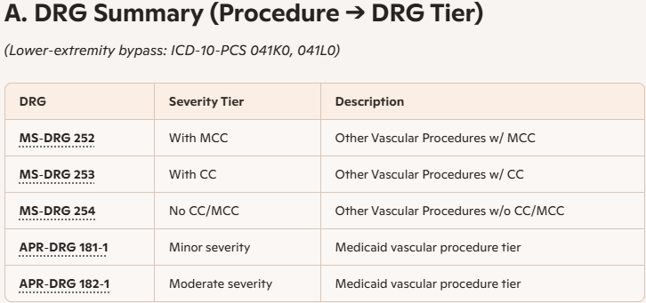
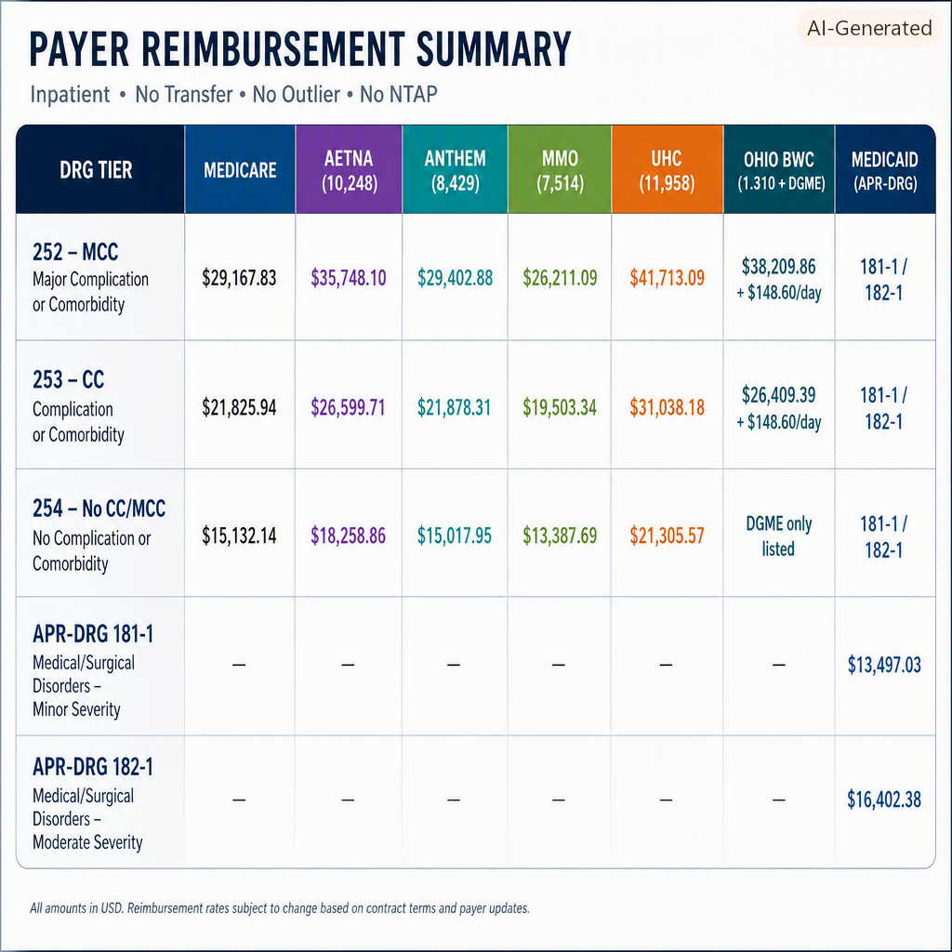
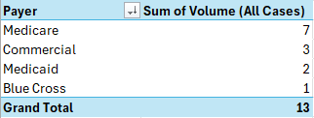
Reimbursement

