Slide 1

Nursing and patient care cva JUNE - 2026 meeting

Slide 2

APRIL recap
WOUND CARE (X2) - APPROVED
BOWEL MANAGEMENT SYS. (X2) - APPROVED
WOUND DRAINAGE (X11) – UNDER REVIEW WITH O.R.

Slide 3
JUNE AGENDA
ADV. WOUND CARE - (Update)
OXIVIR TRIAL - (Update)
TEMP. SENSING PROBES – (COMMITTEE REVIEW)
SURG, EQUIP. COVERS - (COMMITTEE REVIEW)
FLOWMETERS & REGULATORS – (COMMITTEE REVIEW)
SOFTGOODS & SPORTS BRACING – (COMMITTEE REVIEW)

Slide 4
TEMP SENSING PROBES - COMMITTEE REVIEW

Slide 5
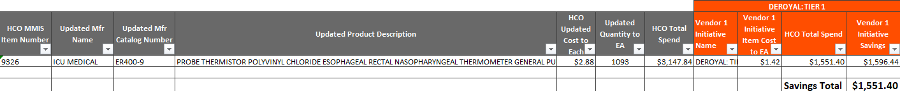
TEMP SENSING PROBES (X1 SKU)

Slide 6


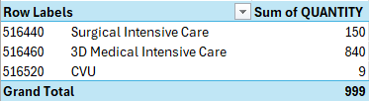
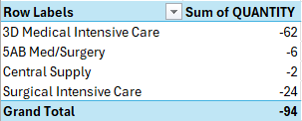
L# 9326

Slide 7
SURG. EQUIPMENT COVERS - COMMITTEE REVIEW

Slide 8
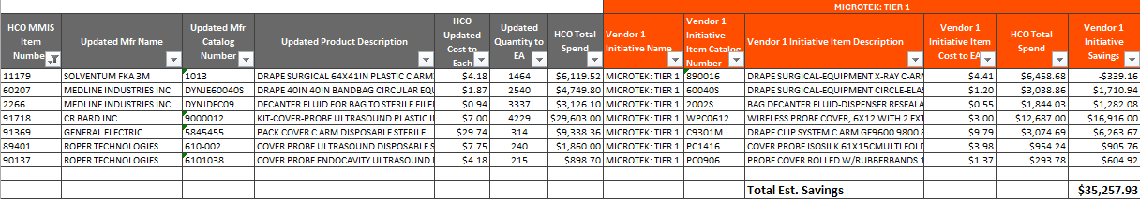
SURG. EQUIPMENT COVERS (x7 sku)

Slide 9

No Inventory for this item
L# 11179

Slide 10
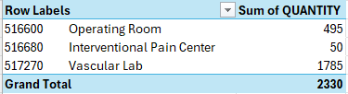

L# 60207

Slide 11

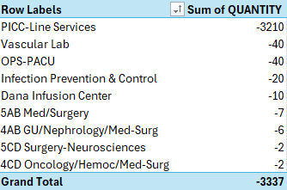
L# 2266

Slide 12
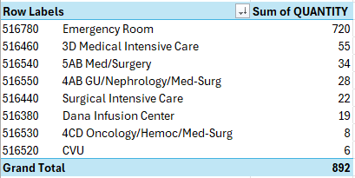

L# 91718

Slide 13


L# 91369

Slide 14

L# 89401

Slide 15

L# 90137

Slide 16
FLOWMETERS & REGULATORS - COMMITTEE REVIEW

Slide 17
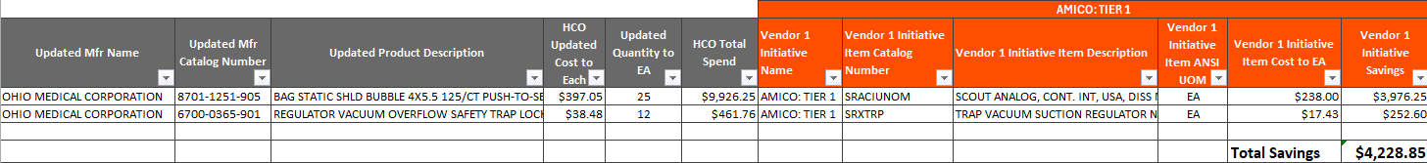
FLOWMETERS & REGULATORS (X2 SKU)

Slide 18
No Inventory for this item
L# 61294

Slide 19

L# 92127

Slide 20
softgoods and sports bracing - COMMITTEE REVIEW

Slide 21
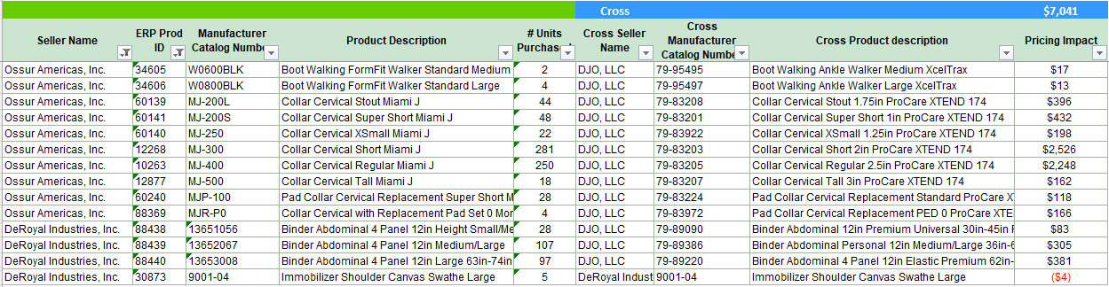
Softgoods and sports bracing (X14 SKU)

Slide 22
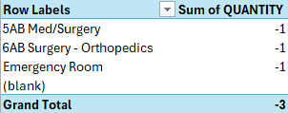
L# 34605

Slide 23

L# 34606

Slide 24

L# 60139

Slide 25

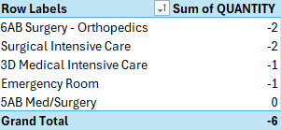
L# 60141

Slide 26

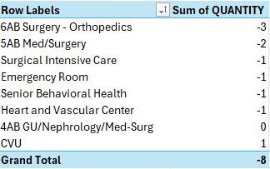
L# 60140

Slide 27

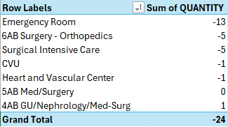
L# 12268

Slide 28

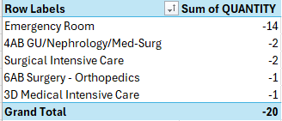
L# 10263

Slide 29

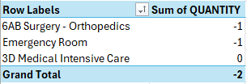
L# 12877

Slide 30
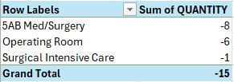
L# 60240

Slide 31
No Inventory for this item
L# 88369

Slide 32

L# 88438

Slide 33

L# 88439

Slide 34
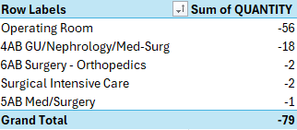
L# 88440

Slide 35
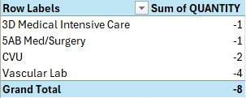
L# 30873

