Slide 1

Nursing and patient care cva October 2025 meeting

Slide 2

SEPTEMBER Agenda recap
DURABLE MEDICAL EQUIPMENT (APPROVED)
BOWEL MANAGEMENT (GO TO NPC)
TRAY THORACENTESIS (DENIED)
DISPOSABLE ECG WIRES (ON HOLD)
SURFACE CLEAN WIPES (TRIAL COMPLETE)
SAGE HEEL PROTECTOR BOOTS (TRIAL COMPLETE)

Slide 3
Agenda
QTR REVIEW TO DATE (JULY-SEPTEMBER)
POST TRIAL COMMITTEE DETERMINATION (2)
OXIVIR DISCUSSION

Slide 4
Review Date | Item | Est. Savings (Annually)
July | Stethoscopes | $2,109.36
July | Phlebotomy Tourniquet | $5,108.04
July | Hot/Cold Pack | $577.84
August | Alcohol Prep Pad | $1,052.41
August | Evac Container (1000ml) | $587.52
August | Pack, Warm, Gel | $2,983.19
September | Pail Commode | $3,529.55
September | Aluminum Crutch (Stand.) | $44.95
September | Aluminum Crutch (Lrg.) | $3.00
Total Savings To Date |  | $15,995.86

Slide 5
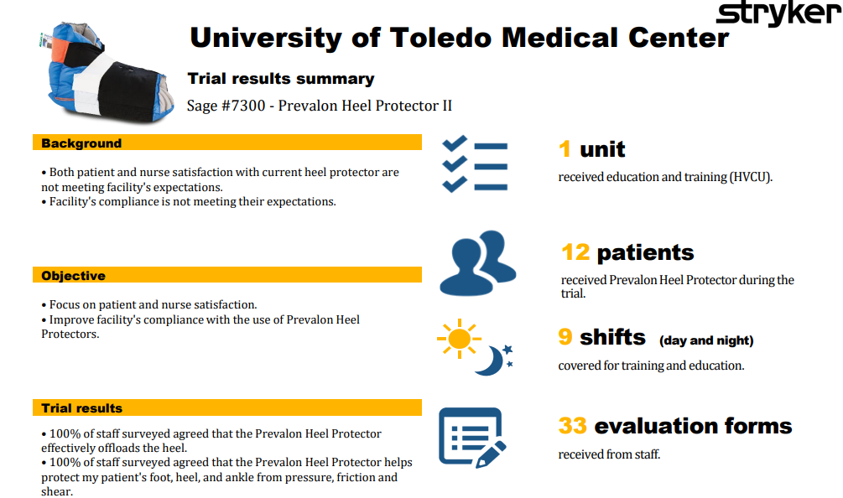

Slide 6
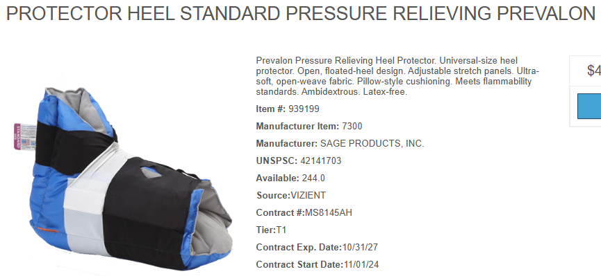
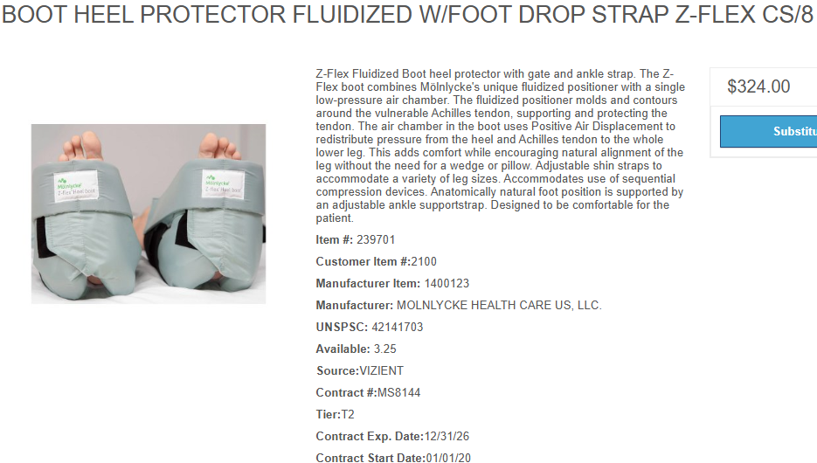

Slide 7
Current Annual Usage:
Lum: 0
Inventory: 655 EA
Total: 655 EA
Current Product:
Manufacturer: Molynycke
Pricing: $40.50/EA
Current Annual Spend: $26,527.50
New Product:
Manufacturer: Stryker Sage
Pricing: $41.88/EA
New Annual Spend: $27,431.40
2% Maint. rebate
3% Growth rebate
Grand Total Annual Spend: $26,059.83

Slide 8



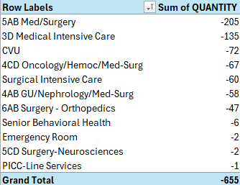

Slide 9
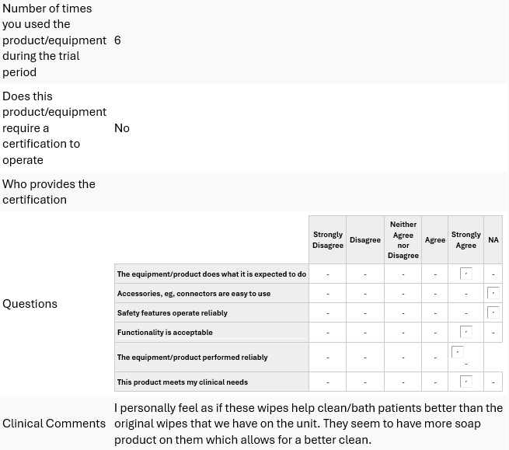
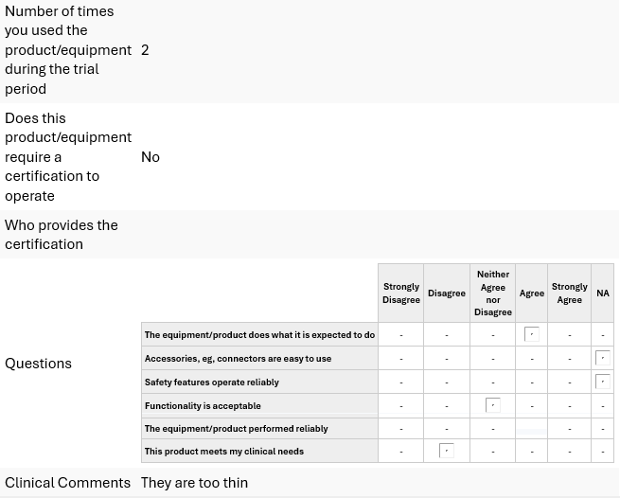

Slide 10
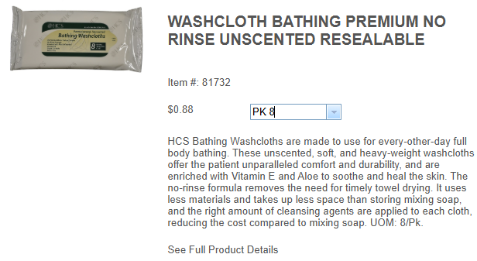
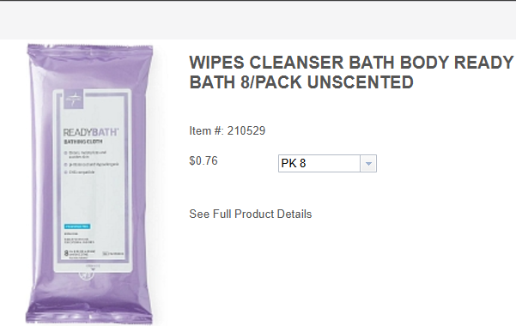

Slide 11
Current Annual Usage:
Lum: 32,675
Inventory: 5,021
Total: 37,696
Current Product:
Manufacturer: HCS
Pricing: $0.88/PK
Current Annual Spend: $33,172.48
New Product:
Manufacturer: Medline
Pricing: $0.762/PK
New Annual Spend: $28,724.35

Slide 12
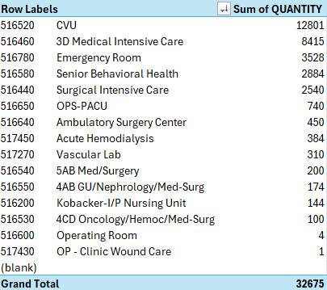
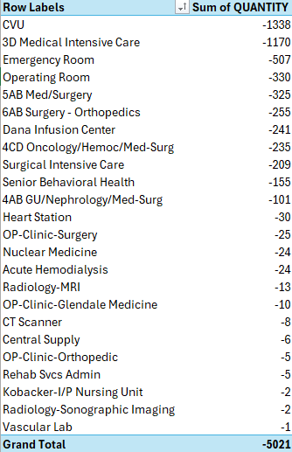

Slide 13
Super Sani-Cloth vs. Oxivir 1 Wipes
Feature | Super Sani-Cloth | Oxivir 1 Wipes
Active Ingredient | Quat + 55% Isopropyl Alcohol | Accelerated Hydrogen Peroxide (AHP)
EPA Dwell Time | 2 minutes for TB, SARS-CoV-2, C. auris | 1 minute for TB, SARS-CoV-2, C. auris
Short Contact Time Kills | Some enveloped viruses <2 min (e.g., HIV 30s, SARS-CoV-2 1 min) | Multiple 30s kills (HIV, HBV, HCV, Trichophyton); some 10s sanitizer claims
Residue/Surface Impact | Quick dry, may streak, can damage plastics/screens | Low residue, safer for plastics and monitors
Compliance Risk | High—often dries <2 min; reapplication required | Low— often stays wet for full 1-min dwell

Slide 14
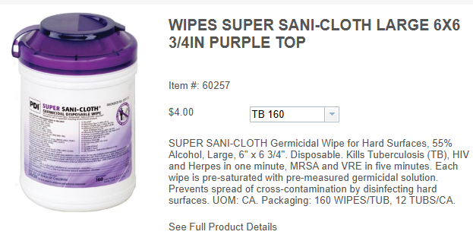
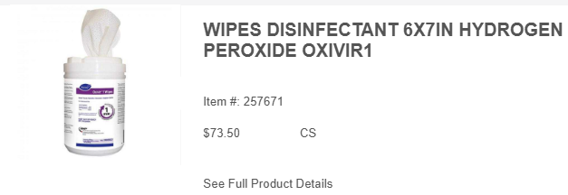

Slide 15
Current Annual Usage:
Lum: 4654
Inventory: 2440
Total: 7,094
Current Product: SANI CLOTH
Manufacturer: PDI
Pricing: $4.00/TB
UOM: 160 Wipes/TB
Current Annual Spend: $28,376.00
New Product: OXIVIR 1
Manufacturer: Diversey
Pricing: $6.13/TB
UOM:160 Wipes/TB
New Annual Spend: $43,486.22
New Product: OXIVIR EXP
Manufacturer: Diversey
Pricing: $6.64
UOM: 220 Wipes/TB
New Annual Spend: $35,310.31

Slide 16
