Slide 1

Commit Taskforce SEPTEMBER 2025 meeting

Slide 2

August Agenda recap
EVAC CONTAINERS (1) (Approved)
MEDICAL SKIN PREP PADS (1) (Approved)
PATIENT CLEANSING (1) (Trial Ongoing)
HEEL BOOT PROTECTOR (1) (Trial Ongoing)
HOT AND COLD PACK (2) Approved/Denied
PATIENT PLASTICS (Multiple) (Denied)

Slide 3
Agenda
DURABLE MEDICAL EQUIPMENT (3)
BOWEL MANAGEMENT (2)
TRAY THORACENTESIS KIT (1)
SURFACE CLEAN WIPES (Trial Requested)
DISPOSABLE ECG Wires (Trial Requested)
NURSING & PATIENT CARE CVA ANNOUNCEMENT

Slide 4
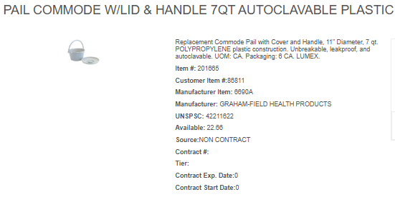
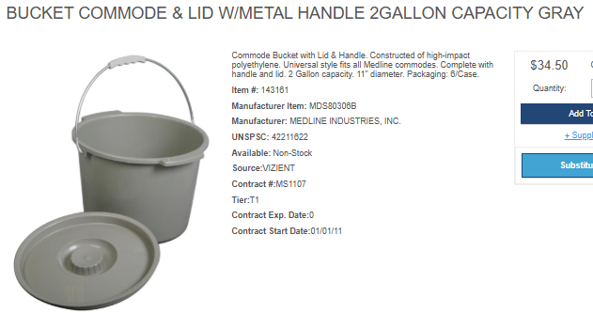

Slide 5
Current Annual Usage:
Lum: 680
Inventory: 287
Total: 967 EA
Current Product:
Manufacturer: Graham-Field Health
Pricing: $8.15 EA
Current Annual Spend: $7,881.05
New Product:
Manufacturer: Medline
Pricing: $4.50 EA
New Annual Spend: $4,351.5

Slide 6


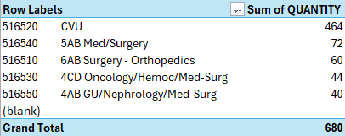
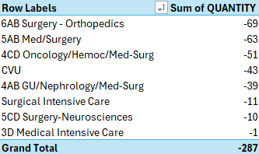

Slide 7
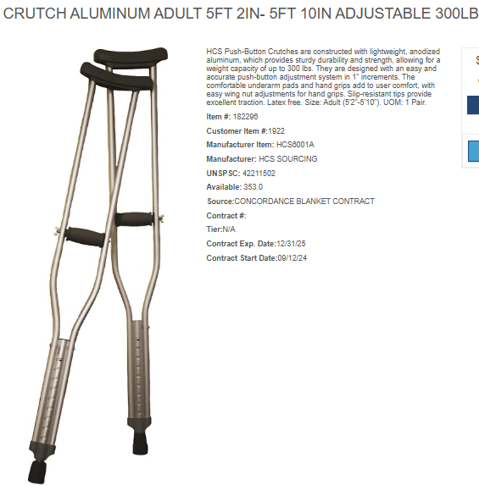
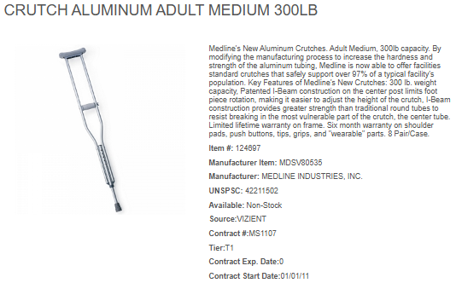

Slide 8
Current Annual Usage:
Lum: 0 EA
Inventory: 29 EA
Total: 29 EA
Current Product:
Manufacturer: HCS Sourcing
Pricing: $8.08 EA
Current Annual Spend: $234.32
New Product:
Manufacturer: Medline
Pricing: $6.53 EA
New Annual Spend: $189.37

Slide 9



Slide 10
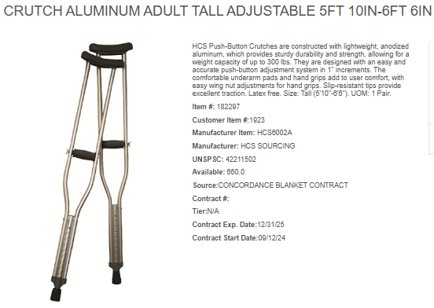
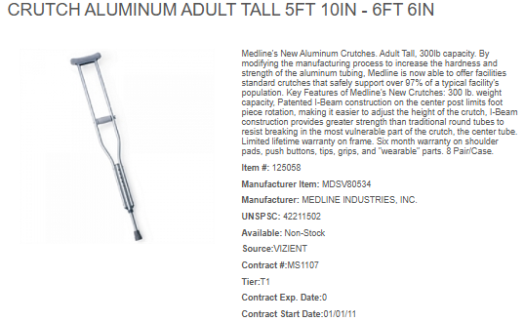

Slide 11
Current Annual Usage:
Lum: 1 EA
Inventory: 1 EA
Total: 2 EA
Current Product:
Manufacturer: HCS Sourcing
Pricing: $8.75 EA
Current Annual Spend: $17.5
New Product:
Manufacturer: Medline
Pricing: $7.25 EA
New Annual Spend: $14.5

Slide 12



Slide 13
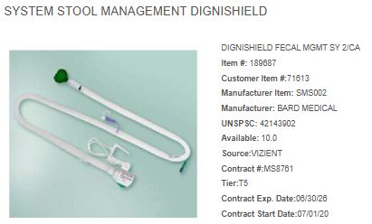
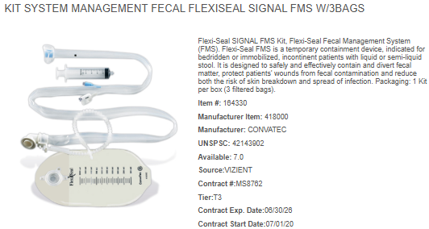
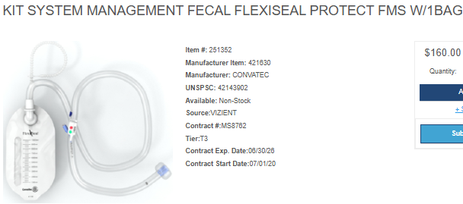

Slide 14
Current Annual Usage:
Lum: 219 EA
Inventory: 54 EA
Total: 273 EA
Current Product:
Manufacturer: BD/Bard
Pricing: $135.00/EA
Current Annual Spend: $36,855.00
New Product: Flexi-Seal Signal
Manufacturer: ConvaTec
Pricing: $107.00/EA
New Annual Spend: $29,211.00
New Product: Flexi-Seal Protect
Manufacturer: ConvaTec
Pricing: $110.00/EA
New Annual Spend: $30,030.00

Slide 15
Row Labels | Sum of QUANTITY
516460 3D Medical Intensive Care | 153
516440 Surgical Intensive Care | 31
516520 CVU | 23
516780 Emergency Room | 12
(blank)
Grand Total | 219
Row Labels | Sum of QUANTITY
5AB Med/Surgery | -21
3D Medical Intensive Care | -14
4AB GU/Nephrology/Med-Surg | -9
6AB Surgery - Orthopedics | -3
Surgical Intensive Care | -2
CVU | -2
Emergency Room | -1
Operating Room | -1
4CD Oncology/Hemoc/Med-Surg | -1
Grand Total | -54

Slide 16
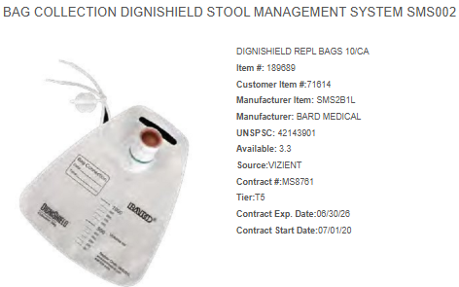
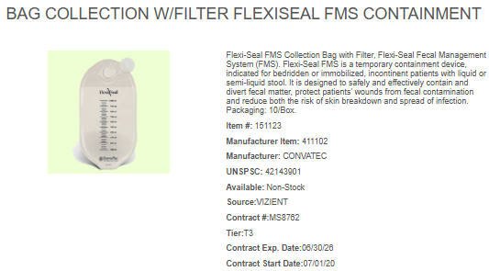
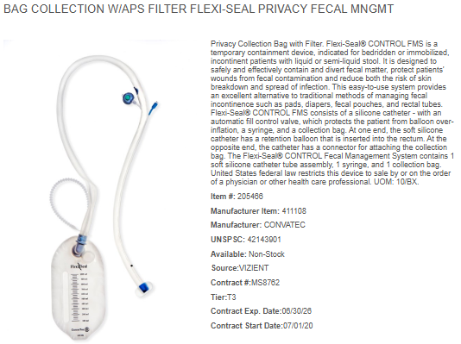

Slide 17
Current Annual Usage:
Lum: 332 EA
Inventory: 82 EA
Total: 414 EA
Current Product:
Manufacturer: BD/Bard
Pricing: $4.65/EA
Current Annual Spend: $1,925.10
New Product: Flexi-Seal Transparent Replacement Bags
Manufacturer: ConvaTec
Pricing: $3.50/EA
New Annual Spend: $1,449.00
New Product: Flexi-Seal Privacy Replacement Bags
Manufacturer: ConvaTec
Pricing: $3.50/EA
New Annual Spend: $1,449.00

Slide 18
Row Labels | Sum of QUANTITY
516460 3D Medical Intensive Care | 278
516520 CVU | 32
516440 Surgical Intensive Care | 22
(blank)
Grand Total | 332
Row Labels | Sum of QUANTITY
5AB Med/Surgery | -49
4AB GU/Nephrology/Med-Surg | -12
3D Medical Intensive Care | -7
CVU | -7
5CD Surgery-Neurosciences | -4
Surgical Intensive Care | -3
Grand Total | -82

Slide 19
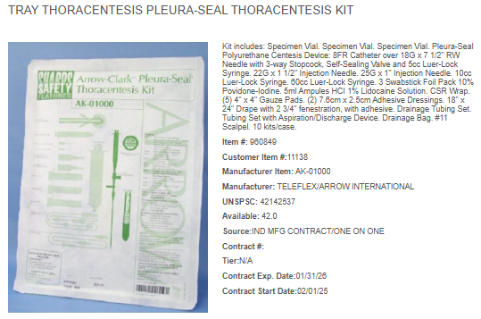
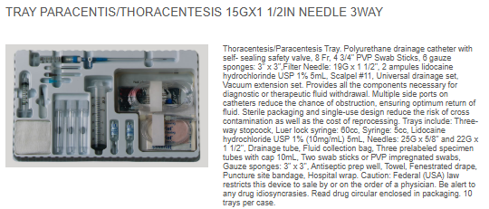

Slide 20
Current Annual Usage:
Lum: 90 EA
Inventory: 41EA
Total: 131 EA
Current Product:
Manufacturer: Teleflex
Pricing: $55.77/EA
Current Annual Spend: $7,305.87
New Product:
Manufacturer: Carefusion
Pricing: $26.57/EA
New Annual Spend: $3,480.67

Slide 22
Super Sani-Cloth vs. Oxivir 1 Wipes
Feature | Super Sani-Cloth | Oxivir 1 Wipes
Active Ingredient | Quat + 55% Isopropyl Alcohol | Accelerated Hydrogen Peroxide (AHP)
EPA Dwell Time | 2 minutes for TB, SARS-CoV-2, C. auris | 1 minute for TB, SARS-CoV-2, C. auris
Short Contact Time Kills | Some enveloped viruses <2 min (e.g., HIV 30s, SARS-CoV-2 1 min) | Multiple 30s kills (HIV, HBV, HCV, Trichophyton); some 10s sanitizer claims
Residue/Surface Impact | Quick dry, may streak, can damage plastics/screens | Low residue, safer for plastics and monitors
Compliance Risk | High—often dries <2 min; reapplication required | Low— often stays wet for full 1-min dwell

