Slide 1

Procedural & Surgical cva FEBRUARY 2026 meeting

Slide 2

FEBRUARY AGENDA
What is CVA?
Procedural & Surgical CVA Team
Meeting Cadence and Times
Example Request Summary
March Requests for Review

Slide 3
What is clinical value analysis???
A cross-functional team of medical and administrative staff that serves as a bridge between clinical and operational departments at UTMC, aligning clinical initiatives, medical equipment, and supply requests with the University’s mission and core values.
An organized forum for stakeholders to systematically evaluate and prioritize requests.
An executive led governance structure that ensures decisions are aligned with institutional strategy, leadership priorities, and financial stewardship.

Slide 4
Clinical Value analysis Governance STRUCTURE
Executive Oversight Committee
Nursing & Patient Care CVA Team
Surgical Services
Cardiovascular Lab
Clinical Leadership
Finance
Infection Prevention
Staff Development
Supply Chain
Radiology
Materials Management
Legal
Rev Cycle
Nursing
Respiratory
Pathology/Lab
Infection Prevention
Staff Development
Supply Chain
Radiology
Surgical & Procedural Services CVA Team

Slide 5
???Meeting Location/ times/cadence???

Slide 6
Example request summary

Slide 7

Griplasty clinical champion: dr. skie vendor: field orthopedics

Slide 8
PRODUCT OVERVIEW Griplasty™ System – Base of Thumb (BoT) with Needles
Treats advanced first CMC joint osteoarthritis; relieves pain and restores thumb stability/strength
Single-incision procedure (volar or dorsal); compatible with trapeziectomy or tendon transfer
V-Sling design provides broad support to reduce first metacarpal migration
Far-cortex anchor deployment enhances pull-out strength
Innovative deployment guidance enables precise and reproducible placement
Outpatient-compatible; supports flexible surgical workflow

Slide 9
Indications for use
Hand/Wrist: Tendon & ligament repair, carpometacarpal arthroplasty, digital transfers
Elbow/Shoulder/Knee: Tendon and ligament repair, joint stabilization
Foot/Ankle: Ligament/tendon repair, mid-foot and hallux reconstruction

Slide 10
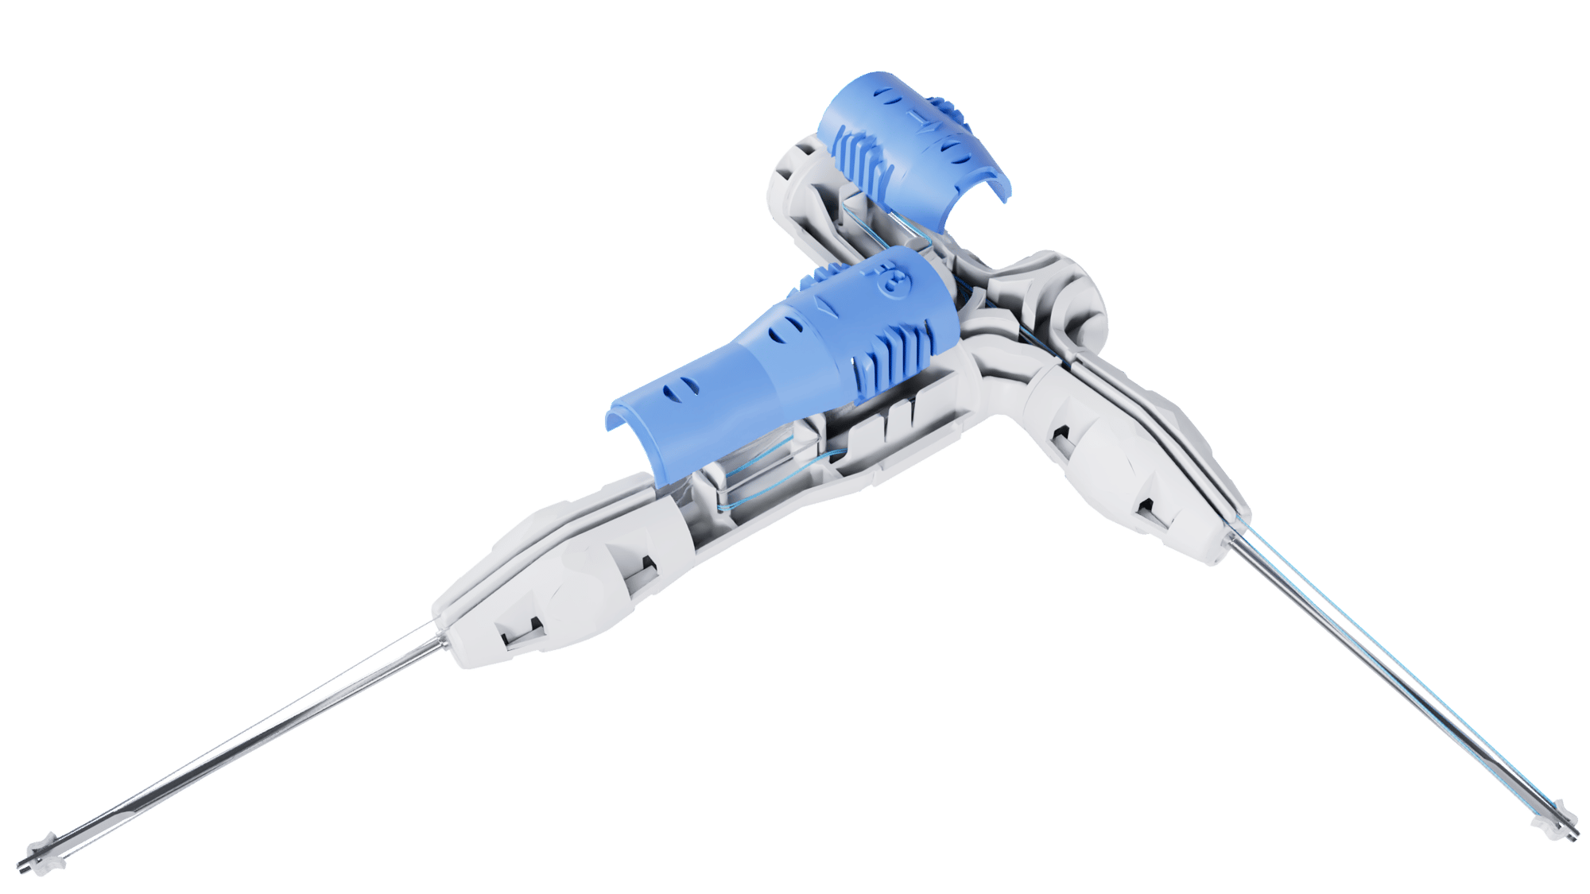
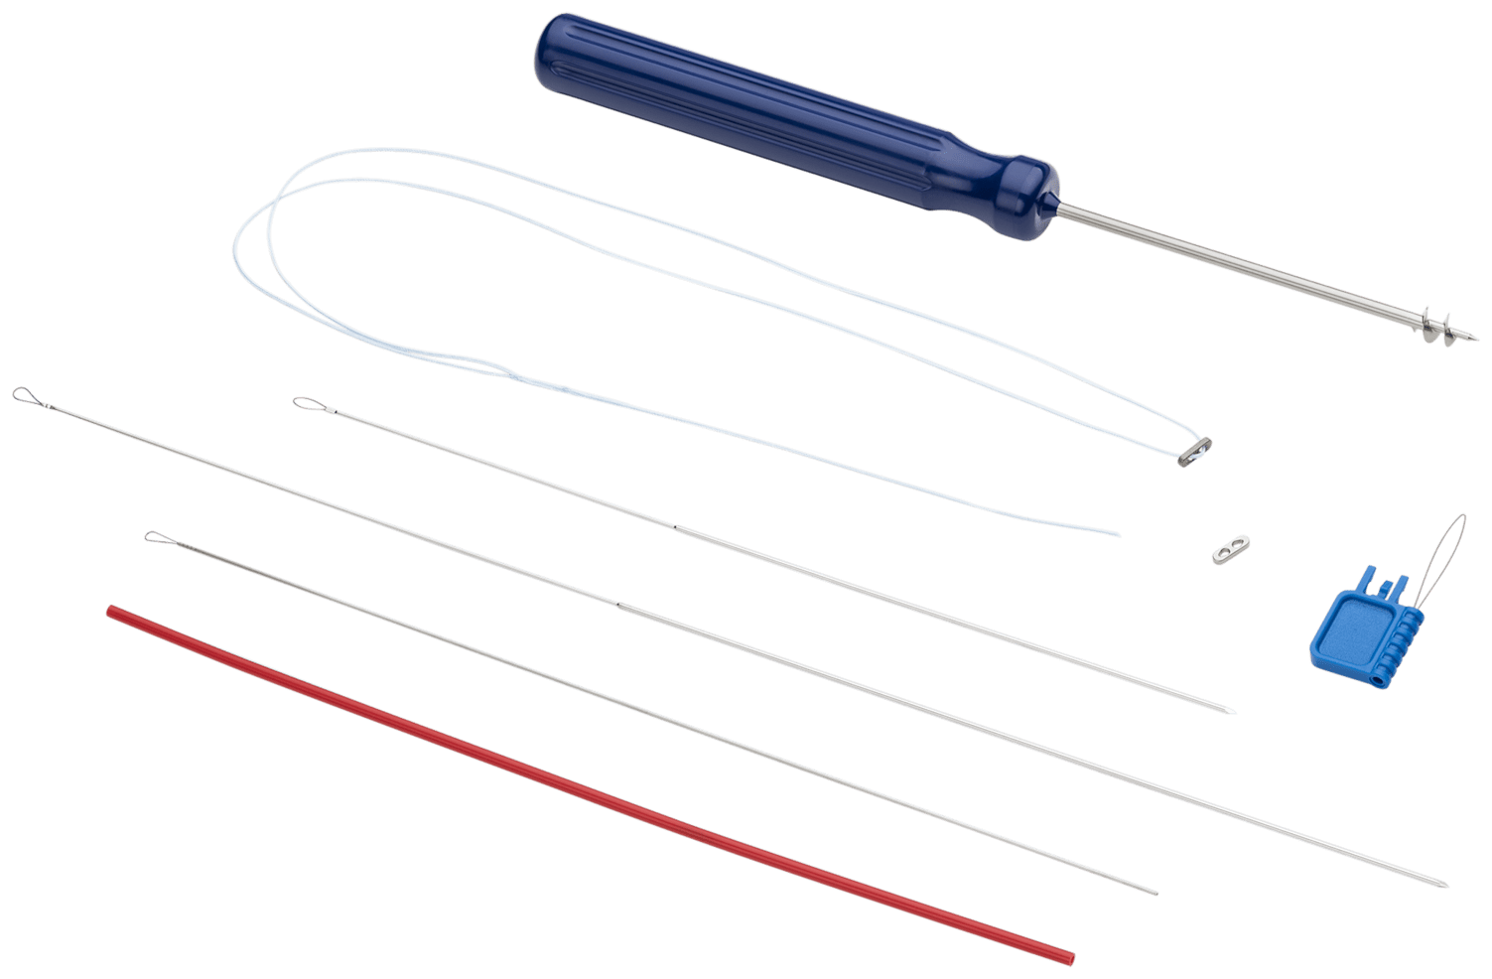
Product information
CMC Mini Tightrope, 1.1mm
Griplasty
Part# AR-8919DS
Vendor: Arthrex
GTIN: 0088867048966
FDA Approval Date: 3-18-2014
Cost: $1,279/EA
No Inventory Commitment (Bill-Only)
Part# GPBOTN
Vendor: Field Orthopedics
GTIN: 9353903030003
FDA Approval Date: 9-12-2024
Cost: $1,600/EA
No Inventory Commitment (Bill-Only)

Slide 11
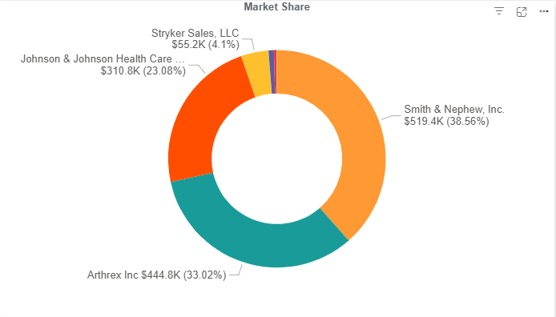
Supply Chain Information
Product Segment: Arthroscopy
Multi-Vendor Space
No Committed Spend
$1.3 Million Annual Spend

Slide 12
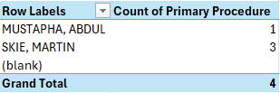
CASE SUMMARY
CPT 25447/25448 – Arthoplasty, intercarpal or carpometacarpal joints
Data Pull (December/2024 – November/2025)

Slide 13
Procedural cost impact
CMC MINI TIGHTROPE 1.1MM
GRIPLASTY
Pick Ticket (Avg): $308
Implant: $1,279
Total Supply Cost $1,587
Medicare Reimbursement: $3,097.63
Contribution Margin/Per Case: $1,510.63
Pick Ticket (Avg): $308
Implant: $1,600
Total Supply Cost: $1,908
Medicare Reimbursement: $3,097.63
Contribution Margin/Per Case: $1,189.63

Slide 14
ESTIMATED reimbursement
CPT 25448 – Arthoplasty, intercarpal or carpometacarpal joints
MEDICARE.MEDICARE ADV. = $3,097.63
OH MEDICAID/MEDICAID ADV. = Do not know EAPG
AETNA COMMERCIAL = $2,380
ANTHEM HMO/PPO = $891.00
MEDICAL MUTUAL OF OHIO = $5,056.37
UNITED HEALTHCARE = $2,874
OH BUREAU OF WORKERS COMP. = $4,637.15

Slide 15
March requests for review
SUBMISSIONS APPROVED FOR MARCH REVIEW:
Nanoknife – Ablation Device
Altaviva – Implantable Tibial Neuromodulation
eCoin – Peripheral Neurostimulator

