Slide 1

Procedural & Surgical cva JUNE 23rd 2026 meeting

Slide 2

JUNE 23rd AGENDA
June 8th Recap
Endovascular Graft(s) – Dr. Farid
Neurostimulator(s) – Dr. Escobar

Slide 3
WL Gore excluder
Cook Zenith iliac device clinical champion(s):
- Dr. farid vendor: WL Gore
FDA Approval: November 6, 2002
Vendor: COOK
FDA Approval: May 30, 2025
The request: permanent use

Slide 4
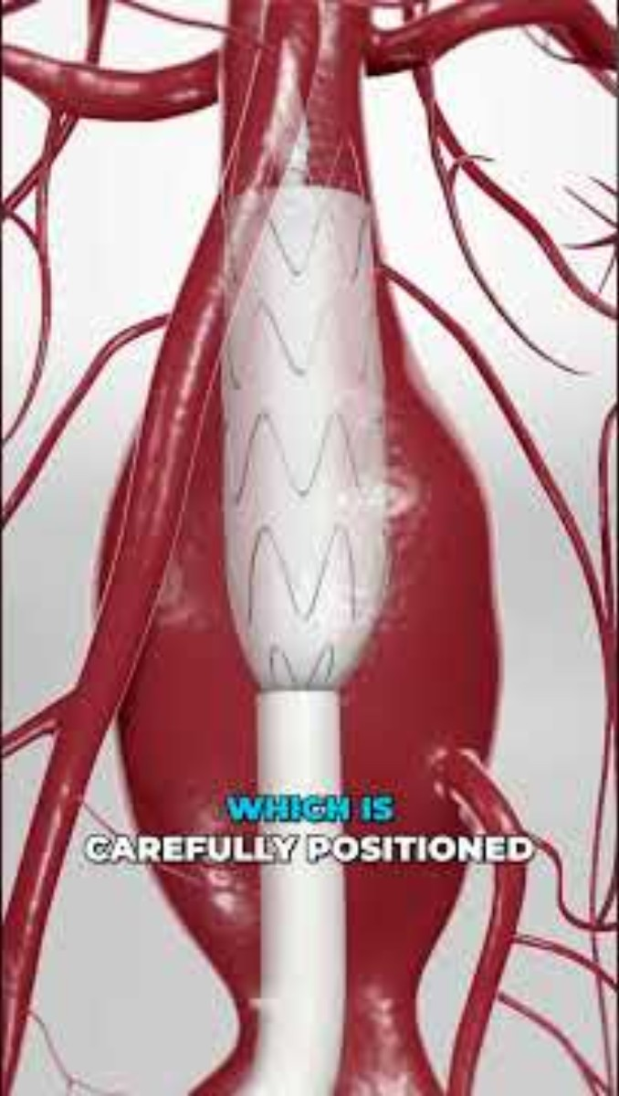
Product overview

Slide 5
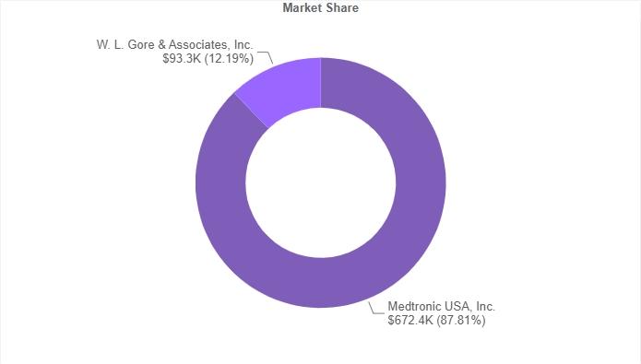
Supply Chain Information
Product Segment: Endovascular grafts
dual vendor Space
$765,700 Spend (Annual)
lc79703 – endo grafts (medtronic)
No contract breach risks

Slide 6


Physician utilization mix – endovascular aortic repair
Data Pull (April/2025 – March/2026)

Slide 7
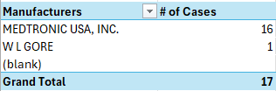
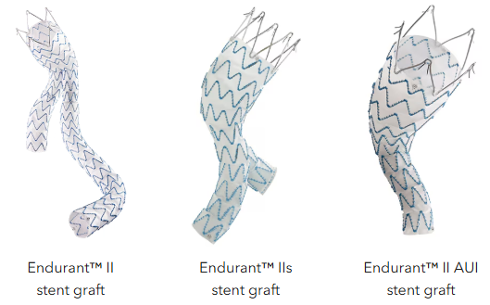
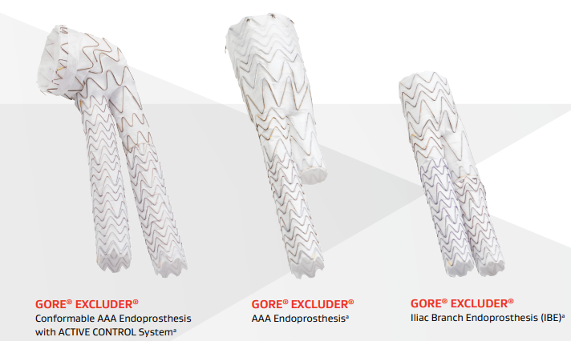
System Utilization Today
Data Pull (April/2025 – March/2026)

Slide 8
Implant cost COMPARISON
ENDURANT II (MEDTRONIC)
EXCLUDER (WL Gore)
ZENITH (Cook)
Standard 2-piece Endurant II EVAR for AAA
Standard 2-piece Excluder EVAR for AAA
Standard 2-piece Zenith EVAR for AAA
Main Body Aorta: $10,374.00
Contralateral limb: $5,382.00
TOTAL: $15,756.00
Main Body Aorta: $13,984.00
Contralateral limb: $5,885.00
TOTAL: $19,869.00
Main Body Aorta: $13,000.00
Contralateral limb: $5,500.00
TOTAL: $18,500.00
Standard 3 Piece Endurant II EVAR for AAA
Standard 3 Piece Excluder EVAR for AAA
Standard 3 Piece Zenith EVAR for AAA
Main Body Aorta: $10,374.00
Contralateral Limb: $5,382.00
Ipsilateral Limb Extension: $8,680.00
TOTAL: $24,436.00
Main Body Aorta: $13,984.00
Contralateral Limb: $5,885.00
Ipsilateral Limb Extension: $5,885.00
TOTAL: $26,125.00
Main Body Aorta: $13,000.00
Contralateral Limb: $5,500.00
Ipsilateral Limb Extension: $5,000.00
TOTAL: $23,500.00
Endurant II EVAR+IBE
Excluder Iliac Branch EVAR+IBE
Zenith Iliac Branch
NO DIRECT OFFERING
Main Body Aorta: $13,984.00
IBE Lliac Branch Component: $13,732.00
Internal Lliac Component: $3,883.00
Contralateral Bridging Limb: $5,885.00
TOTAL: $37,484.00
Proximal Body Aorta: $13,000.00
IBE Lliac Branch Component: $15,999.99
Internal Lliac Component: $5,500.00
Contralateral Bridging Limb: $5,500.00
TOTAL: $39,999.99

Slide 9
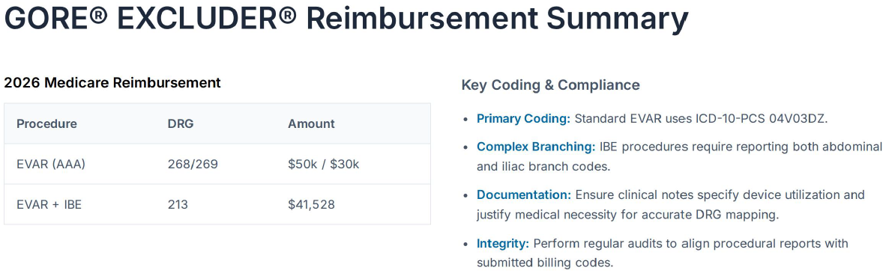

Slide 10
Mainstay medical stimulator reactiv8
Saluda Medical evoke system clinical champion(s):
- Dr. escobar new vendor: mainstay medical
FDA Approval: June 16, 2020 new vendor: SALUDA Medical Evoke System
FDA Approval: FEBRUARY 28, 2022
The request: trial

Slide 11

Product overview

Slide 12
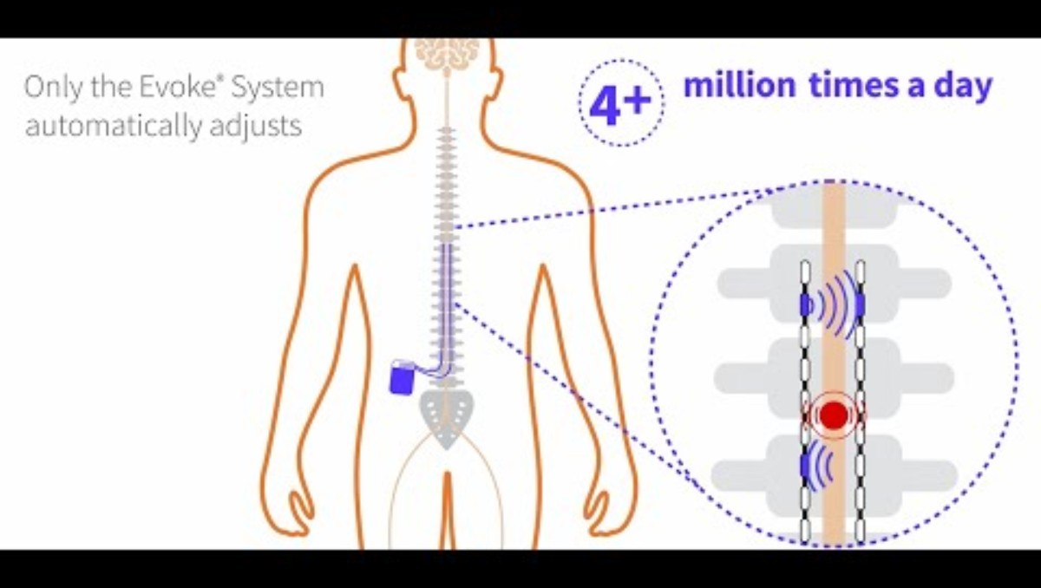
Product overview

Slide 13
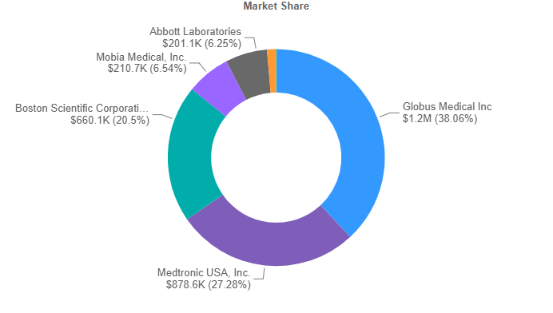
Supply Chain Information
Product Segment: implants – neurostimulation
Multi vendor Space
$3.2 million Spend (Annual)
lc73693 – (medtronic)
lc64566 – (nevro corp)
No contract breach risks

Slide 14

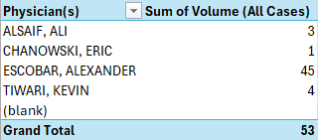
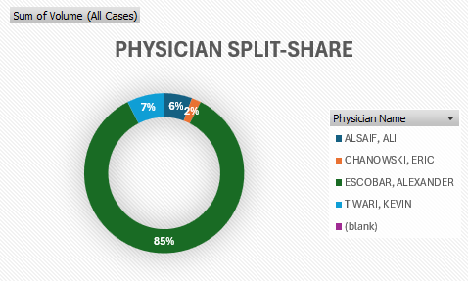
Physician utilization mix – neurostimulator insertion procedures
Data Pull (April/2025 – March/2026)

Slide 15
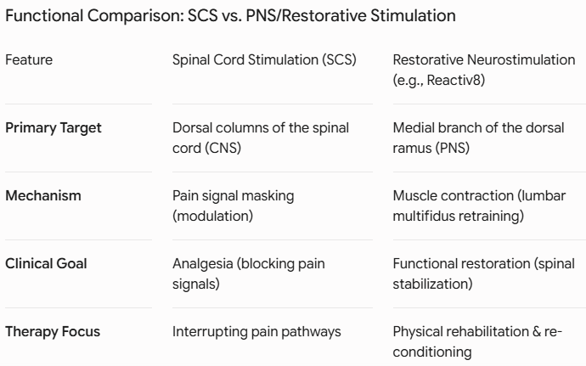
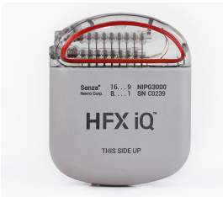
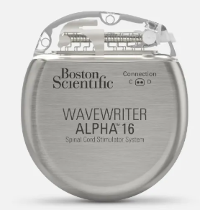
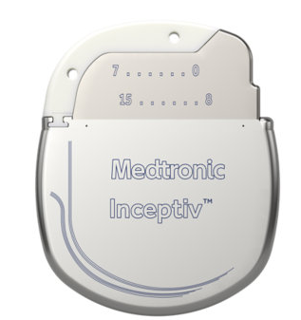
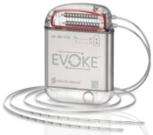
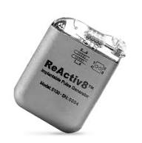
Neuromodulation therapies
Senza HFX iQ
L# 93311
Wavewriter
L# 93756
Inceptiv
L# 93397
Evoke
REACTIV8

Slide 16
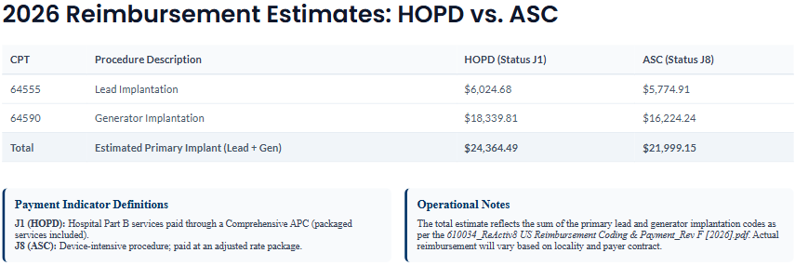
reactiv8 implant cost
Dual Lead Trial System Cost: $5,000.00
Reactiv8 Pulse Generator System: $14,000.00

Slide 17
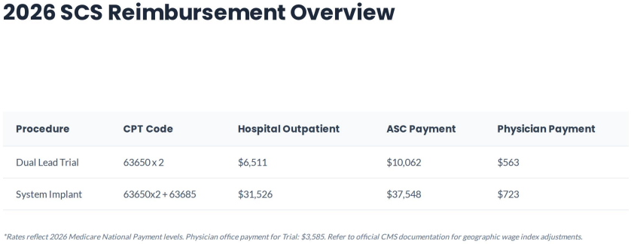
evoke implant cost
Dual Lead Trial System: $1,000.00
Evoke G4 Closed Loop Stimulator System: $22,500.00

