Slide 1

Procedural & Surgical cva MAY 2026 meeting

Slide 2

MAY AGENDA
March Recap
Touch CMC 1 Prosthesis – Dr. Skie
Pounce System– Dr. Cuddy
Nanoknife System – Dr. Sindhwani
TOPS Spine System – Dr. Schroeder & Dr. Hoyt

Slide 3
TOUCH cmc 1 PROSTHESIS clinical champion(s):
- dr. Skie vendor: Kerimedical (Medartis)
FDA Approval: 7-10-25
The Request: approval for trial

Slide 4
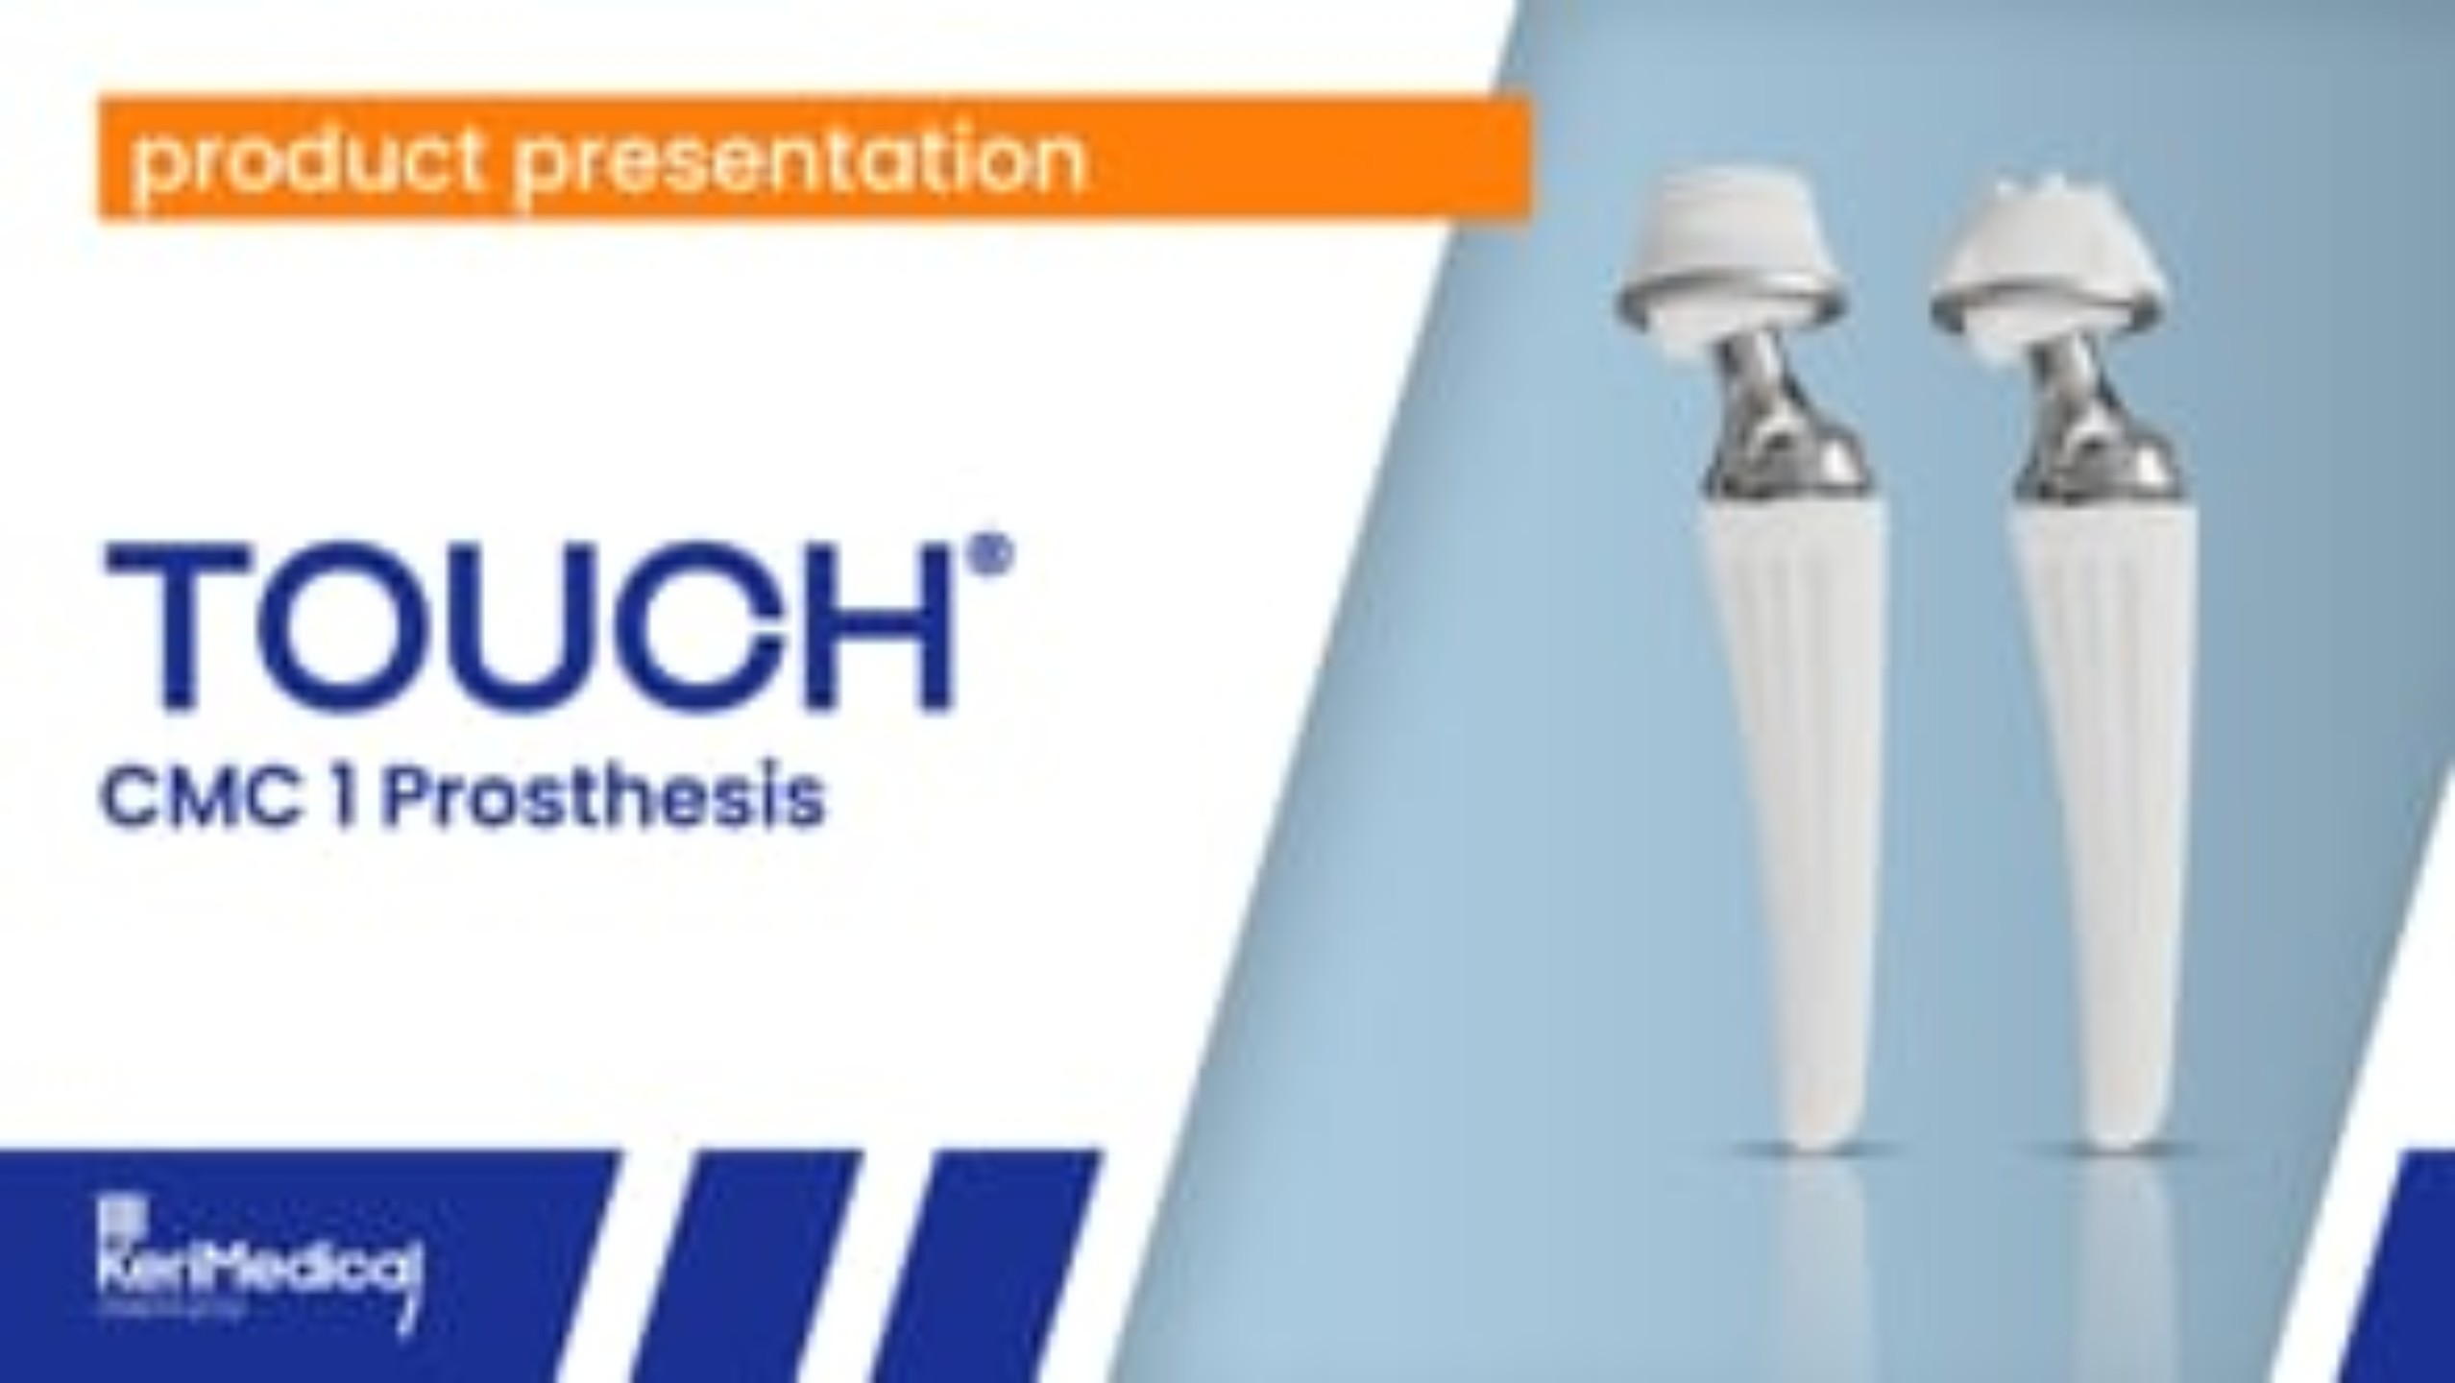
Product overview

Slide 5
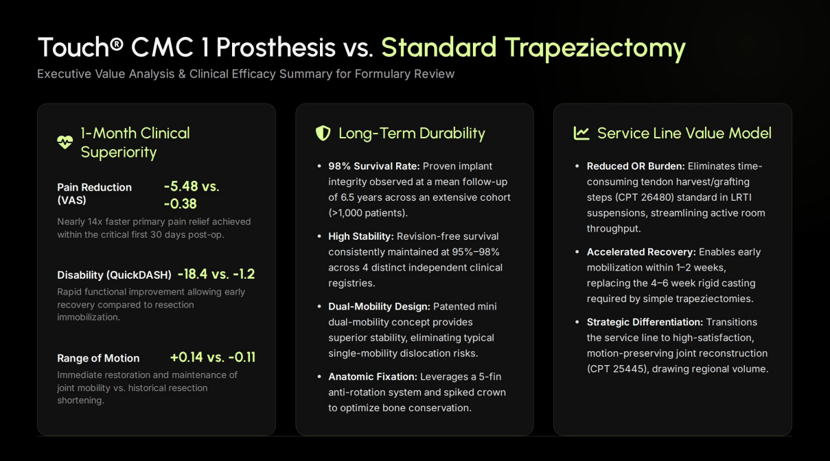

Slide 6
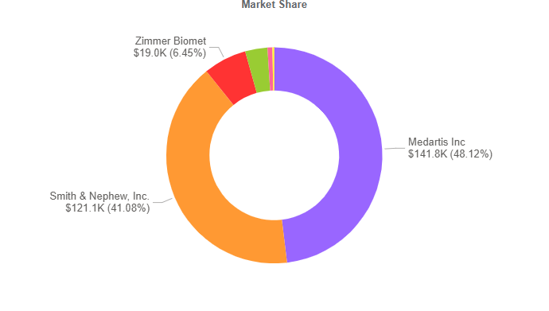
Supply Chain Information
Product Segment: small joints
Dual 80/20 vendor Space
$295,000 Spend (Annual)
No contract breach risks

Slide 7
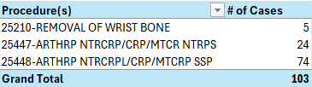
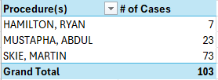
Physician utilization mix – Traditional cmc joint stabilization
Data Pull (April/2025 – March/2026)

Slide 8
touch cmc 1PROSTHESIS Cost
Cup: $3,239.00/EA
Stem: $3,094.00/EA
Neck/Liner: $3,167/EA
Total: $9,500.00
Est. Medicare Reimb.: $11,760.68
Est. Contrib. Margin: $2,260.68
TOUCH CMC 1 PROSTHESIS

Slide 9
POUNCE THROMBECTOMY SYSTEM clinical champion(s):
- dr. cUDDY
- dr. nAZZAL vendor: Surmodics, Inc. (New Vendor)
FDA Approval: 9-11-24
The request: approval for permanent placement

Slide 10
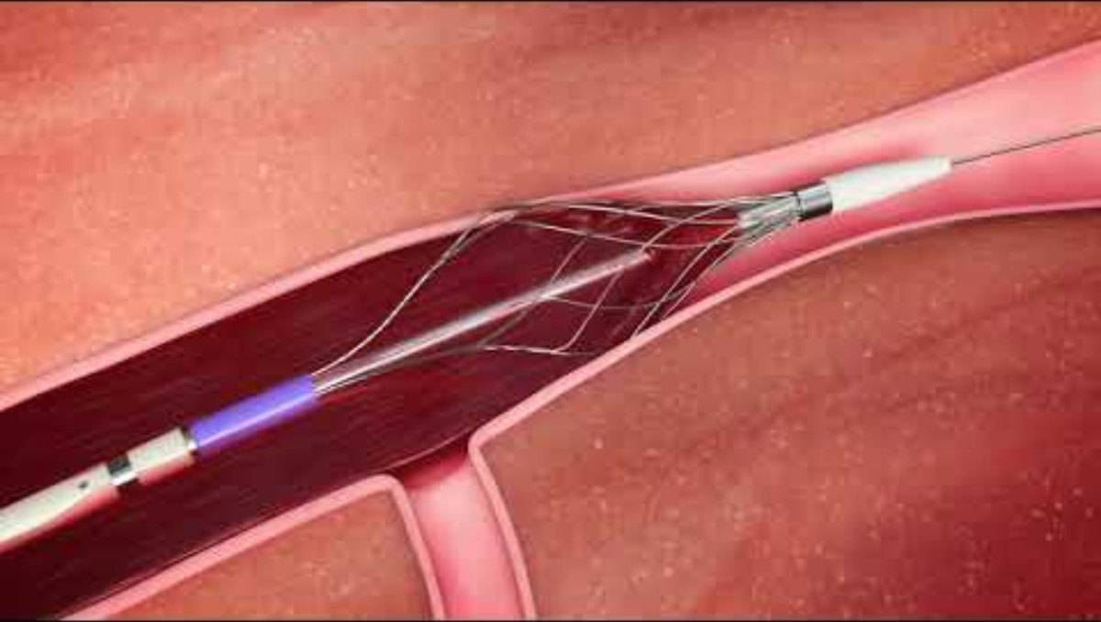
Product overview

Slide 11
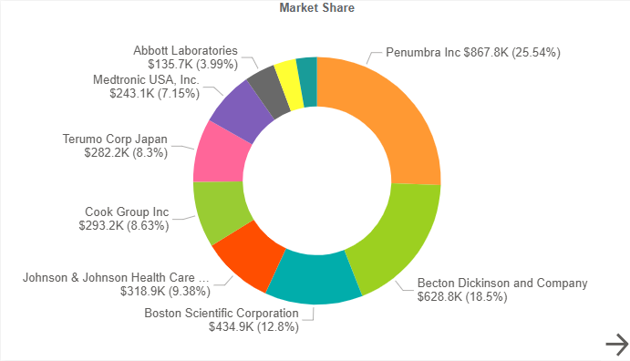
Supply Chain Information
Product Segment: Peripheral vascular products & accessories
Multi-Vendor Space
3.8 Million Spend (Annual)
No contract breach risks

Slide 12
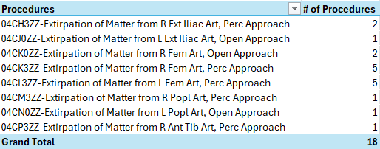
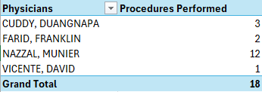
Physician utilization mix – Advanced Mechanical Intervention
Data Pull (April/2025 – March/2026)

Slide 13
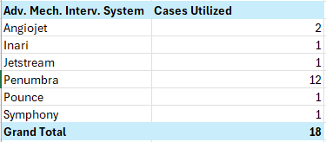
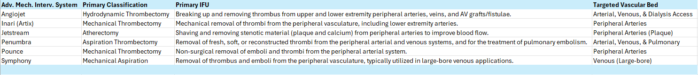
System Utilization Today
Data Pull (April/2025 – March/2026)

Slide 14
Advanced Mechanical intervention Cost Comparison
Penumbra System
Pounce Arterial System
Catheter,Aspiration,Lightn12: $6,690
Catheter,Aspiration,Lightn100: $9,650
Catheter,Aspiration,Lightn16F Flash: $9,650
Catheter,Aspiration,Lightn7: $7,940
Catheter,Aspiration,Lightn 7FR: $9,650
Pounce LP (2-4mm): $4,850
Pounce MP (3.5-6mm): $4,750
Pounce XL (5.5-10mm): $4,950
Pounce Venous System
VTS-KITS-10001 (12F): $8,000
VTS-KITS-10002 (3.5-6mm): $8,000
AngioJet
Set, Solent, Omni, 120CM: $5,040
Set, Solent, Proxi, 90CM: $4,405

Slide 15
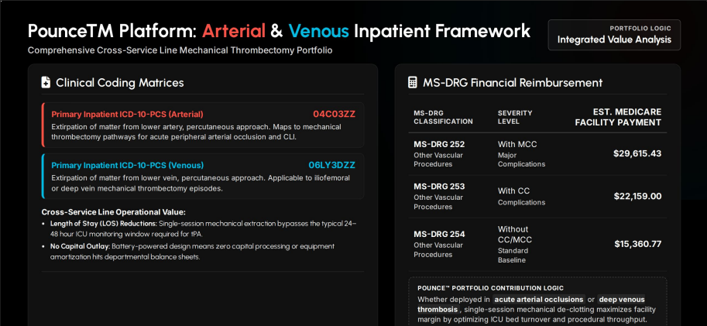

Slide 16
NANOKNIFE clinical champion(s):
- dr. Sindhwani
- dr. el-zawahry vendor: Angiodynamics
FDA Approval: 12-6-24
The Request: approval for trial

Slide 17
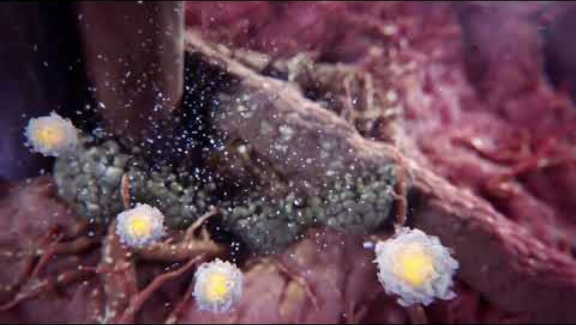
Product overview

Slide 18
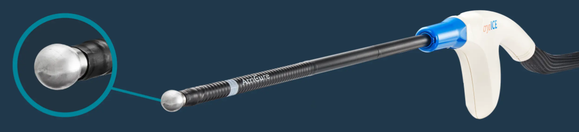
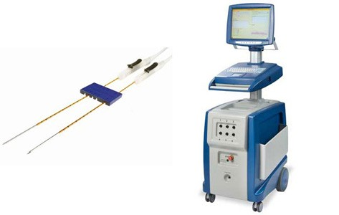
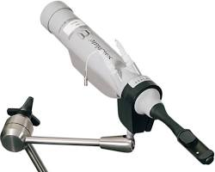
Existing product vs new product
CRYOABLATION
IRREVERSIBLE ELECTROPORATION (IRE)
HIGH INTENSITY FREQUENCY ULTRASOUND (HIFU)

Slide 19
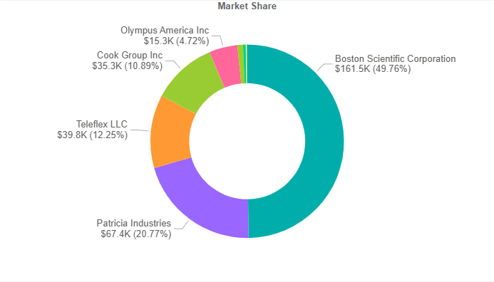
Supply Chain Information
Product Segment: INTERVENTIONAL UROLOGY PRODUCTS
Multi-Vendor Space
$325,000 Spend (Annual)
No contract breach risks

Slide 20


Physician utilization mix – existing prostate ablation cases
Data Pull (April/2025 – March/2026)

Slide 21
Procedural cost COMPARISON
CRYOABLATION (ATRICURE)
NANOKNIFE
Implant: $6,700/Per Pack of 5EA
$1,500 Rental Fee/Per day of use
Implant: $2,650/EA
*** Unable to find cost of rental***
HIFU (SONABLATE)
$5,500/Per Procedure

Slide 22
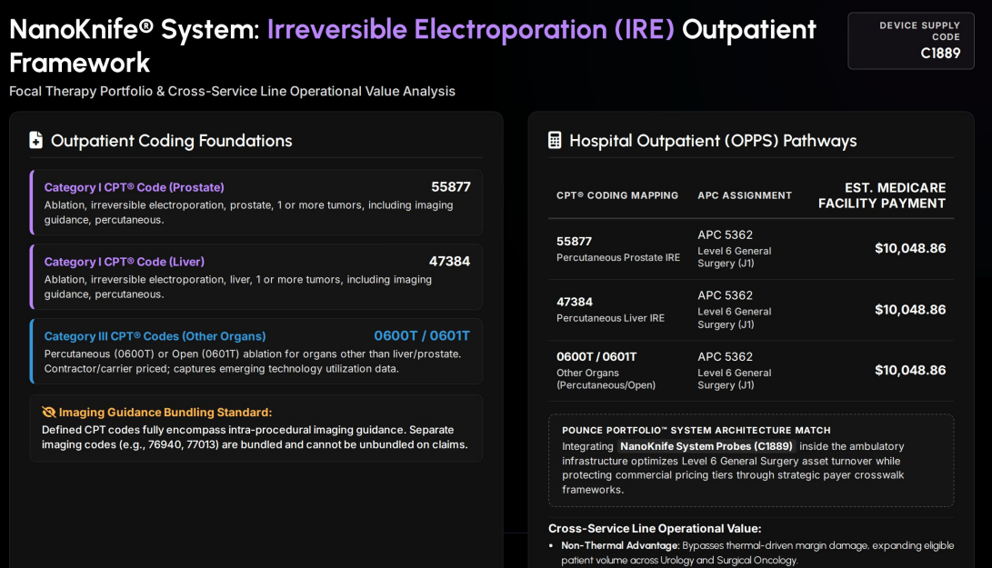

Slide 23
Tops spine system clinical champion(s):
- dr. schroeder
- dr. hoyt vendor: primia spine (New Vendor)
FDA Approval: 7-15-23 the request: approval for trial

Slide 24
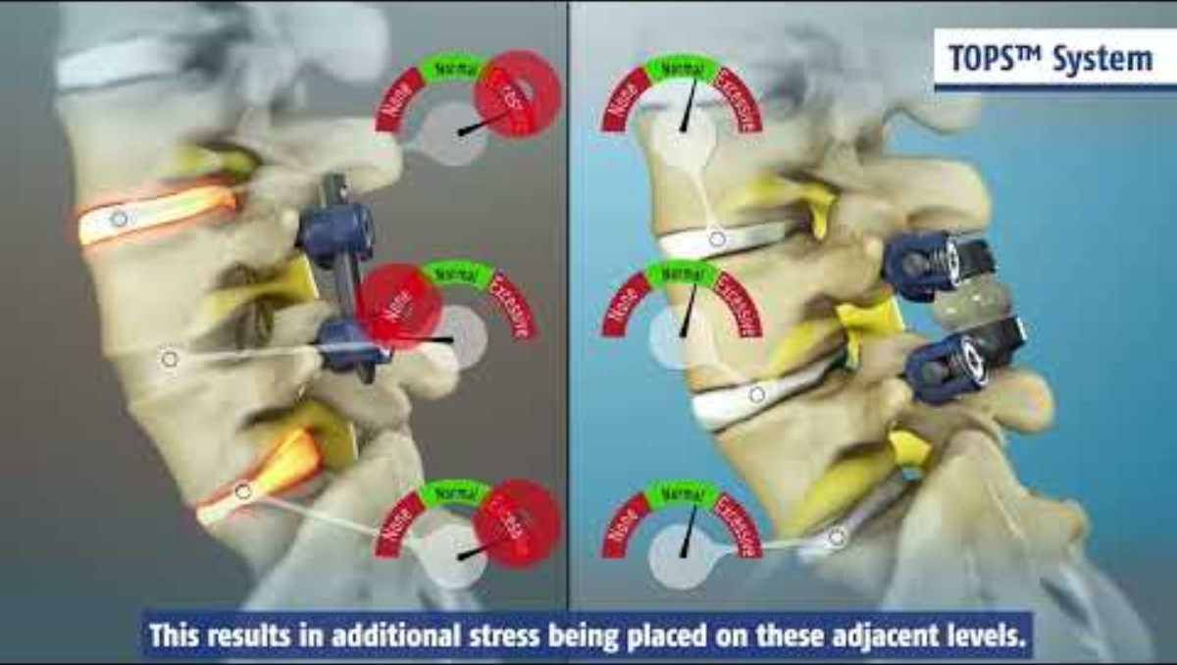
Product overview

Slide 25
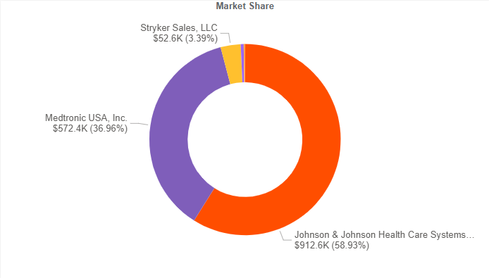
Supply Chain Information
Product Segment: implants - spinal
Dual 80/20 Space
$1.5 million Spend (Annual)
No contract breach risks

Slide 26

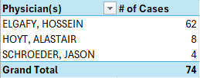
Physician utilization mix – lumbar fusion, single level
Data Pull (April/2025 – March/2026)
***Internal est. of 1/3 of patients may qualify

Slide 27
TOPS SPINE SYSTEM Cost
SCREWS(x4): $900/EA
IMPLANT(x1): $13,900.00/EA
SET SCREWS(x4): $45/EA
Total: $17,680.00
Est. Medicare Reimb.: $31,097.65
Est. Contrib. Margin: $23,207.65
TOUCH CMC 1 PROSTHESIS

Slide 28
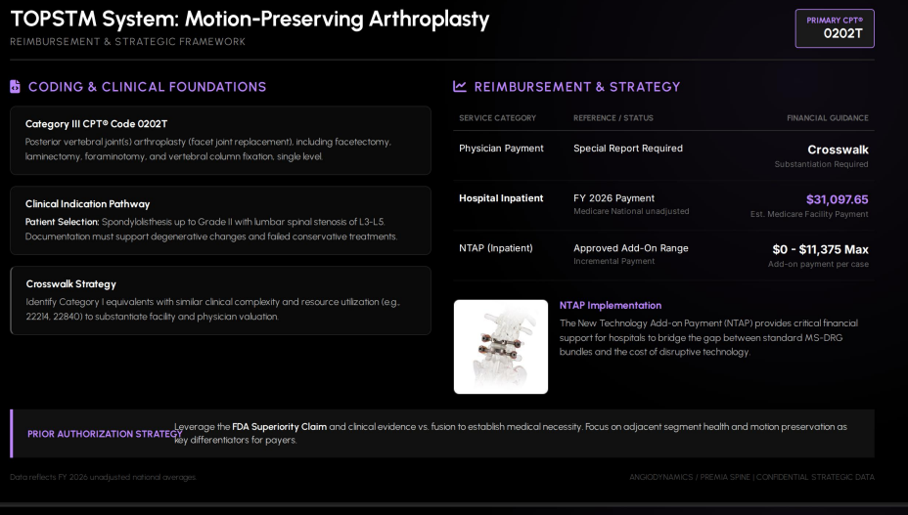

Slide 29
JUNE requests for review
SUBMISSIONS APPROVED FOR JUNE REVIEW:
TBD (FULL LIST OF SUBMITTED REQUESTS BELOW)
Galaxy Robotic Bronchoscopy – Dr. Turner
Coralwell Ureteral Access Sheath – Dr. Ekwenna
Echelon Endopath – Dr. Hsu
Celleraterx Hydrolyzed Collagen Powder – Dr. Hanna
MatriDerm – Dr. Nazzal
Turbett Instrument Pod – Christina Powlesland
Aortic Endograft – Dr. Farid
Symvess aCellular Tissue Engineered Vessel – Dr. Nazzal
Paradise Ultrasound Renal Denvervation System – Dr. Cooper
Poem – Dr. Hart

