Slide 1
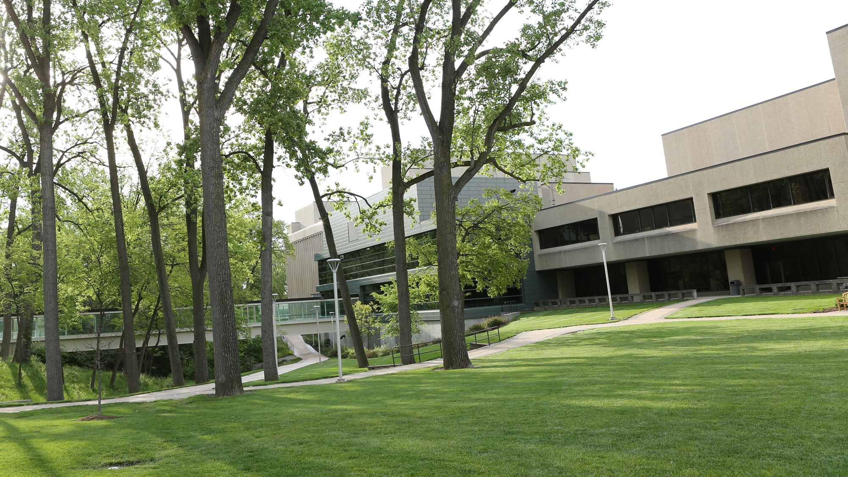

Value Analysis
March 2, 2021
7:00 a.m. – 7:10 a.m. | New: Crossroads stapling system | Dr. Elattar
7:10 a.m. – 7:20 a.m. | New: Lapiplasty | Dr. Elattar
7:20 a.m. – 7:30 a.m. | New: Zephyr Valve | Dr. Omballi
7:30 a.m. – 7:40 a.m. | New: Vashe wound cleanser | Karen Bauer
7:40 a.m. – 7:50 a.m. | New: Kerecis fish skin wound treatment | Karen Bauer
7:50 a.m. – 8:00 a.m. | Old Business: Cortrak Ambu aScope Cystoscopy (Urology) Shock Wave (Vascular) Si Bone (Orthopedic Spine) Inari (Vascular)

Slide 2
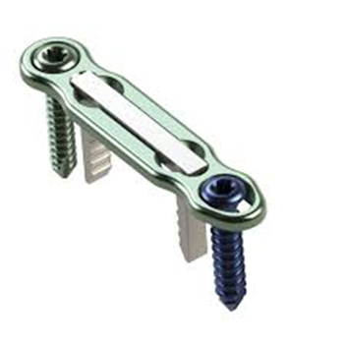
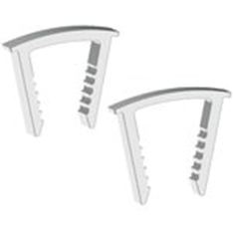
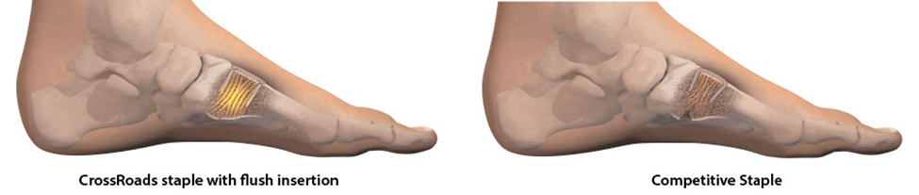
Value Analysis
March 2, 2021
CrossRoads Extremity Systems
Product overview by Lumere Research Team
DynaFORCE MotoClip Max & HiMAX Clips are shape-memory nitinol staples used for osteotomy fixation and joint arthrodesis in the hand and foot. The MotoClip Max is specifically intended for low profile forefoot applications, while the HiMax is used in midfoot and rearfoot applications. The top-loading compressions clips can be inserted flush without tamping and can be reloaded or repositioned intraoperatively.
DynaFORCE MotoClip Max & HiMAX Clips are offered sterile in several staple bridge widths and lengths. The clips are designed to be used simultaneously with the DynaFORCE High-Compression Plates. Reusable stainless steel instrumentation is available through the EcoSmart instrument rebate program.
Indications
The CrossCLIP Implant System is indicated for hand and foot bone fragment osteotomy fixation and joint arthrodesis

Slide 3
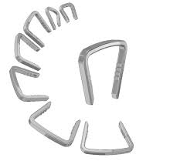
Value Analysis
Stryker $1,023-$1,723
March 2, 2021
Financials:
Crossroads $1,235-$1,464
Crossroads: Construct Price & Break down
$3,608
MTP
$3,463
Lapidus
Stryker: Construct Price
$4,223
MTP
$3,522
Lapidus

Slide 4
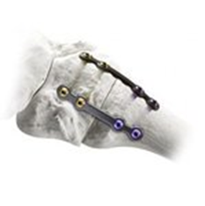
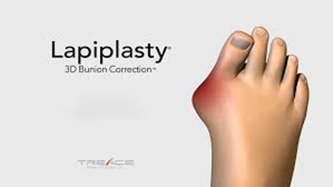
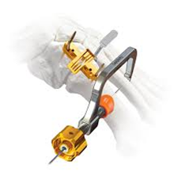
Value Analysis
March 2, 2021
Product overview by Lumere Research Team
The LAPIPLASTY System Anatomic Biplanar Implants are a fixation system used in the foot for first metatarsophalangeal (MTP) joint, tarsometatarsal (TMT) joint, and other midfoot fusions. The system contains low-profile plates and unicortical locking screws manufactured from titanium alloy. Two plates are used at the site of fusion to achieve multiplanar fixation, which distributes forces to promote healing.
The LAPIPLASTY System instrument set, which includes a fulcrum, positioner, joint seeker, and cut guide, is used to facilitate correction of metatarsal rotation prior to fixation with the plates and screws. The positioner is used to position and lock the first metatarsal in the anatomically correct angle while it is cut using the cut guide and a sagittal saw.
Indications
The TMC Plating System is intended for use in stabilization of fresh fractures, revision procedures, joint fusion and reconstruction of small bones of the feet. In the foot, the system can be used for the following specific examples:

Slide 5
Value Analysis
March 2, 2021
Financials:
HCPCS Description APC UTMC Payment Rate
28297 Correction hallux valgus 5114 $5,629.49

Slide 6
Value Analysis
Financials continued: Price list
March 2, 2021
Catalog Number | Description | List Price | University of Toledo Medical Center
SK12 | Lapiplasty® System 1 - Anatomic Biplanar™ Implants | $ 6,695 | $ 4,295
SK14 | Lapiplasty® System 2 - Anatomic Biplanar™ Implants | $ 7,795 | $ 4,895
SD14 | Plantar Python® 2 - Anatomic Tension-Side Plate, Left | $ 3,295 | $ 1,850
SD15 | Plantar Python® 2 - Anatomic Tension-Side Plate, Right | $ 3,295 | $ 1,850
SM-4011 | Lapiplasty® Saw Blade (40mm X 11mm) – Stryker | $ 295 | $ 295
ZMS-4011 | Lapiplasty® Saw Blade (40mm X 11mm) – Linvatec | $ 295 | $ 295
SD16 | Lapiplasty® 2.7mm Long Screw Pack | $ 1,295 | $ 777
SD17 | Lapiplasty® 3.0mm Long Screw Pack | $ 1,495 | $ 995
SK18 | Lapiplasty® 3.0mm Interfrag Screws | $ 995 | $ 595
SK19 | Lapiplasty® 3.5mm Transverse Screws | $ 995 | $ 595
SK20 | Lapiplasty® 2.5mm Headless Screws | $ 995 | $ 595
SK21 | Lapiplasty® 2.0mm Snap-Off Screws | $ 995 | $ 595
SK23 | Lapiplasty® System 3^{R} - Anatomic Biplanar™ Implants | $ 11,995 | $ 6,995
SK25 | Lapiplasty® 4.0mm Interfrag Screws | $ 995 | $ 595
SK26 | Lapiplasty® 4.0mm Headless Screws | $ 995 | $ 595
SK27 | FastGrafter® Autograft Harvesting System | $ 1,695 | $ 995
SK28 | Lapiplasty® Lesser TMT Fixation Pack | $ 3,495 | $ 2,050
SK30 | Lapiplasty® Mini-Incision™ System | $ 8,895 | $ 5,995
SD20 | MI^{S} PlantarPower™ Plate | $ 3,295 | $ 1,850
SD21 | FastPitch™ 2.7mm High Pitch Locking Screws | $ 1,295 | $ 777
C03 003 | 8mm x 8mm Titanium Compression Staple | $ 1,895 | $ 1,100
C03 013 | 10mm x 11mm Titanium Compression Staple | $ 1,895 | $ 1,100
C03 007 S | 1.5mm Staple Guide Wire/Drill | $ 295 | $ 295
C03 208 | 15mm x 15mm Titanium Compression Staple | $ 1,995 | $ 1,200
C03 210 | 20mmx 20mm Titanium Compression Staple | $ 1,995 | $ 1,200
C03 211 | 25mm x 20mm Titanium Compression Staple | $ 1,995 | $ 1,200
B01 248 S | 2.6mm Staple Guide Wire/Drill | $ 295 | $ 295

Slide 7
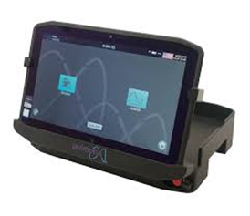
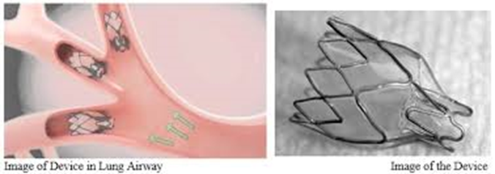
Value Analysis
March 2, 2021
Zephyr Endobronchial Valve Pulmonx

Slide 8
Value Analysis
March 2, 2021
Financials:
Hospital Name | Street | City | State | Zip | DRG 163 | DRG 164 | DRG 165
UNIVERSITY OF TOLEDO MEDICAL CENTER | 3000 ARLINGTON AVENUE | TOLEDO | OH | 43699 | $ 36,629.66 | $19,466.99 | $14,096.17
Center for MS-DRG 163, 164 and 165.
Sources: FY 2021 IPPS final rule Table 1A-1E, Table 5, and Impact File, and Provider of Services 2020 2nd quarter file
Zephyr Valve and Chartis Cost per case $8,100 – $10,800 (3-4 Z Valves used per case inpatient)
Z-Valve $2,200 3-4
Z Catheter $500 3-4
Outpatient Diagnostic Cost per case $1,450
Rental fee (Chartis) $500
Chartis Cath $950
Reimbursement: $4,095

Slide 9
Value Analysis
Financials: Halo effect of treatment
March 2, 2021
CONSIDERATIONS FOR PROCEDURE WORK‐UP AND FOLLOW‐UP
Pre‐Zephyr Valve Typical Work‐up
Screening test description Possible CPT® code (s)
E&M, New patient 99203, 99204, 99205
Spirometry 94010 APC $130.20
Body Plethysmography 94726 APC $238.19
Vital capacity (if done separately) 94150, 94200
DLCO (as required) 94729
6 min walk test 94618 APC $102.61
HRCT (if not current and/or not to specification) 71250 APC $105.48
Ventilation perfusion scan (recommended for homogeneous patients or when
the target lobe is unclear) or SPECT CT if available, warranted
78582, 78598 APC $444.17
Echocardiogram 93350 APC $453.21
Arterial blood gas levels 82803
Blood chemistry panel, complete CBC 85025, 85027,85041
Blood metabolic panel, BMP 80053
Blood test for PT/INR, PTT 85610, 85730
Pulmonary perfusion imaging 78580, 78579, 78597 APC $346.44

Slide 10

Value Analysis
March 2, 2021
Post‐Zephyr Valve Procedure, Possible Work‐up at 1, 3‐ and 6‐months post procedure
Test Description Possible CPT® code (s)
Spirometry 94010 APC $130.20
6 min walk test (optional) 94618 APC $102.61
Chest x‐ray (if patient has experienced no benefit or is experiencing symptoms) 71046 APC $75.11
HRCT (if patient has experienced no benefit or is experiencing symptoms) 71250 APC $105.48

Slide 11
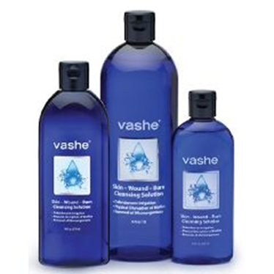
Value Analysis
Vashe Wound Solution
Urgo Medical
March 2, 2021
Product overview by Lumere Research Team
Vashe Wound Solution is a solution used for cleansing, irrigating, moistening, debriding, and removing foreign material from the wound and peri-wound area. Microorganisms can be removed from acute and chronic dermal lesions, stage I-IV pressure ulcers, stasis ulcers, diabetic ulcers, post-surgical wounds, first- and second-degree burns, abrasions or minor irritations of the skin, graft and donor sites, and exit sites. Vashe Wound Solution is also used to moisten or lubricate absorbent wound dressings such as the Drawtex Hydroconductive Wound Dressing. This product is a hypochlorous acid (HOCl) solution that mimics the normal pH of human skin and is non-cytotoxic, non-irritating, non-sensitizing, and has no oral toxicity.
Indications
Under the supervision of healthcare professionals, Vashe Wound Solution is intended for cleansing, irrigating, moistening, debridement and removal of foreign material including microorganisms and debris from exudating and / or dirty wounds, acute and chronic dermal lesions, such as Stage I-IV pressure ulcers, stasis ulcers, diabetic ulcers, post-surgical wounds, first and second degree burns, abrasions, minor irritations of the skin, diabetic foot ulcers, ingrown toe nails, grafted and donor sites, and exit sites. It is also intended for moistening and lubricating absorbent wound dressings.

Slide 12
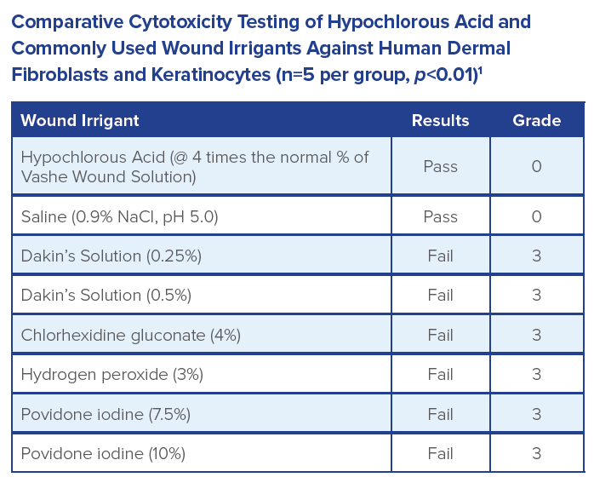
Value Analysis
Vashe Wound Solution
Urgo Medical
March 2, 2021

Slide 13
Value Analysis
March 2, 2021
Financials:
Vashe 16 oz $1.48 per ounce
Dakin 16 oz $1.12 per ounce
Description of Use: clinic: Soak ulcers with dressing changes for decreased bioburden- decrease infection risk and promote wound healing. Infection prevention surgical irrigation, Wound cleanser. IN pt: instill with VAC instill/veraflo and soaking, packing pressure Ulcers, Safety(can be used on any non-intact skin without any harm to patient and does not need to be rinsed out with saline or additional products)

Slide 14
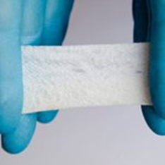
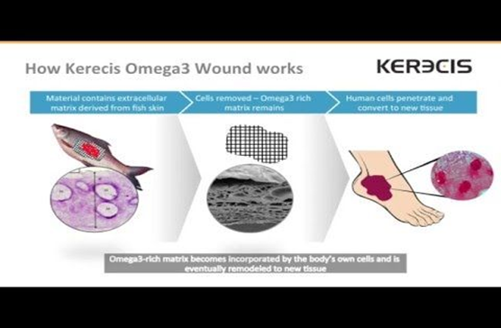
Value Analysis
March 2, 2021
Omega3 Burn Kerecis
Product overview by Lumere Research Team Omega3 Burn is a biologic wound dressing used as a scaffold to regenerate skin tissue in burn wounds. The product is an acellular xenograft from Icelandic fish skin, which has antimicrobial properties and is homologous to human skin. It is specifically designed to facilitate healing in burn wounds through faster revascularization and control of moisture and temperature. Each size offered is full thickness fish skin, which is full of Omega3.
Indications: MariGen Wound Dressing is indicated for the management of wounds including:
Partial and full-thickness wounds, Pressure ulcers, Venous ulcers, Chronic vascular ulcers, Diabetic ulcers, Trauma wounds (abrasions, lacerations, second-degree bums, skin tears), Surgical wounds (donor sites/grafts, post-Mohs surgery, post-laser surgery, podiatric, wound dehiscence), Draining wounds

Slide 15
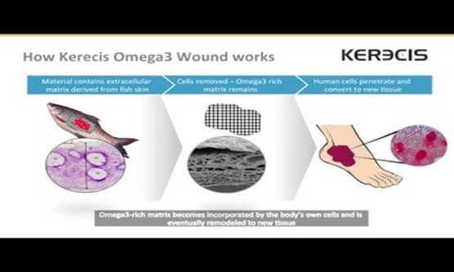
Value Analysis
March 2, 2021
Financials:
HCPSC Descriptor APC UTMC Payment
15271 Skin sub graft trnk/arm/leg 5054 $1,512.13

Slide 16
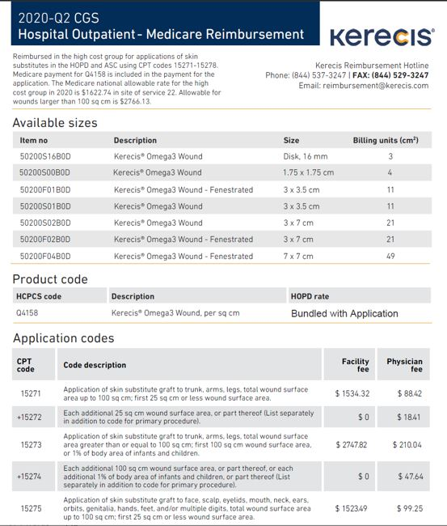
Value Analysis
Financials: Reimbursement
March 2, 2021

Slide 17
Value Analysis
March 2, 2021
Next meeting:
March 16, 2021

Slide 18
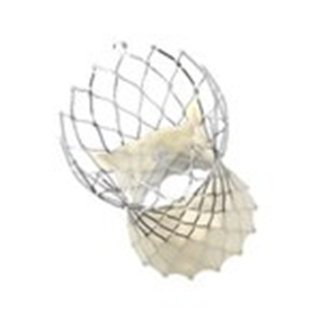
Value Analysis
February 2, 2021
Indications
The Medtronic CoreValve Evolut R, CoreValve Evolut PRO, and Evolut PRO+ systems are indicated for relief of aortic stenosis in patients with symptomatic heart disease due to severe native calcific aortic stenosis who are judged by a heart team, including a cardiac surgeon, to be appropriate for the transcatheter heart valve replacement therapy.
The Medtronic CoreValve Evolut R, CoreValve Evolut PRO, and Evolut PRO+ systems are indicated for use in patients with symptomatic heart disease due to failure (stenosed, insufficient, or combined) of a surgical bioprosthetic aortic valve who are judged by a heart team, including a cardiac surgeon, to be at high or greater risk for open surgical therapy (e.g., STS predicted risk of operative mortality score ≥ 8% or at a ≥ 15% risk of mortality at 30 days).

Slide 19

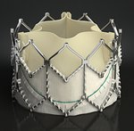
Value Analysis
February 2, 2021
Medtronic Evolut
Edwards Sapien
$32,500
$32,500

Slide 20
Value Analysis
February 2, 2021
Financials for TAVR using Edwards Life Sciences Sapien
Disch Date | Days | Charges | Payments | PCT Payment | Exp Net Rev | Revised Direct cost | Direct Cost | Contribution Margin | Total Cost
6/25/2020 | 2 | 211843.77 | 23002.72 | 10.86 | 23005.72 | 37000 | 34573 | -11567.28 | 47938
6/24/2020 | 1 | 191638.11 | 35661.33 | 18.61 | 35661.33 | 37000 | 32960 | 2701.33 | 45498
7/23/2020 | 3 | 225839.3 | 35652.63 | 15.79 | 36032.79 | 37000 | 35456.7701 | 576.0199 | 51943.039
8/6/2020 | 2 | 196679.01 | 37060.63 | 18.84 | 37060.63 | 37000 | 30878.60457 | 6182.02543 | 45236.1723
8/20/2020 | 2 | 193125.05 | 46391.02 | 24.02 | 46391.02 | 37000 | 30320.63285 | 16070.38715 | 44418.7615
8/20/2020 | 2 | 197367.64 | 43109.65 | 21.84 | 43109.65 | 37000 | 30986.71948 | 12122.93052 | 45394.5572
9/16/2020 | 1 | 179457.07 | 37060.63 | 20.65 | 37060.63 | 37000 | 28174.75999 | 8885.87001 | 41275.1261
9/16/2020 | 1 | 191300.44 | 36742.25 | 19.21 | 36832.11 | 37000 | 30034.16908 | 6797.94092 | 43999.1012
10/16/2020 | 3 | 206953.21 | 40279.68 | 19.46 | 40279.68 | 37000 | 32491.65397 | 7788.02603 | 47599.2383
10/14/2020 | 1 | 177073.08 | 40279.68 | 22.75 | 40279.68 | 37000 | 27800.47356 | 12479.20644 | 40726.8084
11/25/2020 | 1 | 172811.09 | 35349.13 | 20.46 | 35440.13 | 37000 | 27131.34113 | 8308.78887 | 39746.5507
11/25/2020 | 1 | 172930.07 | 42740.56 | 24.72 | 42740.56 | 37000 | 27150.02099 | 15590.53901 | 39773.9161
sum |  |  | 453329.91 |  | 453893.93 | 444000 |  | 85935.78428 | 533549.271

Slide 21
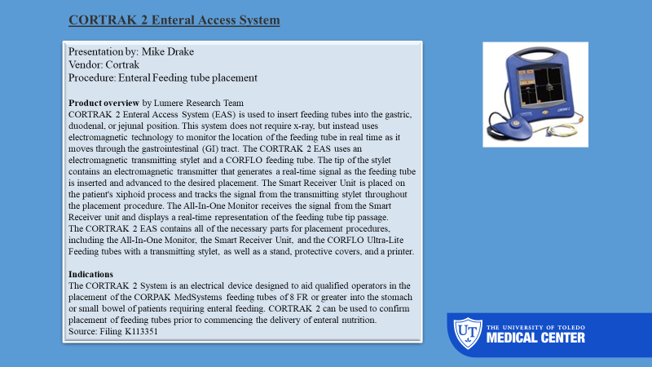
Value Analysis
February 2, 2021

Slide 22
Value Analysis
Cortrak video
February 2, 2021
CORTRAK* can be used to confirm bedside tube placement without x-ray.
An electromagnetic stylet provides real-time location information on the tube tip placement within a patient’s anatomy.
On-screen visualization provides immediate feedback on tube placement, which can reduce or eliminate the need for x-ray confirmation.
With CORTRAK* 2, you can:
  Immediately identify misplaced tubes
  Minimize complications such as lung placements
  Offer improved patient care
  CORTRAK* 2 allows you to control the placement of feeding tubes and facilitate your patients’ successful recovery and optimal outcomes.

Slide 23
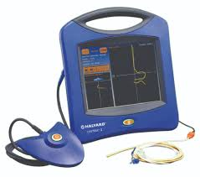
Value Analysis
Financial Considerations
February 2, 2021
Current Product |  |  |  |  |  | Proposed Product
Item | Description | MFG# | Price/ea | 1 yr Usage | Total Spend |  | Description | MFG# | Price/ea | Total Spend | Savings
12300 | TUBE,FEEDING,SILK,8F,43" | 8884720858 | $ 10.71 | 0 | $ - |  | 8fr cortrak feeding tube | 20-9438TRAK2 | $ 75.46 | $ - | $ -
28430 | TUBE,FEEDING,ENTRIFLEX,12F,43" | 8884721252 | $ 10.71 | 164 | $ 1,756.44 |  | 8fr cortrak feeding tube | 20-9432TRAK2 | $ 75.46 | $ 12,375.44 | $ (10,619.00)
Cortrak Access System
Capital acquisition for the $24,000

Slide 24
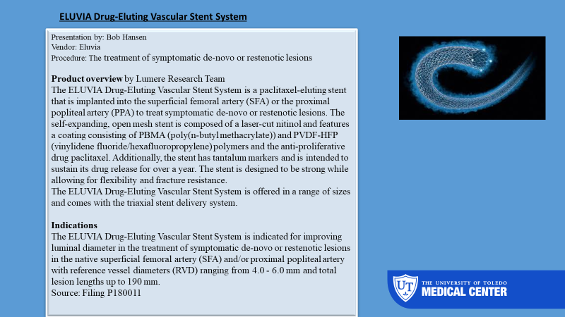
Value Analysis
February 2, 2021

Slide 25
Value Analysis
February 2, 2021
$2,395.00 Zilver
$3,000.00 Eluvia
Incremental increase $605

Slide 26
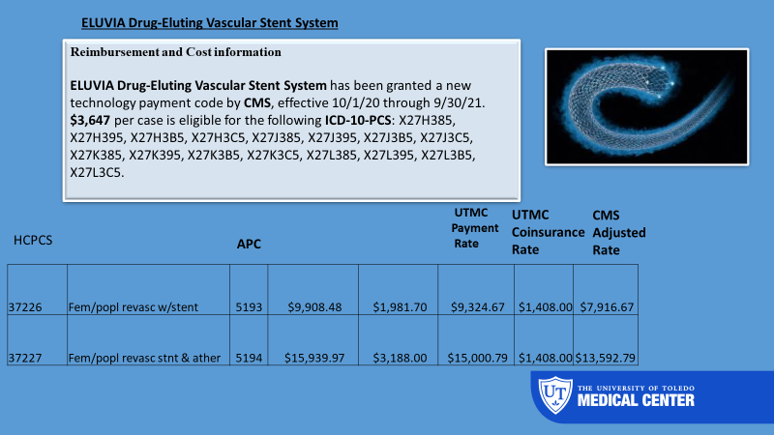
Value Analysis
February 2, 2021

Slide 27
Value Analysis
February 2, 2021
in/out/payer | cases | charges | net rev | direct cost | cont margin
Inpatient | 3 | $ 252,364.21 | $ 64,019.40 | $ 39,621.18 | $ 24,398.22
Aetna | 1 | $ 46,434.96 | $ 16,251.80 | $ 7,290.29 | $ 8,961.51
MMO | 1 | $ 163,546.70 | $ 47,428.54 | $ 25,676.83 | $ 21,751.71
Self Pay | 1 | $ 42,382.55 | $ 339.06 | $ 6,654.06 | $ (6,315.00)
Outpatient | 4 | $ 285,692.84 | $ 44,018.89 | $ 44,853.78 | $ (834.89)
Medicaid Mngd Care | 1 | $ 68,559.67 | $ 4,706.02 | $ 10,763.87 | $ (6,057.85)
Medicare Mngd Care | 2 | $ 151,712.82 | $ 21,649.38 | $ 23,818.91 | $ (2,169.53)
MMO | 1 | $ 65,420.35 | $ 17,663.49 | $ 10,270.99 | $ 7,392.50
Grand Total | 7 | $ 538,057.05 | $ 108,038.29 | $ 84,474.96 | $ 23,563.33

Slide 28
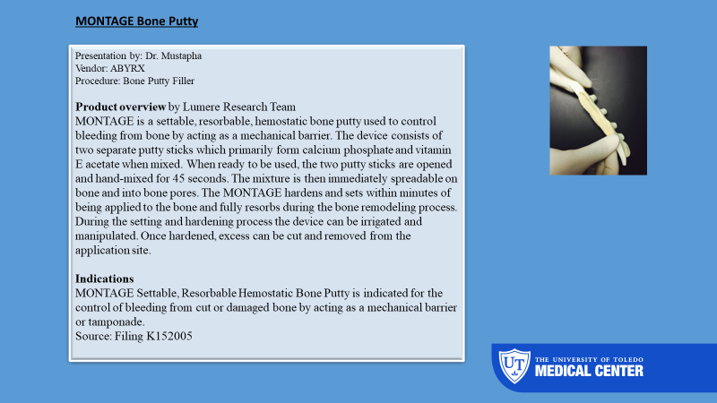
Value Analysis
February 2, 2021

Slide 29
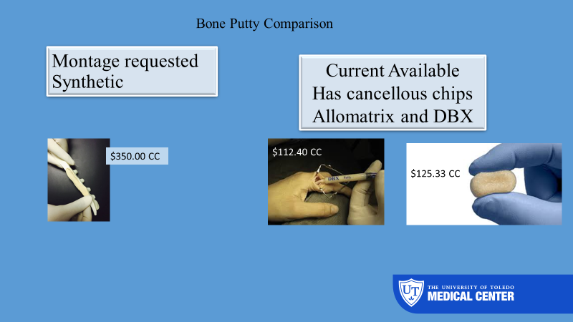
Value Analysis
February 2, 2021

Slide 30
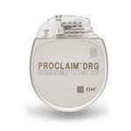
Value Analysis
February 2, 2021
Product overview by Lumere Research Team
The Proclaim DRG Neurostimulator System is an implantable pulse generator used to emit constant-current electrical signals as a treatment for chronic pain. The system stimulates the dorsal root ganglia (DRG) with up to 16 electrodes. The system allows for wireless software upgrades, stimulation control, and program cycling via bluetooth using an Apple iPad controller.
The Proclaim DRG Neurostimulator System is MR conditional in select conditions specified by St. Jude Medical's MRI guidelines. The system is latex-free, and all components are manufactured from titanium, silicone rubber, epoxy resin, polybutylene terephthalate, polyetheretherketone, or a cobalt-nickel-chromium-molybdenum alloy.
Indications
Spinal column stimulation via epidural and intra-spinal lead access to the dorsal root ganglion as an aid in the management of moderate to severe chronic intractable* pain of the lower limbs in adult patients with Complex Regional Pain Syndrome (CRPS) types I and II.**
Proclaim DRG Pain Stim

Slide 31
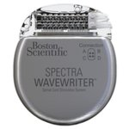
Value Analysis
February 2, 2021
Abbott Proclaim DRG Pain Stim
3664 2 LEAD SYS Proclaim DRG 2 Lead Perm System (System includes: Proclaim DRG
  Neurostimulator Kit, any combination two 50cm or 90cm implant lead kits, Patient Programmer, Connector Cable, and 30cm Tunnelling Tool) $26,500.00 (Including the trial leads)
BSCI Spectra WaveWriter SCS System
Spectra WaveWriter Implantable Pulse Generator Neurostimulator Kit, any combination two 50cm or 90cm implant lead kits, Patient Programmer, Connector Cable, and 30cm Tunneling Tool) $28,660.00 (Including the trial leads)

Slide 32
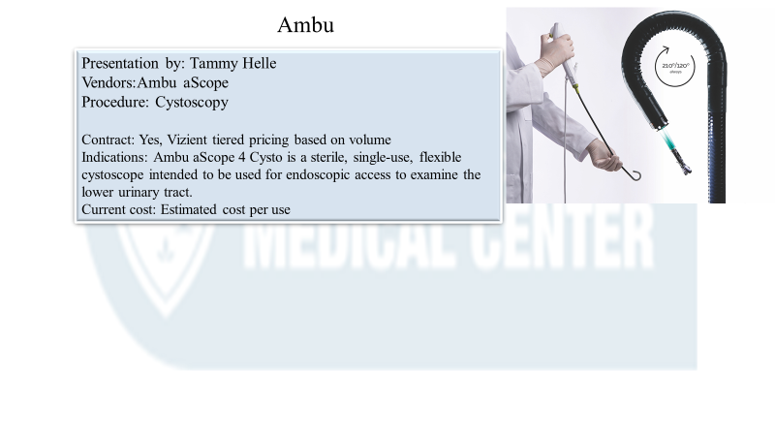
Value Analysis
February 2, 2021

Slide 33
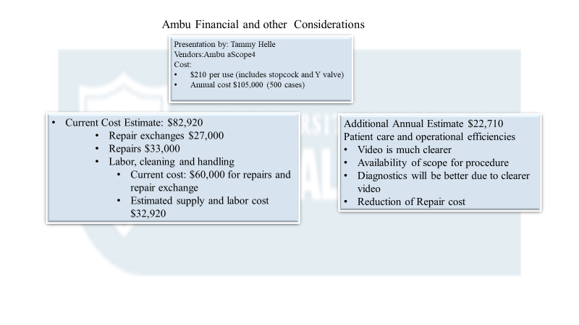
Value Analysis
February 2, 2021

