Slide 1
To create an online account, please visit https://www.fishersci.com/shop/userregistration?enterWOAccNo=WO.
STEP ONE- Fill out information as this will be your personal Fisher account

Slide 2
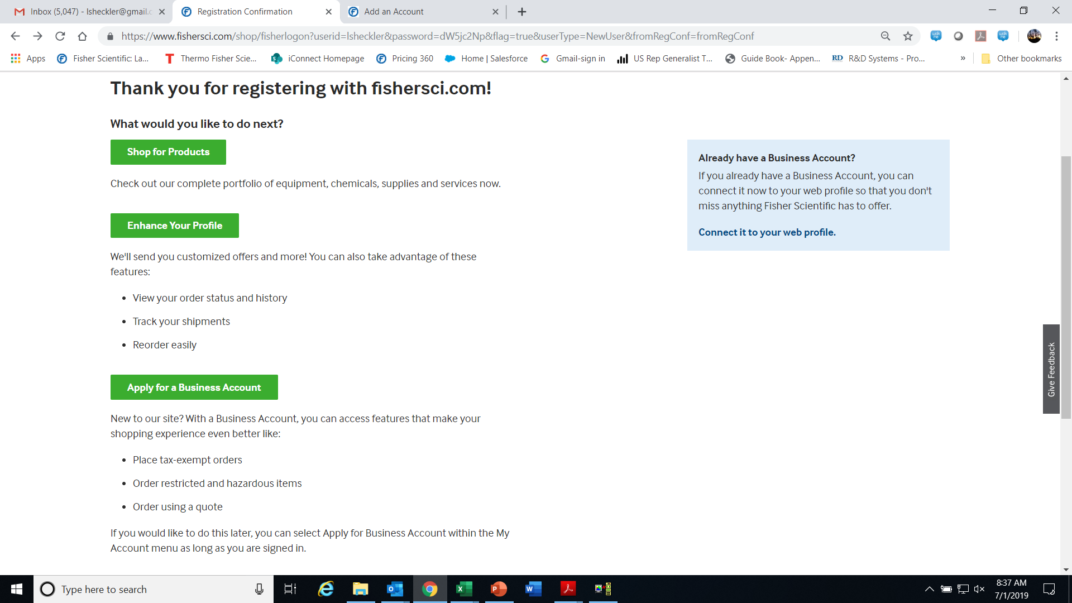
STEP TWO- LINK ACCOUNT NUMBER TO YOUR PROFILE
Once you’ve registered, the next screen will allow you to link your account information to your personal Fisher account
Click link “connect it to your web profile” to add your account to your profile

Slide 3
Please fill out information as seen in dialog boxes as this is information is important to the University’s Fisher account.
At the bottom of the screen please click the green Submit for Approval button.

Slide 4
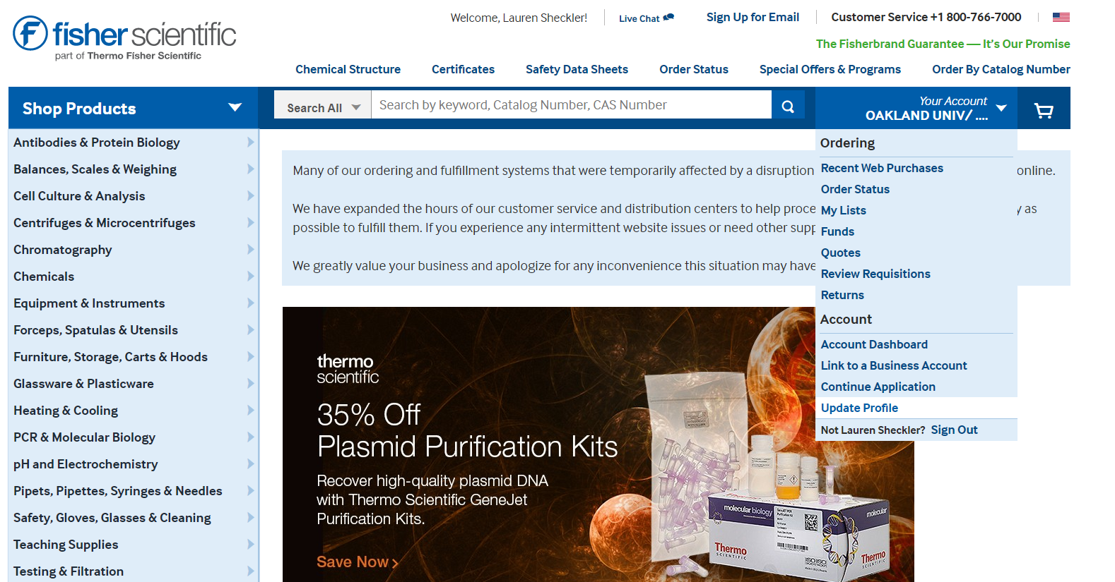
In the drop down menu you can update your profile to add Pcard, edit email preferences, etc

Slide 5
Select Edit to adjust your email preferences
-order confirmations
-Invoice copies
-Shipment notifications
- etc
Add your Pcard to your new account

Slide 6
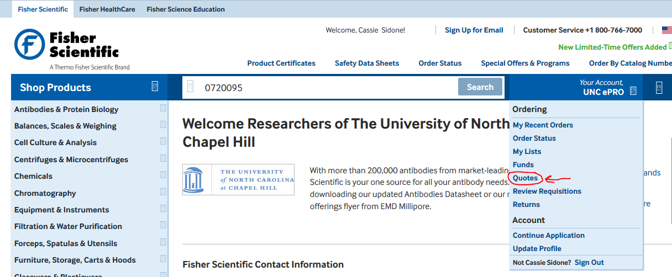
Ordering off a Quote Online
STEP ONE: Click on “Your Account” tab
STEP TWO: Click “QUOTES” tab

Slide 7
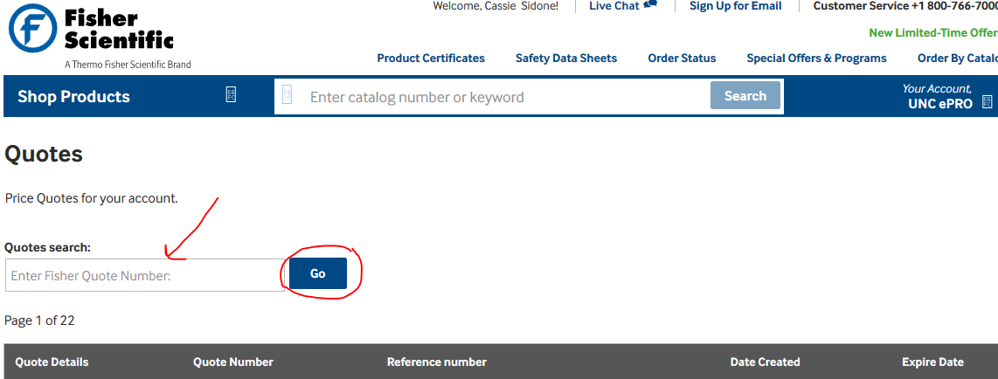
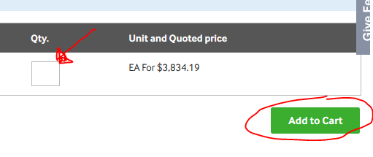
STEP THREE: Enter Quote Number and Search
STEP FOUR: Add the QTY you want to purchase and add it to your cart.

