Slide 2
The GPA Road Trip: Staying on Course
Kim Pollauf, Assistant Dean – University College
Infographics by Michael Douglas, Instructional Designer
August 2019

Slide 3

Grading Scale
A = 4 points
B = 3 points
C = 2 points
D = 1 point
F = 0 points

Slide 4
How it Works – Building Value
By the numbers
Three credit-hours with A grade 3 X 4 = 12 grade-points
Three credit-hours with B grade 3 X 3 = 9 grade-points
Three credit-hours with C grade 3 X 2 = 6 grade-points
Three credit-hours with D grade 3 X 1 = 3 grade-points
Three credit-hours with F grade 3 X 0 = 0 grade-points

Slide 5
How it Works – Building Value
Double and Up
The GPA is derived by dividing total grade-points by GPA hours taken.
If 12 graded hours are taken, 24 grade-points must be earned to have a 2.0 GPA (12 X 2 = 24, 24/12 = 2.0)
Achieving a 2.0 GPA requires twice as many grade-points as GPA hours. A 3.0 requires three times as many grade-points.

Slide 6
Zen and the Year of Balance
The First Year Sets the Tone
Only in the first year can you take a number of hours equal to the first semester and balance it.
After year one, the Law of Diminishing Returns takes over.
Every semester, the number of hours you take becomes a smaller percentage of your total hours.

Slide 7
The Law of Diminishing Returns
The Ratio Effect
Semester 1 15 | Semester 2 15/15 1:1 | Semester 3 15/30 1:2
Semester 5 15/45 1:3 | Semester 5 15/60 1:4 | Semester 6 15/75 1:5

Slide 8
Bridging the Decimal Divide
Go Big or Stay Home
15 hours of F grades will require the following to achieve a 2.0 GPA:
A grades 15 Hours
B grades 30 Hours
C+ grades 101 Hours

Slide 9
Number of Credit Hours to raise your GPA to 2.0

Slide 10
Offsetting Poor Grades
Each 3-hour D grade requires a 3-hour B grade.
Each 3-hour F grade requires 6-hours of B grades OR a 3-hour A grade.
Each semester of poor grades requires at least one additional semester of good to excellent grades.

Slide 11
Getting into a Major at UT
Admission Requirements
Arts and Letters
2.0 UT GPA
Business & Innovation
2.4 for BBA/2.0 AA
Education
2.3 HED 12-29 hrs.
2.5 HED 30-59 hrs./ 2.7 60+
Engineering
2.75 HED, C in MATH 1850 & CHEM 1230/ET 2.25 HED, C in MATH 1340
Health & Human Services
Health Sciences: 2.7 GPA & 12 hrs.
Social Justice: 2.2 12-29 hrs.; 2.4 30-59 hrs.; 2.5 60+ hrs.

Slide 12
Getting into a Major at UT
Admission Requirements
Natural Sciences & Mathematics
2.0 GPA
Nursing
2.75 HED with 12+ hrs
Competitive major: 3.4+ for Clinicals
Pharmacy
2.7 Pre-Professional (PharmD.)
2.7 and Science GPA - BSPS
University College
2.0 GPA for all majors

Slide 13
All GPAs are Not Created Equal
Intersection: Hours & Grades
Raising a 2.0 GPA to a 2.5 GPA
15 graded hours - 15 hours of B grades/5 hours of A grades
30 graded hours – 30 hours of B grades/10 hours of A grades
45 graded hours – 45 hours of B grades/15 hours of A grades

Slide 14
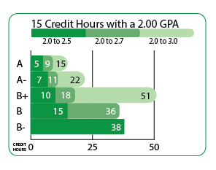
Number of Credit Hours to raise your 2.0 GPA to 2.5, 2.7, or 3.0
Find your current Accumulated Credit Hours table. Use this table to determine how many credit hours
are needed to raise your 2.0 GPA to 2.5, 2.7, 3.0 with potential future grades.

Slide 15
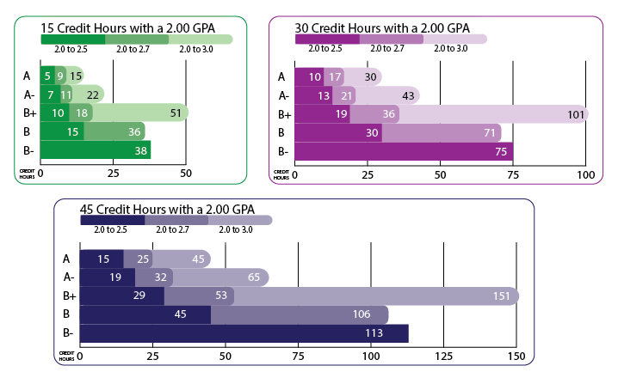
Number of Credit Hours
to raise your 2.0 GPA to 2.5, 2.7, or 3.0
Find your current Accumulated Credit Hours table. Use this table to determine how many credit hours are needed to raise your 2.0 GPA to 2.5, 2.7, 3.0 with potential future grades.

Slide 16
Is .2 a Block or a Mile?
Determining Factors:
Number of graded hours attempted
Level of grade(s) earned
Face Value or Higher Education GPA needed

Slide 17
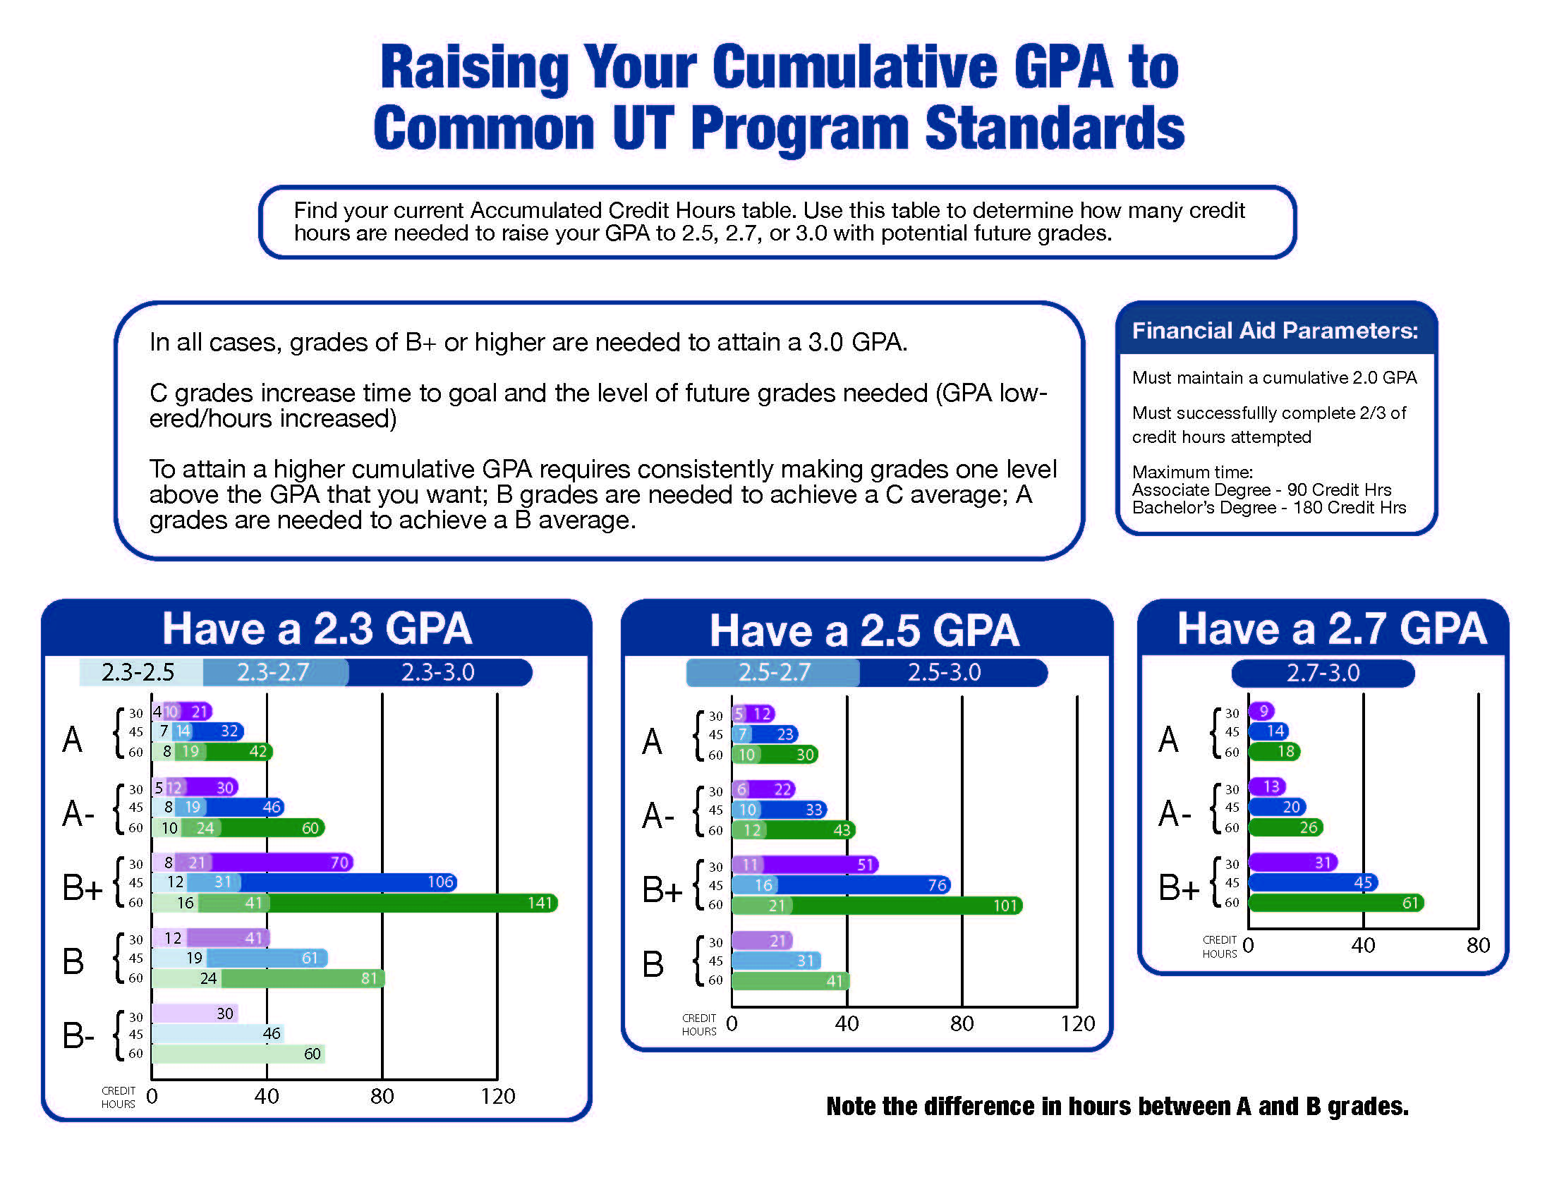

Slide 18
Mapping it Out
What works?
Identify classes in which you have done well.
What is common between those classes?
What strategies have worked for you with time management, studying and preparing for tests?
What three things can you do differently to improve success?

Slide 19
Mapping it Out
What is needed and when
What level of grades are needed?
How many hours of those grades are needed?
Do you qualify for grade recalculations (GR)?
Are you eligible for Academic Forgiveness (AF)?
Does your intended program accept GR or AF?

Slide 20
Benchmarking Progress
How am I doing & How do I know?
Determine goal based on deficit (e.g. 15 hrs. of B grades).
Set pace for achievement of grades (Complete in one term).
Monitor during semester (what is grade on first test, homework, project, etc.).
Are grades improving, slipping or similar w/each assignment? Investigate and seek help as soon as grades slip!

Slide 21
Benchmarking Progress
Now What?
What is the impact, if any, of the three changes you made?
Are you closer to or farther from your goal at end of term?
How much of your life are you willing to give to meet the goal?
What will convince you that the goal is not being met?

Slide 22
Financial Aid Progress
To Maintain Aid Eligibility
Must maintain a 2.0 cumulative GPA.
Must complete 2/3 of all credit hours attempted.
Must complete degree within 150% of hours required (90 for Associate degree/180 for Bachelor’s degree).

Slide 23
How Academic Advisors Can Help
Your Academic Lifeline
Clarify Situation and Verify Information.
Provide Correct and Timely Information about Programs, Requirements and Policies.
Advocate for You and Help You to Effectively Navigate UT.
Refer You to Additional Services, e.g. Tutoring, Mentors, The Writing Center, Success Coaches, etc..

Slide 24
Takeaways for Success
The Big Three
You must make grades at least one level above the grade you seek to raise your GPA (The Curse of the C+). B+ becomes the new C+ when a 3.0 or higher GPA is needed.
Each semester is a smaller and smaller percentage of your total hours as you acquire more credit (i.e. the more hours taken, the higher the grades needed to raise GPA).
Time is not standing still while you figure it out!

Slide 25
Questions?
Please feel free to contact me for any follow-up concerns:
Kim Pollauf, Assistant Dean
University College, The University of Toledo
Kimberly.Pollauf@utoledo.edu
Thank you very much!!!

